Slide 1


Pay or Play Program
Vendor Instructional Guide

Slide 2
Viewing Contracts
Vendor

Slide 3
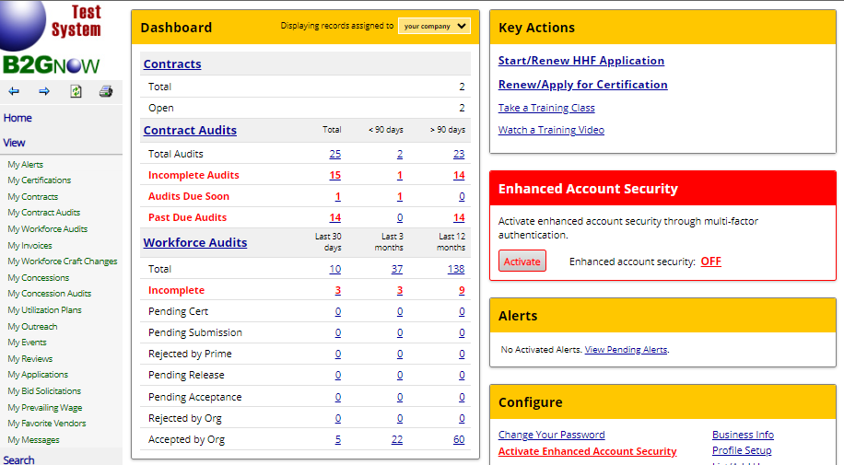
View Contract
Log into the City of Houston system. Then, go to the navigation pane and select the View>>My Contracts options.

Slide 4
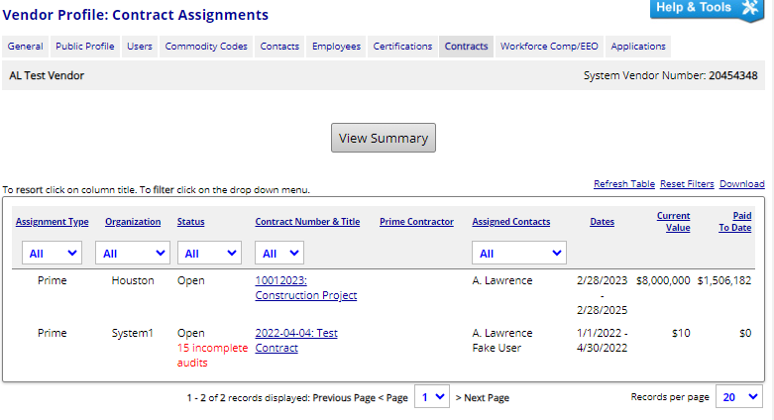
View Contract
Locate the desired contract and under the Contract Number & Title column click the link displayed.

Slide 5
Creating Employee Lists
Vendor

Slide 6
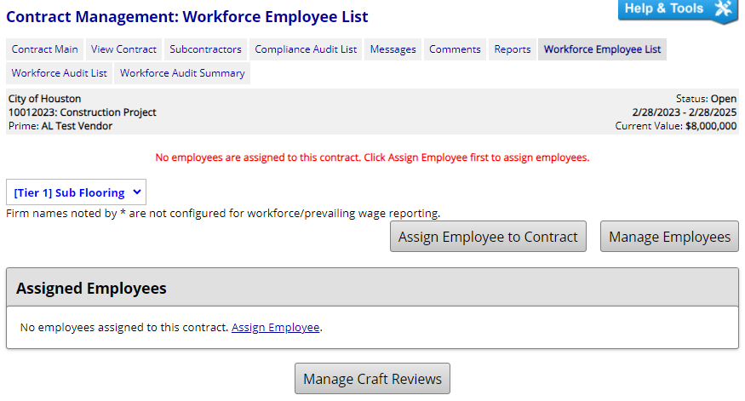
Adding Employees
Select the Workforce Employee List tab.
Click the Manage Employees button.

Slide 7
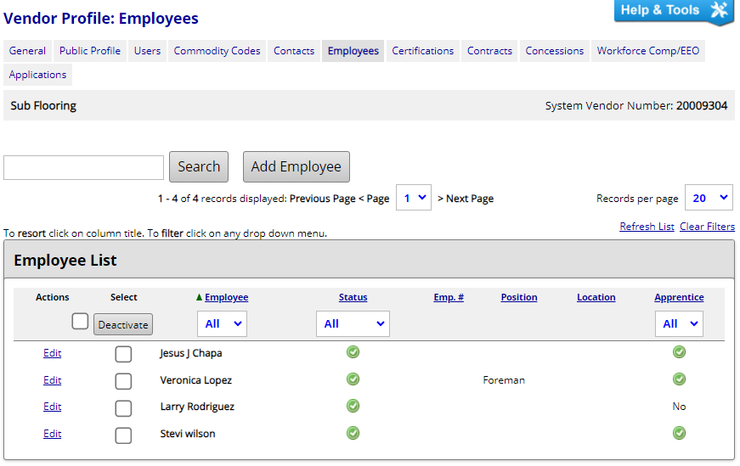
Adding Employees
Click the Add Employee button.

Slide 8
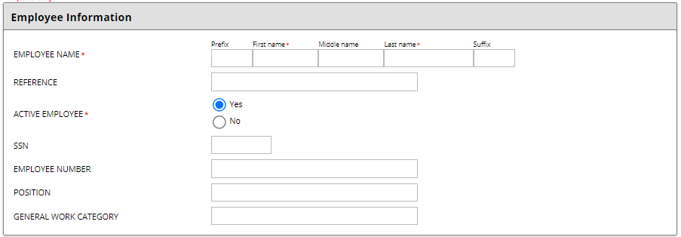
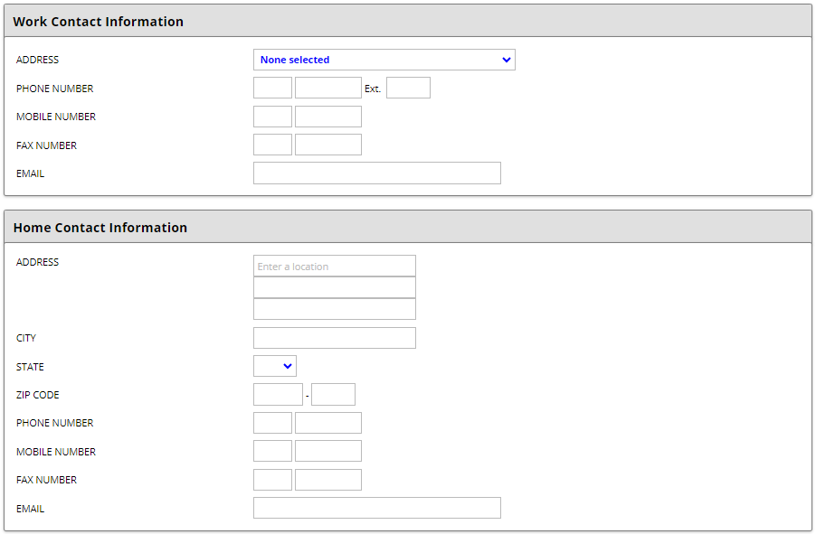
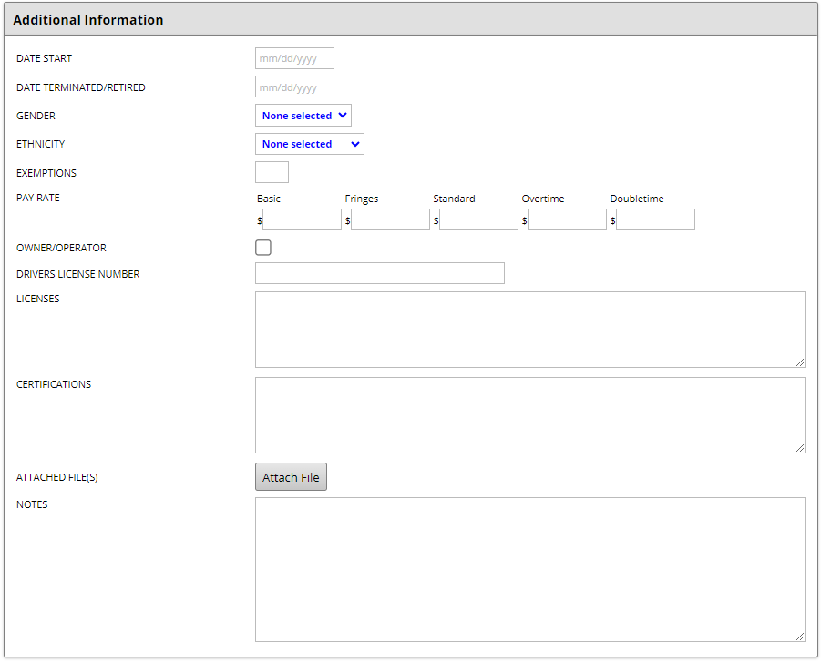
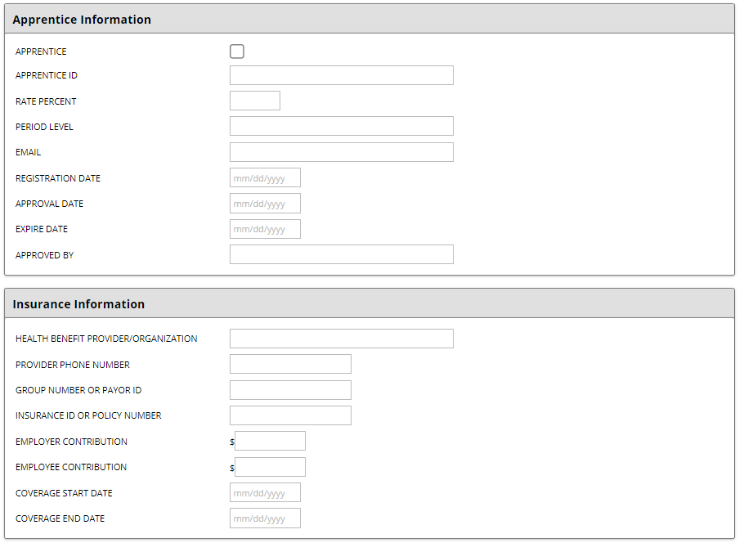
Adding Employees
Enter all the applicable employee details.

Slide 9
Assigning Employees
Vendor

Slide 10
Assigning Employees
Navigate back to the Workforce Employee List tab.
Click the Assign Employee to Contract button.

Slide 11
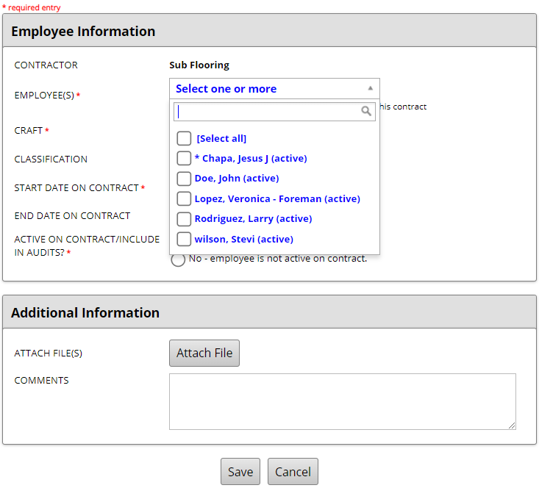
Assigning Employees
Under the Employee Information section, locate the Employee(s) multi-select dropdown option.
Select all applicable employees from the listing.
Note, if an asterisk (*) is next to the name of the employee it is an indicator that the employee is already assigned to the contract.

Slide 12
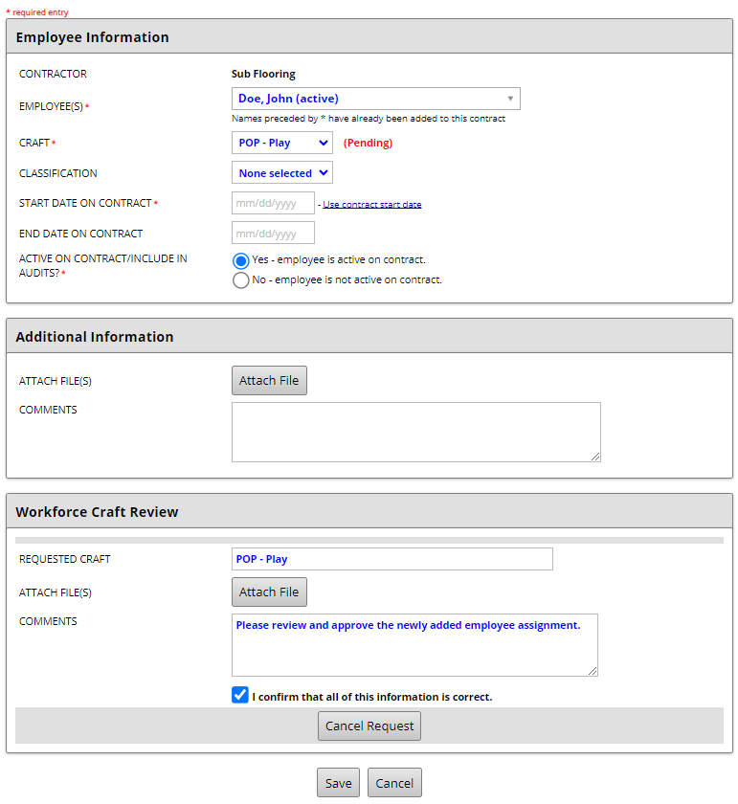
Assigning Employees
Select the applicable Craft dropdown option.
If Pay or Exempt are selected, enter Start Date on Contract and Save the entry.
If Play is selected a Comment and Confirmation will be required. Then, enter Start Date on Contract and Save the request for Staff approval.

Slide 13
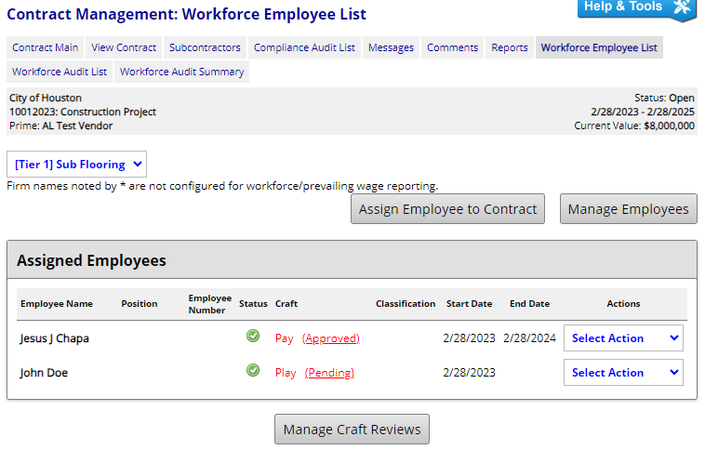
Assigning Employees
Once saved, the system will navigate back to the Workforce Employee List tab.
Here you will see a comprehensive list of all assigned employees.
You will also note that Pay craft selections are automatically Approved, while Play selections require staff approval and remain in a Pending status.

Slide 14
Editing Employee List
To edit an assigned employee, go to the Actions column and select on of the following dropdown options:
Edit Assignments
Edit Employees
Deactivate
Delete
Note, selecting the Delete option does not remove the employee from the system. It will simply remove the name from the contract.

Slide 15
Workforce Audit Reporting
Vendor

Slide 16
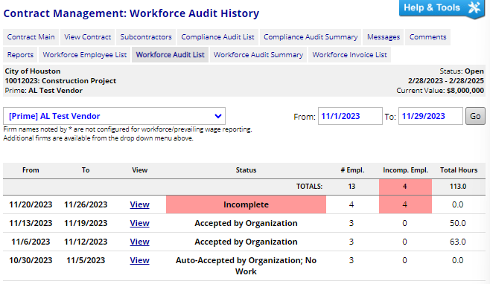
Workforce Audit Reporting
Once all employees have been added and/or have been approved by City of Houston staff, click the Workforce Audit List tab.
Locate the desired audit period. Then, click the View link if the audit is in an incomplete status or click the Add Audit link to open an unopened audit.

Slide 17
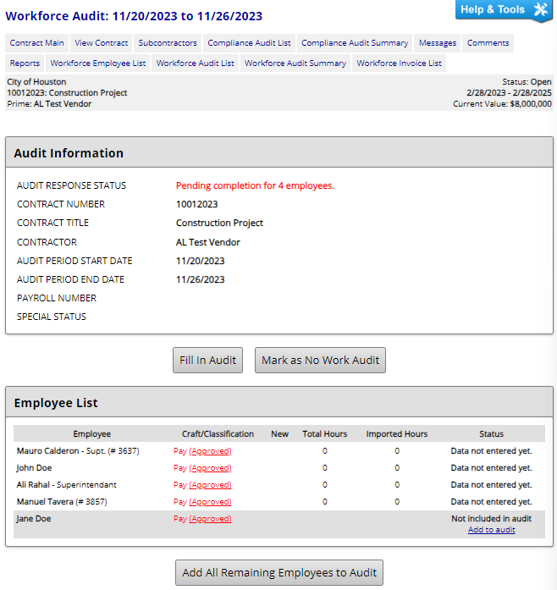
Workforce Audit Reporting
Review Employee List and add any Pay employees that need to be included in the audit by going to the Status column and clicking the Add to Audit link
Once all applicable employees have been added to the audit, click the Fill In Audit button.
Note, if no work was performed this period simply click the Mark as No Work Audit button and proceed to certify the audit.

Slide 18
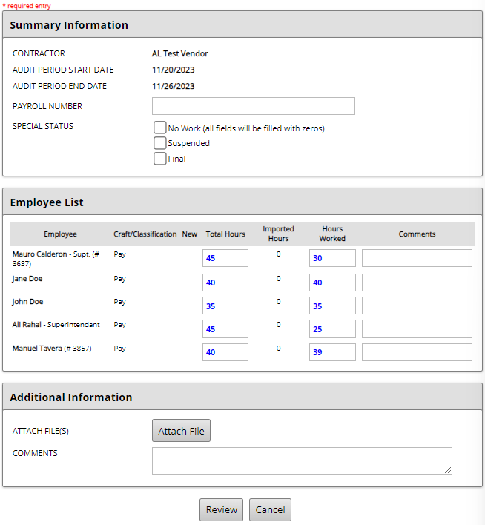
Workforce Audit Reporting
For each Pay employee, enter the Total Hours worked on all projects within the audit period. Then enter the Hours Worked specifically for this contract.
Note, if an employee has worked 30 hours or more an invoice will be generated.
Click the Review button to proceed.

Slide 19
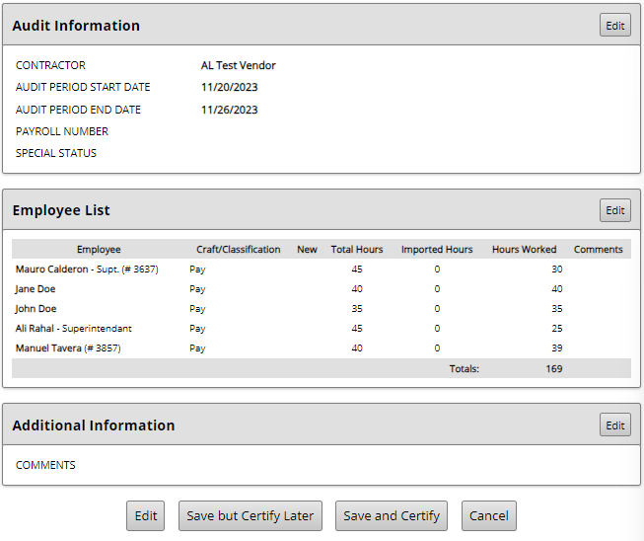
Workforce Audit Reporting
Review Employee List to confirm that all entries are accurate.
Click the Save but Certify Later to save your entries without submitting or click the Save and Certify button if you are ready to finalize submission.

Slide 20
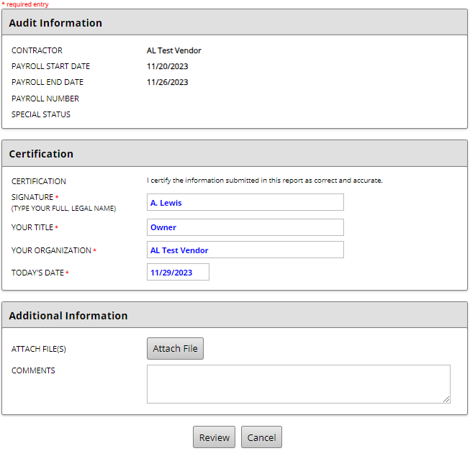
Workforce Audit Reporting
Under the Certification section enter all required fields and click the Review button to proceed.

Slide 21
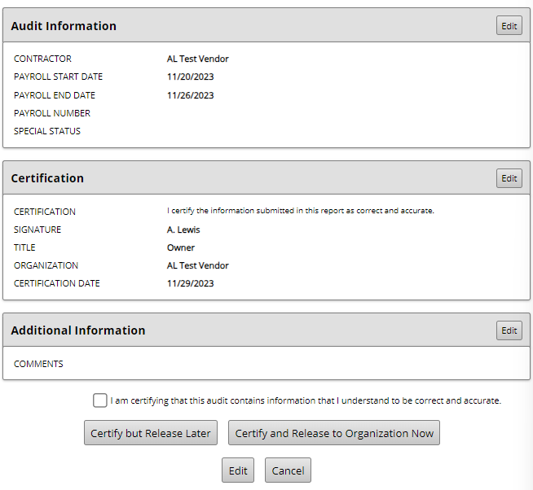
Workforce Audit Reporting
Select the acknowledgment check box and click the Certify and Release to Organization Now button to release the audit to the assigned POP Liaison for review and acceptance.

Slide 22
Viewing and Paying Invoices
Vendor

Slide 23
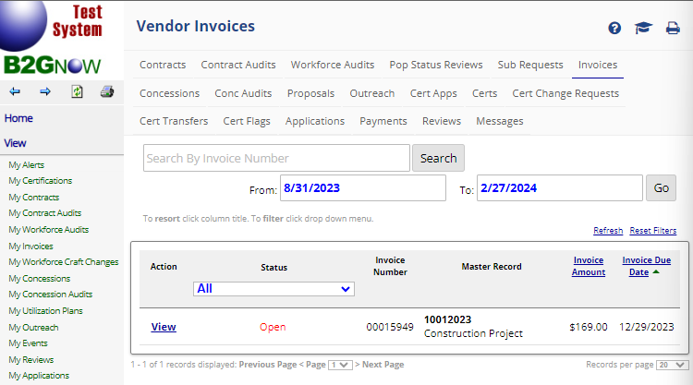
Viewing Invoices
Go to the navigation pane and select View>>My Invoices. Then under the Actions column click the View link.

Slide 24
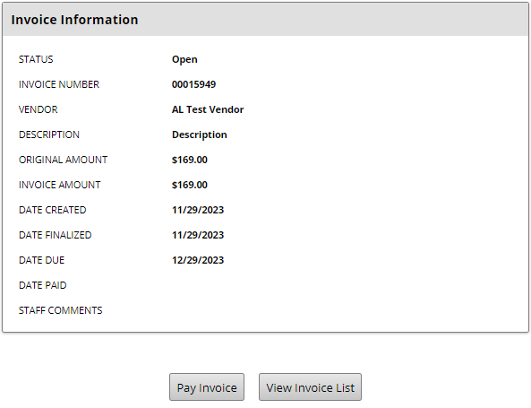
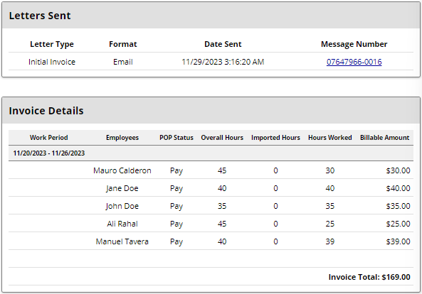
Paying an Invoice
Review invoice details and when prepared to pay simply click the Pay Invoice button.

