Slide 1

Pay or Play Program (POP)
Technical Assistance Training for Contractors/Subrecipients
July 22, 2026

Slide 2


Division Contact Information
Kennisha London
Deputy Director
Chrystal Boyce Compliance Manager
2100 Travis, 9th Floor, Houston, TX 77002
www.houstontx.gov/housing

Slide 3

Discussion Topics
POP Program Overview
POP Program Definitions
POP Program Requirements
POP Submissions in B2Gnow
Final POP Compliance Review
POP FAQs
Additional Resources

Slide 4

Pay or Play Program Overview
Office of Business Opportunity oversees POP Program.
Established on July 1, 2017, under Ordinance 2007-534 and governed by Executive Order 1-7
Levels the playing field between contractors who offer employee health benefits and those who do not, while helping offset healthcare costs for uninsured residents in the Houston/Harris County area.
See Executive Order 1-7 for more information.
https://www.houstontx.gov/execorders/1-7.pdf

Slide 5
POP PROGRAM DEFINITIONS

Slide 6

Pay or Play (POP) “Covered Contracts”
Prime Contracts valued at or above $100,000 or Related Subcontracts valued at or above $200,000
Professional Service, Construction and Service type Contracts
On-Call, Work Order and Job Order Solicitations. (See Executive Order 1-7)
This includes contingencies, amendments, supplemental terms and/or change orders equal or exceeding the above amounts
Subcontracts that start below $200,000 but later reach or exceed the threshold—through adjustments or payments—become POP‑covered.
The Prime contractor is responsible to the City for compliance of covered employees of covered subcontractors.

Slide 7
POP – Program Does Not Apply
Supply / Procurement contracts (51% or more rule)
Intergovernmental contracts/Interlocal agreements, bulk purchasing
Any contract for which the City of Houston has not expended funds, regardless of funding.
A POP 4 form approved by OBO for Exemption
(Must be approved prior to a project going to council)
Contractors that utilize self-employed, owner/operator individuals to complete services (e.g., Truck Drivers, Day Laborers, 1099 independent contractors, etc.) are POP exempt.

Slide 8

Pay or Play (POP) “Covered” Employees
All Employees of a “covered” contractor or subcontractor working onsite or in the office; including contract labor.
Employees that are over 18 years old; and
All Employees that work at least 30 hours per week with any amount of time on the “covered” contract.
All active employees (including exempt staff) working on the City project must be listed in the Workforce Employee List, in B2Gnow.

Slide 9

Pre-Construction Meeting - Pay or Play (POP) Documentation Required
POP 1 Form – POP Acknowledgement Form (Both Prime and Sub)
POP 2 Form – Certification of Compliance (Both Prime and Sub)
POP 3 Form – List of Subcontractors (Prime and Subs with Tier 2 Subcontractors)
B2G Access Form – Access form for B2Gnow (all POP applicable vendors)
Conflict of Interest Disclosure – For all businesses and subcontractors as applicable.
Start of Work Notice-Required by subrecipient and subcontractors as applicable.
POP-8 Waiver Request – If requesting an exemption for an eligible employee
ALL contractors will be given access to LCP Tracker after the Pre-Construction meeting and are required to upload their POP 1-3 forms into the POP Documents folder in LCP Tracker.
Contractors are required to begin complying with POP within 30 days of your Start of Work Notice Date.

Slide 10
Public Service Agreements-Subrecipients
POP-1 Form – POP Acknowledgement Form
POP-2 Form – Certification of Compliance
POP-3 Form – List of Subcontractors (including Tier 2 subcontractors, if applicable)
B2G Access Form – Required for all POP-covered contractors and subrecipients requiring B2Gnow access
Conflict of Interest Disclosure – For all non-entities and subcontractors as applicable.
Start of Work Notice-Required by subrecipient and subcontractors as applicable.
POP-8 Waiver Request – If requesting an exemption for an eligible employee
Note: A POP-3 Form is not required for Public Service Agreements with no subcontractors.
Submission Requirements
Initial documents (POP-1, POP-2, POP-3, Conflict of Interest, and POP-8 Waiver Requests) must be emailed to the POP Administrator for review.
Workforce compliance documents (employee lists, workforce audits, and other required compliance submissions) must be uploaded in B2Gnow.
POP-covered entities must begin complying with POP requirements within 30 calendar days of the Start of Work Notice date.

Slide 11
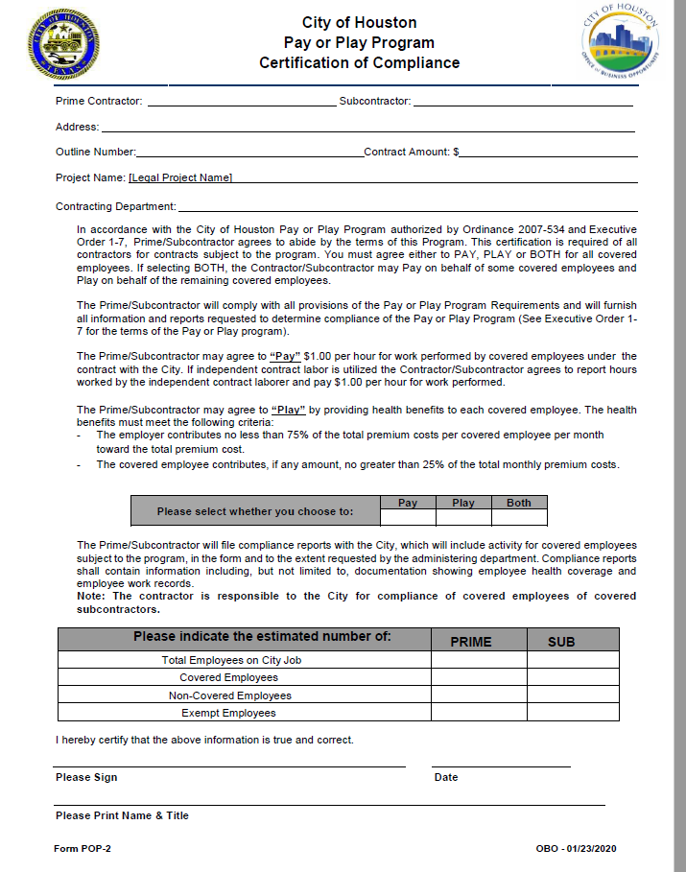
POP 2 Form (Required by Prime and Sub)

Slide 12
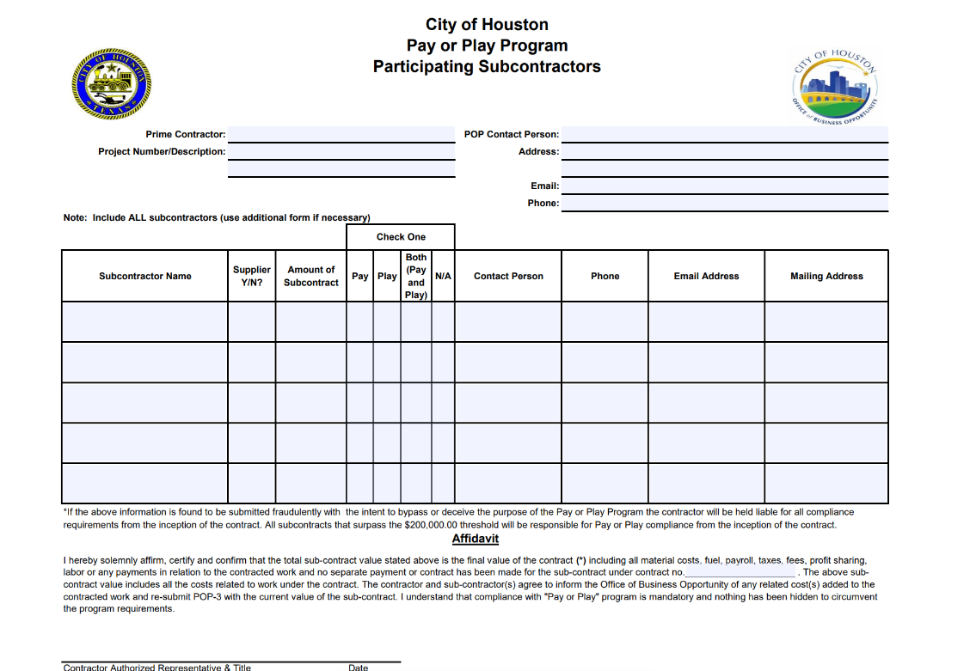
POP 3 Form (Required by Prime and Sub)

Slide 13
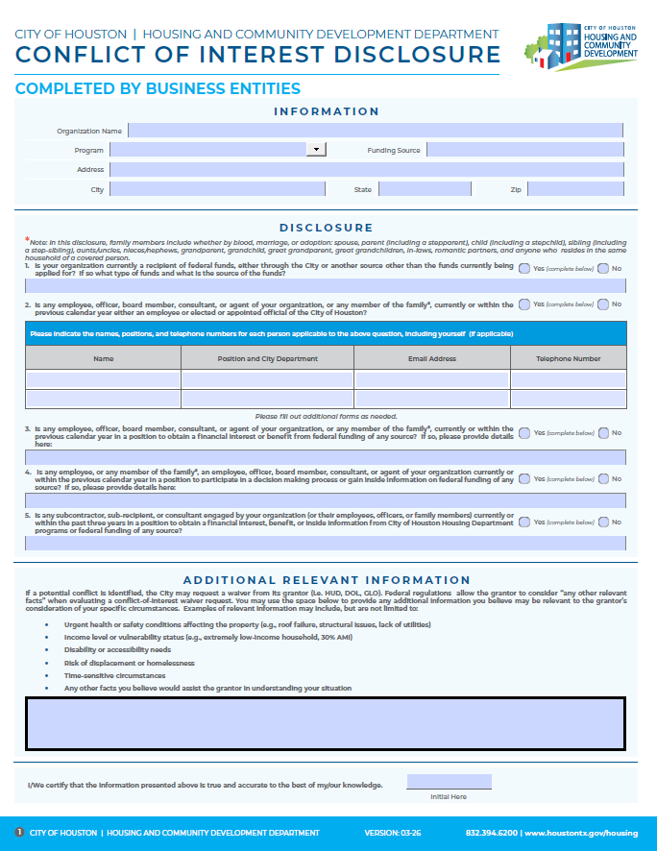



Conflict of Interest Disclosure Form-Contractors

Slide 14
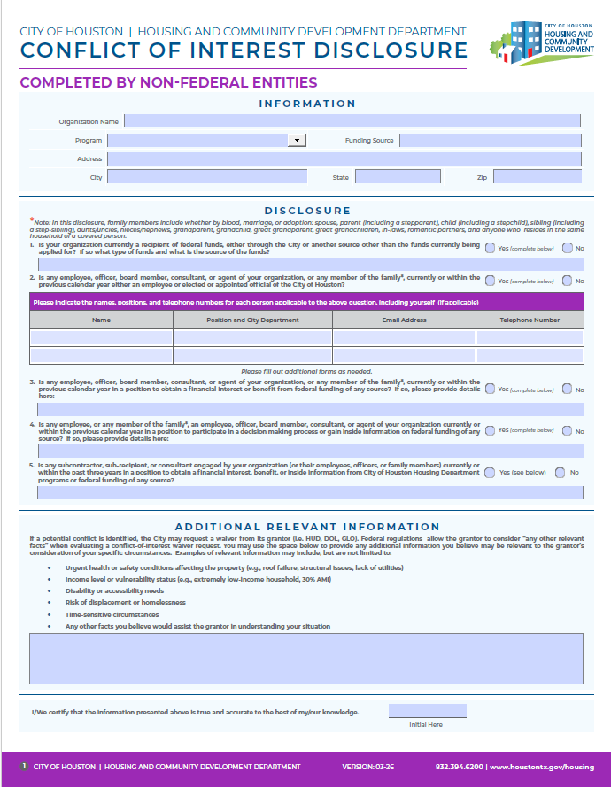

Conflict of Interest Disclosure Form-Subrecipients

Slide 15
POP PROGRAM REQUIREMENTS

Slide 16

PAY - Pay or Play (POP) Program Requirements
Contractors choosing to PAY must contribute $1.00 per hour for each covered employee working on a POP‑applicable contract (maximum $40.00 per employee per week) by the end of each month.
Workforce Reporting
Contractors must enter both of the following for each covered employee:
  Total Hours: All hours worked for the contractor (their company) that week
  Hours Worked: Hours worked specifically on the specific COH contract
Both columns must be completed. Incomplete fields will result in workforce audit rejection.
Billing & Payment
Monthly invoices are generated from Weekly Workforce Audit reports.
Payments are made through Paymentus and must be paid in full. (Partial payments are not accepted)
Payments are due to HCDD within 30 business days of receiving the invoice.
Verification
HCDD may request certified payroll or timesheets to verify reported hours for PAY employees.

Slide 17

PAY Requirements Explained - for POP Program
PAY Example Situations:
John is a “covered” employee who is NOT offered POP benefits:
  The employer must submit weekly PAY submissions by entering John’s Total Hours and Hours Worked into B2Gnow under the Workforce Audit List every week.
John is a “covered” employee and has insurance through his spouse:
  The employer should submit a completed and notarized POP 8 form with proof of healthcare insurance for John via email to the POP Coordinator for review and approval.
John is a “covered” employee and ACCEPTS the POP benefits offered to him:
  John will be considered a PLAY employee, not a PAY employee, and hours are not required to be submitted.

Slide 18
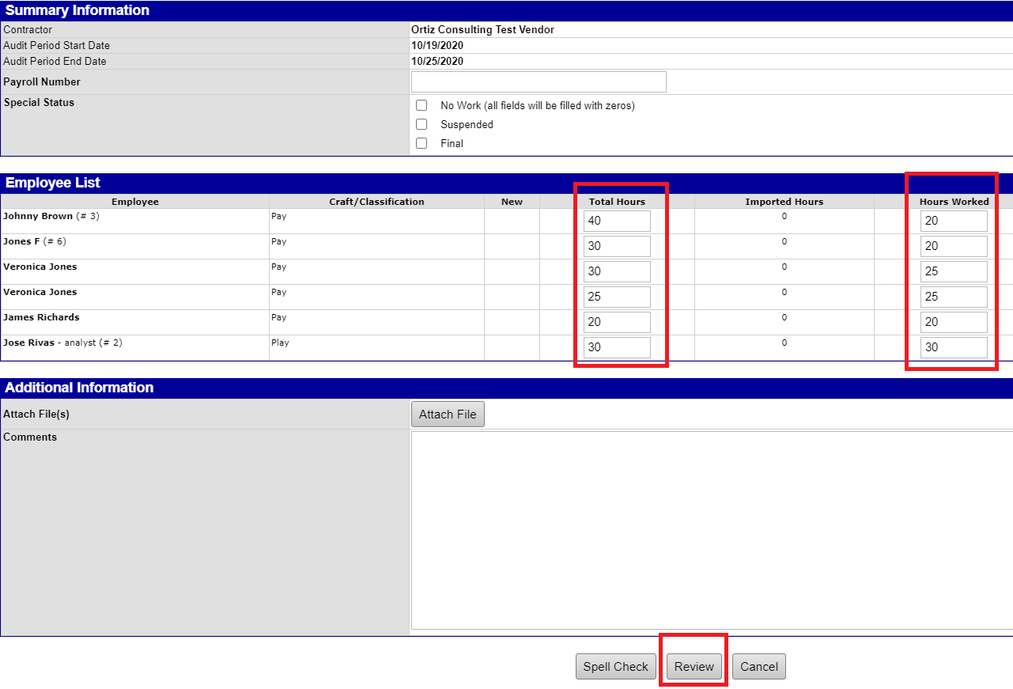
How to Submit PAY: Total and Work Hours

Slide 19

PLAY – Healthcare Requirements for POP Program
Contractors may elect to PLAY by providing acceptable documented proof of health benefits for all covered employees. To qualify, the health plan must meet the following:
  Employer pays at least 75% of the monthly premium
  Employee pays no more than 25% of the monthly premium
Contractors may be asked to submit Verification Documentation
  PLAY Eligibility Verification Form
  Current Pre‑Printed Health Benefits Program / Employee Guide
Important Notes
  If requirements are not met, the contractor will be reclassified as PAY.
  HCDD may request verification documents, including the Eligibility Verification Form and the company’s benefits package.
  Insurance cards are not accepted as proof of coverage for quarterly submissions.
What’s Not Required
  PLAY contractors/subcontractors do not enter weekly workforce hours.
  For additional details, please refer to the POP FAQs.
Please See the POP FAQ's for more information.

Slide 20
PLAY - Quarterly Work Force Submissions
Due in the B2Gnow database by the end of the following months as follows:
1st Qtr. Months (January, February, and March) – Due by April 30
2nd Qtr. Months (April, May, and June) – Due July 31
3rd Qtr. Months (July, August, and September) – Due October 31
4th Qtr. Months (October, November and December) – Due January 31

Slide 21

PLAY – Quarterly Workforce Submissions
PLAY contractors will complete Quarterly Workforce Audits as follows:
Upload POP 7 Form
  Submit the POP 7 form in B2Gnow, listing the same active covered employees.
Provide Required Health Documentation
  Upload supporting company health documents (insurance summaries and invoices) showing: • Employee names • Cost of coverage for each employee • Coverage details for all three months of the reporting quarter
Submission Requirements
All documents must be uploaded to B2Gnow for the audit to be considered complete.
Insurance cards are not accepted as proof of healthcare coverage for quarterly submissions.

Slide 22
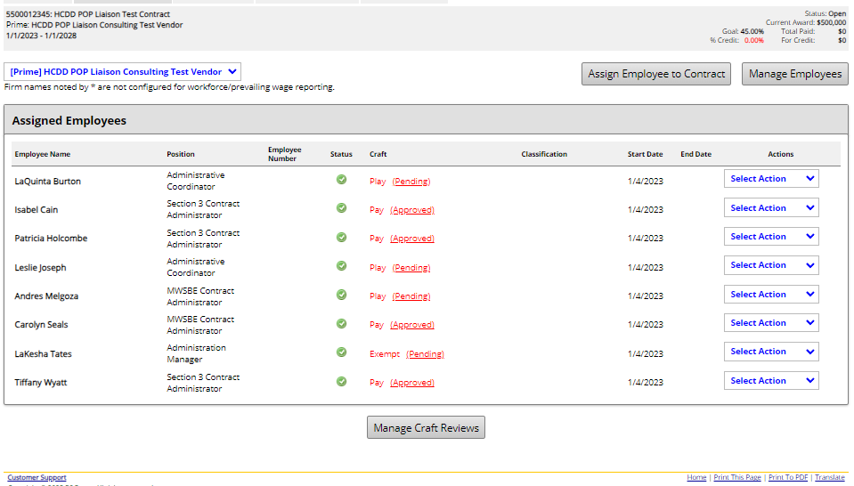
How to Submit PLAY: Quarterly Submission

Slide 23
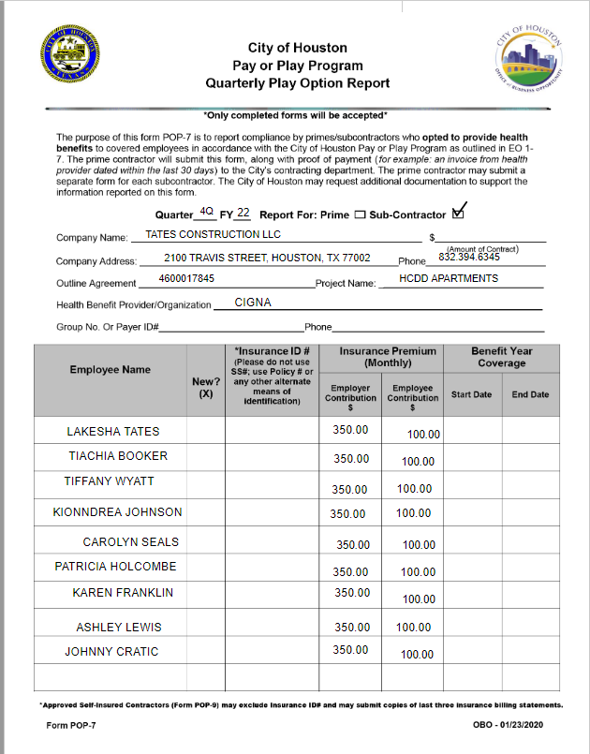
POP 7 Quarterly Play Option Report
Must be uploaded in B2Gnow along with Company health insurance invoices that detail the cost of coverage for PLAY employees.

Slide 24
POP 8 Form - Employee Waiver Request
An employee may be considered exempt if a covered employee has acquired healthcare coverage on their own or if they have refused POP applicable healthcare coverage through their employer for one of the following conditions:
  The employee is under the age of 18.
  The employee has health insurance coverage through a spouse, Medicaid, or Medicare (proof of coverage is required).
  The employee declines the company’s health insurance that meets the City of Houston POP requirements.
  A contractor may request an exemption for an employee by submitting a completed and notarized POP‑8 Waiver Form to the POP Coordinator via email for review and approval. An employee is not considered exempt unless an OBO‑approved POP‑8 Waiver is on file.
Please note: Approved POP‑8 Exemption Waiver forms are valid for one year from the approval date. Contractors must resubmit the waiver annually for each year they continue performing work on a POP‑applicable contract.

Slide 25
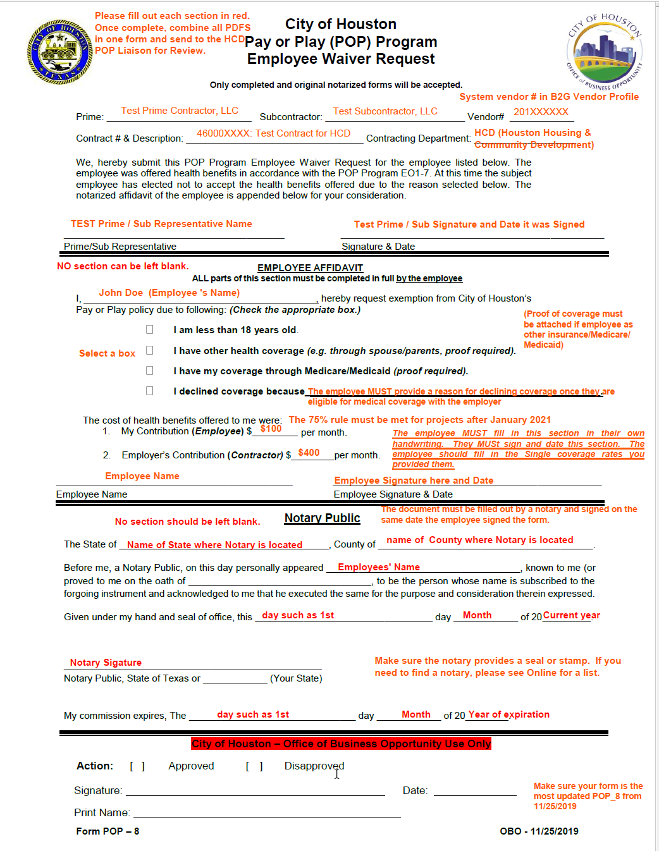
POP 8
Employee Waiver Request

Slide 26

POP 9 Form - Self- Insured Contractor Request
Contractors may request for a POP 9 – Self- Insured Contract Request form to be emailed to them if the employer is using their own money to cover their employees' claims. (only available upon request)
The POP 9 – Self-Insured Contract Request and all required documents must be emailed to the POP Administrative Coordinator for review and approval.
Contractors awarded Self-Insured status will be PLAY participants and required to report once a year.
To qualify as self-insured, a contractor must have an OBO-approved POP 9 form on file. Contractors are required to upload only approved POP 9 forms, along with required documents into LCP Tracker.
Approved POP 9 Forms remain valid for one year from the date of approval. However, they must be resubmitted annually for each year your company continues to work under a POP-applicable contract.

Slide 27
POP SUBMISSIONS IN B2Gnow

Slide 28

B2Gnow - Pay or Play (POP) Management System
B2Gnow is the management system for all POP workforce audit submissions.
POP 7 forms and supporting documents will be submitted as workforce audits in B2Gnow quarterly.
PAY weekly workforce audits are required to be submitted in B2Gnow for review and approval through an online Workforce Utilization Module.
After the Weekly Workforce audits receive approval from the POP Administrator, monthly invoices will be generated and distributed to the contractor or subcontractor.
Utilize Paymentus payment portal in B2Gnow to pay all POP invoices. Partial payments to POP will not be accepted. Invoices must be paid in full.
B2Gnow website link - https://houston.mwdbe.com/

Slide 29

B2Gnow Overview
Viewing POP Contracts in B2Gnow
Adding Employees to B2Gnow
Assigning Employees to a Contract
Submitting Weekly Workforce Audits (PAY)
Filling in Weekly Hourly Audits
Saving and Certifying Audits
Submitting Quarterly Workforce Audits (PLAY)
Uploading and Attaching documents for Audits
Please See the POP FAQ for more information

Slide 30
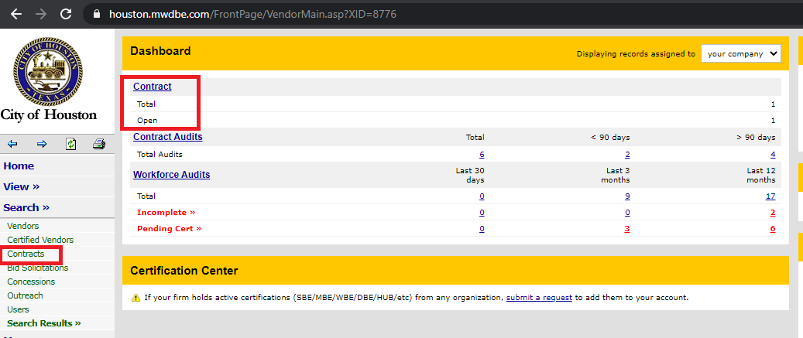
Step 1: Select POP Contract

Slide 31
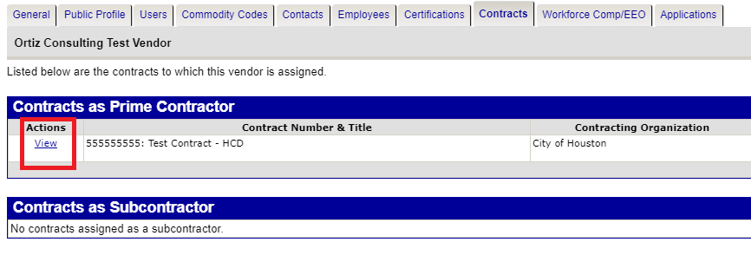
Step 2 : Select POP Contract

Slide 32
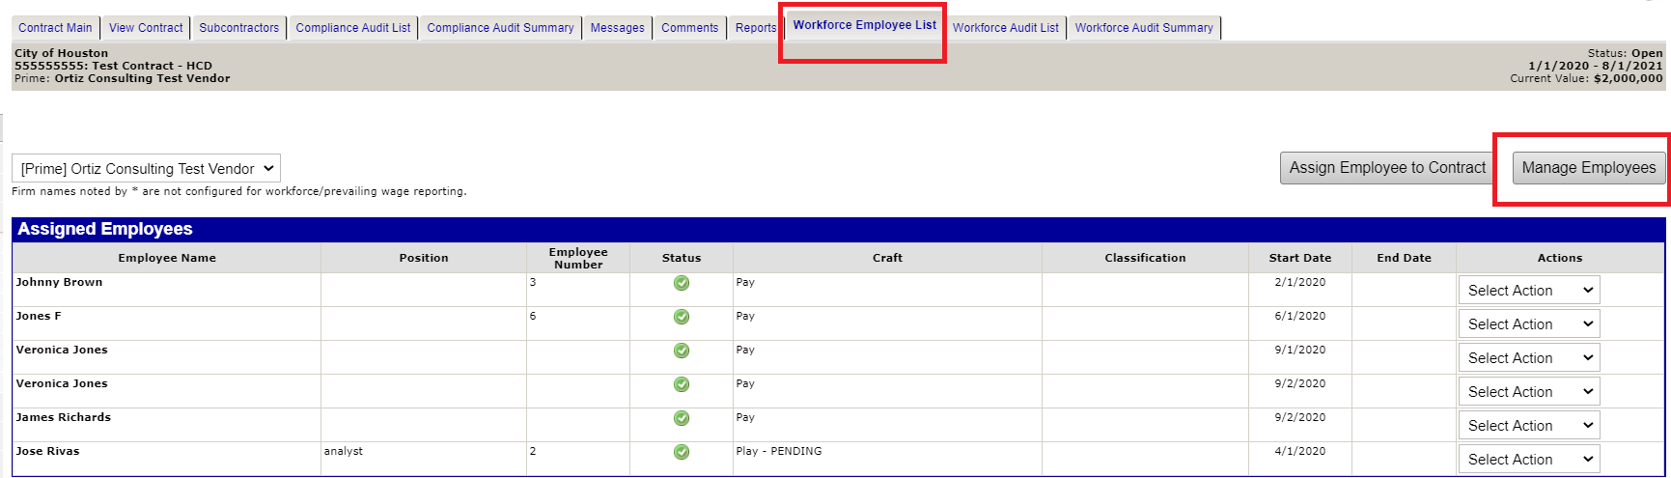
Step 3: B2Gnow - Add Employees
Notes:
.

Slide 33
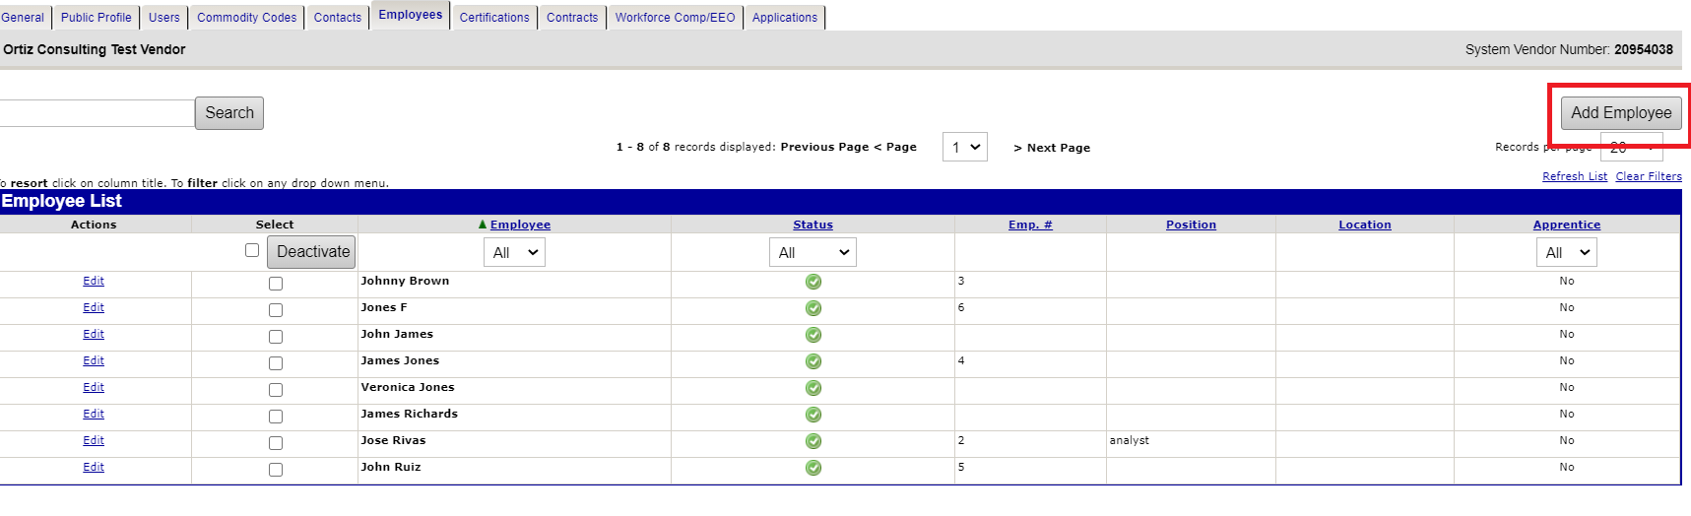
Step 3.1 : B2Gnow - Add Employees Cont.

Slide 34
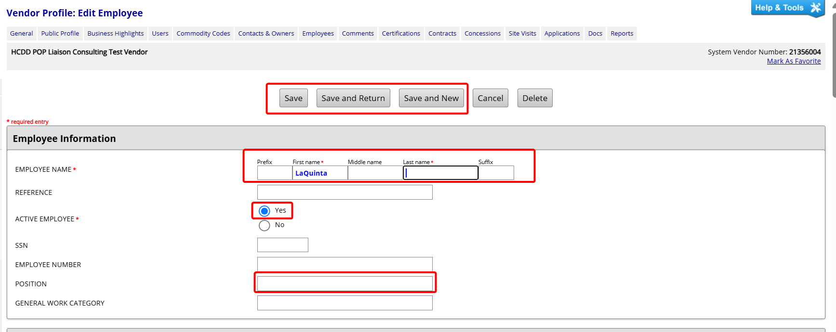
Step 3.2: B2Gnow - “EDIT EMPLOYEE” page

Slide 35
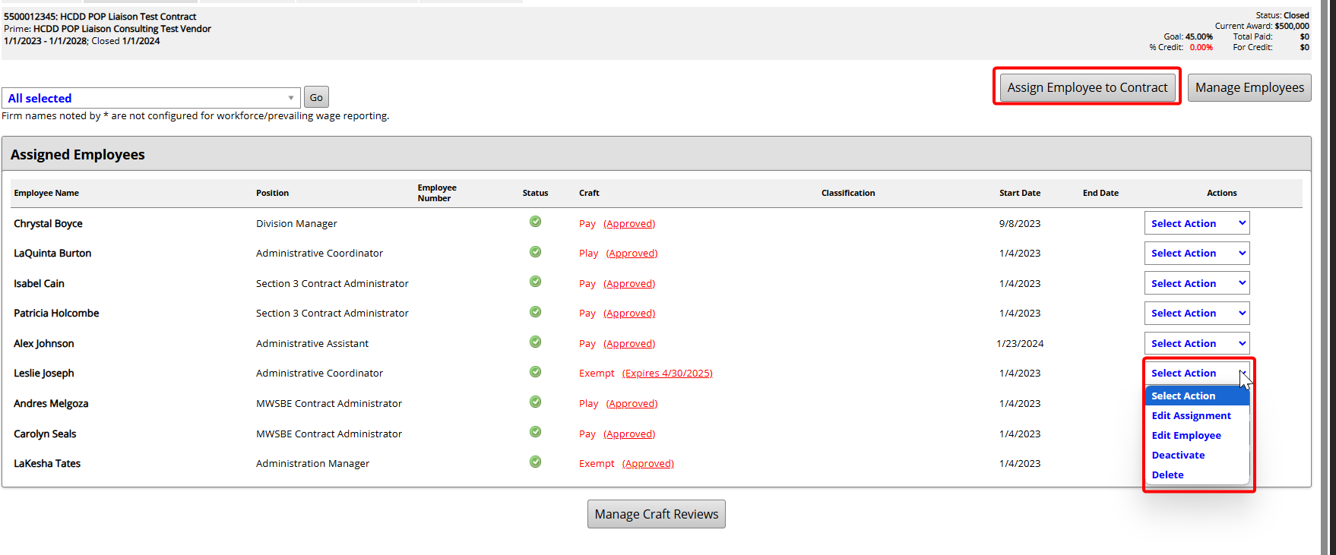
Step 4: Assign Employee to Contract

Slide 36
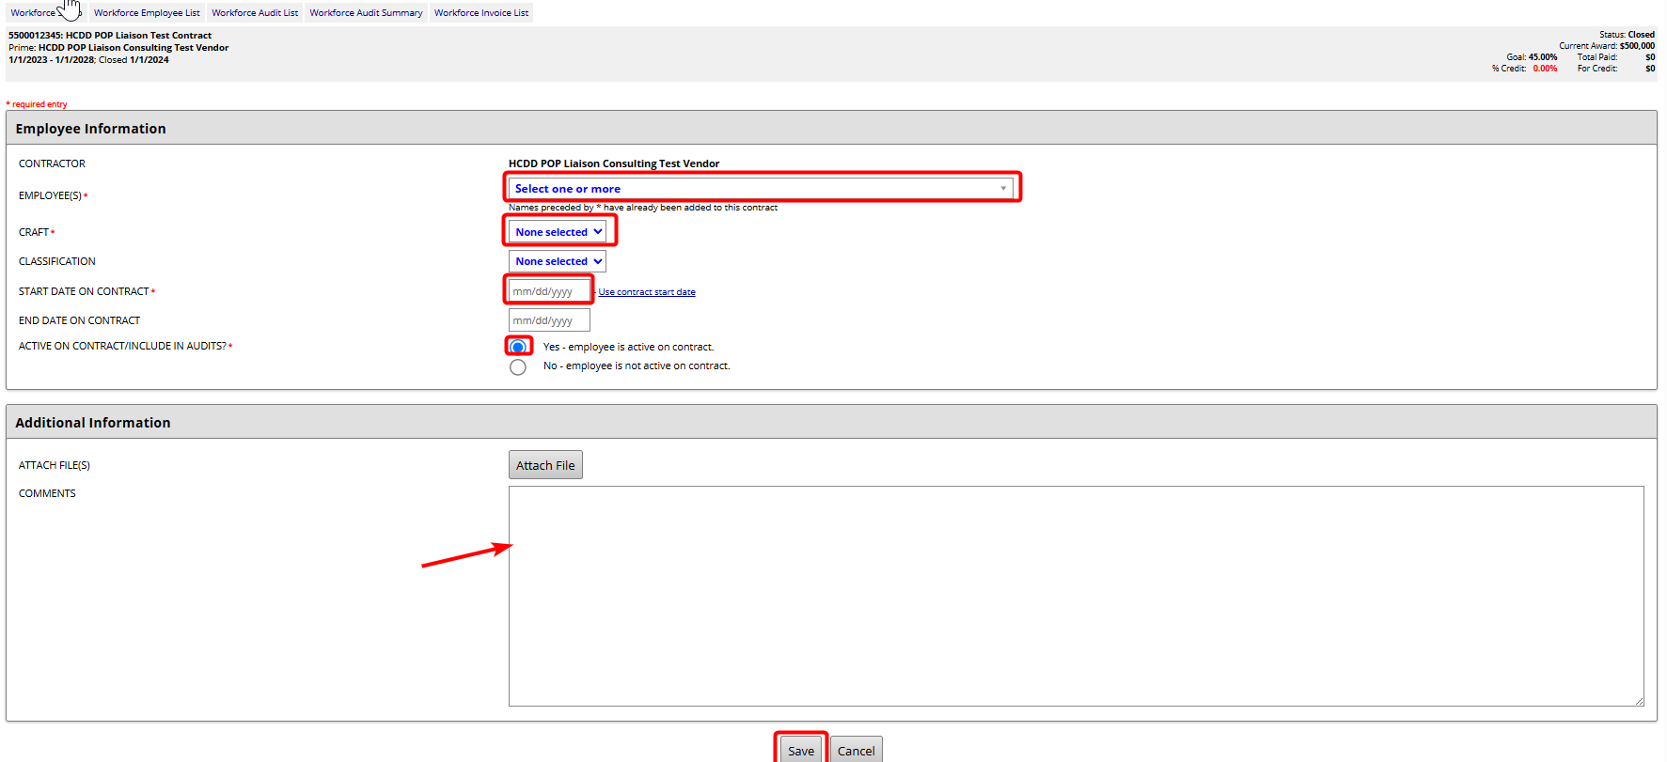
Step 4.1: - Assign Employees/Add Craft

Slide 37
PAY - Weekly (Hourly) Workforce Audit Submissions

Slide 38
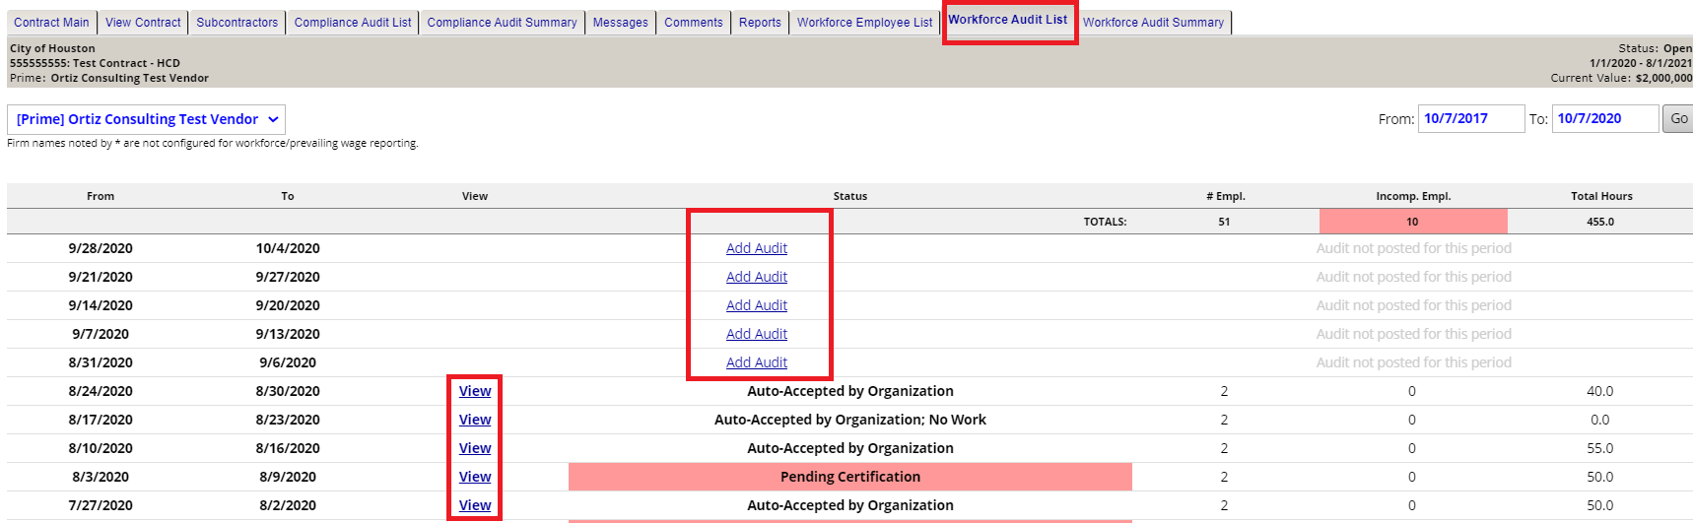
Step 1: Select the Workforce Audits List Tab

Slide 39
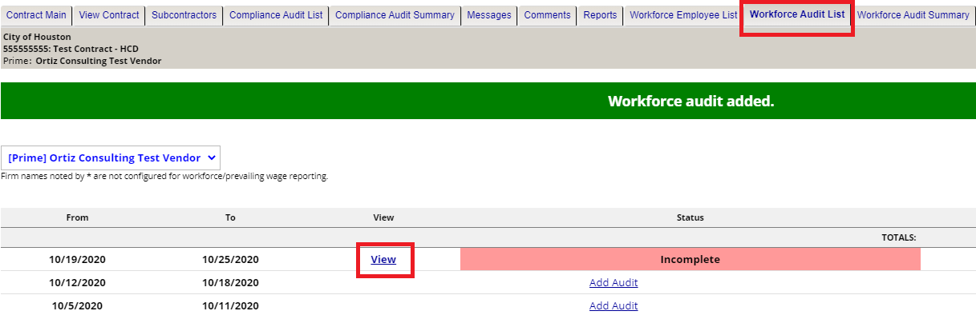
Step 2: PAY Workforce Audits Submissions

Slide 40
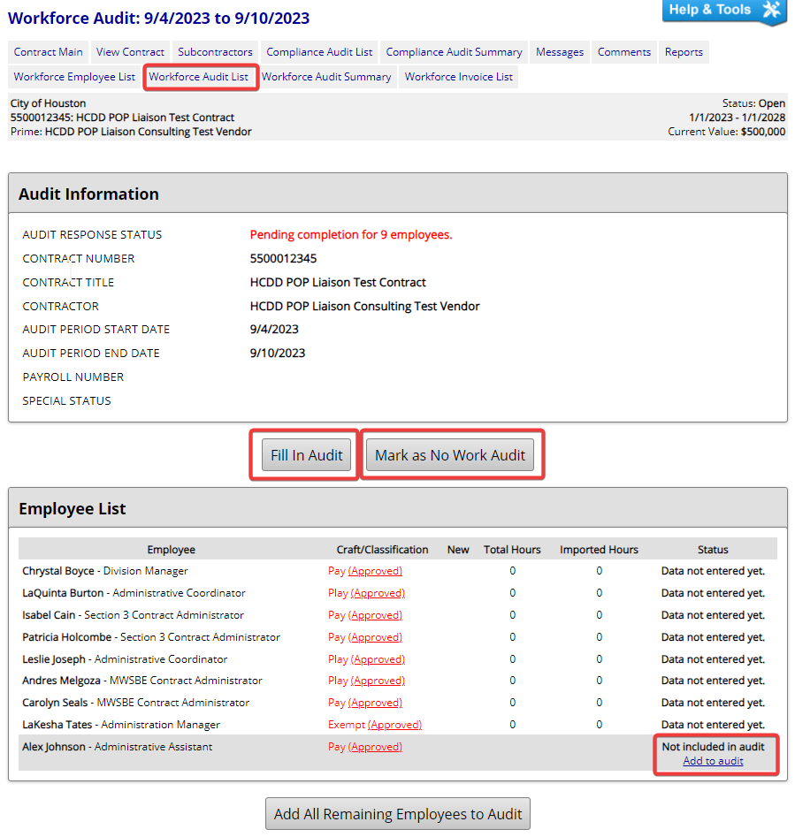
Step 3: Fill In PAY Workforce Audit

Slide 41
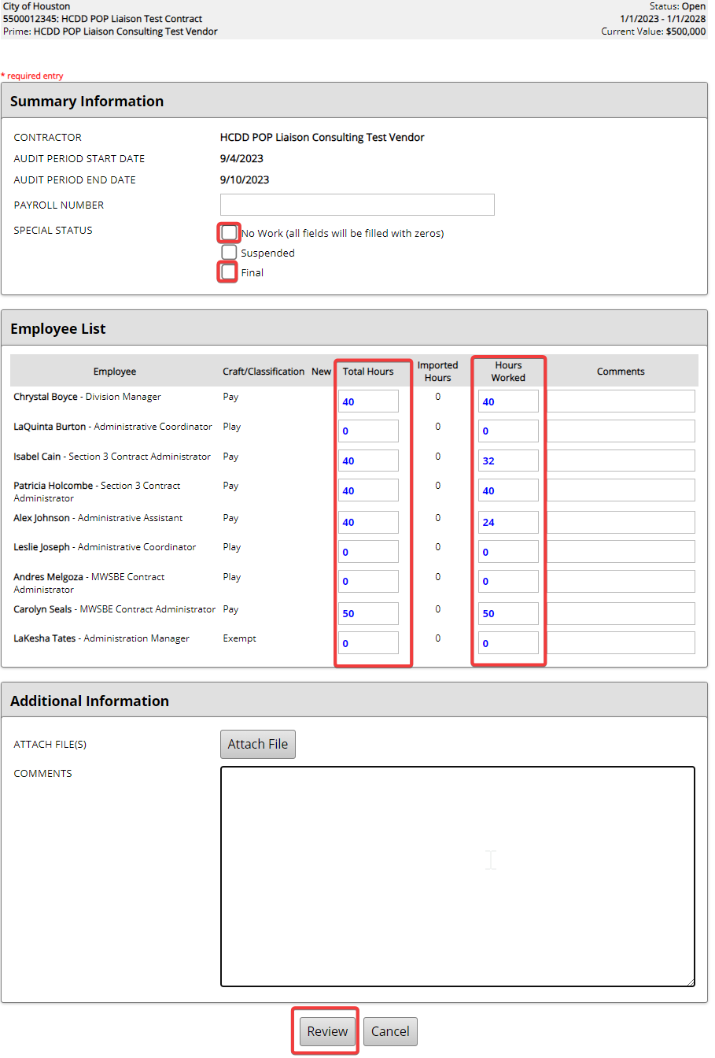
Step 4: Add Total and Work Hours

Slide 42
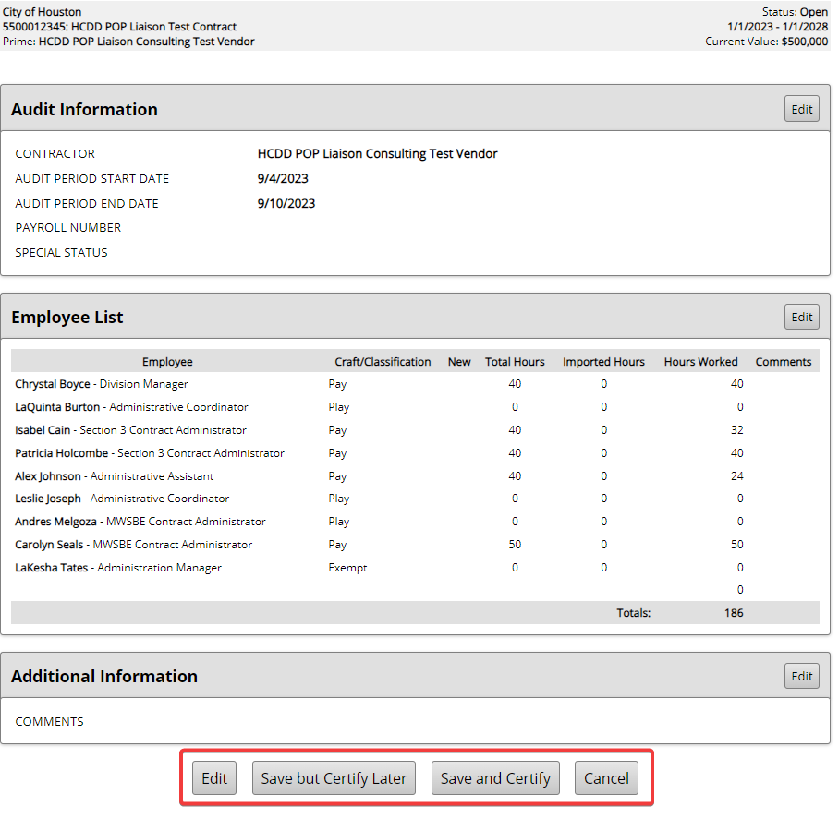
Step 5: Edit, Save, or Certify Audit

Slide 43
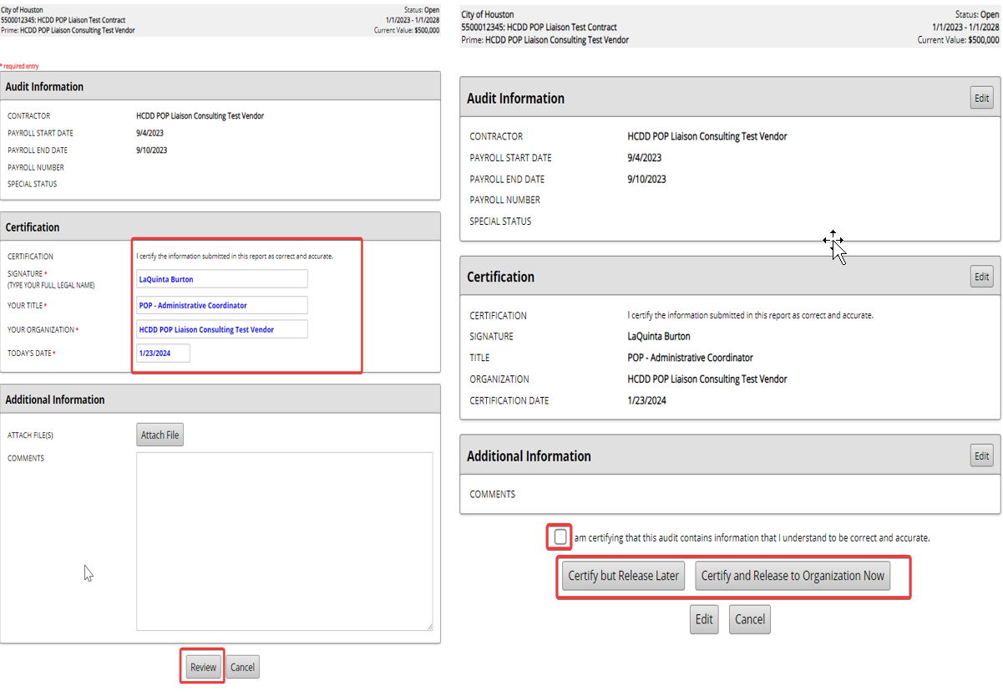
Step 6: Certify, Review Certification

Slide 44
Certified Payroll & Timesheets
DBRA (Davis-Bacon) Projects
Upload weekly Certified Payroll Reports to LCPTracker.
Ensure all payroll submissions are complete, accurate, and submitted in accordance with project requirements.
Non-DBRA Projects
Upload weekly employee timesheets to the applicable workforce audit in B2Gnow.
Timesheets are required for audit and reporting purposes and will be used to verify PAY Program employee time submissions.
Important Reminder
Weekly payroll documentation must accurately correspond to the reported workforce for each project.
Maintain separate records for each program and contract to support compliance reviews and audits.

Slide 45
PLAY - Quarterly (Insurance) Workforce Audit Submissions

Slide 46
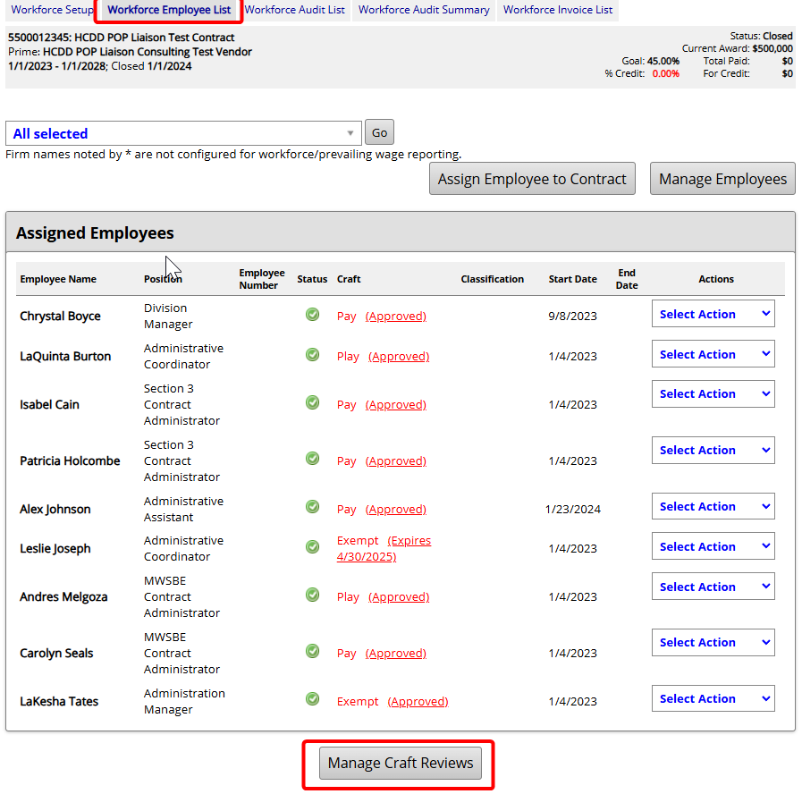
Step 1: Select Workforce Employee List

Slide 47
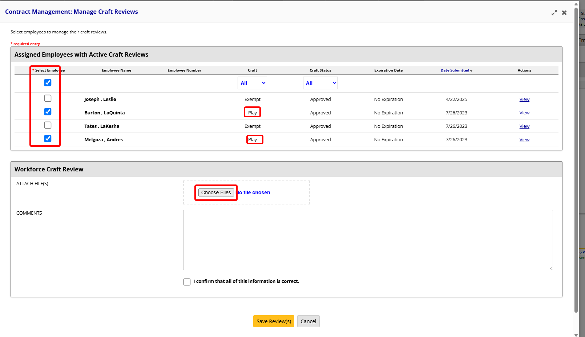
Step 2:
Select PLAY Employees ONLY & Choose File Tab

Slide 48
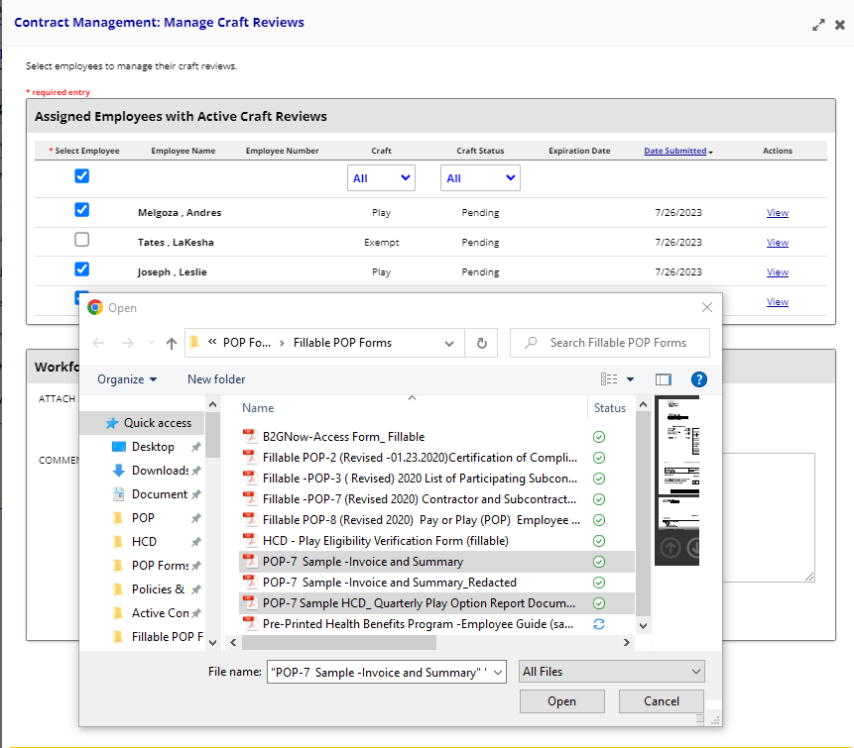
Step 3:
Select PLAY Documents for Quarterly Submission

Slide 49
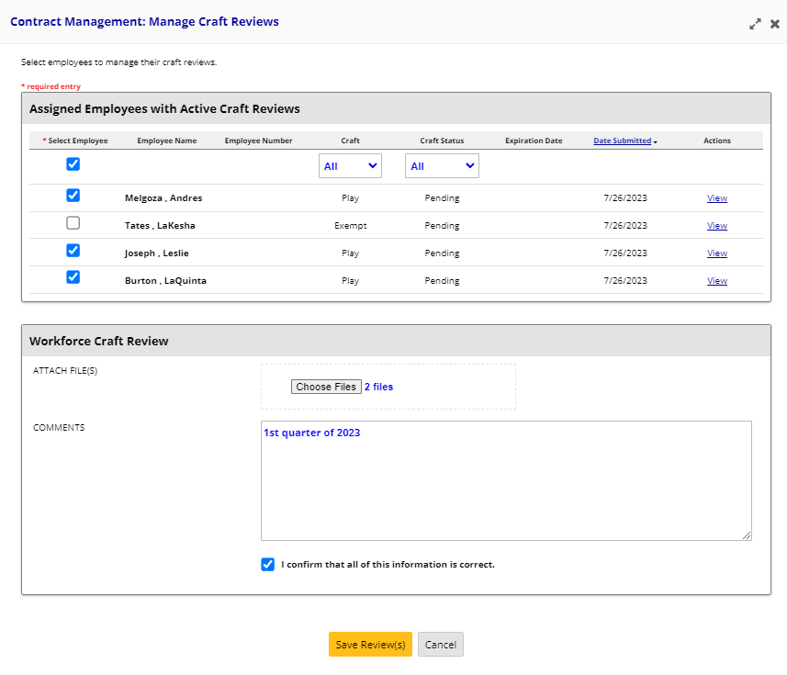
Step 4: Upload & Submit PLAY Quarterly Documents

Slide 50
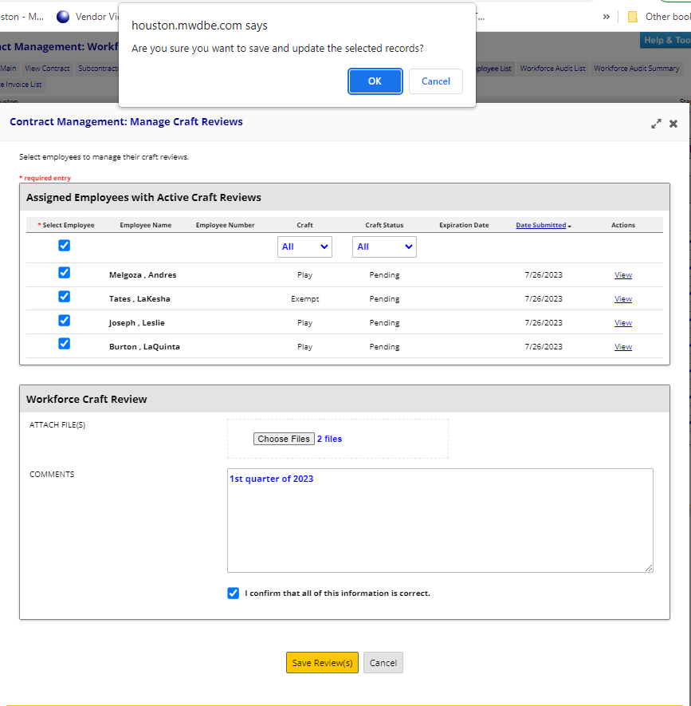
Step 5: PLAY Quarterly Submission Save & Update Records

Slide 51
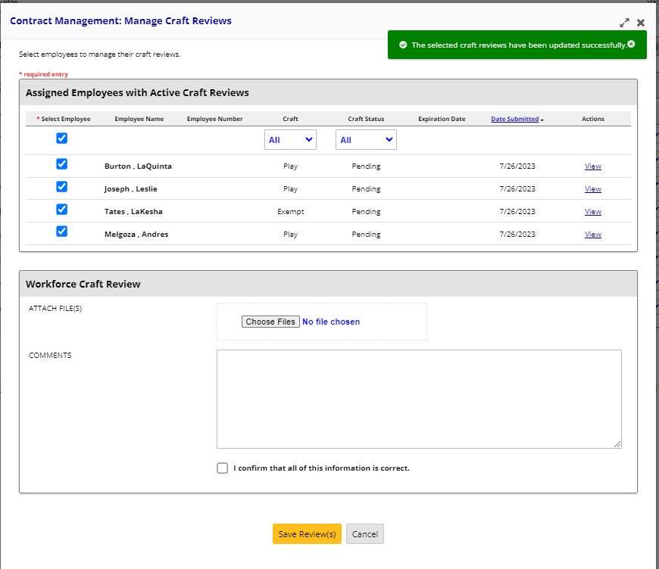
Step 6:
Exit
PLAY Quarterly Submission Page

Slide 52
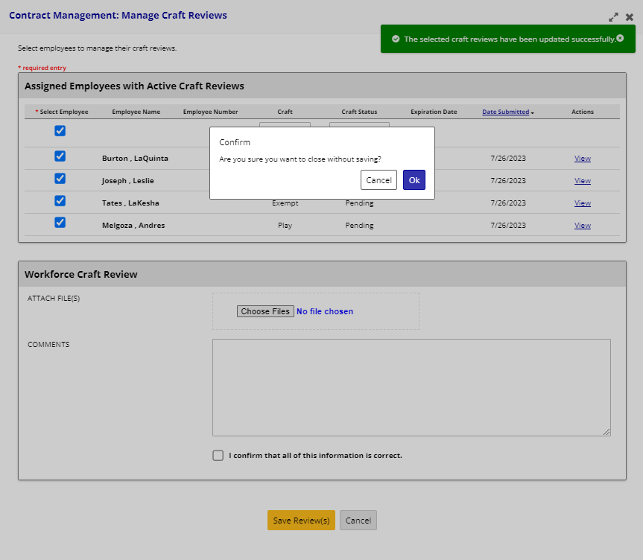
Step 7:
PLAY Quarterly Submission Confirmation

Slide 53
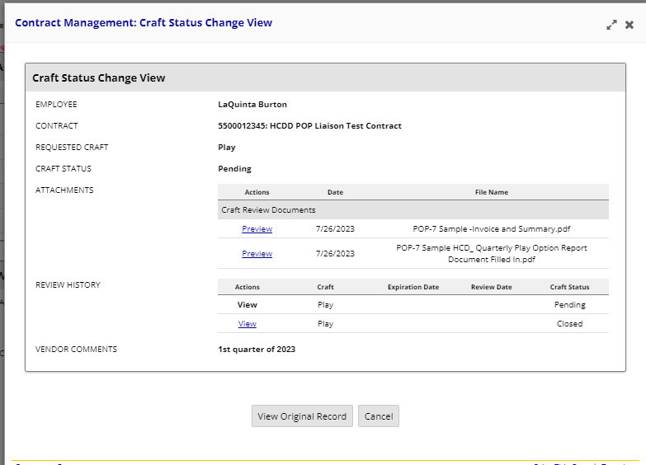
Step 8: PLAY Quarterly Submitted

Slide 54
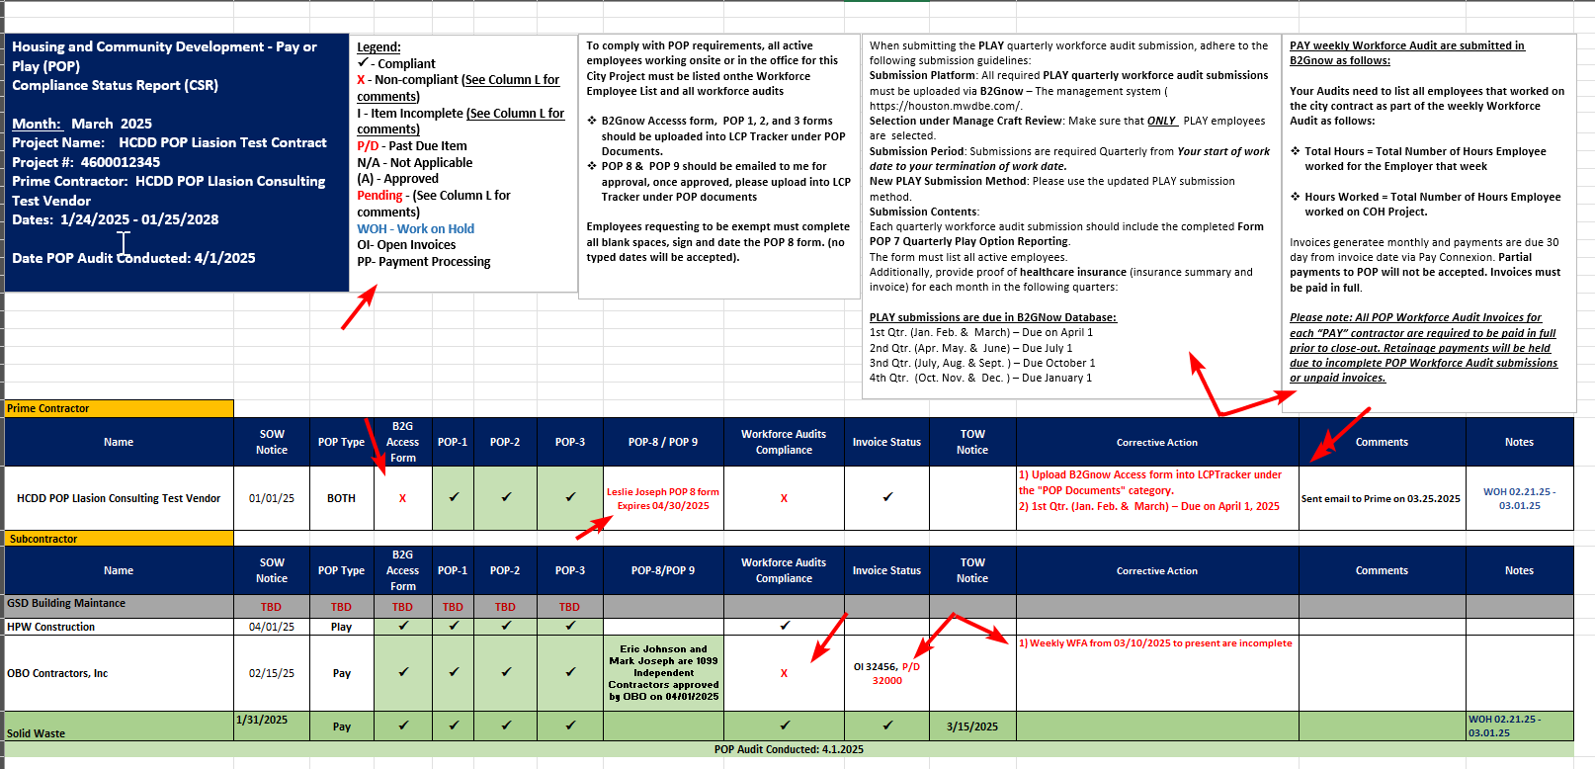
POP Monthly Compliance Status (CSR) Report:

Slide 55
Final POP Compliance Review

Slide 56

Final POP Compliance Review
To ensure full compliance with POP regulations for the FINAL POP Closeout for all projects, please ensure the following requirements are met:
POP Forms: Upload all applicable B2Gnow, POP 1, POP 2, and POP 3 forms into LCP Tracker under the "POP Documents" category.
Approved Forms: Upload any approved POP 8, POP 9 forms, or notarized 1099 letters (if applicable) into LCP Tracker under the "POP Documents" category.
Notices: Ensure that all contractors upload the Start of Work notice, Termination of Work notice, and any applicable Work on Hold notices into LCP Tracker under the "Shared Compliance" category.
PLAY Quarterly Workforce Audits: Submit all required PLAY quarterly workforce audits into B2Gnow, covering the period from the start of work to the end of the contract term.
PAY Weekly Workforce Audits: Submit all weekly workforce audits required, ensuring the final week is marked as FINAL.
Invoice Completion: Verify that all PAY invoices are fully paid by all PAY contractors that performed work on your project.
Additional Documentation: Provide any information requested by the POP Administrator for verification or clarification purposes related to the contract (e.g., letters of explanation, check stubs, notarized statements, etc.).
Failure to meet these POP requirements and provide the necessary documentation will result in retainage payment being withheld until the contract achieves full compliance with POP regulations.

Slide 57
FAQ SECTION

Slide 58
FAQ
No. ALL employees who work on the City Contract, whether onsite or in the office, must be included in the workforce audit employee list and accounted for during the audit.
1. Are only employees working on the job site required to be listed on the workforce audit employee list?
Notes:
R

Slide 59
FAQ
Yes. You must submit a completed and notarized POP 8 form, along with proof of healthcare insurance. This is the only time a copy of an employee's insurance card will be accepted. Email the form along with the insurance card to the POP Administrator for review and approval.
2. My employee has his or her own insurance, and my company does not pay for it; does this mean he or she must submit a notarized POP 8 form for exemption?

Slide 60
FAQ
No. Please upload your Termination of Work (TOW) Notice in LCP Tracker with the date your contract is completed, and then submit FINAL in the B2Gnow database during your final workforce audit week.
3. I am a subcontractor on a City of Houston POP contract, and my contract ends before the Prime Contractor finishes the job, do I still have to submit POP submissions?

Slide 61
FAQ
Yes. All subcontractors with a professional service, construction, or general service contractor whose contract amount meets or exceeds the $200,000 are required to comply with POP requirements.
4. Are subcontractors required to comply with the POP program if they are not MWSBE or Section 3?

Slide 62
FAQ
No. The POP payments are deposited to the Contractor Responsibility Fund (CRF), which shall not be used for any other purpose except to assist in providing healthcare services to uninsured persons in the Houston area.
To learn more, please see the Office of Business Opportunity website at: https://www.houstontx.gov/obo/popforms.html
5. Do any of the POP Workforce Invoice payments benefit my company?

Slide 63
ADDITIONAL RESOURCES

Slide 64
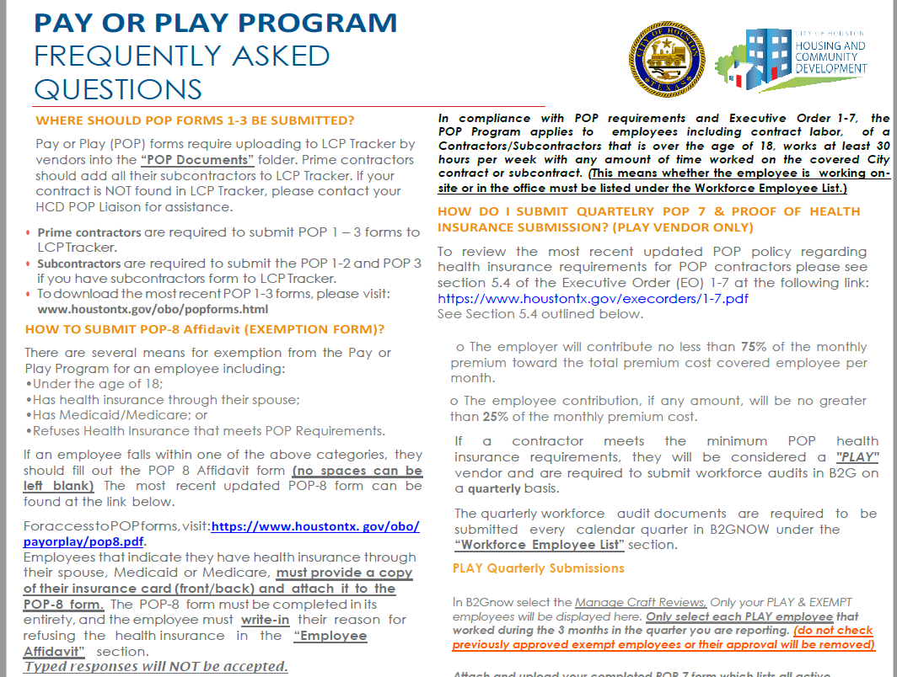
If you would like to request a copy of the POP Frequently Asked Questions, please send an email to your POP Liaison.
POP FAQ's
Where should POP Forms 1-3 be submitted?
How to submit POP 8 Form (Exemption Waiver)?
How Do I submit PLAY submissions?
How do I submit PAY Workforce Audit?
How can I pay my POP Invoice?

Slide 65


Comments & Questions

