Slide 1

WELCOME!
Pre-Award
9:30 AM – 10:30 AM
MWSBE
10:30 AM – 11:30 AM
Pay or Play
11:30 AM – 12:30 AM
We Will Begin Shortly.

Slide 2
Pre-Award Services Technical Assistance Training
AA
OCTOBER 30, 2024 - 8:30AM - 12:20PM
January 29, 2026 - 9:30AM – 10:30 AM

Slide 3

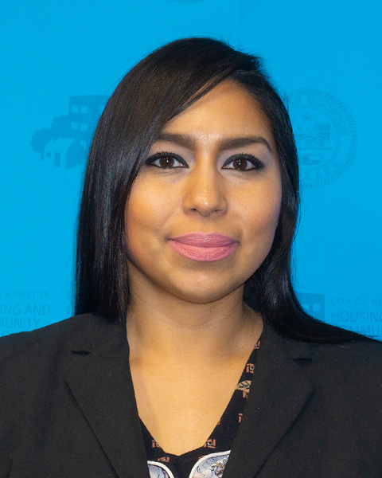
Division Contact Information
Laura Serrano
Division Manager
Chrystal Boyce
Compliance Manager
Michelle Perales
Compliance Manager
2100 Travis, 9th Floor, Houston, TX 77002
www.houstontx.gov/housing
Notes:
Kennisha London is the Deputy Director for the Compliance & Grants Administration Division, while Chrystal Boyce is the Division Manager for Contract Compliance.
Chrystal oversees Pre-Award Services and leads a team of professionals who administer Affordable Rental Housing Compliance, Section 3, Pay or Play, and the Minority Women Owned Small Business Enterprise (MWSBE) programs.

Slide 4

Pre-Award Services
Lakesha Tates
Staff Analyst
Lakesha.Tates@Houstontx.gov
Office: 832-394-6345

Slide 5

Program Overview
Pre-Award Services ensures an effective and efficient solicitation and contract review process by review and approval of required documents related to DBRA, Section 3, MWSBE and Pay or Play requirements.

Slide 6
Pre-Award Benefits
Contracting party receives detailed guidance on applicable program requirements to prevent project delays and non-compliance;
Use of Funds, Cost Allocations and pertinent contacts are provided;
Contract, Employment and Training opportunities are disseminated to local businesses and workers

Slide 7
PRE-AWARD ACTIVITIES

Slide 8
MWBE Prime Participation
Policy Change: The City will now allow MWBE Primes to meet advertised goals by self-performing up to 50% of the total contract goal(s).
MWBE primes will not retain more dollars on each contract, potentially allowing them to grow and build capacity.
Implementation Timeline: Language for the application of this new policy will be explicitly included in new City solicitations. Existing contracts or solidifications already advertised will not be affected by this new policy.

Slide 9
MWBE Prime Participation
Please keep in mind the following regarding the policy change:
MWBE Primes will have to choose which goal they would like to receive credit for on construction projects (MBE or WBE).
Once a goal type for participation is selected, the Primes participation credit will be capped at the proposed percentage or the approved goal, whichever is lower.
This new policy serves to assist MWBE Primes to build their capacity, while not losing focus on ensuring MWBE subcontractor participation on City Contracts.

Slide 10
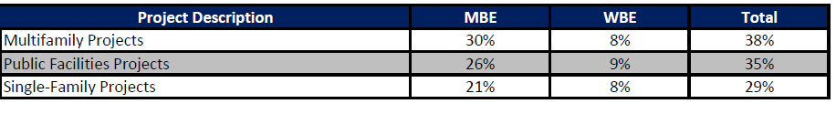
HCD Categorical Goals
Effective immediately, any new procurement initiated by HCDD for goal-oriented contracts of any type must contain a contract-specific M/WBE goal or utilize HCDD approved categorical goals. HCDD approved (categorical goals) will only be applicable for construction related activities on Multifamily, Public Facilities and Single-Family awards .
Implementation Timeline: Language for the application of this new policy will be explicitly included in new City solicitations. Existing contracts or solidifications already advertised will not be affected by this new policy.

Slide 11
Minority Women Owned Small Business Enterprise (MWSBE)
MWSBE Participation Plan w/ Letters of Intent;
MUST complete Form 470 AND/OR FORM(S) 471 and 472.
*Only firms certified through the City of Houston, Office of Business Opportunity can be utilized towards goal achievement*

Slide 12
Achievement Of Goal
MBE and WBE goals are separate subcontracting goals to be met individually.
Any excess of the MBE or WBE Goal cannot be used to meet a deficient MBE or WBE goal.
Only 4% SBE can be used to meet either the MBE and/or WBE Goal, but both cannot get 4% each.
A MBE or WBE certified Prime may count its self-performance for up to 50% of the overall advertised goal. The certified MWBE Prime may count only the work in which the MWBE has performed a Commercially Useful Function. The use of a certified MWBE Prime’s self-performance to meet multiple goals (e.g., MBE and WBE) on a contract is prohibited.
Once a firm is certified as a MWSBE firm, the total dollar value of the subcontract awarded to the MWSBE firm is counted toward the Contract Goals, counting only the work in which the MWSBE has performed a Commercially Useful Function. The use of one MWSBE certified firm to meet multiple goals (e.g., MBE, WBE, SBE goals) on a contract is prohibited, unless expressly approved by OBO.
Only City of Houston Certified firms may be used to meet either the MBE Goal or WBE Goal. Visit the City’s Office of Business Opportunity Website at http://www.houstontx.gov/obo/ and click on directory link to search for COH certified vendors.
Contractor must fill in each box COMPLETELY and SIGN the document
MWSBE Participation Plan must be accompanied with Signed Letters of Intent for goal achievement.
You either turn in ONE document if you meet the Contract Goals: (Document 00470); OR
You turn in THREE documents if you cannot meet the Contract Goals: (Documents 00470, 00471, & 00472
All information must be provided in order to be deemed responsive

Slide 13
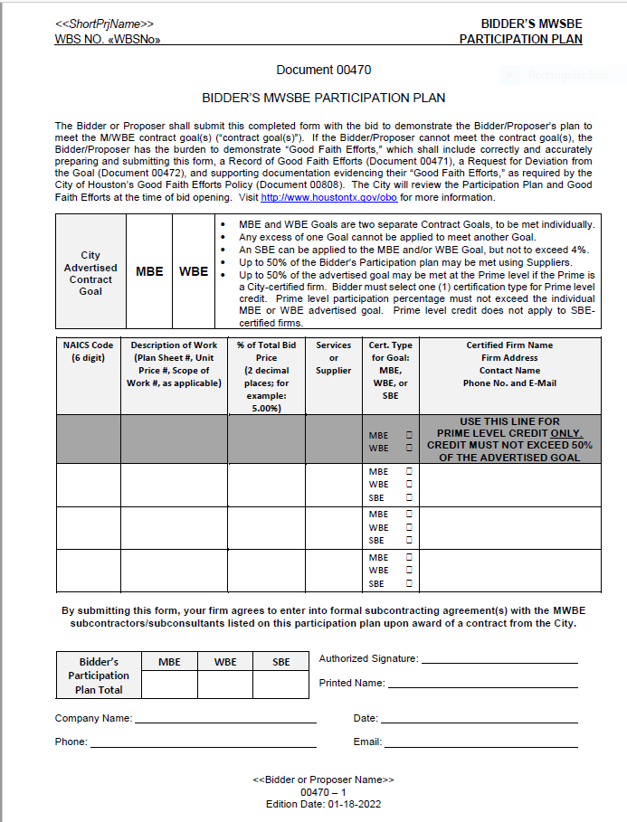
MWSBE Participation Plan Document 470
Captures MWSBE Participation that the Contractor commits to achieve for the contract.
Helps Pre-Award Administration Manager determines whether the Contractor has a plan to actually meet the goal.
Contractor is required to submit Document 470 with MWSBE Signed Letters of Intent

Slide 14
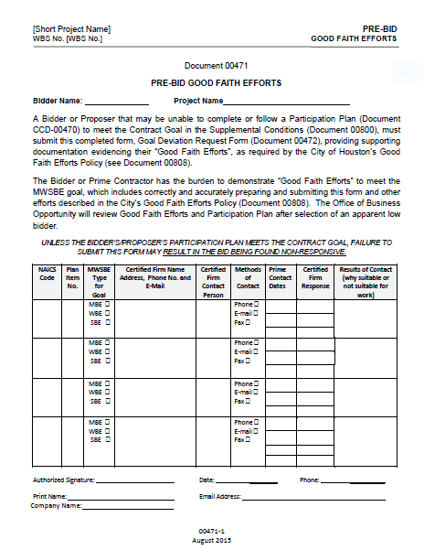
Pre-Bid Good Faith Efforts
Allows the Contractor to document Good Faith Efforts to meet the advertised MWSBE goals.
Allows the Administrating Department to see Contractor’s efforts made to find MWSBE firms.
Contractor must fully complete the bottom portion of the document.
Certified Firm Name, Address, Contact Name, Phone Number and E-mail

Slide 15
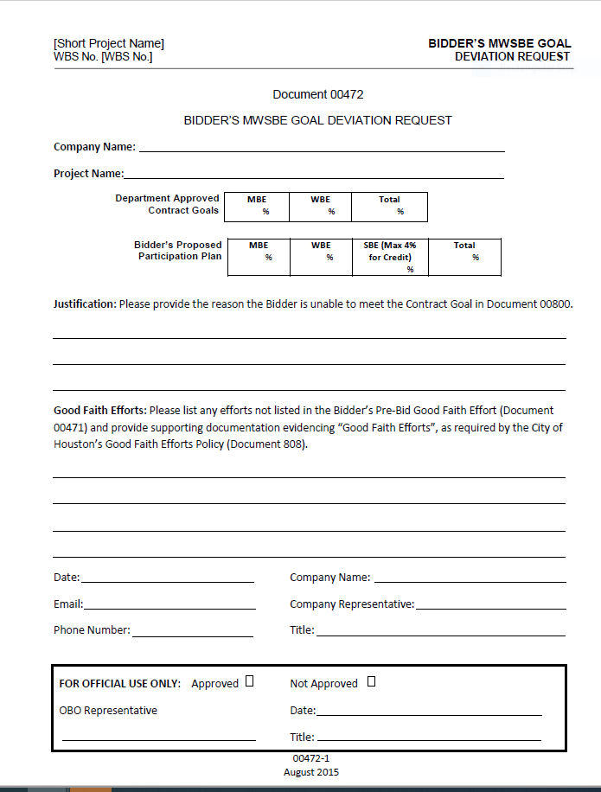
Contractor Deviation Goal Request
Allows Contractor to explain two things:
Why the Contractor was unable to meet the advertised MWSBE goals; AND
What good faith efforts the Contractor made that were not captured on Document 471 and provide additional justification.
Contractor must fully complete the bottom of the form.
Certified Firm Name, Address, Contact Name, Phone Number and E-mail

Slide 16
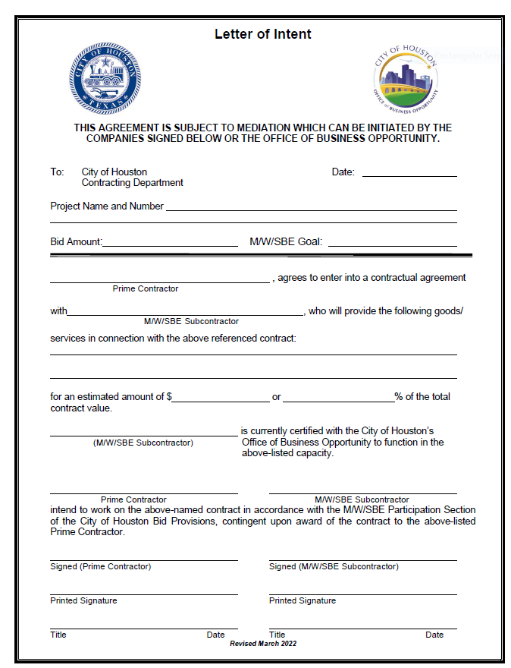
MWSBE Letter of Intent
MWSBE Letter of Intent must be accompanied with the MWSBE Participation Plan.
MWSBE Letter of Intent must be completed entirely.
The Bid Amount on MWSBE Letter of Intent should be direct construction amount from COH funding..
The MWSBE Letter of Intent for the MWSBE can include the estimated amount the GC intent to utilize for that the sub or the percentage you listed on the MWSBE Participation Plan for the certified firm.
The MWSBE Letter of Intent must be signed by the General Contractor and the MWSBE subcontractor or supplier.
All information must be provided in order to be deemed responsive

Slide 17
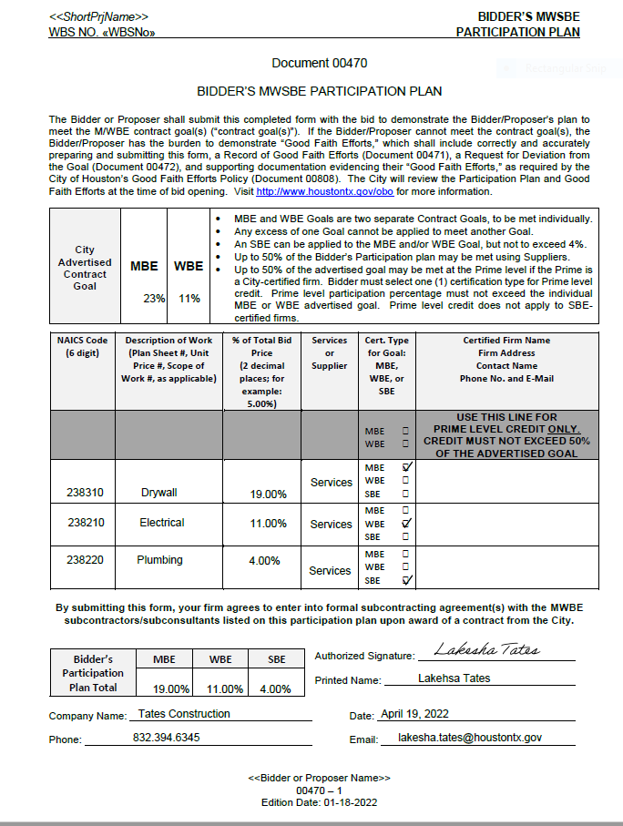
MWSBE Participation Plan Example #1

Slide 18
MWSBE Participation Plan Assessment
Contractor MUST submit Document 470 along with Signed Letter of Intent for each subcontractor or supplier listed for MWSBE goal achievement.
Prime Contractor must fill in each box COMPLETELY and SIGN the document.
All required documents must be provided and the MWSBE Participation Plan must demonstrate meeting the minimum goal requirements in order to be deemed responsive. Standard processing time is 7-10 business days once all Pre-Award documents have been submitted to HCDPreAward@houstontx.gov
If MWSBE Participation Plan and Letters of Intent are deemed responsive an approval email will be disseminated to the Owner Developer, Prime Contractor and Relations Manager recommending to proceed with scheduling of Pre-Construction Meeting
If the Prime Contractor failed to demonstrate meeting the minimum MWSBE minimum goal requirements an email will be sent to the Owner Developer/Contractor and Relations Manager notifying them that the MWSBE Participation Plan is non-responsive and did not meet the minimum goal requirements.

Slide 19
MWSBE Participation Plan Assessment
If MWSBE Participation Plan does not meet the minimum goal requirements the MWSBE Participation Plan (470), Pre-Bid Good Faith Efforts (471) and MWSBE Goal Deviation (472) will be forwarded over to the Office of Business Opportunity (OBO) to evaluate your Good Faith Efforts along with any other supporting documentation.
Office of Business Opportunity standard processing time is 7-10 business days provided all information is submitted. Each time new information is requested and submitted the days restart.
Pre-Award Services is excluded in the evaluation of the non-responsive MWSBE Participation Plan submitted to OBO. OBO will be in contact with the Contractor and provide Pre-Award Services with the final recommendations.
Pre-Award required documents must be reviewed and approved prior to recommending Pre-Construction Meeting and Notice to Proceed.

Slide 20
PAY OR PLAY

Slide 21
Pay or Play
Article VI, Section 7a, of the City Charter of the City of Houston; and City of Houston Code of Ordinance, Chapter 15 Executive Order 1-7
Notes:
The Pay or Play Program (POP Program) creates a more
level playing field and enhances fairness in the bid process between competing contractors
that choose to offer health benefits to their workforce and those who do not. The program also
recognizes and accounts for the fact that there are cost associated with health care of the
uninsured citizens of the Houston and Harris County area. Contracts valued at or above $100,000.00 (contract) and $200,000.00 (sub-contract)
including contingencies, amendments, supplemental terms and/or change orders are require to comply with POP requirements.

Slide 22
Pay or Play Pre-Award Documents
POP-1 Pay or Play Acknowledge Form;
POP-2 Pay or Play Certification of Compliance with Pay or Play Program
POP-3 Pay or Play Program List of Subcontractors
B2GNOW Management System Access Form
*Pay or Play Pre-Award documents must be submitted for reviewal and approval prior to scheduling of Pre-Construction Meeting and Notice to Proceed.

Slide 23
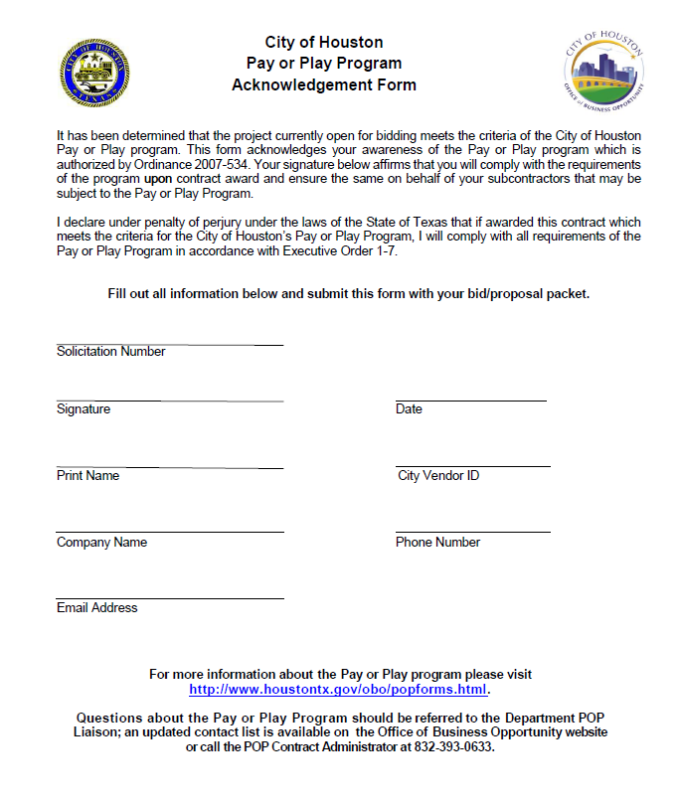
Form POP-1 Pay or Play Acknowledgement
Contractor acknowledges POP Program and agrees to comply if they are the successful contractor.
Contractor must complete and submit with Pre-Award required documents.

Slide 24
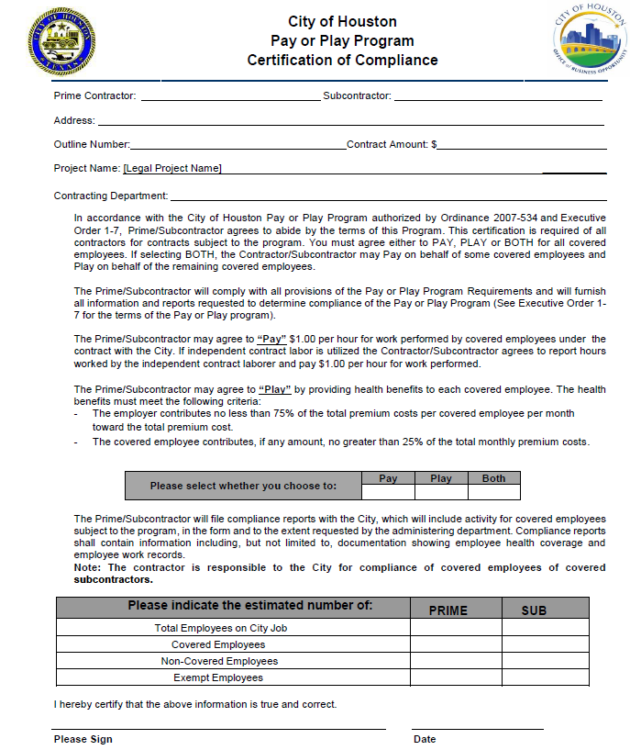
Form POP-2 Certification of Compliance
Contractor chooses how they will participate in the POP Program.
POP-2 must be completed and submitted by the Contractor.

Slide 25
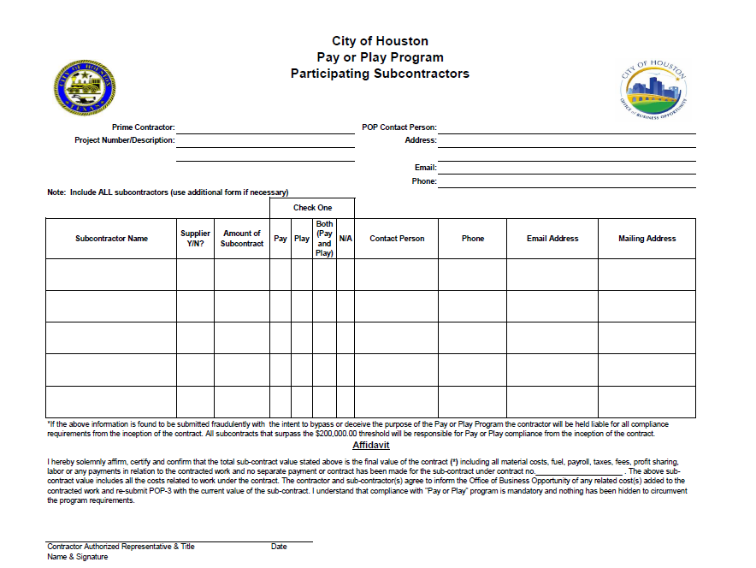
Form POP-3 List of all subcontractors
List of all subs participating on the project.
Filled out and submitted by the Prime Contractor.

Slide 26
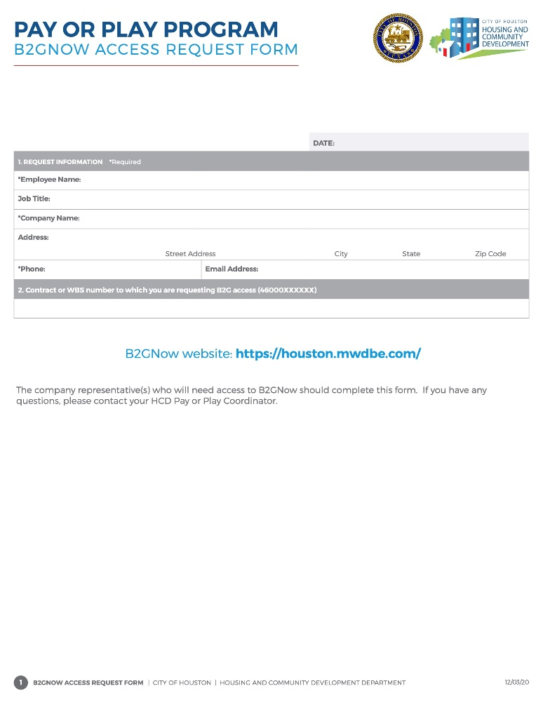
POP Required Form
B2GNOW Access Request Form
Contractor is required to complete the B2GNOW form in its entirety for providing access to the system for POP compliance requirements.

Slide 27


DBRA Requirements
THE CITY OF HOUSTON | HOUSING AND COMMUNITY DEVELOPMENT DEPARTMENT

Slide 28
Prevailing Wage Rates
Prevailing wage rates are issued before the Pre-Bid meeting.
Rates are locked-in by the bid opening date subject to the execution of a general construction contract.
Exceptions apply.

Slide 29
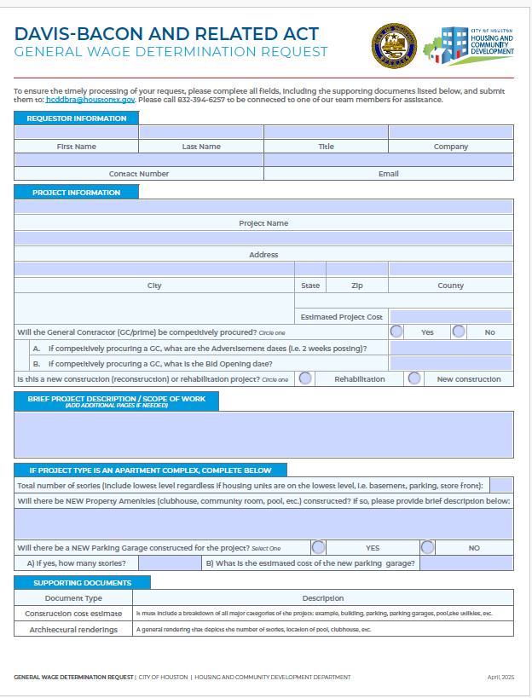
General Wage Determination Form
General Wage Determination Request
Obtain the General Wage Determination Request prior to scheduling the pre-construction meeting.
Confirm that wage rates and the Federal Regulations Compliance Packet are included in both the bid and contract documents as the minimum requirements before proceeding

Slide 30
DBRA Required Meetings
Pre-Bid Meeting for competitively procured contracts: This is best time to provide the bidding contractors an overview of the prevailing rates and our requirements.
Pre-Construction Meeting: In accordance with 29 CFR Part 5, a preconstruction conference must be held with prior to the commencement of construction work.
Onboarding: Before construction starts, the contract administrator must complete the onboarding training session.
THE CITY OF HOUSTON | HOUSING AND COMMUNITY DEVELOPMENT DEPARTMENT

Slide 31
Department of Labor Final Rule
Prevailing rates are subject to change when a contract or order is amended to:
includes additional, substantial construction not within the scope of work, or
perform work for an additional time period not originally obligated, including when an option is exercised on a contract or order.
After Contract Award
THE CITY OF HOUSTON | HOUSING AND COMMUNITY DEVELOPMENT DEPARTMENT

Slide 32
CONTRACT COMPLIANCE ACKNOWLEGDEMENT FORM

Slide 33
Acknowledgement Form
Before recommending to proceed with project activities. This document serves as an affirmation of the contracting party responsibility to ensure compliance with program requirements

Slide 34
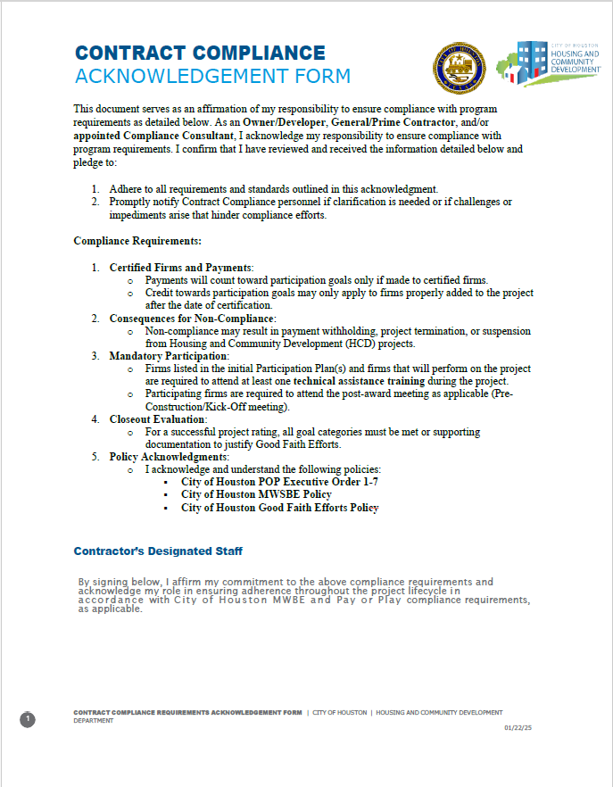
Acknowledgement Form
As an Owner/Developer, General/Prime Contractor, and/or appointed Compliance Consultant, I acknowledge my responsibility to ensure compliance with program requirements.
e

Slide 35
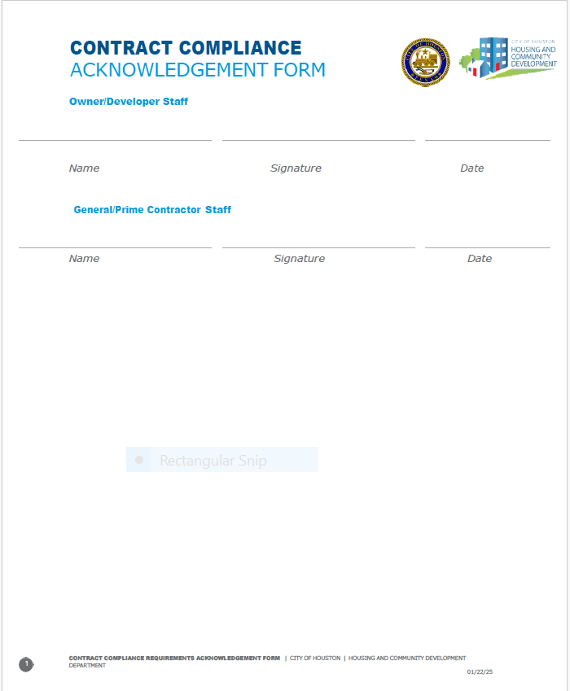
Acknowledgement Form
The Owner/Developer and General/Prime Contractor will complete and date the acknowledgment form, then submit it to the Pre-Award Staff Analyst along with the required Pre-Award documents.
e

Slide 36
REQUIRED SOLICITATION DOCUMENTS

Slide 37
Solicitation Language
Before advertising for a General Contractor or subcontracting, review of solicitation content and attachments must be submitted for review to ensure applicable program requirements are included.

Slide 38
Solicitation Language
Example Solicitation Language for Prime Contractor:
MWSBE: Contractor shall comply with the City’s Minority and Women Business Enterprise (“MWBE”) programs as set out in Chapter 15, Article V of the City of Houston Code of Ordinances and the applicable Office of Business Opportunity’s (“OBO”) Policies and Procedures. Contractor shall make good faith efforts to award subcontracts or supply agreements in at least ­­­­_____% of the value of this Agreement to MWBEs (“Stated MWBE goal”). If the Contractor is a certified MBE or WBE, Contractor may count toward goals the work that it commits to perform with its own work force, capped at 50% of the total advertised goal. Contractor acknowledges that it has reviewed the requirements for good faith efforts on file with OBO and will comply with them.
Pay Or Play
Contractors shall comply with the City's Pay or Play Program, as set out in Executive Order No. 1-7, the requirements and terms of which are incorporated into this RFP for all purposes. Contractors have reviewed the requirements of Executive Order No. 1-7 at http://www.houstontx.gov/obo/popforms.html The Contractors should demonstrate that they have the willingness and ability to comply with the City's Contractors' Pay of Play Program.

Slide 39
Prime Contract Required Documents
DBRA General Wage Determination
The Prime Contract must reference and include the following documents regarding Local, State, and Federal Compliance Requirements:
DBRA General Wage Determination
Federal Regulations Compliance Packet
Requirements for the City of Houston Program for Minority, Women, and Small Business Enterprises (MWSBE)
City of Houston Good Faith Efforts Policy
*A draft copy of all construction contracts must be provided to the Staff Analyst for reviewal and approval of required compliance language and documents for applicable programs.

Slide 40
Pre-Award Compliance Red Flags
Signed Letters of Intent are not submitted with Participation Plan;
Failure to have the MWSBE firm(s) sign the Letters of Intent;
Listing firms on a MWSBE Participation Plan that do not have an active certification with City of Houston, Office of Business Opportunity;
Contractor providing an MWSBE Participation Plan that exceeds the minimum goal requirements;
Contractor substitutes SBE participation of more than 4% of the MBE goal, the WBE goal or portions of the MBE goal and WBE goal;
Listing MWSBEs firms for goal credit without notification;
POP-3 forms not included all subcontractors, consultants, service providers, vendors, and suppliers, etc you intend to utilize regardless of certification status, scope of work or contract amount.
Failure to submit Pre-Award required documents for review and approval in timely manner.

Slide 41
FAQS

Slide 42
FAQS
When are Pre-Award Documents required to be submitted?
Before a pre-construction meeting and/or issuance of a Notice to Proceed is recommended, Pre-Award documents must be approved.
Who do we submit the Pre-Award Documents to?
Pre-Award submissions should be sent via email to Staff Analyst, HCDPreAward@houstontx.gov
What are the next steps following submission of Pre-Award documents?
The Staff Analyst will review documents for completion and compliance before recommendation to proceed based on the responsiveness of required documents.
If the MWSBE Participation Plan is deemed non-responsive what is the next step?
Your MWSBE Participation Plan will be forwarded along with documents 471, 472 and all other supporting documents to the Office of Business Opportunity to review and cure your plan within 7 – 10 business days. Communication regarding a non-responsive MWSBE Participation Plan will be between an Office of Business Opportunity and the Prime Contractor. The Office of Business Opportunity will notify the Staff Analyst and Prime Contractor of the Good Faith Efforts Determination and recommendations.

Slide 43
FAQS
How are Pre-Award Good Faith Efforts Evaluated?
Evaluation is based on a case-by-case basis to determine if the contractor complied with the City of Houston, Good Faith Efforts policy. https://www.houstontx.gov/obo/docsandforms/goodfaithefforts

Slide 44
Before a Notice to Proceed is issued or a pre-construction meeting is scheduled, all preliminary documentation must be submitted by Owner/Developer and or the General Contractor for review and approval
All Pre-Award documents must be sent to HCDPreAward@houstontx.gov

Slide 45


Comments & Questions

