Slide 1

WELCOME!
Pre-Award
9:30 AM – 10:30 AM
MWSBE
10:30 AM – 11:30 AM
Pay or Play
11:30 AM – 12:30 AM
We Will Begin Shortly.

Slide 2
Pre-Award Services
Technical Assistance Training
AA
OCTOBER 30, 2024 - 8:30AM - 12:20PM
July 22, 2026 - 9:30AM – 10:30 AM

Slide 3

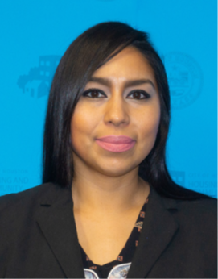
Division Contact Information
Laura Serrano
Division Manager
Chrystal Boyce
Compliance Manager
Michelle Perales
Compliance Manager
2100 Travis, 9th Floor, Houston, TX 77002
www.houstontx.gov/housing
Notes:
Kennisha London is the Deputy Director for the Compliance & Grants Administration Division, while Chrystal Boyce is the Division Manager for Contract Compliance.
Chrystal oversees Pre-Award Services and leads a team of professionals who administer Affordable Rental Housing Compliance, Section 3, Pay or Play, and the Minority Women Owned Small Business Enterprise (MWSBE) programs.

Slide 4

Pre-Award Services
Lakesha Tates
Staff Analyst
Lakesha.Tates@Houstontx.gov
Office: 832-394-6345

Slide 5

Program Overview
Pre-Award Services ensures an effective and efficient solicitation and contract review process by review and approval of required documents related to DBRA, Section 3, MWSBE and Pay or Play requirements.

Slide 6
Pre-Award Benefits
Validates Program Requirements
Improves Contract Execution Readiness
Clarifies Expectations with the Owner/Developers, Prime & General Contractors
Confirms Cost Reasonableness
Reduces Compliance Risks

Slide 7
COMPLAINCE REQUIREMENTS

Slide 8
General Requirements
Pre-award Debarment Verification Requirements
  State and Federal Verification is required for:
    All entities (professional service providers, nonprofits, etc.)
    Prime Contractors
    Subcontractors*
    Lower‑tier Subcontractors*
  Post-award an annual review is required for multi‑year contracts.
Prime Contractors must be registered with SAM.gov to receive a contract award.
Subcontractors and lower-tier subcontractors must have a Unique Entity Identification Number (UEI)
*Verification of debarment must be conducted for certified MWSBE firms before they are listed on a 00471 form. Additionally, debarment verification is required for all other subcontractors and lower-tier subcontractors after the master service agreement is awarded, but prior to awarding any contract to these subcontractors.

Slide 9
General Requirements
According to the HCD Conflict of Interest Policy and federal requirements, Covered Persons may not receive any financial interest or benefit from an HCD‑funded contract, subcontract, or agreement—either for themselves or for anyone with whom they have business or immediate family relationships. This prohibition applies during their service and for one year after their tenure ends.
Covered Persons refers to individuals connected to the City of Houston who work with, represent, or benefit from City‑managed funding. This includes employees, agents, consultants, officers, and elected or appointed officials, as well as participants and subrecipients involved in programs supported by local, state, or federal funds, whether the funding is received directly or indirectly. The term also extends to the immediate family members of these individuals, anyone living in the same household, and people with whom Covered Persons have business or financial relationships.
Part of pre-award requirements is that a Prime Contractor, Subcontractors, Lower-tier Subcontractor must complete a Conflict of Interest form.
Post-award an annual review is required for multi‑year contracts.

Slide 10
PRE-AWARD ACTIVITIES

Slide 11
MWSBE Program Updates
MWBE Primes are allowed to meet advertised goals by self-performing up to 50% of the total contract goal(s).
Construction contracts will now have a SBE goal
4% cap on SBE participation has been removed
Bidders may now use all other locally certified firms (Persons with Disabilities Business Enterprise - PDBE, Veteran-Owned Small Business Enterprise - VOSB, Disabled Veteran-Owned Small Business - DVOSB, Lesbian, Gay, Bisexual, Transgender, and Queer/Questioning Business Enterprise - LGBTQE) these local firms may be utilized for up to 4% in lieu of MBE or WBE or combination of the two.
16% participation cap for Hispanic American firms performing under the MBE certification.
Implementation Timeline: New solicitations will include the revised policy language. Existing contracts and solicitations advertised before February 2025 will continue under the previous policy and are not affected.

Slide 12
MWBE Prime Participation
Please keep in mind the following regarding the policy change:
MWBE Primes will have to choose which goal they would like to receive credit for on construction projects (MBE or WBE).
Once a goal type for participation is selected, the Primes participation credit will be capped at the proposed percentage or the approved goal, whichever is lower.
This new policy took affect January 2022 serves to assist MWBE Primes to build their capacity, while not losing focus on ensuring MWBE subcontractor participation on City Contracts.

Slide 13
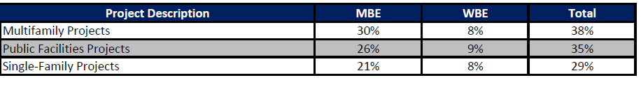
HCD Categorical Goals
HCDD has collaborated with the Office of Business Opportunity, which administers the MWSBE program, to establish categorical goals for HCD similar construction projects across Multifamily, Public Facilities, and Single-Family programs. These categorical goals have been incorporated into NOFAs and solicitations and apply only to construction-related activities within these programs.
Effective February 15, 2026, HCD will no longer use categorical goals and must instead conduct a contract-specific analysis for each award to obtain an approved MWSBE goal from OBO. Therefore, for any new procurements advertised after February 15, 2026, the MWSBE goal may differ from the previously established categorical goals.
Implementation Timeline: Existing contracts or solidifications already advertised will not be affected by this new policy.

Slide 14
Minority Women Owned Small Business Enterprise (MWSBE)
MWSBE Participation Plan w/ Letters of Intent;
MUST complete Form 470 AND/OR FORM(S) 471 and 472.
*Only firms certified through the City of Houston, Office of Business Opportunity can be utilized towards goal achievement*

Slide 15
Achievement Of Goal
A MBE or WBE certified Prime may count its self-performance for up to 50% of the overall advertised goal. The certified MWBE Prime may count only the work in which the MWBE has performed a Commercially Useful Function. The use of a certified MWBE Prime’s self-performance to meet multiple goals (e.g., MBE and WBE) on a contract is prohibited.
Contractors may now use all other locally certified firms for up to 4% in lieu of MBE or WBE or combination of the two
16% participation cap for Hispanic American firms performing under the MBE certification.
Once a firm is certified as a MWSBE firm, the total dollar value of the subcontract awarded to the MWSBE firm is counted toward the Contract Goals, counting only the work in which the MWSBE has performed a Commercially Useful Function. Credit for work subcontracted by a goal credit MWBE firm to a non-certified firm (2nd tier subcontractor) will not count towards the MWSBE goal.
The use of one MWSBE certified firm to meet multiple goals (e.g., MBE, WBE, SBE goals) on a contract is prohibited, unless expressly approved by OBO.
Only City of Houston Certified firms may be used to meet either the MBE Goal or WBE Goal. Visit the City’s Office of Business Opportunity Website at http://www.houstontx.gov/obo/ and click on directory link to search for COH certified vendors.
Contractor must fill in each box COMPLETELY and SIGN the document
MWSBE Participation Plan must be accompanied with Signed Letters of Intent for goal achievement.
You either turn in ONE document if you meet the Contract Goals: (Document 00470); OR
You turn in THREE documents if you cannot meet the Contract Goals: (Documents 00470, 00471, & 00472
All information must be provided in order to be deemed responsive

Slide 16
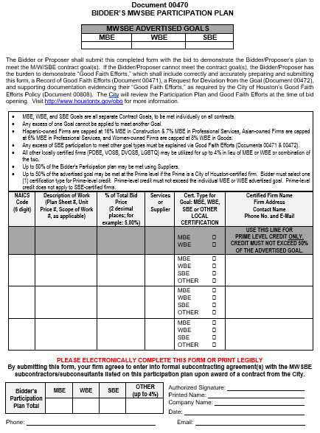
MWSBE Participation Plan
Document 470
Captures MWSBE Participation that the Contractor commits to achieve for the contract.
Helps Pre-Award Staff Analyst determines whether the Contractor has a plan to actually meet the goals.
Contractor is required to submit Document 470 with MWSBE Signed Letters of Intent

Slide 17
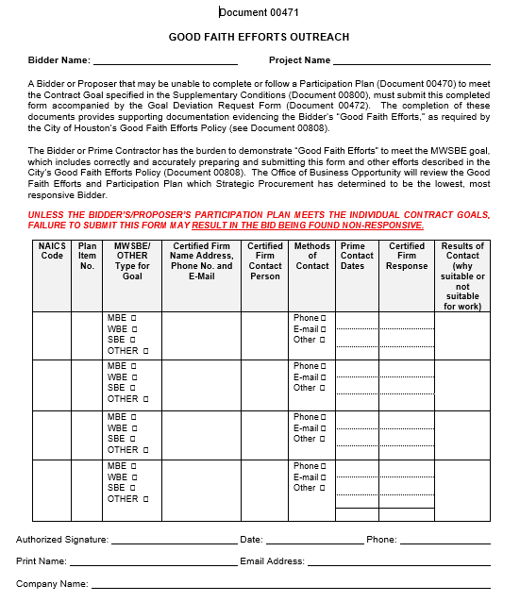
Good Faith Efforts Outreach
Allows the Contractor to document Good Faith Efforts to meet the advertised MWSBE goals.
Allows the Administrating Department to see Contractor’s efforts made to find MWSBE firms.
Contractor must fully complete the bottom portion of the document.
Certified Firm Name, Address, Contact Name, Phone Number and E-mail

Slide 18
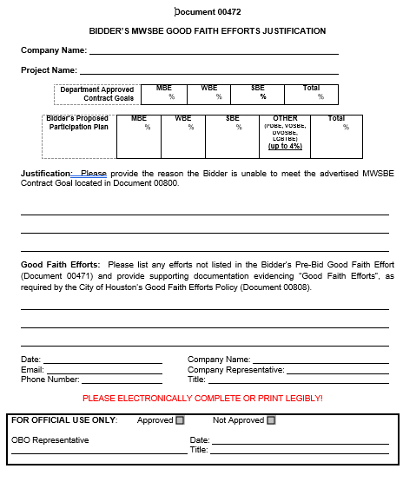
Bidder’s MWSBE Good Faith Efforts Justification Goal Request
Allows Contractor to provide and explain:
Provide the Department-approved Contract Goals and the Bidder’s proposed participation goals
Why the Contractor was unable to meet the advertised MWSBE goals; AND
What good faith efforts the Contractor made that were not captured on Document 471 and provide additional justification.
Contractor must fully complete the bottom of the form.

Slide 19
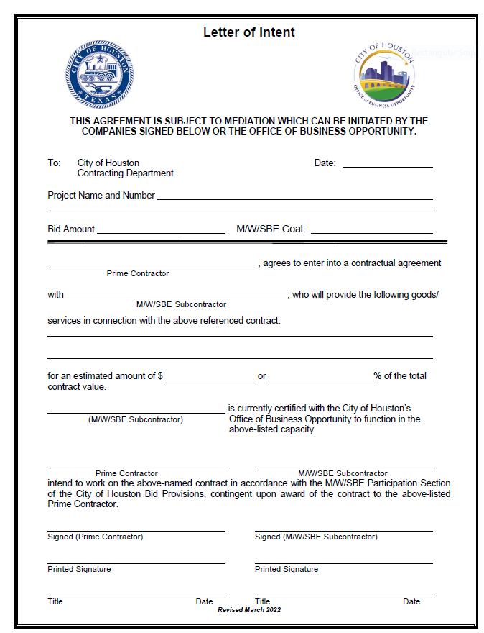
MWSBE Letter of Intent
MWSBE Letter of Intent must be accompanied with the MWSBE Participation Plan.
MWSBE Letter of Intent must be completed entirely.
The Bid Amount on MWSBE Letter of Intent should be direct construction amount from COH funding..
The MWSBE Letter of Intent for the MWSBE can include the estimated amount the GC intent to utilize for that the sub or the percentage you listed on the MWSBE Participation Plan for the certified firm.
The MWSBE Letter of Intent must be signed by the General Contractor and the MWSBE subcontractor or supplier.
All information must be provided in order to be deemed responsive

Slide 20
MWSBE Participation Plan Assessment
Contractor MUST submit Document 470 along with Signed Letter of Intent for each certified subcontractor or supplier listed for MWSBE goal achievement.
Firms are currently certified through COH OBO
Firms are certified for the services listed and perform a commercially useful function
NAICS codes match the work description
Percentages are accurate
MBE, WBE and SBE are individual goals that must be met
The Participation Plan must be signed, dated and demonstrate meeting the established MWSBE goal.
All required documents must be submitted, and the plan must demonstrate meeting the minimum goal requirements to be deemed responsive. If the plan exceeds the advertised goal, the Contractor will be responsible for adhering to the goals as outlined in the approved MWSBE Participation Plan.
Standard processing time is 7–10 business days once all Pre-Award documents are submitted to HCDPreAward@houstontx.gov.

Slide 21
MWSBE Participation Plan Assessment
If responsive:
An approval email will be sent to the Owner/Developer, Prime Contractor, and Relations Manager recommending scheduling of the Pre-Construction Meeting.
If non-responsive:
If minimum goals are not met, the MWSBE Participation Plan is deemed non-responsive. HCD Pre-Award Services will notify the Owner/Developer, Prime Contractor, and Relations Manager by email, and the plan cannot be revised.
Documents (470, 471, 472) will be forwarded to the Office of Business Opportunity (OBO) for evaluation of Good Faith Efforts and supporting documentation.
OBO processing time is 7–10 business days per submission; timelines restart with each new submission.
Pre-Award Services does not evaluate non-responsive plans; OBO will provide final recommendations directly to the Contractor and Pre-Award Services.
Pre-Award documents must be approved before recommending a Pre-Construction Meeting or issuing a Notice to Proceed.

Slide 22
PAY OR PLAY

Slide 23
Pay or Play
The City of Houston Executive Order 1-7
Notes:
The Pay or Play Program (POP Program) creates a more
level playing field and enhances fairness in the bid process between competing contractors
that choose to offer health benefits to their workforce and those who do not. The program also
recognizes and accounts for the fact that there are cost associated with health care of the
uninsured citizens of the Houston and Harris County area. Contracts valued at or above $100,000.00 (contract) and $200,000.00 (sub-contract)
including contingencies, amendments, supplemental terms and/or change orders are require to comply with POP requirements.

Slide 24
Pay or Play Pre-Award Documents
POP-1 Pay or Play Acknowledge Form;
POP-2 Pay or Play Certification of Compliance with Pay or Play Program
POP-3 Pay or Play Program List of Subcontractors
B2GNOW Management System Access Form
*Pay or Play Pre-Award documents must be submitted for reviewal and approval prior to scheduling of Pre-Construction/Kick-Off Meeting and Notice to Proceed.

Slide 25
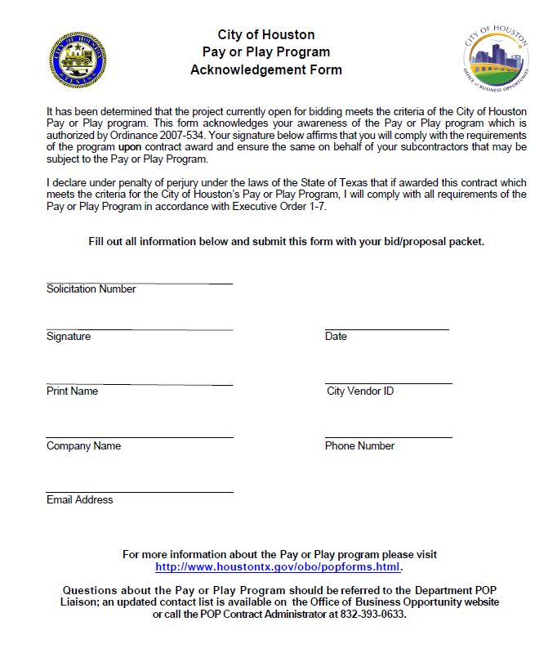
Form POP-1 Pay or Play Acknowledgement
Contractor acknowledges POP Program and agrees to comply if they are the successful contractor.
Contractor must complete and submit with Pre-Award required documents.

Slide 26
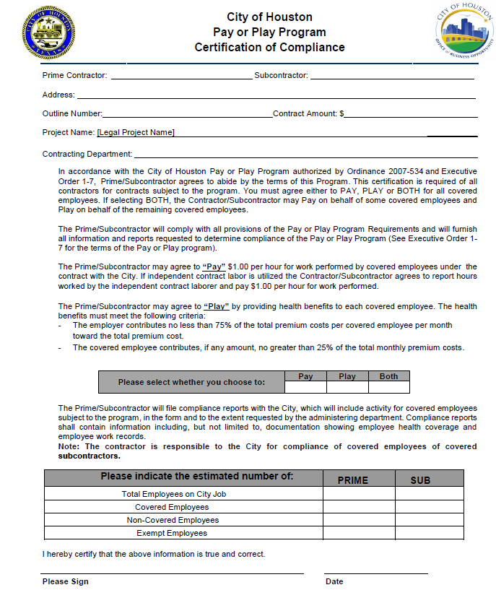
Form POP-2 Certification of Compliance
Contractor chooses how they will participate in the POP Program.
POP-2 must be completed and submitted by the Contractor.

Slide 27
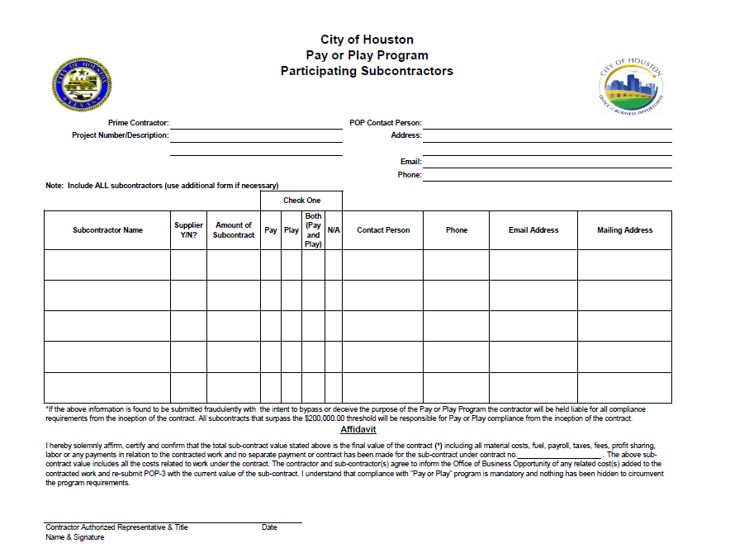
Form POP-3 List of all subcontractors
List of all subs participating on the project.
Filled out and submitted by the Prime Contractor.

Slide 28
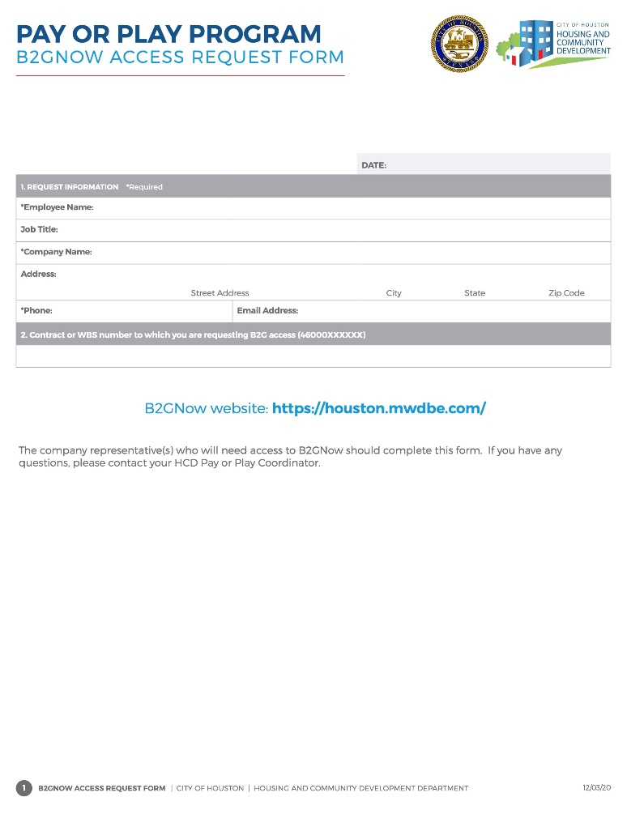
POP Required Form
B2GNOW Access Request Form
Contractor is required to complete the B2GNOW form in its entirety for providing access to the system for POP compliance requirements.

Slide 29


DBRA Requirements
THE CITY OF HOUSTON | HOUSING AND COMMUNITY DEVELOPMENT DEPARTMENT

Slide 30
Prevailing Wage Rates
Federal prevailing wage rates are issued before the Pre-Bid meeting.
Rates are reverified 10-days before the bid opening date. Any modifications are issued through an addendum.
The bid opening date locks in the federal prevailing wage determination(s) subject to the execution of a general construction contract within 90 calendar days.
After the 90 days, the date of the contract is used to lock in the rates.
If a contract is modified to add substantial out‑of‑scope construction work or extend performance (including options), the latest rates must be applied.
This does not apply when extra time is granted to finish the original work or when added work is merely incidental.

Slide 31
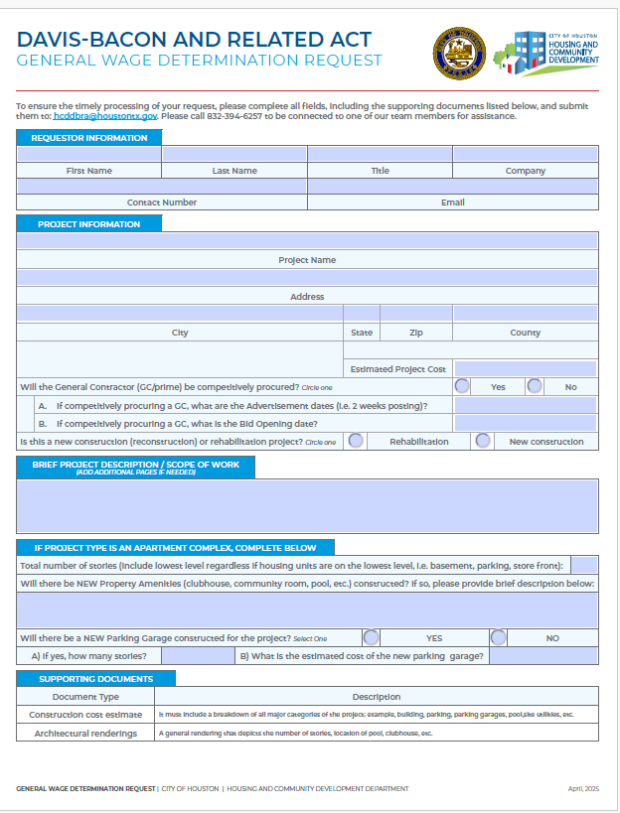
General Wage Determination Form
General Wage Determination Request
Obtain the General Wage Determination Request prior to scheduling the pre-bid and or pre-construction meeting.
Confirm that wage rates and the Federal Regulations Compliance Packet are included in both the bid and contract documents as the minimum requirements before proceeding

Slide 32
DBRA Required Meetings
Pre-Bid Meeting for competitively procured contracts: This is best time to provide the bidding contractors an overview of the prevailing rates and our requirements.
Pre-Construction Meeting: In accordance with 29 CFR Part 5, a preconstruction conference must be held with prior to the commencement of construction work.
Onboarding: Before construction starts, the contract administrator must complete the onboarding training session.
THE CITY OF HOUSTON | HOUSING AND COMMUNITY DEVELOPMENT DEPARTMENT

Slide 33
SECTION 3
PROGRAM REQUIREMENTS

Slide 34
Purpose and Section 3 Updates
The purpose of Section 3 is to ensure that economic opportunities, most importantly employment, generated by certain HUD financial assistance shall be directed to low- and very low-income persons, particularly those who are recipients of government assistance for housing or residents of the community in which the Federal assistance is spent.
Effective March 16, 2026, the U.S. Department of Housing and Urban Development (HUD) has increased the monetary threshold for Section 3 projects receiving Housing and Community Development (HCD) financial assistance from $200,000 to $300,000.
HCD Section 3 Policy has been updated as of April 2026 to align with the Section 3 updates.

Slide 35
Threshold and Applicability
Section 3 projects are housing rehabilitation, housing construction, and other public construction projects assisted under HUD programs that provide housing and community development financial assistance when the total amount of assistance to the project exceeds $300,000 of housing and community development financial assistance.
Section 3 requirements apply to an entire project, regardless of whether the project is fully or partially assisted under HUD programs that provide housing and community development financial assistance.

Slide 36
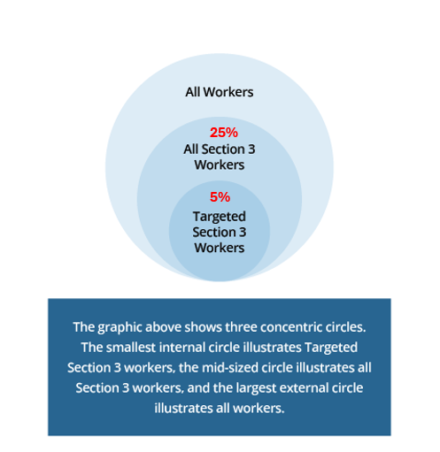
Section 3 Benchmark 25%/5%

Slide 37
Section 3 Reporting
For Section 3 projects, recipients must report the following data annually to HUD on all projects completed within the reporting year and in a manner consistent with reporting requirements for the applicable HUD program:
The total number of labor hours worked
The total number of labor hours worked by Section 3 workers
The total number of labor hours worked by Targeted Section 3 workers
The labor hours reported must include the total number of labor hours worked on a Section 3 project by all workers, including labor hours worked by any subrecipients, contractors, and subcontractors that the recipient is required to, or elects to, report.

Slide 38
Section 3 Certification
We recognize certifications issued by other governmental and quasi-governmental entities.
HCD allows for self-certification of Section 3 business concerns and Section 3/Targeted workers.
Download our forms at https://houstontx.gov/housing/compliance/section3/index.html.
hcdsection3@houstontx.gov
For more information visit: https://houstontx.gov/housing/section3.html#section3

Slide 39
CONTRACT COMPLIANCE ACKNOWLEGDEMENT FORM

Slide 40
Acknowledgement Form
Before recommending to proceed with project activities. This document serves as an affirmation of the contracting party responsibility to ensure compliance with program requirements

Slide 41
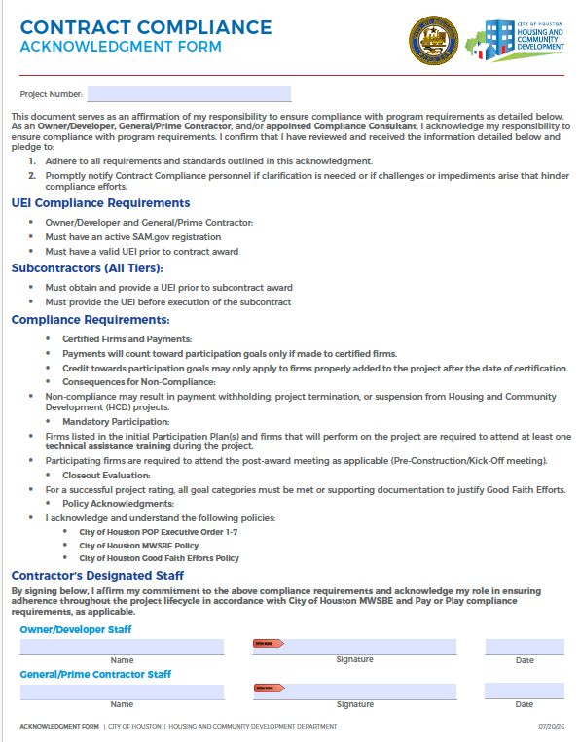
Acknowledgement Form
As an Owner/Developer and General/Prime Contractor, I acknowledge my responsibility to ensure compliance with program requirements.
e

Slide 42
PRE-AWARD UEI COLLECTION FORM

Slide 43
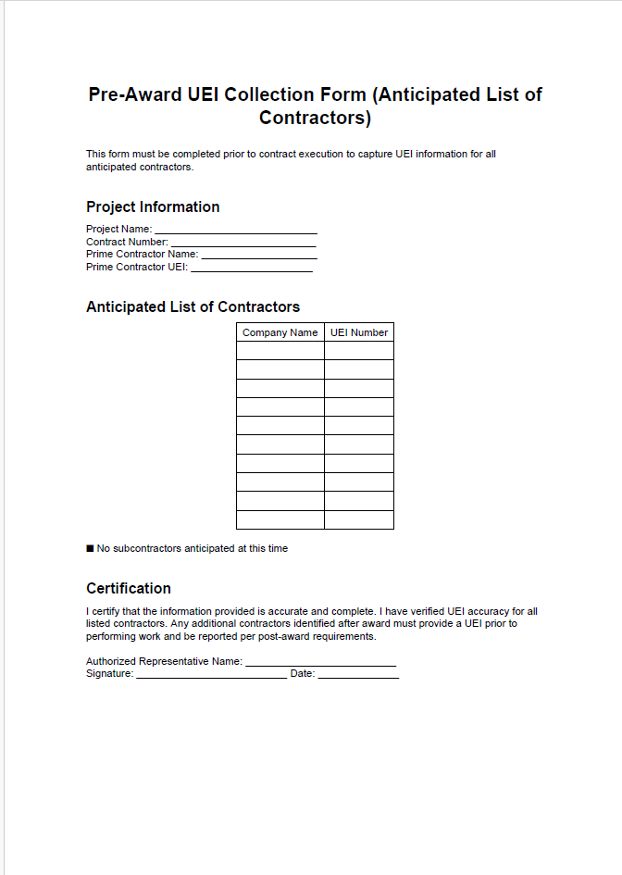
Pre-Award UEI Collection Form (Anticipated List of
Contractors)
Captures UEI information for the prime contractor and all anticipated subcontractors prior to contract execution
Includes certification that the prime contractor has verified the accuracy of all UEIs
Requires that any additional contractors identified post-award obtain and report a UEI prior to performing work
e

Slide 44
REQUIRED COMPLIANCE LANGUAGE

Slide 45
Solicitation Language
Before advertising for a General Contractor or subcontracting, review of solicitation content and attachments must be submitted for review to ensure applicable program requirements are included.

Slide 46
Solicitation Language
Example Solicitation Language for Prime Contractor:
MWSBE: Contractor shall comply with the City’s Minority and Women Business Enterprise (“MWSBE”) programs as set out in Chapter 15, Article V of the City of Houston Code of Ordinances and the applicable Office of Business Opportunity’s (“OBO”) Policies and Procedures. Contractor shall make good faith efforts to award subcontracts or supply agreements in at least ­­­­_____% of the value of this Agreement to MWBEs (“Stated MWBE goal”). If the Contractor is a certified MBE or WBE, Contractor may count toward goals the work that it commits to perform with its own work force, capped at 50% of the total advertised goal. Contractor acknowledges that it has reviewed the requirements for good faith efforts on file with OBO and will comply with them.
Pay Or Play
Contractors shall comply with the City's Pay or Play Program, as set out in Executive Order No. 1-7, the requirements and terms of which are incorporated into this RFP for all purposes. Contractors have reviewed the requirements of Executive Order No. 1-7 at http://www.houstontx.gov/obo/popforms.html The Contractors should demonstrate that they have the willingness and ability to comply with the City's Contractors' Pay of Play Program.
*The solicitation must reference and include an updated copy of the City of Houston MWSBE Program Requirements and Good Faith Efforts Policy*

Slide 47
Construction Contract Language
MWSBE and POP requirements requires standard language that must be incorporated into construction contracts between the Owner/Developer, Prime Contractor, and all Subcontractors. These requirements should be included in the applicable contract documents to ensure compliance with program guidelines and contractual obligations.

Slide 48
Minority and Women Business Enterprise Compliance
Contractor shall comply with the City’s Minority and Women Business Enterprise (“MWBE”) programs as set out in Chapter 15, Article V of the City of Houston Code of Ordinances and the applicable Office of Business Opportunity’s (“OBO”) Policies and Procedures. Contractor shall make good faith efforts to award subcontracts or supply agreements in at least ­­­­_____% of the value of this Agreement to MWBEs (“Stated MWBE goal”). If the Contractor is a certified MBE or WBE, Contractor may count toward goals the work that it commits to perform with its own work force, capped at 50% of the total advertised goal. Contractor acknowledges that it has reviewed the requirements for good faith efforts on file with OBO and will comply with them.
For purposes of this paragraph, “Contract Year” means a twelve (12) month period during the term of the contract commencing on the Effective Date of this Agreement and each anniversary thereof. If the term of this Agreement exceeds one Contract Year and Contractor’s MWBE participation level in a Contract Year is less than the Stated MWBE goal, then within 30 calendar days of the end of each Contract Year Contractor must provide a written explanation to both the Director and Office of Business Opportunity Director (“OBO Director”) of the following: (1) the discrepancy between Contractor’s MWBE participation level and the Stated MWBE goal, (2) the reason for the discrepancy, and (3) Contractor’s good faith efforts (in accordance with the City’s policy) towards achieving the Stated MWBE goal. As part of the good faith efforts assessment, the OBO Director may consider Contractor’s failure to timely submit the notice or explanation required by this provision and the OBO Director may impose sanctions or other penalties on Contractor for said failures in accordance with Chapter 15 of the Code of Ordinances, OBO’s policies and procedures, and the City’s good faith efforts policy.
Contractor shall maintain records showing:
  Subcontracts and supply agreements with Minority Business Enterprises;
  Subcontracts and supply agreements with Women Business Enterprises;
  Subcontracts and supply agreements with Small Business Enterprises (if any);
  Written confirmation from MWBE subcontractors and suppliers that they are participants on the contract; and
  Specific efforts to identify and award subcontracts and supply agreements to MWBEs. Contractor shall submit periodic reports of its efforts under this Section to the OBO Director in the form and at the times he or she prescribes.
Contractor shall ensure that all subcontracts with MWBE subcontractors and suppliers contain the following terms:
  [Name of MWBE subcontractor] shall permit representatives of the City of Houston, at all reasonable times, to perform (1) audits of the books and records of the subcontractor, and (2) inspections of all places where work is to be undertaken in connection with this subcontract. Subcontractor shall keep such books and records available for such purpose for at least four (4) years after the end of its performance under this subcontract. Nothing in this provision shall affect the time for bringing a cause of action nor the applicable statute of limitations.
  Within five (5) business days of execution of this subcontract, Contractor [prime contractor] and Subcontractor shall designate, in writing, to the City of Houston's OBO Director ("the OBO Director") an agent for receiving any notice required or permitted to be given pursuant to Chapter 15 of the Houston City Code of Ordinances, along with the street, mailing address, phone number, and email address of such agent.
  After reasonable attempt(s) to resolve disputes between the parties involving the terms, covenants, or conditions of this subcontract, a request for dispute resolution may be submitted to the Director. The Director may prescribe procedures to provide dispute resolution services in accordance with the requirements of Chapter 15 of the Houston City Code of Ordinances.

Slide 49
Pay or Play Compliance
The requirements and terms of the City of Houston Pay or Play Program, as set out in Executive Order 1-7, as revised from time to time, are incorporated into the Contract for all purposes. Contractor has reviewed Executive Order 1-7 and shall comply with its terms and conditions. IF CONTRACTOR DOES NOT PAY IN ACCORDANCE WITH THE PAY OR PLAY PROGRAM WITHIN 30 DAYS OF THE DATE DIRECTOR SENDS CONTRACTOR WRITTEN NOTIFICATION, CITY CONTROLLER MAY DEDUCT FUNDS UP TO THE AMOUNT OWED FROM ANY PAYMENTS OWED TO CONTRACTOR UNDER THIS CONTRACT, AND CONTRACTOR WAIVES ANY RECOURSE

Slide 50
REQUIRED COMPLIANCE DOCUMENTS

Slide 51
Construction Contract Required Documents
The Owner/Developer, Contractor and Prime Contractor contracts must reference and include the following documents regarding Local, State, and Federal Compliance Requirements:
DBRA General Wage Determination
Federal Regulations Compliance Packet
HCD Contract Compliance Form Packet (not required but encouraged)
Requirements for the City of Houston Program for Minority, Women, and Small Business Enterprises (MWSBE)
City of Houston Good Faith Efforts Policy
SAMs Exclusion certification records for all parties.
*A draft copy of all primary construction contracts must be provided to the Staff Analyst for reviewal and approval of required compliance language and documents for applicable programs.

Slide 52
Pre-Award Compliance Red Flags
Signed Letters of Intent are not submitted with Participation Plan;
Failure to have the MWSBE firm(s) sign the Letters of Intent;
Listing firms on a MWSBE Participation Plan that do not have an active certification with City of Houston, Office of Business Opportunity;
Contractor providing an MWSBE Participation Plan that exceeds the minimum goal requirements;
Listing MWSBEs firms for goal credit without notification;
UEI and POP-3 forms not included all subcontractors, consultants, service providers, vendors, and suppliers, etc you intend to utilize regardless of certification status, scope of work or contract amount.
The Construction Contract does not include applicable program requirements, required compliance language, or required documentation. Additionally, the agreement has been properly signed and dated by all required parties.
Failure to submit Pre-Award required documents for review and approval in timely manner.

Slide 53
FAQS

Slide 54
FAQS
When are Pre-Award Documents required to be submitted?
Before a pre-construction meeting, kick-off meeting and/or issuance of a Notice to Proceed is recommended, Pre-Award documents must be approved.
Who do we submit the Pre-Award Documents to?
Pre-Award submissions should be sent via email to Staff Analyst, HCDPreAward@houstontx.gov
What are the next steps following submission of Pre-Award documents?
The Staff Analyst will review documents for completion and compliance before recommendation to proceed based on the responsiveness of required documents.
If the MWSBE Participation Plan is deemed non-responsive what is the next step?
Your MWSBE Participation Plan will be forwarded along with documents 471, 472 and all other supporting documents to the Office of Business Opportunity to review and cure your plan within 7 – 10 business days. Communication regarding a non-responsive MWSBE Participation Plan will be between an Office of Business Opportunity and the Prime Contractor. The Office of Business Opportunity will notify the Staff Analyst and Prime Contractor of the Good Faith Efforts Determination and recommendations.

Slide 55
FAQS
How are Pre-Award Good Faith Efforts Evaluated?
Evaluation is based on a case-by-case basis to determine if the contractor complied with the City of Houston, Good Faith Efforts policy. https://www.houstontx.gov/obo/docsandforms/goodfaithefforts

Slide 56
Before a Notice to Proceed is issued or a pre-construction or kick-off meeting is scheduled, all preliminary documentation must be submitted by Owner/Developer and or the General/Prime Contractor for review and approval
All Pre-Award documents must be sent to HCDPreAward@houstontx.gov

Slide 57
Resource Links
Chapter 15 Article V of the City of Houston Code of Ordinances
https://library.municode.com/tx/houston/codes/code_of_ordinances?nodeId=COOR_CH15 CO_ARTVMIWOSMBUEN
City of Houston MWSBE Program Requirements
https://www.houstontx.gov/obo/department-services.html
City of Houston Good Faith Efforts Policy
http://www.houstontx.gov/obo/docsandforms/goodfaithefforts.pdf
City of Houston Executive Order 1-7 (Pay or Play)
https://www.houstontx.gov/execorders/1-7.pdf
Notes:
As we come to a close of the training, here are resource links that may be beneficial to you.

Slide 58


Comments & Questions

