Slide 1
MWSBE Technical Assistance Training for Contractors
AA
January 29, 2026 - 10:30AM – 11:30PM

Slide 2


Division Contact Information
Kennisha London
Deputy Director
Chrystal Boyce Compliance Manager
2100 Travis, 9th Floor, Houston, TX 77002
www.houstontx.gov/housing

Slide 3



MWSBE Team Members
Carolyn Seals
Contract Administrator
John McGee
Contract Administrator
Nicole Joseph
Administrative Coordinator
Notes:
Also, at the end of the presentation, please, take a moment to complete the survey. The link is provided in the chat box.

Slide 4
Discussion Topics
Contract Agreements
Compliance Forms Packet
Deviation Request
Contractor Performance
Close-Out Evaluation
MWSBE Policy Overview
MWSBE Certification Benefits
Commonly Used MWSBE Terms
B2GNow Participation/Payment Tracker
LCP Tracker Document Submission Portal

Slide 5

Benefits of MWSBE Certification
Office of Business Opportunity www.houston.mwdbe.com
Advantage in procurement selection process;
Receives regular alerts of networking and contracting opportunities;
Company profile is listed in the City’s MWDBE/SBE/PDBE online directory;
Opportunity to bid on goal- oriented contracts.
Covered under City of Houston Chapter 15 Ordinance;
Adds trust to services offered;
Other Texas certification agencies accept City of Houston MWDBE/SBE/PDBE certifications.

Slide 6



MWSBE Policy Overview
It is the policy of the City of Houston to strengthen Minority, Women-Owned, Small Business Enterprises (or MWSBE) participation during all phases of contracts. The objective is to ensure local firms are afforded equal opportunities that promote utilization and eliminate discrimination.
HCDD contracts must comply with federal procurement regulations, which mandates contracts to include all necessary affirmative steps to ensure Minority, Women-Owned, Small Business Enterprises are utilized to maximum capacity.
As a result, HCDD contracts must adhere to local and federal requirements as it relates to Minority, Women-Owned, Small Business Enterprises.

Slide 7
COMMONLY USED MWSBE TERMS

Slide 8
Commonly Used MWSBE Terms
General Contractor or Prime Contractor: The main contractor responsible for the overall coordination of a project that includes communication with all involved parties concerning site activity, change orders, subcontractor participation, etc.
Subcontractor: a contractor hired to perform portions of work on contract of a General Contractor.
Supplier: A company that supplies product.
Lower Tier Sub: A firm or individual that received work under another subcontractor that sublets a part of their contract.
Good Faith Efforts: Steps taken that demonstrate efforts to meet MWSBE goal requirements.
MWSBE: Minority, Women-Owned Small Business Enterprise
Goal Oriented Project: A competitively bid project with a MWSBE goal requirement.
SOW: Start of Work
TOW: Termination of Work

Slide 9
POST AWARD COMPLIANCE REQUIREMENTS

Slide 10
Goal Achievement
After a Prime Contractor is awarded a project on a goal-oriented project, compliance can only be achieved by (1) meeting goal requirements or (2) demonstrating acceptable Good Faith Efforts in an attempt to meet the goal. For more information on acceptable Good Faith Efforts, visit: http://www.houstontx.gov/obo/docsandforms/goodfaithefforts.pdf
Only firms certified through the City of Houston, Office of Business Opportunity participation can be credited towards participation goals. For more information regarding the City of Houston MWSBE certification process, visit: http://www.houstontx.gov/obo/certificationoverview.html
MBE & WBE goals are separate and must be met individually!
24.00% MBE & 10.00% WBE = 34.00% Overall Goal
Notes:
Good news for the MWBE contractors, you can self perform and receive goal credit up to 50% of the project.

Slide 11

LCP Tracker
Following a Pre-Construction and/or Kick Off Meeting, a Compliance Monitor will create the project profile and assign the Prime Contractor as the Prime Approver.
The Prime Contractor will be responsible for assigning each subcontractor and supplier to the project in the LCP Tracker.
The Prime will also have the capability to review each document submitted by contractors for approval.
The information required to set up a contractor assignment would be found on the Compliance Forms Packet Cover Sheet.
Each contractor must be assigned to a project in order to submit required compliance documents.
Notes:
LCP Tracker is the compliance program used to house all compliance documents. Following a Pre-Construction Meeting, your assigned Contract Administrator will create the project profile and assign the Prime Contractor as the Prime Approver in LCP Tracker. All information needed to enter the subcontractors can be found on the Compliance Packet Cover Sheet, each contractor must be assigned to the project before documents can be uploaded into LCP Tracker.
The Prime Contractor is responsible for adding each subcontractor and supplier to their project, this includes certified and non certified subcontractors. Subcontractors must be assigned to the project in order to upload documents.

Slide 12
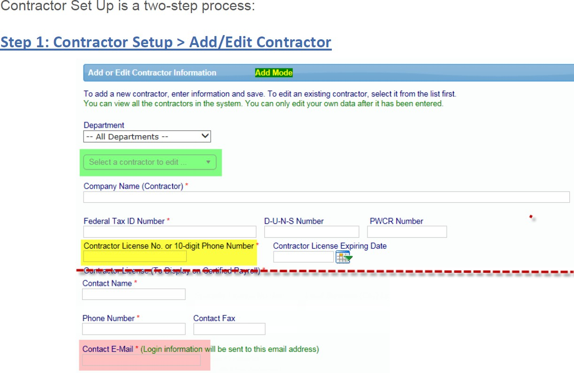
Contractor Set Up is a two-step process
BBB Construction
11-1111111
888-888-8888
Jane Doe
888-888-8888
jane@bbbconstruction.com

Slide 13
Step 2: Prime Contractor Steps to Assign a Contractor to Project
Step 1
Step 2
Step 3
Step 4
Step 5
Step 6
Log in https://prod.lcptracker.net/WebForms/Login.aspx
Select “Set Up” from the toolbar tab. Then, click Add/Edit Contractors.
To add a “New” contractor, enter the contractor information and click save. If the contractor already has an account, and you have difficulty locating the contractor profile, add the contractor and enter the “Contractor ID” as shown on the contractor cover sheet.
Go to “Set Up” and click “Contractor Assignment”
Click “Add New Assignment”, select project and contractor adding.
Select project, enter field information and press save.
Notes:
The prime contractor must add subcontractors to the project. First use your login credentials, select setup tab, click add/edit contractors. Make sure you enter all pertinent information for the subcontractor as shown on the coversheet, assign contractor to the project and select save. Now you can upload compliance documents for that subcontractor.

Slide 14
Steps to Upload Documents
Step 1
Step 2
Step 3
Step 4
Have document available on your computer. The document can be almost any type that can be viewed by internet browser: txt, pdf, xls, doc, tif, etc.
Go to Set Up and select Add/Edit Document
Enter Required Fields
Upload Document under appropriate file name
Notes:
Review your documents before uploading, save on desktop or file, next step select set up tab select if you want to add or edit document and upload under the correct file name.

Slide 15
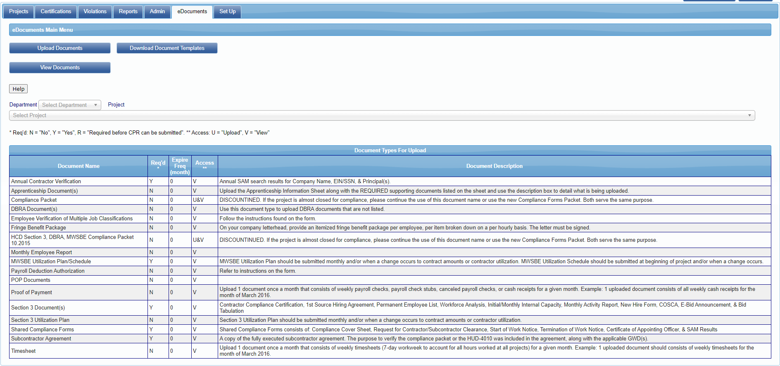
Steps to Upload Documents
On the header tab, Click eDocuments
Click upload documents
Notes:
This screen allows you to see how to upload documents. On the menu bar, you will select the eDocuments tab, then click upload documents.

Slide 16
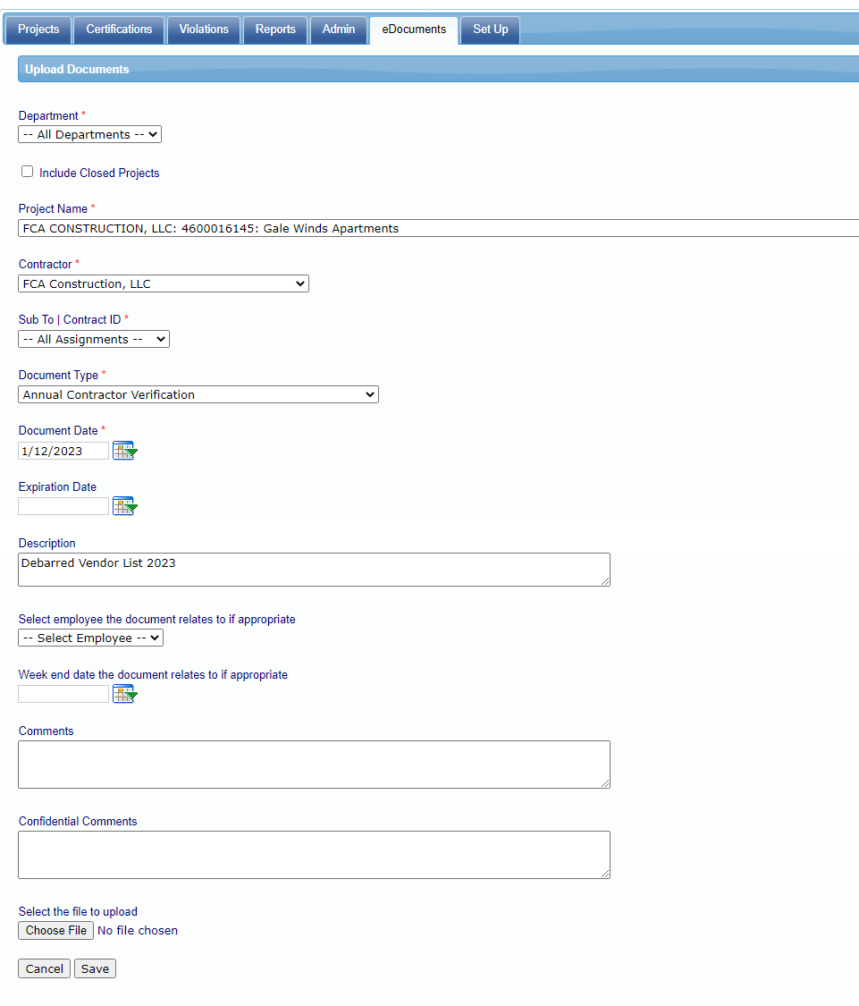
Steps to Upload Documents
Notes:
Select the project name, then select the subcontractor, document name type, upload the document and don't forget to press save.

Slide 17
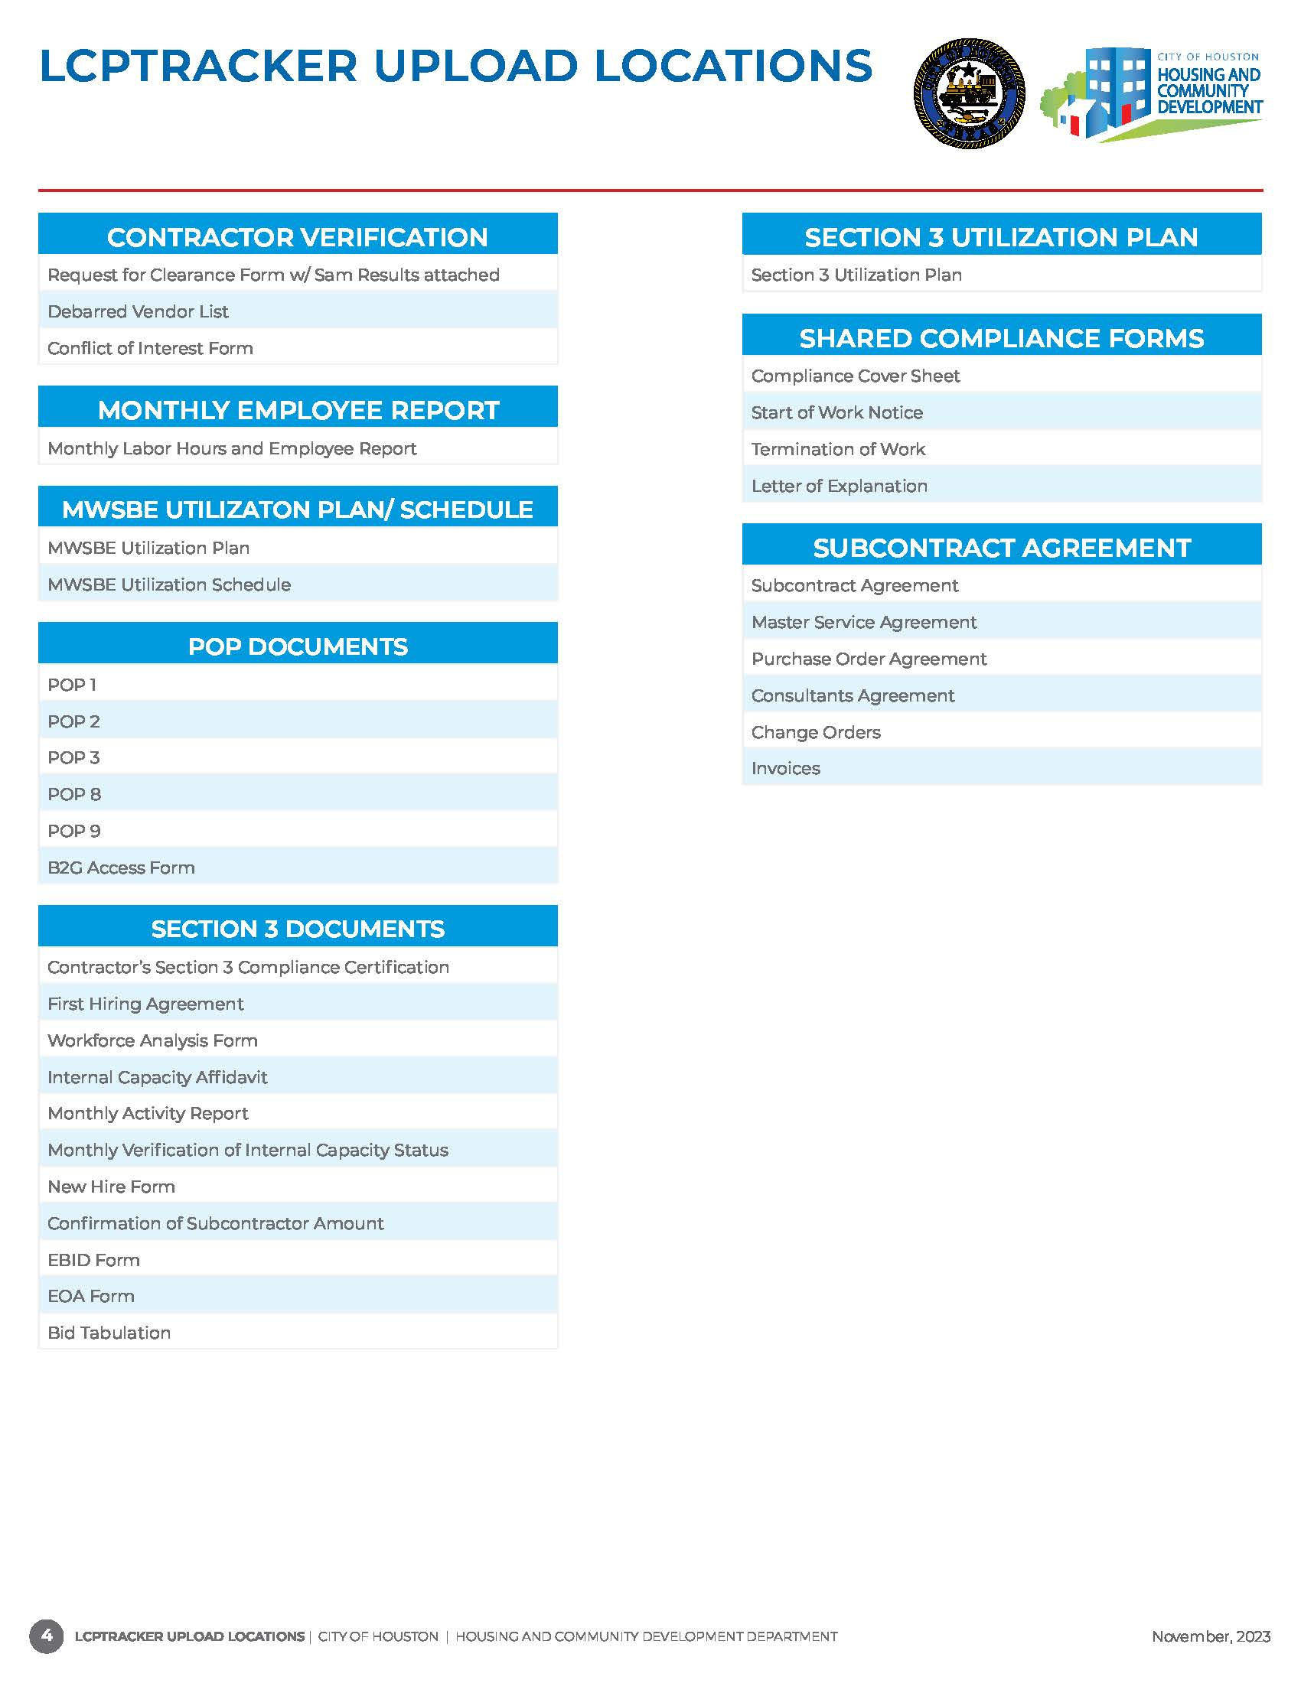
Document Upload Locations
Documents uploaded in the wrong location will be rejected and considered non-compliant.
Notes:
MWSBE monitors the following document locations: Contractor Verification (Annual Documents), MWSBE UP/Sch, Shared Compliance forms and subcontract agreements. Please ensure the documents are uploaded in the correct location or they will be rejected.

Slide 18
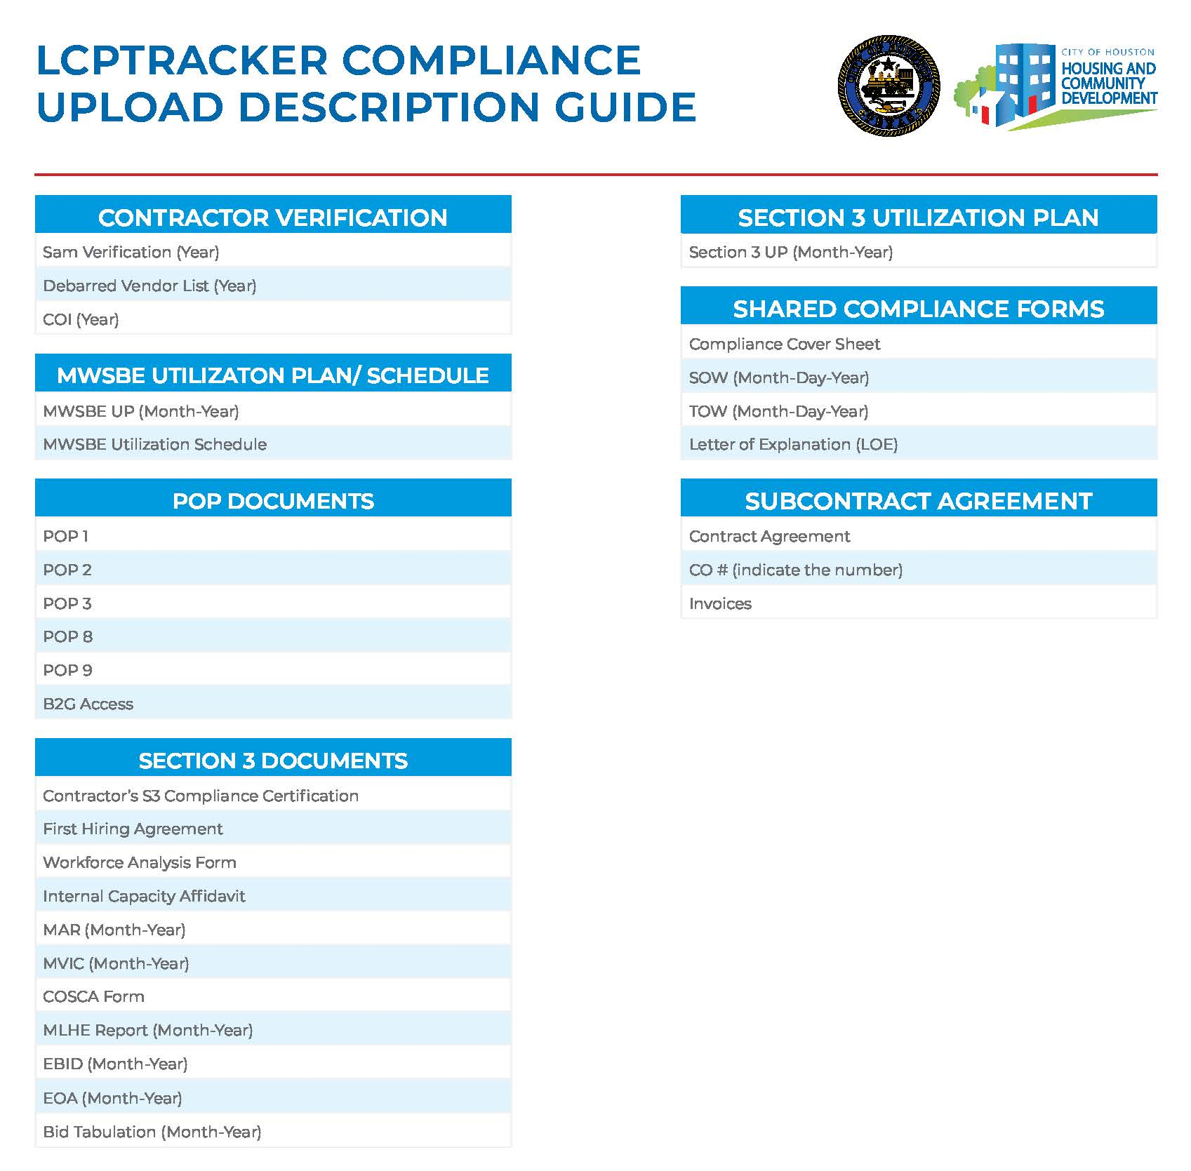
Document Description Guide
Notes:
The description guide is an awesome tool to use when naming your documents. This help the CA to identify the documents immediately. Make a copy and keep for your records.

Slide 19
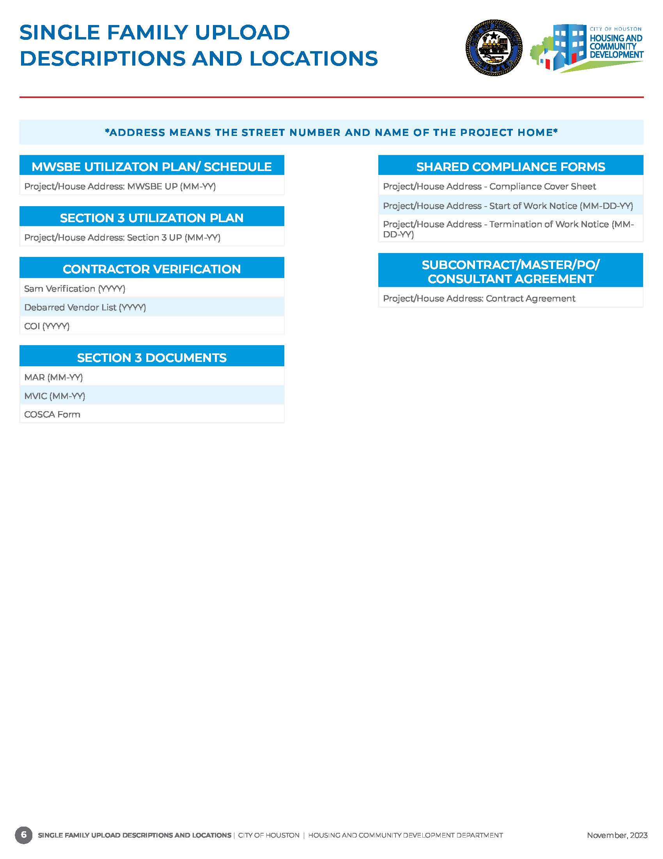
Document Description Guide
SINGLE-FAMILY ONLY
All Compliance Documents must include Address
Notes:
The description guide for single family homes on require the addresses to be added to each form. Excluding the Contractor Verification form which are uploaded annually for the entire project.

Slide 20
B2GNow Payment Reporting & MWSBE Participation Tracker
After a project is awarded, a profile is set-up in B2Gnow for payment and participation tracking of certified and non-certified firms.
The assigned MWSBE Coordinator will be responsible for adding contractors to B2GNow.
The Prime Contractor is required to enter payments to subcontractors and suppliers within 5 days of payment receipt from the City.
Subcontractors, suppliers and professional service providers are required to confirm payments entered by the Prime.
Notes:
After the project is awarded, a profile is setup in B2G Now for the prime contractors. Payments to the prime and all subcontractors on the project will be monitored in B2G Now. Only the assigned MWSBE Administrator will be able to add contractors in B2G Now. Within 5 days of payment the prime must make payments to subcontractors working on the project. The subcontractors must confirm payments entered by the prime.
Subcontractors, suppliers, and professional service providers are required to confirm payments entered by the Prime.

Slide 21
Automated Compliance Audit Process
SAP populates payments made Prime Contractor
Prime is notified of payment via email
Prime enters payment
data for subs
Subcontractor is notified via email
Subcontractor confirms or rejects payment
If the Subcontractor rejects a payment, the Subcontractor and Prime are notified via email of the discrepancy.
Compliance Audit Complete
Notes:
The page give you an idea of B2G Now notification process.

Slide 22
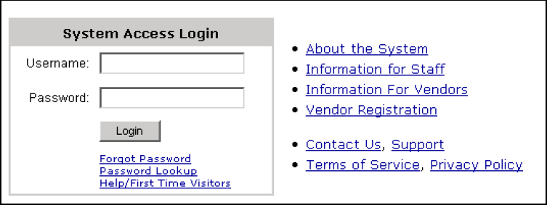
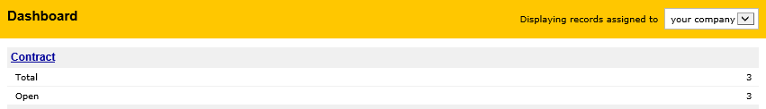
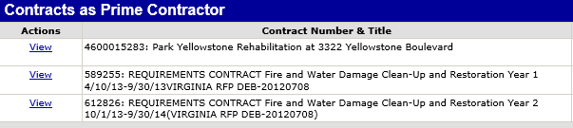
Access to Contracts in B2GNow
Step 1
Step 2
Step 3
Login to B2G with your company
Credentials.
Under Dashboard, click “Contract”.
A list of all active projects will appear. To access a project, click “view”

Slide 23
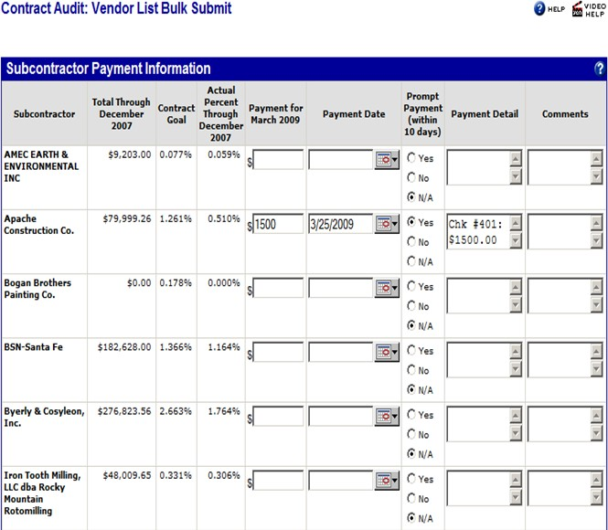
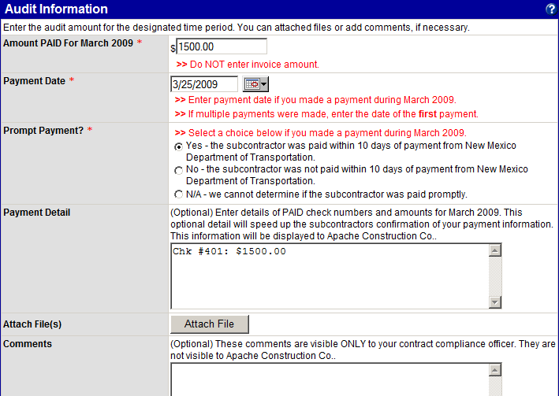
Prime Contractor Payment Process
The prime can report individual payments or subcontractor payments all at once
Notes:
The prime contractor can enter payments per subcontractor individually if needed or all payments can be entered at once for each applicable contractors as viewed on the screen. I advise the prime to attach payment document for proof of payment.

Slide 24
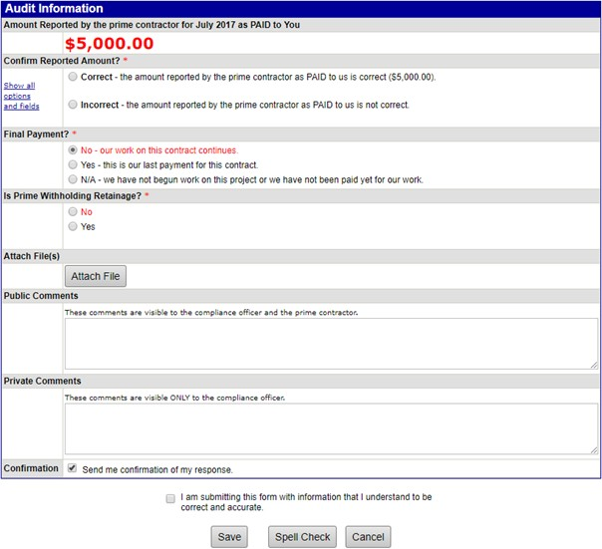
Subcontractor Payment Confirmation Process
Notes:
The prime contractor has entered payment of $5K their sub, this screen allows the sub to agree or disagree to the entry. As mentioned the prime contractor and subcontractor are advised to work out all discrepancies before the CA is notified.

Slide 25
COMPLIANCE FORMS PACKET

Slide 26
MWSBE Compliance Packet for Certified & Non-certified firms
One-Time/ Initial Documents
Recurring Document
MWSBE Utilization Plan
Request for Contractor Clearance Form
Start of Work
Termination of Work
Executed Contract Agreements
SAM Verification
MWSBE Monthly Utilization Plans (Certified and Non-Certified Firms)
Compliance Cover Sheet
Company Name, Principal Owners & EIN
Mediation Clause
Texas Comptroller Debarred Vendor List
MWSBE Utilization Schedule
Annual Document
Conflict of Interest Form
Texas Comptroller Debarred Vendor List
Request for Contractor Clearance Form
SAM Verification
Company Name, Principal Owner(s) & EIN
Notes:
The Compliance packet is utilized by the prime contractor and all certified and non-certified firms working on the project.

Slide 27
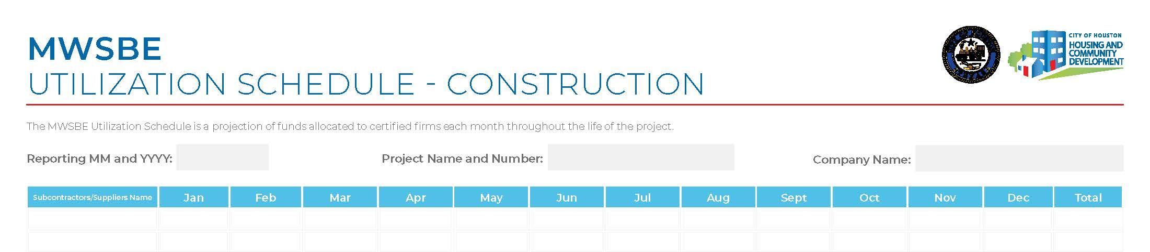
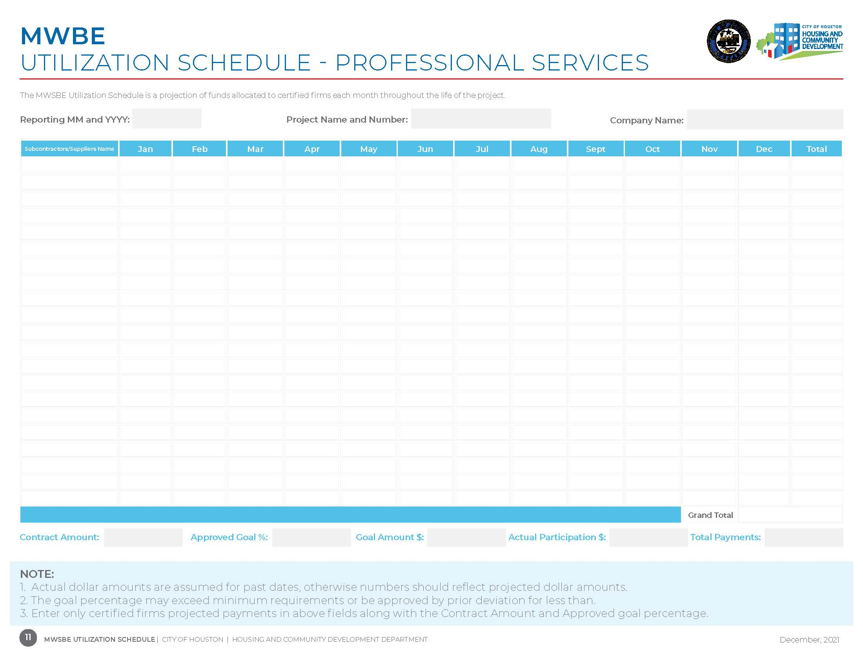
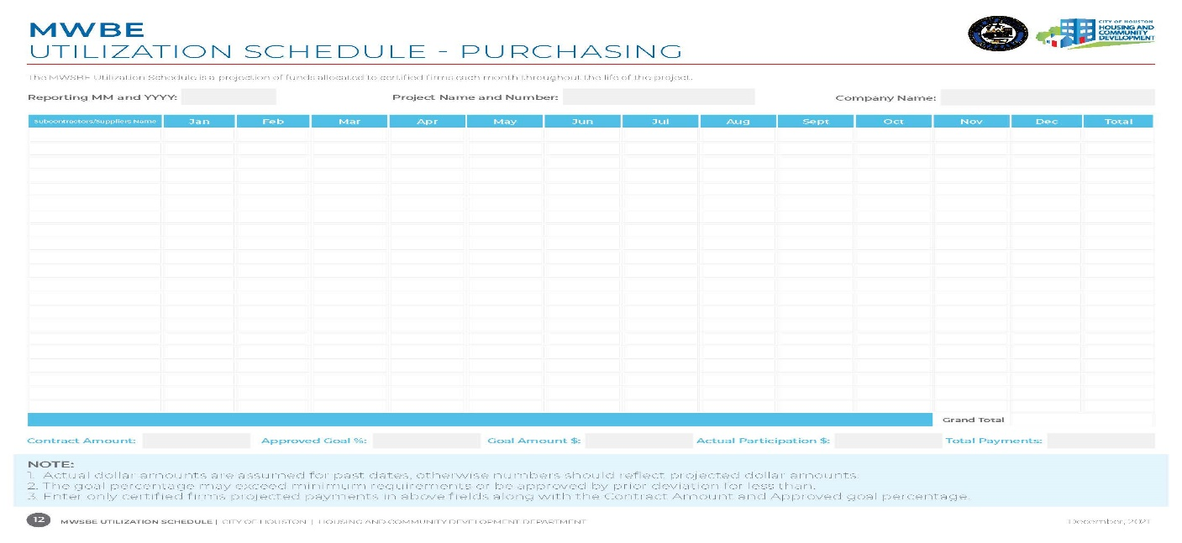
Utilization Schedule
Prime Contractor Only Requirement
The Utilization Schedule is a forecast of your company’s utilization of certified firms to meet the participation goal on this project.
A projection of monies to be allocated to certified firms for each month of the project.
This form must be completed and submitted for review and approval before start of work and each time there is a change to the plan. A new plan must be submitted when submitting a deviation request and responding to a “Not Meeting the Goal” letter.
Notes:
The UP schedule is for the prime only, this is to give a forecast on when the certified contractors will start on the project. This allows the contract administrator to monitor monies to be allocated monthly. This form also must be submitted when submitting an deviation request which I will cover later in the presentation.

Slide 28
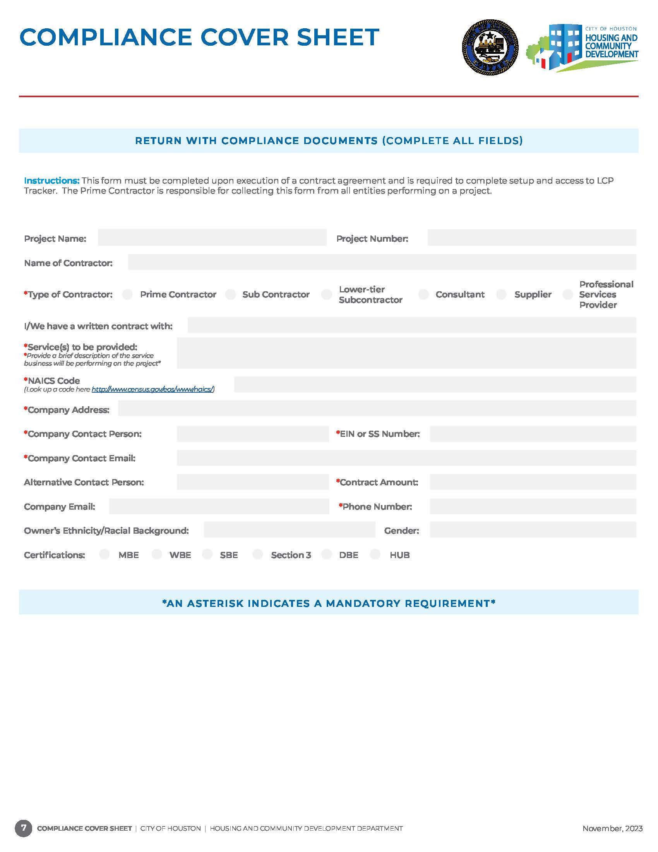
The Prime Contractor is responsible for collecting this form to complete contractor setup and access to LCP Tracker.
This form must be completed and submitted within five business days upon execution of a contract agreement and/or purchase order by all contractors, suppliers and consulting firms.
All fields are required to be completed except for the following:
Pre-existing LCP Tracker User ID
Fax Number
Certification Type "Complete only if Applicable"
Document must include contractors point of contact information.
If contractors are utilizing a consulting firm, DO NOT add their information on the document.
Notes:
The coversheet is what I call the bible of all documents in the compliance packet! The required information for each contractors is covered on this one form. Make sure that all the fields are completed before uploading in LCP Tracker.

Slide 29



UNACCEPTABLE FORM
Baldwin Lofts
Baldwin Lofts
460001111
BBB Construction
BBB Construction
X
Jones Construction, Inc.
Concrete paving
Concrete paving
238910
111 Avenue K, Houston, TX 11111
11-1111111
111 Avenue K, Houston, TX 11111
Jane Doe
Jane Doe
jane.doe@bbbconstruction.com
ACCEPTABLE
FORM
jane.doe@bbbconstruction.com
N/A
$500,000.00
888-888-8888
888-888-8888
African American
Male
X
Notes:
This is a screen shoot of what is acceptable and unacceptable.

Slide 30
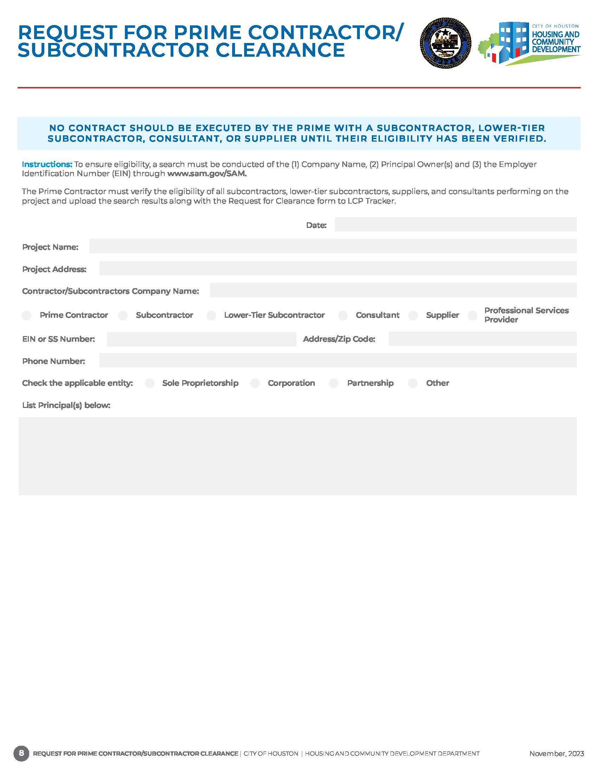
The Prime Contractor must submit a Contractor Clearance form for every contractor, supplier, lower tier subcontractor, consulting firms, etc. intended to perform on a project. The date must reflect the same year when the Sam verification results was conducted. The request for clearance form and all generated Sam verification results must be combined in one pdf format.
1/12/2023
Baldwin Lofts
5500 Baldwin Road, Houston, TX 11111
BBB Construction
11-1111111
111 Avenue K, 11111
888-888-8888
x
Ruben Doe
Myles Doe
Notes:
The clearance form must be completed and submitted in LCP Tracker along with the SAMs result attached! The form must have the same year with the SAMs result was conducted or it will be rejected.

Slide 31
SAM Verification
To verify eligibility of a contractor to work on a federally funded project, a search must be conducted on the following credentials: 1) Full Company Name, (2) Principal Owner(s) and (3) the Employer Identification Number through www.sam.gov
Search results and the Request for Clearance form must be uploaded in LCP Tracker for all contractors and suppliers.
No contract should be executed with a Prime Contractor, Subcontractor or Supplier until their eligibility has been verified.
The site now requires the creation of an account to conduct searches. The person conducting the search must be logged into the site, otherwise no search results can be retrieved.
Each search results must include date from the website when search was conducted.

Slide 32
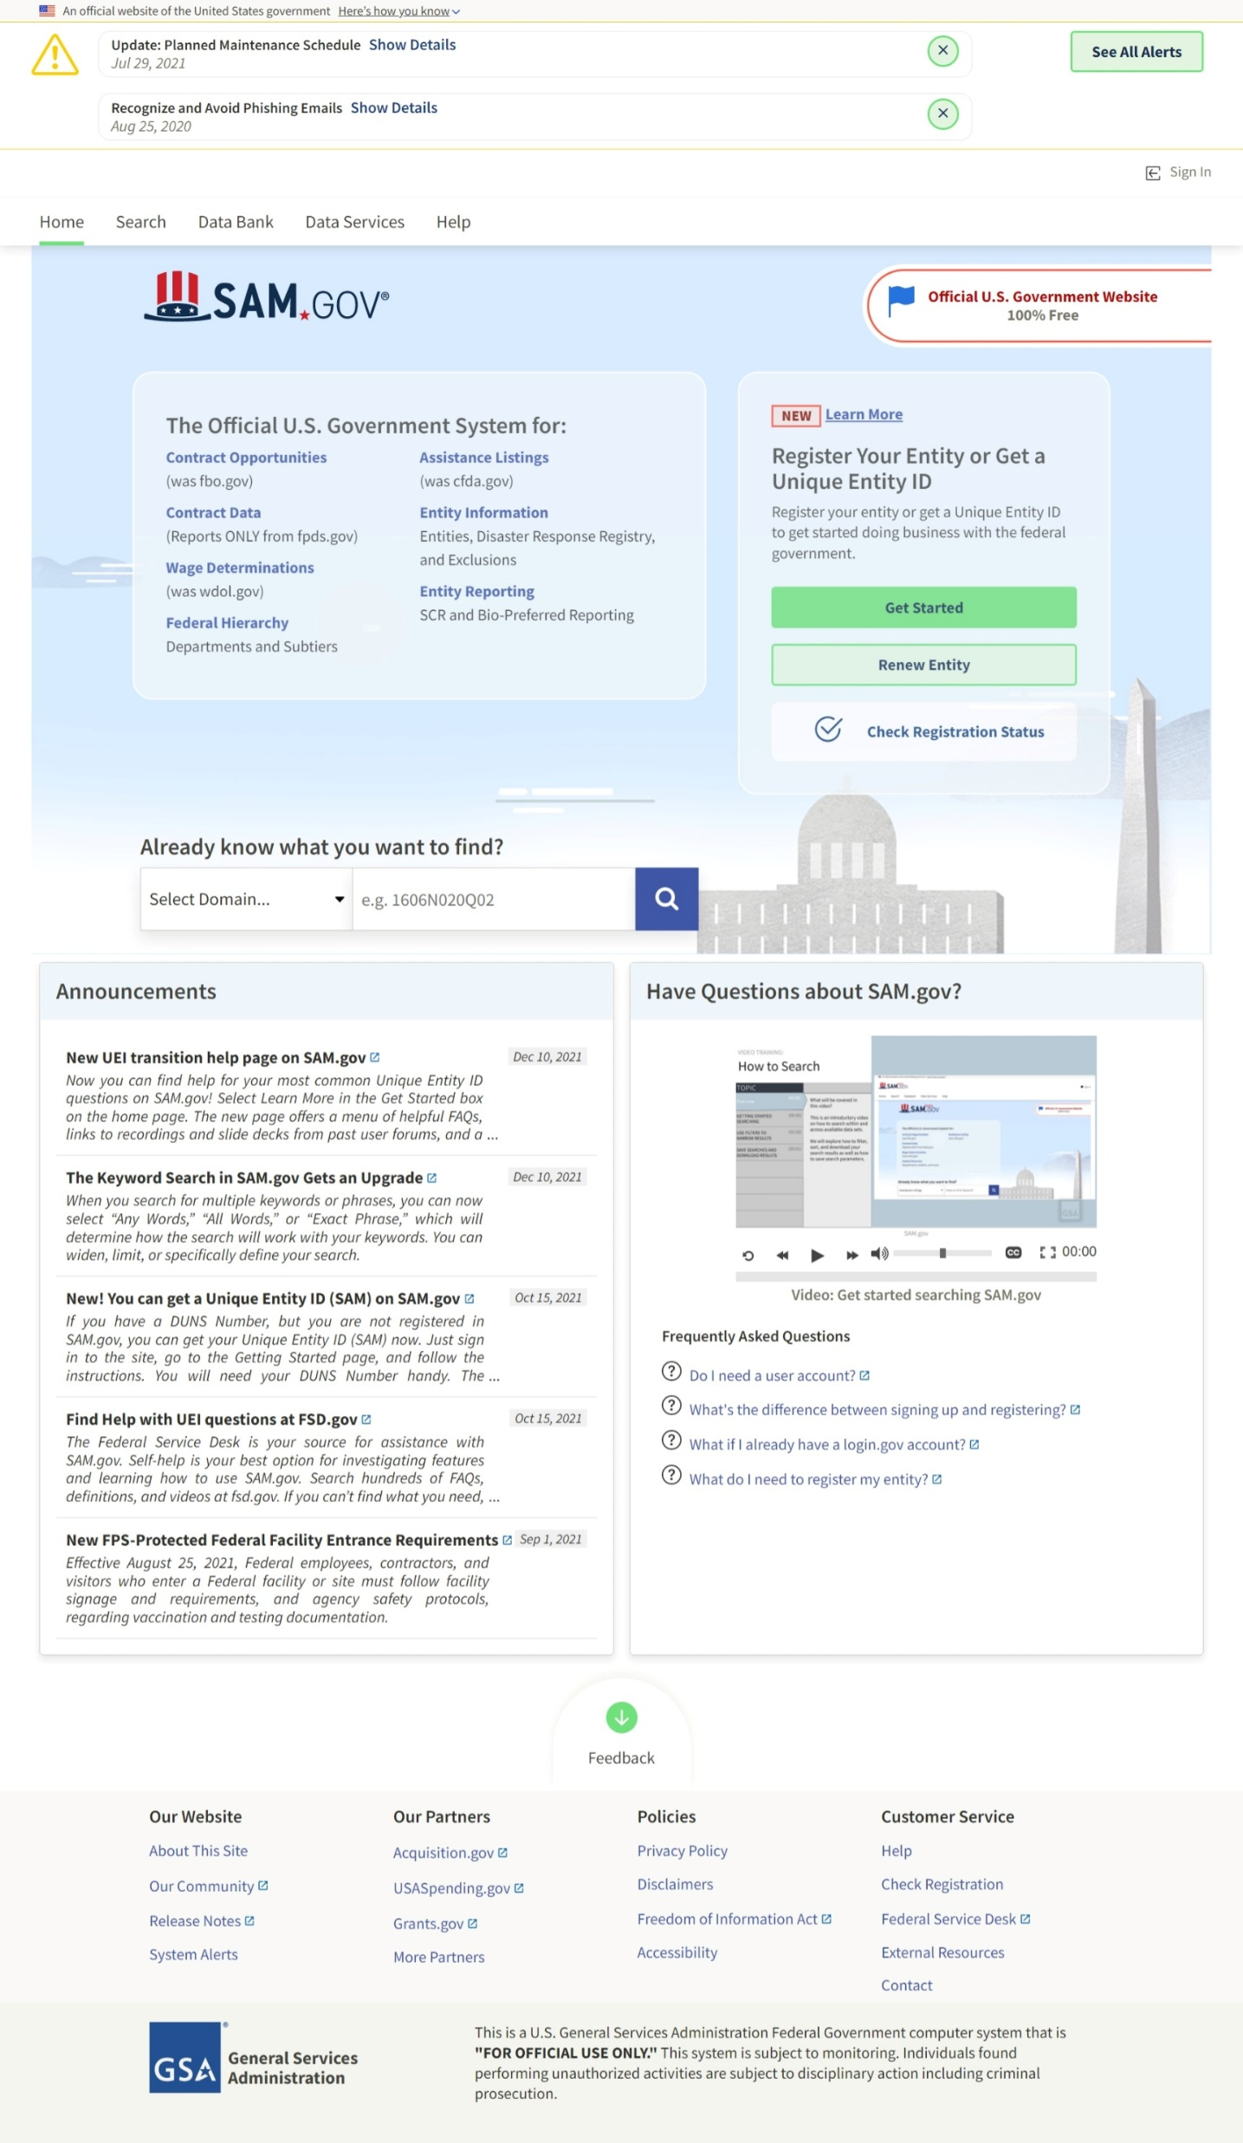
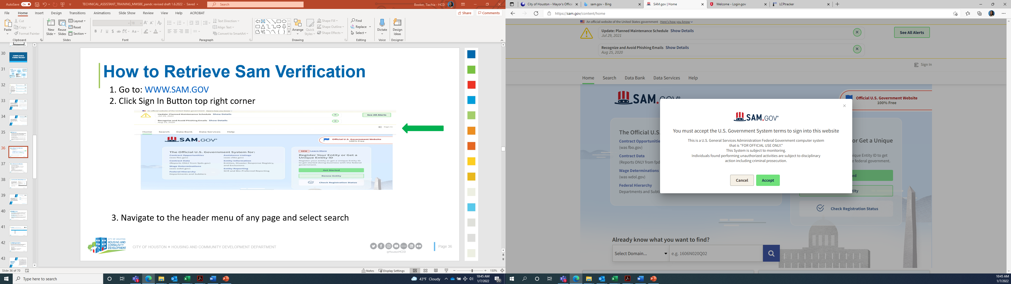
How to Retrieve Sam Verification
1. Go to: WWW.SAM.GOV
2. Click the “Sign In” button on top right corner
Sign In
3. A box will appear, Click “accept.”
Notes:
Go to www.SAM.Gov and sign in, before you can sign in you must create an account. Note: You do not have to register to create an account.

Slide 33
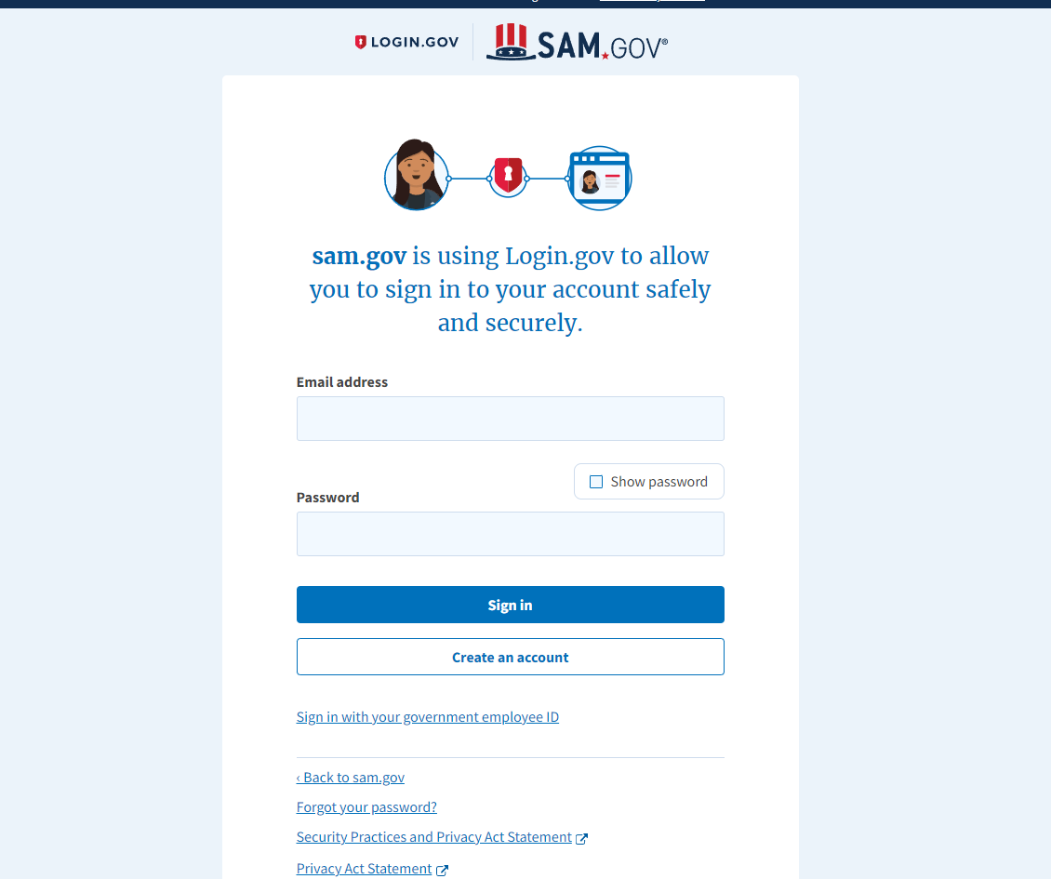
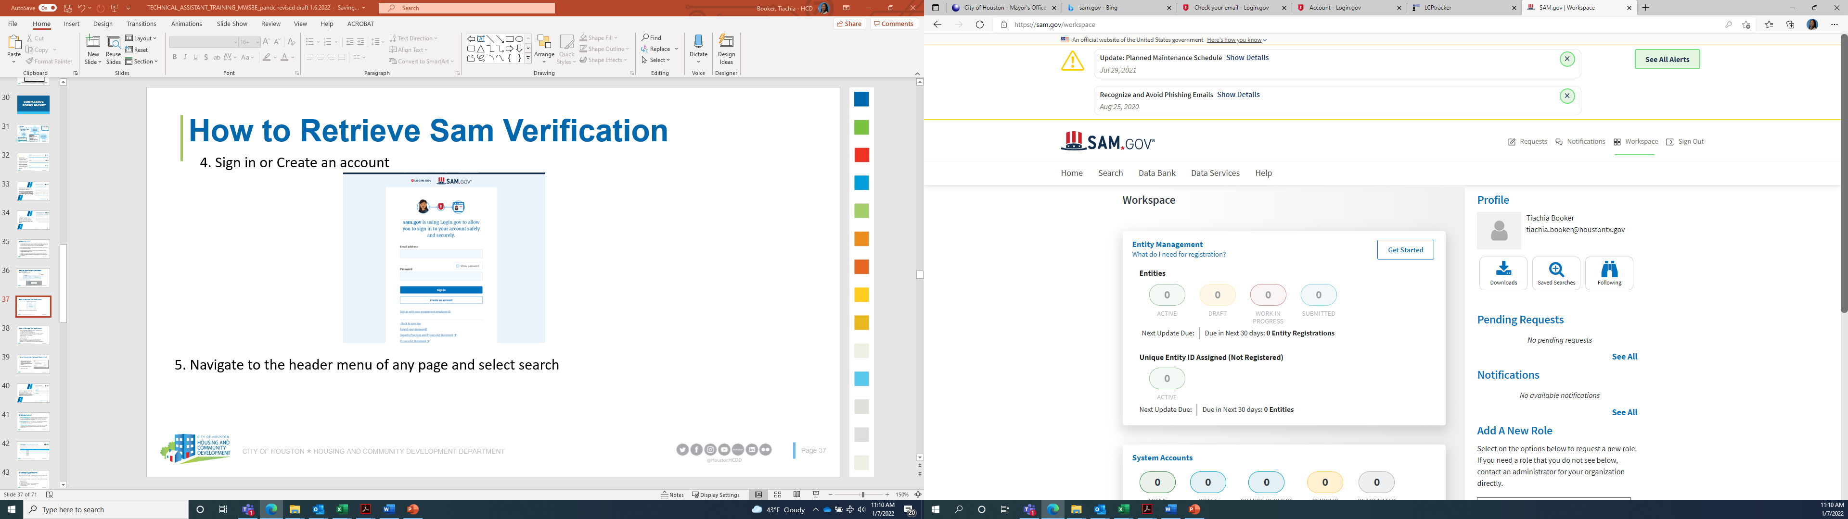
How to Retrieve Sam Verification
4. Sign in or Create an account
5. Navigate to the header menu of any page and select search
Notes:
Sign in and navigate to the header menu and select search

Slide 34
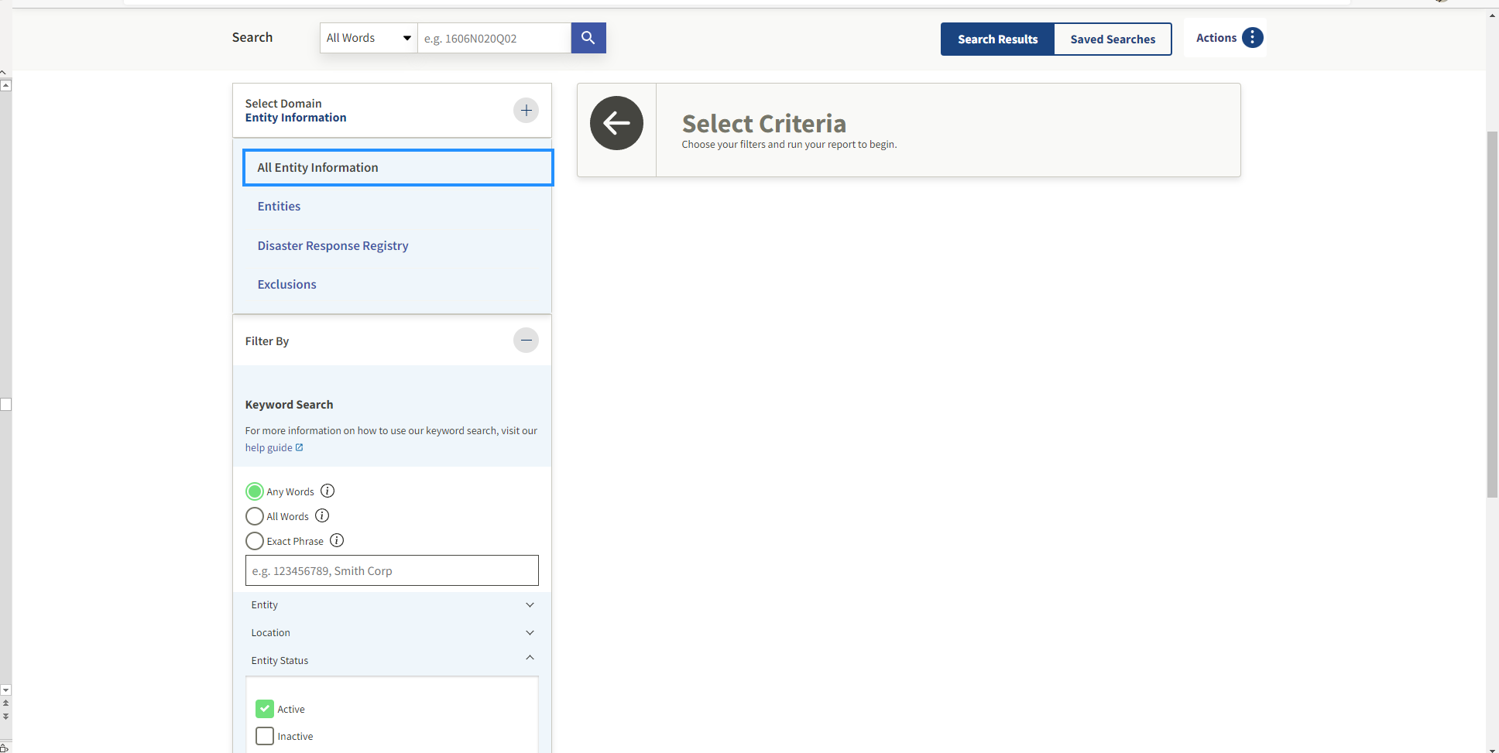
How to Retrieve Sam Verification
6. From the search page, navigate to the left-side bar. Select the “plus” icon to the right of the “select domain.”
Select Entity Information and click all Entity Information
7. Under filter by check the “Any
Words” box
8. Enter the applicable information (Company name, EIN # and principal names) in the Search box and press enter
Select
Select
Check
Enter
Notes:
Check the any words box

Slide 35
How to Retrieve Sam Verification
9. Print the first 3-4 pages of the search-exclusion matches and ensure that the contractor is not an exact match:

Slide 36
How to Retrieve Sam Verification
10. Upload all results generated (Full Company, EIN#, and Principals) along with the Request for Contractor Clearance form into one document in LCPTracker.
Baldwin Lofts
1/12/2023
5500 Baldwin Road, Houston, TX 11111
x
BBB Construction
11-1111111
111 Avenue K, 11111
888-888-8888
x
Ruben Doe
Myles Doe
NOTE: If any exact match is identified, contractor, subcontractor, or lower-tier subcontractor will not be eligible to conduct any business on federal projects. Any partial matches would need to be verified by HCDD and additional information may be requested.
Notes:
Upload all results along with the Request for Contractor Clearance form as one document and upload in LCP Tracker in the correct document type Contract Verification.

Slide 37
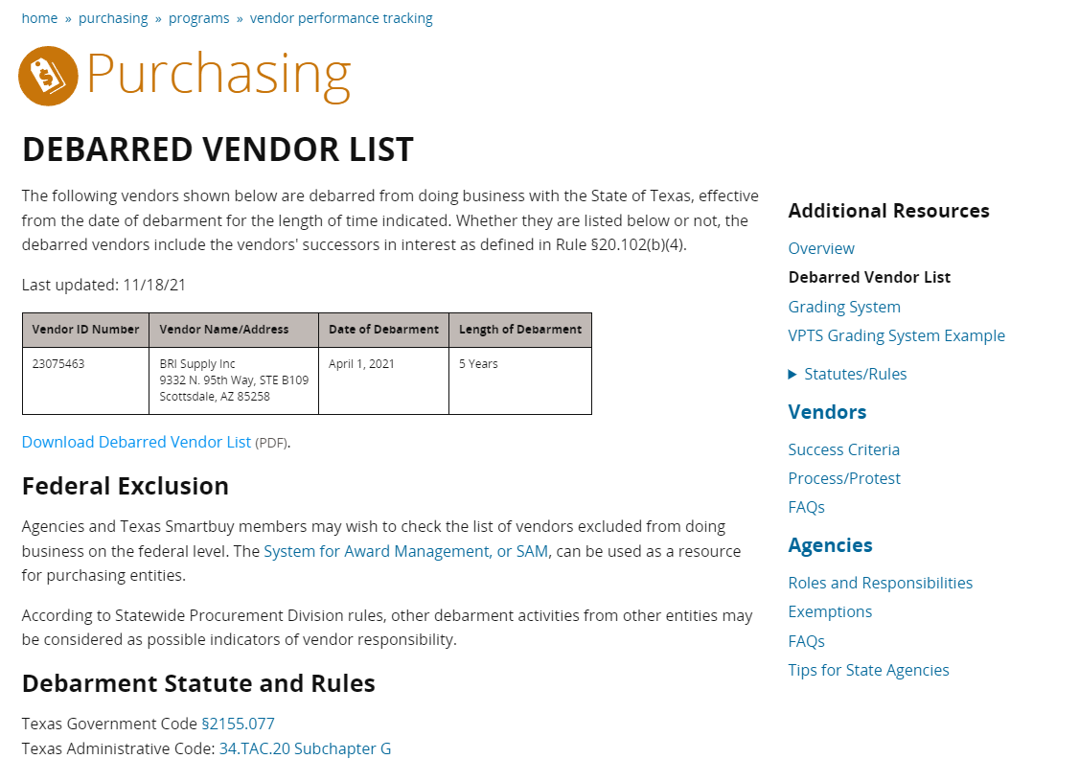
Proof of non-debarment from the state comptroller’s office must be provided by prime contractors, subcontractors, suppliers, consulting firms and lower tiers.
Document must include date from website when search was conducted.
Do not manually write the date on the document
Notes:
Next is the debarred vendors list, the form is to ensure the contractors are not debarred from working on state projects.

Slide 38
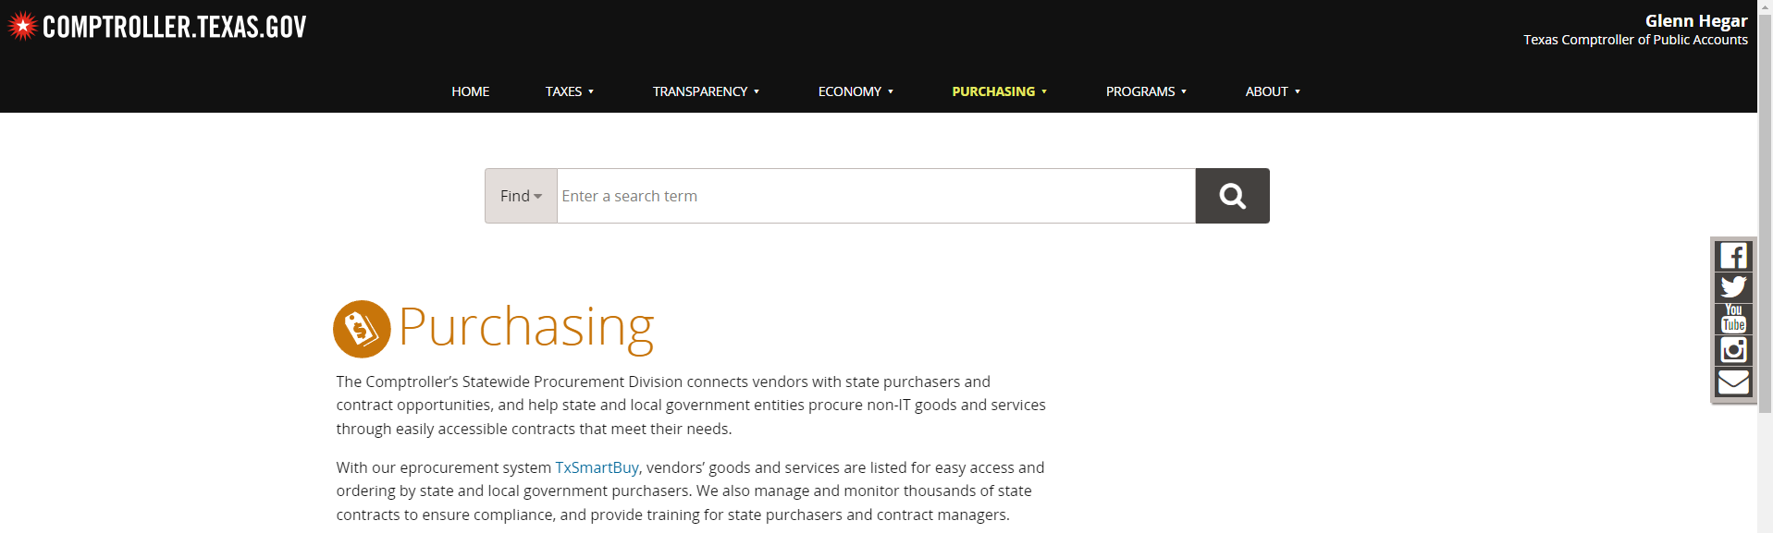
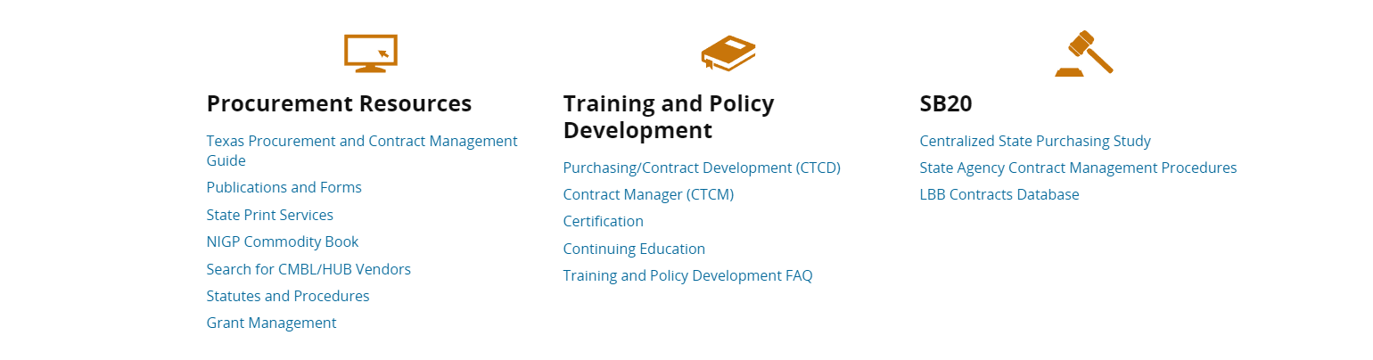
How to Retrieve Debarred Vendor List
1. Go to: https://comptroller.texas.gov/purchasing
2. Scroll down to Procurement Resources and click “Search for CMBL/HUB Vendors.”
Click

Slide 39
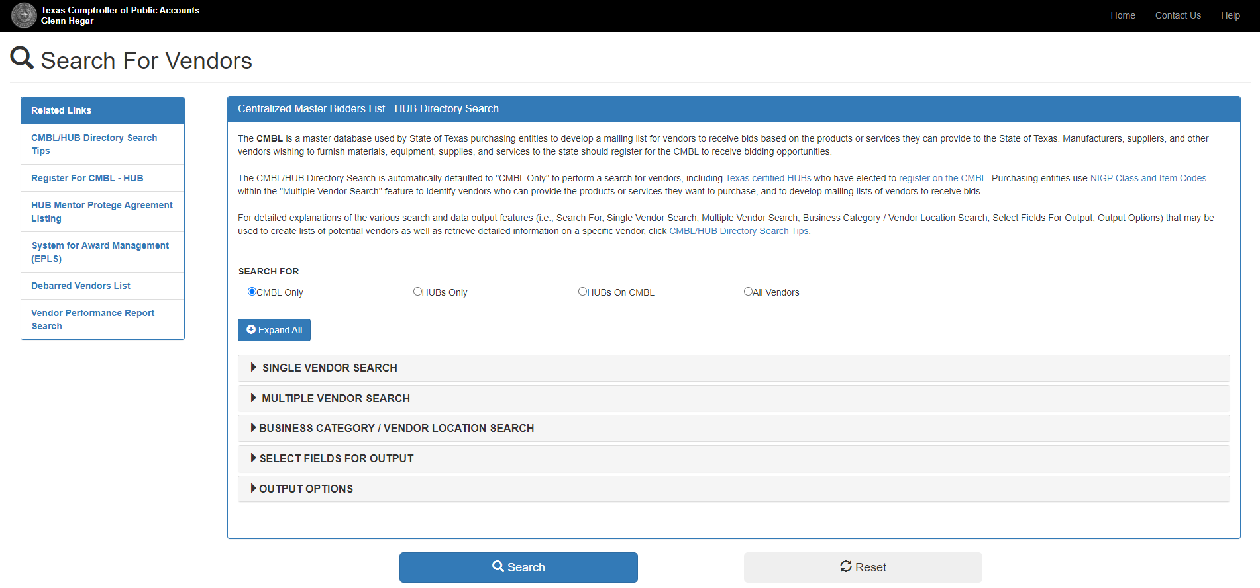
How to Retrieve Debarred Vendor List
3. Click on the Debarred Vendors List on the left-hand side:
Click

Slide 40
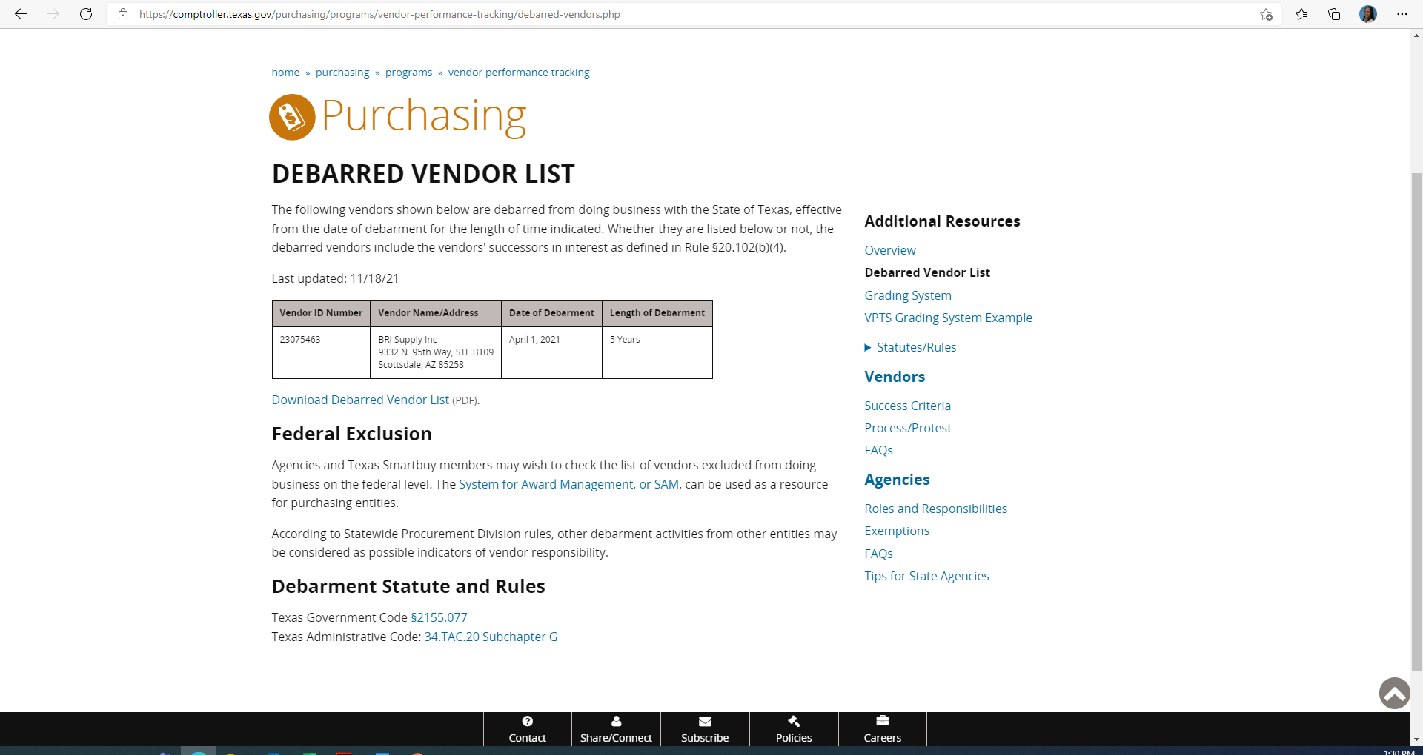
How to Retrieve Debarred Vendor List
4. The Debarred vendor list will appear on the screen:
5. “Ctrl + P” to print or save as PDF. Ensure that the date is on the list. (Note: Date does not appear on the download form, therefore, DO NOT use the Download link for the Debarred Vendor List)
6. Upload copy of the Debarred Vendor List into LCP tracker under “Annual Contractor Verification” document type.

Slide 41
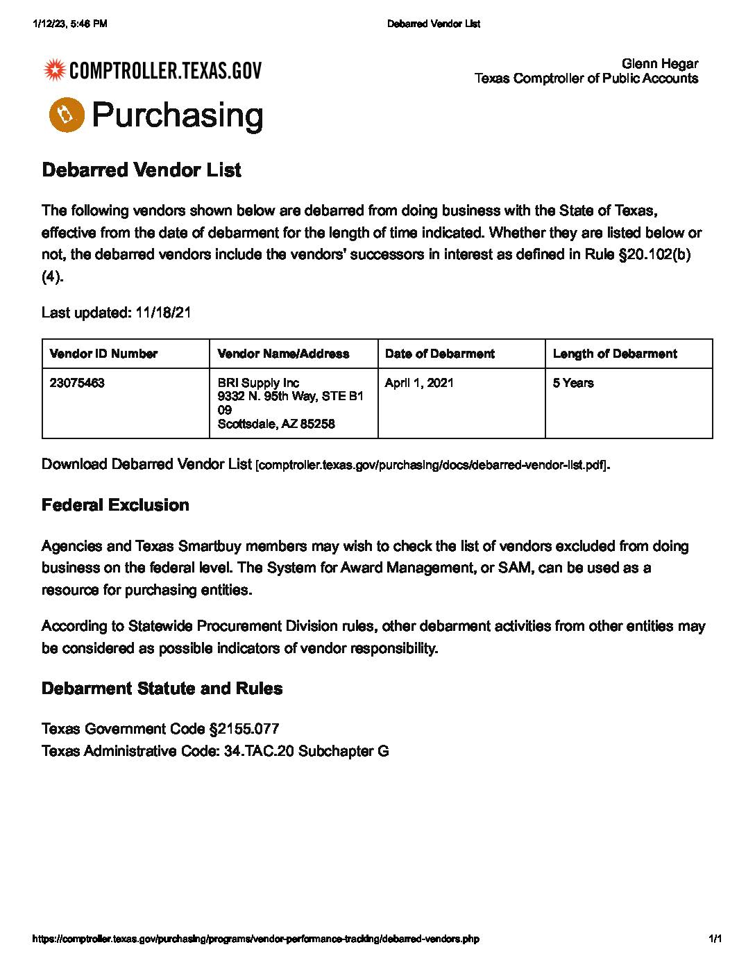

Slide 42
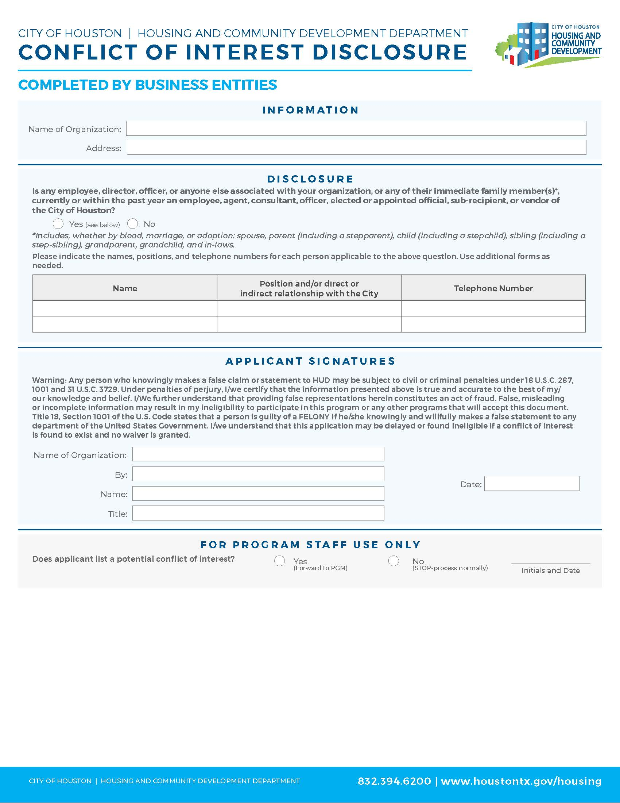
This form will help ensure full disclosure and no personal interests that violate program rules. Document must include either a wet or electronic (cursive) signature. Document must include a date. Do not write in area below the blue line "For Program Staff Use Only".
Notes:
As simple as this document may seem to complete, this document is gets rejected the most! Please follow the instructions before uploading in LCP Tracker!

Slide 43
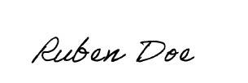
Baldwin Lofts
Baldwin Lofts
5500 Baldwin Road, Houston, TX 11111
UNACCEPTABLE
FORM
x
x
Baldwin Lofts
Baldwin Lofts
Ruben Doe
1/12/2023
Ruben Doe
1/12/2023
Owner
ACCEPTABLE
FORM

Slide 44
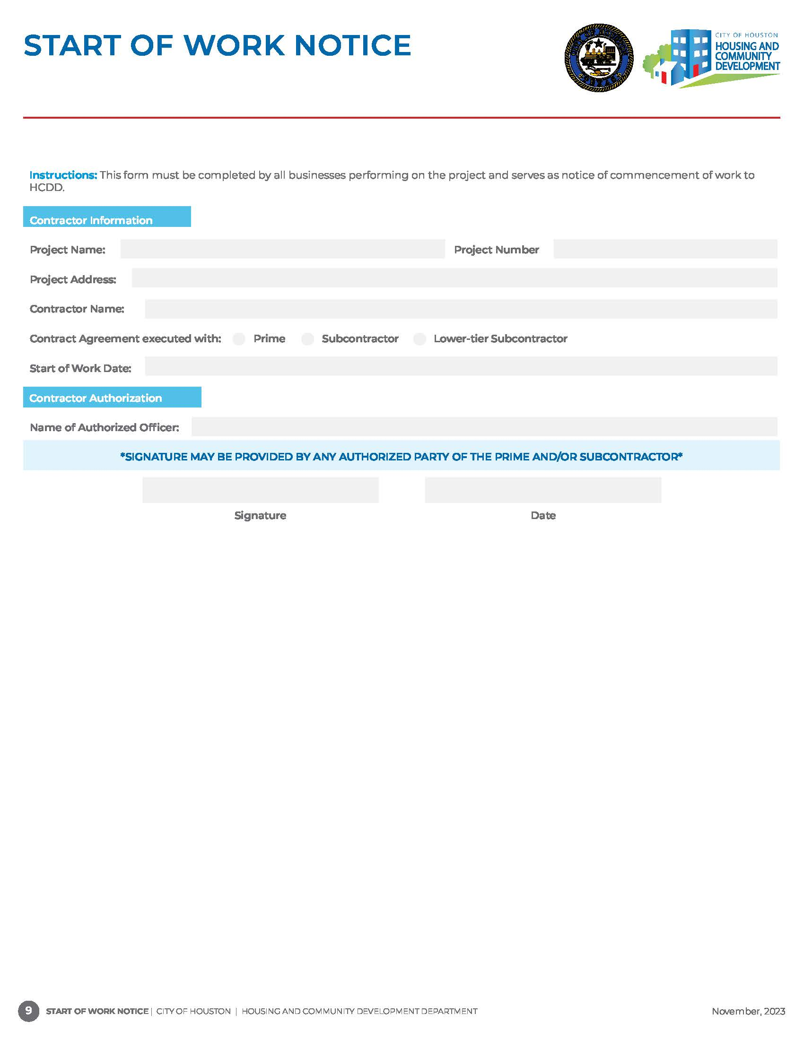
This form must be completed by the prime contractor, subcontractors, suppliers, and professional service providers as notice of commencement of work. Document must include both the prime contractor and subcontractor name. Document must include month, day and year when contractor scope of work has started.
Baldwin Lofts
5500 Baldwin Road, Houston, TX 11111
Jones Construction
X
1/20/2023
Ruben Doe
Ruben Doe
1/19/2024
Start of Work Notices submitted with the following language will be rejected in LCP Tracker:
TBD
Estimated
January 2024
Notes:
The next compliance form is the Start of Work Notice. This form is uploaded as a Share Compliance document.

Slide 45
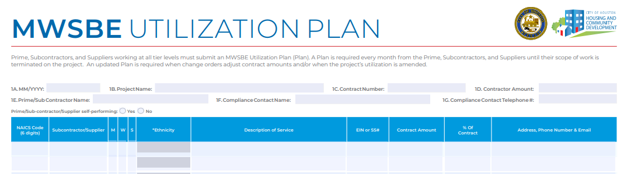
Utilization Plan
All contractors are responsible for submitting a Utilization Plan prior to the start of work.
All contractors must submit a Utilization Plan once every month until termination of work.
Prime contractors must include all subcontractors, suppliers, professional services, etc., on their monthly utilization plan who worked on the project for the reporting month.
Subcontractors who hire lower tier contractors must include the subs on their monthly utilization plan if they worked on the project for the reporting month.
Notes:
Our next compliance form is the Utilization Plan. This is the only form that is required to be uploaded monthly until a TOW is submitted! Once the start of work notice is uploaded we expect to also have a MWSBE UP uploaded in LCP Tracker. The prime must include all subcontractors working on the project for that month.
Prime contractors must include all subcontractor certified and non-certified on this form. Subcontractors who hire lower tier contractors must include the subs on their monthly utilization plan.

Slide 46
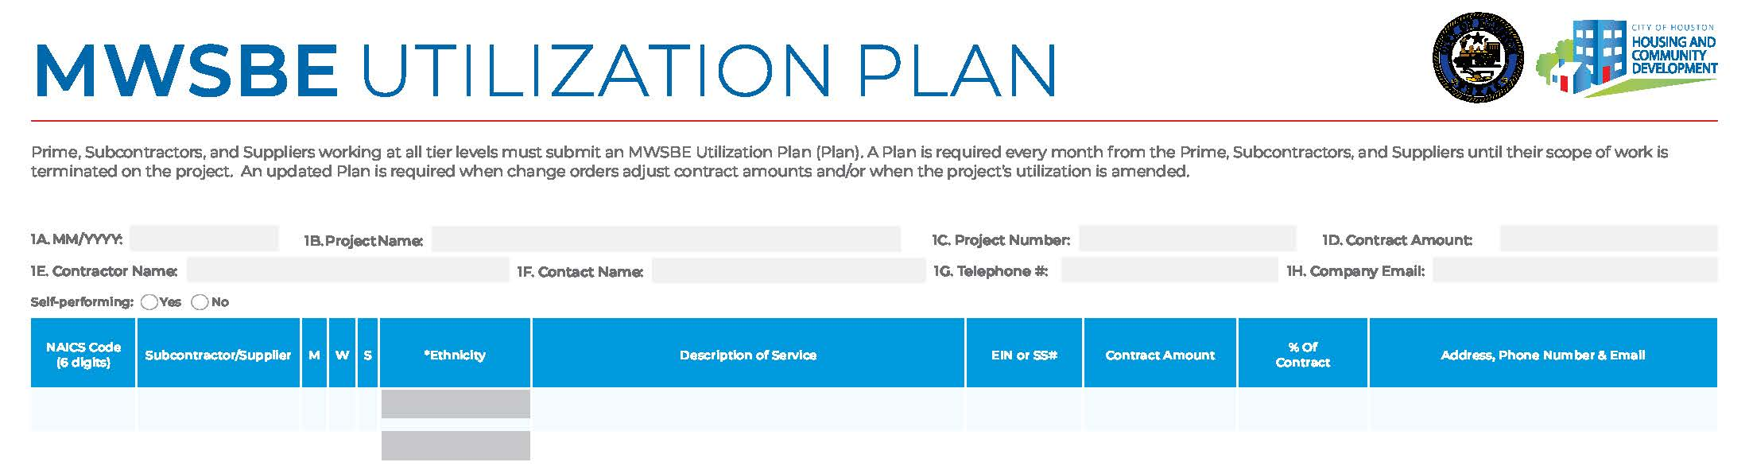
Utilization Plan
NOT
SELF PERFORMING
01/2023
Baldwin Lofts
4600011111
$3,000,000.,00
Jones Construction
Jill Doe
555-555-5555
JillDoe@email.com
x
238910
11-1111111
x
Concrete Paving
$500,000.00
8%
111 Avenue K, Houston, TX 11111
BBB Construction
SELF PERFORMING
01/2023
Baldwin Lofts
4600011111
$500,000.00
BBB Construction
Ruben Doe
888-888-8888
RubenDoe@email.com
x

Slide 47
Contract Agreements
A contract agreement and/or purchase order should be executed with every subcontractor, supplier and professional service provider including lower tier subcontractor participating on a project.
A contract agreement and/or purchase order must include the following:
Scope of Work
Contract Amount
Signatures & Dates for Prime & Subcontractor
Address(es) of home(s) – Single Family
Mediation Clause

Slide 48
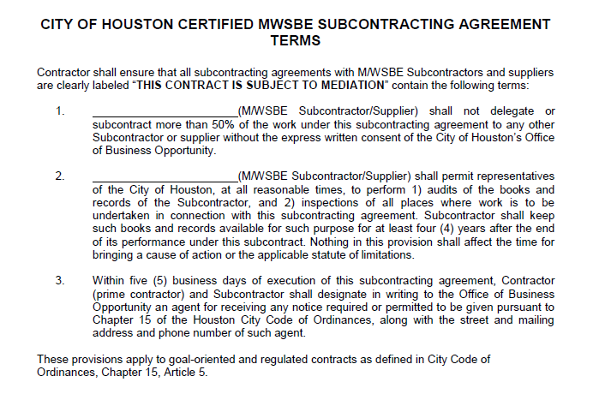
Mediation Clause
Mediation is used to try to resolve differences between the prime and subcontractors and get the companies back to working together.
Mediation can be initiated by either party or HCDD.

Slide 49
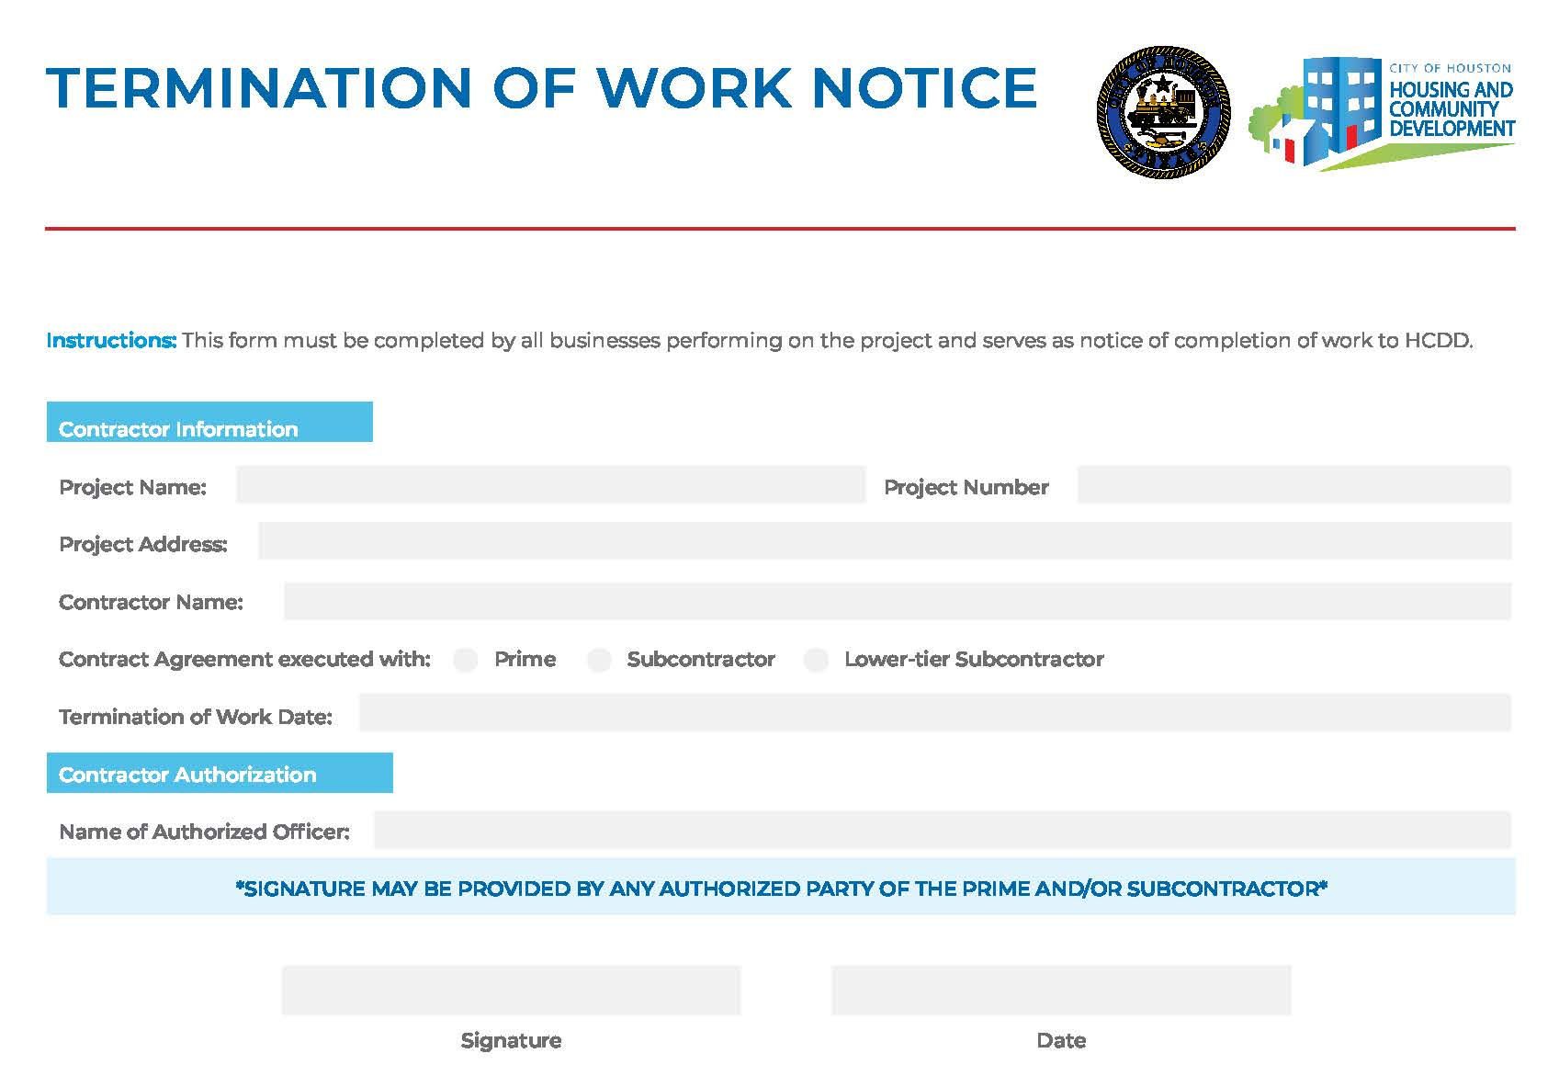
This form must be completed by the prime contractor, subcontractors, suppliers, and professional service providers as notice that work has been completed. Document must include both the prime contractor and subcontractor name. Document must include month, day and year when work has finished.
Baldwin Lofts
5500 Baldwin Road, Houston, TX 11111
Jones Construction
X
Termination of Work Notices submitted with the following language will be rejected in LCP Tracker:​
​
TBD​
Estimated ​
January 2024​
9/25/2023
Ruben Doe
Ruben Doe
1/19/2024

Slide 50
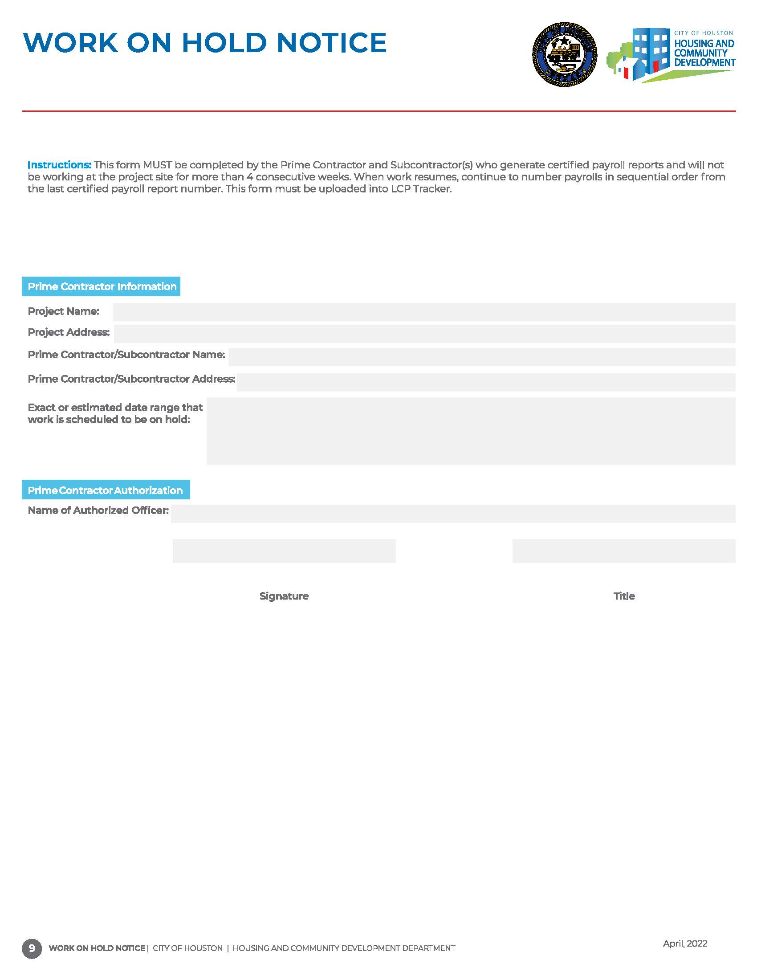

It is not a part of the MWSBE, Section 3 or Pay or Play programs.
Monthly compliance documents are still required to be submitted for these program areas unless a termination of work is submitted.
Work on Hold Notices are only applicable to DBRA.
Notes:
Work-on-Notices do not apply to MWSBE you must continue to submit an utilization plan monthly until the termination of work.

Slide 51
Single Family Prime Contractor Requirements
Must submit an executed contract agreement, Contract Coversheet, Utilization Plan (UP), Start of Work Notice and Termination of Work Notice for every project address;
All contractor including lower tier subcontractors, suppliers, consulting firms, professional service providers, etc. are required to submit a monthly UP on every address by the end of every month.
A Request for Contractor/Subcontractor Clearance form and SAM verification, Debarred Vendor List and Conflict of Interest form is required for all subcontractor, supplier, and professional service provider ONCE throughout program.
If a contractor has not previously worked under this program and/or has not been verified through SAM.gov, verification records will be required to ensure the contractor is eligible to perform on federally funded projects.

Slide 52
Single Family Subcontractor Requirements Example
Contractor: ABC Company
1112 Lane Road
Start of Work (SOW)
2221 Lane Road
Compliance Coversheet
Start of Work (SOW)
Utilization Plans
Contract/ PO Agreement
Termination of Work
Compliance Coversheet
Utilization Plans
Contract/PO Agreement
Termination of Work
Document Provided Once/Annually
Request for Clearance Form/ Sam Verification Results
Debarred Vendor List
Conflict of Interest Form
Notes:
This is an example of the Single Family document requirements, documents must be provided for each contractor monthly for each address

Slide 53
DEVIATION REQUEST

Slide 54
Deviation Request Requirements
Work designated in your approved plan cannot be completed by any other subcontractor and/or supplier unless you receive permission from the Housing and Community Development Department.
To deviate from the approved MWBE Participation Plan, the request must be submitted in writing to the assigned MWSBE compliance monitor stating your proposed change, the specific reason for removal and how you plan to meet your MWBE goal.
A Deviation Request is only required to add or remove a certified MWSBE firm.
The request should include reasons for the deviation; Who, What, When and Why.
When removing a firm, a plan to achieve the impacted MWSBE goal is required.
A deviation request does not reduce or increase the contract goal. The prime contractor is responsible for achieving the approved participation goal at the time of award.
Prime contractor cannot replace a certified firm with a non-certified firm.

Slide 55
ONGOING MONITORING

Slide 56
Ongoing Monitoring
Random site visits will be conducted to monitor project activities and contractor’s participation.
Compliance documents will be compared with information gathered from interviewing employees and site action.
Documents submitted for reporting and monitoring purposes by all contractors will be reviewed for accuracy and compliance with requirements.
The Prime Contractor will be notified of any items identified as non-compliant via email, by the 5th of every month.
Notes:
Random site visits will be conducted, a Compliance Status Report (CSR) will be conducted monthly monitoring compliance documents and payments will be monitored in B2G Now.

Slide 57
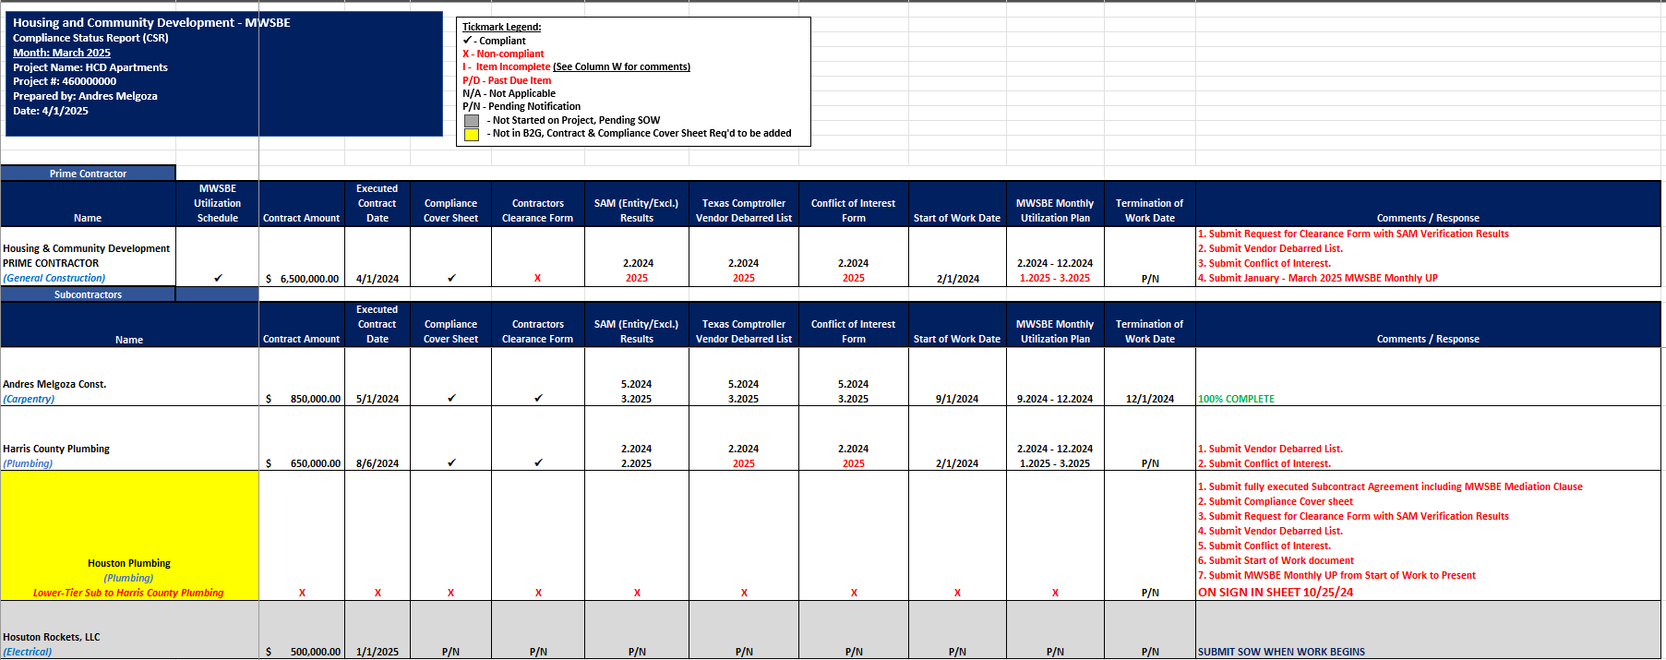
Compliance Status Reports
Notes:
The text in red identify the non-compliant items needed in LCP Tracker.

Slide 58
Commercially Useful Function (CUF) Audits
A CUF Audit is authorized by the City of Houston Code of Ordinances under Chapter 15, Article V, Section 15-84 (a).8.d.
HCDD will perform CUF audits of certified firms to assess the level of credit the Prime Contractor should receive for the certified firm’s performance. In determining whether a certified firm is performing a Commercially Useful Function, factors including but not limited to the following shall be considered:
Whether it is performing a real and actual service that is a distinct and verifiable element of the work called for in a contract.
Whether it has the skill and expertise to perform the work solely, for which it is being utilized and possesses all the necessary licenses.
Whether it is in the business of performing, managing, or supervising the work for which it has been certified and is being utilized.
Whether it is certified in the North American Industry Classification System (NAICS) code in which it is performing, and the firm is certified in that scope.
An audit will be conducted on each certified firm to ensure contractors are performing in the NAICS code of their certification, using their own forces. Credits are being applied according to their actual performance on the project.
Notes:
CUF will be conducted while on site visits for the MWSBE contractors, to ensure the scope of work is being performed on the NAICS codes of their certification.

Slide 59
CONTRACTOR PERFORMANCE

Slide 60
Compliance Red Flags
Prime Contractor fails to meet MWBE goal requirements and does not demonstrate acceptable Good Faith Efforts.
Prime Contractor fails to submit required compliance documents.
Prime Contractor fails to review and/or submit accurate compliance documents for subcontractors and suppliers.
Prime Contractor fails to complete monthly payments audits in B2G Now.
Prime Contractor fails to submit a deviation request to remove goal credit firms.
Prime Contractor fails to comply with program requirements.

Slide 61
Substantial Non-Compliance
If contractors fail to comply with program requirements, the Compliance Monitor may recommend withholding of payment draws.
Payment Withholding
If Contractor(s) fail to comply with the terms of the contract documents, HCDD may temporarily suspend/terminate the contract at any time.
Termination of Contract
Suspension, Debarment, Suspension, or Limited Denial of Participation
Upon termination, HCDD may also include Contractor(s) on Nationwide Debarred and Suspended List of Contractors.

Slide 62
PENDING CLOSEOUT PROJECT ACTIVITIES

Slide 63
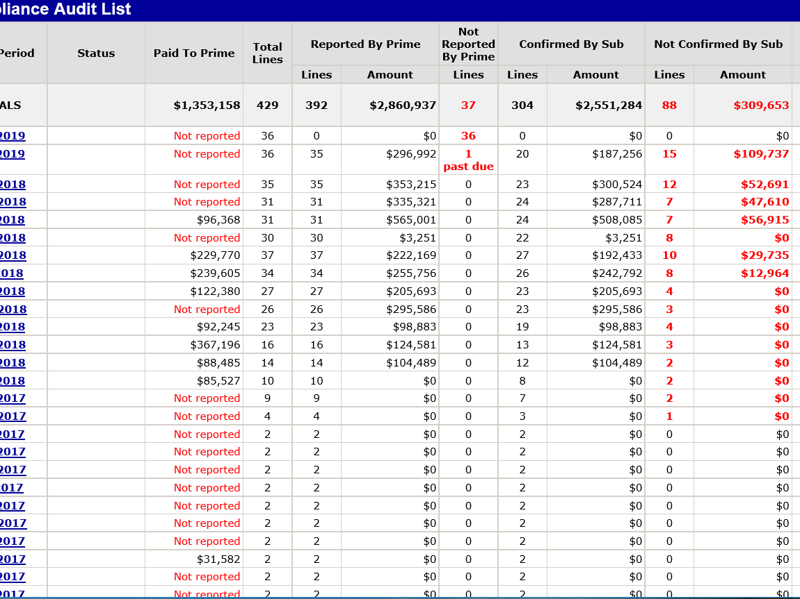
Pending Closeout Project
When site activities are completed under contract terms, contractors should submit a Termination of Work Notice.
The final payment in B2GNow should also be marked “final.”
Retainage payments must be entered in B2G by contractors with the total amount of retainage being held.
A project CANNOT be closed with any “Outstanding” compliance audits. Outstanding audits are a result of unconfirmed payments, unreported payments and payment discrepancies.
47

Slide 64
Project Close Out & Evaluation
A Closeout evaluation consists of evaluating the Prime Contractor MWBE goal and compliance with program requirements.
Subcontractors’ performance may impact evaluation ratings of the Prime Contractor.
Notes:
You will be notified when the goals are substantially not being met by sending a Not Meeting the Goal Letter. It is my goal as a Contract Administrator to have open communication with the Prime and/or compliance rep on all projects to advise on maximizing the goals requirements. If you have any questions regarding MWSBE compliance you are welcome to email your questions or concerns or simply call and we will assist you.

Slide 65
Resource Links
24 CFR 85.36 Federal Procurement
https://www.hud.gov/sites/documents/24CFR85-36PROC.PDF
Chapter 15 Article V of the City of Houston Code of Ordinances
https://library.municode.com/tx/houston/codes/code_of_ordinances?nodeId=COOR_CH15 CO_ARTVMIWOSMBUEN
City of Houston Good Faith Efforts Policy
http://www.houstontx.gov/obo/docsandforms/goodfaithefforts.pdf
Notes:
As we come to a close of the training, here are resource links that may be beneficial to you.

Slide 66


Comments & Questions
Notes:
I would like to thank you for participating in the MWSBE Virtural Training, I hope the information was beneficial to you. Please take a moment to complete the survey and tell us how we did this morning. Next will be Pay or Play presented by LaQuinta Jones. Thank you for joining us!
Please take a moment to complete the survey.

Slide 67


