Slide 1
Houston Police Department - Kingwood Division
Captain C. Weatherly

Slide 2
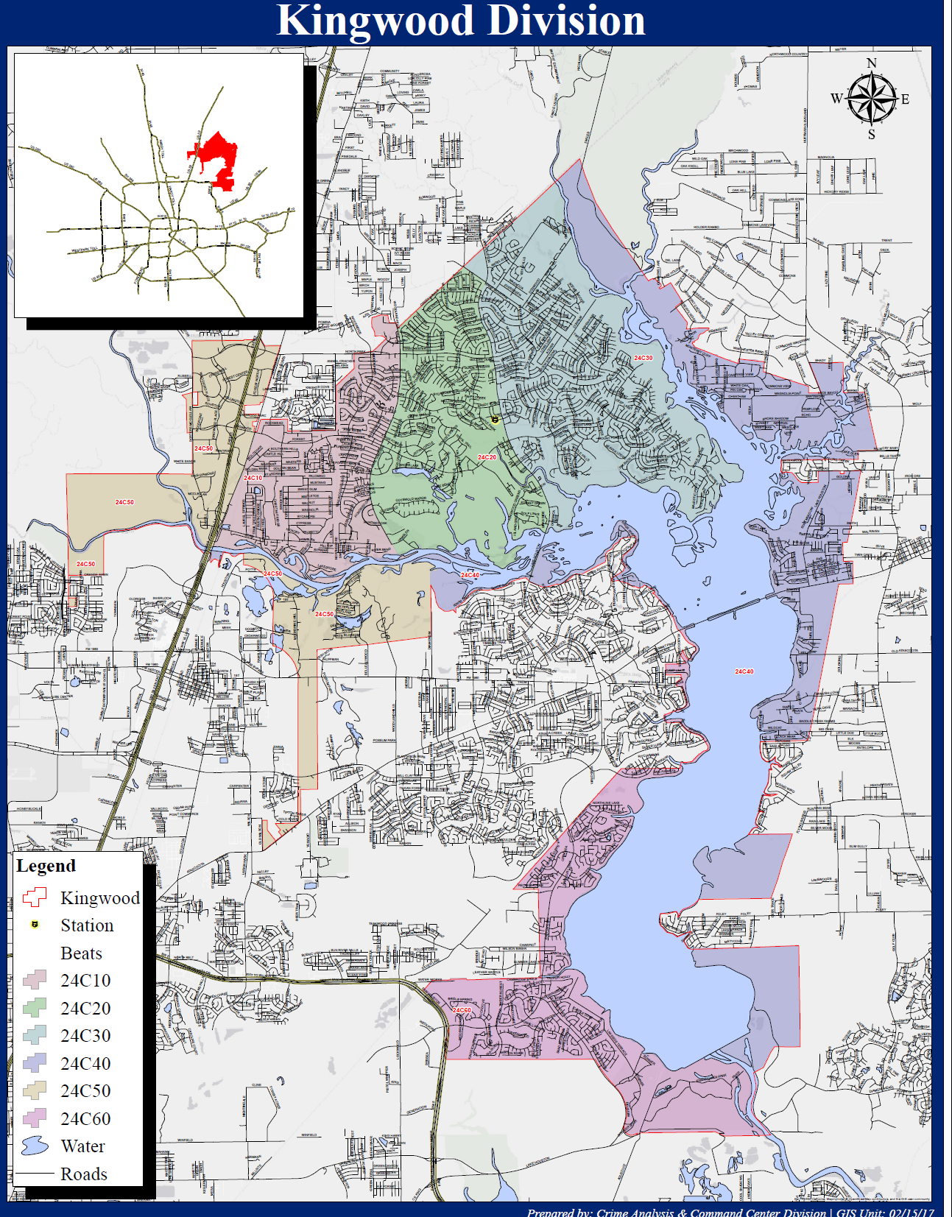

Slide 3
Property Crime 2012 - 2016

Slide 4


Crime Prevention

