Slide 1

District E Capital Improvement Projects Houston Parks and Recreation Department Date: February 16, 2017

Slide 2
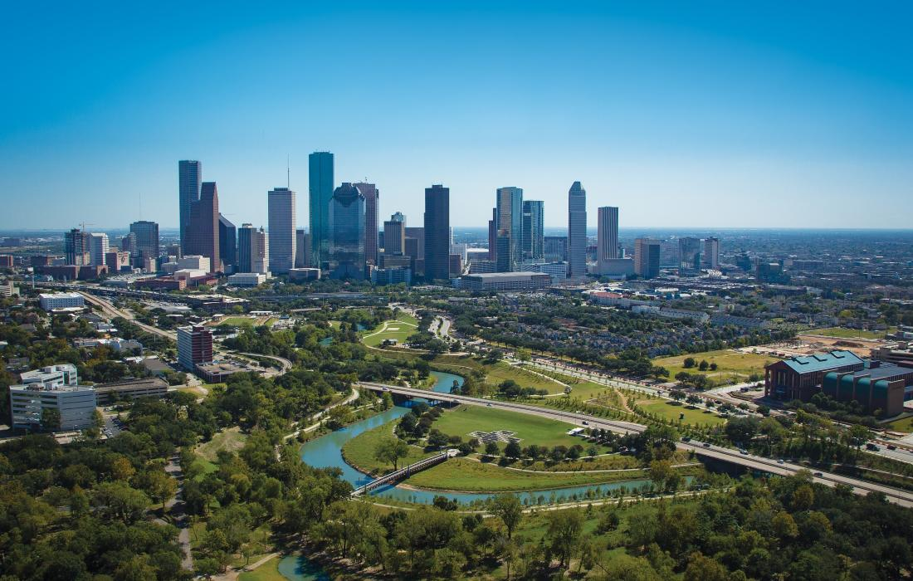
Houston Parks and Recreation Department Overview
City of Houston Population:
2.239 million
Houston area:
656 square miles
Number of Parks:
371 Parks
Acres of Park Land
& Open Space:
37,856 acres

Slide 3
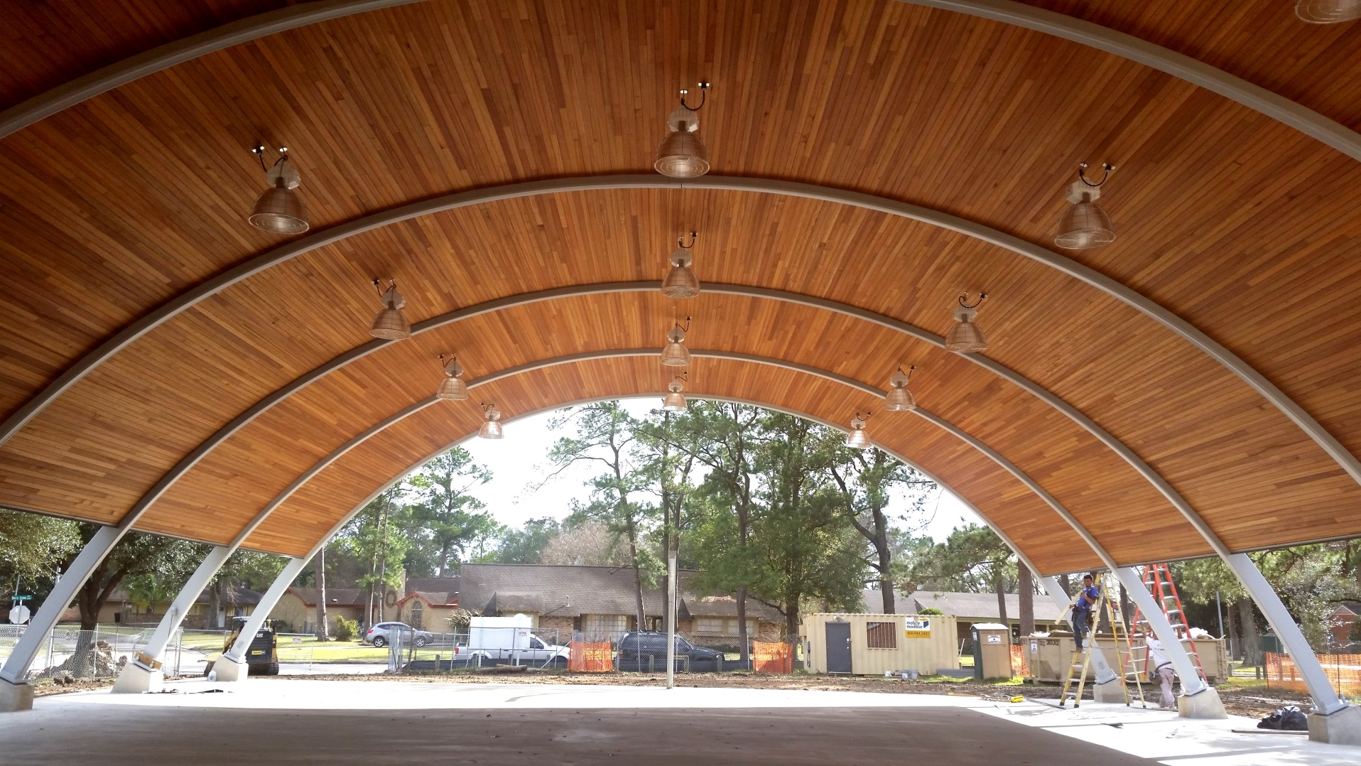
Meadowcreek Park Pavilion

Slide 4
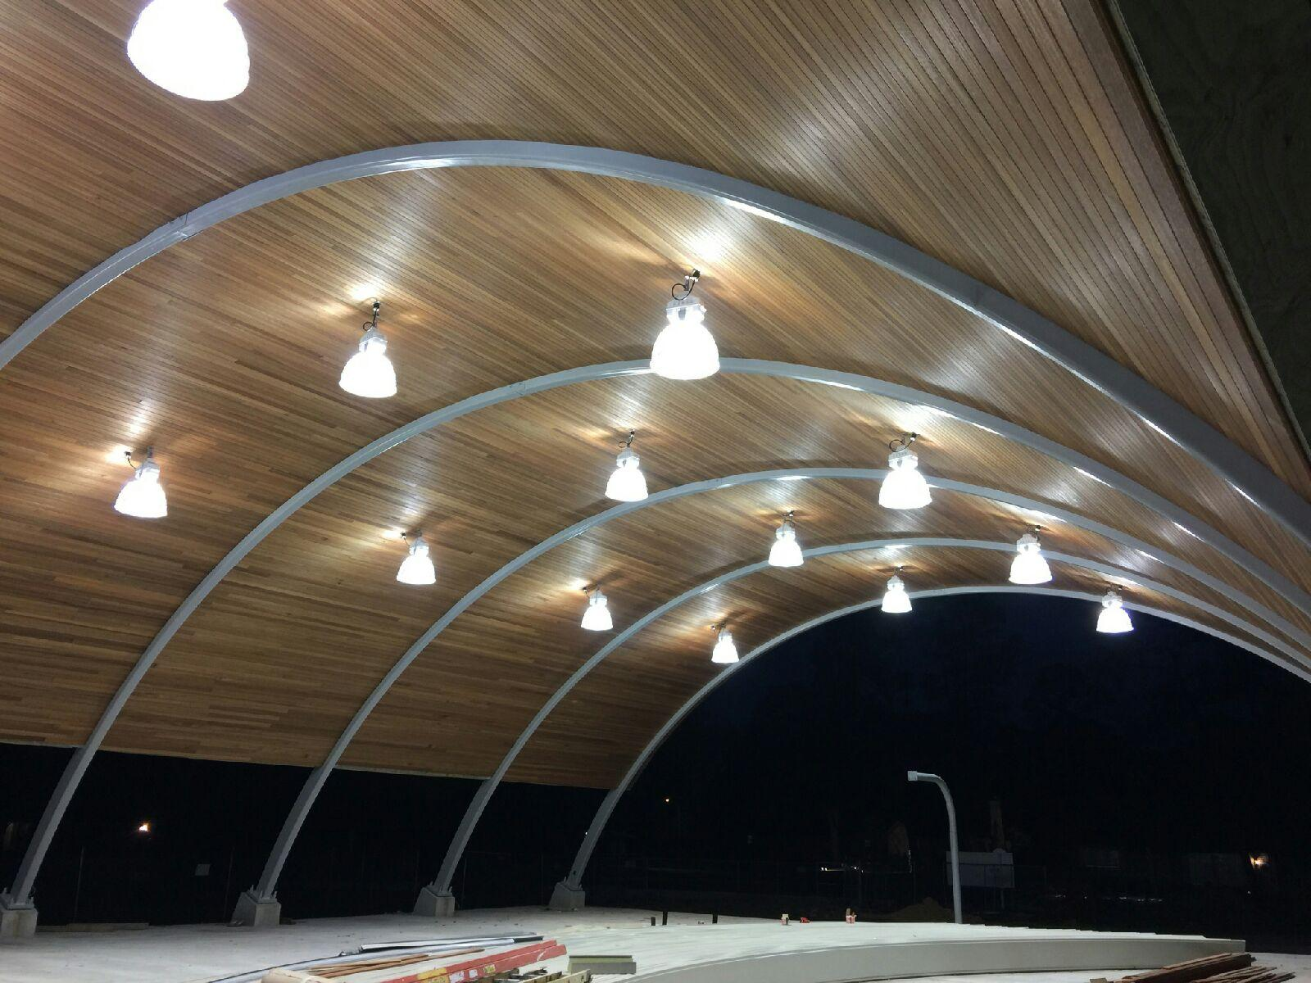
Meadowcreek Park Pavilion

Slide 5
Wilson Memorial Park – Moat Removal

Slide 6
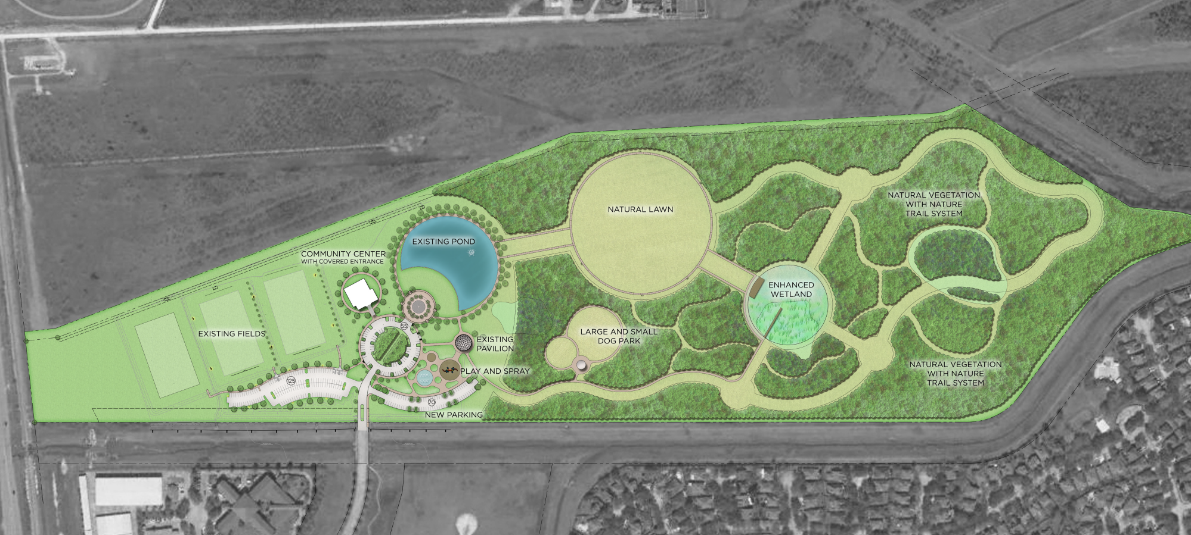
Sylvan Rodriguez Park Proposed Master Plan

Slide 7
Thank you!

