Slide 1

CH. 9 & 13 STORMWATER DESIGN REQUIREMENTS
HOUSTON PUBLIC WORKS
MAY 2018

Slide 2
Redevelopment Rules and Drainage Task Force Recommendations
DESIGN STANDARDS

Slide 3








SUMMARY & GOALS Redevelopment & Drainage Task Force
MEMBERS
FOCUS
GOALS
DETENTION
Support responsible development without negative impacts.
1
FILL
Support application and enforcement of design standards to protect drainage.
2
RESIDENTS
ENGINEERS
DEVELOPERS
CITY ROW
REAL ESTATE
CONSTRUCTION
GREEN COMMUNITIES
Notes:
Membership
Residents, city and county officials, members of engineering, development, real estate, construction, and green communities
Focus
Detention
Fill
Encroachments in the city right of way
Goals
Effectively and consistently apply and enforce drainage-related development rules
Ensure design standards are conducive to responsible development

Slide 4





RECOMMENDATIONS OVERVIEW Detention
Require payment of a fee in lieu of detention
Allow sale of excess detention capacity
Provide detention credit for green/low-impact developments
Private sector involvement creating regional detention in parks/public land
Eliminate detention credit for existing impervious cover during redevelopment
Notes:
REQUIRE PAYMENT OF A FEE IN LIEU OF DETENTION FOR LOT SIZES UNDER 15,000 SQ. FT (EXISTING PAGE CH 9-23; 9.05H2A)
Caveats:
Place collected funds in dedicated fund to be only used in specific service area where funds are collected (similar to park dedication fund) (Funds have not been collected.)
Ensure amounts collected are sufficient to be effective. (Will require a Fee Structure Study and Ordinance creation.)
Provide detention credit for broad range of green low impact development techniques
Caveats
Allow for the sale of excess detention capacity within the same hydraulic service area (Detention volume banking) (Proposed DPC, Page Ch 9-11, 9.05.C.2.b(3)) (Will need changes of Ordinance)
Eliminate detention credit for existing impervious cover when redeveloping site. Require mitigating detention for entire redeveloped site. (Proposed changes page Ch 9-23 to Ch9-26)
Caveats
Implement phasing strategy (For IDM, normally, we issue effective date, but not phasing the requirements.)
Clearly define what constitutes redevelopment (Proposed Disturbed Area, Page Ch 9-4, 9.04G)

Slide 5



RECOMMENDATIONS OVERVIEW Fill
Remove the one-acre threshold in IDM Chapter 9
Accommodate natural drainage patterns
Clearly define “Engineered Grading”
Change threshold amount for Engineered Grading
Notes:
Remove the one-acre threshold in IDM Chapter 9 Section 9.02(C)
Clarify contradictory language in IDM Chapter 9 Section 9.02(C) and specify need for flexibility to accommodate natural drainage patterns
Clearly define “Engineered Grading” In Houston Amendments to 2012 IBC
Change threshold amount for Engineered Grading from 5000 CY to 1000 CY in Houston Amendments to 2012 IBC

Slide 6


RECOMMENDATIONS OVERVIEW Encroachments
Public Roadside Drainage Education Campaign
Re-establish Drainage in the City ROW
Notes:
Initiate a widespread public education campaign to inform citizens of their responsibilities regarding roadside drainage.
Fully enforce all applicable rules to re-establish drainage in the public right-of-way

Slide 7
RECOMMENDATIONS DETENTION
RECOMMENDATIONS | ACTION | IDM OR IBC REFERENCE
ELIMINATE DETENTION CREDIT FOR EXISTING IMPERVIOUS COVER | Accepted. Redevelopments required to meet same detention requirements as new developments. | IDM pg. 9-23 to 9-26 and 9-4;9.04G
PROVIDE DETENTION CREDIT FOR LOW IMPACT DEVELOPMENT TECHNIQUES | Accepted. Clarify connection to Chapter 13. | IDM pg. 9-26;9.05H3j and pg. pg. 13-6 to 13-17; 13.05 B1-7
PAYMENT OF FEE IN LIEU OF DETENTION | Accepted. Proposed study to be conducted. No changes to IDM required. | IDM pg. 9-23; 9.05H2a)
ENCOURAGE PRIVATE SECTOR INVOLVEMENT | Accepted. Added Developer Participation Contract (DPC). | IDM pg. 9-11;9.05C2b(3)
ALLOW FOR THE SALE OF EXCESS DETENTION CAPACITY | Accepted. Currently conducting study. | IDM pg. 9-11;9.05C2b(3))
Currently conducting green storm water infrastructure study, with the support of Houston Endowment, to determine incentives for private sector, including potential future changes to IDM.
Notes:
Eliminate Detention Credit: Redevelopments required to meet same detention requirements as new developments.
Encourage private sector involvement in creating regional detention in parks or on public land
Included Developer Participation Contract (DPC). Currently conducting green storm water infrastructure study, with the support of Houston Endowment, to determine incentives for private sector, including potential future changes to IDM.
IDM pg. 9-11;9.05C2b(3)

Slide 8
RECOMMENDATIONS FILL
RECOMMENDATIONS | ACTION | IDM OR IBC REFERENCE
REMOVE THE ONE-ACRE THRESHOLD CHAPTER 9 SECTION 9.02(C) | Accepted. Demonstrate no impact to sheet flow for all developments. | IDM pg. 9-1
CLARIFY CONTRADICTORY LANGUAGE IN IDM CHAPTER 9 SECTION 9.02(C) | Accepted. Allow preservation of existing drainage patterns. | IDM pg. 9-1
CLEARLY DEFINE “ENGINEERED GRADING” IN HOUSTON AMENDMENTS TO 2012 IBC | Accepted. Clarification added.¹ | IBC 106.3
CHANGE THRESHOLD AMOUNT FOR ENGINEERED GRADING FROM 5000 CY TO 1000 CY IN HOUSTON AMENDMENTS TO 2012 IBC | Accepted. Lowered threshold to 1000 cubic yards for Engineered Grading. | IBC 106.3, 106.4

Slide 9
RECOMMENDATIONS ENCROACHMENTS
RECOMMENDATIONS | ACTION | IDM OR IBC REFERENCE
FULLY ENFORCE ALL APPLICABLE RULES TO RE-ESTABLISH DRAINAGE IN THE PUBLIC RIGHT OF WAY | Accepted. Added calculations and drawings requirements for design of street parking pads over existing ditch (ordinance Chapter 42). | IDM pg. 9-20 to 9-21; 9.05.E.3.c
INITIATE PUBLIC EDUCATION CAMPAIGN TO INFORM CITIZENS OF THEIR RESPONSIBILITIES REGARDING ROADSIDE DRAINAGE | Accepted. Houston Public Works is currently developing a campaign for FY’19 deployment. | N/A

Slide 10
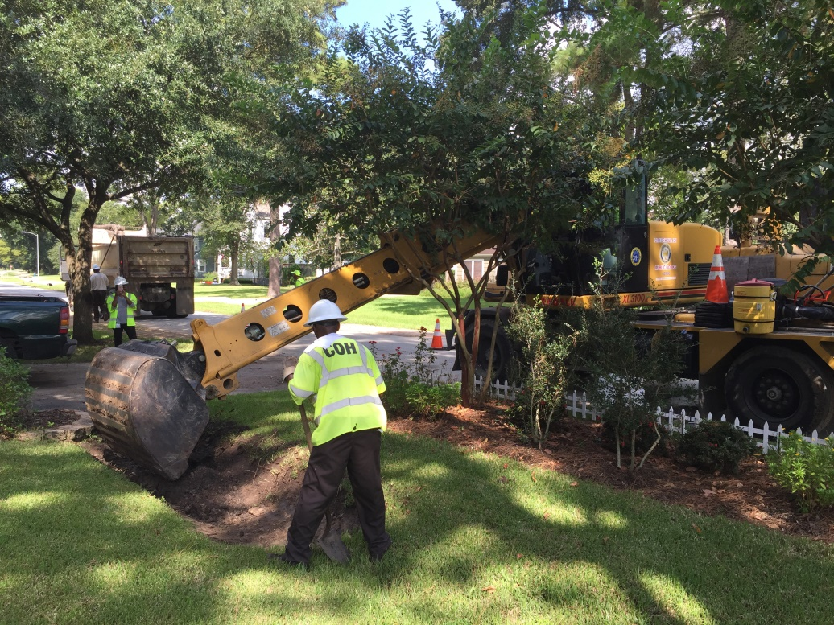
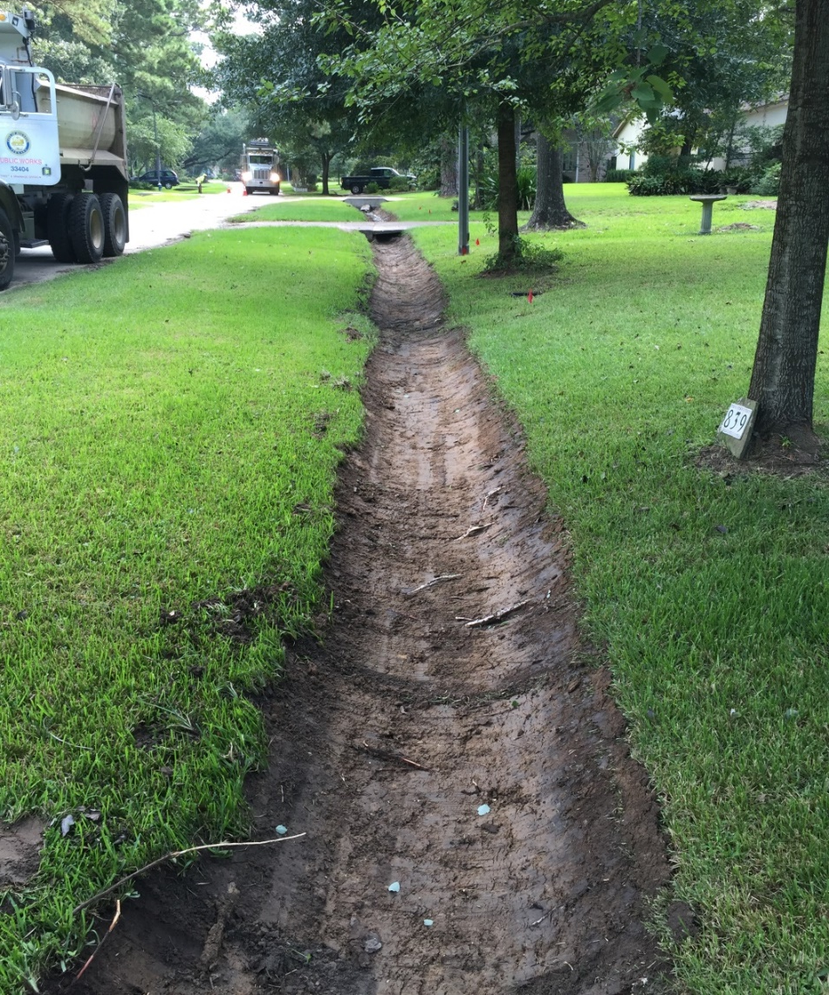
ROADSIDE DITCH

Slide 11
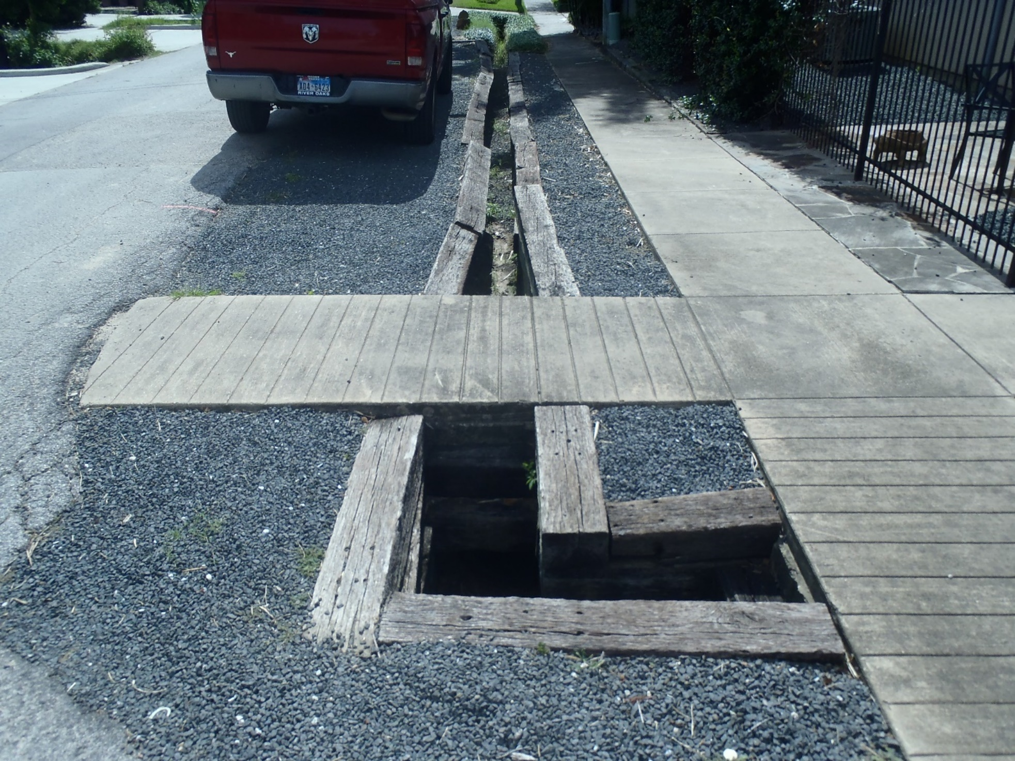
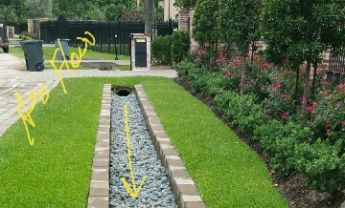
EXAMPLES OF ENCROACHMENT

Slide 12
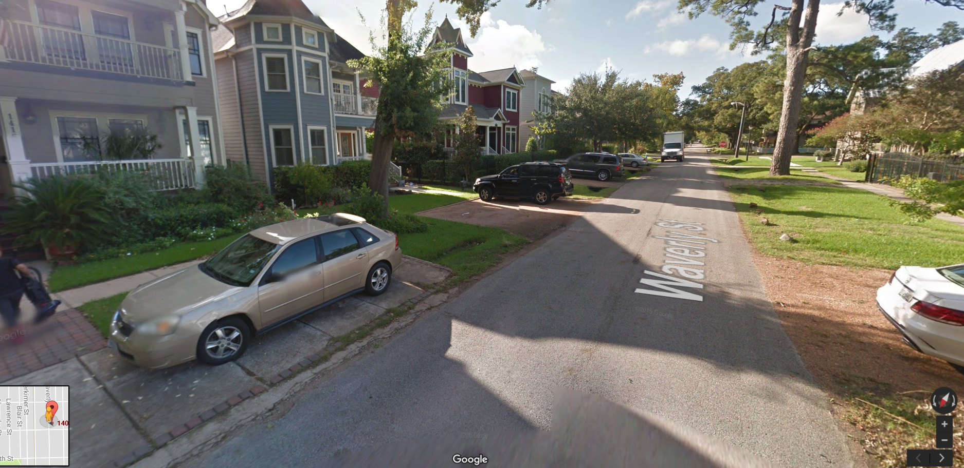
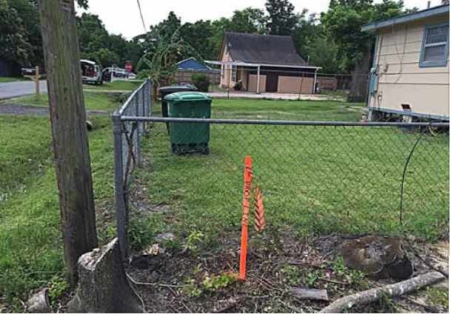
EXAMPLES OF ENCROACHMENT

Slide 13
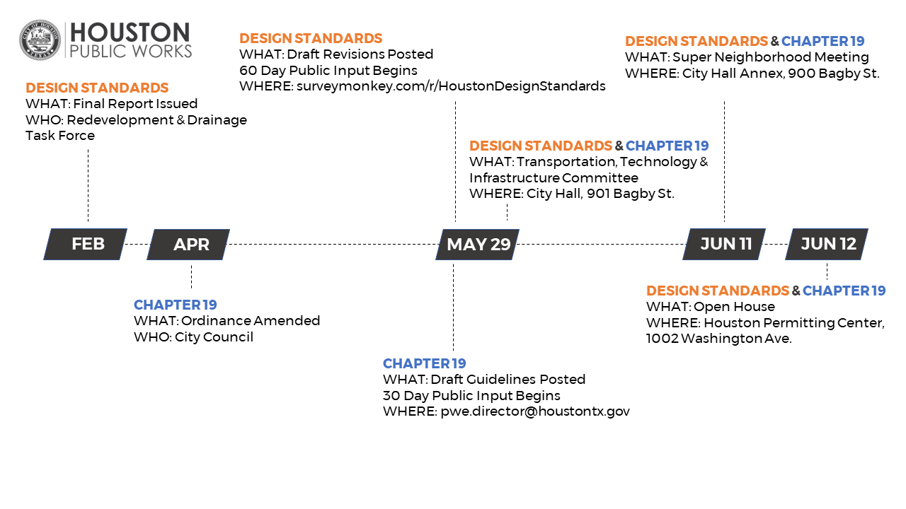

Slide 14
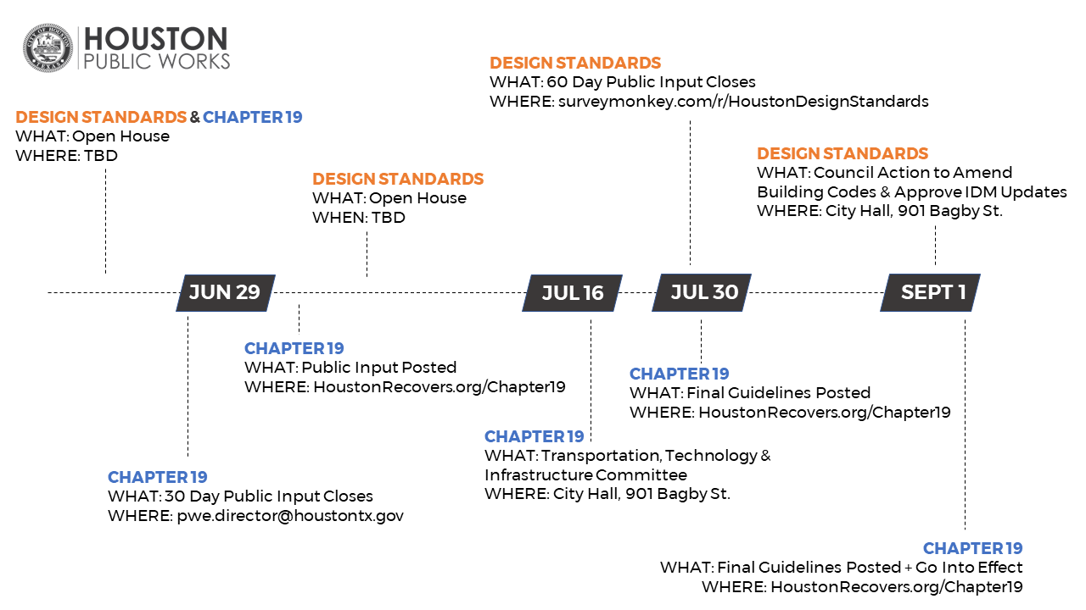

Slide 15
THANK YOU
houstonrecovers.org

Slide 16
Detention Calculation Details
SFR less than 15,000 (No change)
Impervious Cover is less than or equal to 65%: Exempt
Impervious Cover is more than 65%:
Detention = 0.2 x (Area more than 65%) or
If shared driveway, etc. used,
Detention = 0.2 x (Area more than 65%)
Note: Shared Driveway, etc. should be included in the Area more than 65% calculation.

Slide 17
Detention Calculations
Areas Less than 1 acre and not subject to (1) above:
Total Detention Volume required is calculated as follows:
V_{T} = [43,560 x (0.50 x A_{II})]
V_{T} = Total Detention Volume for the proposed project (Cubic Feet)
A_{II} = Area of Impervious Cover (including all disturbed area) (Acres)
Note: Subdividing of larger tracts (greater than 1 acre) into smaller tracts of 1.0 acre or less to reduce stormwater detention requirements will not be permitted.

Slide 18
Detention Calculations
Areas greater than 1 acre and less than 50 acres:
Total Detention Volume required is calculated as follows:
V_{T} = [43,560 x (0.50 x A_{II})]
V_{T} = Total Detention Volume for the proposed project (Cubic Feet)
A_{II} = Area of Impervious Cover (including all disturbed area) (Acres)

