Slide 1
Hewlett Packard Agreement TTI Presentation
Date: April 18, 2018
Lisa Kent, CIO
Roswell Dixon, Acting Deputy CIO- Enterprise Infrastructure

Slide 2
Bottom Line Up Front
Vendor | Hewlett Packard (HP)
Purpose: | Service contract providing departments with computer hardware equipment, to include desktops, notebooks, laptops, memory, monitors and ancillary equipment; and, services that include the installation of computer systems, connection of peripherals, de-installation of previously installed computers and asset tagging.
Original Contract Amount: | $9,000,000.00
Requested Spend Authority: | $ 4,122,329.93
Original Term: | February 25, 2015 – February 24, 2020
Primary Department Users: | All City Departments

Slide 3
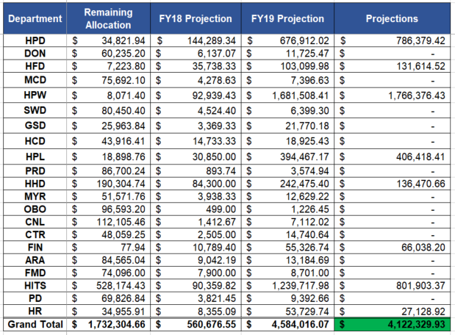
Detail Utilization Breakdown
Notes:
As CIP funding is not available annually to refresh; when available, departments are utilizing operational funding to address computing needs as shown by the annual spends in HITS supported departments

Slide 4
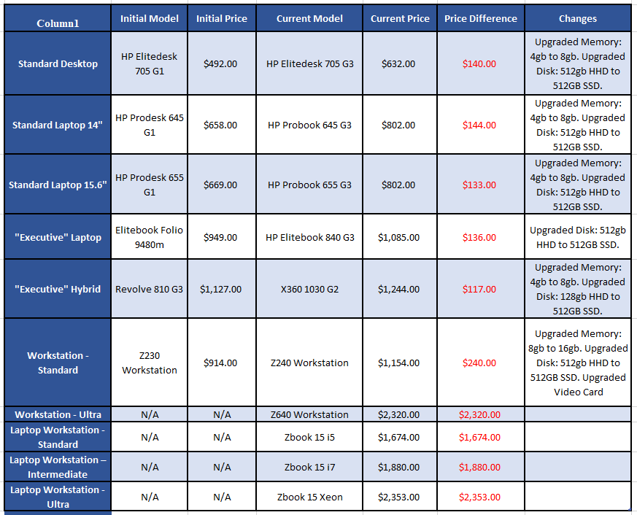
Significant Changes
Notes:
At the time the HP contract was established, the computer standards were rather restrictive in terms of performance and the standards that were being offered. Over time we increased the performance of each model to keep up with the ever growing demands of the software running in the organization. The single biggest impact to performance was the move from traditional mechanical storage to modern solid state drives. We also added extra offerings to meet some of high performance computing workloads such as software development, GIS and video editing.

Slide 5
FY18-19 Desktop Refresh Forecast
Model | Count | Cost
Elitebook 840 G5 | 169 | $ 191,760.92
HP Z240 Workstation | 83 | $ 99,905.44
Probook 655 G3 | 39 | $ 33,215.52
Prodesk 705 G3 | 1502 | $ 1,023,883.36
Total | 1795 | $ 1,348,765.24
PCs over 4.5 years old
Excluding HAS, HPD, CTR and PWE
Best match by performance level
Installation costs included.
Docking stations and monitors not included
Notes:
Under the current contract HITS received CIP funding in FY15 totaling $1,056,000 and again received funding in FY18 totaling $852,000. However currently does not have additional funding until FY2022; while the forecasting model predicts a minimal annual need of $1M to try and ensure that devices are never more than 5 year old. The refresh does not include HAS, HPD or HPW as these organizations support their own computing devices budgetarily however they do so utilizing the HITS Enterprise HP Contract spending authority. . Additional funding has been added for HPW and HPL for refresh of devices that are outside the HITS device refresh.

Slide 6
FY18-19 Desktop Refresh Forecast
Notes:
Under the current contract HITS received CIP funding in FY15 totaling $1,056,000 and again received funding in FY18 totaling $852,000. However currently does not have additional funding until FY2022; while the forecasting model predicts a minimal annual need of $1M to try and ensure that devices are never more than 5 year old. The refresh does not include HAS, HPD or HPW as these organizations support their own computing devices budgetarily however they do so utilizing the HITS Enterprise HP Contract spending authority. . Additional funding has been added for HPW and HPL for refresh of devices that are outside the HITS device refresh.

Slide 7
Questions?

