Slide 1

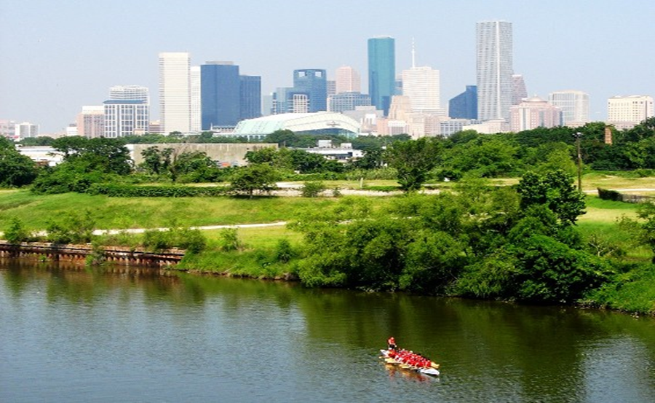

Municipal Setting Designations
Mark A. Wooten Jr.
Program Coordinator

Slide 2
What is an MSD?
A voluntary deed restriction that prohibits the use of impaired groundwater as potable water
    A tool property owners can use to address environmental impairments to groundwater
    Allows reinvestment and redevelopment of impaired properties
A public health protection

Slide 3
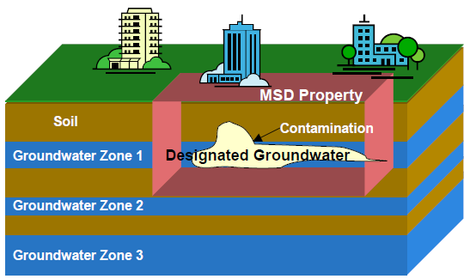
MSD Depiction

Slide 4
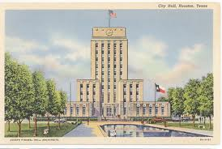
What is an MSD?
It is a State Program
    Administered by the Texas Commission on Environmental Quality (TCEQ)
    Requires Local Support
Article 13 of Chapter 47
    Public Hearing Required

Slide 5
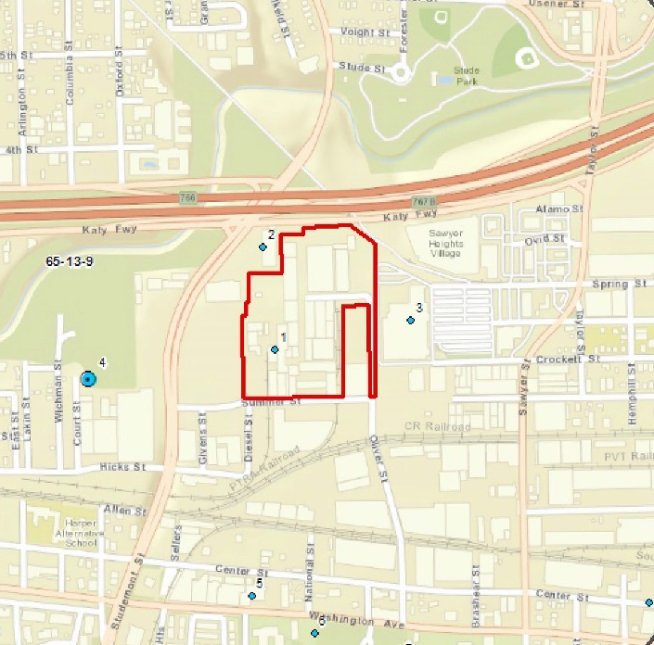
1705 Oliver Street

Slide 6
Summer Street Retail, LP
  Approximately 21 acres
  Developed for Industrial purposes in the 1930s.
  Texas Tile Manufacturing (TexTile) operated a tile manufacturing and storage/distribution facility from 1986-2014.
  Currently owned by Summer Street Retail
  Site is vacant with no structures onsite
  Future Redevelopment plans: Residential and Commercial.
  TCEQ Voluntary Cleanup Program 2015

Slide 7
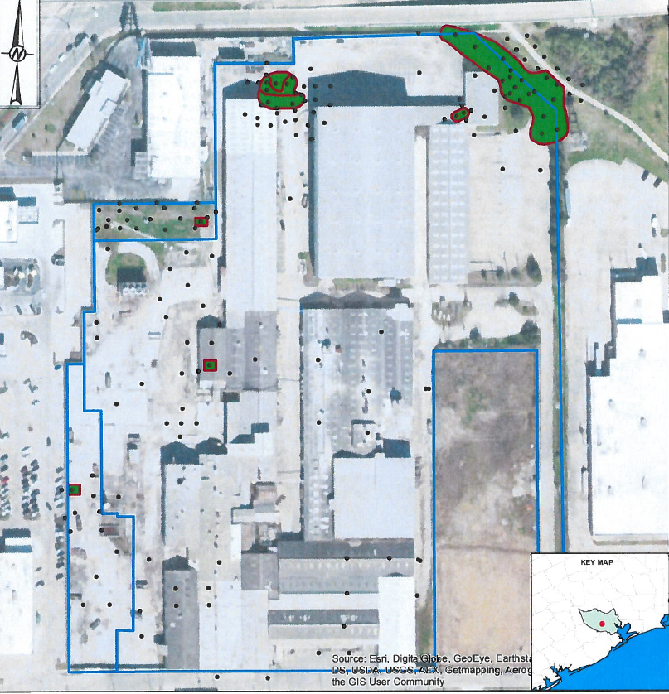
Groundwater Impacts

Slide 8
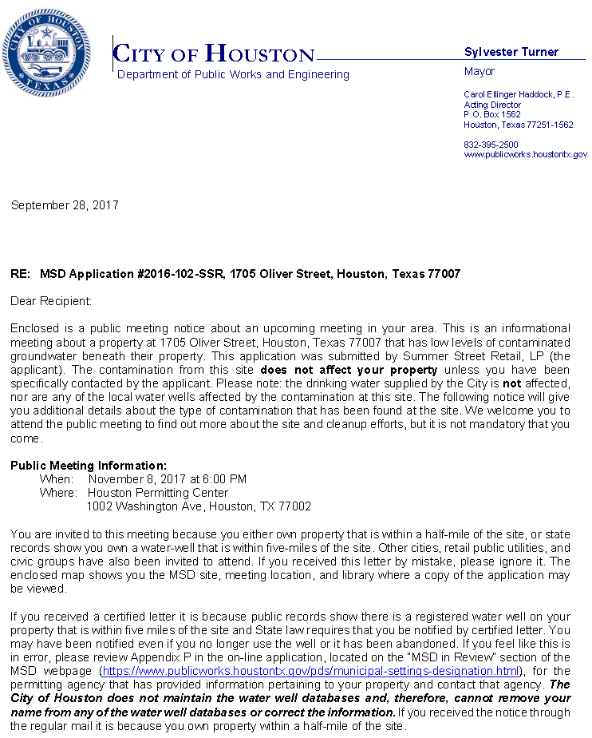
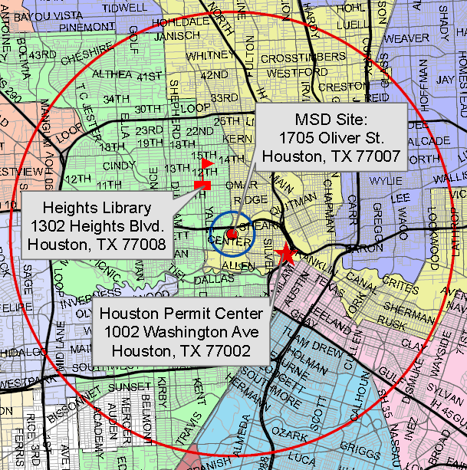
MSD Notice Letters
Property Owners
First-Class Mail
½-Mile Radius
City Requirement
Water Well Owners
Certified Mail
5-Mile Radius
State Requirement

Slide 9
Contact Information
Mark A. Wooten Jr.
Program Coordinator
Public Works & Engineering
City of Houston
1002 Washington, 3rd Floor
Houston, Texas 77002
msd@houstontx.gov
(832) 394-9005

