Slide 1

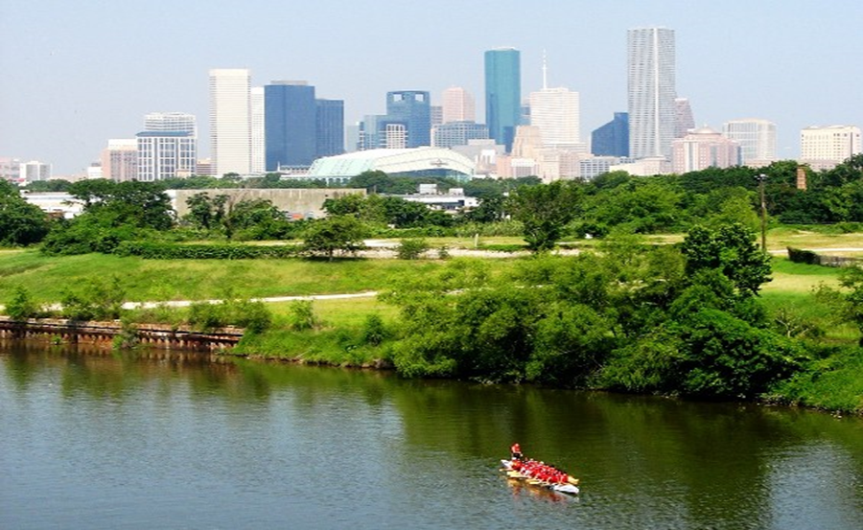

Municipal Setting Designations
Mark A. Wooten Jr.
Program Coordinator

Slide 2
What is an MSD?
A voluntary deed restriction that prohibits the use of impaired groundwater as potable water
A tool property owners can use to address environmental impairments to groundwater
Allows reinvestment and redevelopment of impaired properties
A public health protection

Slide 3
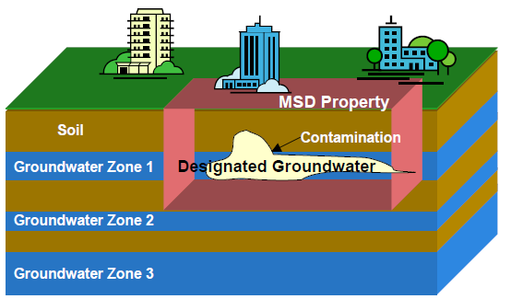
MSD Depiction

Slide 4
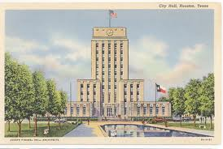
What is an MSD?
It is a State Program
Administered by the Texas Commission on Environmental Quality (TCEQ)
Requires Local Support
Article 13 of Chapter 47
Public Hearing Required

Slide 5
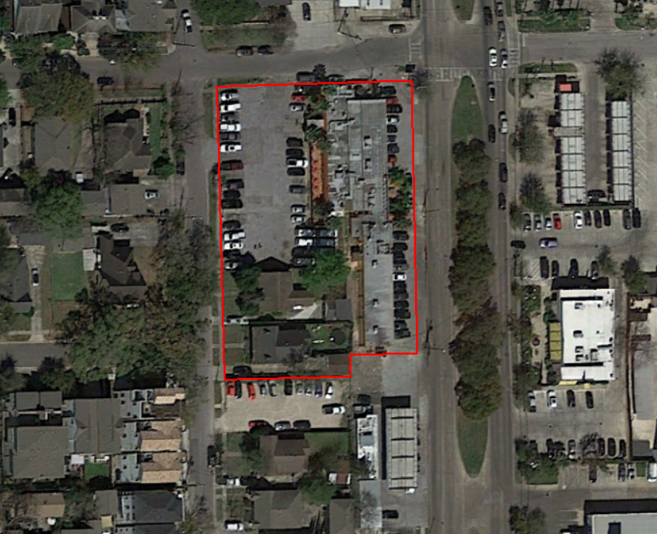
1302 Montrose Boulevard
Montrose Boulevard

Slide 6
Sunrise Montrose Apartments, LLC
1920s to 1960s: Residential property.
1960s to 2000s: Corner grocery/convenience store at 1302 Montrose Boulevard (Building 1).
1971 to 1975: Pilgrim Laundry and Cleaners at 1304 Montrose Boulevard (Building 1).
1971 to 1991: Kwik Wash Launderers at 1316 Montrose Boulevard (Building 1).
1991 to present: no dry cleaner operations on site.
Enrolled in TCEQ Voluntary Cleanup Program in 2014 (VCP No. 2701)

Slide 7
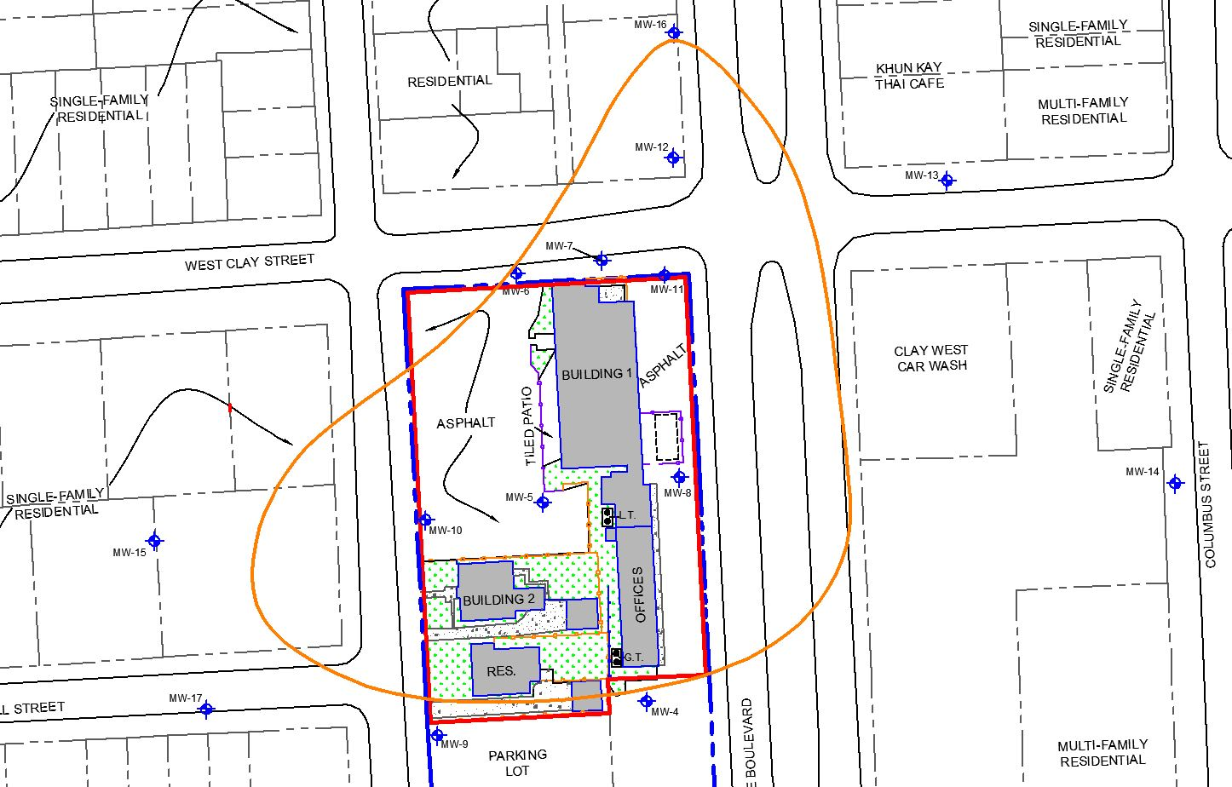
Groundwater Impacts

Slide 8
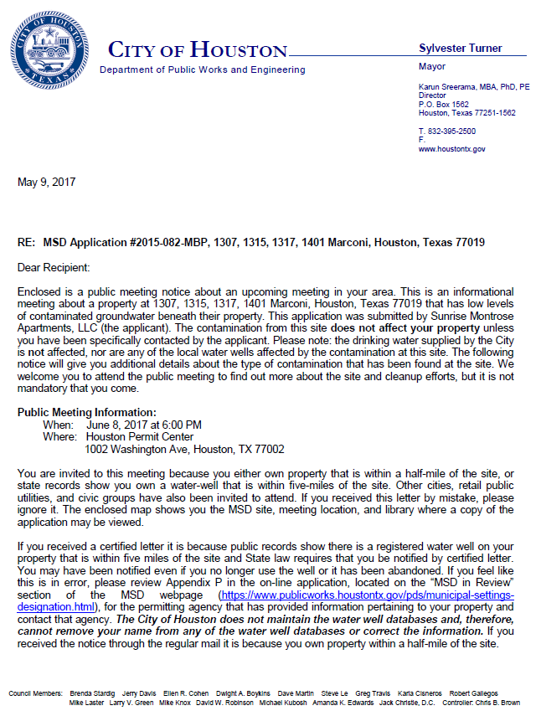
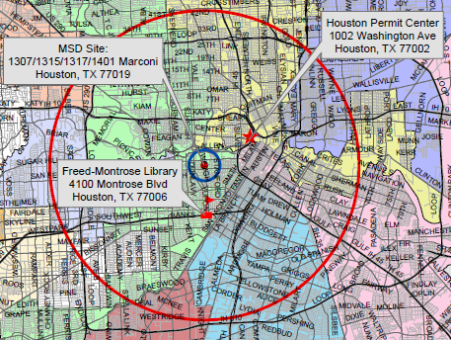
MSD Notice Letters
Property Owners
First-Class Mail
½-Mile Radius
City Requirement
Water Well Owners
Certified Mail
5-Mile Radius
State Requirement

Slide 9
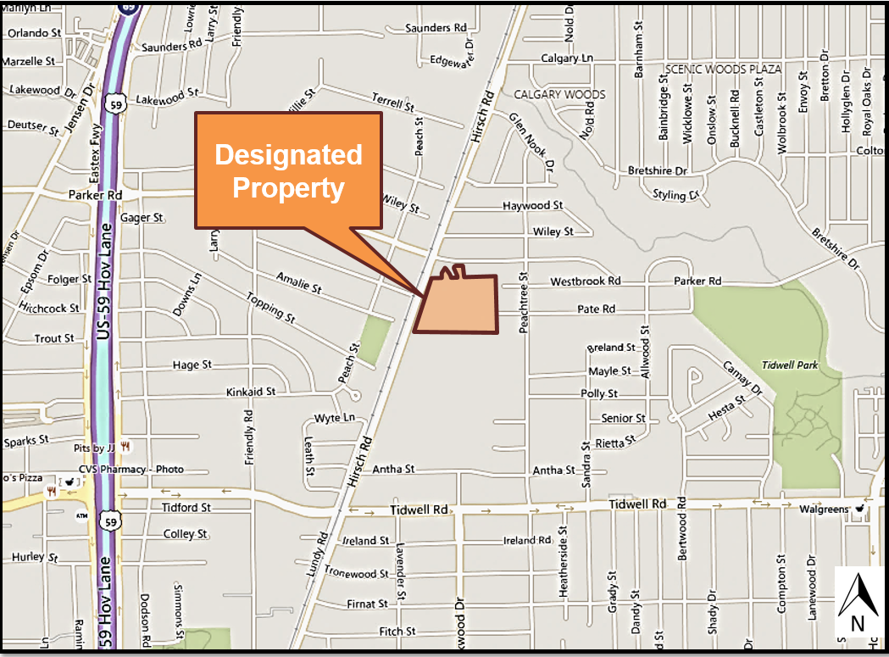
10100 and 10120 Hirsch Rd.

Slide 10
Hirsch Road Properties
1945 (approx.): Developed for industrial purposes by Dixie Chemical - manufacture of chemicals including glycol and solvents.
1969, property divided:
Southern (10100 Hirsch Road) purchased by Oakite Products for chemical manufacture, blending, and distribution. Oakite acquired by Chemetall US, Inc.
Northern (10120 Hirsch Road) purchased by Georgia-Pacific for the processing of chrome lignosulfate. Sold to Orion Chemical/Dallas Tech in 2001. Sold to current owner RC Transportation in 2011.
Current Status:
Southern - property is vacant/undeveloped. Operations discontinued Dec 2002. Buildings and structures demolished - Dec 2012. VCP No. 526
Northern – Chemical operations ended in 1969. Owned by RC Transportation used for commercial/industrial purposes (transportation, transfer, storage, and shipping of bulk materials). Georgia-Pacific remains the potentially responsible party. Anticipated use will continue to be commercial/industrial. VCP No. 1116

Slide 11
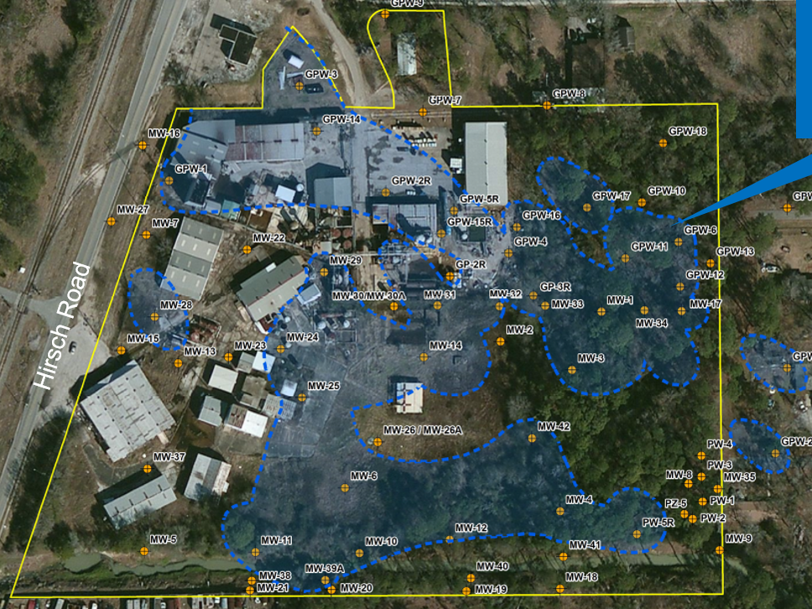
Groundwater Impacts

Slide 12
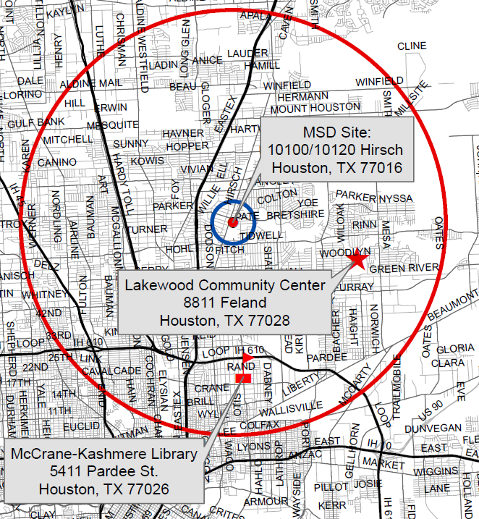
MSD Notice Letters
Property Owners
First-Class Mail
½-Mile Radius
City Requirement
Water Well Owners
Certified Mail
5-Mile Radius
State Requirement

Slide 13
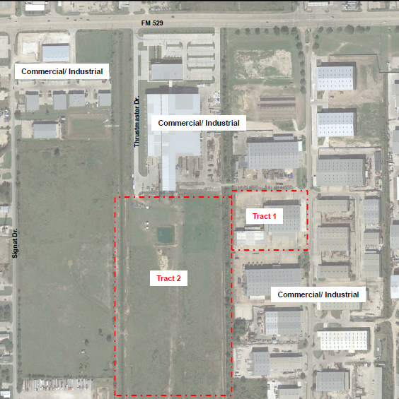
12255 and 0 FM 529

Slide 14
Milner Road Building, LLC
The facility was used for storing, blending and repackaging chemicals for resale. No manufacturing.
Chemicals included solvents, acids, caustics, and cleaners
In 1988 a spill of 1,1,1-TCA occurred while filling an AST. The spill was investigated through the State
Incidental spills and releases in the solvent packaging area contributed to another plume area.
In 2007 the property was enrolled in the Texas Voluntary Cleanup Program and assigned VCP No. 2091

Slide 15
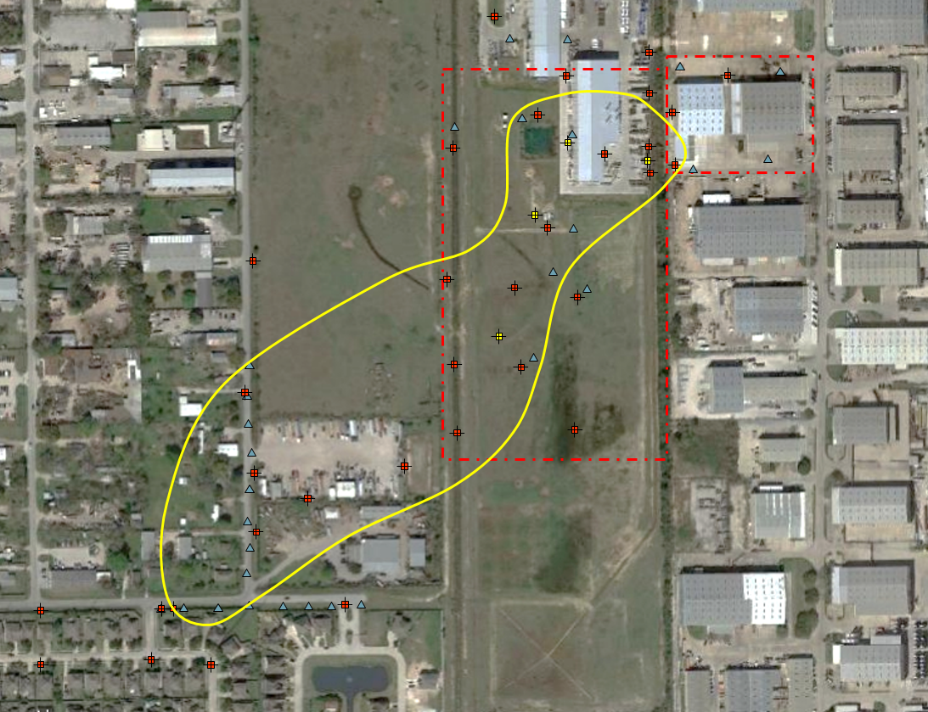
Groundwater Impacts

Slide 16
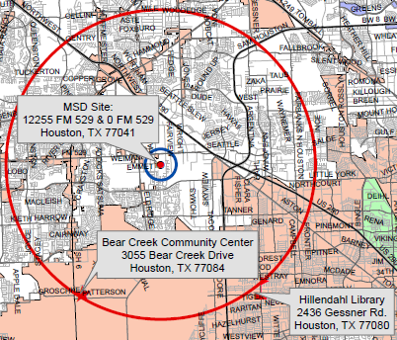
MSD Notice Letters
Property Owners
First-Class Mail
½-Mile Radius
City Requirement
Water Well Owners
Certified Mail
5-Mile Radius
State Requirement

Slide 17
Contact Information
Mark A. Wooten Jr.
Program Coordinator
Public Works & Engineering
City of Houston,
1002 Washington, 3rd Floor
Houston, Texas 77002
msd@houstontx.gov
(832) 394-9003

