Slide 1
Willow Waterhole/Levitt Pavilion
Presentation to:
Joint TTI/Quality of Life Committee
Joe Turner, Director
Parks and Recreation Department
Andy Icken
Chief Development Officer

Slide 2
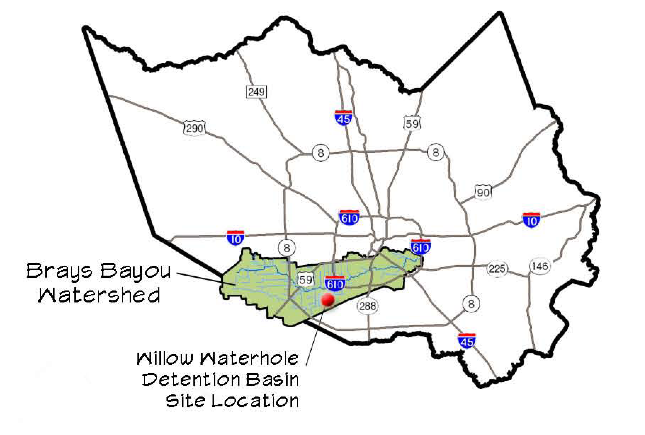

Slide 3
Willow Waterhole
Willow Waterhole is located near the intersection of South Post Oak Road and South Main Street in District K
Willow Waterhole is a $75m, 291 acre detention project and greenspace owned by Harris County Flood Control District
The City of Houston maintains the property for recreational purposes via an interlocal agreement between the City and the HCFCD

Slide 4
Mortimer & Mimi Levitt Foundation
The Mortimer & Mimi Levitt Foundation was founded in 1963 and supports access to the performing arts for the benefit of the public
Mission is to transform neglected outdoor spaces into welcoming destinations where the power of free, live music brings people together and invigorates community life
Levitt venues are publicly owned facilities located in public spaces, typically parks
Locations include:
Westport, Connecticut
Los Angeles and Pasadena California
Bethlehem, Pennsylvania
Memphis, Tennessee
Arlington, Texas
Denver, Colorado – scheduled to open 2017
Dayton, Ohio – scheduled to open in 2018

Slide 5
Levitt Foundation
The Levitt Foundation will provide funding to the Friends of Levitt Houston for the design, construction and operation of the Levitt Pavilion to provide free performances and professional concerts for the benefit of the public
The Foundation will provide the following grants to Levitt Houston:
First 5 years of operations, the Foundation will provide a total of $750k
$50k in additional grants for capacity building in each of the initial 5 years
Thereafter the Foundation will provide $100k for operational support annually and $50k annually in capacity building grants
Friends of Levitt Houston estimate fundraising needs of $7m

Slide 6
Levitt Pavilion Houston
Levitt Pavilion Houston will be built on South Post Oak between South Willow and Gasmer
It is adjacent to the Westbury neighborhood which includes elementary, middle and high schools each of which features a highly regarded “music magnet” program
A bowl for performance will be sculpted, creating a stage at water’s edge and a hill to mute traffic noise

Slide 7
Levitt Agreement
Levitt Houston will be responsible for operating and managing the Levitt Pavilion, including the booking coordination and scheduling of events
The Levitt Pavilion will be available to third parties as a performance venue and event space
It will also be available to the City for a minimum of 25 potential city events per year
The agreement has a term of 30 years and will expire on December 31, 2046

Slide 8
Levitt Agreement/Houston First Corporation
Under the Levitt agreement, the City will be responsible for certain capital repair costs during the first 15 years of operation and HFC will fund these obligations on the City’s behalf
During the Pavilion’s first 15 years of operation, HFC will fund certain capital repair costs on the City’s behalf at $100,000 per year up to a maximum of $1m in total during the term of this agreement
Houston Parks and Recreation Department will be responsible for the grounds maintenance of the Pavilion
In exchange for HFC’s funding commitment, Levitt Houston will designate one voting seat on its Board for HFC

Slide 9
Levitt Pavilion Houston
Levitt Pavilion Houston will present an annual series of 50 free concerts featuring a diverse professional lineup between April 1 and October 31 of each calendar year
The Pavilion will be available for use by schools, community groups and other arts organizations and non-profits and the City during the balance of the year
Prior to commencing construction, Levitt Houston must obtain approval of its parking plan for the Pavilion from the City in accordance with Chapter 26 parking requirements
Levitt Pavilion Houston is targeting the Spring of 2020 for its opening

Slide 10
