Slide 1


CITY OF HOUSTON:
ADDITIONAL WATER SUPPLY
TTI Council Committee
November 14, 2016

Slide 2
A Historical Perspective
  1878 City Council Contracts with Houston Water Works Company
  Contract Requirements
    Provide 55 Fire Hydrants
    150,000 Gallon Reservoir
    3,000,000 gallons per day
    4 miles of distribution mains
    Free Water to 3 City Fountains
    Rate Limit of 5 Cents/100 gallons
    Water Supply: Buffalo Bayou

Slide 3
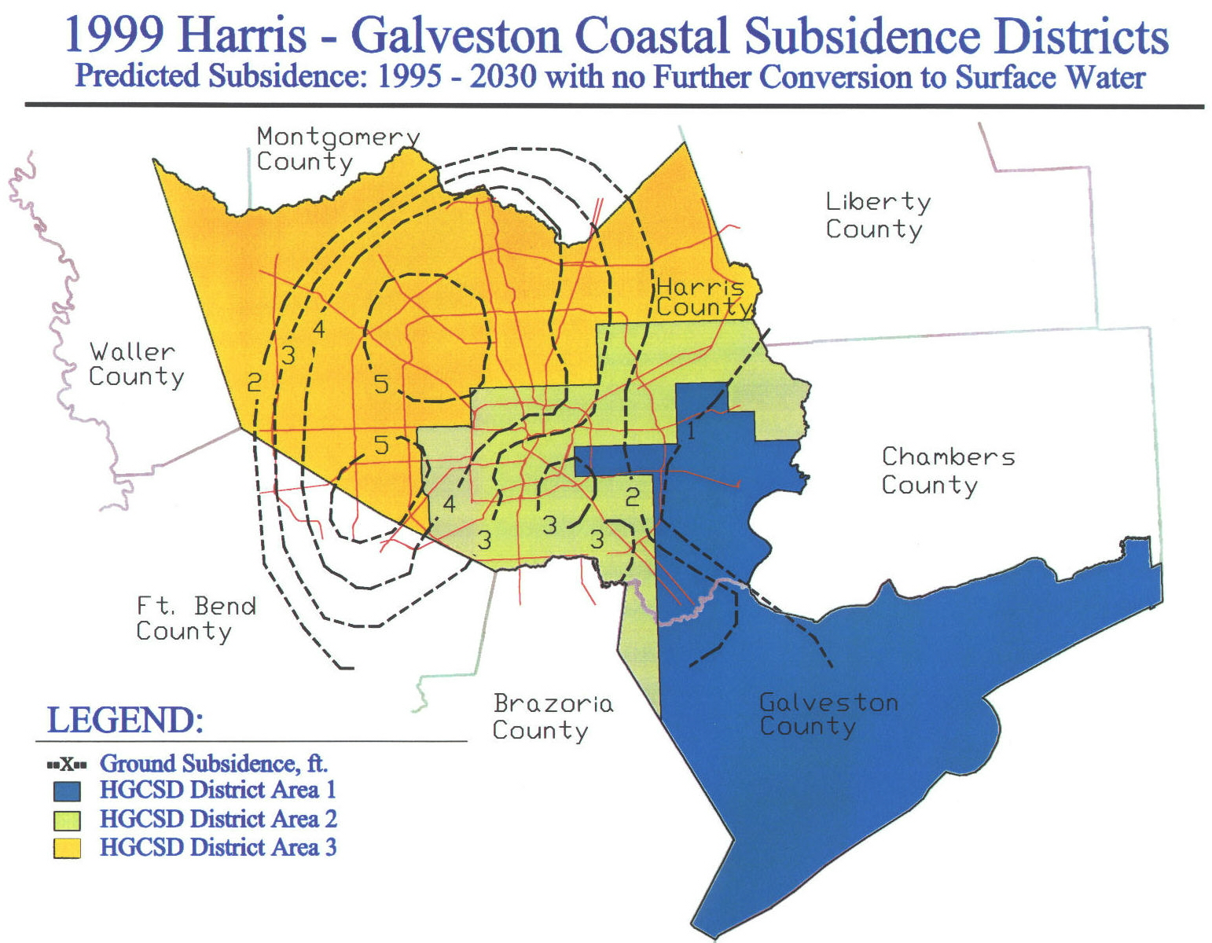

Slide 4
Houston Water Supply
Groundwater
Groundwater + Subsidence Regulations
HGSD manages subsidence by regulating the amount of groundwater that can be withdrawn in each Area in accordance with its Regulatory Plan
Area 3
2010 - 70% GW Limit
2025 - 40% GW Limit
2035 - 20% GW Limit
Area 2
20% GW Limit
Area 1
10% GW Limit

Slide 5
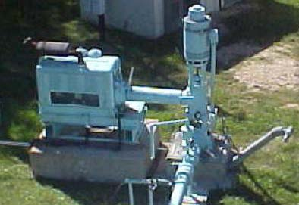
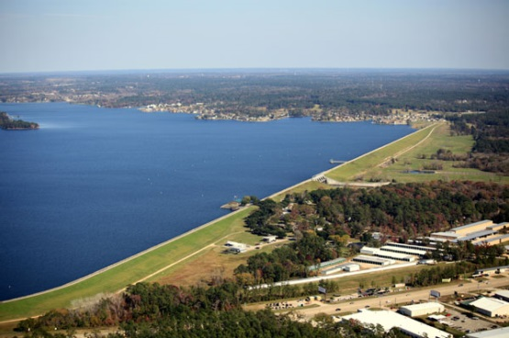
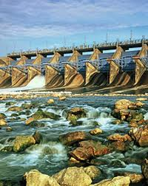
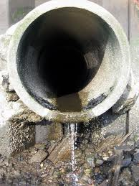
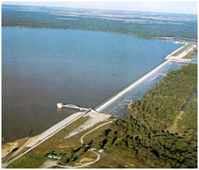

Houston Water
Current Strategies
Surface Water
  Lake Houston
  Lake Livingston
  Lake Conroe
Groundwater
Water Conservation
Reclaimed/Reuse Water

Slide 6
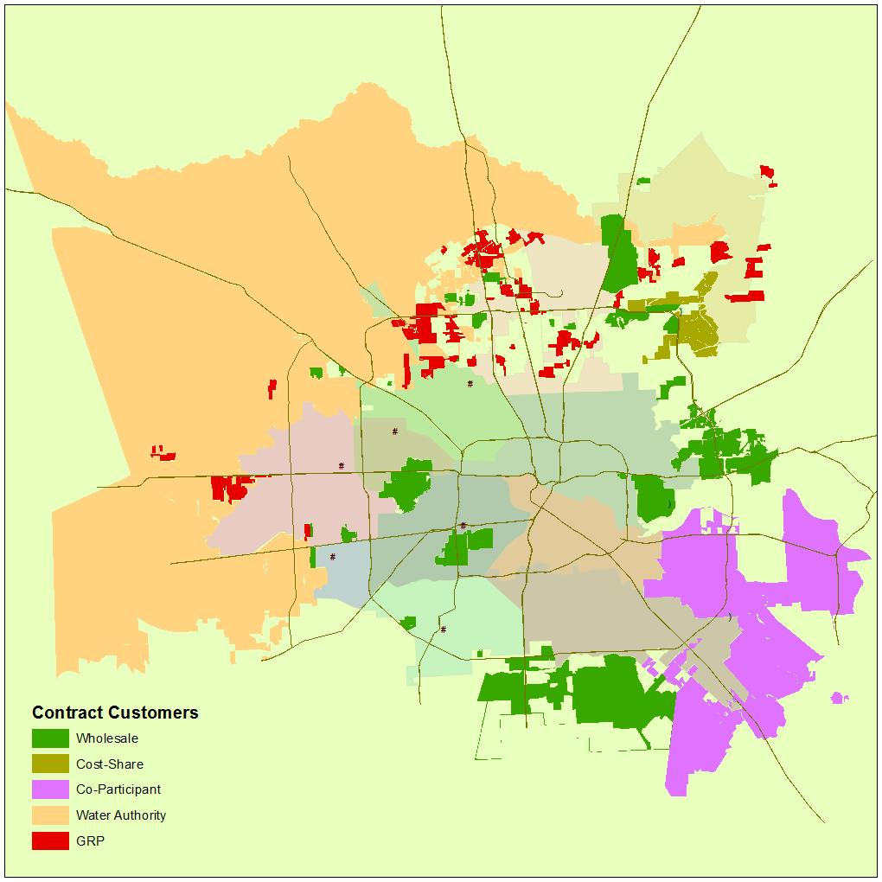
Strategic Partnerships/Customers
Houston Water
Contract Types
Treated Water Contracts | 49
GRP Water Contracts (Areas I, II and III) | 98
Raw/Untreated Water Contracts | 112
Strategic Partnership Contracts (Regional Water Authorities and SE Plant Co-Participants) | 14
Reclaimed Water Contracts | 2
TOTAL | 275

Slide 7
Houston Water
Current Forecast
Notes:
Lake Houston: 162.6 MGD Lake Conroe: 59.5 MGD Groundwater: 214 MGD San Jacinto: (35.7 MGD) Lake Livingston: 806 MGD Reuse: 259 MGD

Slide 8
Houston Water Supply Inventory
San Jacinto River Basin
Lake Conroe 60 MGD
Lake Houston 163 MGD
with an additional 36 MGD Run of River
Bayou & Reuse permits 375 MGD
includes 50% reduction for environmental flows dedication
Trinity River Basin
Lake Livingston 806 MGD
Wallisville 34 MGD
Barbers Hill Canal 40 MGD
Dayton Canal 34 MGD
Brazos River
Allens Creek 62 MGD Construction Pending
Total Permitted Water Rights 1,609 MGD

Slide 9

Water Supply in Houston
The Basics
Houston City Limits: 640+ square miles
Houston Population Served: approx. 2.1 million+
4th Largest City in the United States
Overall Water Supply Area: 1,550+ square miles
  Three Counties
Total Water Customers Served: approx. 4.3 million+

Slide 10
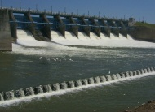
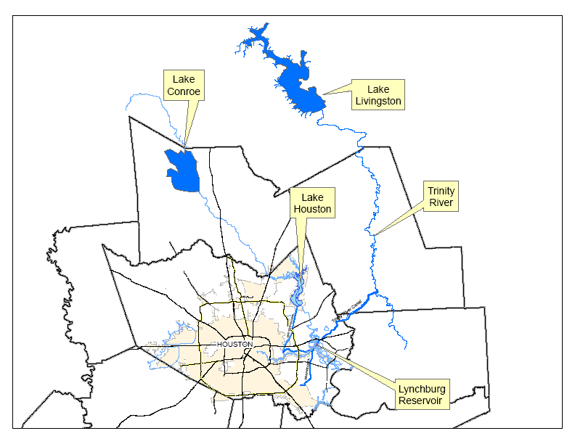
Surface Water-Lake Livingston
Water from Trinity River
1969 – Houston and Trinity River Authority Construct Lake Livingston
  83,000 Surface Acres
  Dam: 2.5 miles long
  Storage: 1.7Million Acre-feet
COH Share: 70%
Notes:
Ownership split: Houston 70% TRA 30%

Slide 11
Surface Water– Additional TRA Purchase
COH to purchase right to use 200,000 acre-feet a year from TRA’s share through 2066
Contract allows for an additional purchase of 100,000 acre-feet (Right of first refusal)
COH will pay a reservation fee beginning in 2017, no cash payment to TRA for water delivered until 2040 unless water is needed sooner.
Reservation Fee: 25% of TRA Wholesale Rate (Currently $95/acre-ft)
Offset against original Dam Construction costs
Notes:
Ownership Split: Houston 70% BRA 30%

Slide 12
Houston Water
Current Forecast
Notes:
Lake Houston: 162.6 MGD Lake Conroe: 59.5 MGD Groundwater: 214 MGD San Jacinto: (35.7 MGD) Lake Livingston: 806 MGD Reuse: 259 MGD

