Slide 1



Municipal Setting Designations
Mark Wooten, MPA
Program Coordinator

Slide 2
What is an MSD?
A voluntary deed restriction that prohibits the use of impaired groundwater as potable water
    A tool property owners can use to address environmental impairments to groundwater
    Allows reinvestment and redevelopment of impaired properties
A public health protection

Slide 3
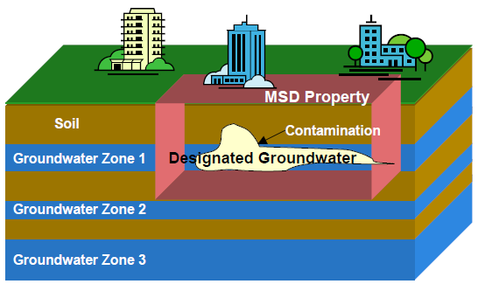
MSD Depiction

Slide 4
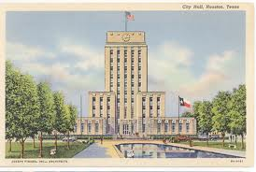
What is an MSD?
It is a State Program
    Administered by the Texas Commission on Environmental Quality (TCEQ)
    Requires Local Support
Article 13 of Chapter 47
    Public Hearing Required

Slide 5
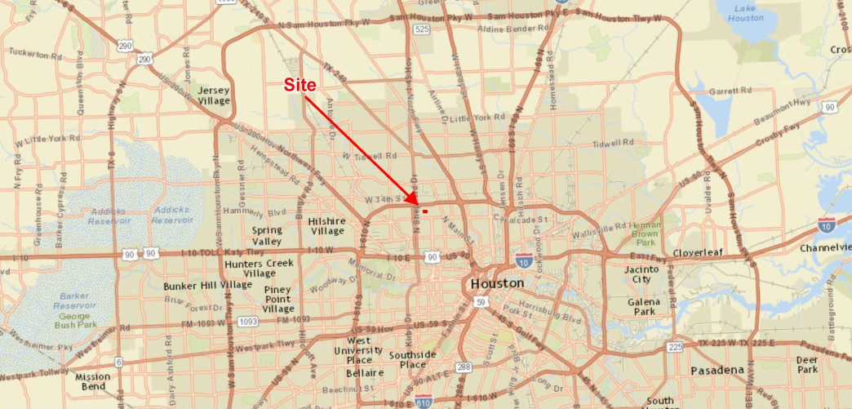
349 West 24th Street

Slide 6
NFF Realty, LLC
  The Site has historically been a machining and forging facility – used for industrial purposes from at least 1938 to 2010
Former chrome plating operations have been identified as the groundwater contaminant source
The site is currently vacant and located in a residential area of the Houston Heights

Slide 7
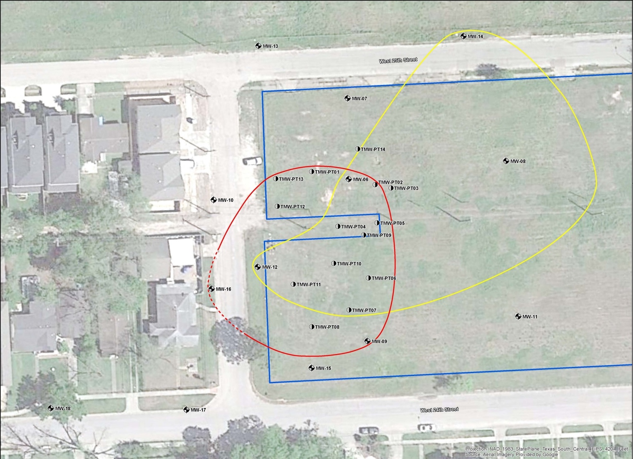
Groundwater Impacts

Slide 8
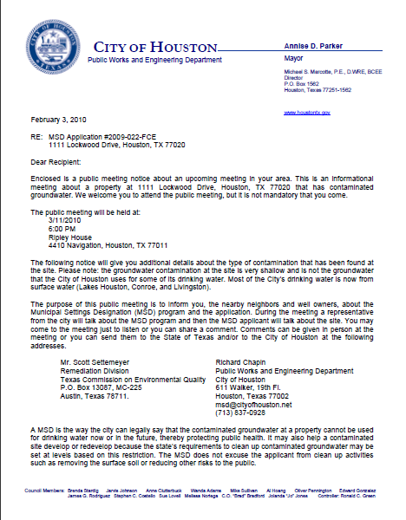
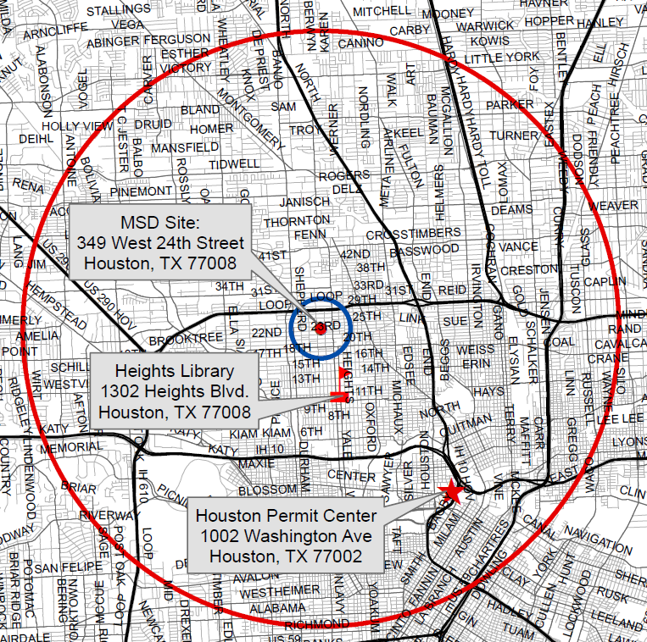
MSD Notice Letters
Property Owners
First-Class Mail
½-Mile Radius
City Requirement
Water Well Owners
Certified Mail
5-Mile Radius
State Requirement

Slide 9
Contact Information
Mark Wooten, MPA
Program Coordinator
Public Works & Engineering
City of Houston,
1002 Washington, 3rd Floor
Houston, Texas 77002
msd@houstontx.gov
(832) 394-9003

