Slide 1

Transportation, Technology and Infrastructure Committee
August 22, 2016
Lisa Kent, Interim Director/CIO
Houston IT Services

Slide 2
Agenda
Microsoft Enterprise Agreements
Multifunction Printer RFP

Slide 3

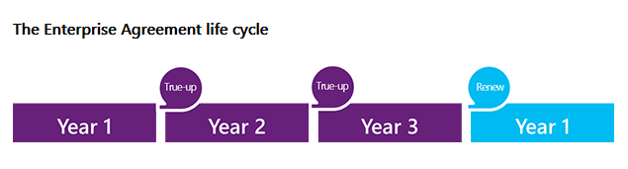
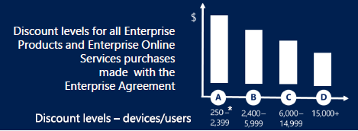
Microsoft Enterprise Agreements
Definitions
“EA”, or Enterprise Agreement
  Volume licensing for Windows operating system, Office applications (i.e. Word, Excel, Powerpoint, etc.), Skype, Office 365 (email), Sharepoint
  Software Assurance provides 24x7 technical support, access to most current version of all applications, planning services, end-user and technical training
  May use Microsoft cloud services, on-premises software, or a mix of both and migrate at our own pace
  Allows flexibility to add licenses as needed with annual true-up process
  The City already achieves the highest volume discount level across all EA agreements

Slide 4
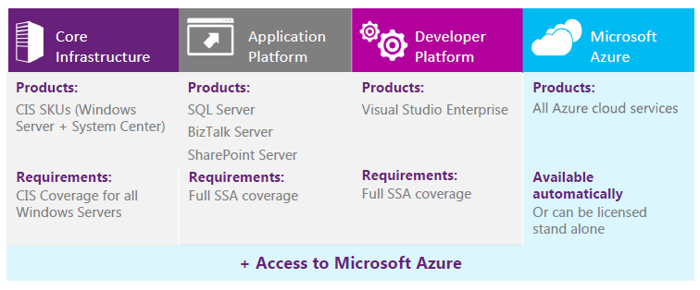
Microsoft Enterprise Agreements
“SCE”, or Server Cloud Enrollment
  Volume licensing for Windows server operating systems and System Center (infrastructure administration tools)
  SQL database licenses
  Sharepoint server
  Azure = cloud infrastructure-as-a-service (run our software in Microsoft’s data center on their equipment)

Slide 5
Microsoft Enterprise Agreements
History: recent council action on June 29, 2016
  Extended three HITS agreements and one HAS agreement by 90 days to allow coterminous expiration with the HITS Master Agreement.
  Approved payment of fourth Enterprise Agreement. Total HITS payment amounts approved = $916,239.85
Purpose of prior action: enable coterminous expiration and consolidation into Master Enterprise Agreement beginning FY2017, and annual spending authorization for SCE agreement.
HITS Enterprise Agreements | Duration | Payment Amount
8434907 (mixed EA/SCE) | 3 months | $304,239.85
5909411 (mixed EA/SCE) | 3 months | $100,086.30
8575900 (mixed EA/SCE) | 3 months | $148,062.20
6467965 (mixed EA/SCE) | Annual | $363,851.50
Total |  | $916,239.85

Slide 6
Microsoft Enterprise Agreements
Summary of upcoming HITS Microsoft EA-related RCAs
Enterprise Agreement | License Type | FY17 | FY18 | FY19 | Spending Authority Request
7658069 (MASTER EA) | Consolidated EA Sharepoint True up Addition of O365 | $3,772,779 | $3,658,151 | Agreement expires 09/30/2018 | $7,430,930
6467965 8434907 5909411 (MASTER SCE) | Consolidated SQL SCE License Step ups True ups Addition of Azure MCD SQL upgrade HFD SQL upgrade | $814,410 + $425,000 $1,239,410 | $401,216 | $401,216 | $2,041,842
6306663 | Server SCE | $218,587 | $218,587 | Agreement expires 09/30/2018 | $437,174
Premier Support | Microsoft Premier Support | $98,980 | $112,290 | $118,130 | $329,400
TOTAL |  | $5,329,756 | $4,390,244 | $519,346 | $10,239,346

Slide 7
Multifunction Printer Replacement
Current Contract
Proposed Contract
Vendor: Xerox
Contract owner - ARA
Term: 5 years + 6 months*
Contract expiration - 10/31/2016*
Total contract value: $13,320,000
Past 12-month average spend:
  $220,000 / month
  $2,640,000 / year
MWBE Goal participation:
  10.3% (11% goal)
*Separate RCA will propose Amendment 2 to extend by an additional 3 months.
Vendor: Ricoh
Contract owner – HITS
Term: 4 years
Council Agenda – 8/31/2016**
Total contract value:
  $7,233,476 base contract
  $1,808,369 25% contingency
  $9,041,845 total funding requested
Forecasted spend for 862 devices:
  $150,697 / month (savings: $ 69,303)
  $1,808,364 / year (savings: $831,636)
Forecasted MWBE participation
  15% (11% goal)
**Phase-in time needed: minimum 8 weeks.
Notes:
Other notes:
Xerox has been the City’s copier / multifunction print contractor for the past 15 years. Current contract extended in amendment 1 through 10/31/2006
Xerox extension amendment 2 – through December 31, 2016. However, we do have the ability to decrease our inventory count at the City’s convenience
ARA – will own the contract until the end of the Xerox Contract
HITS – will own the new Ricoh Contract
Ricoh 48 month starts the day we install the printer

Slide 8
Selection Process
The City desired additional rigor in comparing multifunction printer provider capabilities and services.
Hybrid approach: cooperative purchasing + proposal solicitation
Evaluation committee considered the following criteria and weight
Heavy emphasis on SERVICE
  PM Plan ³ Breakdown Response Plan ³
  Lemon Equipment Plan ² Process for ordering supplies ²
  Helpdesk ³ Standard Reports ¹
  Equipment ² Installation Plan ²
  Flexibility ¹ Price ¹
  Managed Print Capabilities ¹

Slide 9

Price Comparison of top 2 vendors
Evaluation pricing based on inventory at time of evaluation = 901 devices
 | Ricoh (Lease) | Xerox (Rental)
New Proposed Monthly | $178,522 | $185,460
Base Model (with card readers) | $161,934 | $163,836
Follow Me Print | $ 16,588 | $ 21,624
Global Scan (Valued @ $70,278) | $ 0 | -
Estimated monthly savings vs. other vendor | $ 6,938 | --
Current contract average monthly spend | $220,000
Estimated monthly savings vs. current contract | $ 41,478 | $ 34,540
Estimated annual savings vs. current contract | $497,736 | $414,480
Notes:
Pricing Notes:
We are currently in a rental agreement with Xerox – we can add or subtract machines at will. The Ricoh lease agreement is a LEASE - we are committed to the number of devices for 48 months. However, the City has scrubbed the requirements and has reduced our projected inventory. Not only has the printer count been reduced we have also lowered cost based on ordering model units compatible to the business needs. The lease model enforces accountability of fleet management in thinking twice before ordering new equipment (vs. relocating equipment if its determined a machine is not being properly utilized to its true capacity).
Overall procurement driver was service, not price.
In a nutshell, we are saving money whether we select Ricoh or Xerox.
Features
PaperCut/Follow Me Print (included in price displayed)
With PaperCut the City of Houston employees will print to a secure global virtual queue and the job will only print when the user releases the job at any of the Ricoh MFPs. This reduces unnecessary printing and increases security because print jobs only come out when the user releases them at the MFPs. PaperCut monitors and manages print and copy activity on every Ricoh MFP and provides over 50 reports to monitor print and copy usage by user and department.
Reduce waste by managing print and copy usage
Increased data security because documents are not left unsecured on the MFP
Reduced burden on IT by reducing the need to manage print drivers
Increased employee satisfaction because they can send multiple print jobs to the queue and pick them up at their leisure at any Ricoh MFP
DMNX (included in price displayed)
Ricoh Device Manager NX Enterprise is a comprehensive fleet management solution that allow organizations to optimize device performance across the enterprise from a centralized location.
Check status and activity on every device at once
Includes device mapping so devices can be located via a detailed floor plan
Run detailed reporting to optimize efficiency including status as well as meter trends
Web based interface with Dashboards to monitor Device Summary information, Status and usage
Automated meter readings for networked connected devices
Global Scan/Follow Me Scan
Global Scan NX makes it easier and more efficient than ever to integrate paper documents into a digital workflow, with a simple ‘Scan to me’ or Scan to e-mail buttons to scan directly to the desired location. Document processes are improved with next-generation scanning; productivity is raised by distributing, sharing and managing documents digitally
Simple, user-friendly interface
Scan to Searchable PDF or convert the physical document to a Word or Excel document
After 2 consecutive contracts - Xerox has offered a monthly savings of $59, 928 – displaying the notion Xerox has over charged the City for years now offering the same services at a significant price difference.
Note about Xerox service failures:
Xerox – failed to provide reporting of usage reports, properly managing fleet changes, continued issues with equipment credits, untracked supplies, etc.

Slide 10
Service Comparison of top 2 vendors
Service | Ricoh (Lease) | Xerox (Rental)
Onsite Fleet Manager | Yes | Yes
Fleet mgr. monitors, end-user can order from web portal | Yes | No
Technician on-site visits to order and deliver | Yes | No
Notification of City Help Desks regarding status, delays, and completion of requests | Yes | Yes
City can utilize regular recycling services when applicable | Yes | No
City can use own boxes with - provided labels (no charge) | Yes | No
City can receive recycle boxes | Yes | Yes
After hours break-fix requests 24 X 7 (place service call) | Yes | No
Minimize travel time | Yes | No
Provide ETA update for City end users | Yes | No
Tech visibility of all car stock and location of the entire team if a part needed not in inventory | Yes | No
Service Techs Portable Hand Held Data Device | Yes | No
Mobile app for service requests | Yes | N/A
Notes:
FEEL FREE TO REMOVE WHAT YOU DON’T WANT AND USE THE OTHERS AS SPEAKING POINTS.
5/6 services

Slide 11



















Ricoh Clients
Notes:
A few of RICOH’s clients include but are not limited to…

Slide 12
Questions?

Slide 13
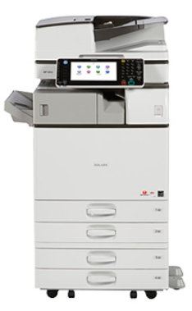
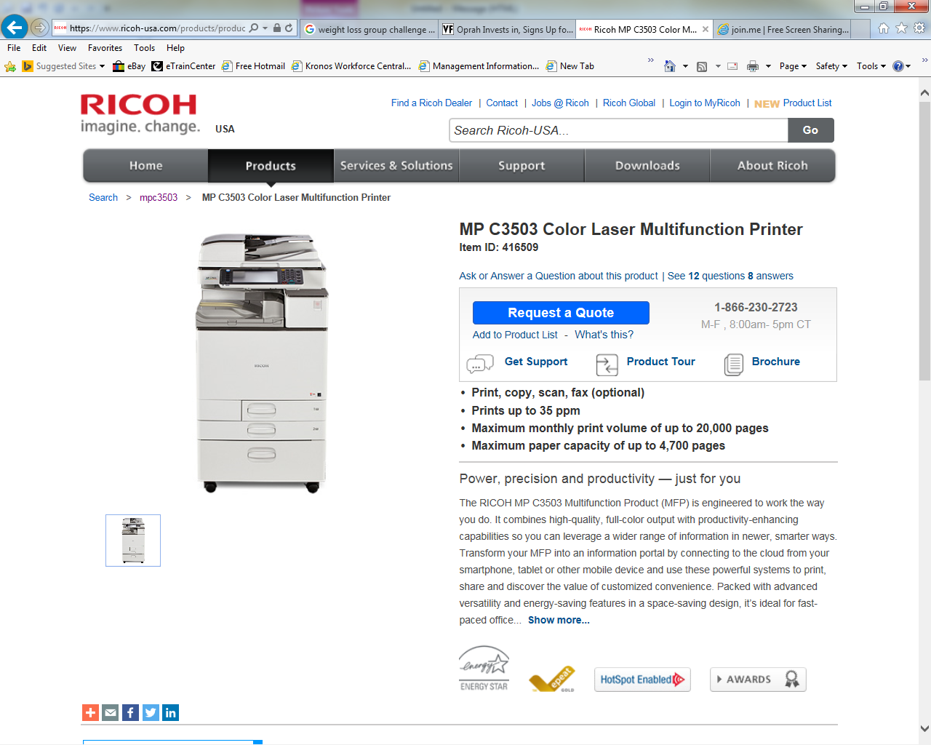
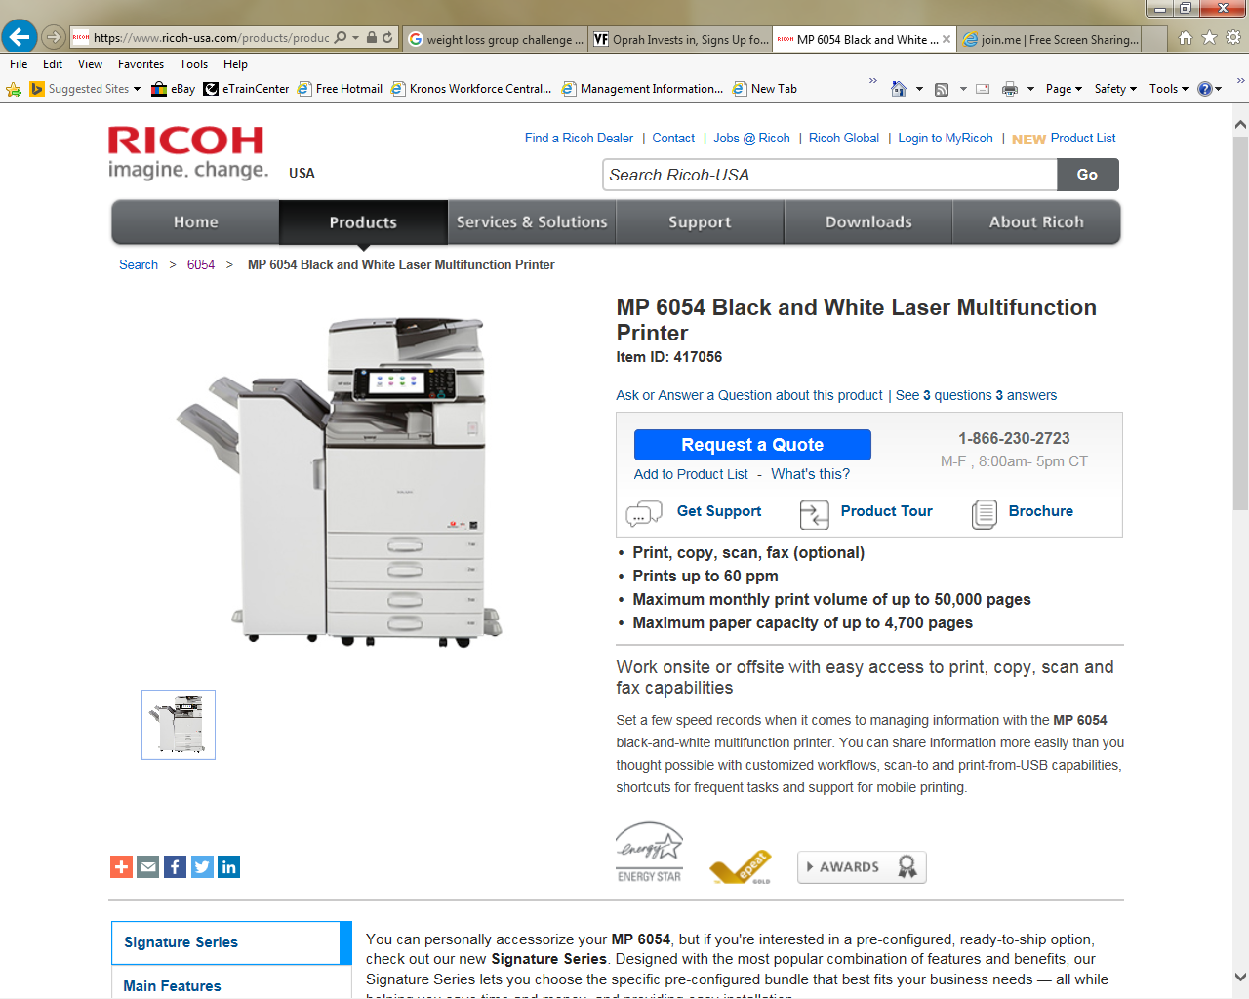
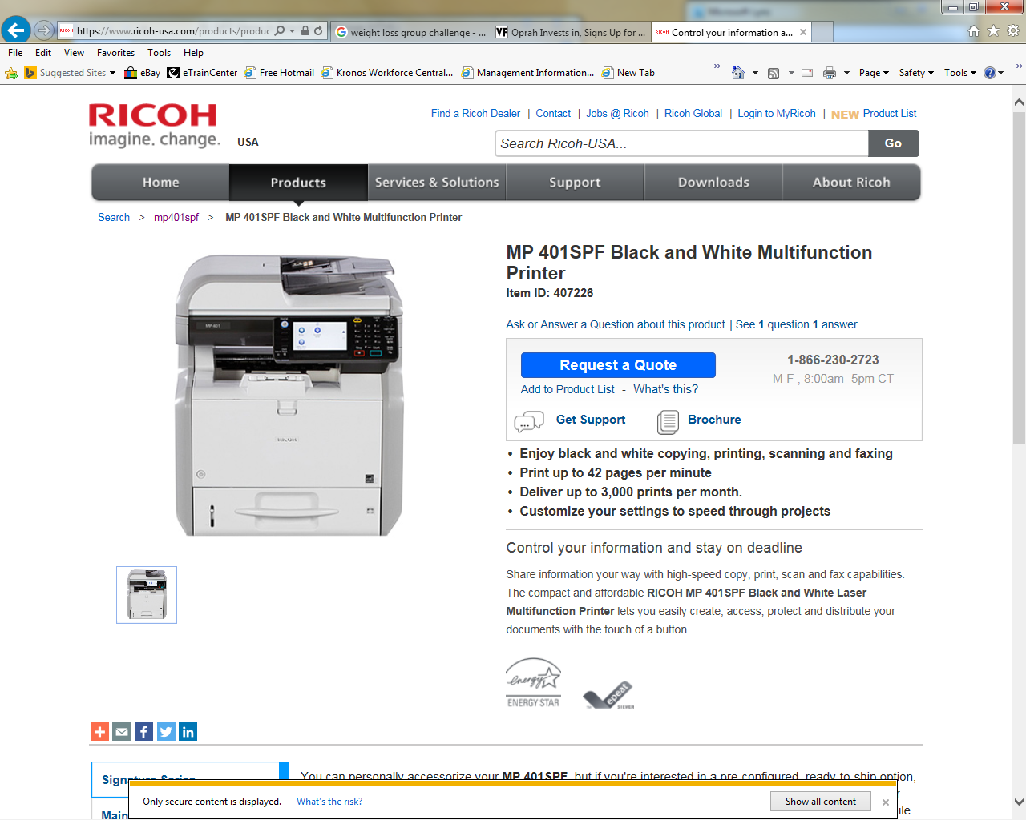
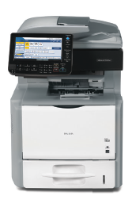
Replacement Standard Models
MP401SPF--Low Segment B/W MFP (up to A4) includes FAX at no additional charge NOT A TABLE TOP INCLUDES CABINET
MP5210SPF--Low Segment B/W MFP (up to A4) includes FAX at no additional charge.
TABLE TOP
MP4054SP--Low/Mid Segment B/W MFP (up to A3)
MP6054SP--Mid/High Segment B/W MFP (up to A3)
MPC3503SP--Mid Segment Color MFP (up to A3)
Comparable to Xerox WC3550 & WC3615
Comparable to Xerox WC3550 & WC3615
Comparable to Xerox WC5150, WC5135, WC5335, WC5945
Comparable to Xerox WC5875, WC5890, WC5775, WC5790, WC5890
Comparable to Xerox WC7120, WC7220, WC7835, WC7855, WC7935, WC7435, WC7535
Notes:
RICOH has Standard MFDs that will replace all existing XEROX models.
New environment will be reduced from 18 models to 4 models (Small, Medium, Large Capacity & Color) + 2 exception model printers (Total of 6 models)
4 models (Small, Medium, Large Capacity & Color)
MP401SPF--Low Segment B/W MFP (up to A4) includes FAX at no additional charge
SP5210SF--Low Segment B/W MFP (up to A4) includes FAX at no additional charge
MP4054SP--Low/Mid Segment B/W MFP (up to A3)
MP6054SP--Mid/High Segment B/W MFP (up to A3)
2 exception model printers (Total of 6 models)
MP7502SP--High Segment B/W MFP (up to A3)
MPC3503SP--Mid Segment Color MFP (up to A3)

Slide 14
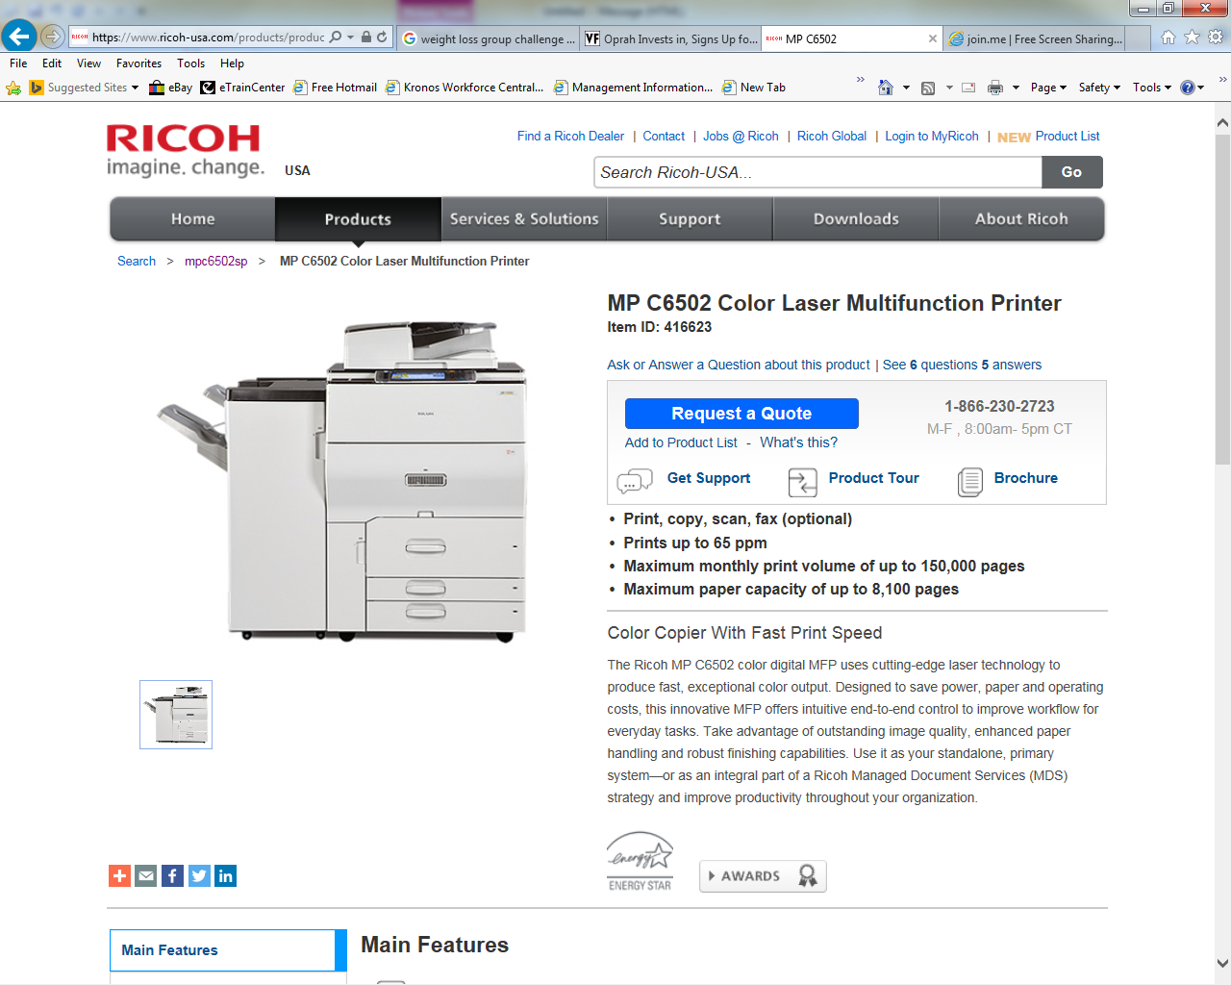
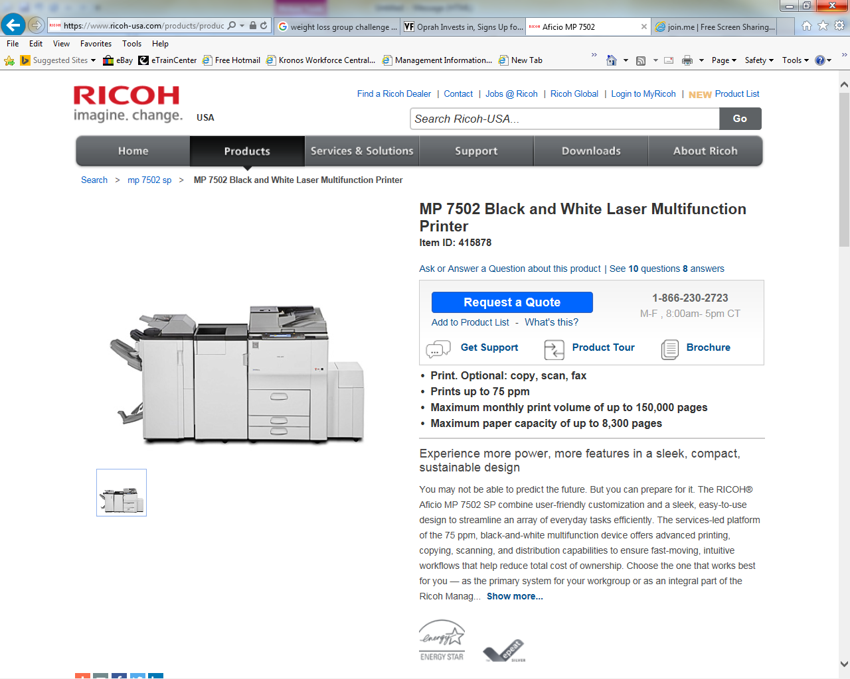
Replacement Exception Models
MP7502SP--High Segment B/W MFP (up to A3)
MPC6502SP--High Segment Color MFP (up to A3)
*All Base Models Are Configured with at least Scan, Copy, and Print, Two Paper Trays, and a Cabinet
Notes:
RICOH has Standard MFDs that will replace all existing XEROX models.
New environment will be reduced from 18 models to 4 models (Small, Medium, Large Capacity & Color) + 2 exception model printers (Total of 6 models)
4 models (Small, Medium, Large Capacity & Color)
MP401SPF--Low Segment B/W MFP (up to A4) includes FAX at no additional charge
SP5210SF--Low Segment B/W MFP (up to A4) includes FAX at no additional charge
MP4054SP--Low/Mid Segment B/W MFP (up to A3)
MP6054SP--Mid/High Segment B/W MFP (up to A3)
2 exception model printers (Total of 6 models)
MP7502SP--High Segment B/W MFP (up to A3)
MPC3503SP--Mid Segment Color MFP (up to A3)

