Slide 1

City of Houston
Matching Grant Program
Sponsored by the Department of Neighborhoods
Regulation & Neighborhood Affairs (RNA) Committee Presentation-September 8, 2020

Slide 2
What is a matching grant?
The Neighborhood Matching Grant Program helps neighborhoods fund various beautification and improvement projects by providing a dollar-for-dollar matching grant reimbursement ranging from $500.00 to $5,000.00 dollars. This program is administered in partnership through the City of Houston Department of Neighborhoods and the City of Houston Council Member’s Offices.
Notes:
It is designed to build solid relationships among neighbors, cultivate the spirit of volunteerism, and to develop projects that build a sustainable and stronger community.
Our goal is simple. We want to improve the quality of life for Houston communities and partner with active residents to:
• Improve neighborhood organization and pride.
• Improve community appearance and beautification.
• Enlist and increase community participation.

Slide 3
DON Matching Grant Contacts
Council District | DON Grant Coordinator | Contact
A, E, F, K, and Knox and Robinson (At-Large) | Mr. Landon Taylor (interim) | Phone: (832) 393-0857 Email: Landon.Taylor@houstontx.gov
D, I, H, J, and Kubosh (At-Large) | Mrs. Mayra Hypolite | Phone: (832) 394-0701 Email: Mayra.Hypolite@houstontx.gov
B, C, G, and Alcorn and Plummer (At-large) | Mr. Rashad Cave | Phone: (832) 393-0970 Email: Rashad.Cave@houstontx.gov

Slide 4

Application and Process To obtain an application, visit the Department of Neighborhoods website located at www.houstontx.gov/neighborhoods Look for “Neighborhood Matching Grants” under the section entitled “Our Programs”. Application packages will be accepted yearly beginning August 1st through the council member’s office and due the first Friday in November. Only completed applications will be accepted. This is a firm deadline-no exceptions.

Slide 5
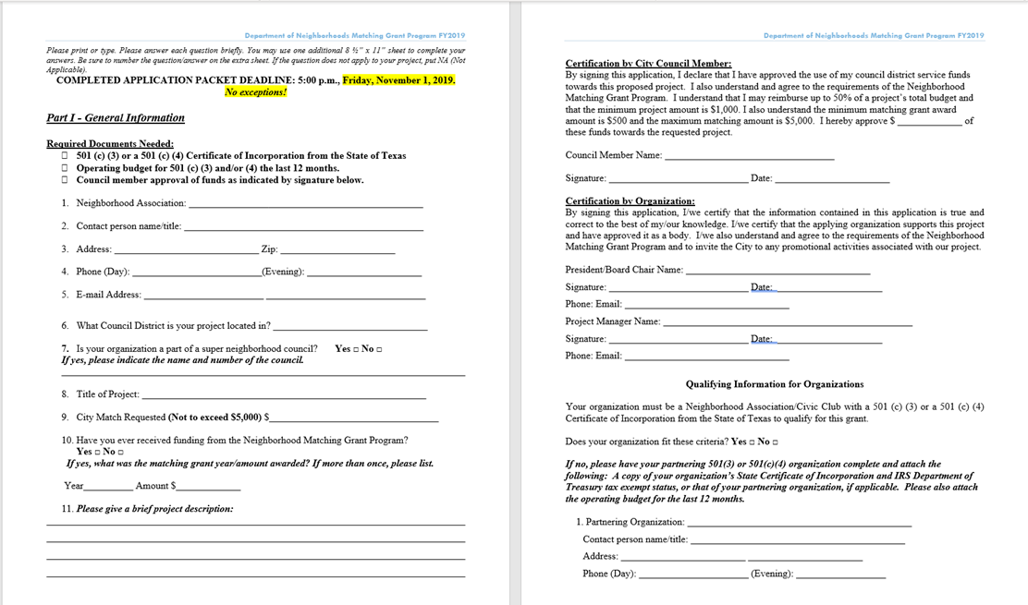

Application Process
First step: Obtain CM’s approval.
Please do not pursue the rest of the application without securing the approval of the CM for your proposed project.

Slide 6
What is an eligible project?
Proposed projects must meet the following requirements:
Improve a neighborhood through a physical improvement.
Involve neighborhood residents, have long-standing benefits.
Accessible to the public.
What is not eligible?
The program will not pay for ongoing operation or maintenance such as upkeep of landscaping or a community garden.

Slide 7
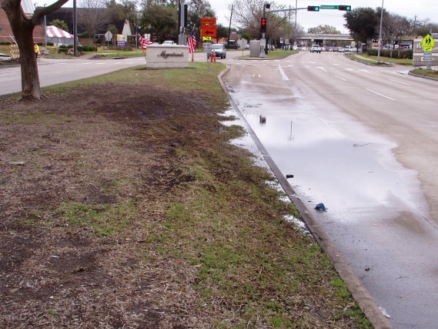
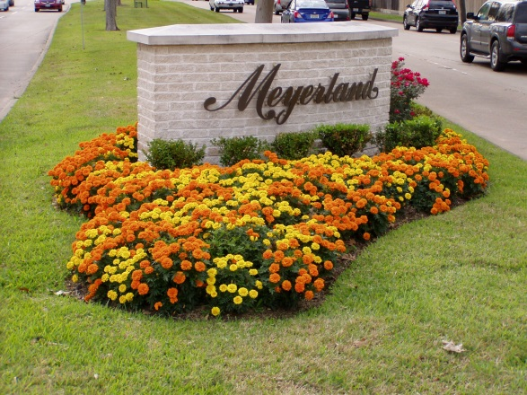
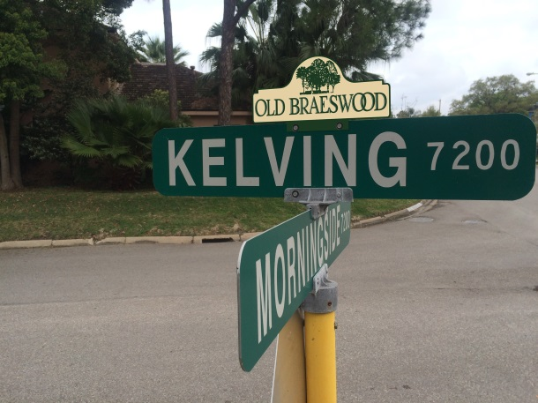
Examples of eligible projects
Before
After
Street sign toppers
Entryway signage
Entryway columns
Esplanade landscaping and irrigation
Park benches
Electrical signage
Walk ways with pavers
Murals, etc.
Street sign toppers

Slide 8
2019 Program recipients and projects
•Community Garden Game Tables-
Alief Super Neighborhood Council
• Cherryhurst Street Sign Toppers-
Cherryhurst Civic Association
• Yale Green Corridor Street Signage -
Houston Heights Association
• Hogg Outdoors –Track and Field–
Learn Local App
• Hillcroft Beautification-Maplewood South-
North
•Pine Brook Baseball Field Lighting –Pine
Brook Community Association
• Neighborhood Marquee-Washington
Terrace Civic Association
• Soccer goals to Sneed Elementary’ s
Spark Park-Westchase District
Community
• Westmoreland Triangle Park
Improvement -Westmoreland Civic
Association

Slide 9
City of Houston Matching Grant Process
Phase I-Application
APPLICATION COMPLETION
DON DIRECTOR’S APPROVAL
LEGAL
&
MAYOR’S OFFICE
APPROVAL
CNL NOTIFICATION
&
PROCUREMENT PHASE BEGINS
Notes:
-Once the application packet is complete, it is submitted to the Director of the Department of Neighborhoods for approval. Prior to submission, the DON Council liaison (DCL) will check the package to ensure it is correct and complete. Once approved by the Director of the Department of Neighborhoods, the application is forwarded to Vernita Jones, Administrative Office of City Council (AOCC) to forward to Deidre Penny in the Legal Department and the Mayor’s office for approval.
-Once approved by Legal and MST, Vernita Jones will forward the approved application back to the Councilmember’s office and the eligible organization may begin the project. The organization MUST NOT begin work on their project prior to receipt of a purchase order.

Slide 10
City of Houston Matching Grant Program Two Phases:
Application and Procurement
Application packet checklist:
ALL questions answered.
501 (c) (3) or a 501 (c) (4) Certificate of Incorporation from the State of Texas
12-month operating budget for 501 (c) (3) or a 501 (c) (4) organization
Council member approval of funds
Letter of permission from owner of the proposed site
Proof of ownership of proposed site
Photo of proposed site
3 letters of support for your project
ALL required City of Houston approval(s)
Scope of Work/Quote (complete with total dollar amount and services to be rendered and/or goods to be provided by vendor)
Notes:
Eligible organization completes application with all applicable signatures. The minimum project amount is $1,000. The minimum matching grant award amount is $500 and the maximum matching amount is $5,000. The City requires that permission is provided for use of private or public land. This information is required for eligibility.
- If the proposed project involves approval (s) from another city department, the eligible organization must get the requisite approval from that department. The DON Council liaison (DCL) for that district will assist council district office in identifying and contacting the appropriate city departments for approval.
-If the request involves using the CDSF funds to pay for subdivision markers, the Public Works and Engineering Department (PWE) has to approve the installation of subdivision markers in the City’s right of way, via the application. In this instance, Council District Service Funds may be used for the reimbursement of costs for installing subdivision markers by the eligible organization. The application is submitted to DON Director and MST for approval. Once approved the procurement process begins.

Slide 11
City of Houston Matching Grant Process
Phase II-Procurement
If there is already a vendor chosen there must be a city vendor number assigned for future payments
If assistance is needed choosing a vendor the DON liaison will solicit bids
Purchase order will be forwarded to the eligible organization, via the DON Finance Office
Once the purchase order is received the project may begin
The project must be completed by the last business day of May. This year’s due date is Friday, May 28, 2021. NO exceptions.
Once completed, the eligible organization will pay for the project in full
Submit original receipts/invoices to DON liaison within 5 days of completion
The project must be completed by the project deadline and paid in full by the organization in order to be eligible for reimbursement
DON Finance office will process the reimbursement to the vendor within 30 business days of receipt
Notes:
▪ If the eligible organization does not need assistance choosing vendors, the vendors must first have a City vendor number in order to establish a purchase order for future payment. You must submit a Supplier Registration Form and an IRS W-9 form to Martha Ramirez, City of Houston Strategic Procurement Division,;
Once your organization has received a vendor number you must then submit the completed application which includes a Scope of Work and associated cost to the DON Council liaison (DCL), who will then submit to the DON Finance Office for purchase order processing. The purchase order process will take from 5 – 7 business days after receipt for request. After issuance, the purchase order will be forwarded to the eligible organization, via the DON Finance Office. Once the purchase order is received, the work on the project may begin.
Once the project is completed, the eligible organization will pay for the project in full, and submit original receipts/invoices and cancelled checks/credit card receipts to the appropriate DON Council liaison within 5 business days of the project completion. The project must be completed by the project deadline and must be paid in full by the organization in order to be eligible for reimbursement.
The DON Finance Office will process the reimbursement to the vendor within 30 business days of receipt in the approved grant amount from the Council member with DON funds. Checks will only be made payable to the organization listed on the Purchase Order, which must be the sponsoring 501 (c) (3) organization. Once the Purchase Order is complete, no changes can be made. Please verify that all information on the Purchase Order is correct (ex. Name, Address, etc.); checks will be mailed to the Name and Address listed on the Purchase Order only.

Slide 12
Procurement phase
Procurement checklist:
Approved application packet
City vendor number
Proof of services and payment (Original receipts/completed invoices and cancelled checks/credit card receipts)
Notes:
Procurement checklist:
Approved application packet
City vendor number
Proof of services and payment (Original receipts/completed invoices and cancelled checks/credit card receipts)

Slide 13

Department of Neighborhoods
Q & A

