Slide 1

Regulation and Neighborhood Affairs Committee Meeting
February 13, 2020
Director TaKasha L. Francis

Slide 2
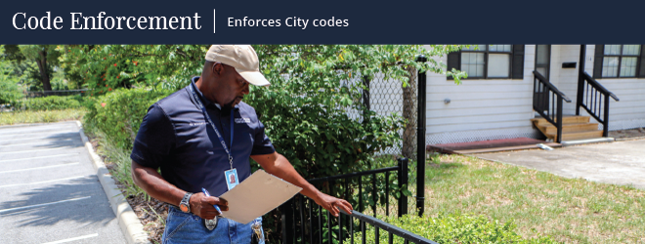
Inspections and Public Service Division
Residential Code Enforcement
Inspections & Public Service division of the Department of Neighborhoods (IPS) cleans up neighborhoods enforcing residential building codes, sign codes, nuisance violations, and coordinating beautification projects.
DON-IPS enforces:
Chapter 10 of the Code of Ordinances related to nuisances on private property, such as open/vacant buildings, junk motor vehicles, weeded lots, graffiti, and minimum standard violations in single family homes.
Chapter 28 -Enforces and impounds bandit signs
Chapter 39- Enforces heavy trash violations (Junk/tree waste)

Slide 3
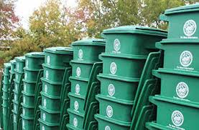
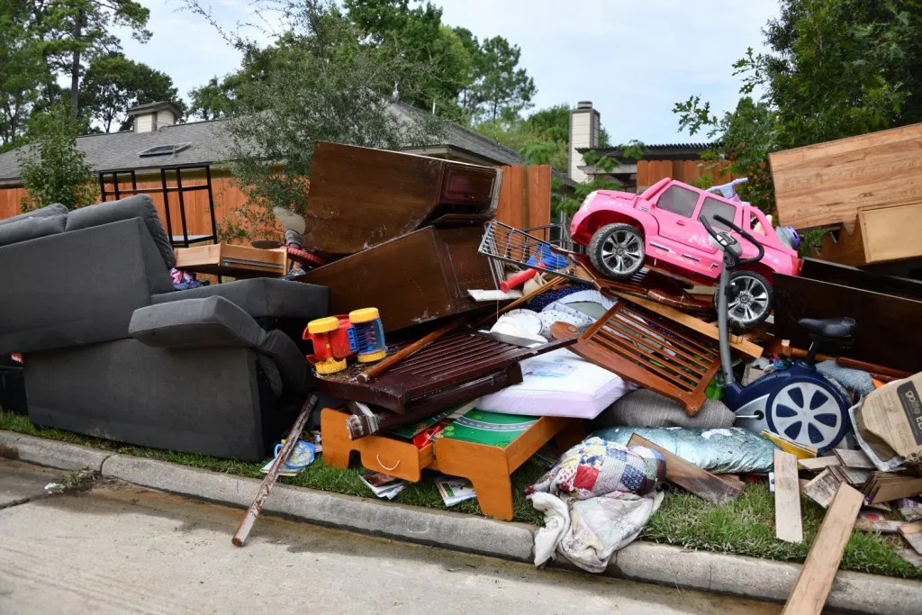
Heavy Trash Enforcement
Violation: Early Placement of Trash
Sections 39-65 (c) & 39-77 (d)
39-65 (e) It shall be unlawful to place or to allow to remain any materials at the curbline for basic garbage collection service by the department prior to 6:00 p.m. of the day preceding a day designated by the director for basic garbage collection service at that location. Basic garbage collection service shall commence at 7:00 a.m. on the day designated by the director. It shall be unlawful to place or allow to remain any materials at the curbline on a designated collection day after department collection service personnel have passed the site for that day, and the department shall not have any obligation to return to collect items not present at the curbline when the department vehicle serviced the site.
Notes:
Trash is placed before scheduled time/not properly bundled is a violation.

Slide 4
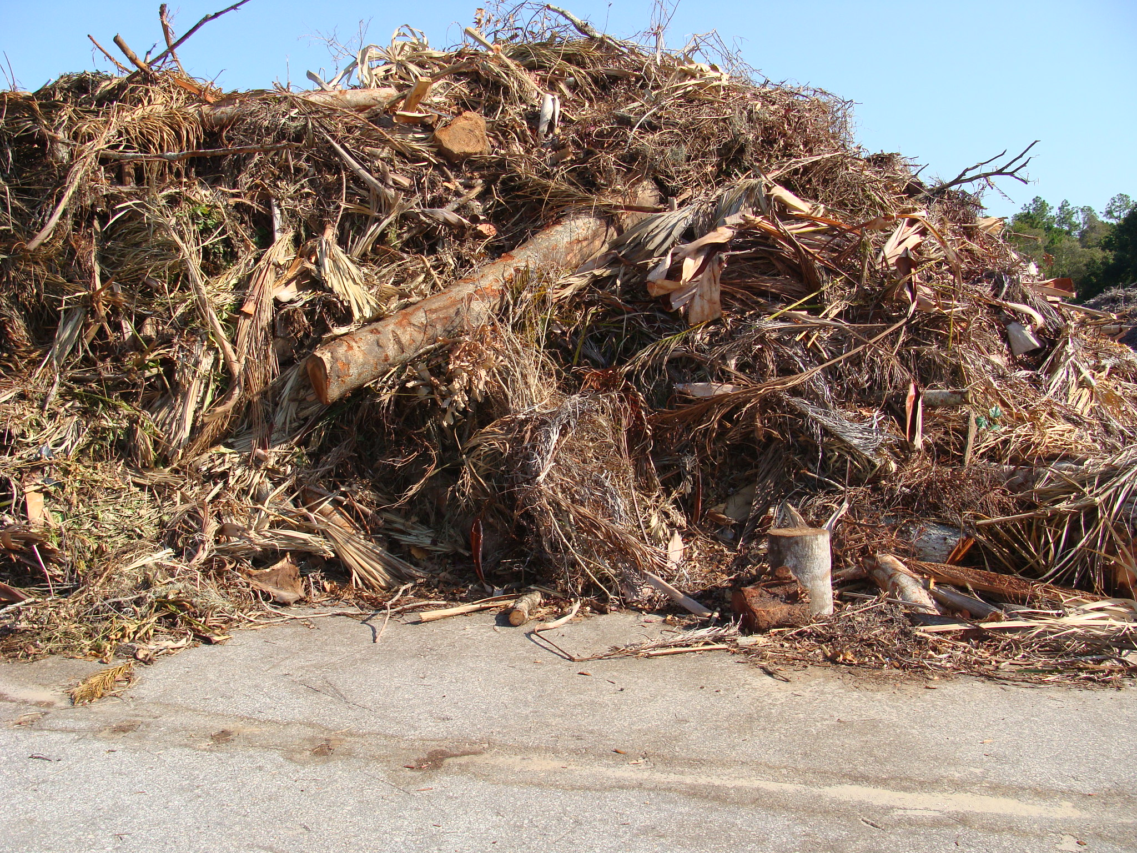
Heavy Trash Enforcement
Violation: Early Placement of Trash
Sections 39-77 (d)
(a) Junk and tree waste shall be collected on separate days on the basis of a schedule established and promulgated by the director.
(b) Service shall be limited to materials authorized under rules established by the director as provided in section 39-50 of this Code, and no more than eight cubic yards (216 cubic feet) of material shall be collected from any one residential unit on any scheduled collection day.
(c) Service shall be limited to items that are placed at the curbline in an unobstructed location, such that automated department equipment may reach and pick up the items. Without limitation, service will not be provided if the items are obstructed by fire hydrants, trees or vegetation, parked cars or other objects that prevent the automated function of the department's equipment.
(d) It shall be unlawful to place or to allow to remain any materials at the curbline for junk or tree waste collection service prior to 6:00 p.m. of the Friday next preceding a day upon which the collection service for the site is scheduled by the director.
(e) When any property is found in violation of subsection (d) of this section, such fact shall be prima facie evidence that the current record owner or occupant of the property committed such offense. It is a defense to prosecution under subsection (d) of this section that the property owner or occupant can name and identify the person who committed the offense.
(f) All persons have an affirmative duty to comply with all provisions of this section, and it shall not be a defense to prosecution of such persons that they were acting without a culpable mental state.
* If authorized items are mixed with unauthorized items, the material will not be sorted and will not be collected.
Notes:
Trash is placed before scheduled time is a violation. Mixed debris piles are also violations and will be cited and not picked up. Owner must remove the items.

Slide 5
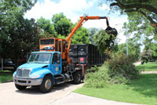
Tree Waste Pick up
(Odd numbered Months)
  January
  March
  May
  July
  September
  November

Slide 6
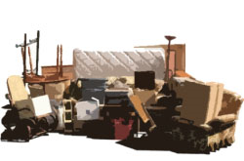
Junk Waste Pick up
(Even numbered Months)
  February,
  April,
  June,
  August,
  October
  December

Slide 7
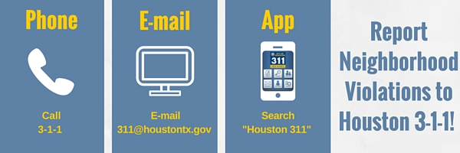
Steps to Report
Violations
Contact 3-1-1 first!
Please provide descriptive information, such as:
  Location, date, time of observed violation
  Collect photographic evidence, if possible
Notes:
If possible, send as much information as possible if dumping is observed. Any information obtained will be provided to the police department.

Slide 8
THANK YOU!
For more information, please visit our website at: www.houstontx.gov/ips
DON’s Email Address: contact.don@houstontx.gov

