Slide 1
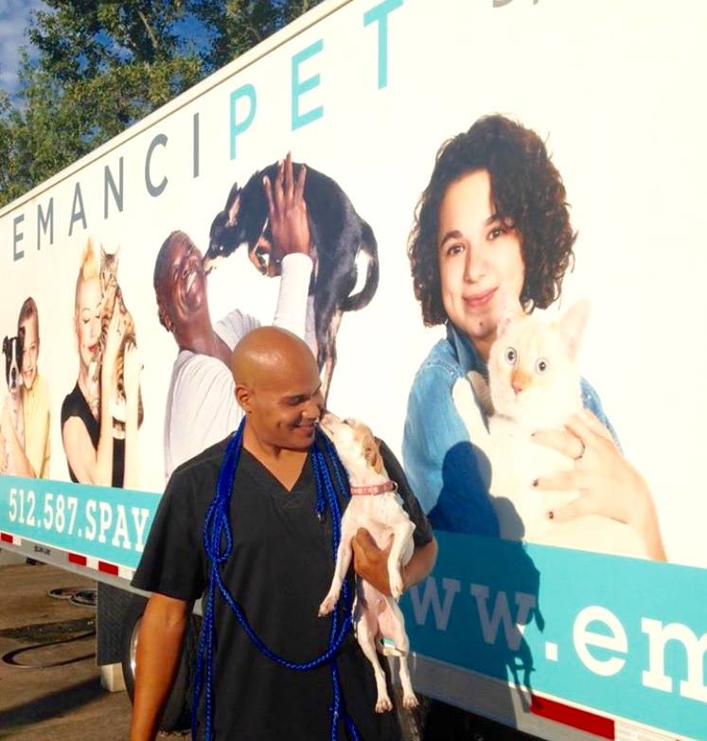
Emancipet East End
Presented by Kelly McCann, VP

Slide 2
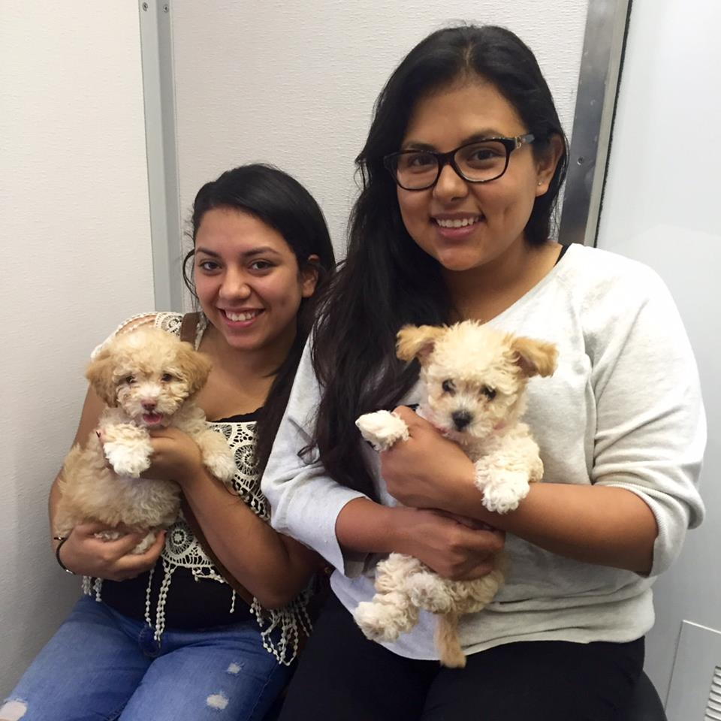
Emancipet was founded in Austin in 1999
Mission: To make spay/neuter and high quality veterinary care affordable and accessible to all
Since then, we have provided over 260,000 s/n surgeries in Texas!

Slide 3
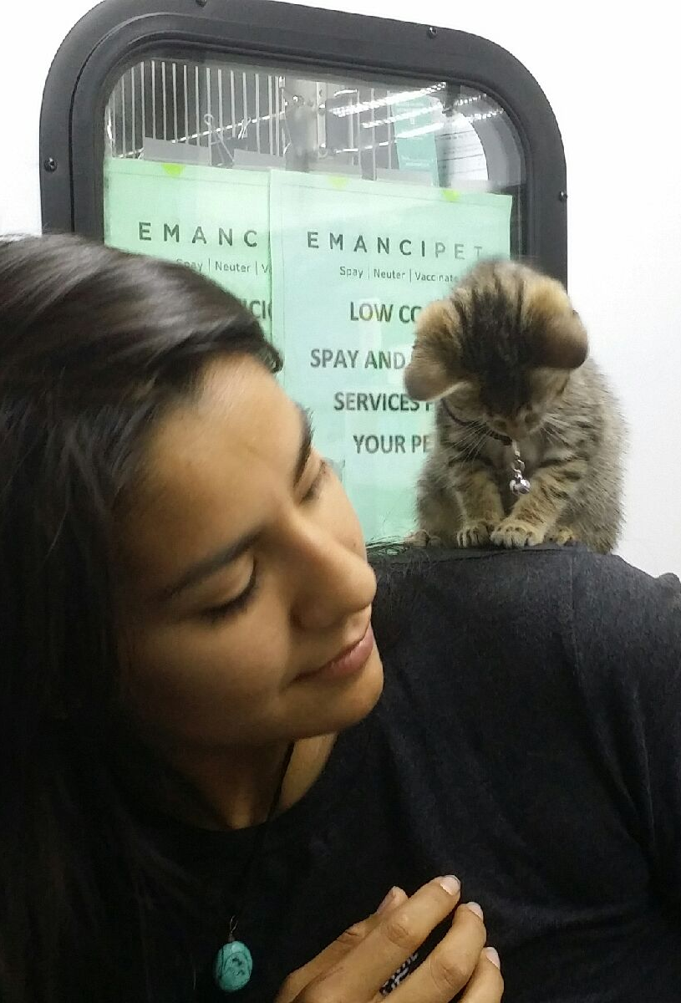
Clinics:
East Austin
Central Austin
Mobile Unit
Pflugerville
Killeen
Houston and soon...
Philadelphia!
Programs:
Outreach to underserved communities
Customized training and consulting programs
Advocacy for strategies and public policy
Notes:
-In addition to managing an expanding national network of high-quality, low-cost clinics,(currently 6 in operation and Philly coming in Feb)
-Outreach to underserved communities to share information about their pets' health needs and services available. Three levels of customers...
- Customized Training and Consulting programs to animal welfare organizations nationwide
-Advocate for strategies and public policy that improve the lives of pets in underserved communities

Slide 4
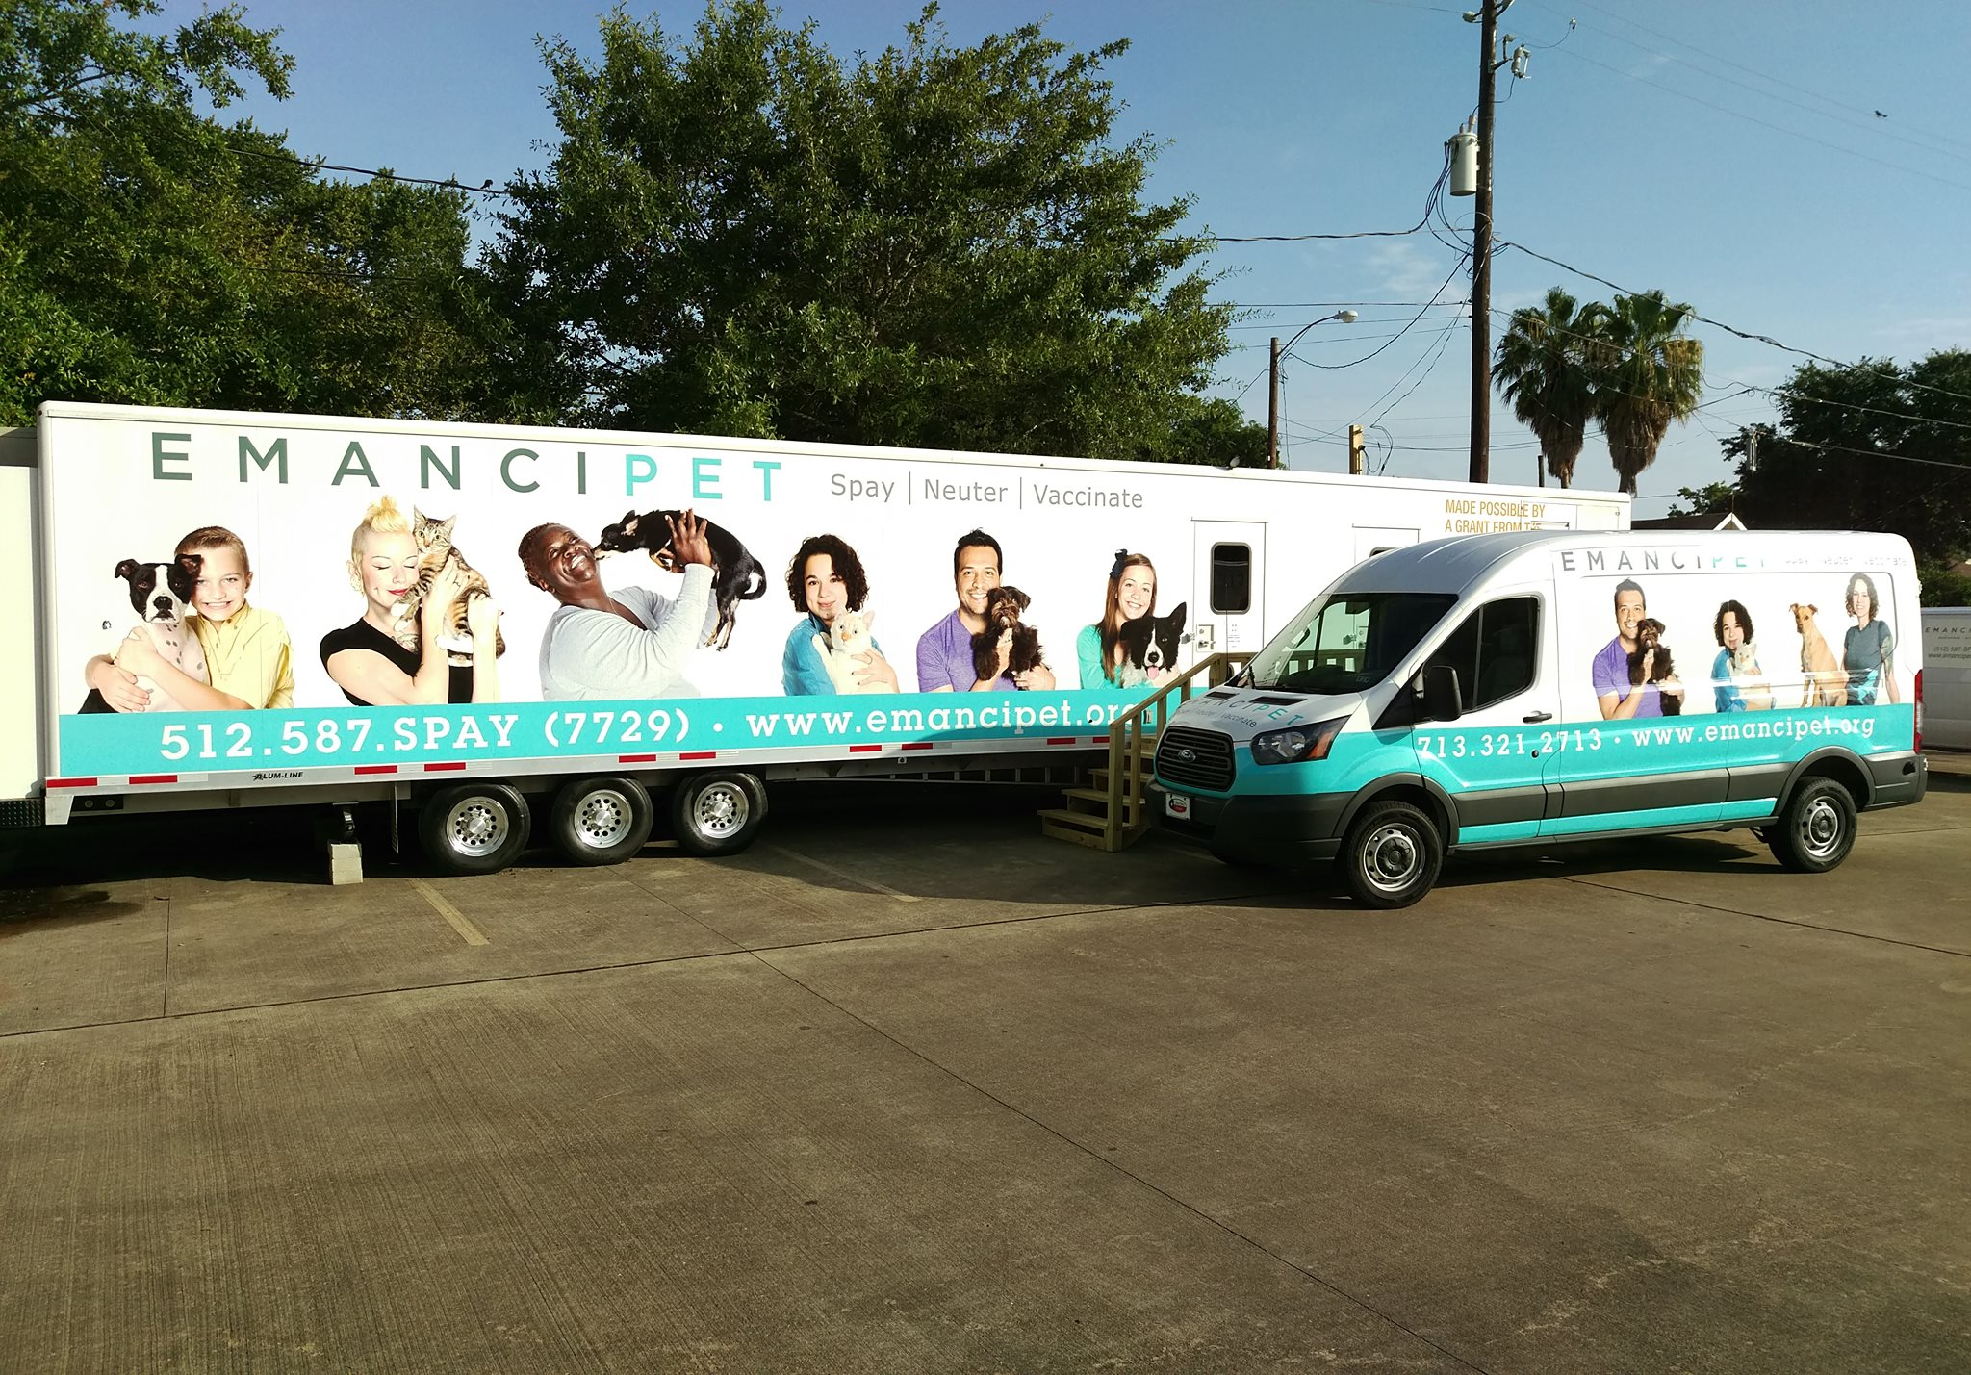
Emancipet Houston
East End Clinic opened in April 2015
Temporary location at Ripley House
Notes:
Began serving BARC animals in Apr, opened to community in June 2015

Slide 5
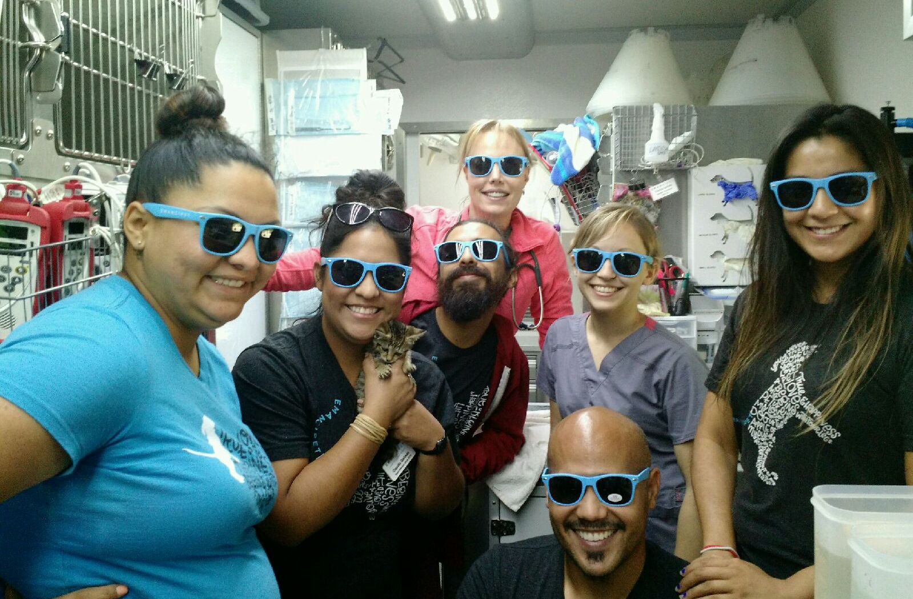
Emancipet Staff inside Gooseneck
48 foot long trailer
Surgical suite, prep area, wellness clinic, and cages
Notes:
ANd about 240 sq ft of people space for 6 – 7 people

Slide 6
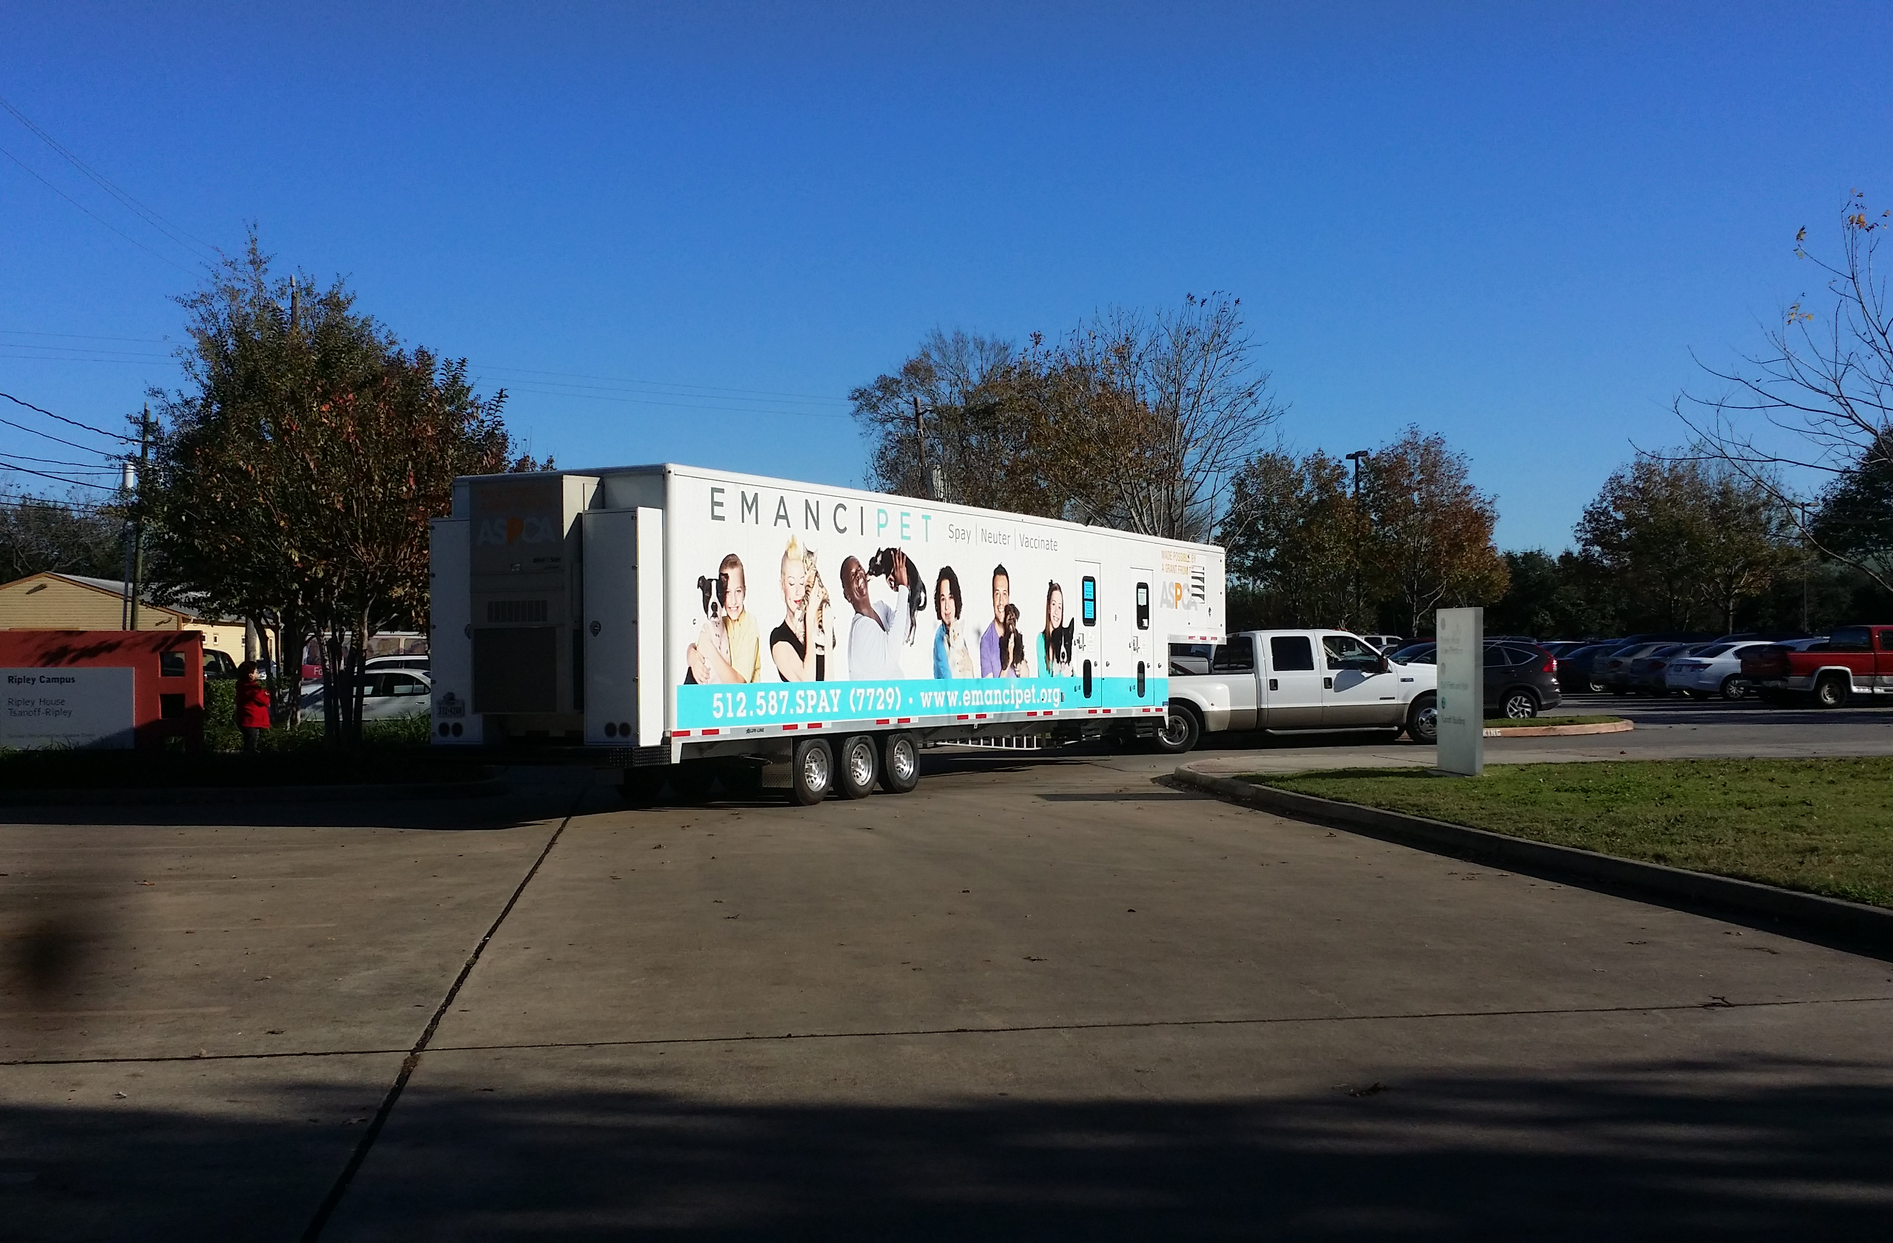
Gooseneck was closed and moved on 9/15/16
In preparation for move to new brick & mortar space

Slide 7
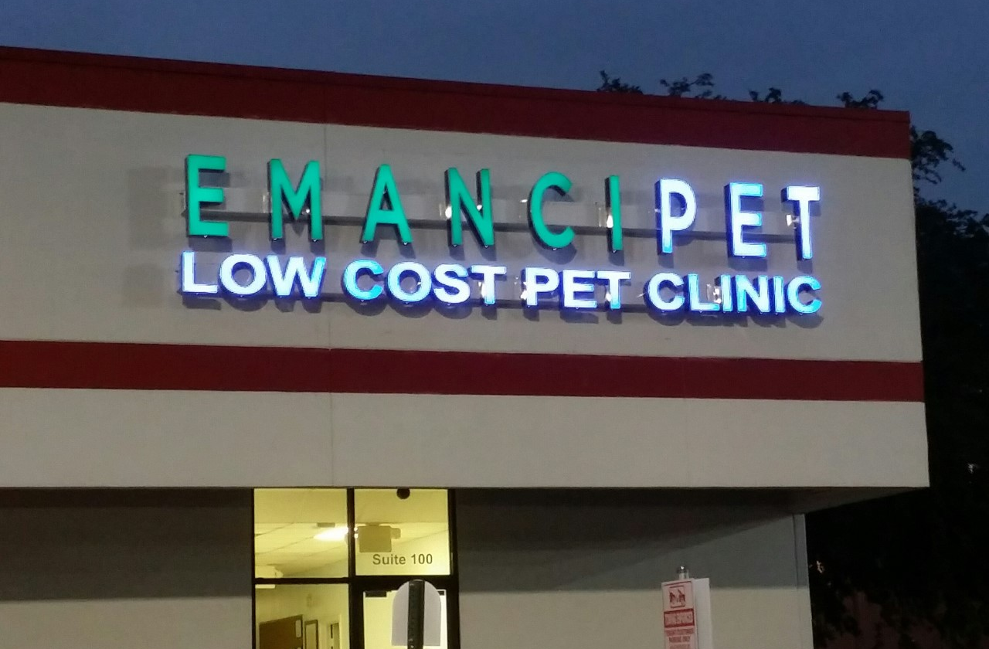
New Brick and Mortar Clinic
910 S. Wayside, #100
Notes:
2800 sq ft,
Increased days of operation and larger setting will allow us to increase the number of clients we see by 25-40%

Slide 8
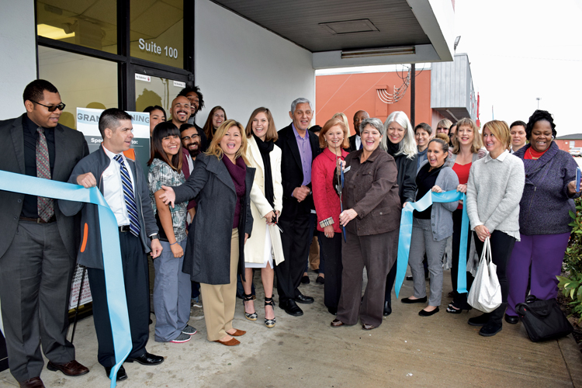
Grand Opening and Ribbon-Cutting Ceremony
December 5, 2016
Notes:
Thank you, CM Gallegos and CM Cisneros for attending.

Slide 9
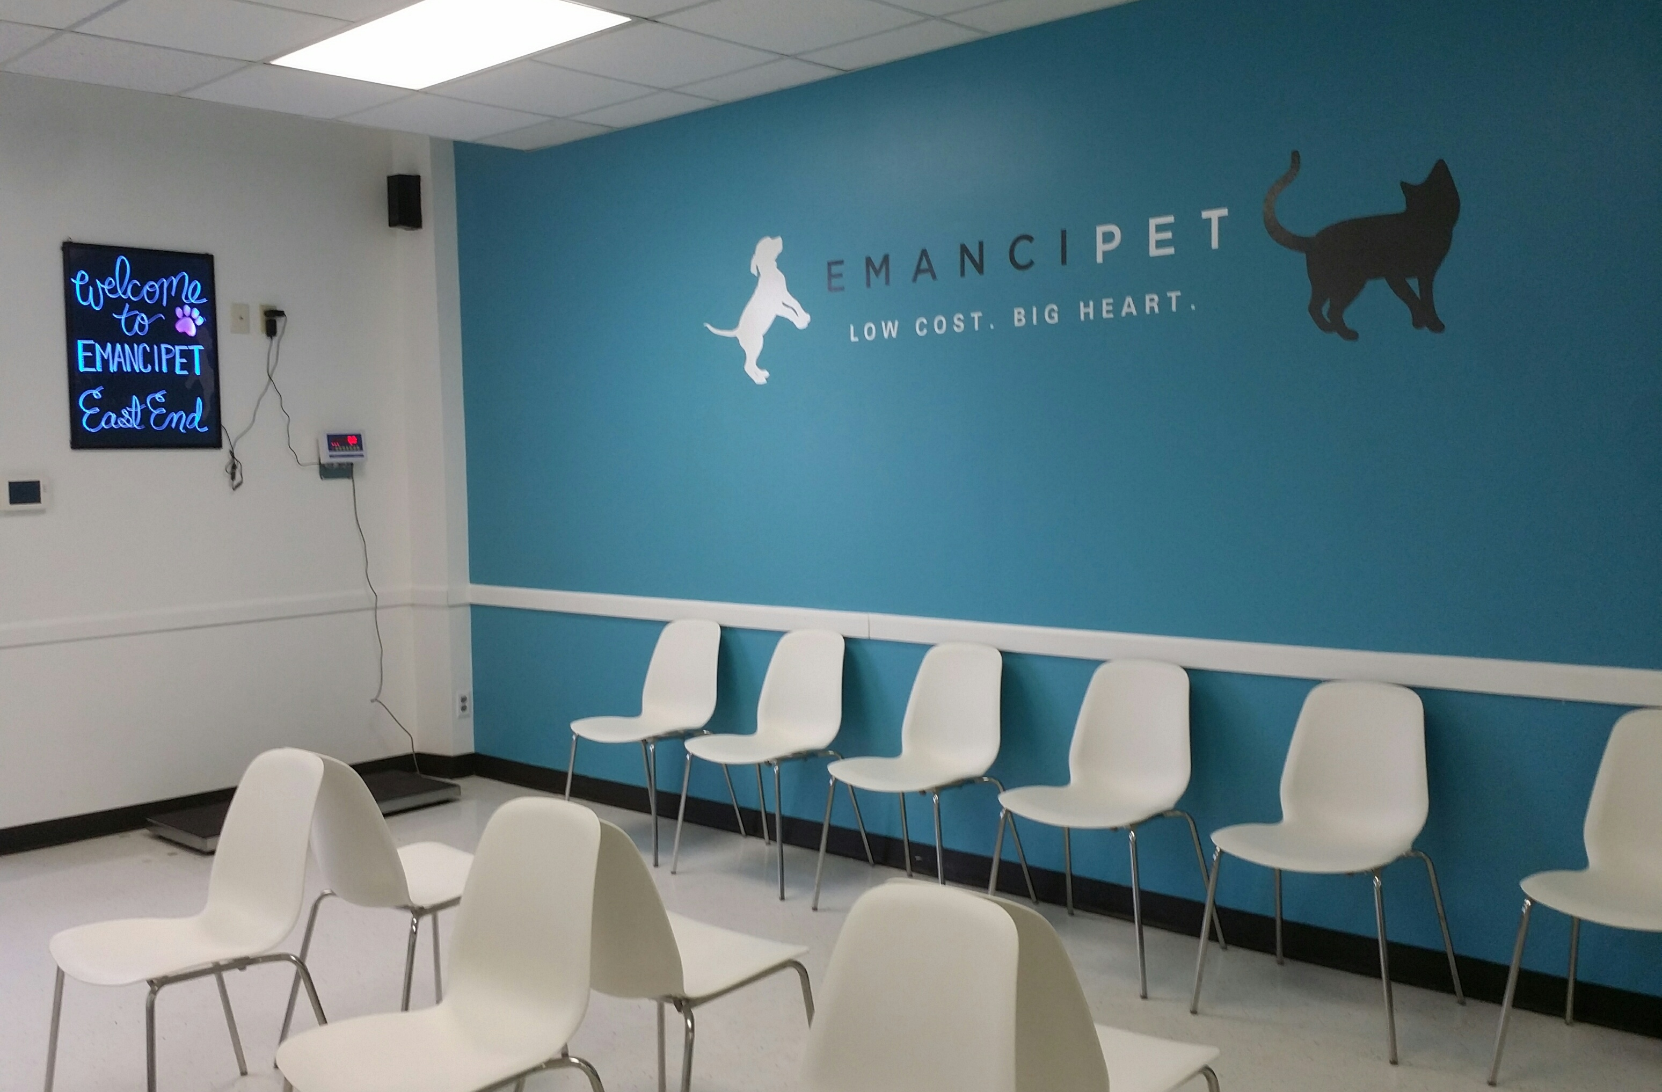
Lobby/Waiting Room
We also have a waiting room just for cats.

Slide 10
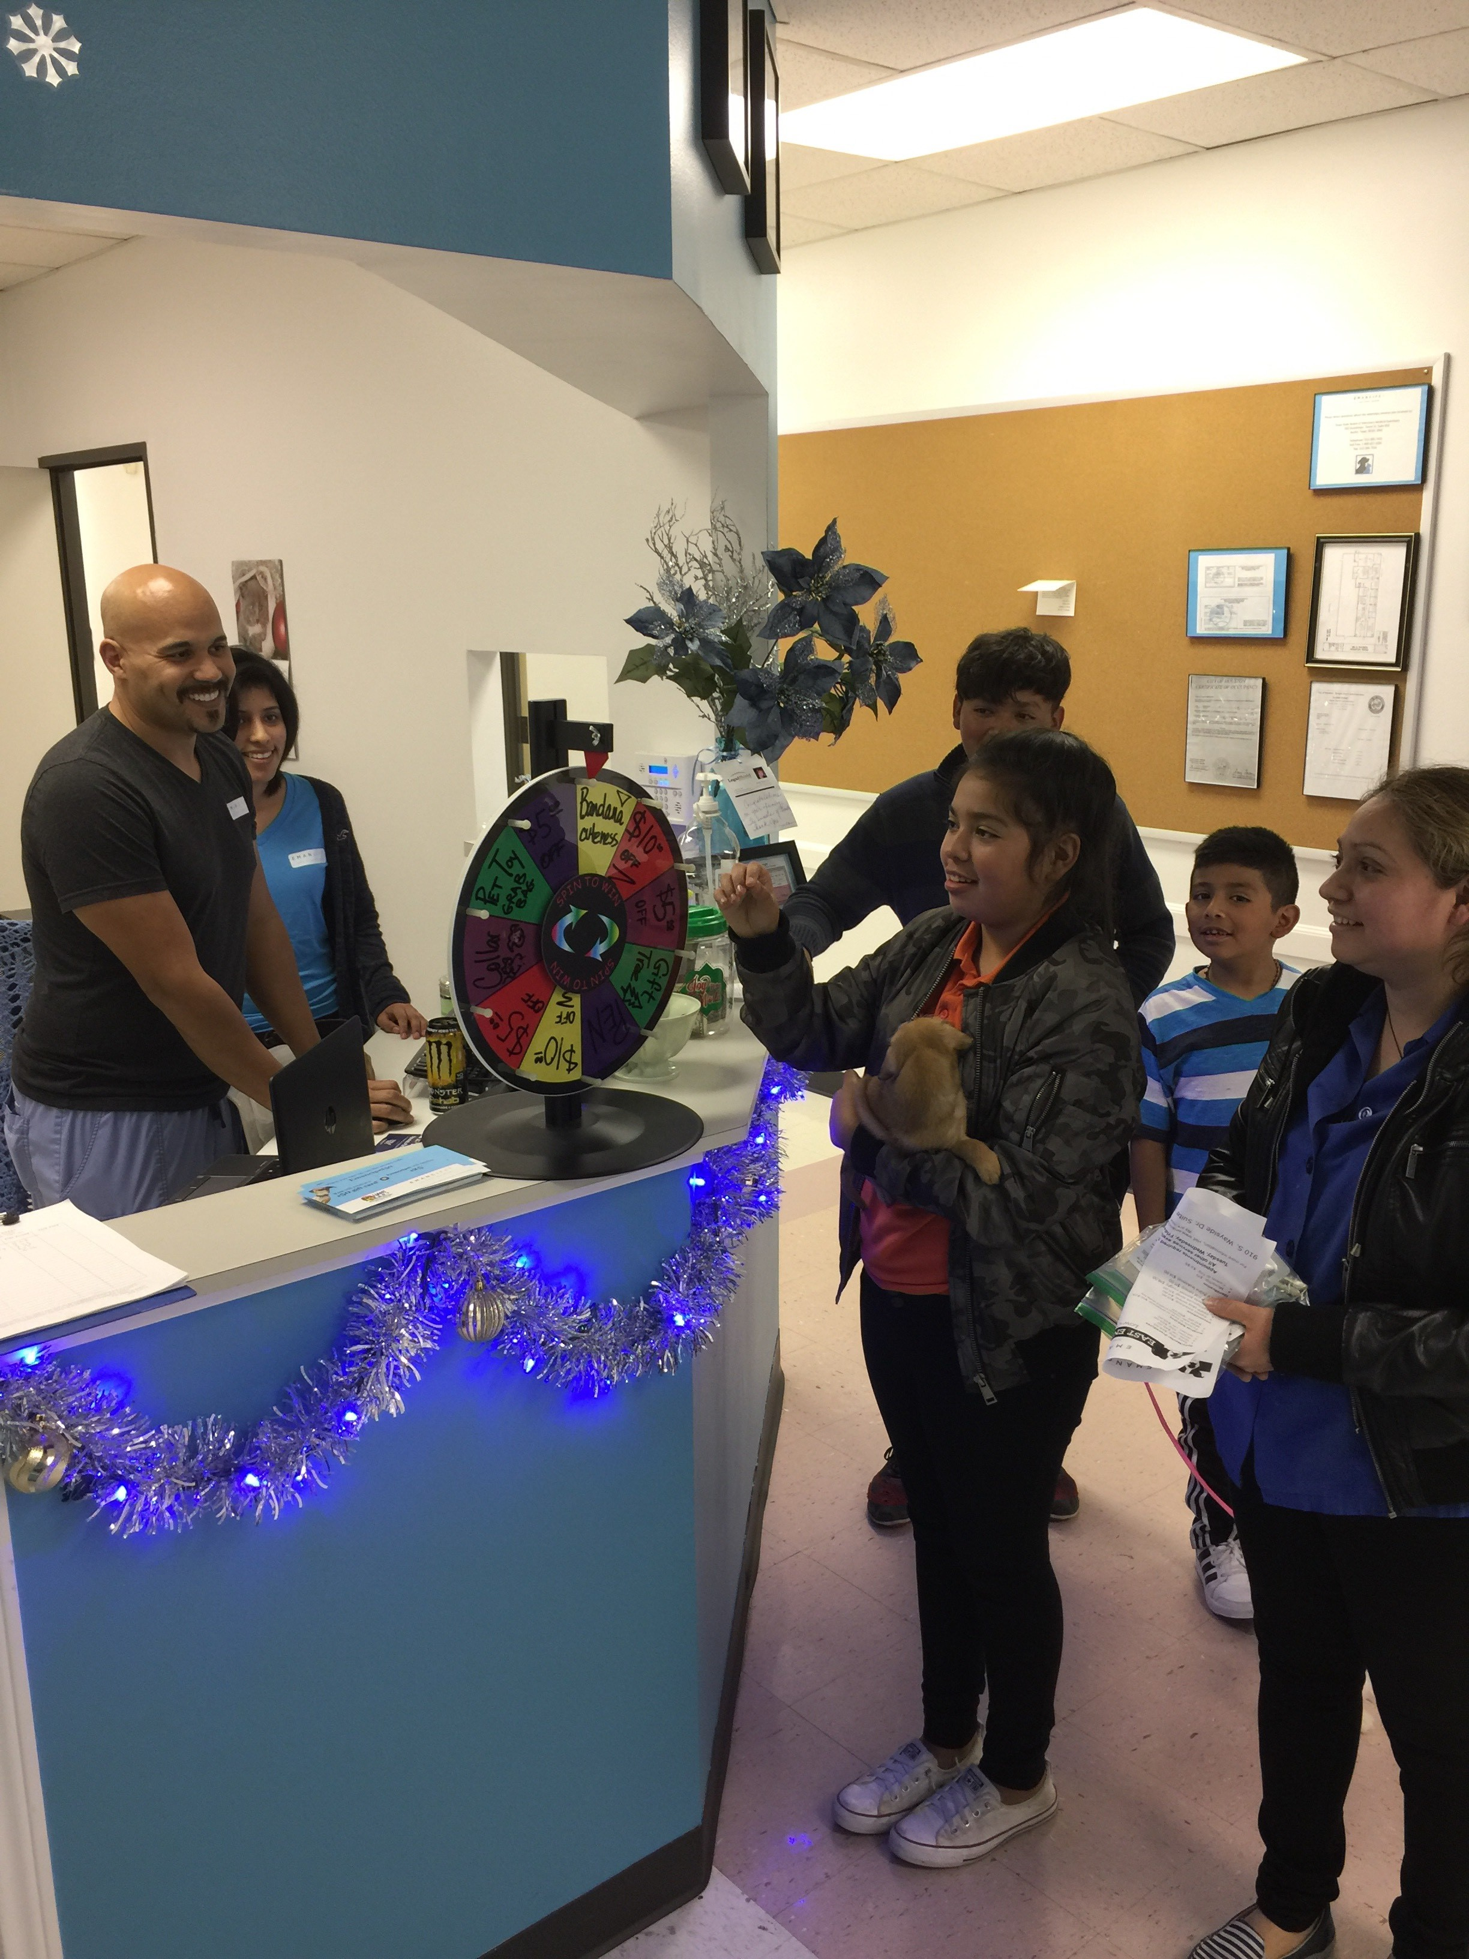
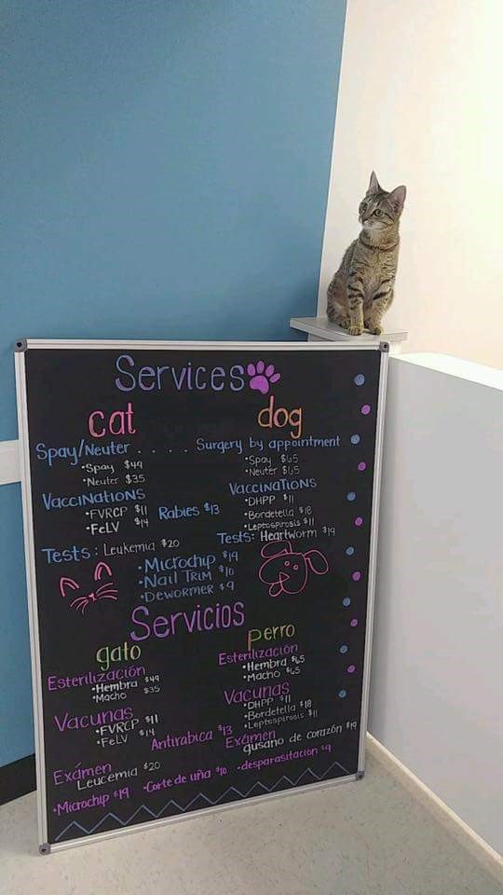
Front Desk and Reception

Slide 11
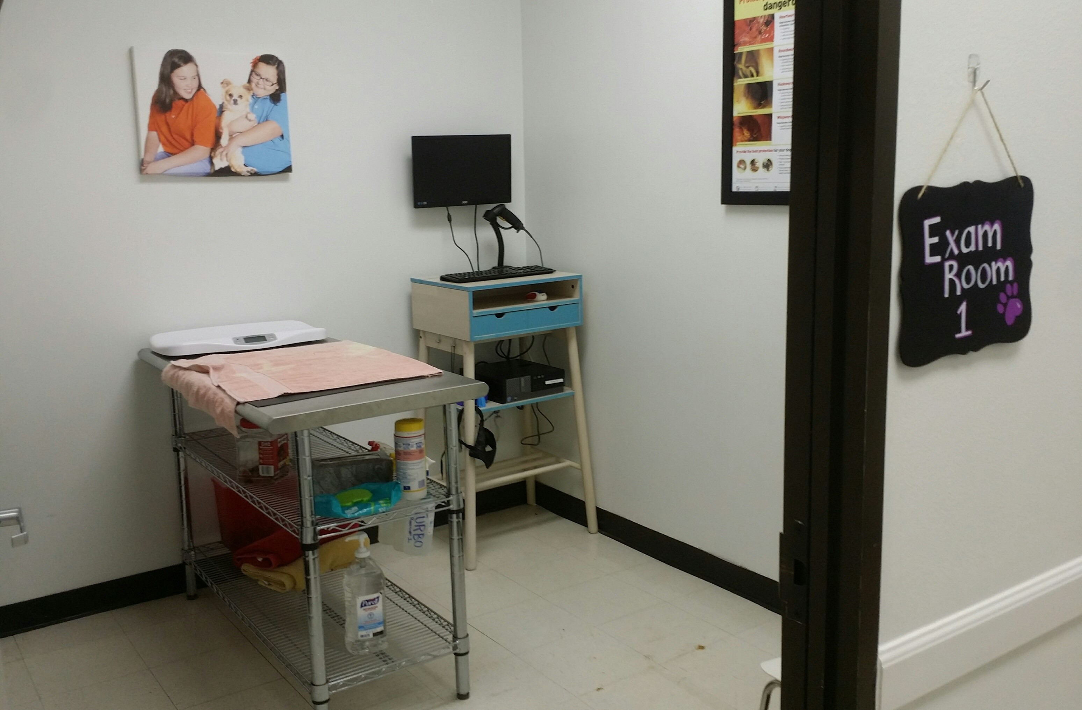
Exam Room 1

Slide 12
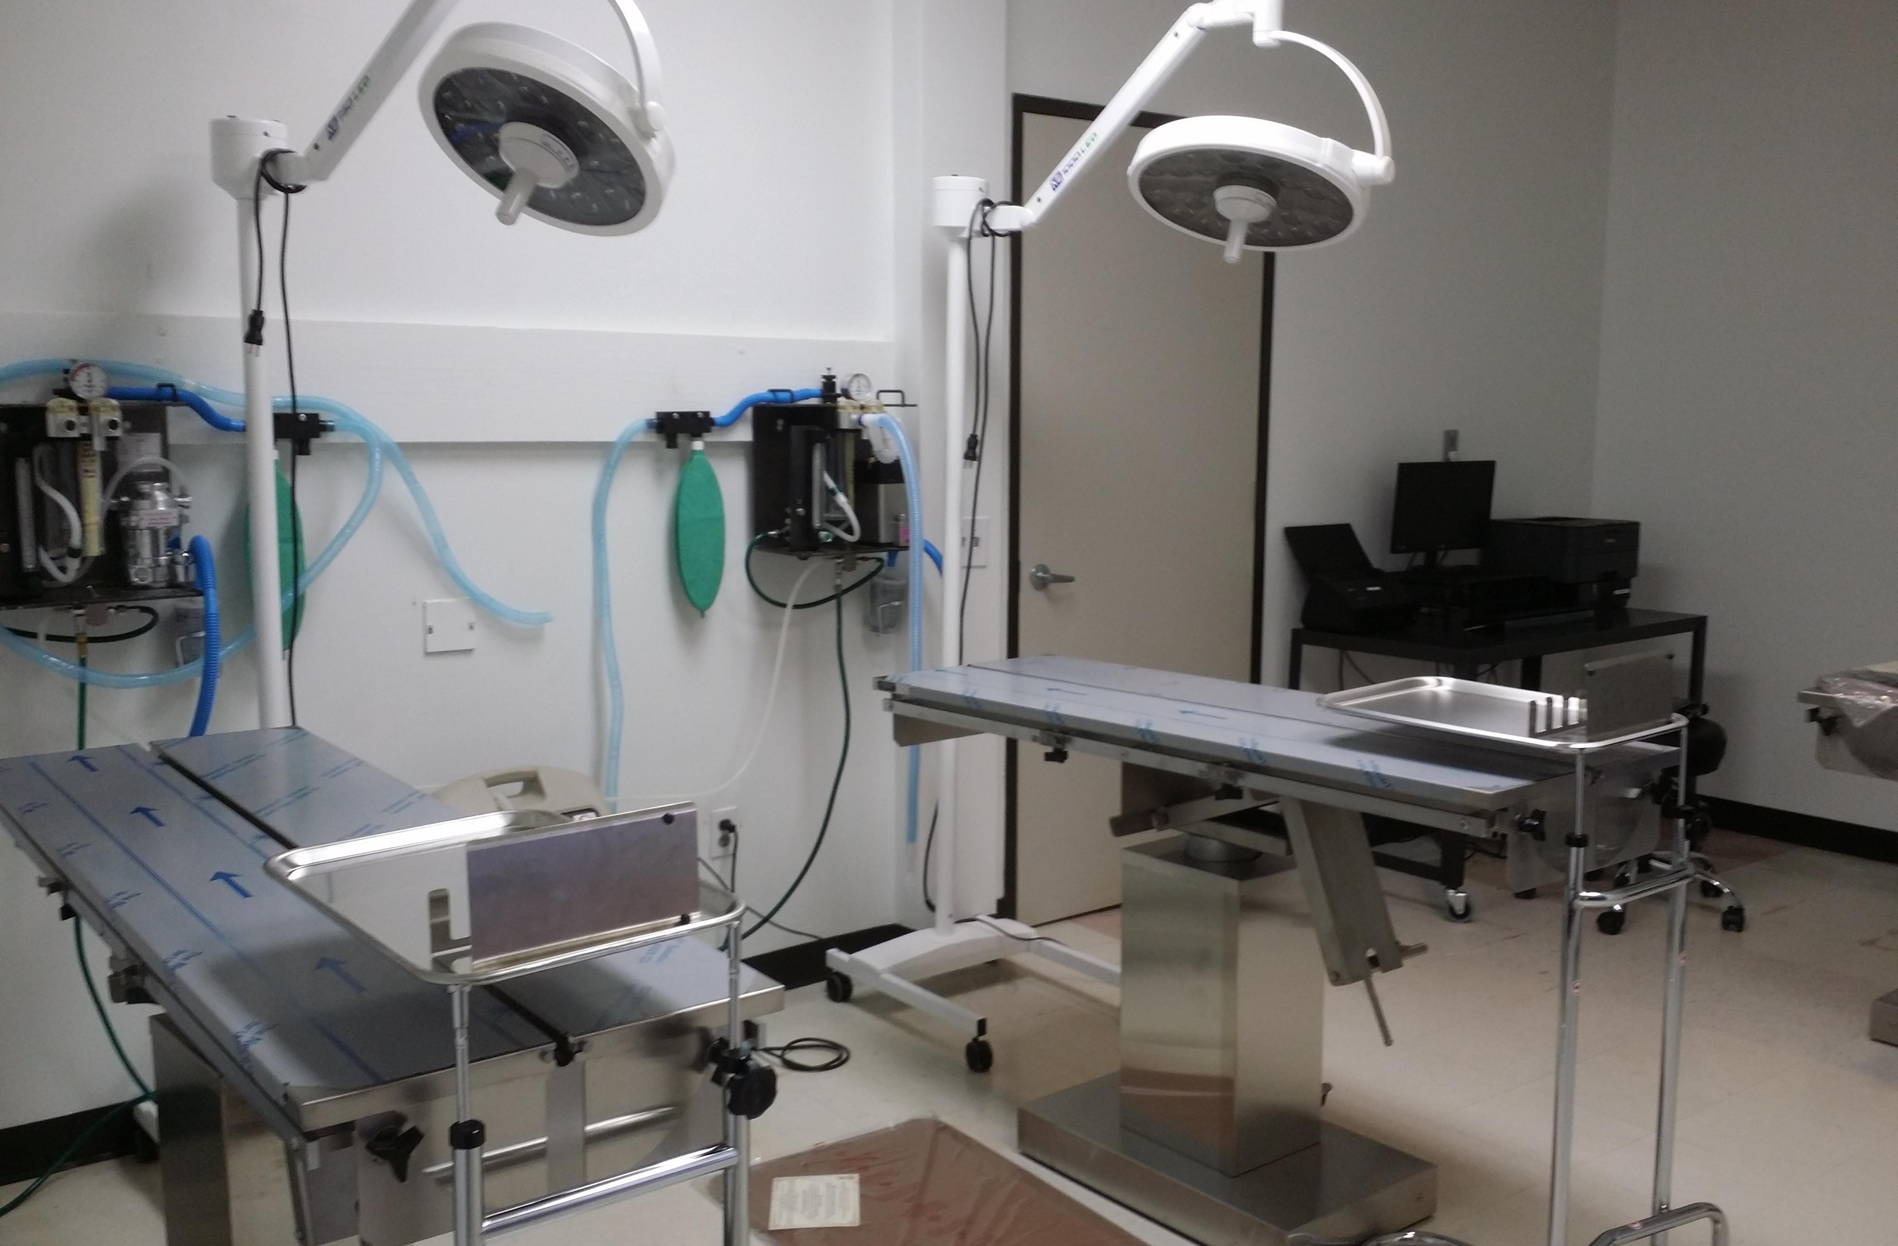
Surgery Suite
With room to expand!

Slide 13



Partnerships
BARC –Healthy Pets Healthy Streets
IMGH – Animeals on Wheels
Big Fix Houston

Slide 14
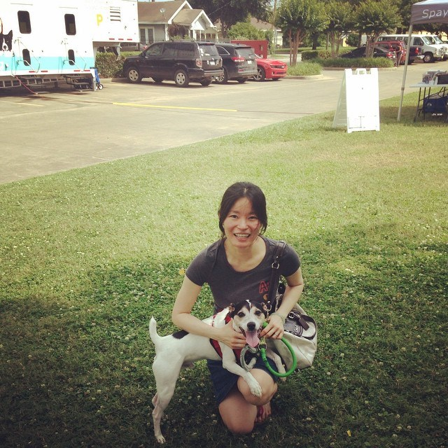
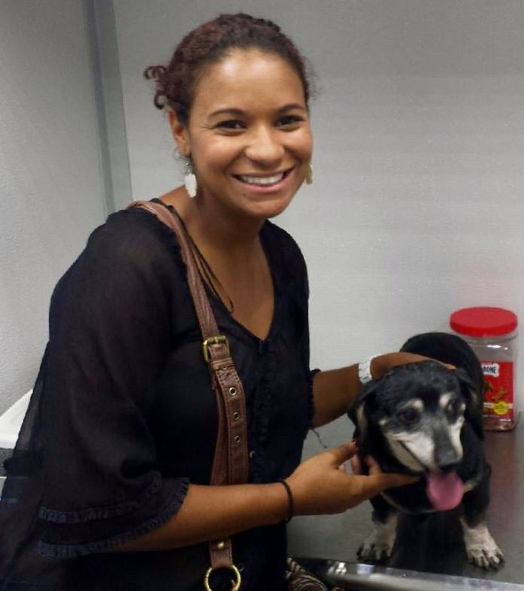
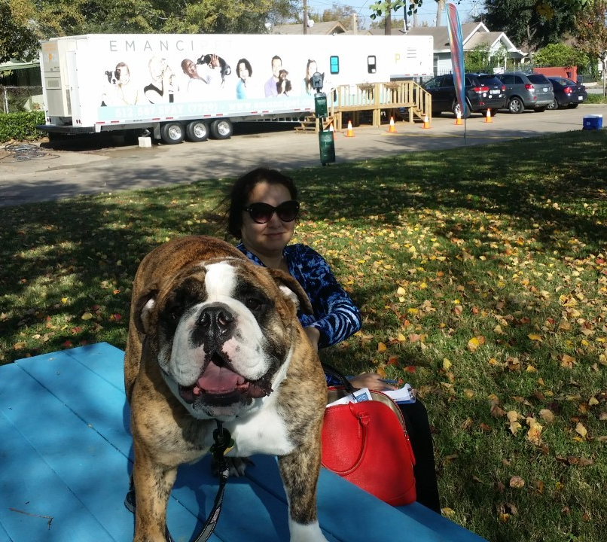
Impact
After 15 months of service in Houston, Emancipet has provided:
5249 spay/neuter surgeries
7683 Healthy Pets visits
Notes:
These numbers were achieved while working out of the GN, just 3 days per week. 95%
Also significant is that almost 40% of these surgeries were done at no cost to the owner.

Slide 15
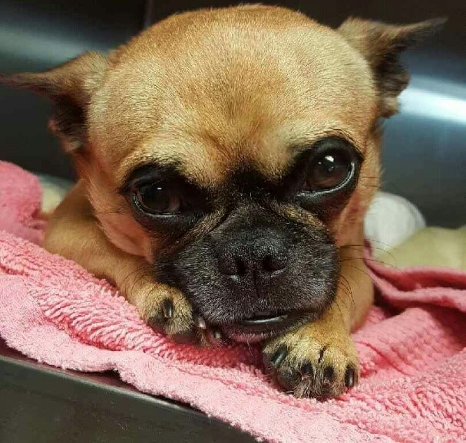
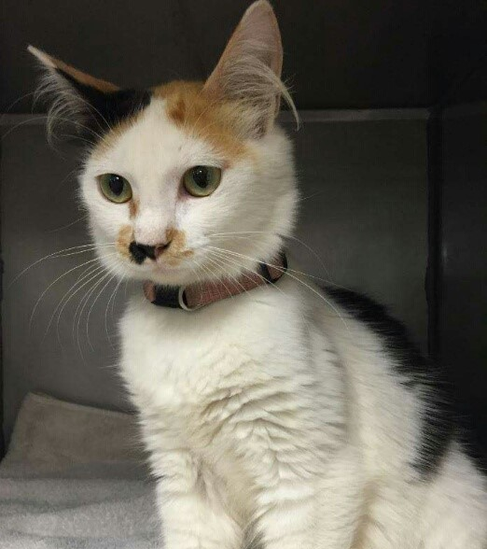
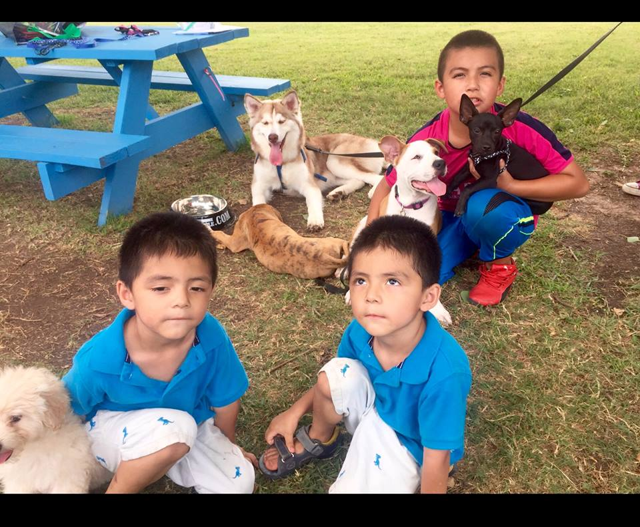
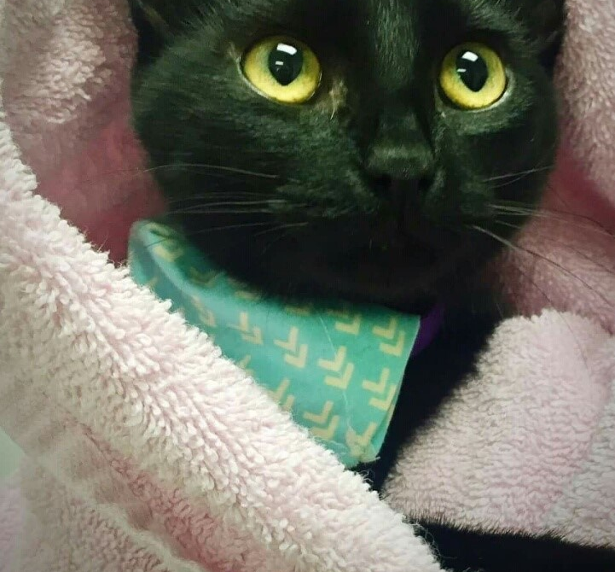
Plans for 2017
Increase # animals served
Expand services offered
Open 2nd location
Select site for 3rd location
Notes:
HW treatment,skin issues

Slide 16

Questions?
Kelly McCann, VP kelly.mccann@emancipet.org
713.301.5250 www.Emancipet.org
Please, spay/neuter your pets!

