Slide 1
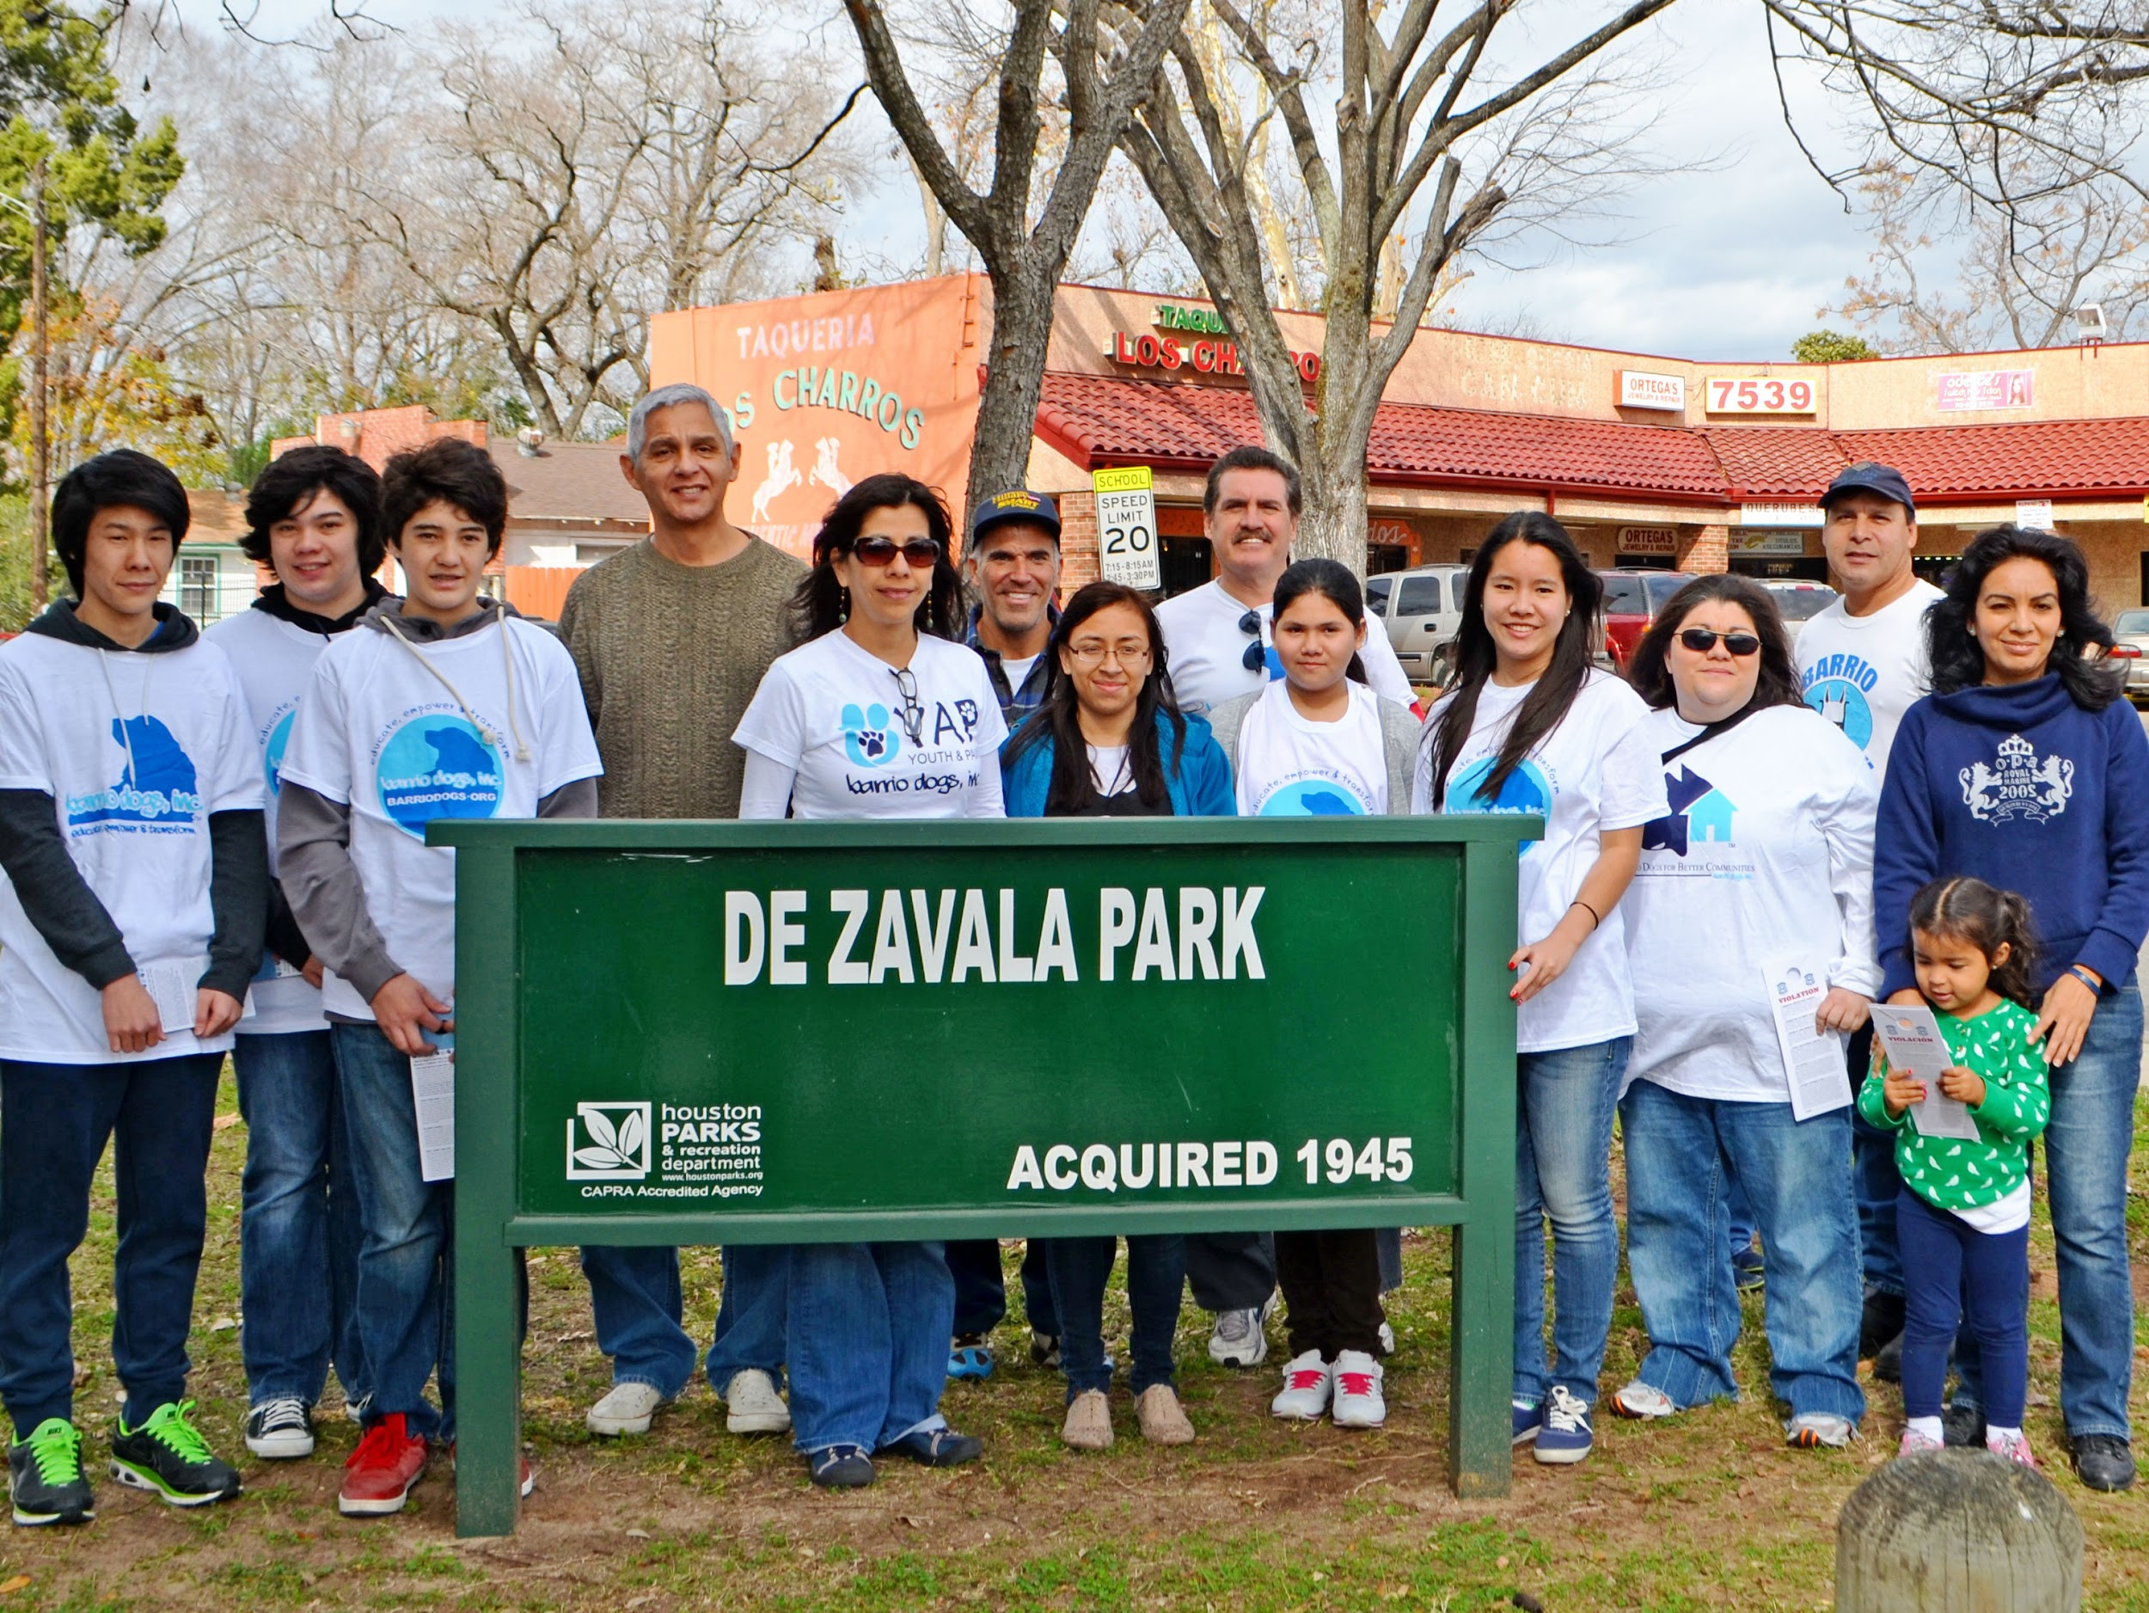
Barrio Dogs, Inc.
A community-based, grassroots, nonprofit animal welfare organization

Slide 2
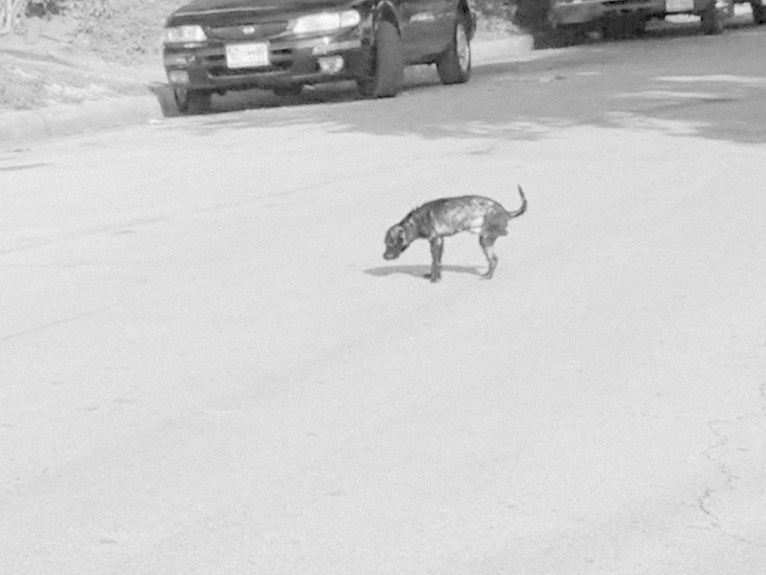

Barrio Dogs’ Approach
Our goal: to educate and empower residents to improve conditions for the animals around them.
Our message: the humane
treatment and care of all animals
and zero tolerance for their
mistreatment and neglect will
create safer, healthier, higher
property value communities for us all.

Slide 3
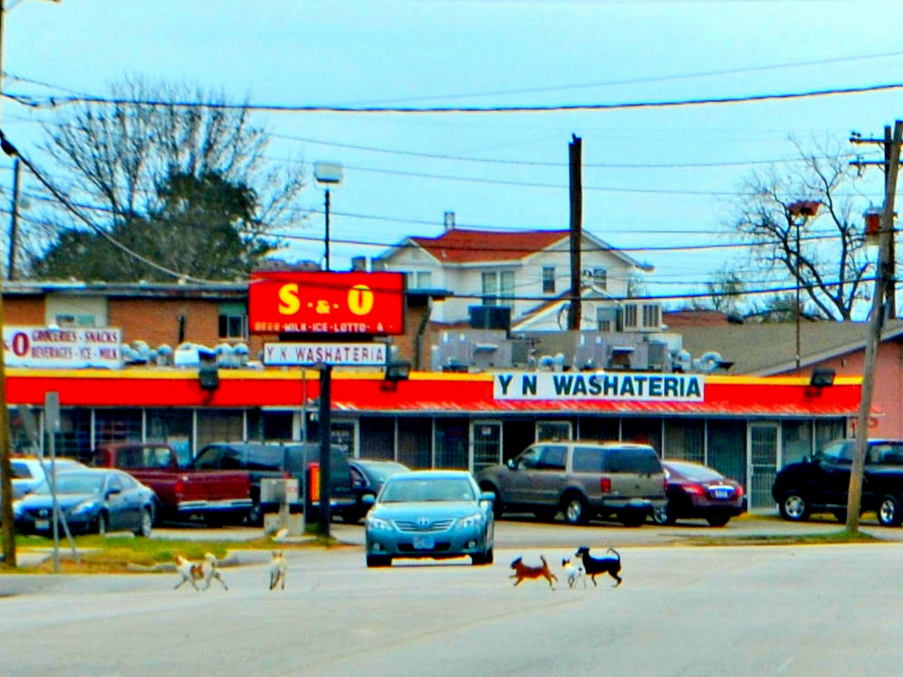
We’ve been working since 2010 in Houston’s East End to educate and empower residents to properly care for their pets and in the process, create a better neighborhood for everyone.
We urge pet owners to always:
Spay, neuter and vaccinate their pets, and
Observe Houston’s leash laws and not let their dogs run loose on the streets, a common practice in the area.

Slide 4
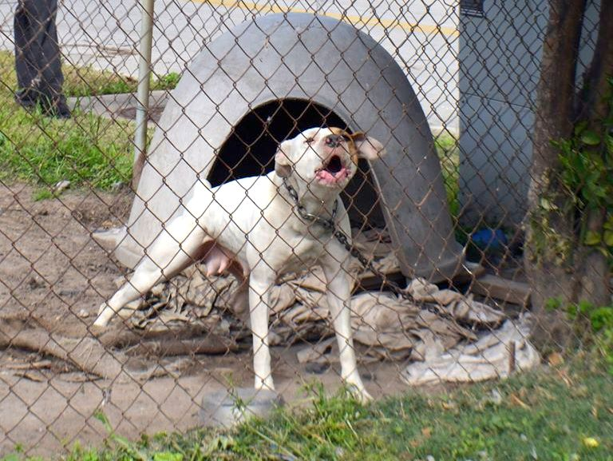
Another common practice is inhumanely tethering or chaining dogs. We inform the owners that their tethering may violate state law, is unpleasant for the dog and may make it more aggressive. We encourage everyone to report animal abuse or neglect.

Slide 5
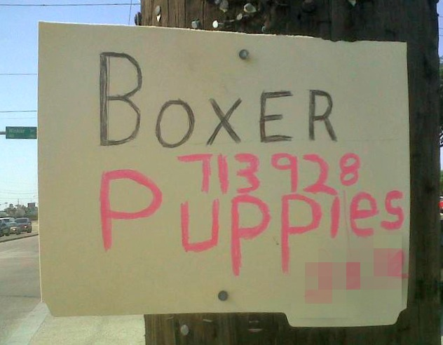
We spread the word that backyard breeders must have a license to breed and sell dogs and that roadside sales of dogs are illegal in Houston.

Slide 6
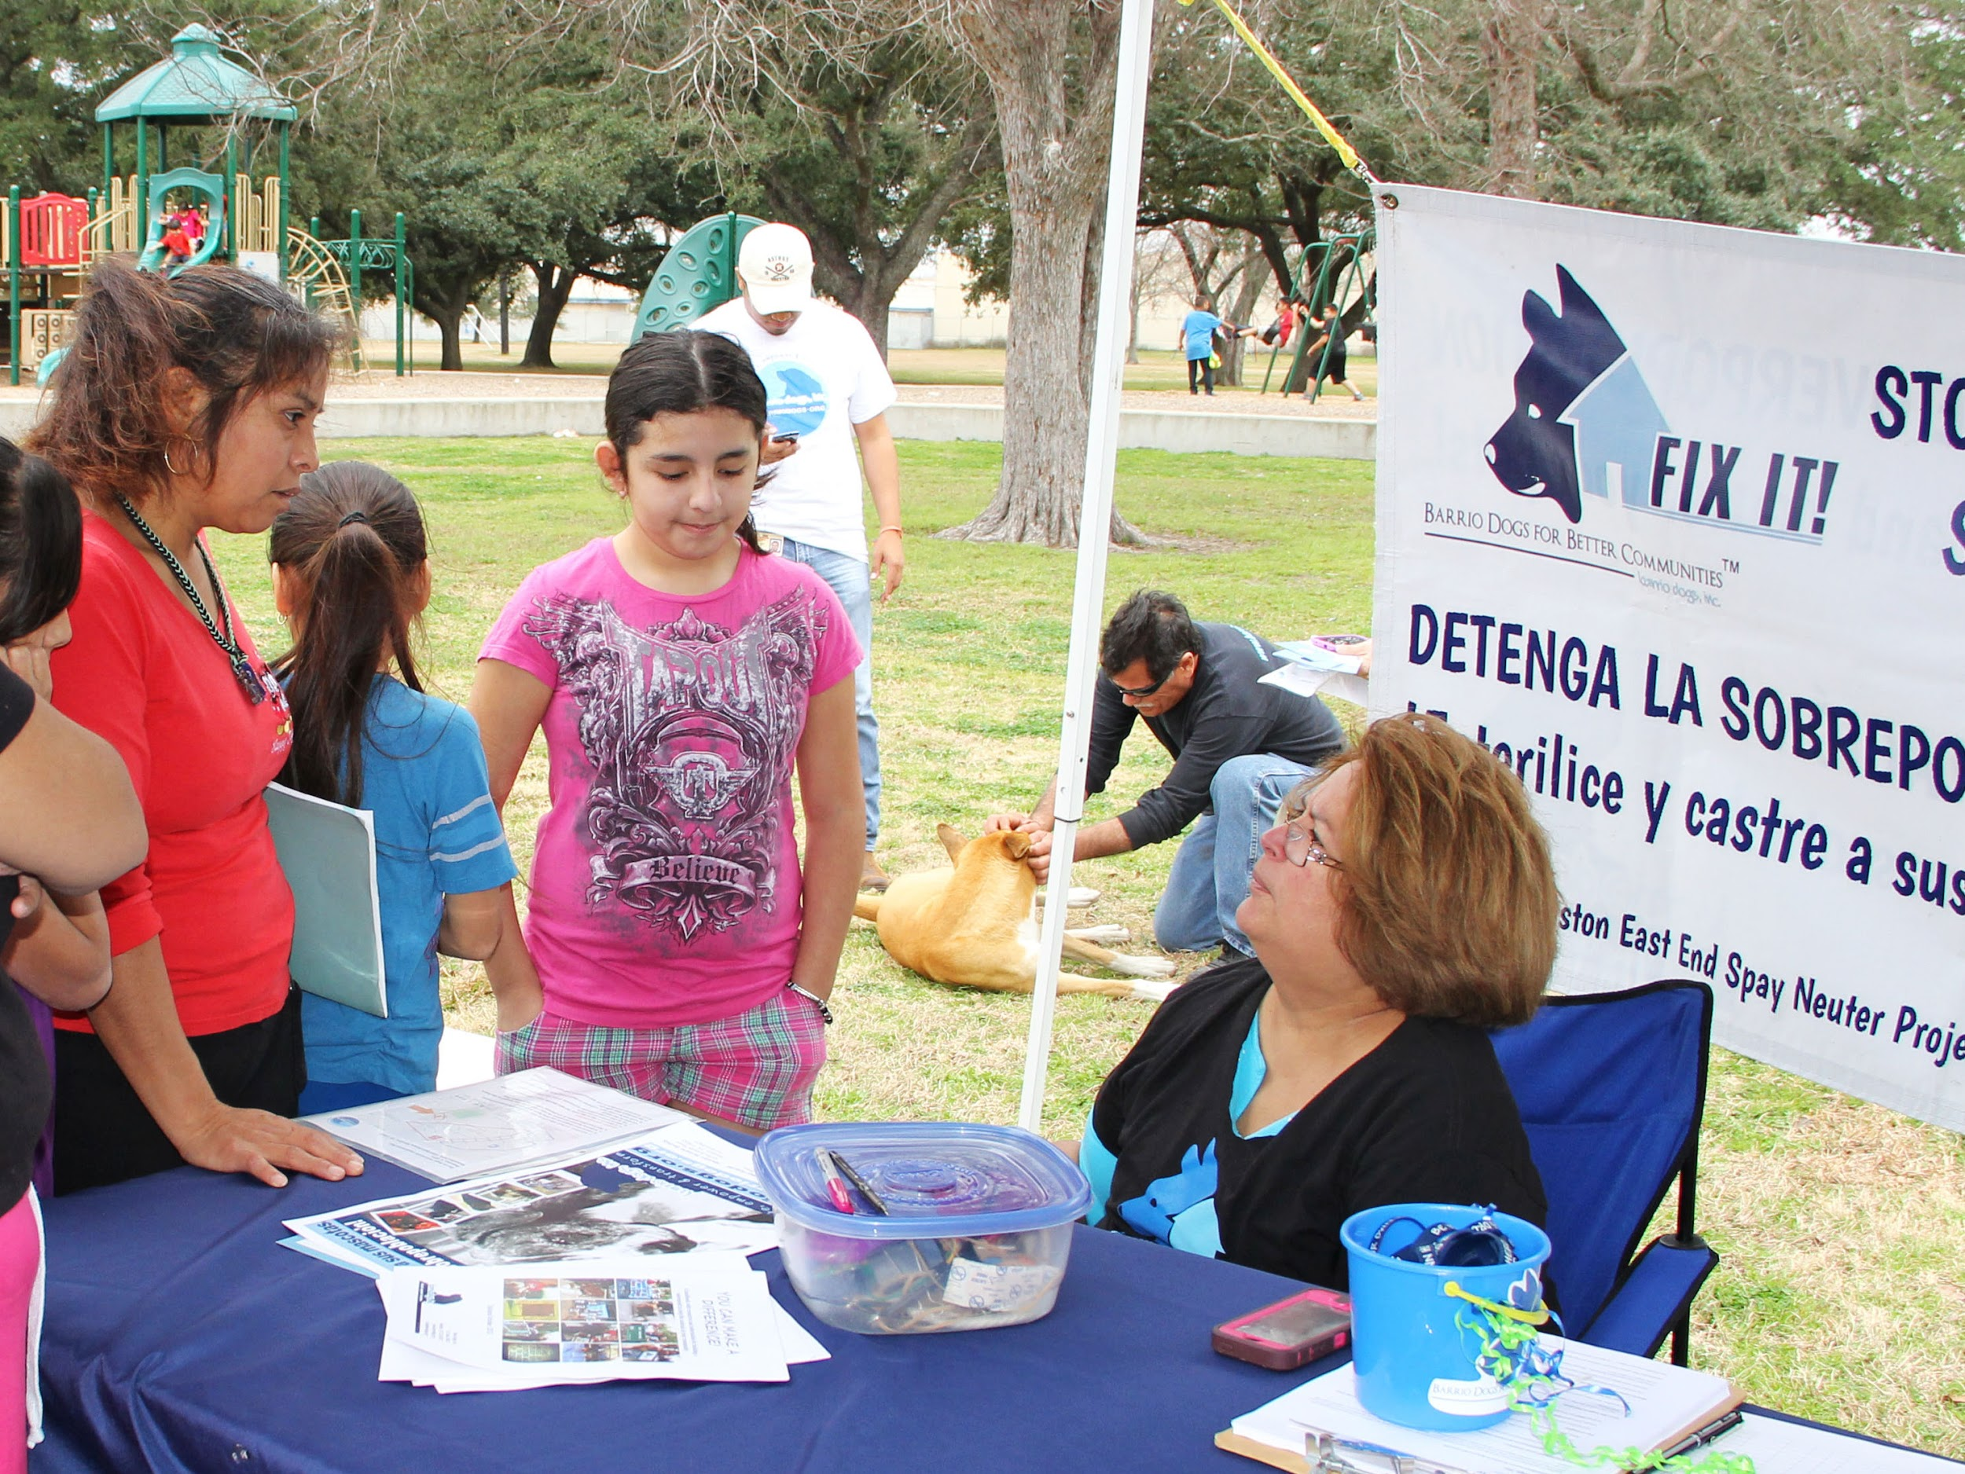
We have outreach events at parks, neighborhood centers, civic association meetings, etc. and provide information about low cost vet clinics and leash, tethering and no dumping laws.

Slide 7
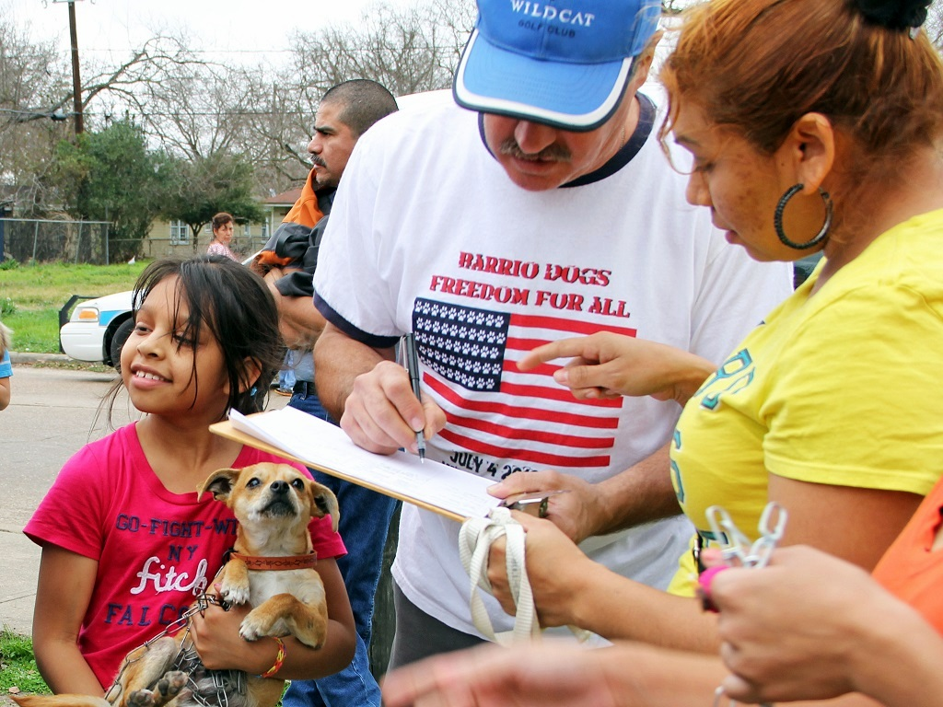
When possible, we sign up pets for free spay, neuter and vaccinations at an East End vet clinic. Often, these pets have never been to a veterinarian.

Slide 8
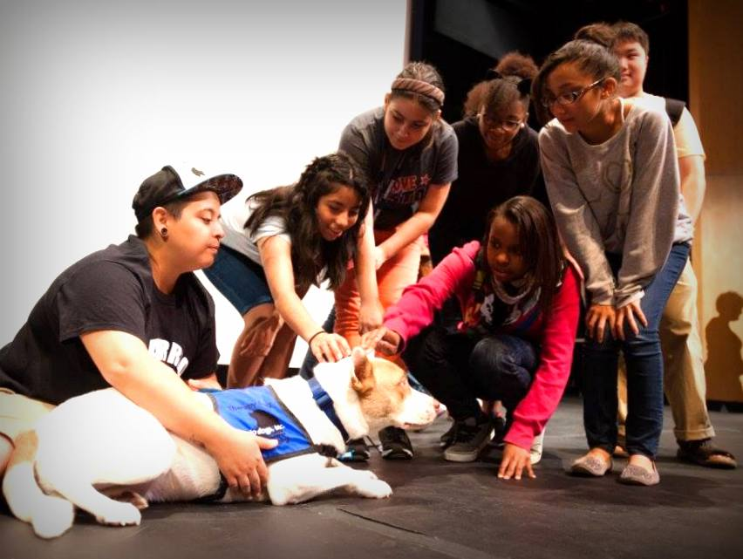
We reach out to schools and colleges with information and resources, often accompanied by a therapy dog.

Slide 9
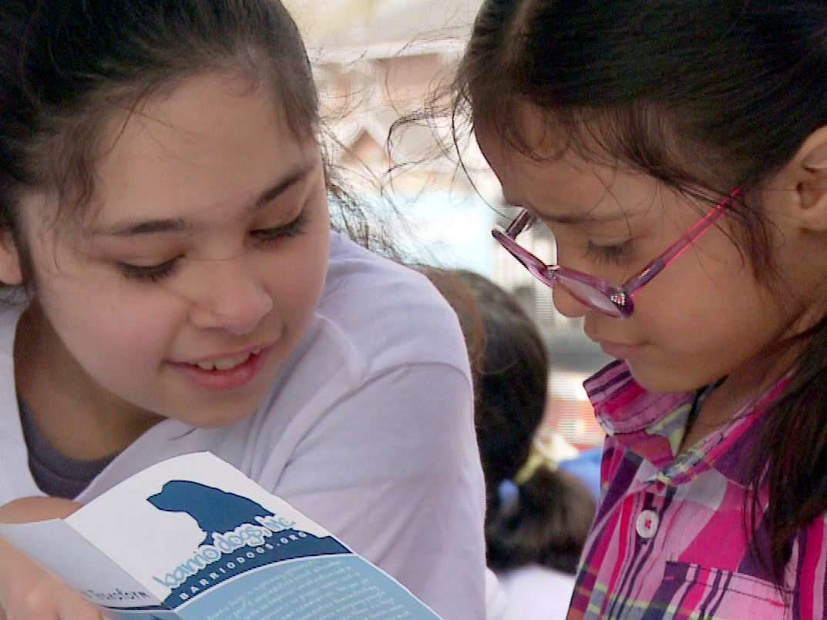
We work hard to teach young people about proper animal care and why it's so important to fix their pets. We know that helping children understand and respect animals is critical to the future of our community.

Slide 10
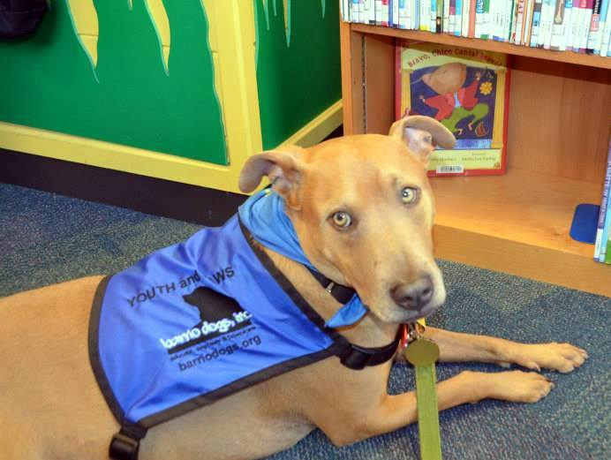
Although we are not a rescue group, we have picked up and found homes for hundreds of East End street dogs. We found Rusty trapped in an underground drainage pipe at an area cemetery. He is now an AKA Canine Good Citizen therapy dog who helps with our educational outreach.

Slide 11
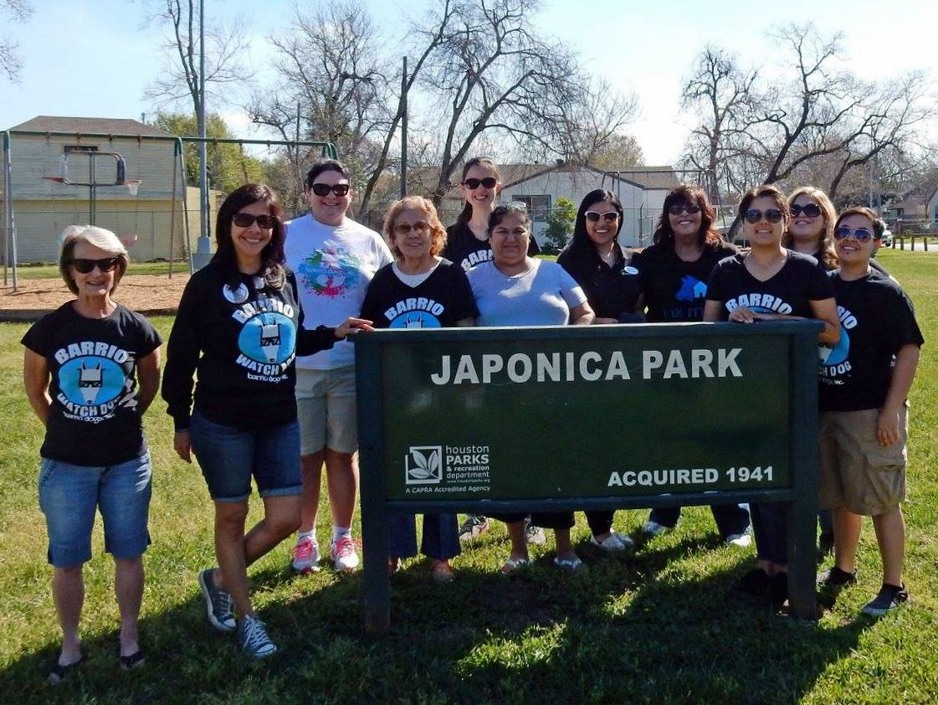
We are all unpaid volunteers united by our deep commitment to helping the animals around us.

Slide 12
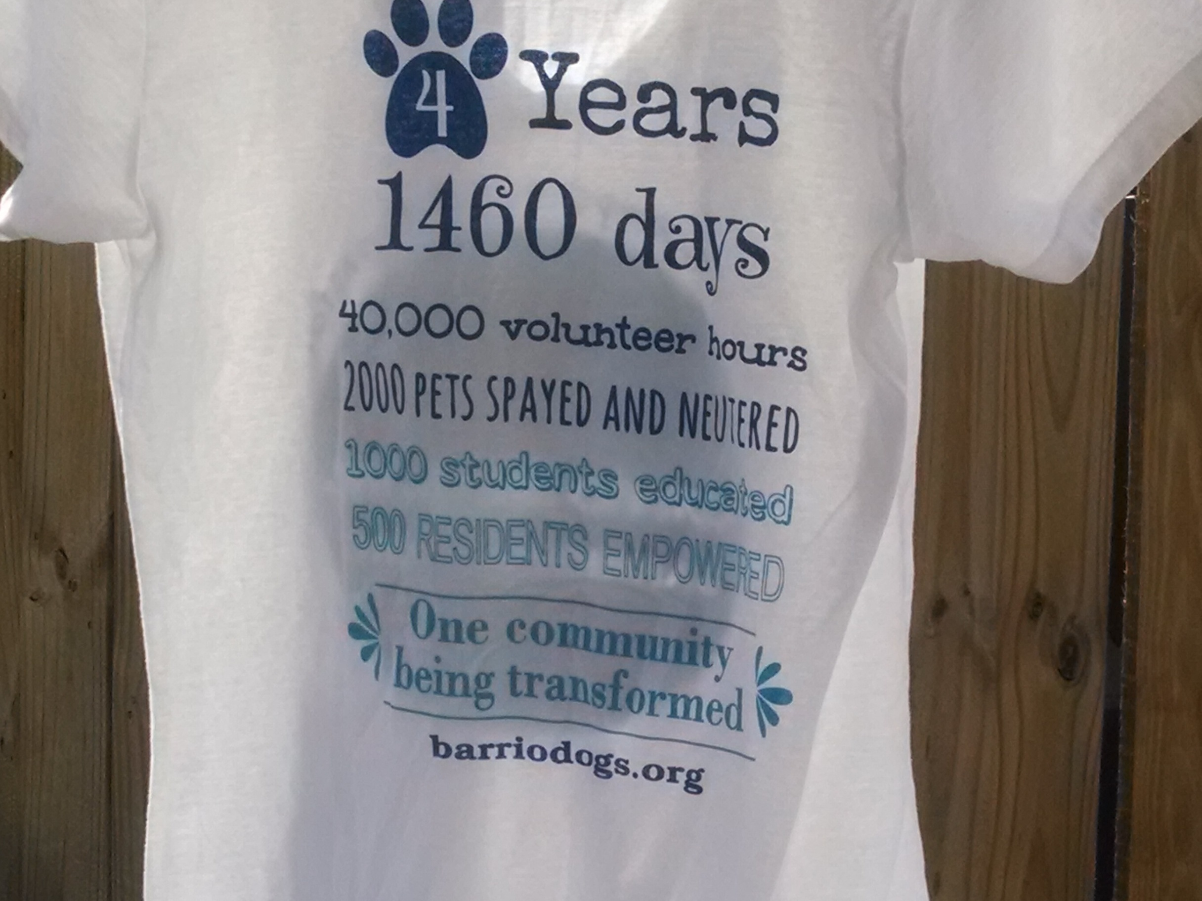
We’re proud of what we’ve accomplished so far but realize much remains to be done. This is a shirt we prepared for our fourth anniversary celebration in 2014. To learn more about our work, go to www.barriodogs.org or follow us on Facebook.

