Slide 1

Updates to Houston City Council
Amy Mills & Kelly McCann
March 2016

Slide 2
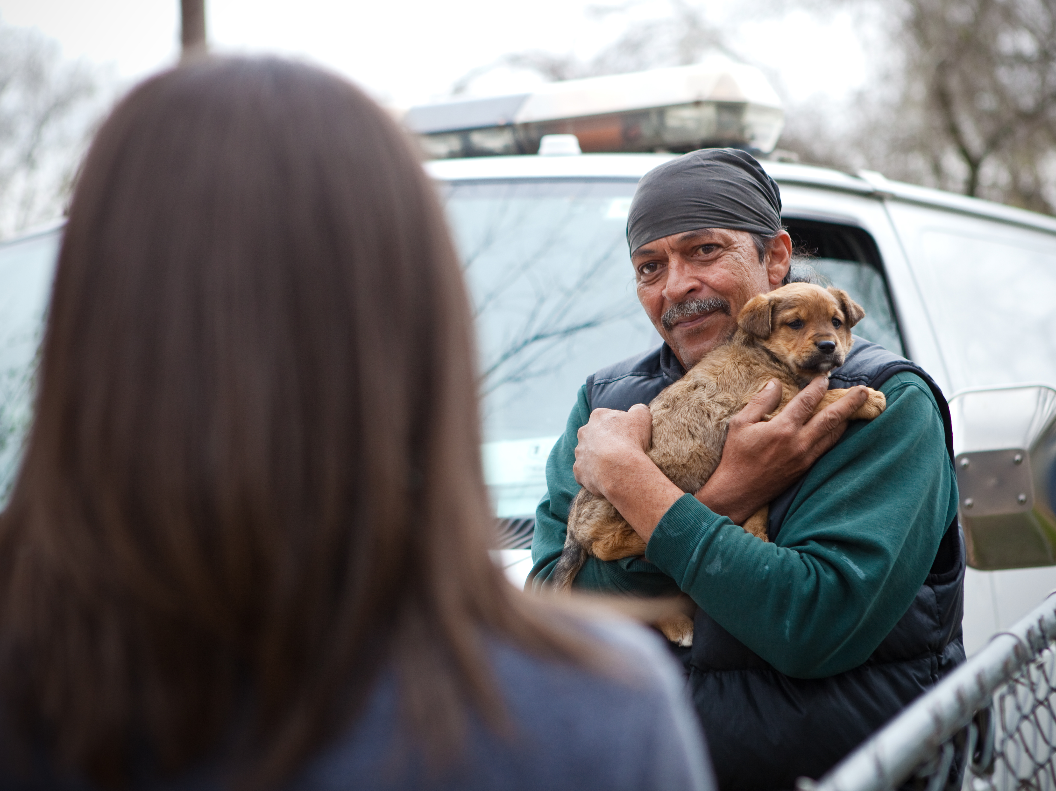
Who We Are
Notes:
Emancipet is a…

Slide 3
There are about 179 million pet dogs and cats in the US
*
Most (80%) are spayed or neutered
*
3-5% of US pets (6-8 million) will become homeless this year
Notes:
Let’s look at the big picture. Things are really, really good for animals in the US today. compared to the 1970s when sheltering was at a peak and some estimates said we were euthanizing 100 animals for every 1,000 residents, things are really great.
It is a fraction of animals that ends up homeless, and things are getting better in shelters too. Conferences like this show how much people care about making life better for the animals that do end up homeless.
But we do still face big challenges in animal welfare. Even though it’s the smallest percentage of pets ever becoming homeless, we don’t want that to happen. And, what’s frustrating is that the number of animals becoming homeless hasn’t really come down signficantly in the last ten years – meaning we are a little stalled out. The efforts that we’ve been doing recently haven’t worked as much.

Slide 4
Spay/Neuter Rates by Household Income

Slide 5
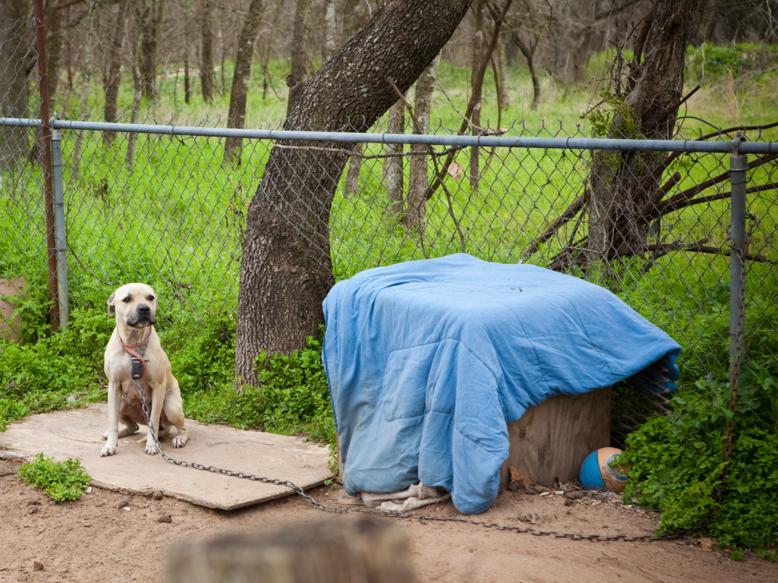
More than 23 million US pets live in poverty.
Notes:
Factor 2: The impact of poverty on animals, and what the appropriate response should be.
There is now emerging data about the impact of poverty on animals. We just saw spay/neuter statistics, but the new data from Pets for Life and similar programs shows that pet owners in poverty have also never interacted with an animal shelter or called for help. They’ve never seen a veterinarian for any reason.
And, while many animals from underserved areas do end up in shelters and drive shelter intake, due to high risk factors for disease and injury, many of these animals would never even make it to a shelter.
As a field that has focused mostly on animals in the shelter, we are going to have to decide how we feel about the fact that only 8 million animals will end up in a shelter this year but more than 23 million will live in poverty without access to the things shelter animals have…

Slide 6
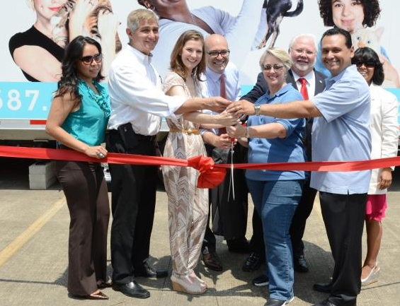
June 2015
Notes:
Emancipet is a…

Slide 7
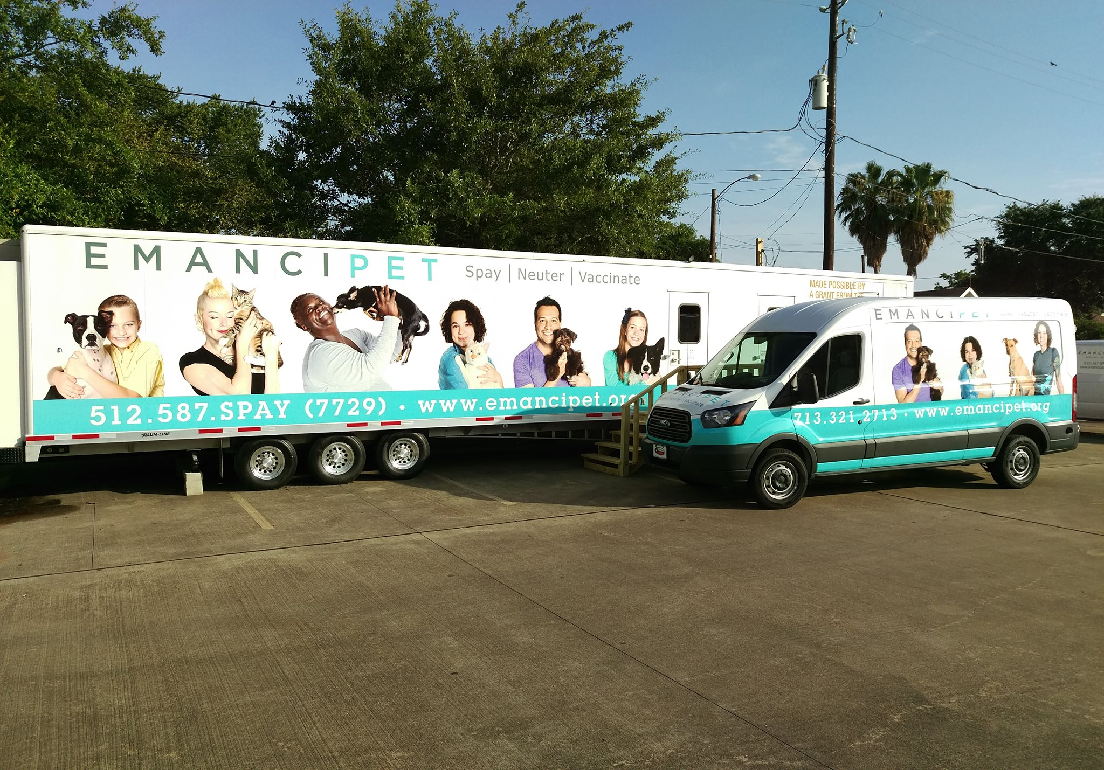
1 Temporary Clinic at Ripley House
1 Transport Vehicle for Outreach

Slide 8
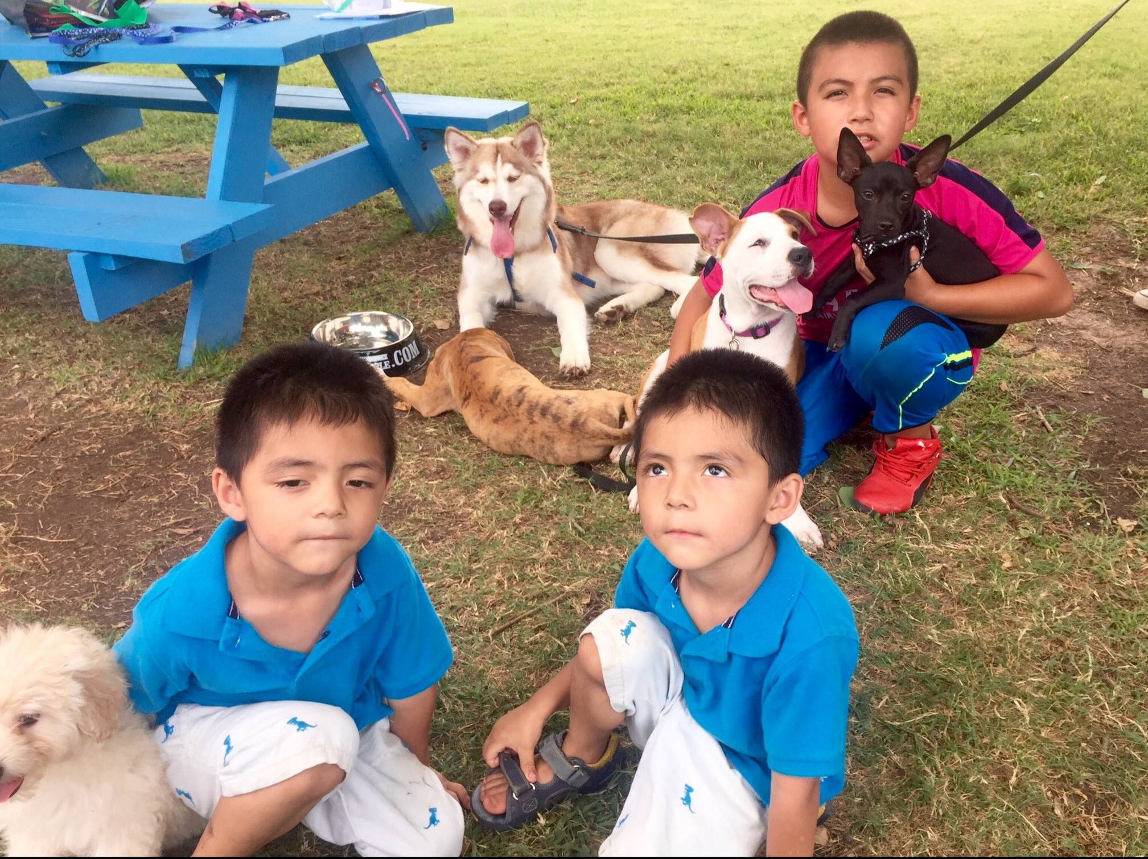
Services:
Spay/Neuter
Vaccinations
Microchipping
Flea & Heartworm
Prevention

Slide 9
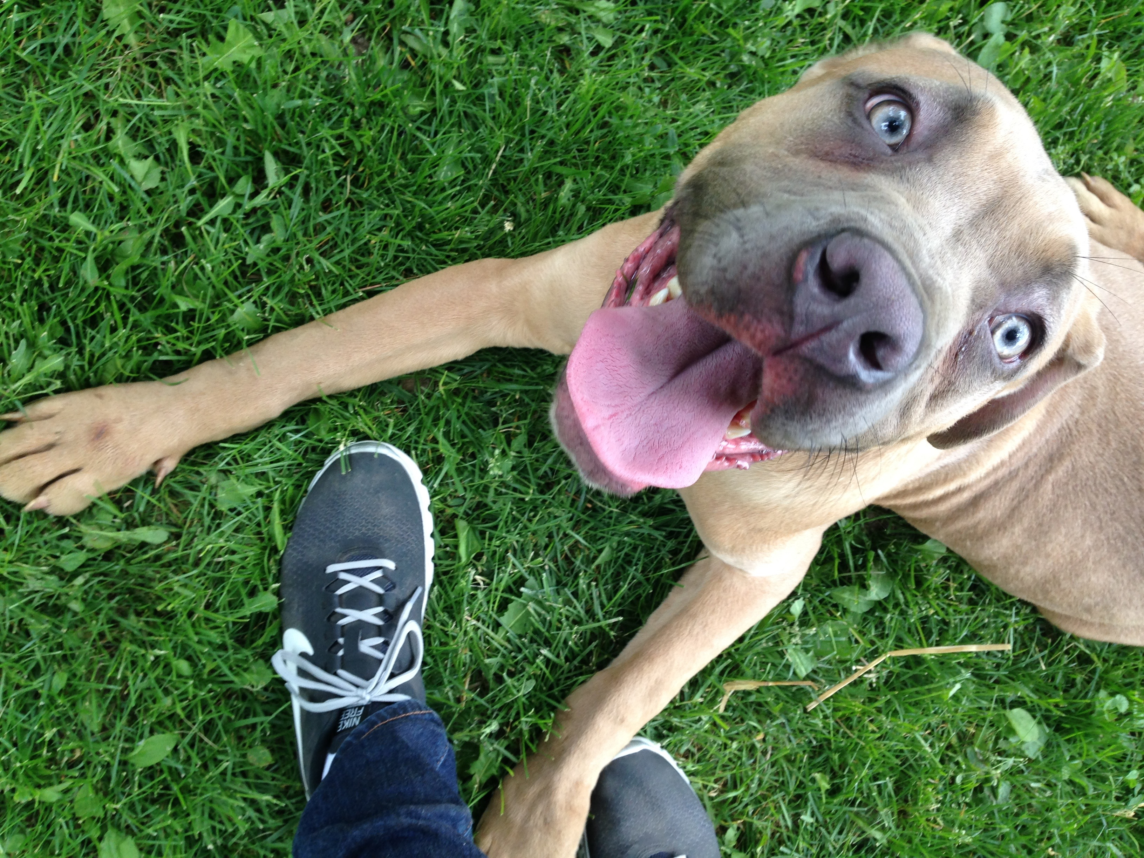
6,300 Total Pets Served
3,104 Pets Spayed/Neutered
46% at no cost to pet owners

Slide 10
WHAT’S NEXT?
Transition into a brick & mortar facility in the East End
*
Increase access to services – add more service days per week
*
Begin the search for a second clinic location
*
Phase in additional veterinary services

Slide 11
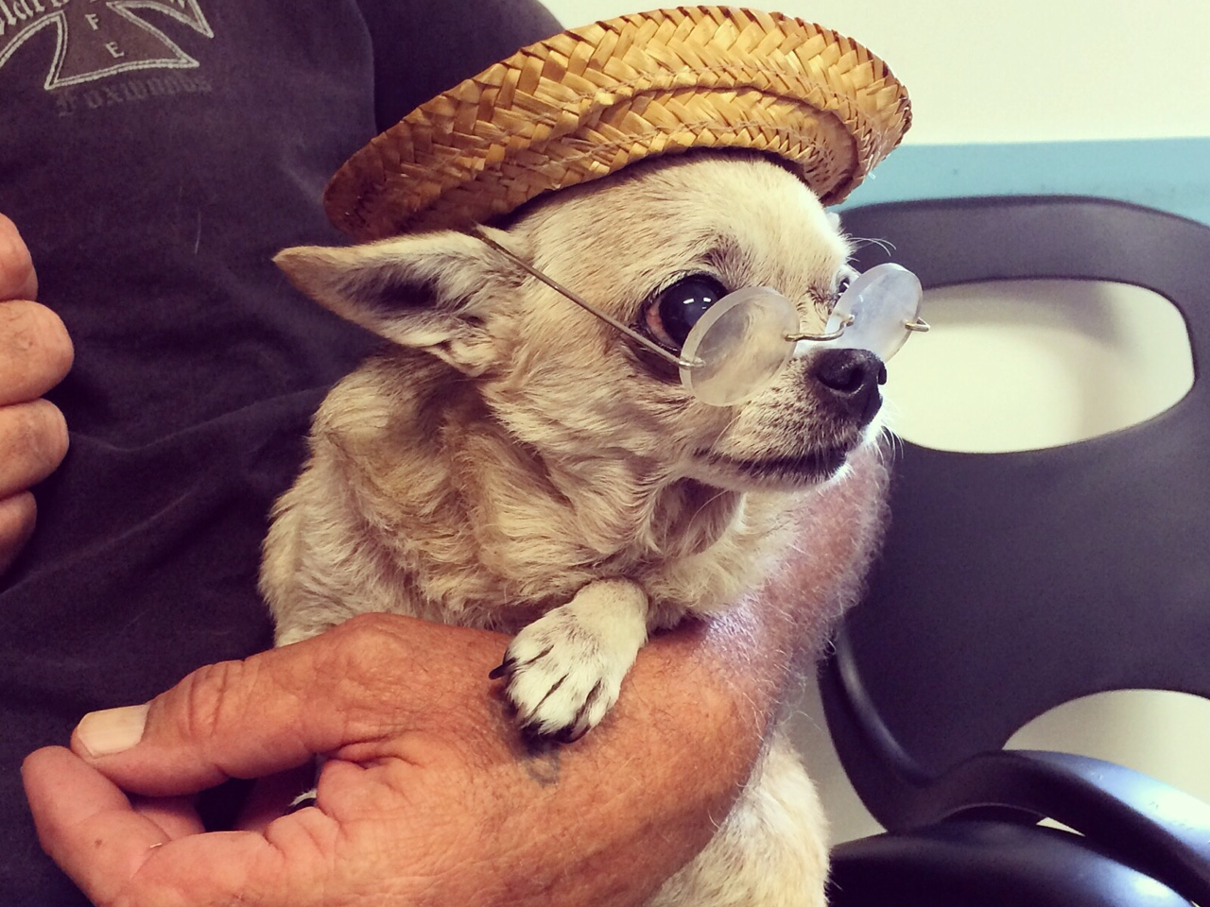
What are your questions?

