Slide 1



Regulation and Neighborhood Affairs (RNA) Committee Presentation
Presented by Greg Damianoff,
Asst. Director, ARA Dept.
Shelter Director, BARC Animal Shelter & Adoptions

Slide 2
Key Programs
Brief overview of BARC
Animal Enforcement
Spay/Neuter
  Healthy Pets Healthy Streets
  Individual Community Outreach
  Fixin’ Houston
Wellness Clinic

Slide 3
Animal Enforcement
Priority Matrix

Slide 4
Animal Enforcement
Dangerous dog: makes an unprovoked attack that causes injury or death to a human.
  94 dangerous dogs in BARC’s registry.
  9 currently active.
  85 euthanized or moved to a different jurisdiction.
Aggressive dog: bites, assaults, or otherwise attacks a person without provocation or displays aggressive tendencies that causes a person of normal sensibilities to fear the dog.
  6 aggressive cases since 2014;
  1 is current
  5 have been euthanized.
Nuisance dog: substantially interferes with the right or enjoyment of life by excessive barking or howling, repeated defecation on property, domestic animal attacks, etc.
  6 nuisance cases reported.
  Resolved through Animal Enforcement mitigation without an official declaration.

Slide 5
Animal Enforcement Tools
Complainant completes affidavit declaring an argument for making a dog dangerous, aggressive or public nuisance (dangerous dog affidavit must be notarized).
BARC reviews complaint and if the case meets the definition, conducts an investigation.
Upon completion of the investigation, BARC determines if the animal meets the designation definition and determines next steps.
If the dog is deemed aggressive or a nuisance by City ordinance, BARC will order the dog owner to follow the mandates described in the City ordinance. If the dog is deemed dangerous due to severe bodily injury or death, it could be euthanized. All other dogs deemed dangerous will follow the prescribed State law and City ordinances

Slide 6
Animal Enforcement Tools
Dangerous Dogs: comply at all times with Chapter 822 of the Texas Health and Safety Code and Chapter 6-154 of the City of Houston Code of Ordinances (see handout).
Aggressive Dogs: comply at all times with Chapter 6-165 of the City of Houston Code of Ordinances (see handout).
Nuisance Dogs: comply at all times with Chapter 6-168 of the City of Houston Code of Ordinances (see handout).

Slide 7
Spay/Neuter Programs
The Vision
Why prioritize spay/neuter?
  Problem: Overpopulation of unowned animals due to unwanted litters
  Problem: Houstonians without access to spay/neuter
  Solution: Educate communities and offer free services on a personal level through neighborhood and district-specific efforts

Slide 8
Healthy Pets Healthy Streets
Began as a beachhead endeavor to “clean up” neighborhoods with the largest stray animal populations, one-by-one, by providing same-day spay/neuter services in each area
Expanded to include key council districts with the greatest need for free spay/neuter education and services
Partners: Friends For Life, SNAP and Emancipet
The Results
Since the program began in July 2013, we have held 73 events in five key districts in Houston
More than 2,880 dogs and cats have been spayed or neutered

Slide 9
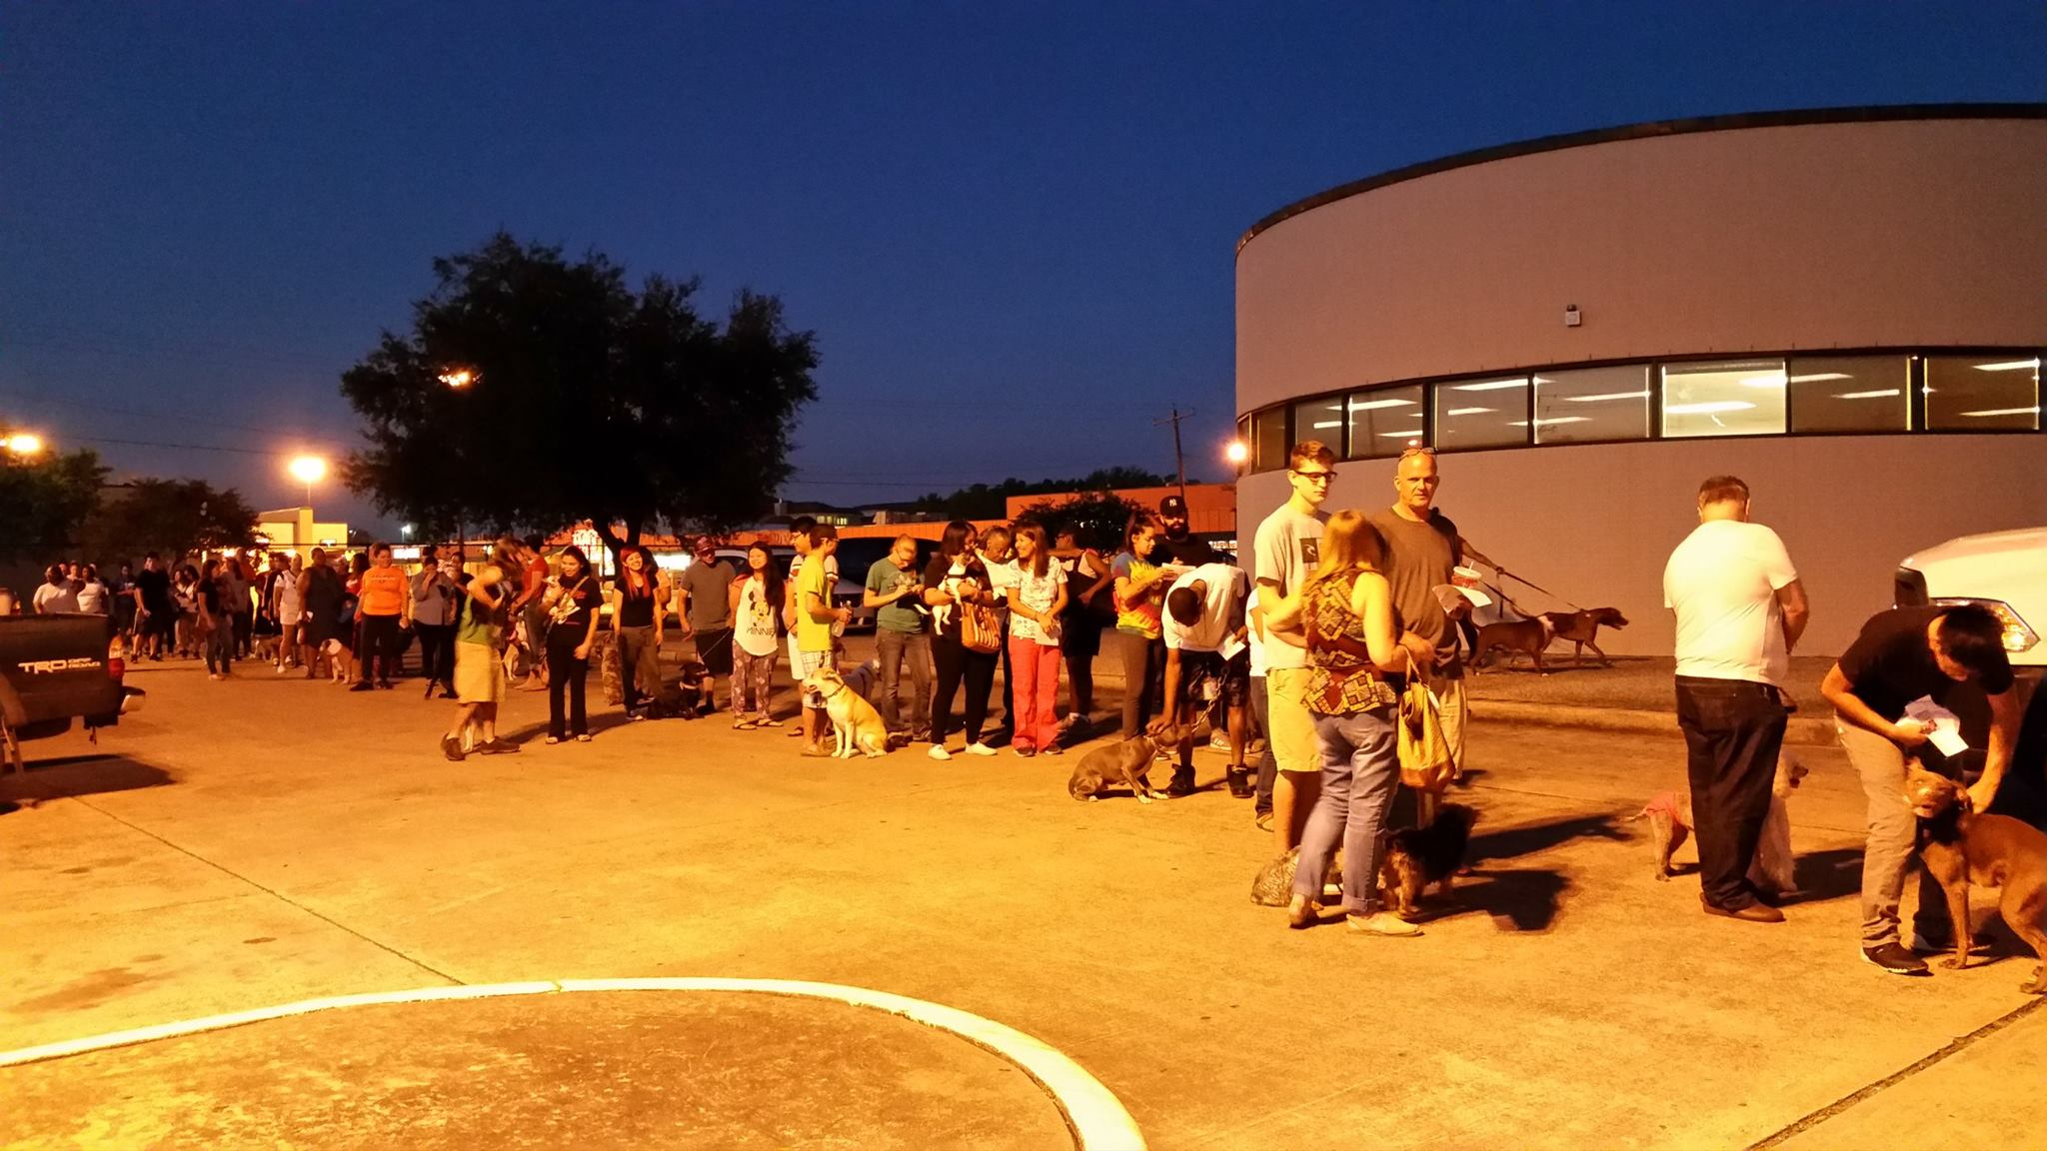
Healthy Pets Healthy Streets event Sunny Side Multi Service Center (District D) on September 19, 2015

Slide 10
Door-to-Door Community Outreach
Began as a supplement to Healthy Pets Healthy Streets to reach Houstonians that need pet spay/neuter services but may not readily understand the value of the surgery
The program focuses on reaching neighborhoods through block-walking and direct interactions with citizens
The Results
Since the program began in July 2015, we have visited 2566 homes and performed 267 spay/neuter surgeries

Slide 11
Fixin’ Houston
In November 2014, BARC launched Fixin’ Houston — the first public, in-house, low-cost municipal spay/neuter clinic in Texas.
The Results
BARC has performed 3,796 spay/neuter surgeries through the low-cost clinic

Slide 12
BARC’s Wellness Clinic
BARC’s Wellness Clinic opened in 2012 to provide basic wellness services to pets at a low-cost
The clinic offers annual vaccinations and monthly flea and heartworm preventatives in packages or a-la-cart
More than 18,300 customers have been through the wellness clinic since it opened

Slide 13
Wellness Customers

Slide 14
Wellness Revenues

Slide 15
Questions?

