Slide 1
Municipal Setting Designations program public hearing for:
3511 w. 12th st., Houston, tx
2023-172-ACP
Cassandra Walker, MPA
MSD Program Manager
Regulatory Compliance and Utility Development, Houston water

Slide 2

AGENDA
City of Houston – Programmatic
What the MSD is
Who the MSD impacts
Steps in the MSD process
MSD Applicants – Technical
Specific information on the site:
  2023-172-ACP 3511 12th Street
  Houston, TX 77008
Questions / Comments

Slide 3
Environmental Protection in Texas
The State of Texas has jurisdiction over environmental protection
Texas Commission on Environmental Quality (TCEQ)
Environmental Complaints
TCEQ Contacts
  By Phone: 1-888-777-3186
  Online: www.tceq.texas.gov/compliance/complaints
City of Houston Contacts
  By Phone: 311
  Online: www.houstontx.gov/311/

Slide 4
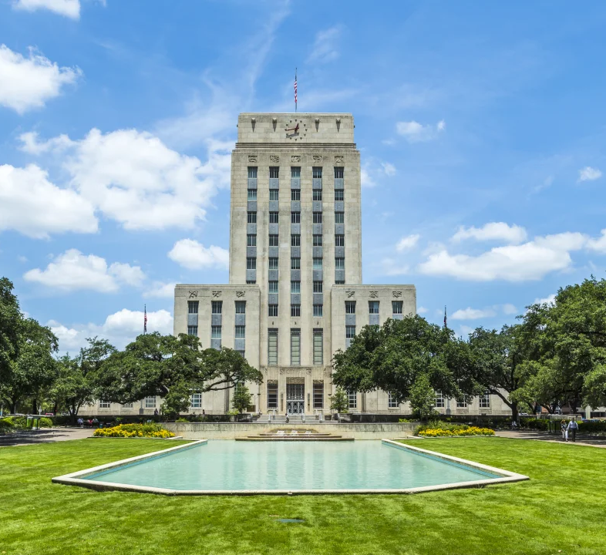
What is An MSD
A voluntary deed restriction to prevent the use of contaminated groundwater
  No water wells on the subject property for drinking water purposes
  A legally binding way to ensure the public is not exposed to contaminants by drinking water ingestion

Slide 5

Who the MSD Impacts
An MSD certificate applies to the applicant’s property only and prohibits the use of shallow groundwater as drinking water by deed recordation. This allows impacted properties to be redeveloped, which benefits the communities in which the MSD is located.

Slide 6

Environmental Cleanup
The MSD is only one step in the cleanup process
Responsible parties remain liable for any consequences resulting from contaminated groundwater originating from the application site

Slide 7

City’s Requirements of the Applicant
Enrollment in a state or federal cleanup program
Thorough investigation confirming that the groundwater plume (contamination) is stable or decreasing, and fully delineated (exact position identified)
Source of contamination has been removed
A third-party Engineer (P.E.) or Geologist (P.G.) must certify the application

Slide 8
Steps in the Process
Submit Application to the City
Review Application
Pre-Application Meeting
City Council Approves or Denies
Hold Public Hearing
Hold Public Meeting
Comments
Comments
Submit Application to the TCEQ
TCEQ Approves or Denies
MSD Ordinance is filed in the County Deed Records
Comments

Slide 9
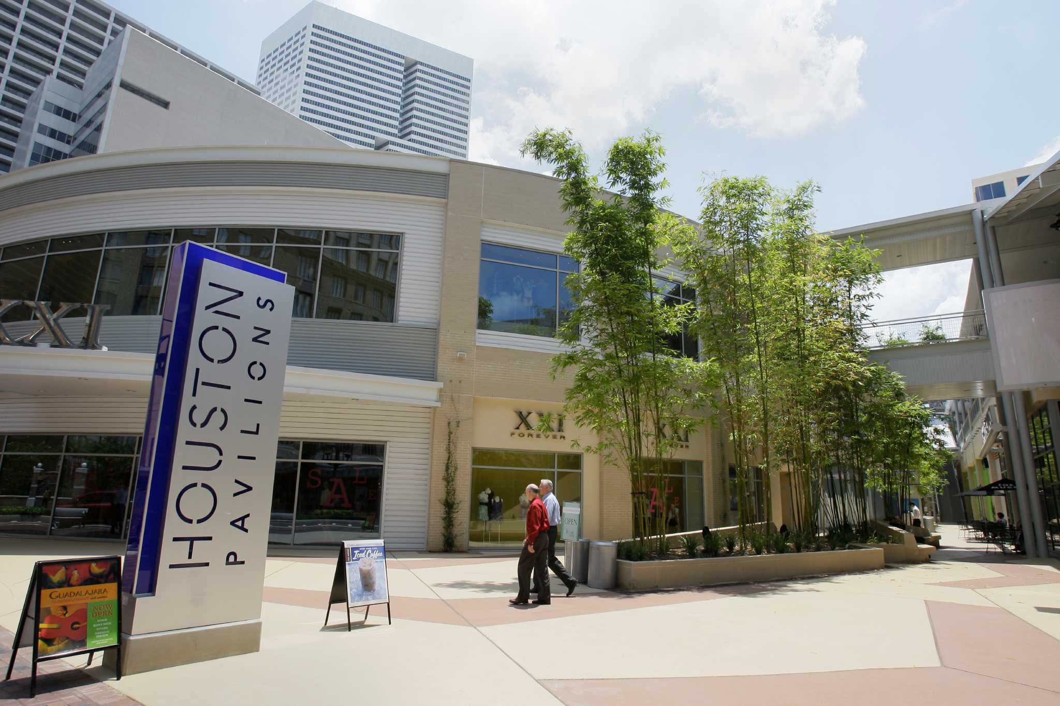
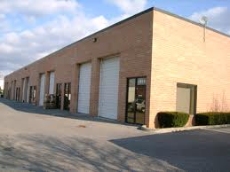
Why Support An MSD?
Protects the public from consumption of contaminated groundwater
Encourages clean-up of contaminated sites
Promotes redevelopment of under-utilized properties

Slide 10
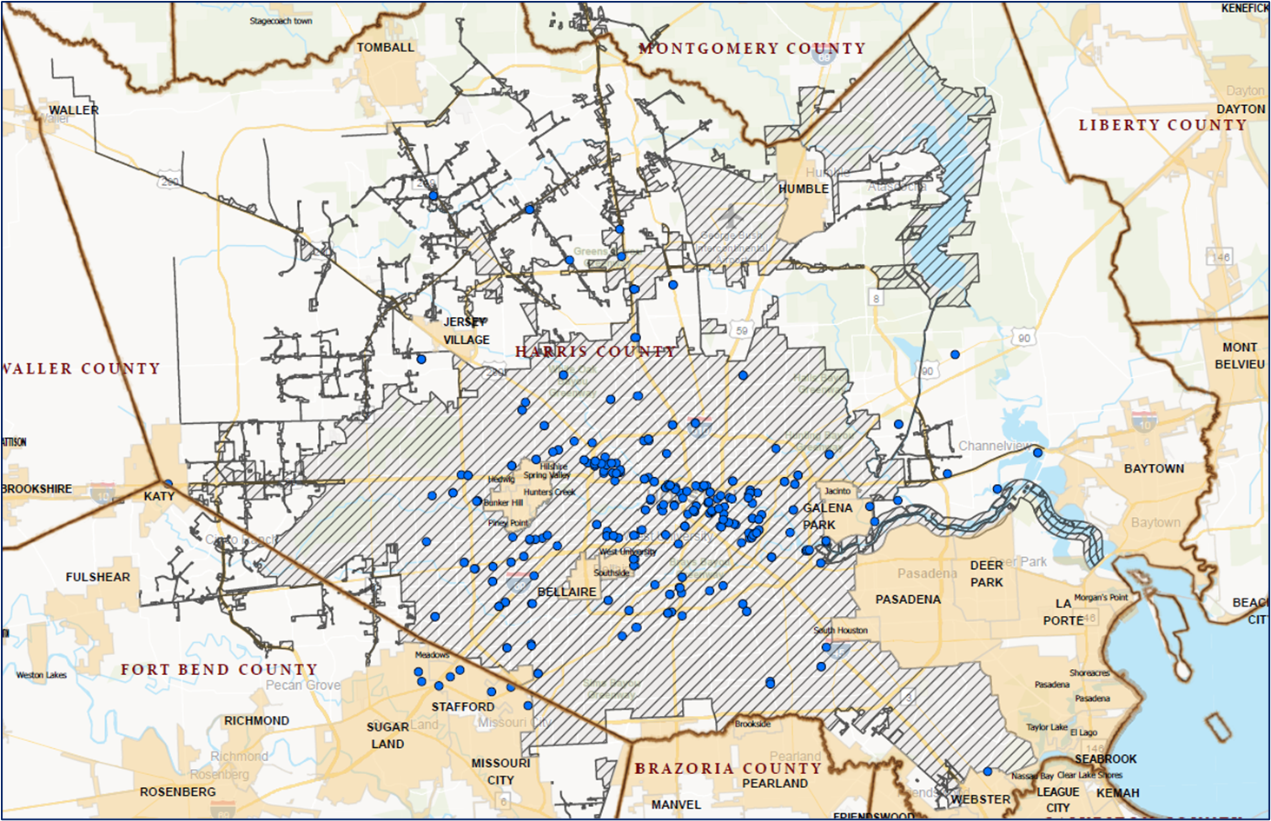
MSD Sites in Houston

Slide 11
Notice of public meeting
WATER WELL OWNERS
certified mail
5-mile radius
state requirement
PROPERTY OWNERS
first-class mail
½-mile radius
city requirement
Notes:
Please find on this screen the public meeting notice that went out on August 8, 2025. Notifications went out to water well owners in a 5-mile radius and to property owners in a ½ mile radius of the property.

Slide 12
3511 W. 12th st. COMMERCIAL PROPERTY
Represented BY: Darrell Maudlin, PG, SKA Consulting, L.P.
Background
The property is located at 3511 West 12th Street in Houston, Texas.
The 5.745-acre property comprised of two parcels owned by three entities, Players I, Ltd., Players II, Ltd., and 3535 West 12th Street LLC.
Property Tract Descriptions:
  Tract 1 comprises 5.4913 acres of unoccupied commercial land developed with an approximately 5,563 sq-ft office building on the southwest portion
  Tract 2 comprises 0.2537 acres of land adjacently west of Tract 1. Tract 2 is developed with asphalt or concrete paved parking and driving areas used by the west adjacent multi-tenant office building.

Slide 13
3511 W. 12th st. COMMERCIAL PROPERTY
Site Information
The designated property is registered with the Texas Commission on Environmental Quality (TCEQ) and enrolled in the Industrial Hazardous Waste (IHW) Corrective Action Program under Solid Waste Registration (SWR) No. 38591
No municipalities, other than the City of Houston, have corporate limits within one-half mile of the boundary of the designated property.
Public drinking water is currently available to the designated property and properties located within a 0.5-mile radius surrounding the designated property by the COH public water supply system.

Slide 14
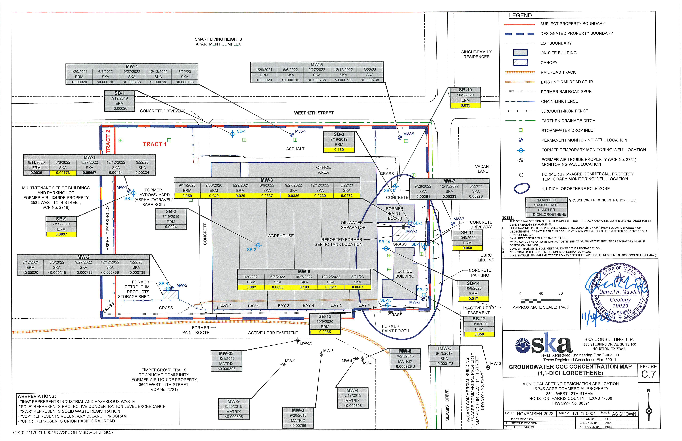
3511 W. 12th st. COMMERCIAL PROPERTY
ATTENUATION
This image of the site depicts the “protective concentrations level exceedance zone” (PCLE zone), which is based on the sampled groundwater data from wells installed as part of the TCEQ VCP project. The PCLE zone is confirmed to be stable and/or decreasing.

Slide 15
Groundwater Contamination
Deed Restriction
Sampling Well
Water Well
Source
Groundwater Flow
Groundwater Zone
(Sands)
20 to 60
feet
Contaminant Plume
Confining Clay Layer
600 +
feet
Please Note: Houston has shallow contaminated groundwater scattered across the City

Slide 16
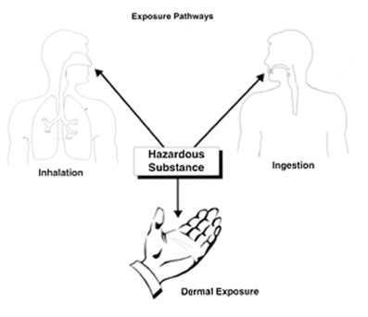
Exposure Pathways
  Cleanup programs are based on public exposure to contaminants and reducing public health risks.
  Exposure Pathways
      Ingestion
      Inhalation
      Contact (dermal)
      Soil
      Groundwater to surface water
      Ecological

Slide 17

MSD Application Availability
Acre Commercial Property
Heights Neighborhood Library
1302 Heights Blvd.
Houston, Texas 77008
Also available online at:
www.houstonpublicworks.org/municipal-settings-designation

Slide 18


Contact Information
Cassandra Walker
Location: Houston Public Works
611 Walker St. 18th Floor
Houston, Texas 77002
Direct Email: Cassandra.Walker@houstontx.gov
Team Email: msd@houstontx.gov
Phone: 832-393-7966
Website: www.houstonpublicworks.org/municipal-settings-designation
Notes:
This is an interactive slide:
This cross-section graphic depicts what an MSD is.
1. Houston has shallow contaminated groundwater scattered across the City. (1st click)
2. This source eventually seeps through the soil into the shallow groundwater zone and creates a contaminant plume. (2nd click)
3. Once the source is no longer actively contributing to the contamination (plume) either from the source being removed or from the operation ceasing from the property, it begins to retract. (3rd click)
4. To define the area of the plume the owner installs a number of sampling wells. (4th click)
5. The MSD program addresses water that is typically 20-60 feet below the surface. This ground water is not used for drinking water. (5th click)
6. Water wells designated for drinking water are much deeper. (6th click)
7. Generally, 600 feet or more. (7th click)
8. Quarterly sampling events help determine if the groundwater contamination is decreasing or stable.
Now that the owner knows where the contamination is and verifies that it’s decreasing or stable, the owner can apply to have an MSD restriction placed on the property. The Deed restriction prohibits the use of groundwater to ever be used for drinking water.
During the MSD process, the applicant is also required to verify that there is state regulated public drinking water available to the site.
The owner can now comfortably pursue redeveloping the site while ensuring the public that contaminated water will never be used as drinking water. (Next Slide)

