Slide 1
Community Code Enforcement
Prohibited Yard Parking
Assistant director
Christopher Shannahan
February 2nd, 2026

Slide 2
City of Houston ordinances
Prohibited Yard Parking (PYP) Ordinance
ARTICLE 10, SECTION. 28:301-305

Slide 3
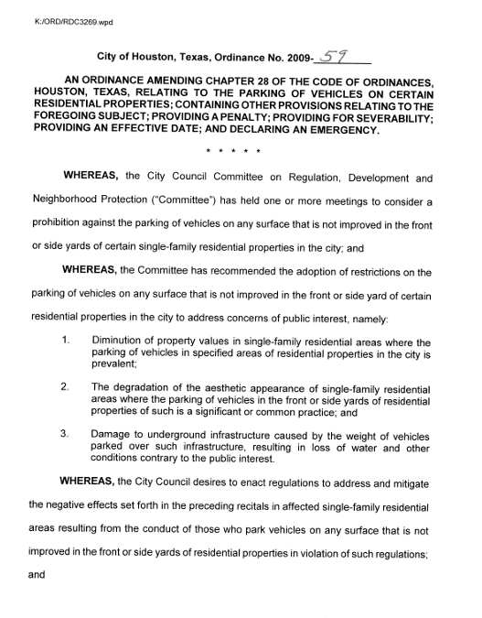
Background
Background
  Who started the program:
  Planning Development created the 2009 City of Houston, Texas, Ordinance No. 2009-59- Prohibited Yard Parking
  Who enforces the program
  Houston Public Works, Community Code Enforcement but was previously enforced by the Houston Police Department
  Who can participate
  Active Homeowners Associations and civic groups applied to become part of the program
Notes:
Original Verbiage: The Prohibited Yard Parking Program to-date has 221 approved applications which are intended to protect neighborhood property values, prevent damage to the City of Houston’s underground infrastructure, and to stop the degradation of the aesthetic appearance of single-family residential areas.
Windows, doors, and other openings of vacant structures must be locked, covered, or secured to prevent unauthorized entry.
If a structure becomes vacant and is not secured, the property owner may be required to board it up.
Storage sheds and garages fall under the same requirement to be secured.
Property owners must also maintain structures in a safe and structurally sound condition.
To avoid fines, ensure all openings are secured and obtain the necessary permits for any repairs.
Emergency Abatement: This may be performed by the City if a structure poses a serious risk of bodily injury and immediate corrective action is needed.
(Reference: Chapter 10, Sec 10-371)

Slide 4
Background
Applications
  Application process
  Applications accepted on the first two business days of each month
  Submitted to Planning and Development Director
  Common reasons applications not approved
  Insufficient petition of support (60% of property owners)
  Lack of evidence
  - block face criteria
  - sufficient curb space
  Renewals
  No current renewal process. Participants would need to repeat the application process after 20 years.
Notes:
Original Verbiage: The Prohibited Yard Parking Program to-date has 221 approved applications which are intended to protect neighborhood property values, prevent damage to the City of Houston’s underground infrastructure, and to stop the degradation of the aesthetic appearance of single-family residential areas.
Windows, doors, and other openings of vacant structures must be locked, covered, or secured to prevent unauthorized entry.
If a structure becomes vacant and is not secured, the property owner may be required to board it up.
Storage sheds and garages fall under the same requirement to be secured.
Property owners must also maintain structures in a safe and structurally sound condition.
To avoid fines, ensure all openings are secured and obtain the necessary permits for any repairs.
Emergency Abatement: This may be performed by the City if a structure poses a serious risk of bodily injury and immediate corrective action is needed.
(Reference: Chapter 10, Sec 10-371)

Slide 5
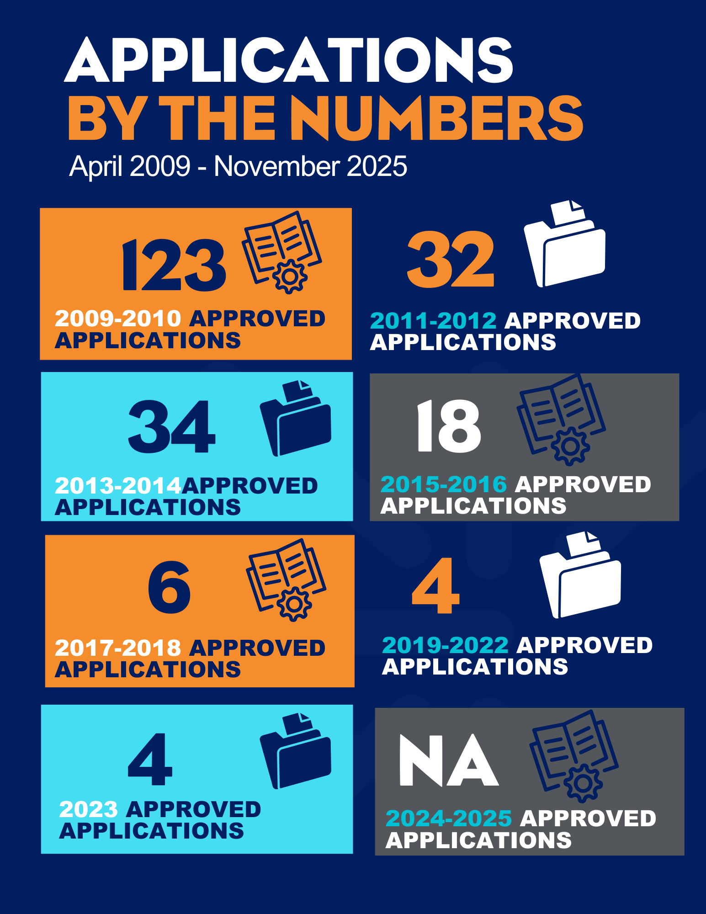
Participation
The Prohibited Yard Parking Program has approved 221 applications to date. The program is intended to:
    Protect neighborhood property values
    Prevent damage to the City of Houston’s underground infrastructure
    Stop the degradation of the aesthetic appearance of single-family residential areas
  (Based on City of Houston Ordinance,
  Chapter 28, Article 10, Section 28-301-305)
Notes:
Original Verbiage: The Prohibited Yard Parking Program to-date has 221 approved applications which are intended to protect neighborhood property values, prevent damage to the City of Houston’s underground infrastructure, and to stop the degradation of the aesthetic appearance of single-family residential areas.
Windows, doors, and other openings of vacant structures must be locked, covered, or secured to prevent unauthorized entry.
If a structure becomes vacant and is not secured, the property owner may be required to board it up.
Storage sheds and garages fall under the same requirement to be secured.
Property owners must also maintain structures in a safe and structurally sound condition.
To avoid fines, ensure all openings are secured and obtain the necessary permits for any repairs.
Emergency Abatement: This may be performed by the City if a structure poses a serious risk of bodily injury and immediate corrective action is needed.
(Reference: Chapter 10, Sec 10-371)

Slide 6
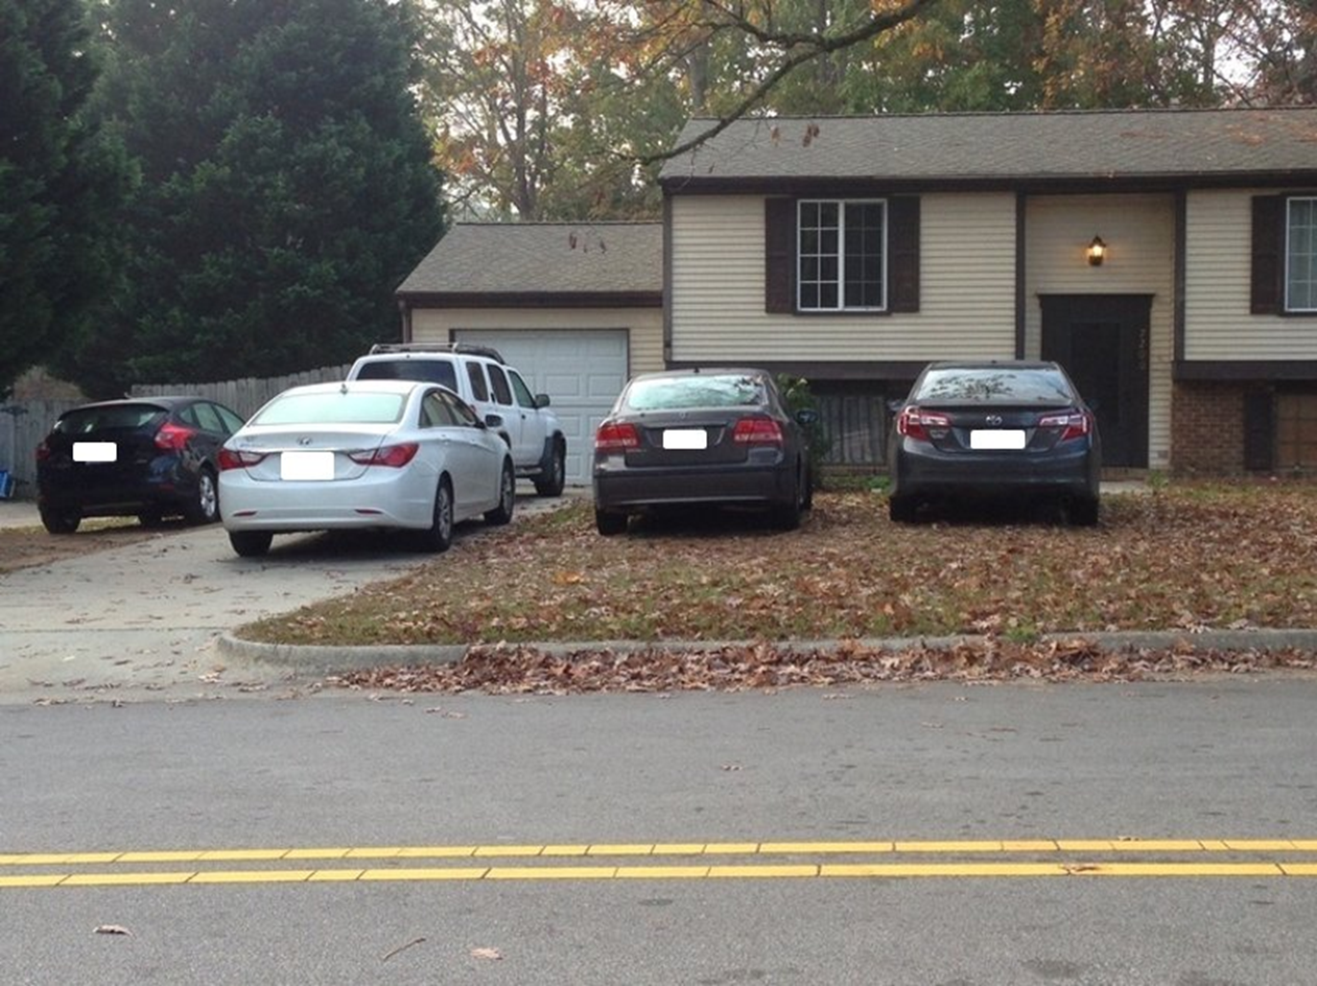
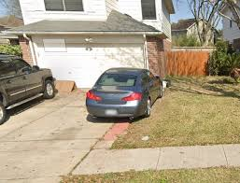
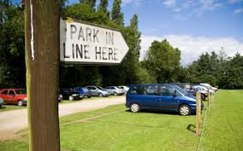
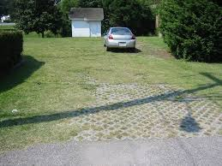
Prohibited yard parking
Parking of vehicles or equipment on any surface that is not an improved surface in the front or side yard areas of an improved single-family residential lot.
Sec. 28-303 (b) Offense.
...it is presumed that the registered owner of the vehicle or equipment is the person who parked, caused, suffered or permitted the vehicle or equipment to be parked in violation of this article.
Sec. 28-305. - Penalty.
Any person who violates any provision of this article shall be guilty of a misdemeanor and, upon conviction thereof, shall be punished by a fine not to exceed $150.00. Each day a violation of this article shall continue shall constitute a separate offense.
The provisions of this article may be enforced by any law enforcement officer, the neighborhood protection official, or the parking official.
Examples of Violations
Notes:
SEC. 10-532. JUNK/INOPERABLE VEHICLE
A junked vehicle or a part of a junked vehicle that is located in a place where it is visible from a public place or right of way.
Primary violator is Vehicle Registered Owner
HPW Inspector has to research registered owner listed in TXDOT / TXDMV
Secondary violator is land-owner for “suffering” or “permitting” parking on their parcel

Slide 7
strategy
GO LIVE
Collect Data Points
Violation volume, Compliance rate, and Efficiency Options
Review Data Points
Reassess department needs
Enforcement and Evaluation Plan
January 12, 2026
May 2026
Notes:
City of Houston Ordinances: Chapter 10
Nuisances: Whatever is dangerous to human health or welfare, or whatever renders the ground, the water, the air, or food a hazard to human health is declared to be a nuisance.

Slide 8
Reporting prohibited yard parking in neighborhoods

Slide 9
Reporting to 311
Report a complaint to 311
Community Code Enforcement receives the case from 311
Case is created if complaint address IS enrolled in program
The case is assigned to an inspector for review and research
Follow up Inspection is completed after 48 hours
Complaints reallocated based off Prohibited Yard Parking Program
Case is closed if complaint address is NOT enrolled in program
If violation still exists a citation is mailed to vehicle owner
If violation is resolved Case Closed
Contact is made utilizing Red Door Hanger identifying violation
Note: Cases are handled in the order they are received.
Notes:
Explain what happens after a report is submitted to 311.
Emphasize that cases are handled in the order received.

Slide 10
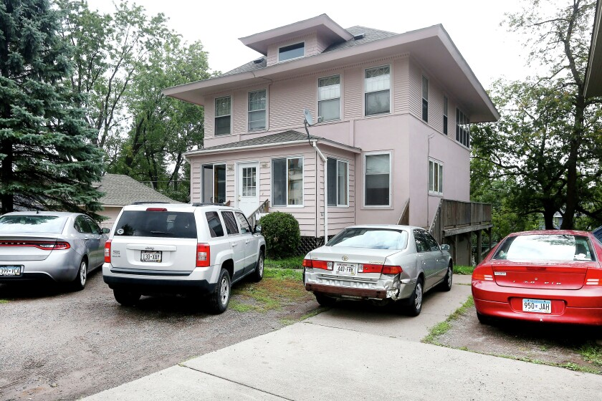
Important information for Property Owners, Residents, and Businesses
  Check with Homeowners Associations to ensure:
    The location you are reporting is an approved prohibited yard parking area.

Slide 11
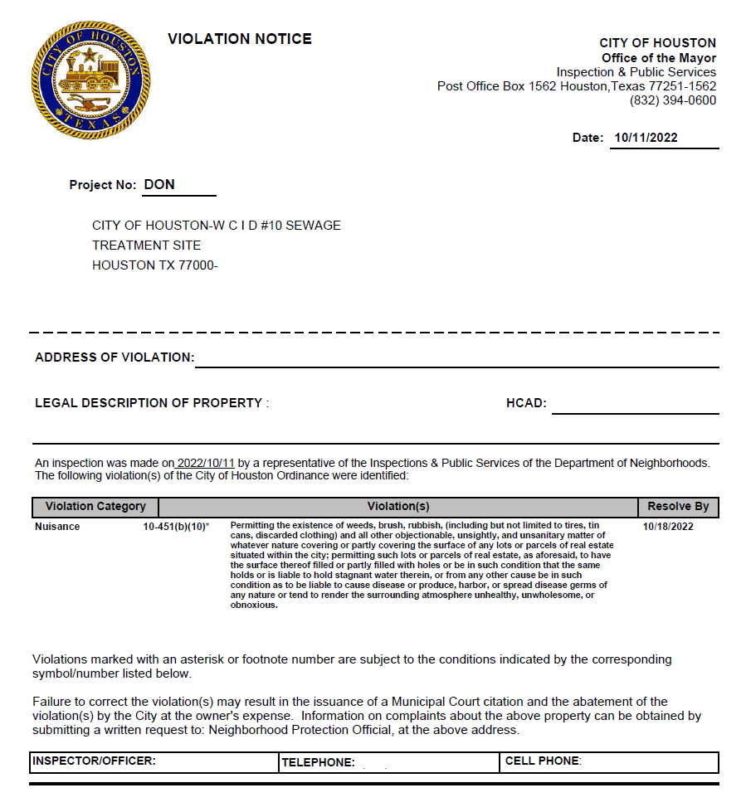
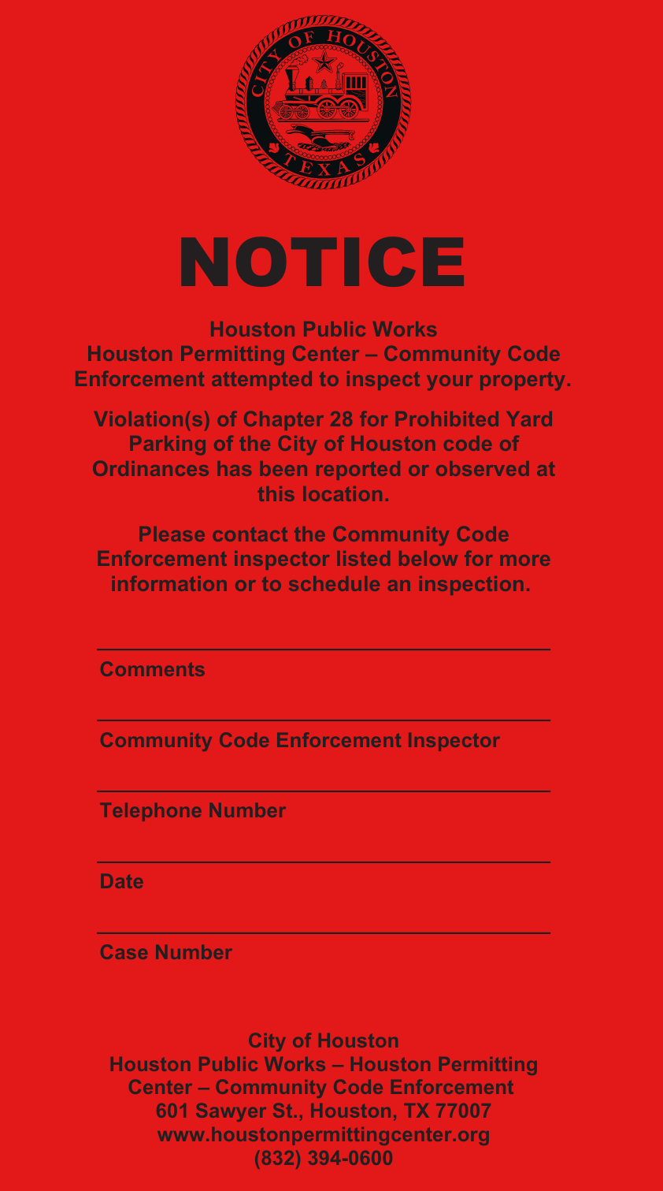
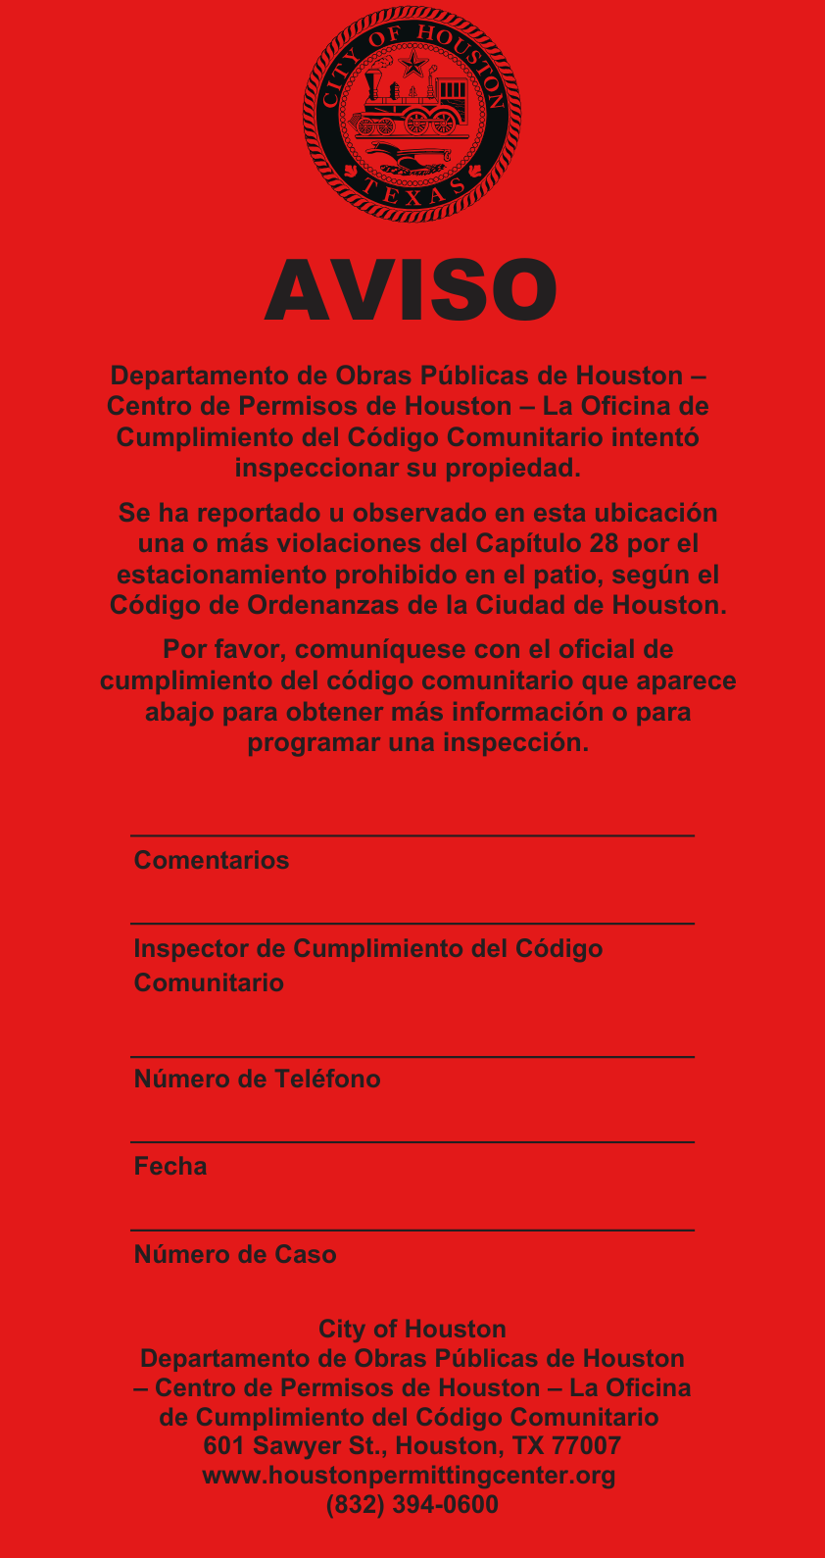
EXAMPLE OF NOTIFICATIONS
EXAMPLES OF MAIL NOTICES
EXAMPLES OF PLACARD
(RED DOOR HANGER)

Slide 12
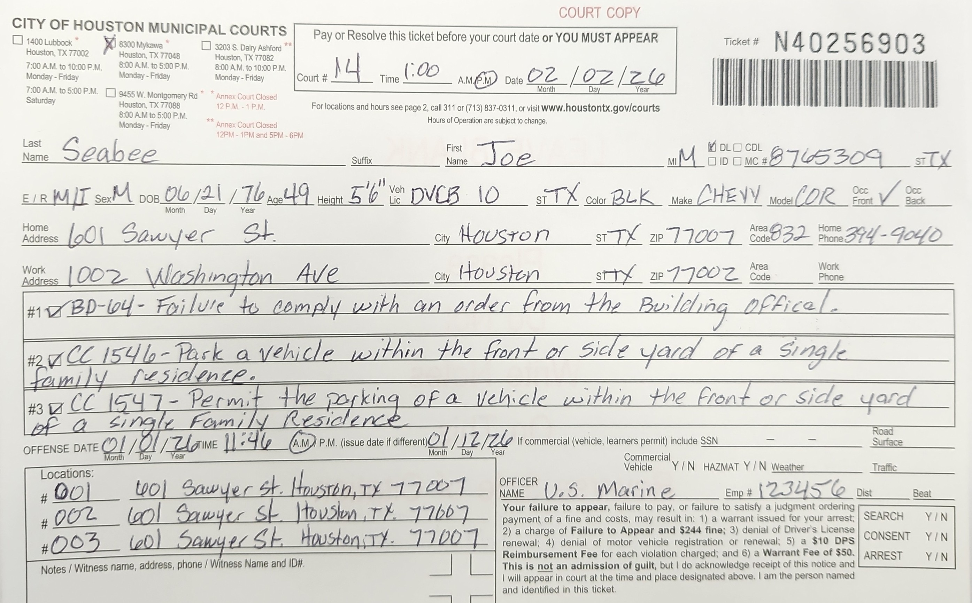
EXAMPLE OF CITATION

Slide 13
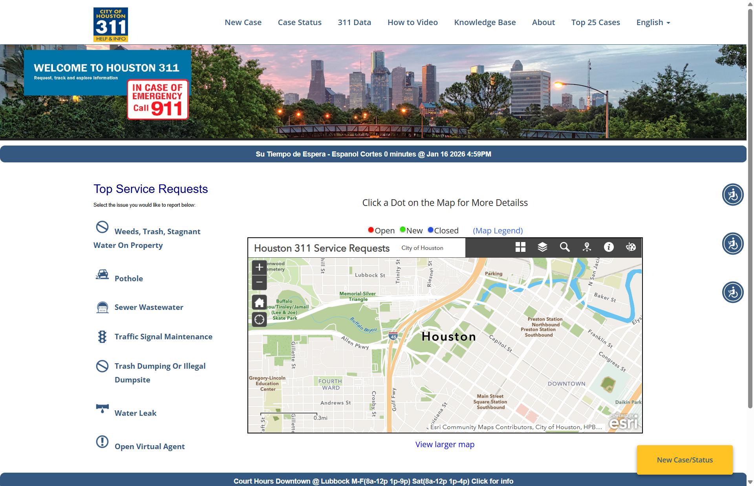
How to report a violation
Report Violations to 311
Call 311 or 713-837-0311
Available Q2 of 2026
.www.houstontx.gov/311.
.311@houstontx.gov.
Houston 311 mobile app available on:
  Google Play
  App Store
Prohibited Yard Parking Zones Map:
bit.ly/ProhibitedYardParking.

Slide 14
Prohibited yard parking Team

Slide 15
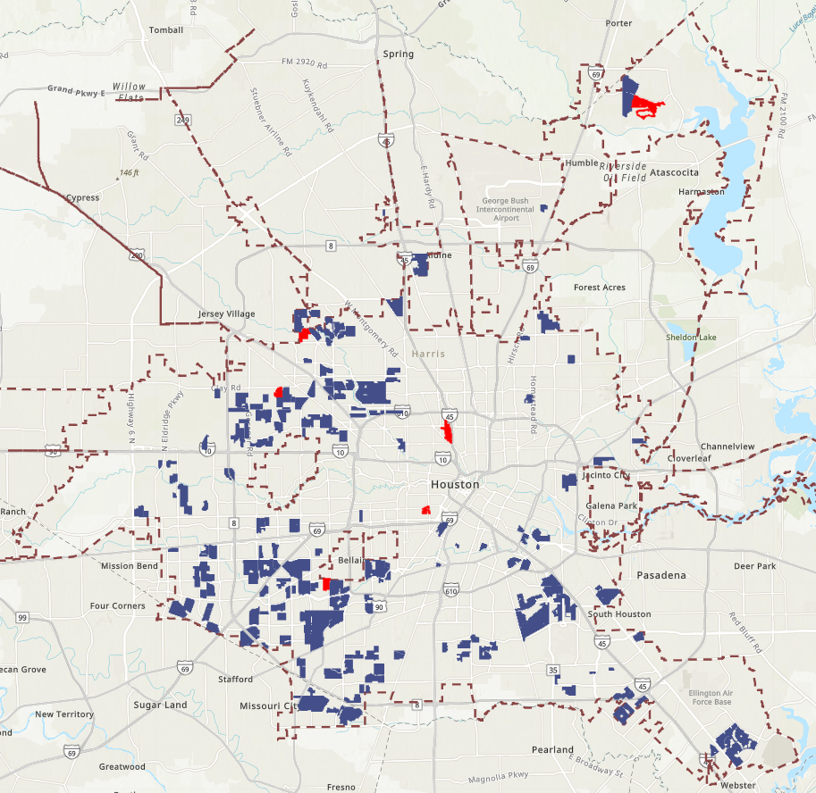
Who enforces Current Areas
Junk Motor Vehicle team of 4 field inspectors handles ALL incoming cases of Prohibited Yard Parking
1,200,000 parcels (land where house is located) in City of Houston Limits
18,500 parcels registered for Approved Prohibited Yard Parking enforcement as of current
Notes:
City of Houston Ordinances: Chapter 10
Nuisances: Whatever is dangerous to human health or welfare, or whatever renders the ground, the water, the air, or food a hazard to human health is declared to be a nuisance.

Slide 16
RISKS & HAZARD MITIGATION
RISKS
MITIGATION
Civilian inspectors
Agitated citizens
Potential escalation of physical violence
Loose animals
Inspectors have been educated on
de-escalation strategies:
Assess the environment
Leave the property immediately if safety concerns
Contact Differential Response Team
  Sgt. Matthew Simon
  Contact #: 832-393-1313
  Email: Matthew.Simon@HoustonPolice.Org.

Slide 17
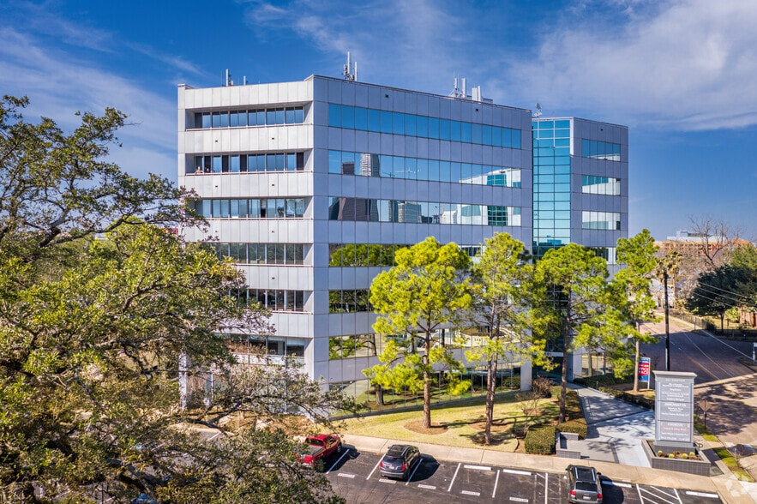
Contact US
Community Code Enforcement
Email: hpc.ccecallcenter@houstontx.gov
Phone: 832-394-0600
In Person: 601 Sawyer St., Suite 110
Houston, Texas 77007
Assistant Chief PYP
Email: David.Allmer@houstontx.gov
Phone: 832-393-3973
Before contacting us, please have your 311 reference number

Slide 18
thank you!

Slide 19








CONTACT US
Houston Permitting Center
Facebook
@COHPermits
X
@COHPermits
Instagram
@COHPermits
YouTube
@COHPermits
832.394.9000
Houston Permitting Center
1002 Washington Ave.
Houston, TX 77002
www.houstonpermittingcenter.org
askHPC@houstontx.gov
Notes:
Here are some other ways we like to reach out to you. You can scan these bar codes and
find us on various social media platforms.

