Slide 1
Municipal Setting Designations
Cassandra Walker, MPA
MSD Program Manager
Regulatory Compliance and Utility Development, Houston water

Slide 2

AGENDA
City of Houston – Programmatic
What the MSD is
Who the MSD impacts
Steps in the MSD process
MSD Applicants – Technical
Specific information on the sites:
2023-166-GSP- 6525 Goforth St., 6505 Foster St., and 0 Foster St., Houston, TX 77021
Questions / Comments

Slide 3
Environmental Protection in Texas
The State of Texas has Jurisdiction over Environmental Protection
Texas Commission on Environmental Quality (TCEQ)
Environmental Complaints
TCEQ Contacts
By Phone: 1-888-777-3186
Online: www.tceq.texas.gov/compliance/complaints
City of Houston Contacts
By Phone: 311
Online: www.houstontx.gov/311/

Slide 4
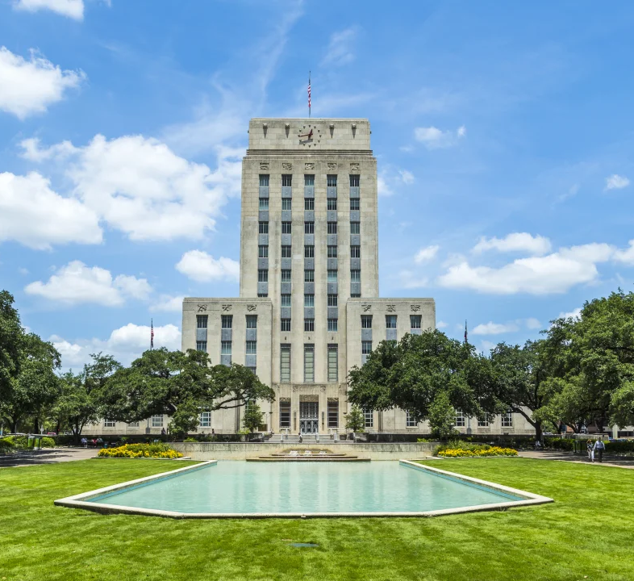
What is An MSD
A voluntary deed restriction to prevent the use of contaminated groundwater
No water wells on the subject property for drinking water purposes
A legally binding way to ensure the public is not exposed to contaminants by drinking water ingestion

Slide 5

Who the MSD Impacts
An MSD certificate applies to the applicant’s property only and prohibits the use of shallow groundwater as drinking water by deed recordation. This allows impacted properties to be redeveloped, which benefits the communities in which the MSD is located.

Slide 6

Environmental Cleanup
The MSD is only one step in the cleanup process
Responsible parties remain liable for any consequences resulting from contaminated groundwater originating from the application site

Slide 7

City’s Requirements of the Applicant
Enrollment in a state or federal cleanup program
Thorough investigation confirming that the groundwater plume (contamination) is stable or decreasing, and fully delineated (exact position identified)
Source of contamination has been removed
A third-party Engineer (P.E.) or Geologist (P.G.) must certify the application

Slide 8
Steps in the Process
Submit Application to the City
Review Application
Pre-Application Meeting
City Council Approves or Denies
Hold Public Hearing
Hold Public Meeting
Comments
Comments
Submit Application to the TCEQ
TCEQ Approves or Denies
MSD Ordinance is filed in the County Deed Records
Comments

Slide 9
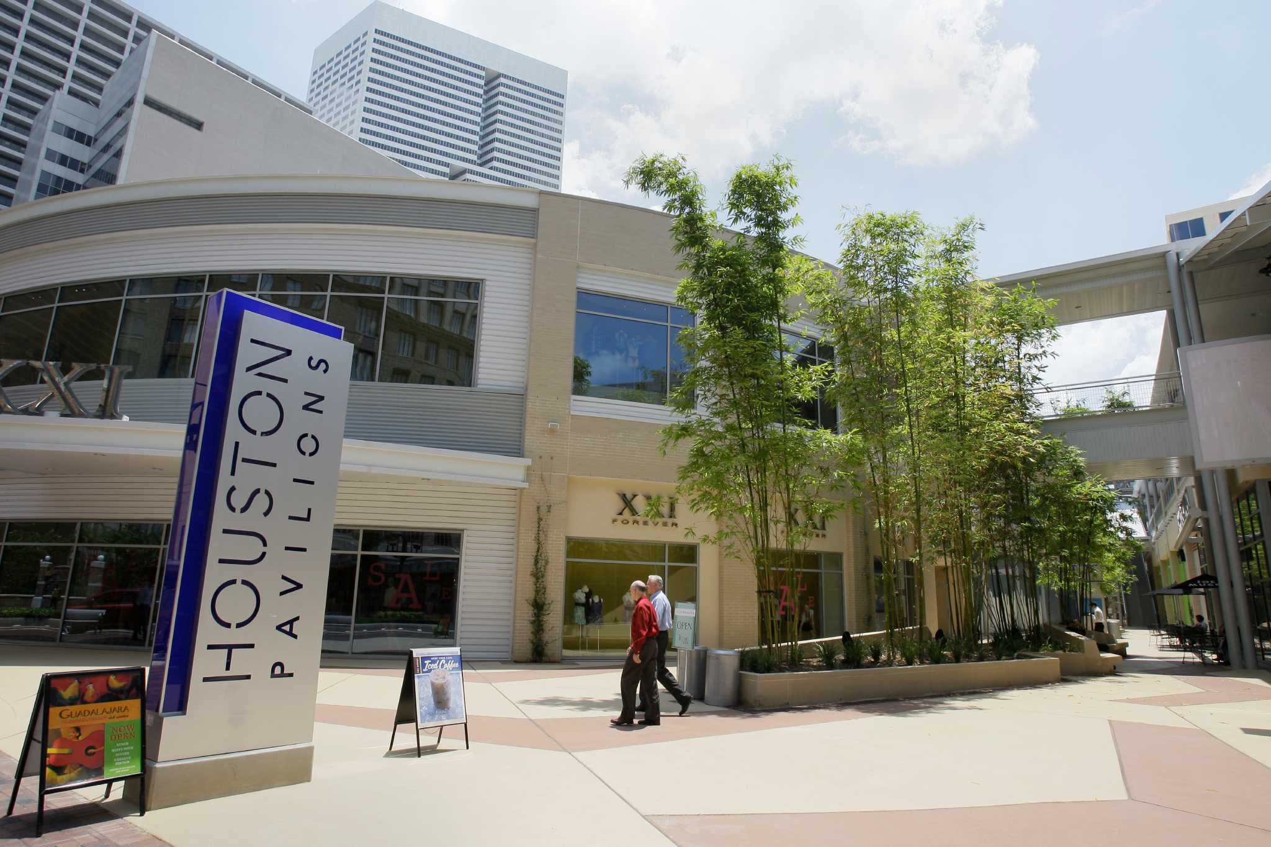
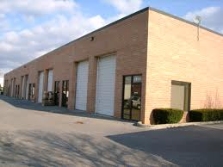
Why Support An MSD?
Protects the public from consumption of contaminated groundwater
Encourages clean-up of contaminated sites
Promotes redevelopment of under-utilized properties

Slide 10
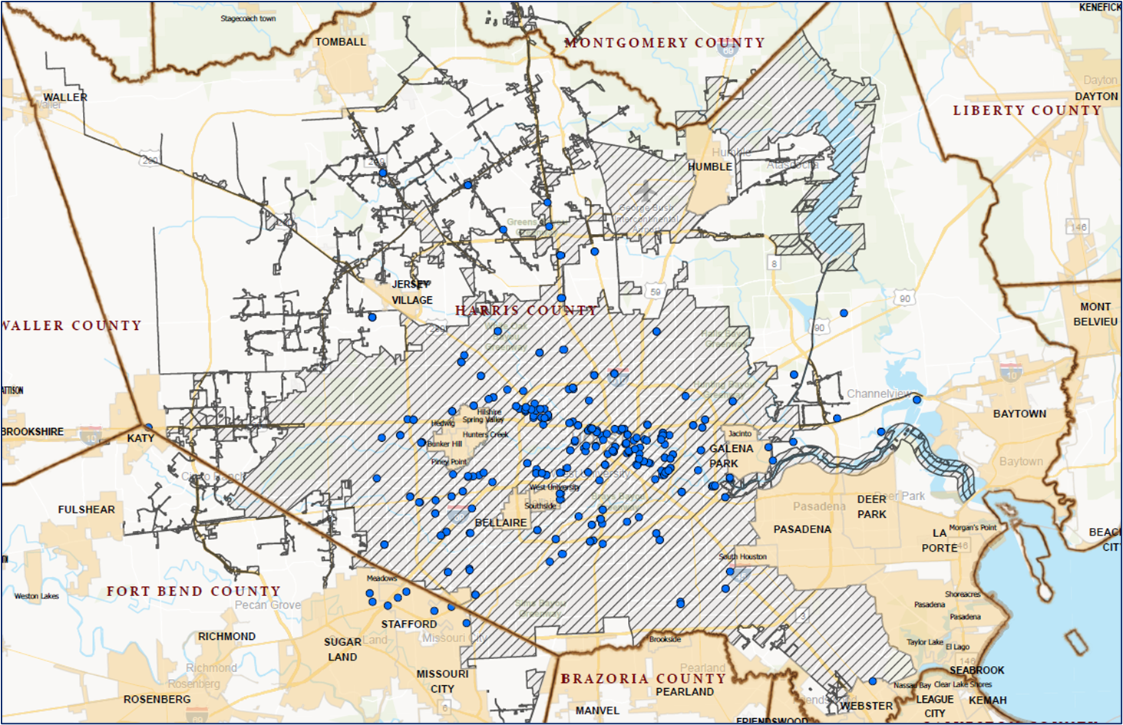
MSD Sites in Houston

Slide 11
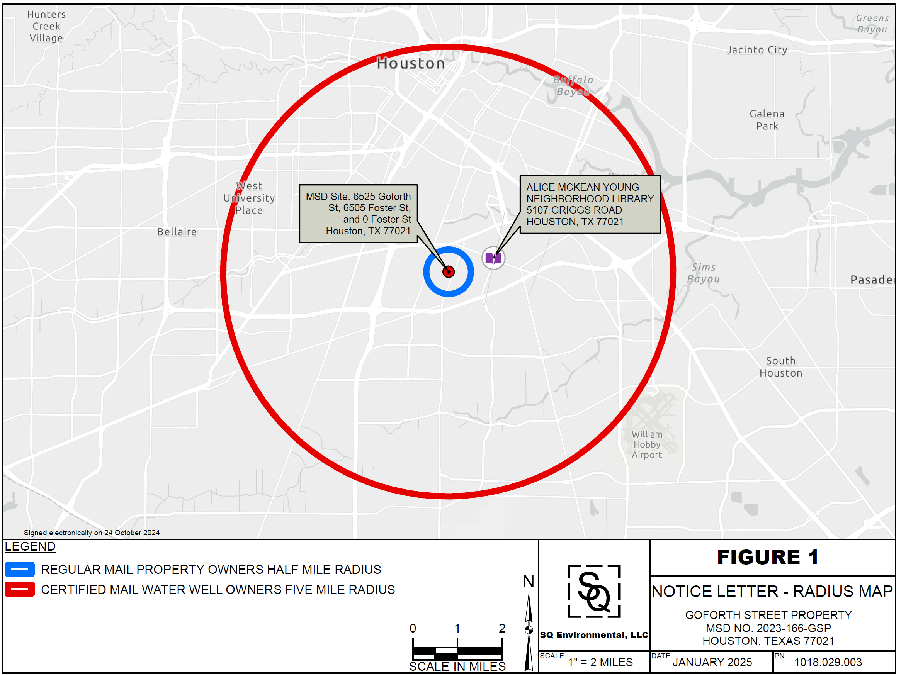
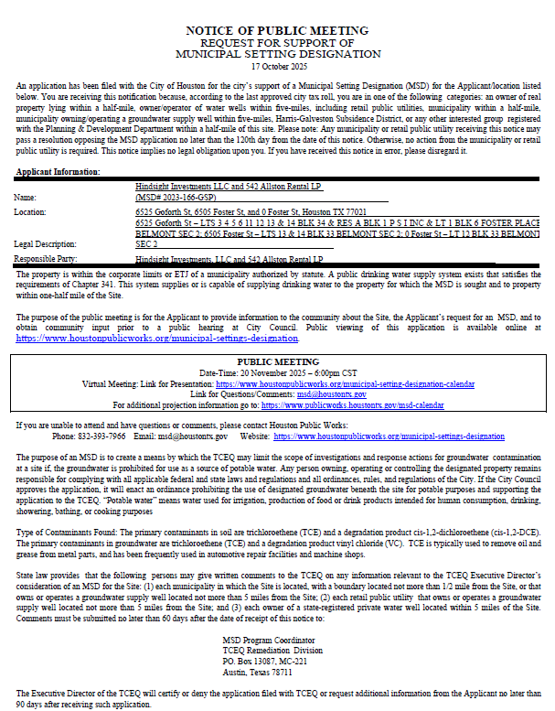
MSD Notice of public meeting – GoForth
Property 11/20/2025
WATER WELL OWNERS
certified mail
5-mile radius
state requirement
PROPERTY OWNERS
first-class mail
½-mile radius
city requirement
Notes:
The Applicant and the City of Houston are required to provide those stakeholders, which include all:
Citizens via legal announcements in the newspaper,
Elected representatives via certified mail,
Property owners within a ½-mile radius via first class mail, and
Well owners within a 5-mile radius with a minimum of 30-days notice of this Public Meeting.

Slide 12
goforth street REPRESENTED BY:
Trevor cole, pg (SQ Environmental, LLC)
Background
The property is located approximately 1.6 miles east of the intersection of Interstate 610 and Highway 288. The property is approximately 1.2 miles south of Brays Bayou, which generally runs east to west.
The privately-owned portions of the designated property are currently participating in the TCEQ Voluntary Cleanup Program (VCP) and have been assigned VCP ID No. 3207.
Public drinking water is currently available to the properties located within a one-half-mile radius surrounding the designated property by the City of Houston public water supply system. No domestic or commercial water wells were identified within 500 feet of the designated property.

Slide 13
goforth street, REPRESENTED BY: Trevor cole, pg
Site Information
February 24, 2022, the property was accepted into the VCP after identification of chlorinated solvent constituents in soil and groundwater, and to a lesser extent, petroleum-related compounds, associated with historical operations.
No municipalities, other than the City of Houston, have corporate limits within one-half mile of the boundary of the designated property.
The site includes properties that encompass three parcels in Houston, Harris County, Texas, totaling 3.1271 acres, located at:
6525 Goforth St.
6505 Foster St.
0 Foster St.

Slide 14
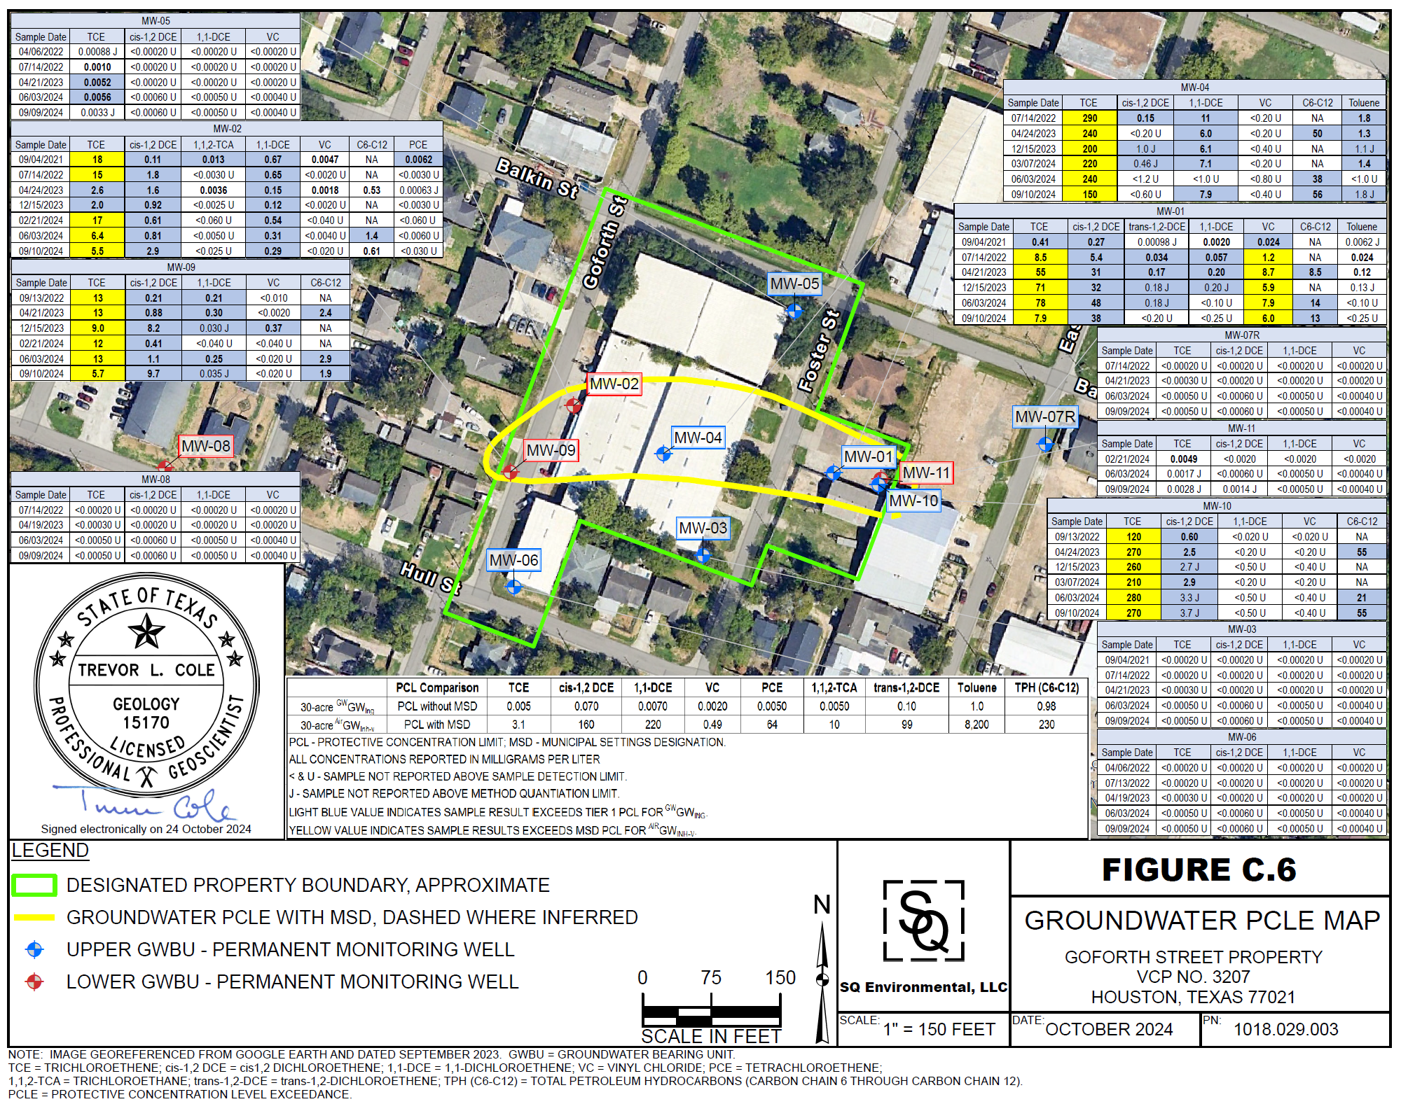
Goforth property ATTENUATION
This aerial image of the site depicts the “protective concentrations level exceedance zone” (PCLE zone), which is based on the sampled groundwater data from wells installed as part of the TCEQ VCP project.

Slide 15
Groundwater Contamination
Deed Restriction
Sampling Well
Water Well
Source
Groundwater Flow
Groundwater Zone
(Sands)
20 to 60
feet
Contaminant Plume
Confining Clay Layer
600 +
feet
Please Note: Houston has shallow contaminated groundwater scattered across the City

Slide 16
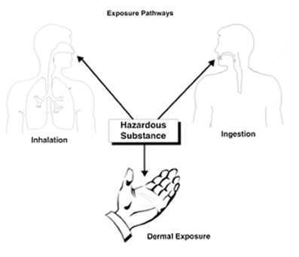
Exposure Pathways
Cleanup programs are based on public exposure to contaminants and reducing public health risks.
Exposure Pathways
Ingestion
Inhalation
Contact (dermal)
Soil
Groundwater to surface water
Ecological

Slide 17

MSD Application Availability
Goforth Street Properties
Alice McKean Young Neighborhood Library
5107 Griggs Road, Houston, TX 77021
Also available online at:
www.houstonpublicworks.org/municipal-settings-designation

Slide 18


Contact Information
Cassandra Walker
Location: Houston Public Works
611 Walker St. 18th Floor
Houston, Texas 77002
Direct Email: Cassandra.Walker@houstontx.gov
Team Email: msd@houstontx.gov
Phone: 832-393-7966
Website: www.houstonpublicworks.org/municipal-settings-designation

