Slide 1


Community
Reentry Network Program

Slide 2

Community Reentry Network Program:
Purpose
The Community Reentry Network Program (CRNP) provides support to ex-offenders by identifying physical and behavioral health needs. The CRNP links individuals to healthcare services, supportive housing resources, family reunification, evidence based programming, education and training programs and workforce development. The program offers many services, supports and life skills courses at no cost. Annually, the program enrolls approximately 500 individuals. As of June 2019, our 3-year recidivism rate was 13.4% as compared to the statewide average reconviction rate of 37.8%.
Why we are here today:
The CRNP proposes to provide two additional classes that are court ordered, supervision stipulated or required to retain employment. The classes will be offered at an affordable rate to participants.
The proposed rates are based on the Municipal Courts established rates or the COH Finance recommended rates. The program will reassess the fees in two years to determine if an adjustment is warranted.
The fees will be used to help sustain the CRNP operations and ensure staff maintain required credentialing.
2

Slide 3
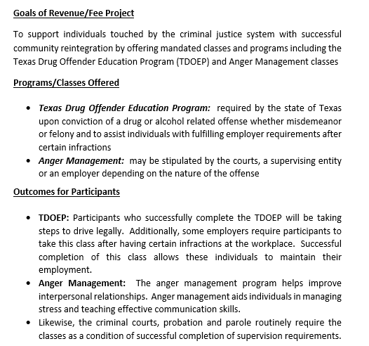
CRNP Fee Generating Programs:
Goals and Outcomes
Established in 2008
The Community Re-Entry Network Program (CRNP) provides support to ex-offenders by identifying physical and behavioral health needs. CRNP links individuals to healthcare services, supportive housing resources, family reunification, evidence based programming, education an training programs and workforce development.
Program Components
Evidence Based Programming, Job Readiness and Peer Support
Time and Stress Management
Maintaining Mental and Physical Health
Eliminating the Thinking Errors
Professionalism and Interview Etiquette
Financial Literacy
3

Slide 4
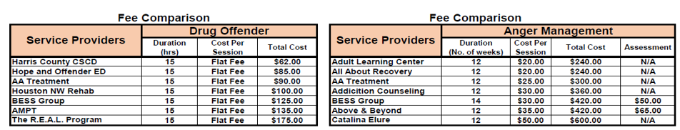
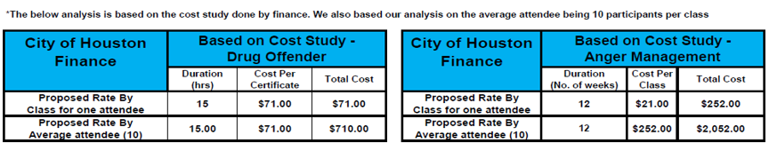

Community Reentry Network Program:
Proposed Fees
$21.00
$252.00
$252.00
4

Slide 5
The CRNP thanks you for your support.
LaTosha Selexman, MPA
Division Manager
Community Reentry Network Program
4802 Lockwood Dr.
Houston, TX 77026
832.393.5508
LaTosha.Selexman@houstontx.gov
5

