Slide 1
Presentation to the Quality of Life Committee Presented by: Andy Icken the Office of the Mayor
October 31, 2019

Slide 2
History of the proposed Changes to the Sign Code:
November 2017, several Sign Code changes were proposed by Scenic Houston and Sign Administration.
Covered areas included creation of an airport corridor, management of abandoned signs, and a number of commonsense technical fixes
Concluded we need to have further discussion.

Slide 3
History of proposed Changes to the Sign Code cont’d:
A taskforce was led by Tommy Friedlander and Philip Schneidau, who agreed to pull together all industry groups and Scenic Houston.
Considerable interactions have occurred concerning the proposed changes, and today’s proposal reflects the agreement reached by the taskforce.
These changes are supported by:
Houston First
Scenic Houston
Houston Real Estate Council (HREC)
Institute of Real Estate Management (IREM)
Building Owners & Managers Association (BOMA)
National Association of Industrial & Office Parks (NAIOP)
Houston Apartment Association (HAA)
Houston Hotel Association
Greater Houston Restaurant Association

Slide 4
Proposed Changes:
Creation of the Airport Corridor District
Define Abandoned Signs and Signs Not In Use
Allow on-premise signs to update advertising displays without losing grandfather status
Allow illuminated on-premise signs to update their lighting mechanism to LED without losing grandfather status
Allow wall signs to anchor above rooflines

Slide 5
Airport Corridor District
Purpose: To reduce the height and size of signs along the freeways between the City’s airports and its central business district. This will reduce distraction to drivers and improve the first impression of travelers driving into the City from the City’s airports.

Slide 6
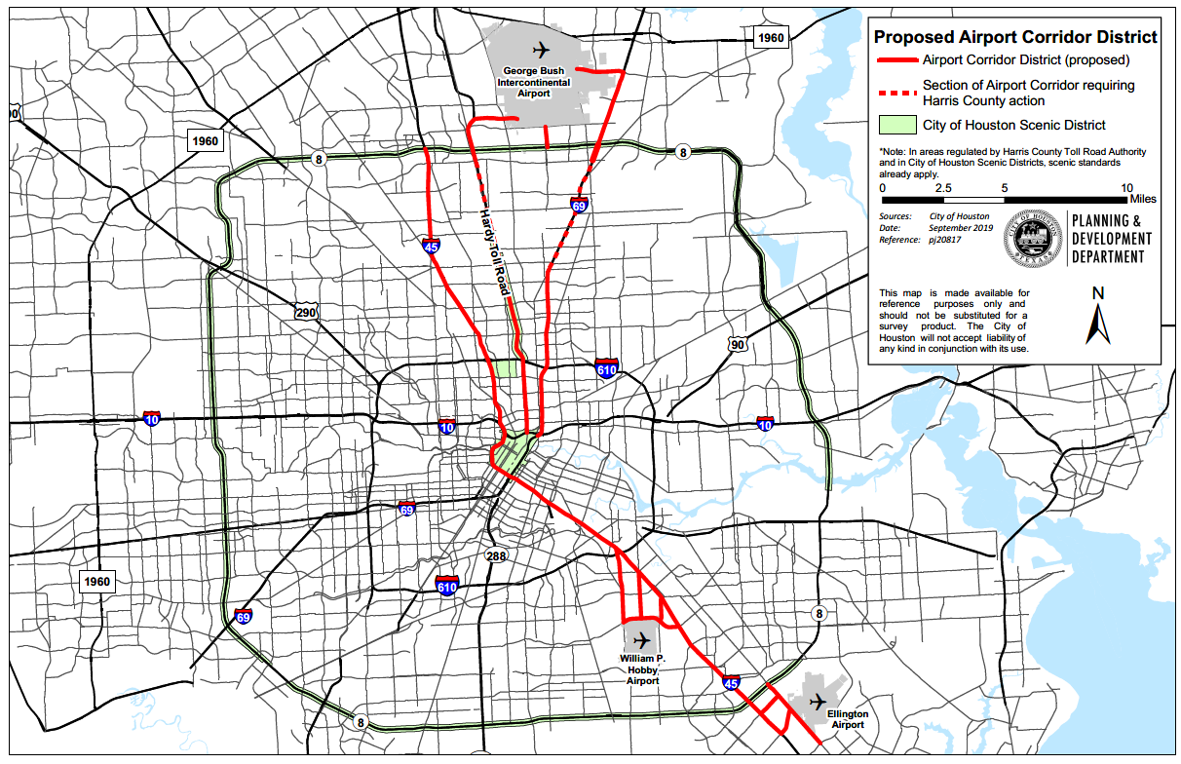
Airport Corridor District

Slide 7
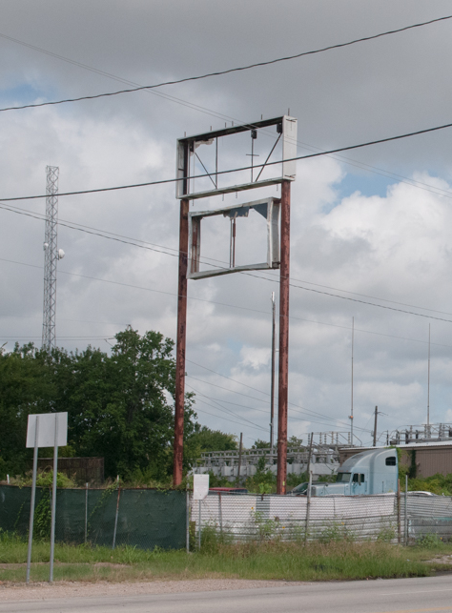
Abandoned signs
Background: Currently, there are numerous abandoned signs around the City in various states of disrepair.
Purpose: To create a definition for abandoned signs in the Sign Code to facilitate the removal of these signs from throughout the City.

Slide 8
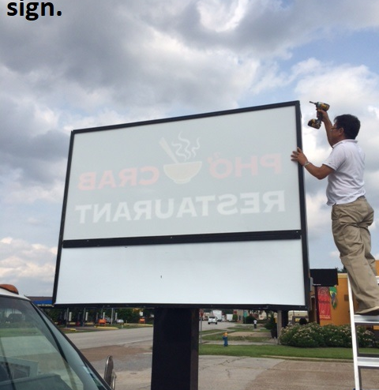
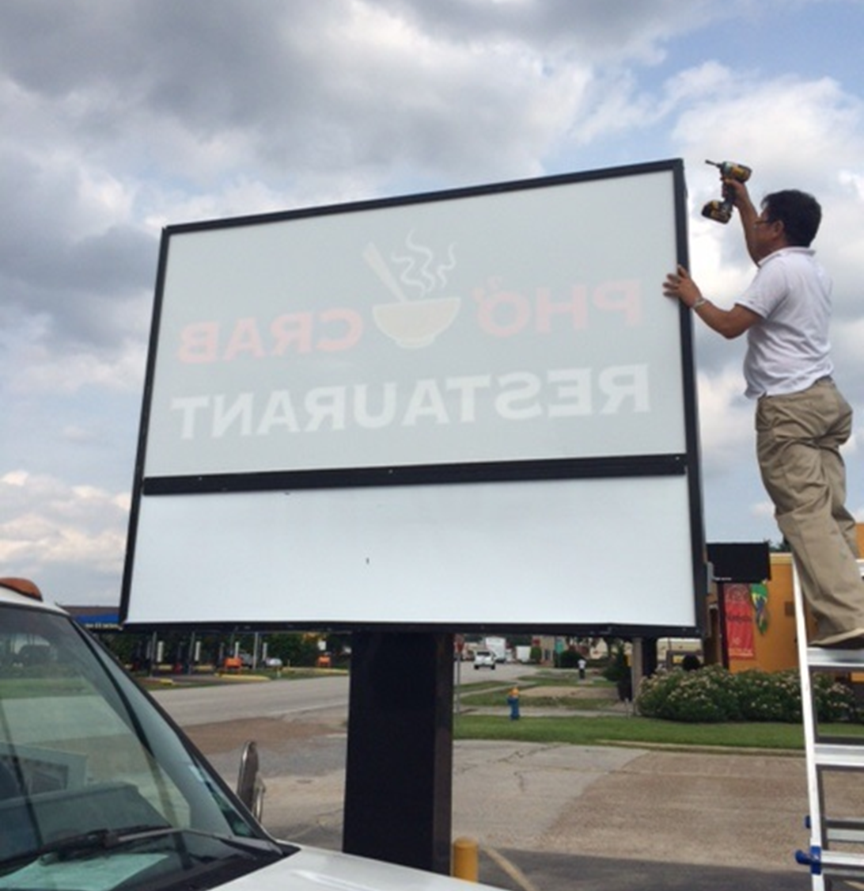
Sign not in use
Background: Some signs remain unused for long periods of time, although their owners maintain them and intend to use them in the future.
Purpose: To add a definition for such signs to improve clarity and require that these signs be permitted to distinguish them from abandoned signs.

Slide 9
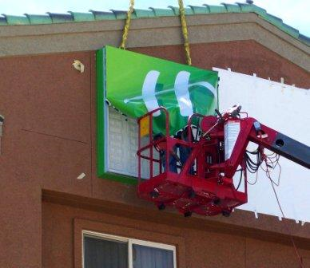
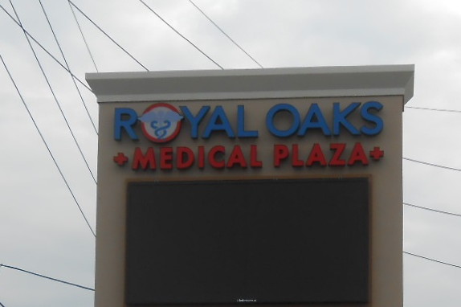
Advertising Display
Background: Currently, on-premise sign owners must obtain a new permit if they replace or make structural changes to a sign. In order to obtain a new permit, they must first bring the sign into compliance with the height and size restrictions set forth in the Code.
Purpose: To allow owners to make certain types of changes to their on-premise signs (e.g. changes in ornamental features, channel letters, symbols, and flex face) while still maintaining the current height and size of their signs.
Sign owners will still be required to obtain appropriate permits for these changes.

Slide 10
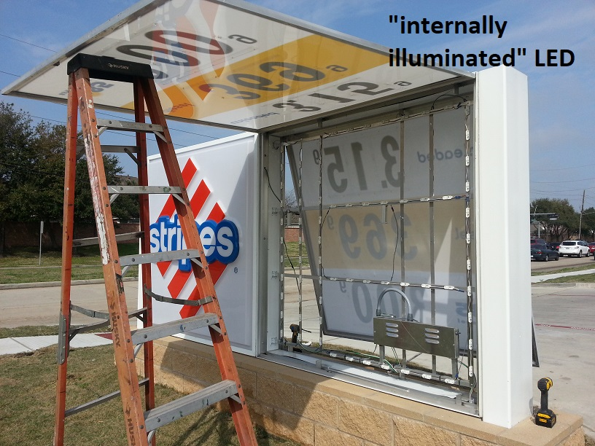
LED Lighting
Background: LED lights are more energy-efficient than incandescent and fluorescent lighting, and their brightness can be controlled. Currently, upgrading to LED causes a sign to lose grandfather status.
Purpose: To allow sign owners to convert a conventional lighting mechanism to LED without losing grandfather status.
Internally illuminated sign with LED

Slide 11
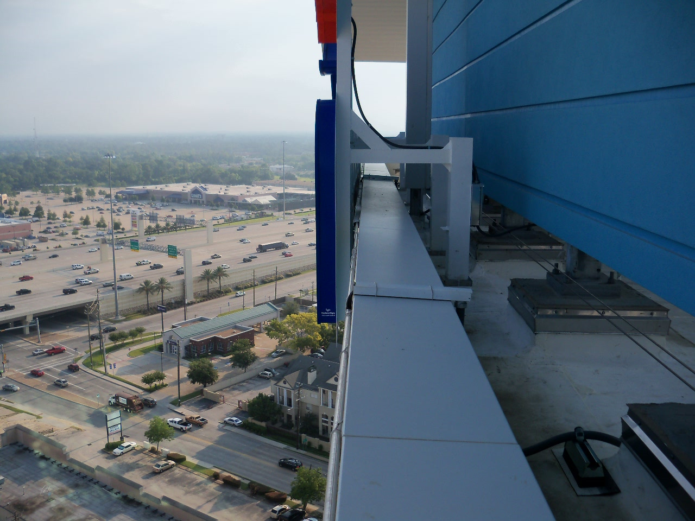
Background: Currently, wall signs are not allowed to have an anchoring mechanism above the roofline. Purpose: To allow business owners to attach the upper edge of a wall sign to the building roof for support purposes only. No portion of the sign’s message shall extend above the roofline.
Wall Signs

Slide 12
Summary
What the proposed changes accomplish:
Addresses sign blight over time.
Focuses stakeholder resources on maintenance improvements and landscaping enhancements.
Establishes a regulatory structure for focusing on removal of abandoned signs.
What the proposed changes will NOT do:
Off-premise signs (billboards) are not addressed or in any way impacted by this ordinance.
Does not require removal of existing non-conforming on-premise signs.
Does note require additional City enforcement or capital resources (i.e. no fiscal note).

Slide 13
Proposed Timeline
Quality of Life Committee, October 31, 2019.
Proposed Ordinance and detailed presentation posted on City website, October 30 – November 30, 2019.
Comments tabulated and responses posted by December 6, 2019.
Council Action, to be defined.

Slide 14
Contact for Public Comment: signadministration@houstontx.gov

