Slide 1
Amendments to the City of Houston Sign Code

Slide 2
Presentation to the Quality of Life Committee Presented by: Sign Administration & Office of the Mayor
October 31, 2019

Slide 3
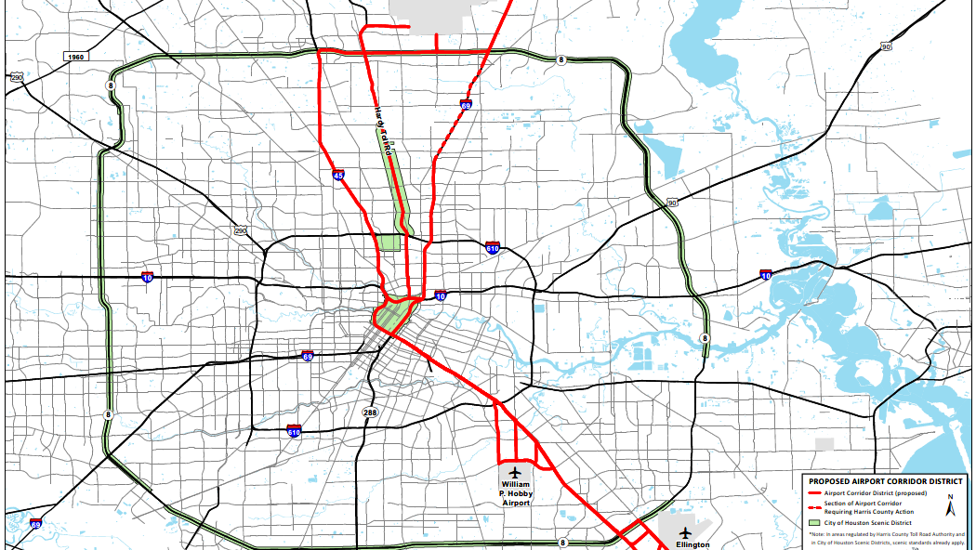
Airport Corridor District

Slide 4
Sign Code Changes
November 2017, several sign code changes were proposed by Scenic Houston and Sign Administration.
Covered areas were:
On premise “Airport Corridors.”
Management of abandoned signs and signs not in use.
Changes to existing signage.
Conversion to current technology (LED).
Wall signs.
Concluded we need to have further discussion.

Slide 5
Sign Code Changes
A taskforce led to Tommy Friedlander and Philip Schneidau, who agreed to pull together all industry groups and Scenic Houston.
Considerable interactions have occurred, and proposal today reflects agreement reached.
These changes are supported by:
GHP & Houston First
Scenic Houston
Houston Real Estate Council (HREC)
Institute of Real Estate Management (IREM)
Building Owners & Managers Association (BOMA)
National Association of Industrial & Office Parks (NAIOP)
Houston Apartment Association (HAA)
Houston Hotel Association
Greater Houston Restaurant Association

Slide 6
Airport Corridor District
Purpose: To reduce the size and visibility of signs along the freeways between the City’s airports and its central business district. This will reduce distraction to drivers and improve the first impression of travelers driving into the city from the city’s airports.

Slide 7
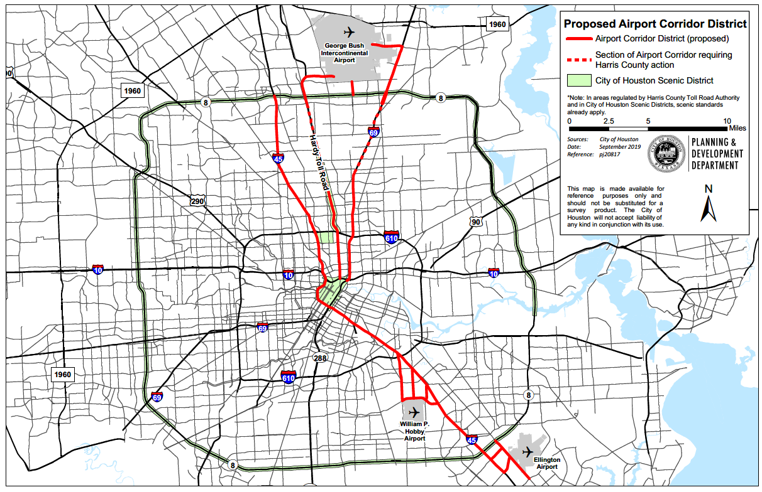
Airport Corridor District

Slide 8
Category A – Ground signs on major thoroughfares in Airport Corridor District (previously in Category B) Category E – Ground signs on freeways in Airport Corridor District (previously in Category C) (Note: the proposed changes would only apply to prospective signs installed along the airport corridor)
TABLE 4611 ALLOWABLE ON-PREMISE GROUND SIGN HEIGHTS AND SIZES BY SIGN TYPE AND CATEGORY OF RIGHT-OF-WAY
SIGN TYPE | CATEGORY A |  | CATEGORY B |  | CATEGORY C |  | CATEGORY D |  | CATEGORY E
 | Height | Size | Height | Size | Height | Size | Height | Size | Height | Size
 | (Ft.) | (SFt.) | (Ft.) | (SFt.) | (Ft.) | (SFt.) | (Ft.) | (SFt.) | (Ft.) | (SFt.)
SINGLE BUSINESS | 14 | 100 | 20 | 150 | 42½ | 225 | 8 | 60 | 31 | 150
MULTI-TENANT 2 OR 3 BUSINESSES | 19 | 200 | 26 | 300 | 42½ | 450 | 10 | 120 | 31 | 300
MULTI-TENANT 4 OR MORE BUSINESSES | 24 | 300 | 31 | 450 | 42½ | 600 | 12 | 180 | 31 | 450
FLAG | 20 | — | 35 | — | 50 | — | — | — | — | —

Slide 9
Abandoned signs & signs not in use

Slide 10
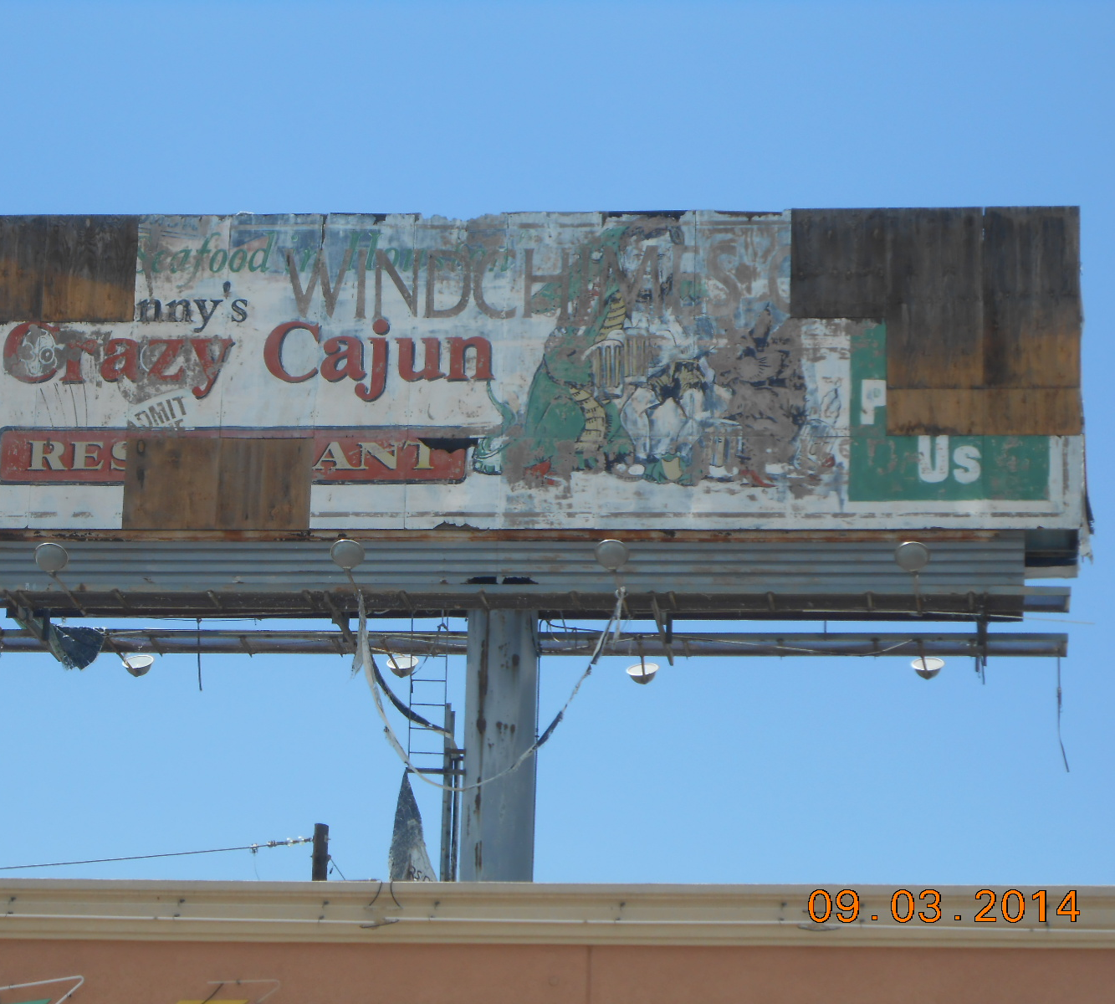
“Abandoned signs”
Background: Currently, there are numerous abandoned signs around the City in various states of disrepair.
Purpose: Facilitate the removal of abandoned signs in the City.
The first step in this process is to identify what an abandoned sign is, as there is currently no definition in the Code.

Slide 11
“Abandoned sign”
Proposed Definition: “…An on-premise sign that has been without a permit for a period of two years. A multi-tenant sign is deemed to be an abandoned sign only when no cabinet on the sign structure is permitted for a period of two years.”
Abandoned signs are expressly prohibited under the revisions.
The proposed two-year period tracks state law.

Slide 12
“Sign not in Use”
Some signs remain unused for long periods of time, although their owners maintain them and intend to use them in the future.
Section 4607(e) lists requirements for the maintenance of such signs, but the Code does not currently define or require a permit for these types of signs.
The proposed revisions to the Code will add a definition for such signs to improve clarity and require that these signs be permitted to distinguish them from abandoned signs.

Slide 13
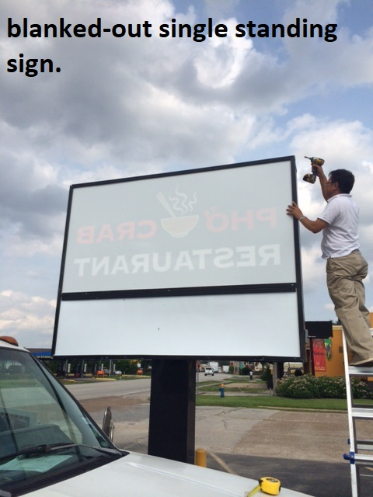
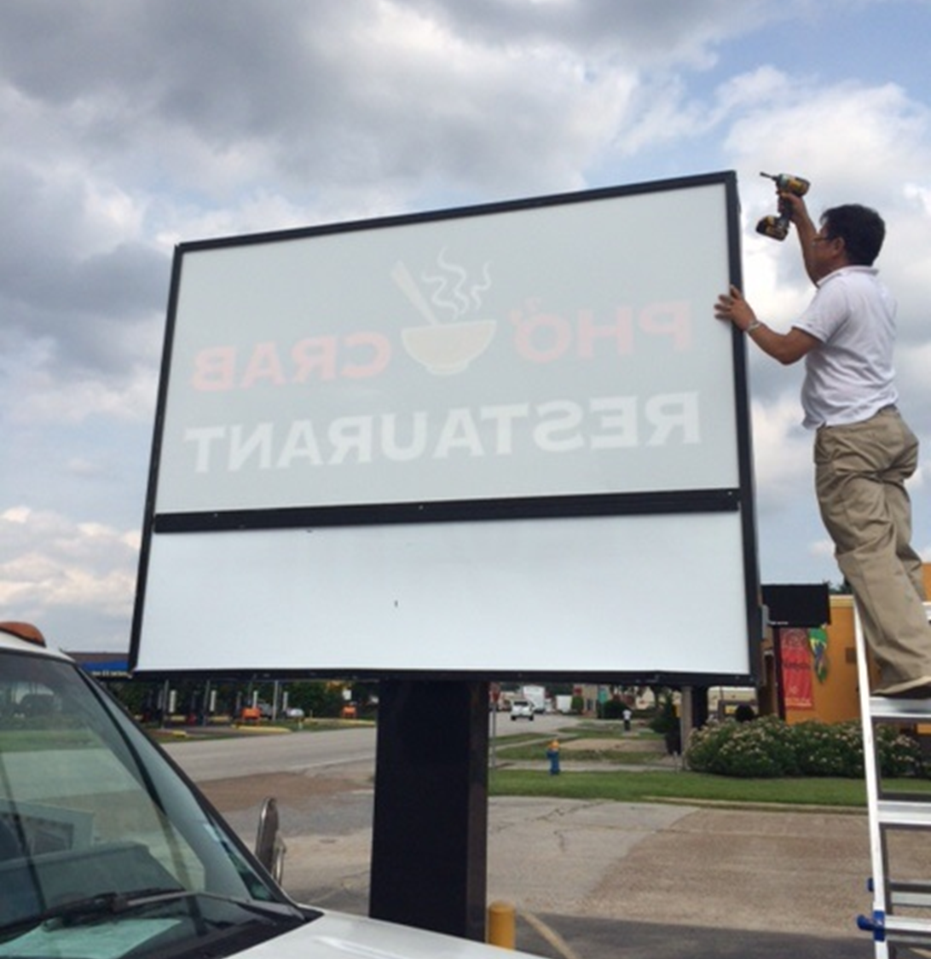
“Sign not in use”
“an on-premise sign that does not identify, advertise, or provide information about at least one existing business, person, activity, good, product or service at the premises. A multi-tenant sign is deemed to be a sign not in use when no cabinet on the sign structure identifies, advertises, or provides information about an existing business, person, activity, good, product or service at the premises.”

Slide 14
Signs not in use must be permitted and blanked out.

Slide 15
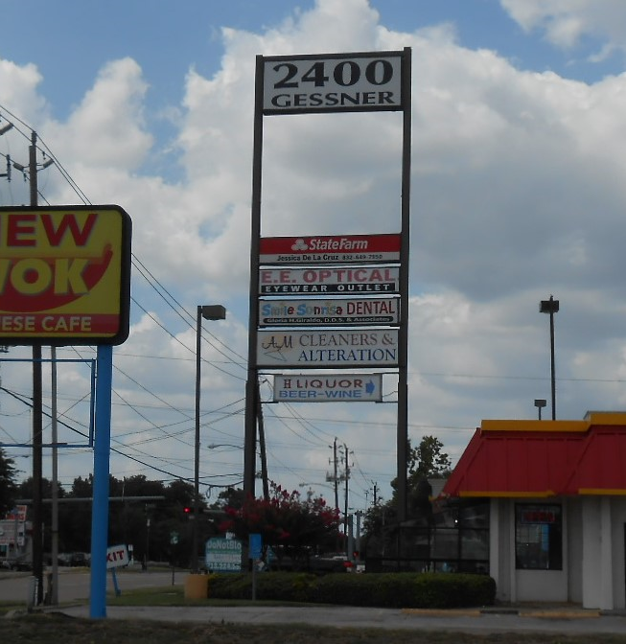
Multi-Tenant Signs
Presently, there are two permitting methods for multi-tenant signs, depending primarily on when the signs were permitted.
1. Individual permits for each cabinet
2. Single permits for the entire sign structure
Definitions for abandoned signs and signs not in use are necessary to effectively enforce both of these permitting methods.

Slide 16
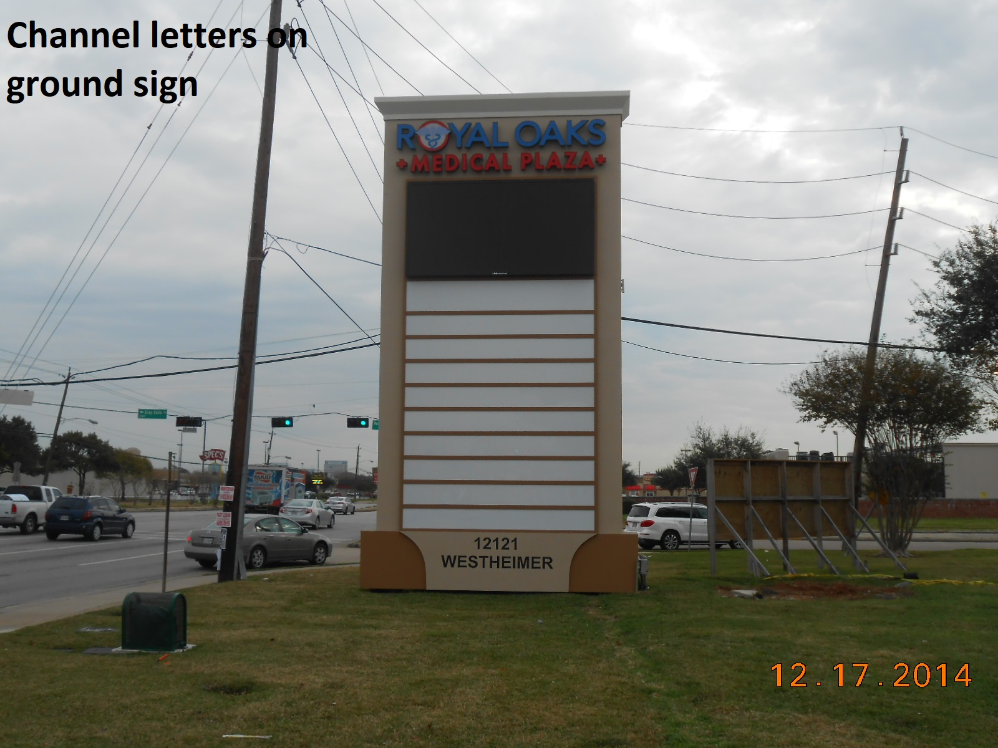
Multi-Tenant Signs
“A multi-tenant sign is deemed to be an abandoned sign only when no cabinet on the sign structure is lawfully permitted for a period of two years.”

Slide 17
Multi-Tenant Signs
“A multi-tenant sign is deemed to be a sign not in use when no cabinet on the sign structure identifies, advertises, or provides information about an existing business, person, activity, good, product or service at the premises.”

Slide 18
“advertising display”

Slide 19
“Advertising Display”
Background: Currently, on-premise sign owners must obtain a new permit if they replace or make structural changes to a sign. In order to obtain a new permit, they must first bring the sign into compliance with the additional restrictions in Section 4611(i), which would generally require them to reduce the height and size of the sign.
Purpose: Under the proposed ordinance, sign owners will be able to make a few specified types of changes to their on-premise signs, including changes in ornamental features, channel letters, symbols, and flex face, and retain the current height and size of their signs.
Sign owners will still be required to obtain appropriate permits for these changes.

Slide 20
Proposed Amendment to Section 4605(e)
(3) The owner of an existing, previously permitted sign must apply to make changes to advertising display features. The following advertising display changes to a previously permitted sign shall not trigger compliance with the requirements in Section 4611(i):
a. Ornamental features
b. Channel letters, so long as the letters and symbols remain the same
c. Symbols
d. Flex face, Lexan or other similar elements or materials
e. Conversion of an illuminated sign to a high technology sign

Slide 21
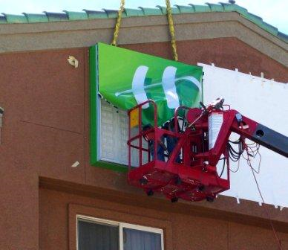
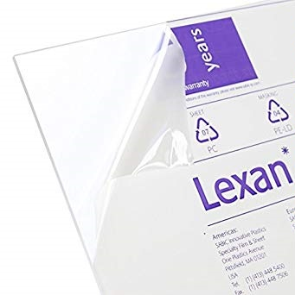
Will not trigger compliance with 4611(i):
Flex Face
Lexan

Slide 22
Channel letters

Slide 23
Conversion to High-technology

Slide 24
Light-Emitting Diodes (“LED”)
Background: Under the current Sign Code, in order for a sign owner to upgrade a non-conforming sign from a light source other than LED to LED, the sign owner must obtain a new permit, which would require the owner to bring the sign into conformance with provisions of the Sign Code that were previously avoided due to a grandfather clause in the Code. This creates a disincentive for sign owners to upgrade their signs to more energy-efficient technology.

Slide 25
LED
Purpose: Sign Administration acknowledges the benefit of upgrading signs to LED lighting, and would like to remove the disincentive that is currently preventing businesses from doing so.

Slide 26
LED
LED lights use at least 75% less energy than incandescent bulbs for the same amount of light, and half as much as compact fluorescents, without toxic mercury. Additionally, an LED bulb lasts much longer than either other type.
Lighting accounts for 15% of global energy use. LED lights transfer 80% of their energy use into creating light—rather than heat, like older technologies, and reduce electricity consumption accordingly.

Slide 27
Proposed Amendment to Section 4605(e)
(3) The owner of an existing, previously permitted sign must apply to make changes to advertising display features. The following advertising display changes to a previously permitted sign shall not trigger compliance with the requirements in Section 4611(i):
***
e. Conversion of an illuminated sign to a high technology sign
(4) No existing sign may be converted to an electrical sign, high technology sign, or changeable message sign without also fully complying with the requirements described in section 4611(j), except as allowed in 4605(e)(3).

Slide 28
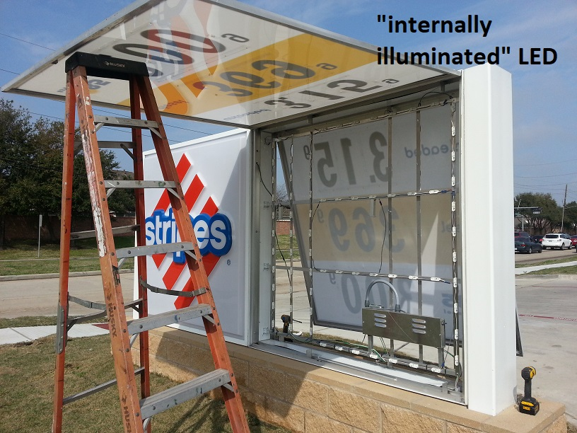
Owners may convert a conventional lighting mechanism to LED without losing grandfather status.
Internally illuminated sign with LED

Slide 29
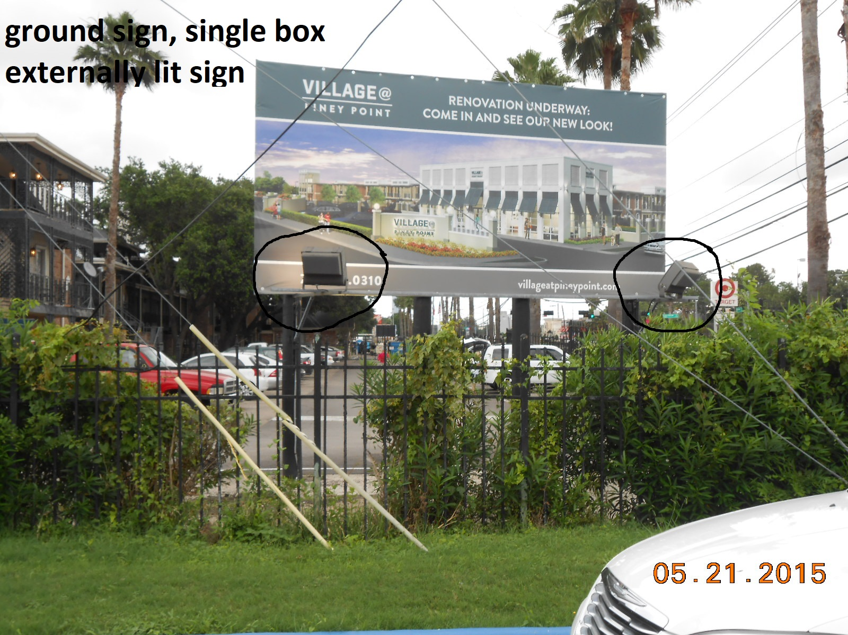
Owners may convert a conventional lighting mechanism to LED without losing grandfather status.
Externally illuminated sign with LED

Slide 30
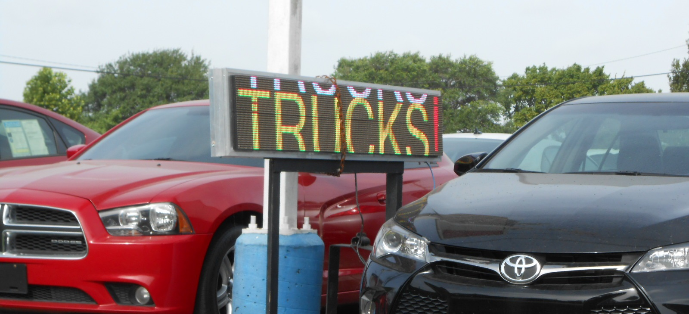
“Changeable messaging capabilities”
Spectacular sign, changeable electronic message board

Slide 31
Wall signs

Slide 32
Wall Signs
Background: Currently, wall signs are not allowed to have an anchoring mechanism above the roofline.
Purpose of Revision: To allow business owners to attach the upper edge of a wall sign to the building roof for support purposes only. No portion of the sign’s message shall extend above the roofline.

Slide 33
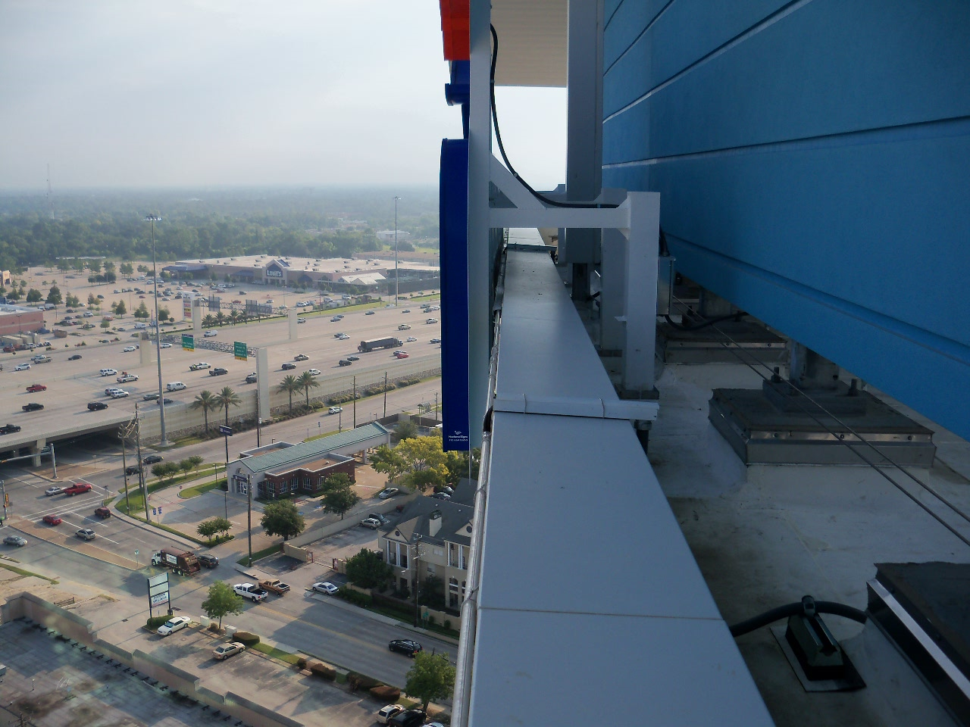
“Wall signs shall not extend above the roofline of the building to which they are attached, except for portions of the signs that are used solely for support or to anchor the signs to the building to which they are attached.”

Slide 34
Contact for Public Comment: signadministration@houstontx.gov

