Slide 1


Houston Police Department
Public Safety & Homeland Security Report Card
Chief Troy Finner
09.21.2023

Slide 2
Strategic Guidance: Public Safety Priorities
Priority guidance as established by Mayor Turner in the February 2023 Strategic Guidance publication.
Responsive & Efficient
Classified Staffing
Provide responsive and efficient public safety services.
Increase the number of police officers.
Prevention & Enforcement
Retention & Attrition
Improve public safety through effective crime prevention and enforcement.
Improve police officer retention and attrition rates.
Reduce Murder
Technology
Reduce the murder rate to pre-pandemic levels.
Increase the use of technology to enhance crime fighting capabilities.
Reduce Firearms
Reduce the number of guns on the street.
2

Slide 3
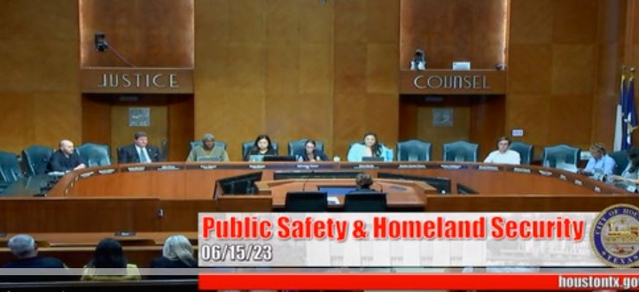

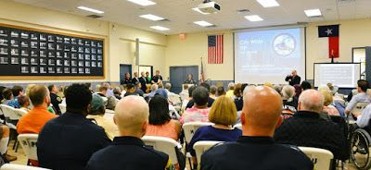
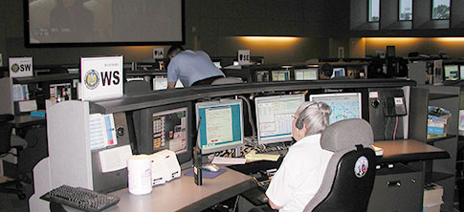
Responsive and Efficient Police Services
HPD Initiatives to increase responsiveness, efficiency and transparency.
To provide the most responsive and efficient police services possible, HPD has engaged our community partners and utilized various public forums to inform the public of upcoming initiatives and seek both cooperation and collaboration to assist in our efforts.
HPD is currently working to expand our alternative resources to respond to lower priority calls for service (PDU), freeing up patrol officers for the most urgent calls.
Committee Presentations
Media Briefings
Positive Interaction Program (PIP)
Patrol Desk Unit (PDU)
3

Slide 4
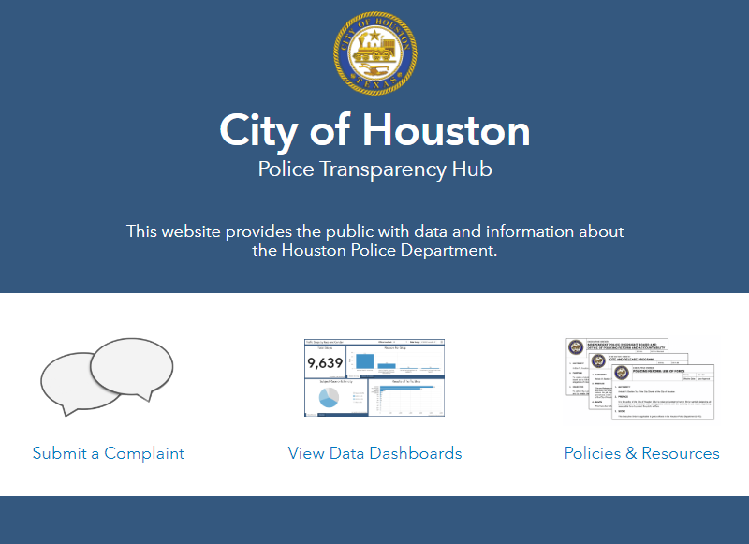
Responsive and Efficient Police Services
HPD Initiatives to increase responsiveness, efficiency and transparency.
In addition to the reports and datasets HPD makes available via our department website, Mayor Turner’s Office of Policing Reform and Accountability (OPRA) maintains a set of dashboards on the City of Houston Police Transparency Hub.
In the coming months, HPD will be working with OPRA to expand upon these dashboards, making more data publicly available.
4

Slide 5

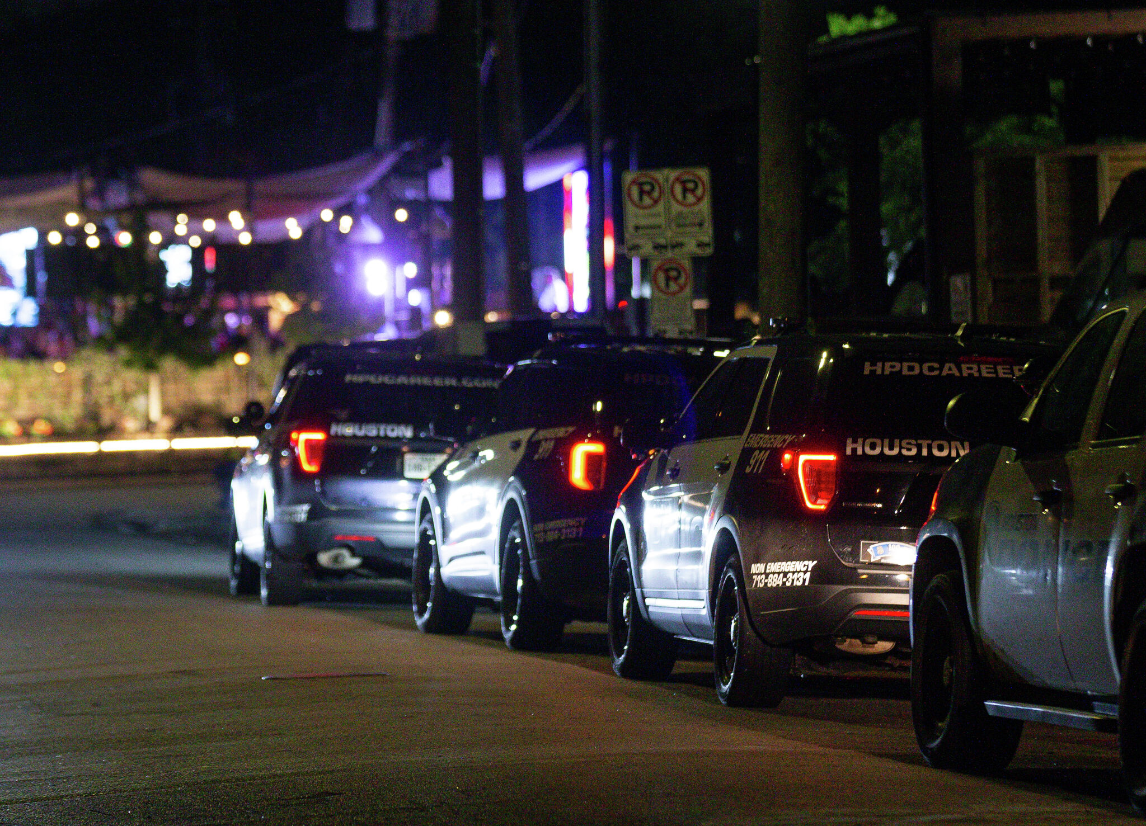


Prevention and Enforcement
HPD Initiatives to prevent and reduce crime within our community.
Over the past four years, the City of Houston has implemented several new ordinances. These ordinances help HPD address quality of life issues for our community.
Ordinance Examples include:
Ordinance regulating BYOB Establishments
Chapter 8 Changes (Towing/Storage Lots)
Catalytic Converter Ordinance
Outdoor Music Ordinance
Convenience Store Ordinance
Security Camera Ordinance
5

Slide 6

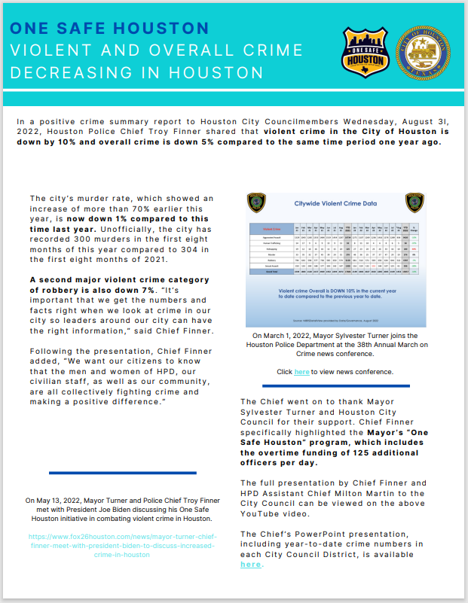
Prevention and Enforcement
HPD Initiatives to prevent and reduce crime within our community.
HPD has conducted strategic, large-scale initiatives to reduce crime under the One Safe Houston (OSH) umbrella.
Some OSH successes include:
Enhancing Traffic Enforcement and Safe Roadways Initiative
Reduction of human trafficking and restoration the Bissonnet Corridor.
Increased Domestic Abuse Response Team (DART) presence
Expanded Crisis Intervention Response Teams (CIRT) and Crisis Call Diversion (CCD) Program
Facilitated youth programs like the Youth Police Advisory Council (YPAC), Greater Houston Police Activities League (GHPAL), and the Explorers Program
6

Slide 7
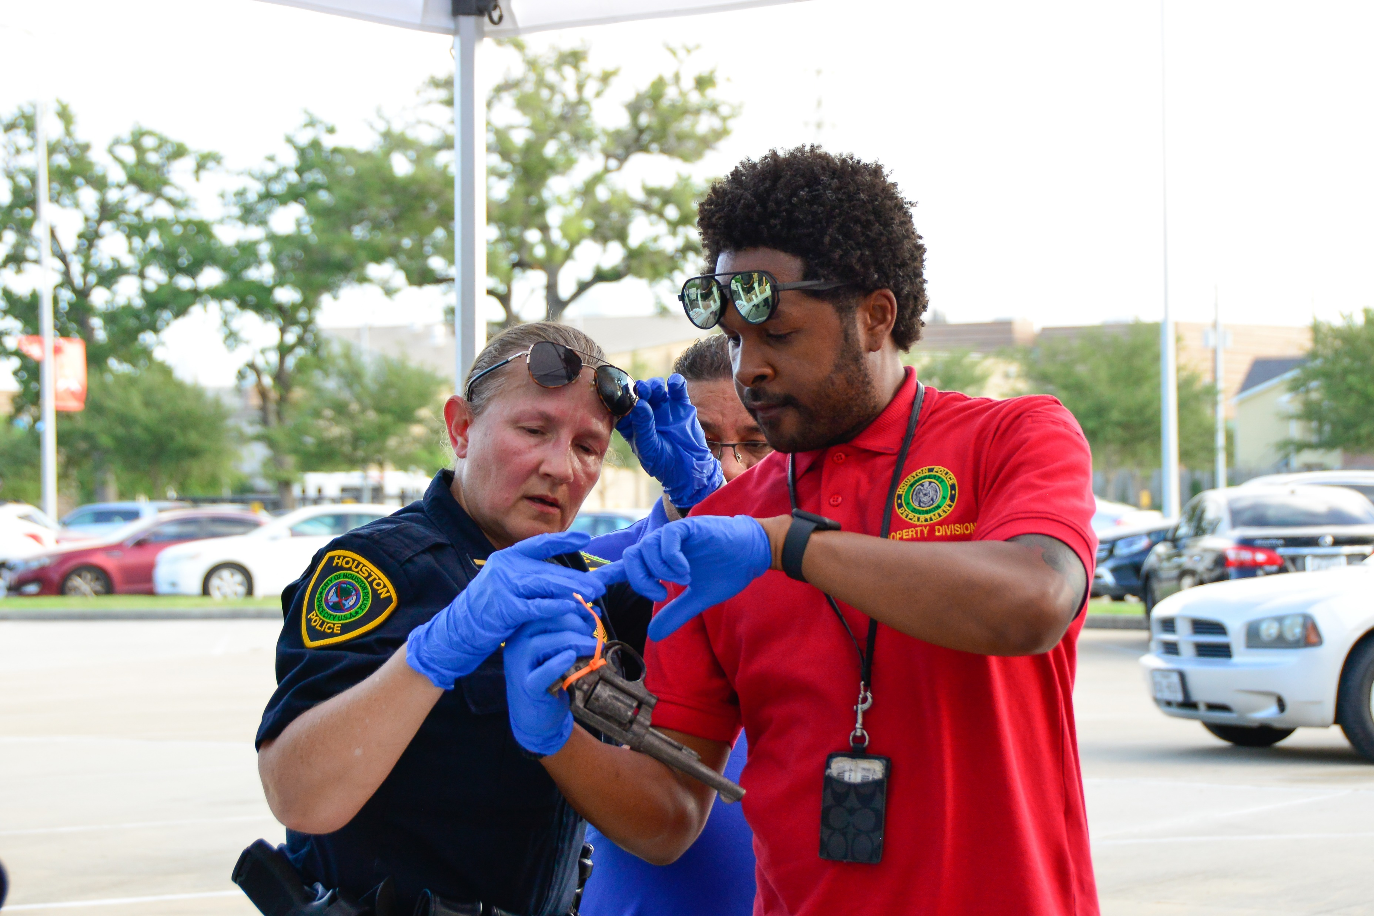
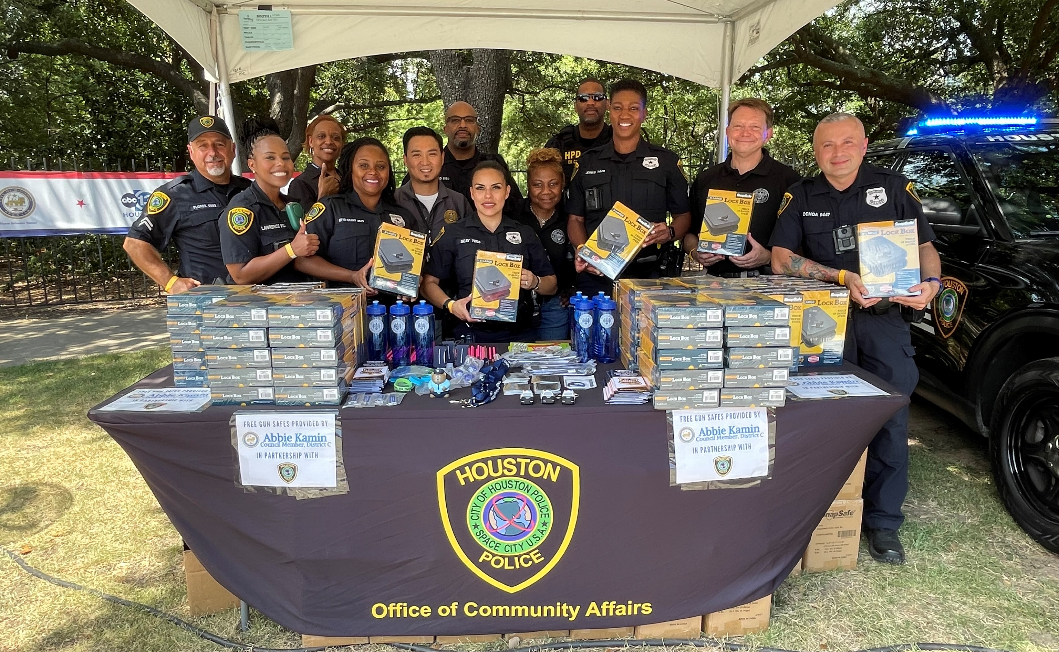
Reduce Firearms
HPD initiatives to reduce unlawful access to guns and increase overall gun safety.
To reduce unlawful access to guns and increase overall gun safety, HPD has taken a multi-phased approach by working with community partners to:
Donate 7,000+ gun safes to Houston families
Distribute thousands of free gun locks at community-based events
Facilitated three gun buyback events, recovering approximately 3,500 unwanted firearms
Supported Houston Health Department initiative to create a public-facing firearm injury dashboard
Participated in local academic research to further study the impact of gun violence
Disrupted 3 gangs and gang-related activity involving the illegal possession of firearms
7

Slide 8
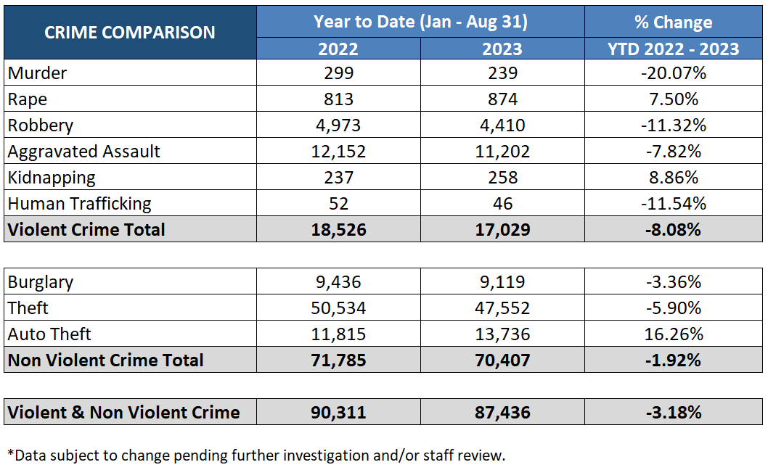
Reduce Murder
Year to Date Violent and Non-Violent Crime Comparison.
8

Slide 9

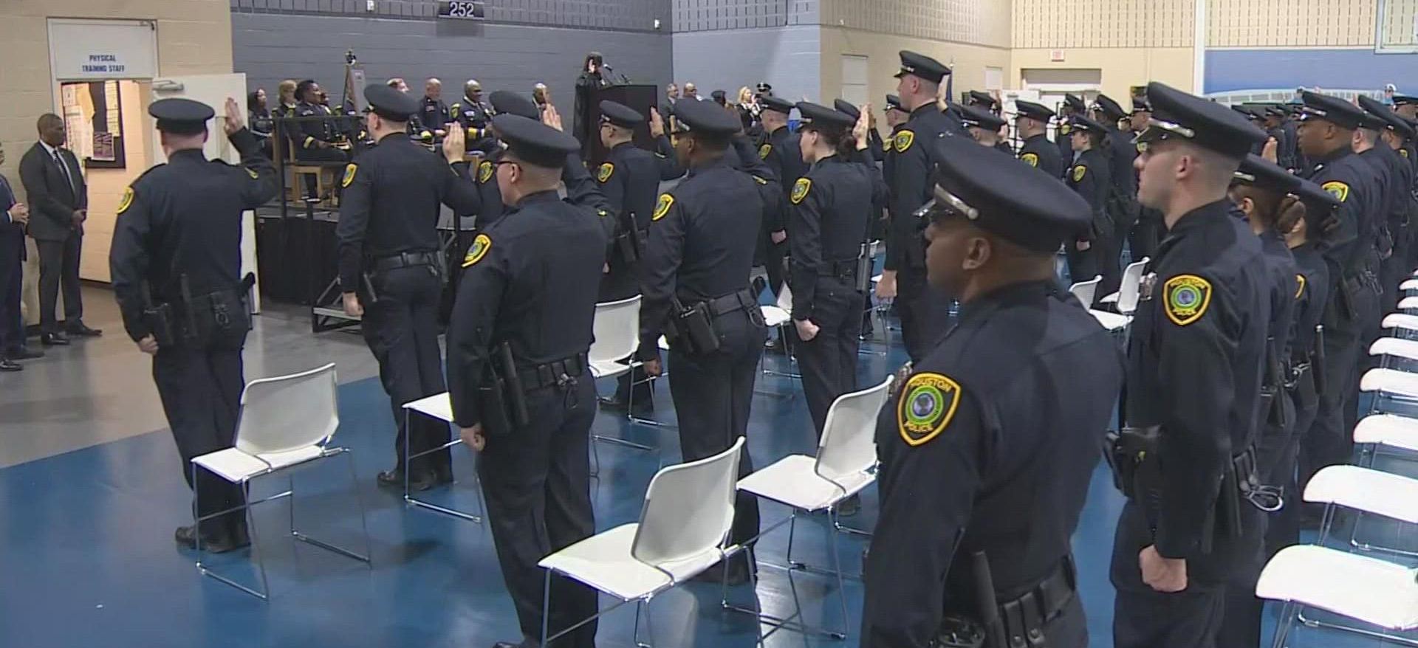
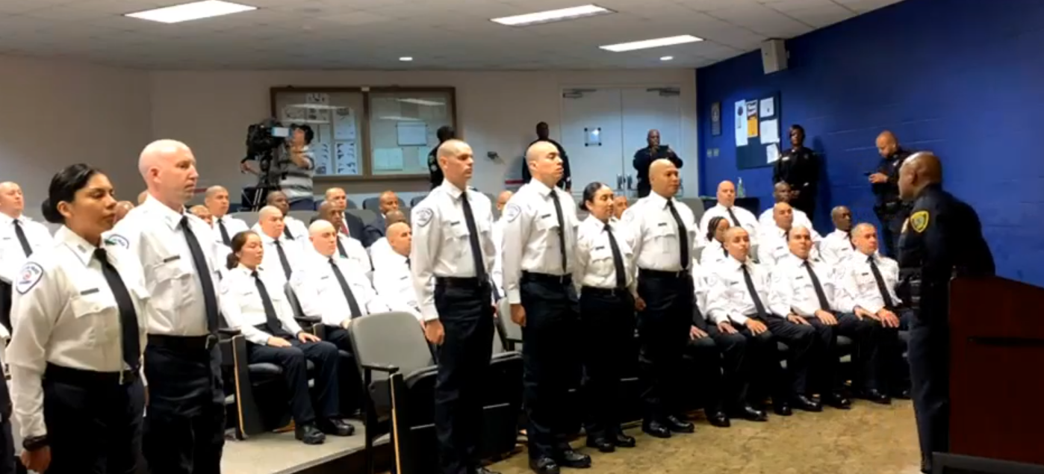
Classified Staffing: Recruitment, Retention & Attrition
HPD Initiatives to increase recruitment and retention while reducing attrition.
To ensure we have personnel trained and ready to continue this great work, we’ve increased our recruitment efforts. With the support of our City Leaders, HPD is now offering a $10,000 signing bonus to new cadets and funded raises for classified and civilian staff.
Recruitment
Retention
Under Mayor Turner, HPD has added more than 2,300 cadets to our ranks and 214 individuals are currently in training at the Police Academy.
73% Male |  | 27% Female
34% White | 32% Hispanic | 25% Black | 9% Asian
9

Slide 10

Classified Staffing: Recruitment, Retention & Attrition
HPD Initiatives to increase recruitment and retention while reducing attrition.
At the same, we’re investing in the health and wellness of our personnel.
Policing is a demanding career and, by building a supportive HPD community, personnel will have access to resources as needed.
Employees have access to:
A robust Peer Support Network
Cordico (a wellness cell phone app)
Psychological Services Staff
Community, Peer Support & Employee Wellness
10

Slide 11
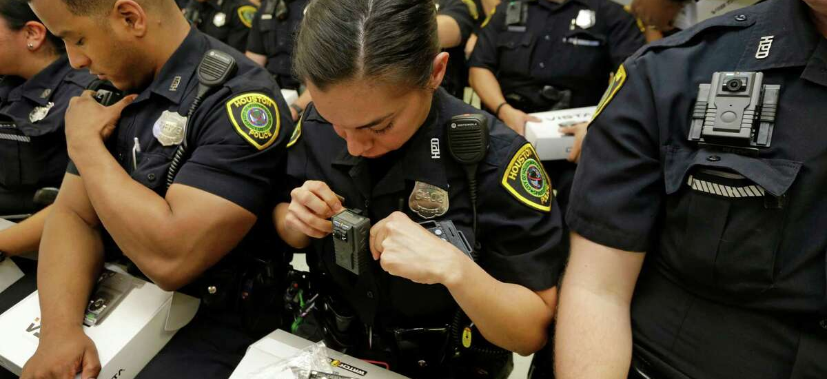
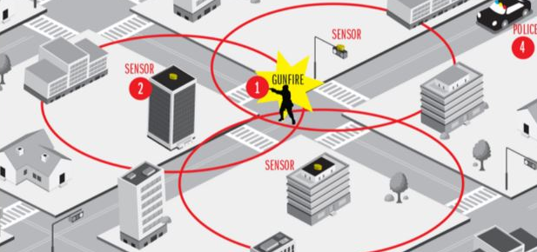
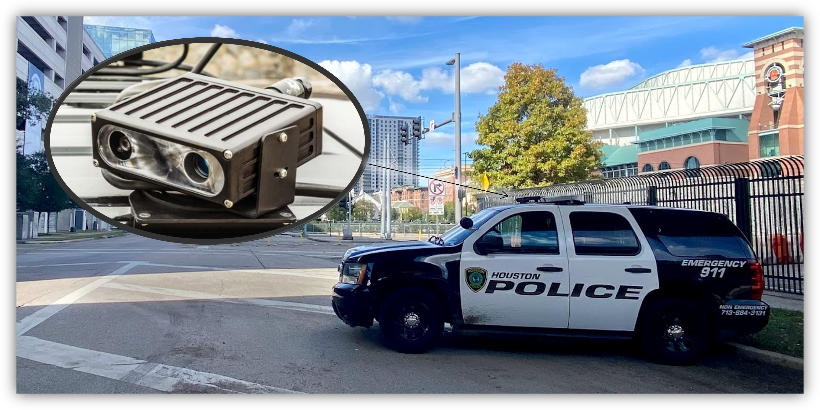

Technology & Equipment
HPD Initiatives to increase the use of technology as a force multiplier.
HPD is continuously evaluating new and emerging technology to improve efficiency and transparency. Smart investments require a pragmatic review of policies, practices, and procedures.
The Procurement and use of these technologies should be developed with input from the community and adhere to best practice recommendations.
Departmental policies regarding the use of these technologies are regularly reviewed and updated.
Body Worn Cameras (BWC)
Gunshot Detection
License Plate Readers (ALPR)
Records Management System (RMS)
11

Slide 12


Policy Review: HPD’s Vehicle Pursuit Policy
Last week, HPD announced modifications to the department’s vehicle pursuit policy.
1. Revewing
2. Targeting
3. Marketing
4. Achieving
When conducting internal policy reviews, HPD reviews department trend data, other agency policies, best practice recommendations, and community feedback.
12

Slide 13
Policy Review: HPD’s Vehicle Pursuit Policy
After conducting the policy review, HPD determined policy modifications were necessary.
Findings YTD 2023 as compared to the same time frame in 2022.
26% Increase in the number of vehicle pursuits.
63% Increase in the number of collisions related to pursuits.
38% Increase in the number of injuries sustained in pursuits.
* YTD 2023 (January 1 – August 31, 2023)
13

Slide 14
Policy Review: HPD’s Vehicle Pursuit Policy
Policy modifications include chase prohibitions under some circumstances.
1
2
3
Class C Offenses
Traffic or Municipal
Warrants
Non-Violent
Misdemeanor Warrants
“When the vehicle or a suspect in the vehicle is the subject of an ongoing criminal investigation or when the vehicle has no license plates displayed or license plates issued to a different motor vehicle, the officer may obtain authorization from a supervisor to engage in a motor vehicle pursuit, even when the above provision applies. The officer should obtain authorization prior to the traffic stop.”
14

Slide 15
Working Together
Together, all of these engagements, initiatives, and practices help HPD remain one of the most professional, transparent and responsive police forces in the nation.
15

Slide 16

Thank You
16

