Slide 1
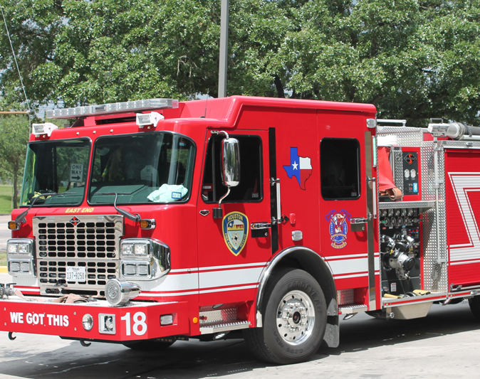
Houston Fire Department Recruiting
Shelby Walker
Assistant Fire Chief
Human Resources

Slide 2


Slide 3
HFD Trainee Salary
HFD trainee salary is $36,000 annually + $5000 incentive.
$47,843 upon graduation from academy.
$51,842 upon successful completion of probationary period.

Slide 4
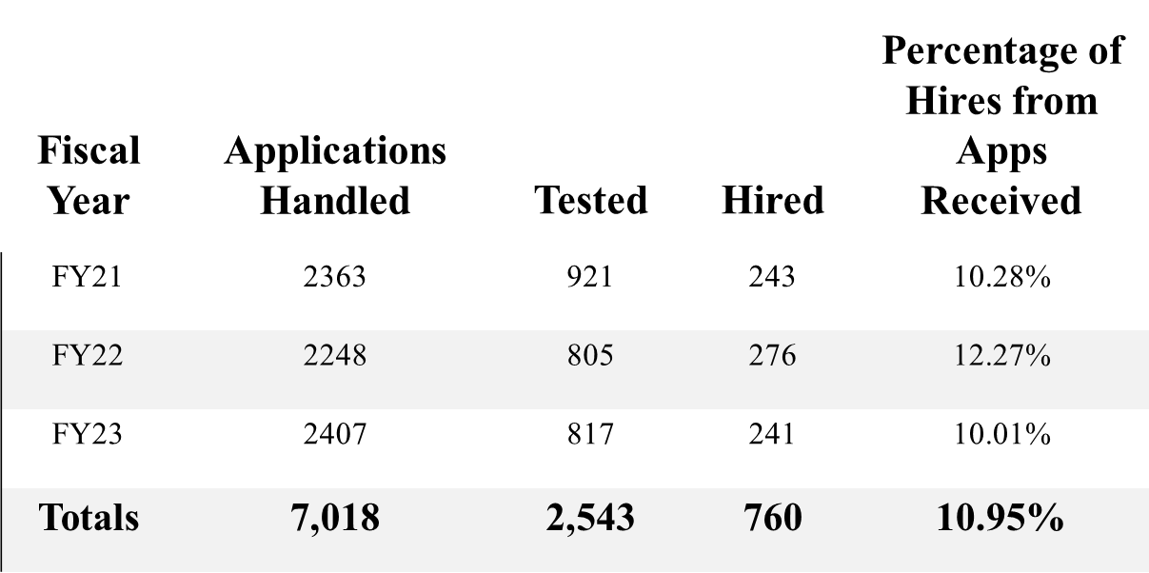
The Numbers
Approximately 10% of the applicants for HFD are hired.

Slide 5
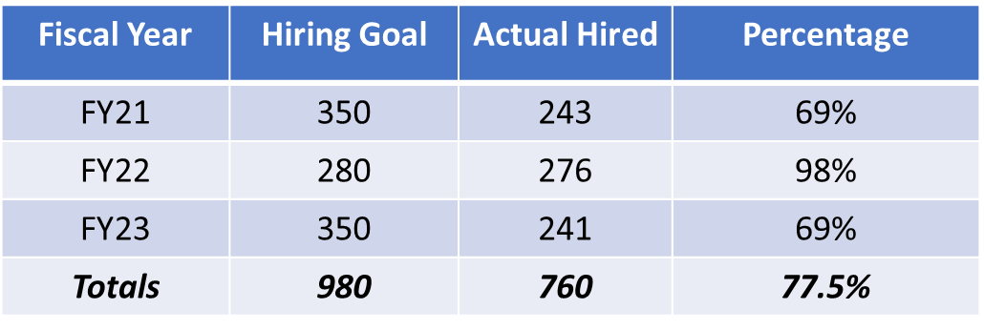
HFD Recruiting
77 % of our hiring goals

Slide 6
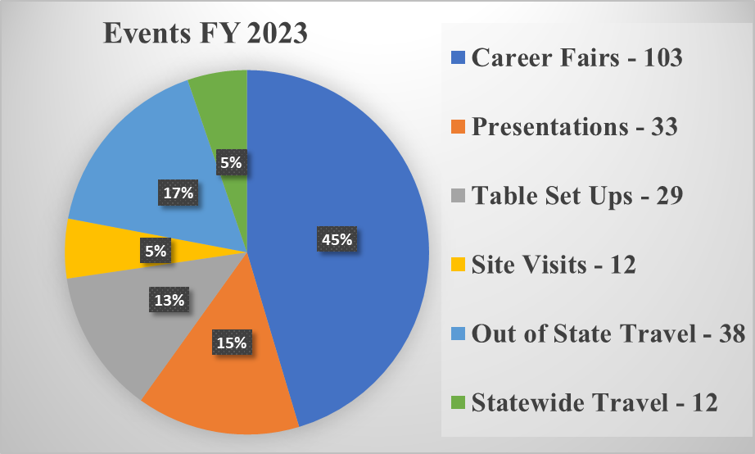
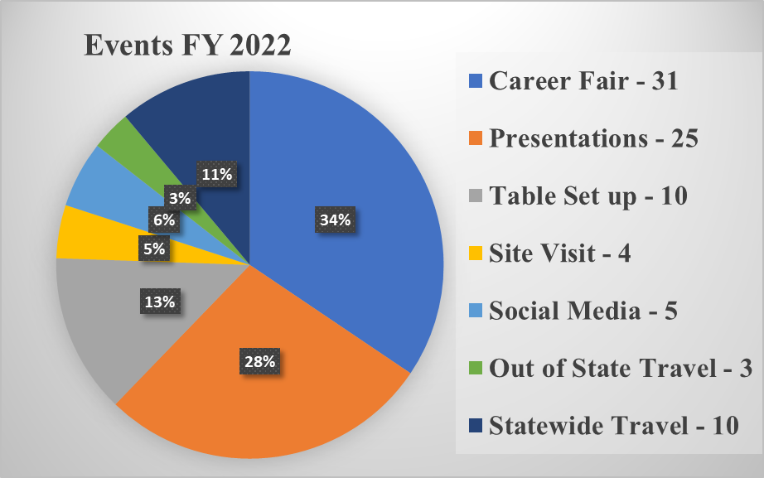
Recruiting Efforts
Increased participation in College Career Fairs.
Seeking opportunities in other States

Slide 7
Recruiting Strategies
Community Colleges
Fire and/or EMT Schools
Colleges and Universities
Career Placement Center
Military Organizations
College of Nursing/Criminal Justice/Biology/Emergency Management/Fire Science etc.
Athletic Department / Band
Fraternities / Sororities et al
Military Bases
Career Fairs
Community Events
Site Visits and Drop Offs
Table Set Ups
Billboards
Mall Marque
Radio
Streaming Radio and Television
Social Media

Slide 8
Radio and Media Advertising
Radio – Interviews and advertising.
Streaming TV – MTV/VH1/BET and Comedy Central
Billboards in the Houston area.
Marque advertising at Willowbrook Mall
Que Onda Magazine

Slide 9


Recruiting Activities

Slide 10
Civil Service tests

Slide 11

Cadet Training
Michael Zapata
Assistant Fire Chief
Professional Development
Houston Fire Department
Notes:
Brief overview of the cadet training division of Professional Development.

Slide 12
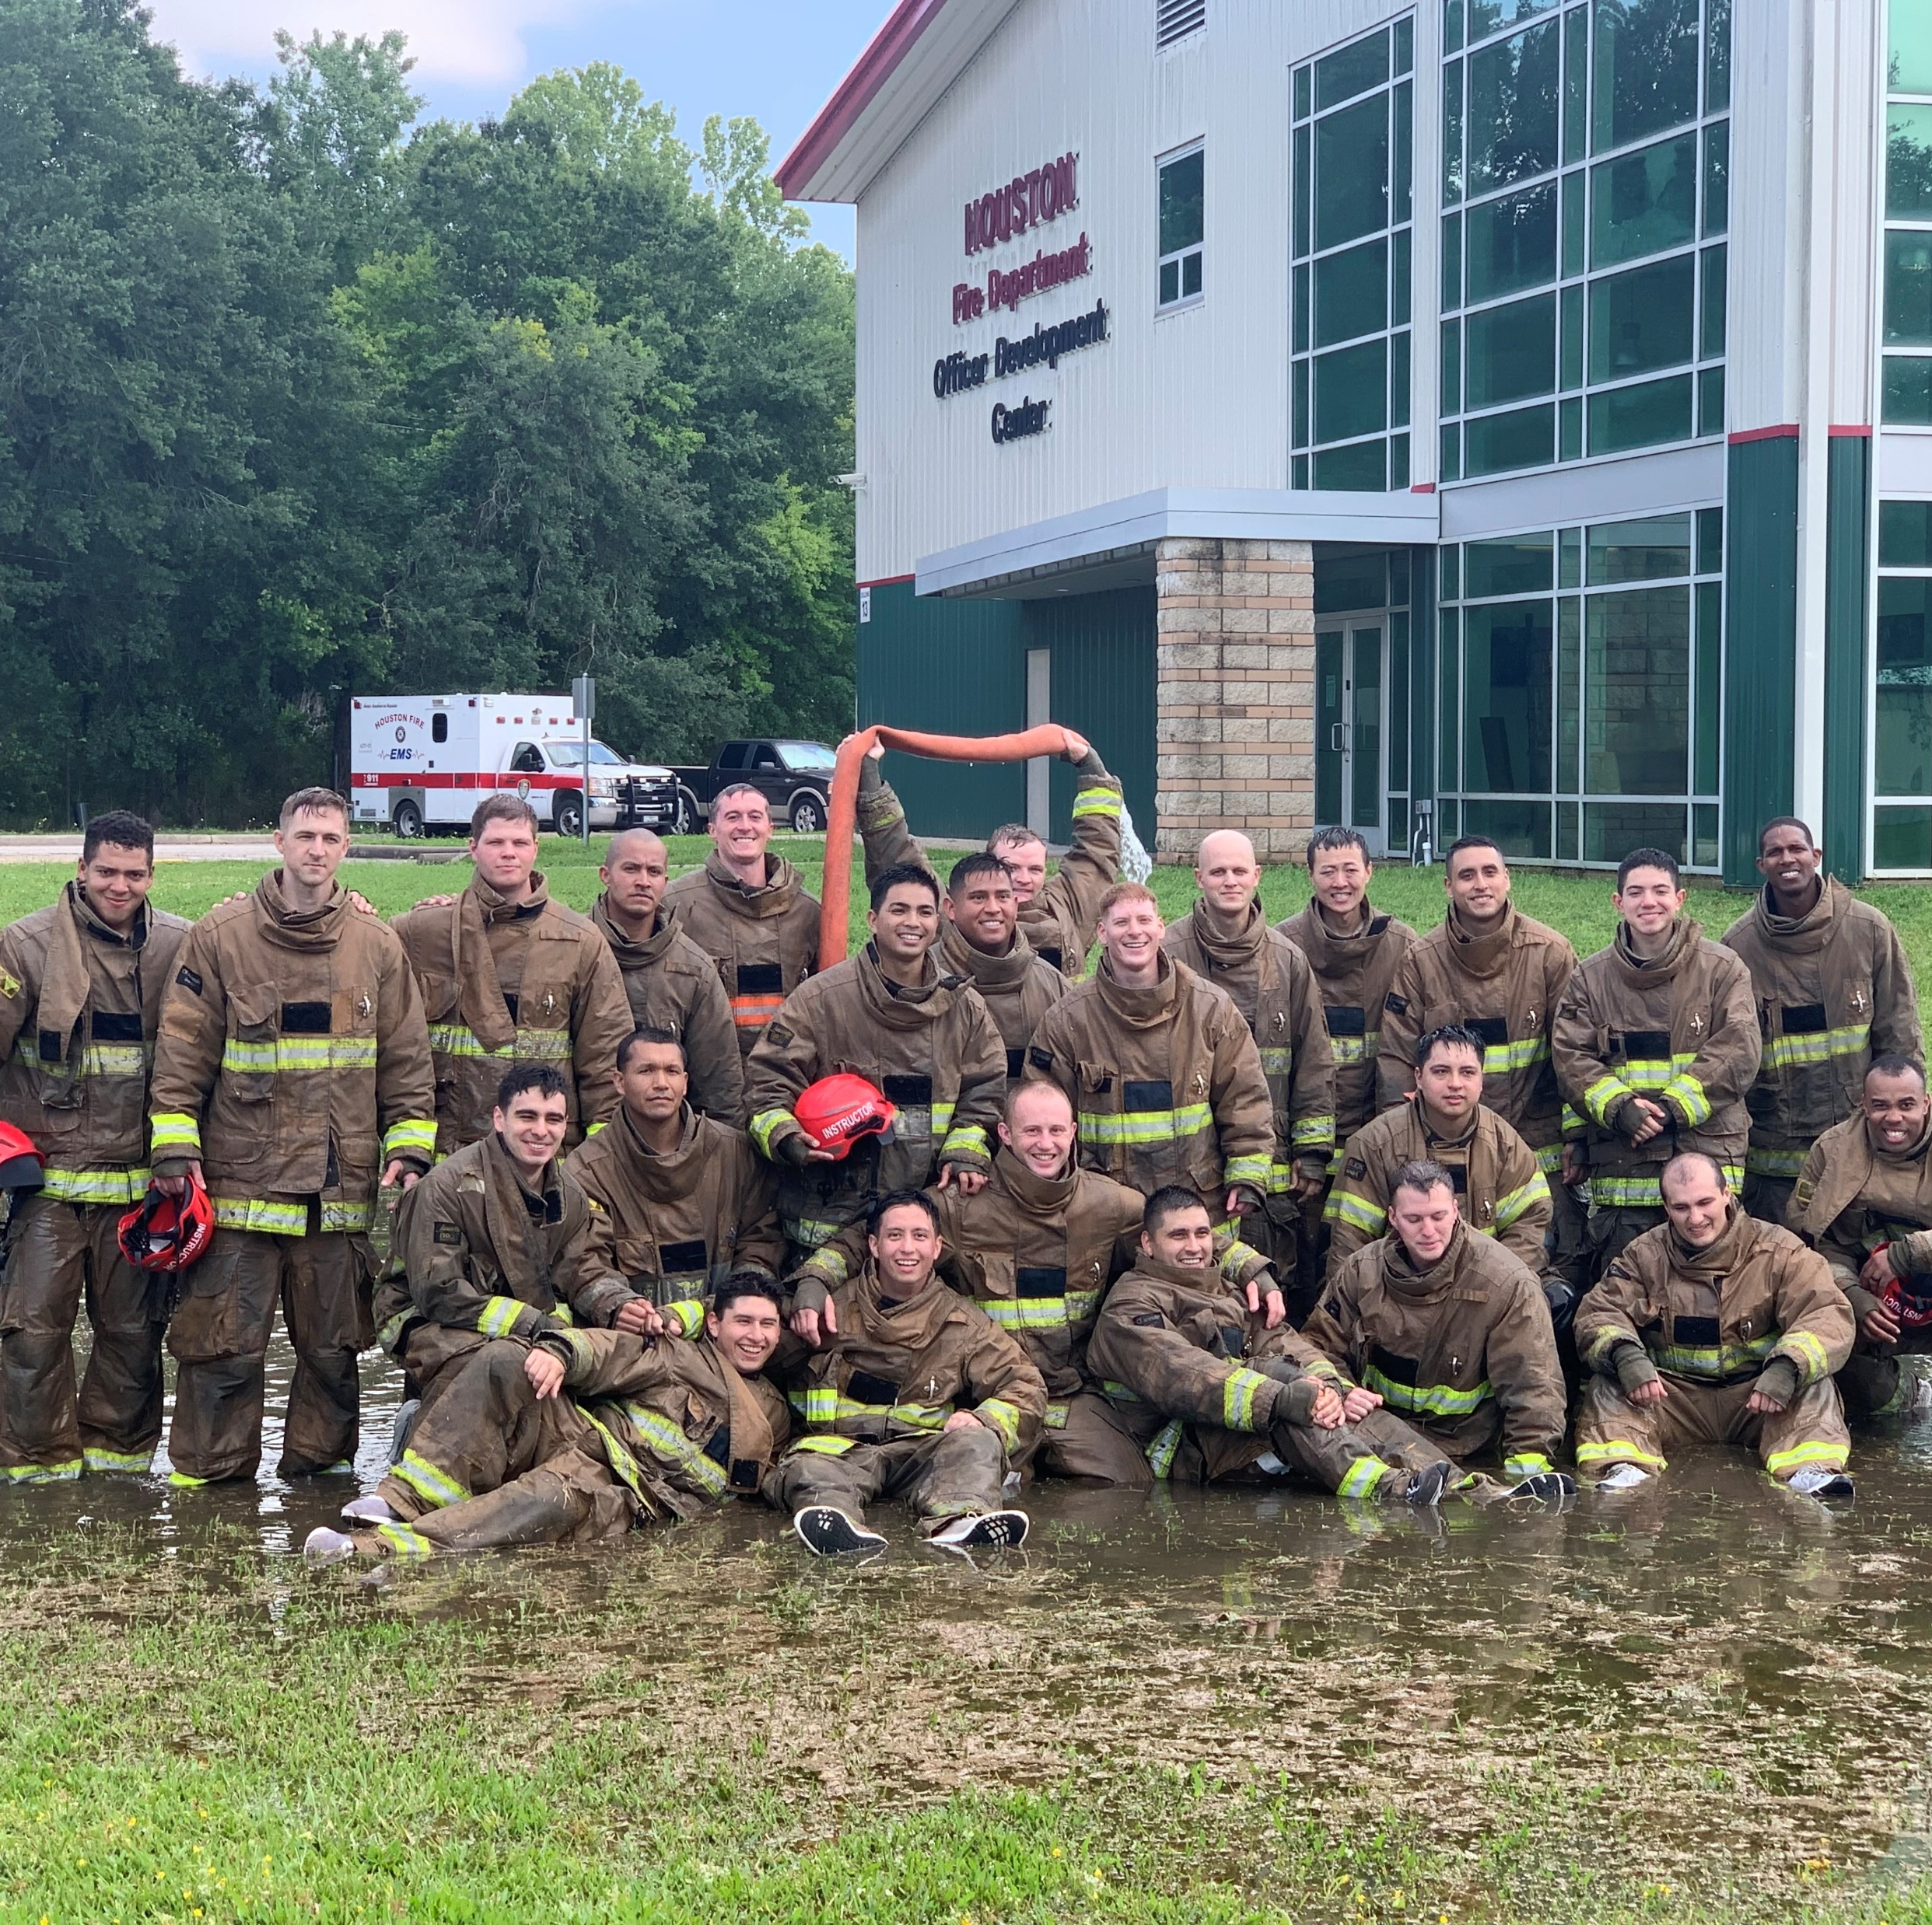
Cadet Training
The Val Jahnke Training Facility has been training Houston Firefighters since 1969.
Notes:
We have been training Houston Firefighters since 1969. At times we have trained up to 400 cadets a year and have trained thousands of civilians and firefighters from our region and around the world.

Slide 13
Class Types
Long Track
Fast track
Notes:
At the training academy, we have two types of cadet classes. Long track and short track classes.

Slide 14
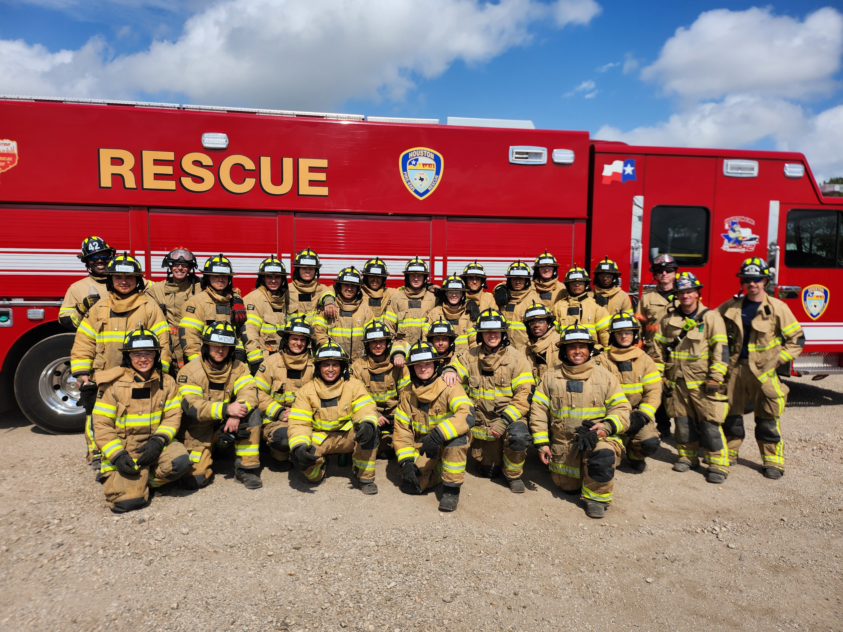
Long Track
4 classes per fiscal year. Starting in the months of April, June, August and October
8 months long.
70 or more per class.
EMT and Fire school.
Notes:
We have 4 long track classes per fiscal year starting in April, June, August/Sept. and October. Each class is approximately 8 months long and has up to 70 or more cadets. The classes start with EMT school and move to Fire school.

Slide 15
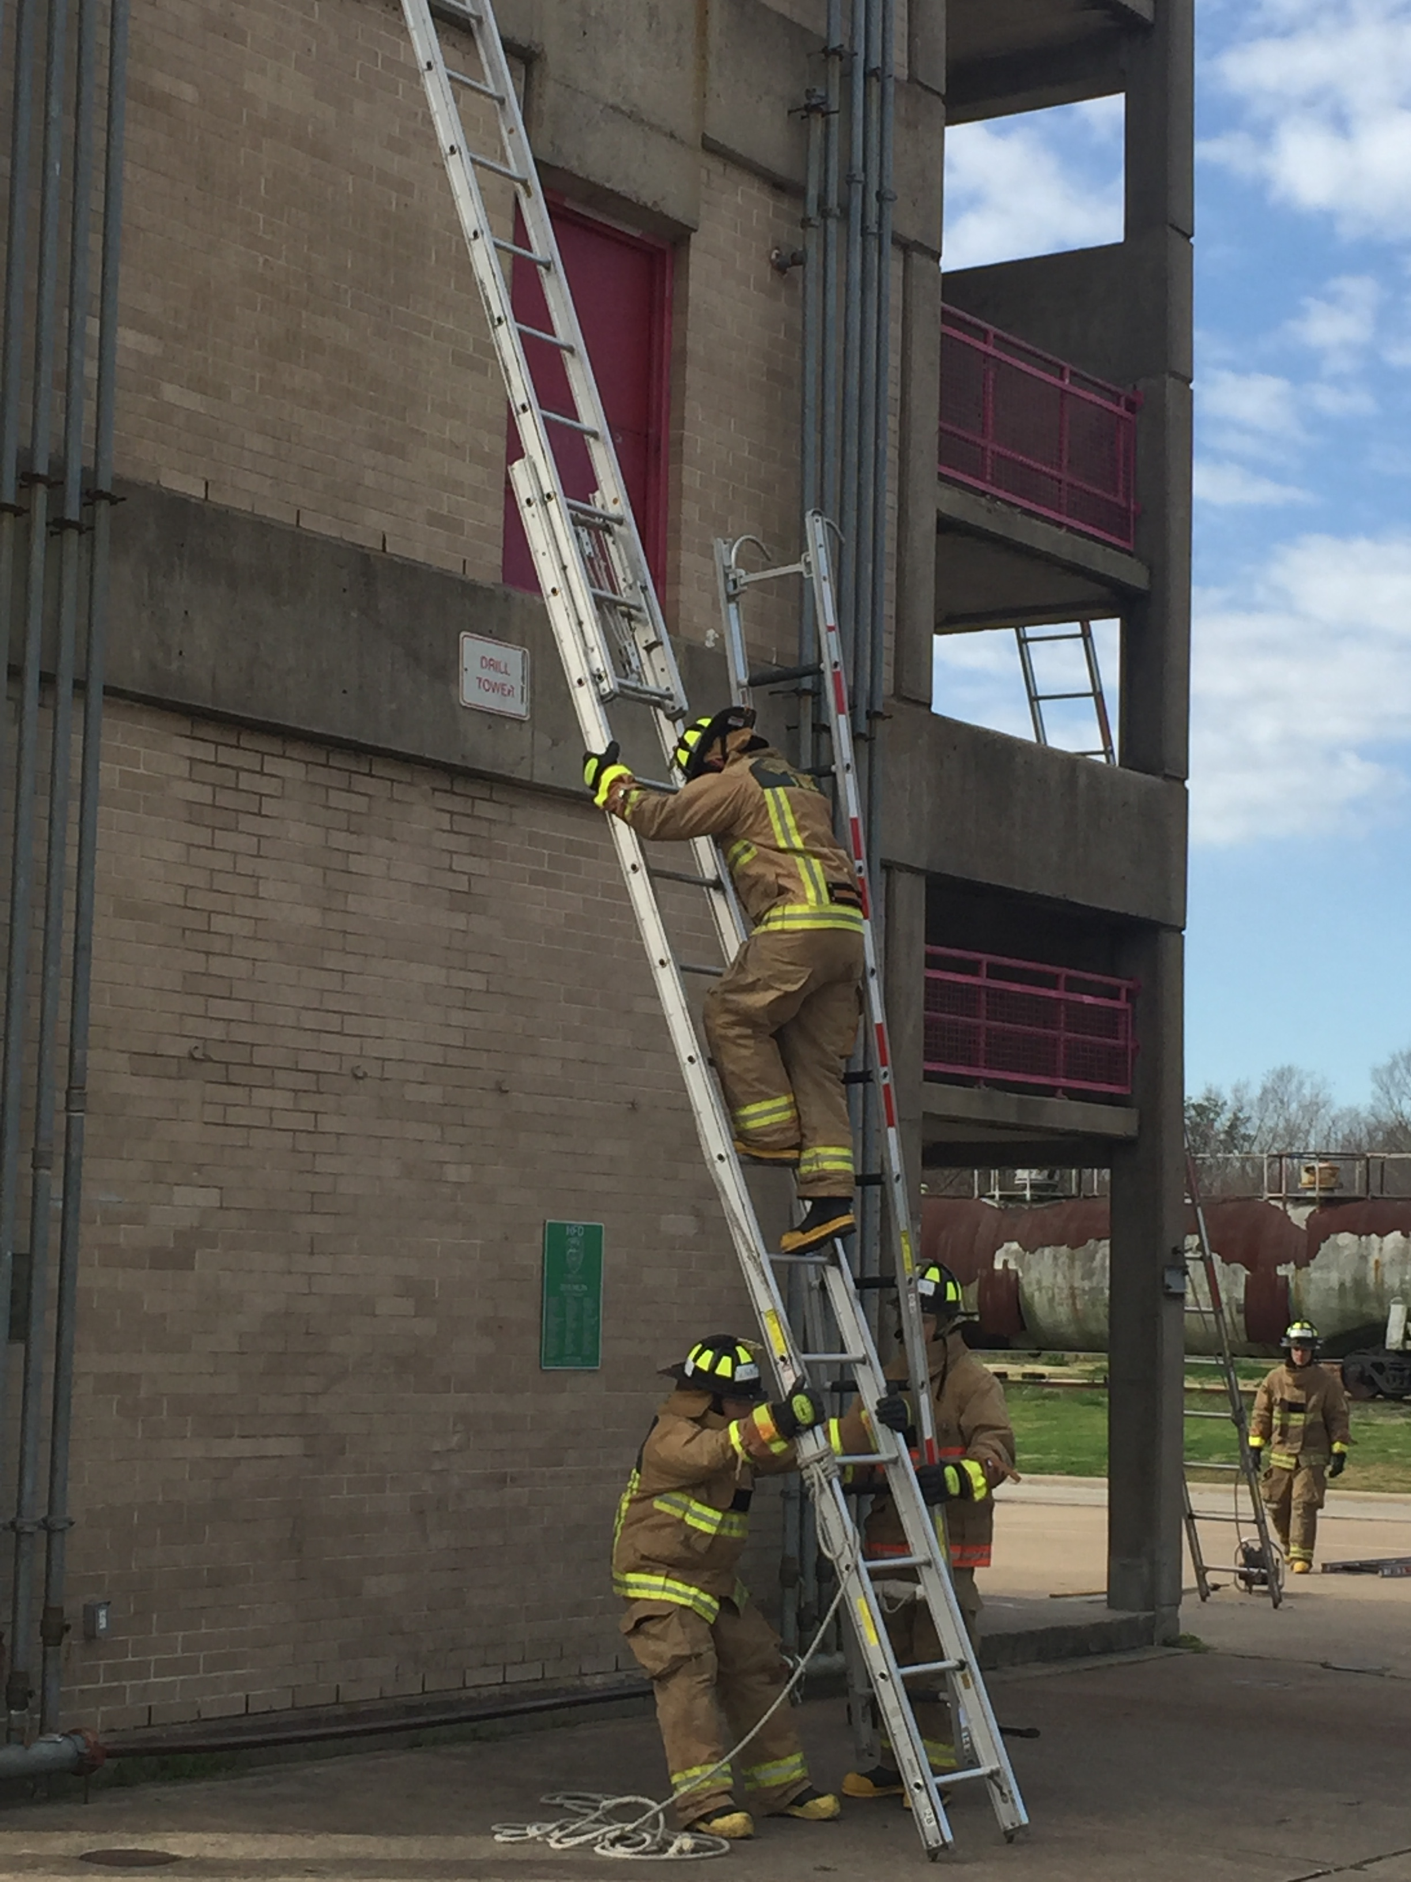
Long Track
EMT school is approx. 6-7 weeks of instruction.
Texas Commission on Fire Protection requires a minimum of 468 hours for fire certification.
Houston Fire Academy approximately 650 hours. About 22 weeks of instruction.
Notes:
EMT school is approx. 6-7 weeks of instruction, 2 weeks of clinicals and a week for NREMT testing. TCFP requires 468 hours of training for a basic FF certification. Houston Fire Academy is approx. 650 hours and about 22 weeks of instruction.

Slide 16
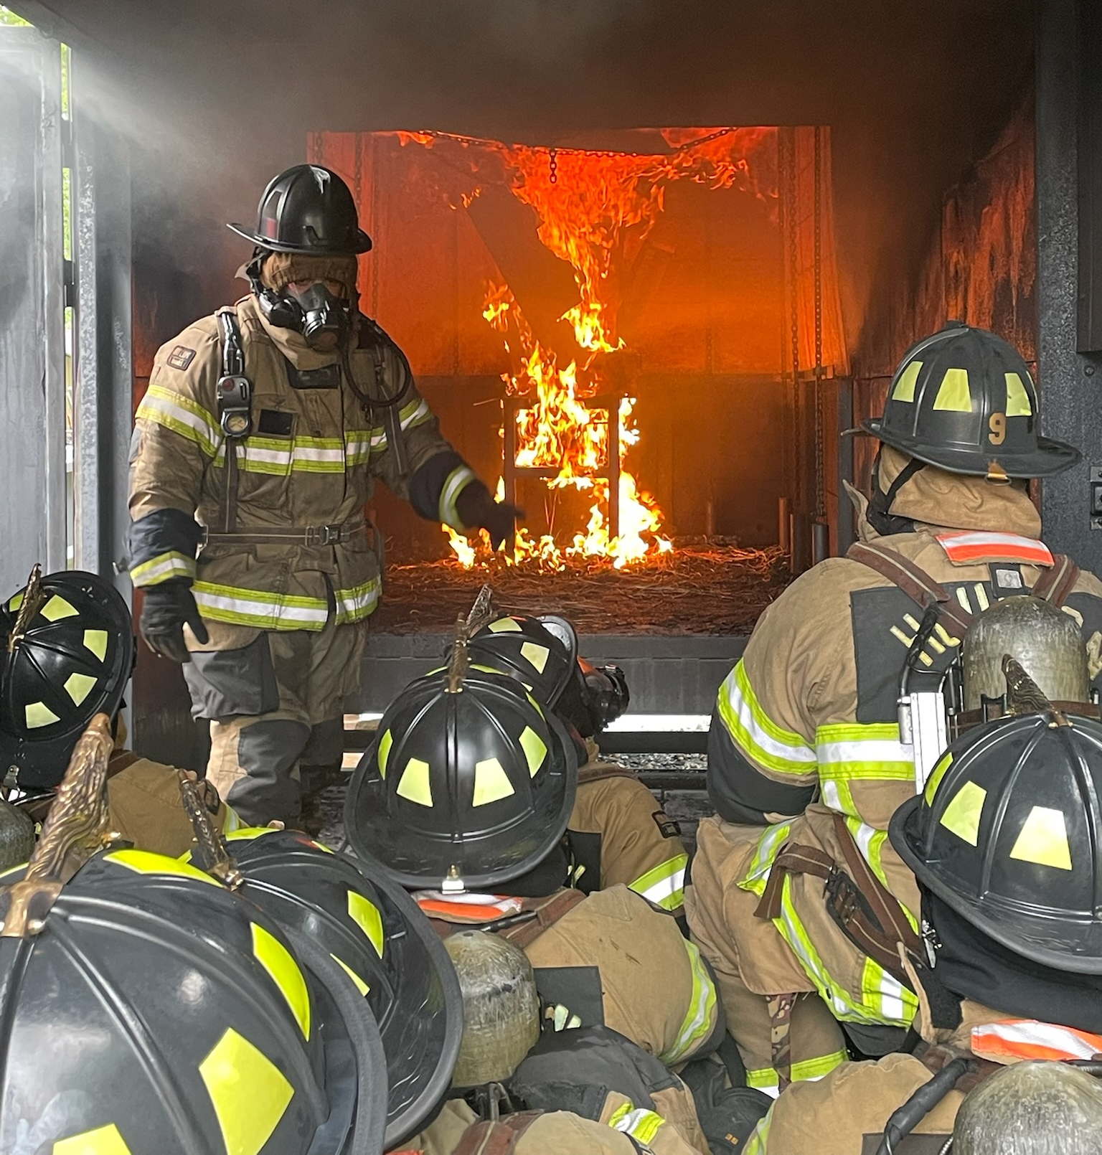
Long Track Graduation Rate
Fiscal Years | Hiring Goal | Hired | Graduated | %
FY21 | 350 | 243 | 140 | 58
FY22 | 280 | 276 | 210 | 87
FY23 | 350 | 267 | 163 | 61
Notes:
You can see here that we get close to our hiring goals. Our graduation rates average about approximately 60%. In FY 22 we did really well with an 87% graduation rate. FY 23 does not reflect the Fast track numbers. 25 were hired and we graduated 23. 92%

Slide 17
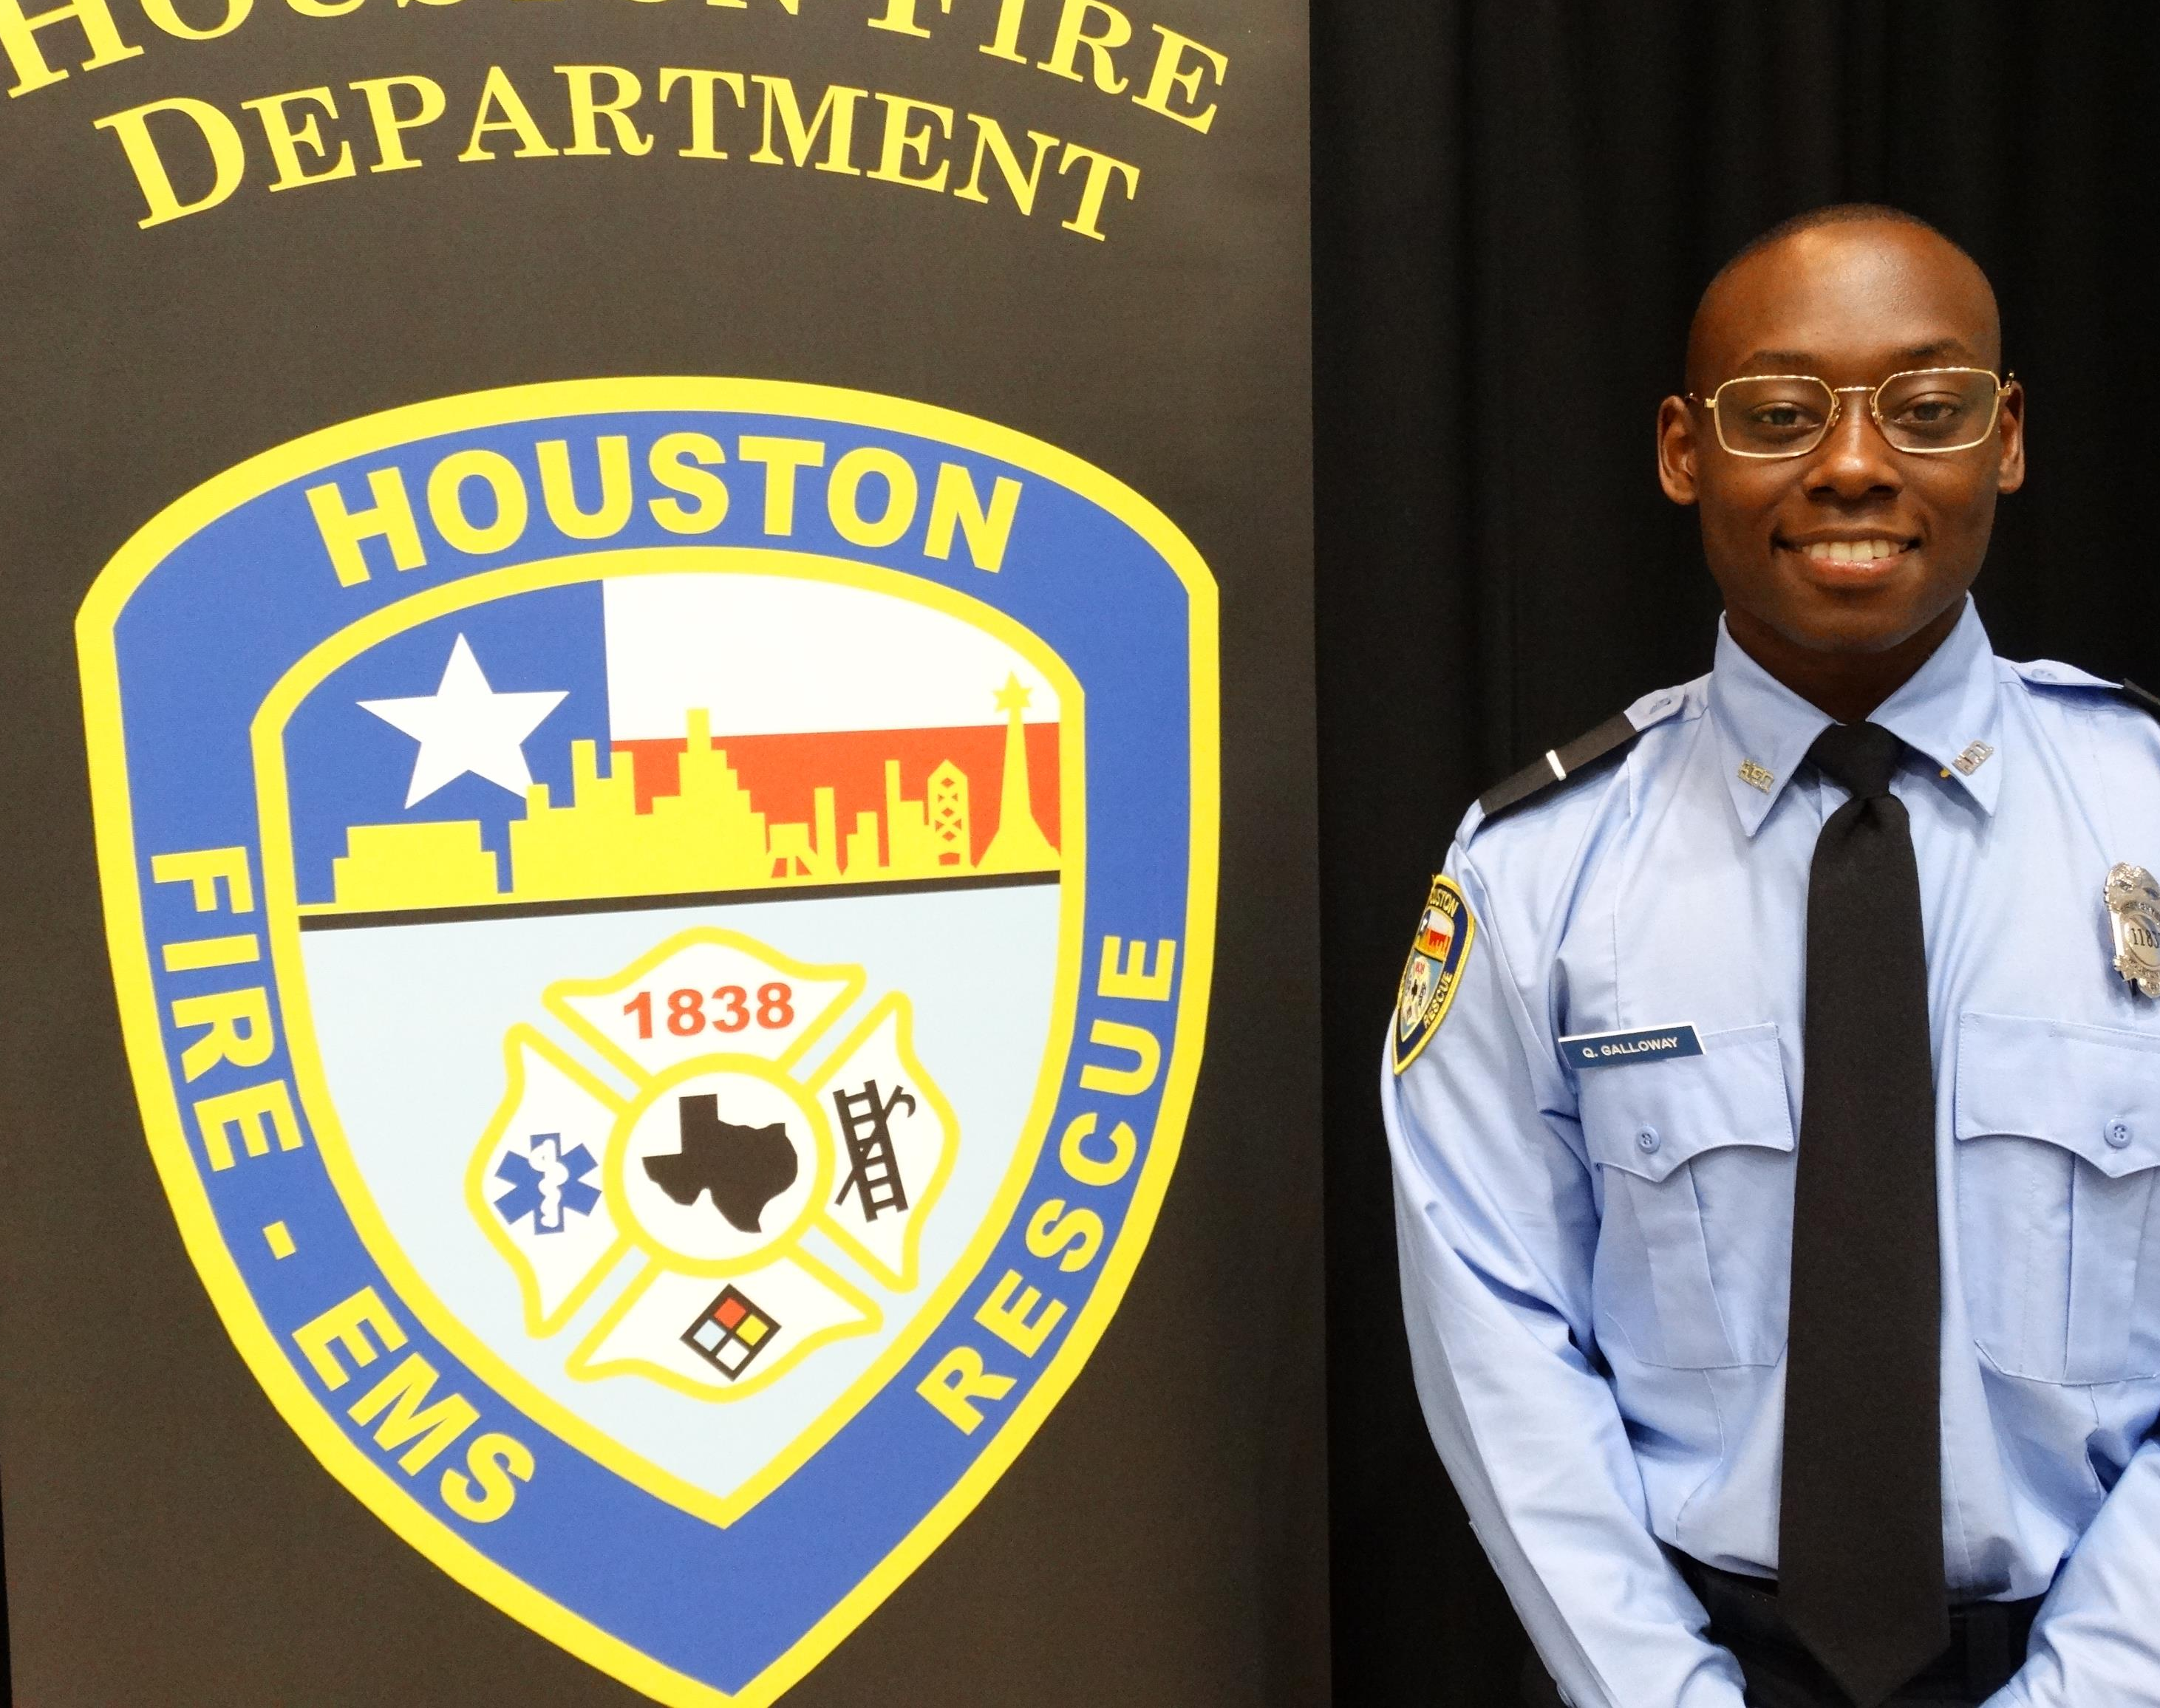
Success in a Long Track
EMT school
Work Experience
Physical Fitness
Aptitude for service.
Notes:
Success depends on performance in EMT school. 2 semesters of instruction are packed into 7 weeks of instruction. It is very fast paced and difficult. Previous work experience in a job that requires hard labor helps. Military service is very helpful. Cadets who are in good physical condition do much better. Finally, cadets who do not have a good aptitude for service do not do well at the fire academy.

Slide 18
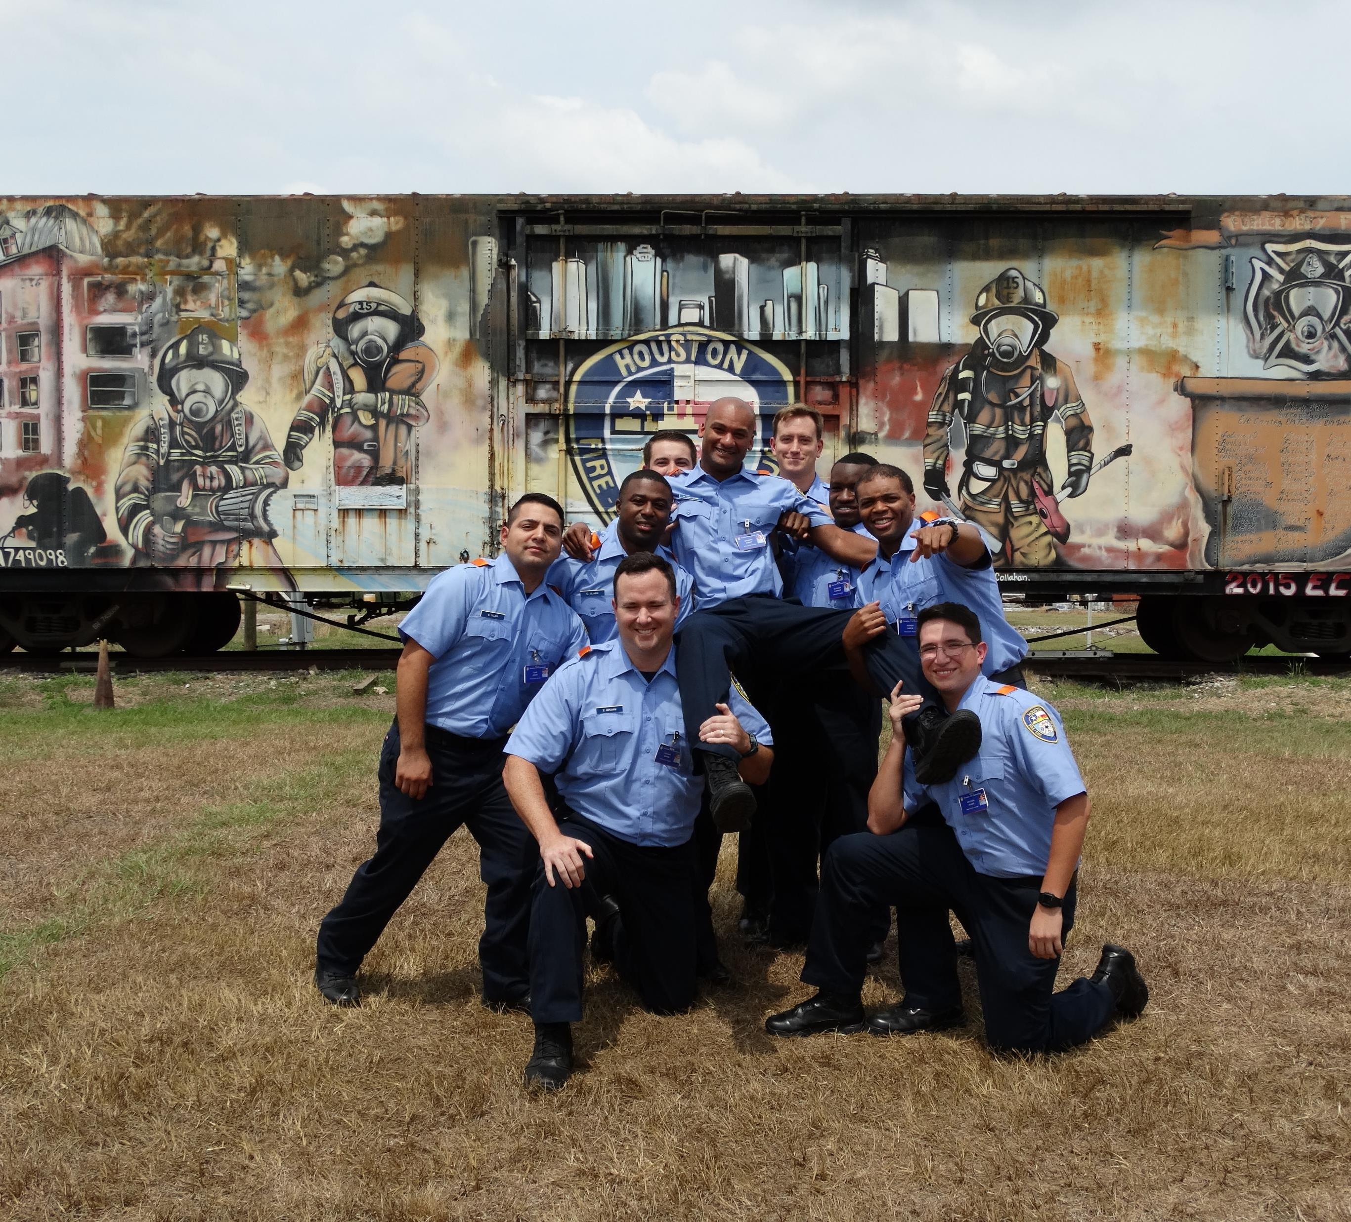
Fast Track
Certified Firefighter/EMT
Approx. 3 months long.
20 – 40 members per class.
Notes:
Fast track classes are designed for recruits who are certified firefighters and EMTs or Paramedics. These classes are only 3 months long and usually have 20 – 40 cadets per class.

Slide 19
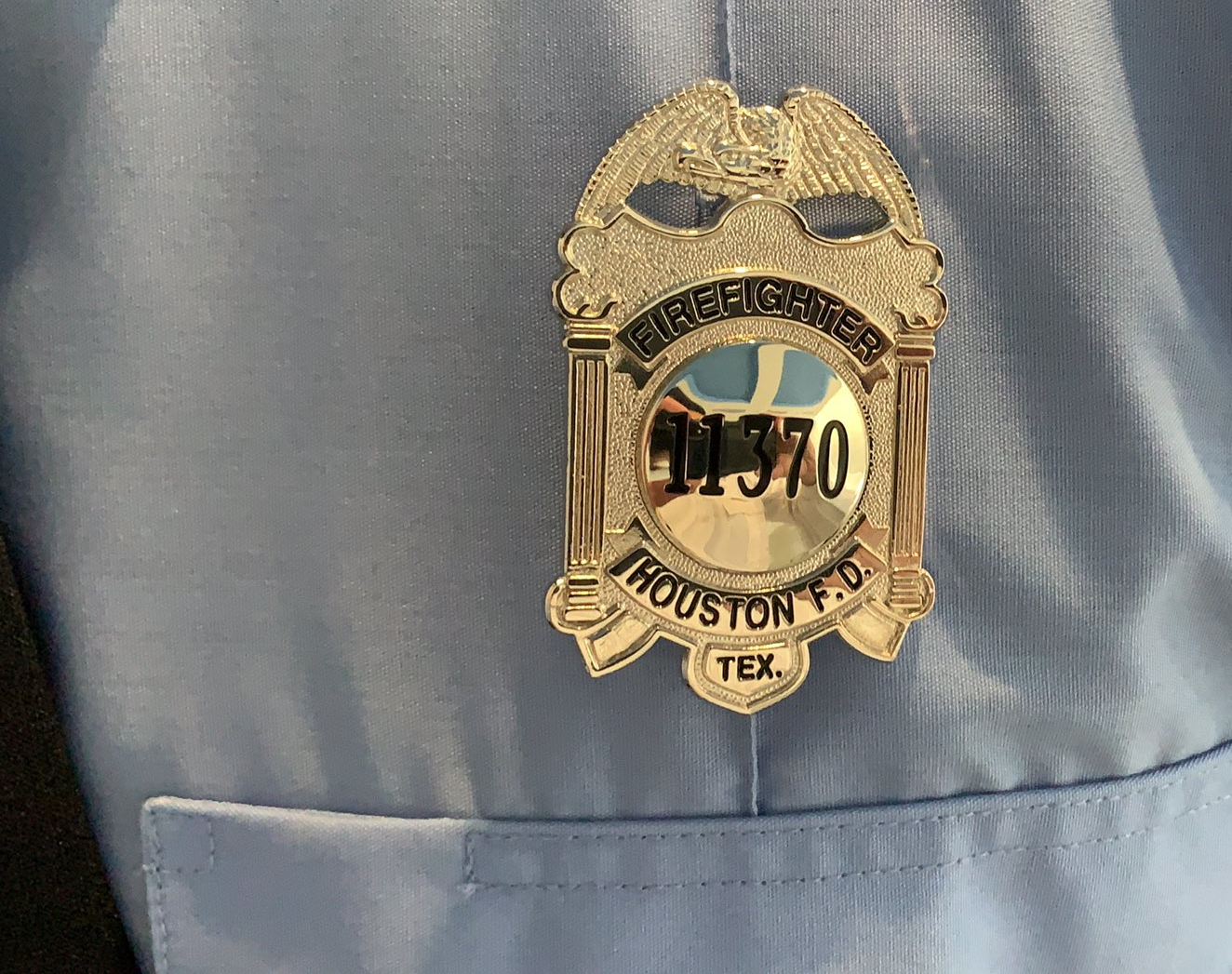
Success in Fast Track
Physical fitness. Shorter class/less time to get in shape.
Certified FF/EMT ≠ fire department experience.
Graduation rates much higher. Sometimes 100%
Notes:
On the PT side, it could be a bit more difficult for a fast-track cadet since the class is shorter. The cadets have less time to meet the physical training standards as the long track cadets have.
Some certified FF/EMTs do not have work experience in the fire department. Extra time may be needed for them to accomplish our performance standards.
Even with these difficulties, fast track graduation rates are usually very high, sometimes 100%.

Slide 20
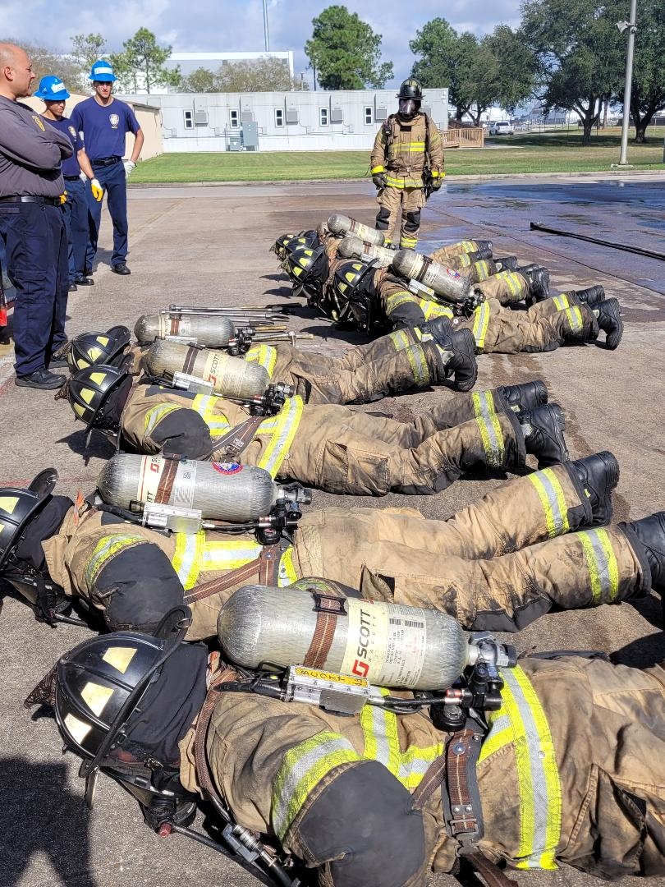
Fast Track
Not enough certified applicants
Must have at least 10 in the class.
Recruitment efforts and incentives
Notes:
With less applicants, we have fewer certified recruits. Sometimes there are just not enough to make a class. Fewer than 10 certified cades will be assigned to a long track class.
Our efforts and incentives will hopefully result in an increase in certified recruits.

Slide 21
Cadet Training Issues
Less applicants means smaller classes.
Many recruits do not have experience in labor intensive work.
Physical Fitness
Notes:
Again, less applicants have resulted in smaller classes. A long track class has approximately 40 – 60 cadets in it.
Work experience can help tremendously but is not an absolute. Many of the recruits are “trying out” the fire department as a job and are not used to the workload.
Physical fitness is a major factor at the academy. The physical training standards at the fire academy can be intense.

Slide 22

Standards and Goals
Only those recruits who maintain the high standards of HFD with the desire to serve the citizens of Houston
Notes:
We can not afford to, nor will we lower the performance standards required and needed to be a Houston Firefighter. The citizens of Houston have come to expect a confident, well trained servant firefighter and the Fire Academy is going to make sure they get just that.

Slide 23
Standards and Goals
Recruitment efforts have led to increased candidates.
Target certified firefighters to join the ranks of HFD
Implement firefighter specific physical training for recruits.

