Slide 1

Office of Emergency Management
Thomas Munoz
Deputy Director
Public Safety & Homeland Security Committee
April 20, 2023

Slide 2

AlertHouston
269,285 contacts are registered to receive alerts.
106k CitizensNet
22k AlertHouston
16k STEAR
Can be sent to individual, groups, or geo-targeted
Alert Categories
Emergency Incidents
Recovery
Major Traffic & Transit
Missing People
Severe Weather
Special Events & Planned Drills
Asthma Air Aware Day

Slide 3
Subscriptions
Anyone can subscribed at:
https://www.alerthouston.org
Click Register > Fill out Questionnaire > Choose what types of alerts they want to receive
Alerts can go out in English and Spanish

Slide 4
AlertHouston
Based on subscribers
Can send voice call, text, and email
Has no distinct tone
Has a character count of 2500.
Can post to social media.
Can be used for any incident
Effective for general advisories and public information
Allows for languages other than English/Spanish
(no special characters/No ASL)

Slide 5
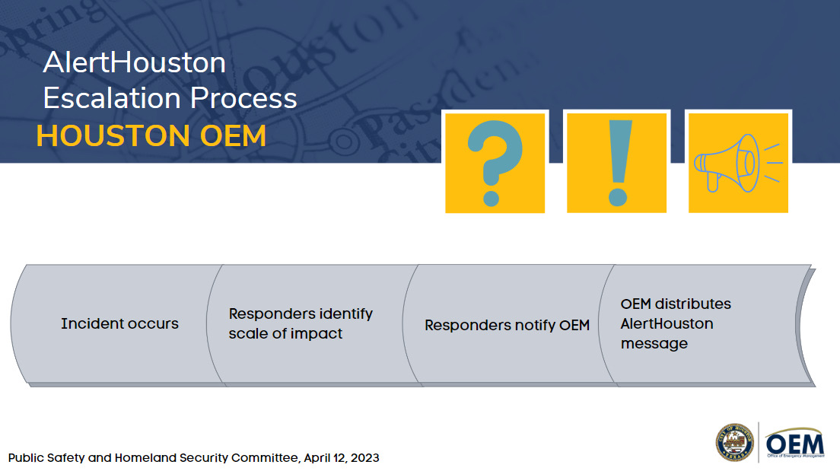
AlertHouston
Based on subscribers
Can send voice call, text, and email
Has no distinct tone
Has a character count of 2500.
Can post to social media.
Can be used for any incident
Effective for general advisories and public information
Allows for languages other than English/Spanish
(no special characters/No ASL)

Slide 6

City of Houston Hazard Mitigation Plan Update

Slide 7
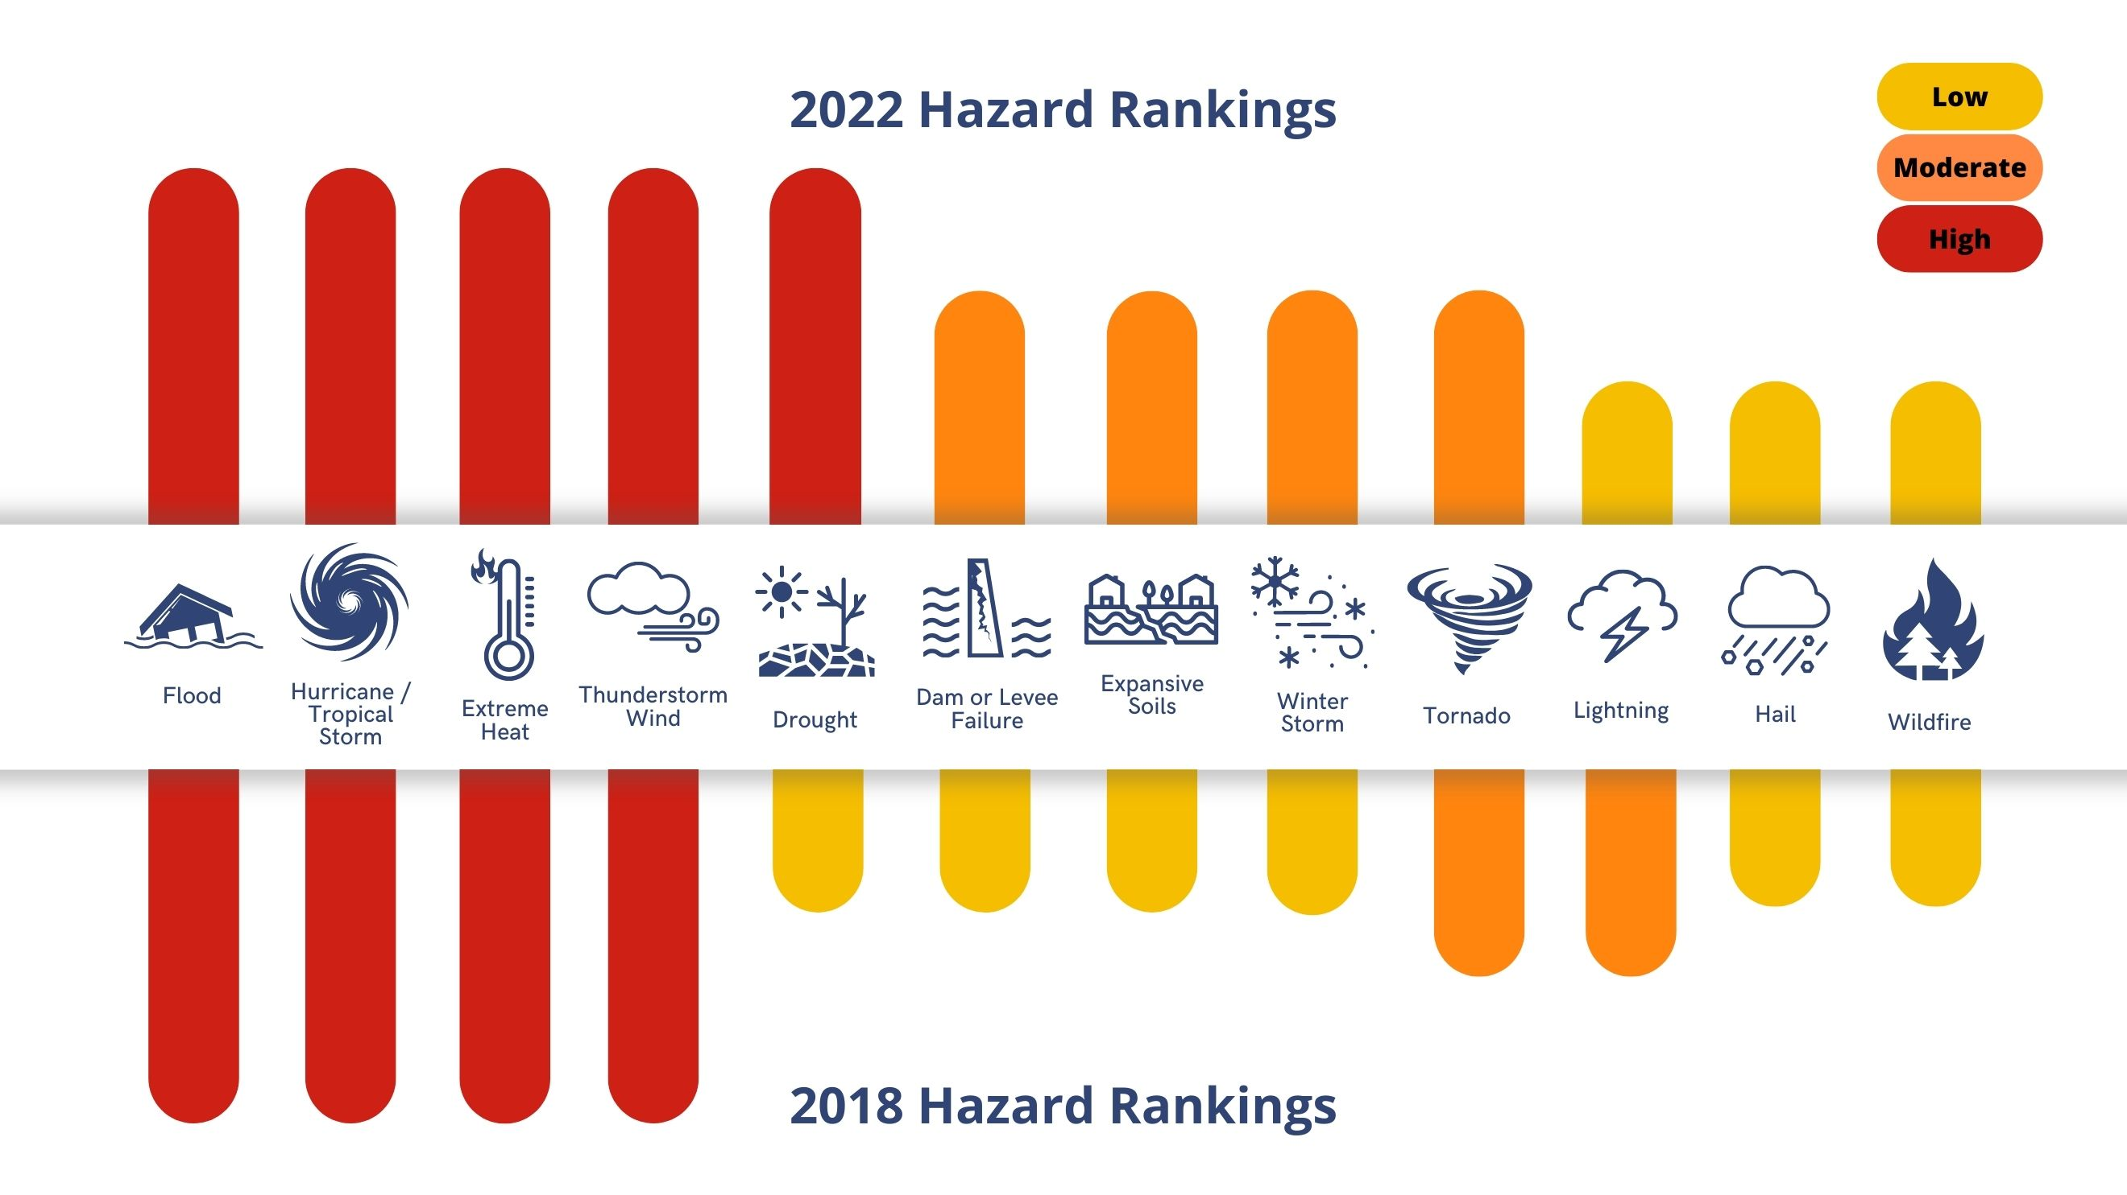
2022 VS 2018 HAZARD RANKING

Slide 8
Hazards Assessed
Hazard | Probability | Annual Occurrence | Average Annualized Loss
Dam / Levee Failure | 0.0 | Unlikely | $0
Drought | 0.11 | Occasional | $567,705
Expansive Soils | 0.0 | Unlikely | $0
Extreme Heat | 2.42 | Highly Likely | $0
Flood | 2.60 | Highly Likely | $715,890
Hail | 2.39 | Highly Likely | $524,919
Hurricane/ Tropical Storm | 0.38 | Highly Likely | $7,020,790
Lightning | 0.94 | Highly Likely | $46,326
Thunderstorm Wind | 2.79 | Highly Likely | $792,128
Tornado | 0.46 | Highly Likely | $401,720
Wildfire | 51.88 | Highly Likely | 149.44 Acres
Winter Storms | 0.60 | Highly Likely | $276

Slide 9
Vulnerability Discussion
Hazard | Vulnerability*
Dam / Levee Failure | Structures in Estimated Inundation Zones
Drought | Vulnerable Populations
Expansive Soils | Critical Facilities, Vulnerable Structures​
Extreme Heat | Vulnerable Populations
Flood | Critical Facilities in Floodplain​
Hail | Critical Facilities, Vulnerable Structures​
Hurricane/ Tropical Storm | Critical Facilities, Vulnerable Structures
Lightning | Critical Facilities, Vulnerable Structures​
Thunderstorm Wind | Critical Facilities, Vulnerable Structures​
Tornado | Critical Facilities, Vulnerable Structures​
Wildfire | Critical Facilities, Vulnerable Structures​
Winter Storms | Vulnerable Populations ​
*Quantifiable. We also address agricultural impacts, utility impacts, infrastructure impacts, and emergency operation disruptions in narrative form.

Slide 10
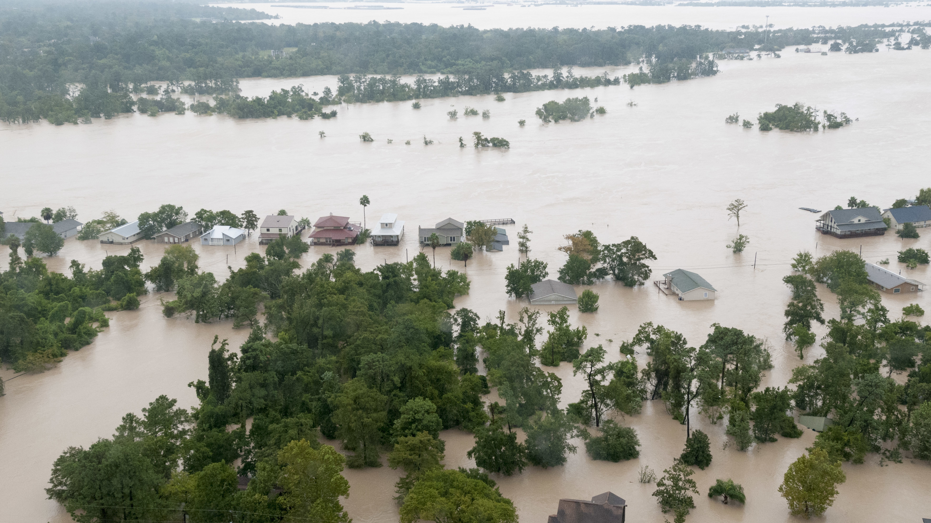
Mitigation strategy
Mitigation Goals
Based upon findings of the Risk and Capability Assessments​
Lessons learned from previous and ongoing mitigation projects
Identification and analysis of mitigation projects addressing natural hazards.

Slide 11

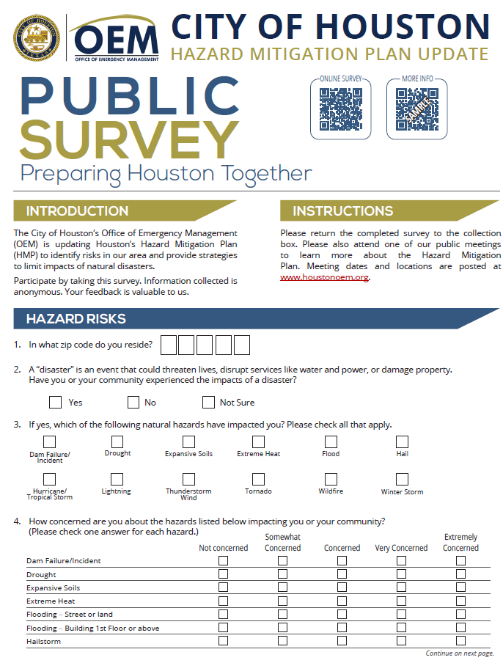
Outreach & Engagement – Key Dates
OEM Website Updates Live to Promote Awareness & Invite Participation January 1, 2023
Public Survey Print & Digital Live to Collect Public Feedback on Hazard Mitigation January 1, 2023 through January 31, 2023
3 Public Meetings (details pending) to Present HMP & Engage In-Person with City Residents January 15 through February 15, 2023
Selected Locations
Magnolia Park
Acres Home Multi Service Center
Sunnyside / Third Ward
Promotional flyer (English/Spanish)
Survey tool
(English/Spanish)

Slide 12
Outreach & Publicity
Objective is to activate local networks to spread the word and invite participation.
Email blasts/bulletins through established communications networks
Complete Communities Monthly Newsletter
OEM contact lists
And more
Outreach to City of Houston District Council Members
Social Media Posts
Communications will Include:
Link to Survey, Meeting Invitation, Link to OEM website & flyer
Spanish Interpretation & ASL provided
Notes:
Ongoing coordination with OEM’s Emergency Management Community Outreach Lead

Slide 13
LETTER OF Extraordinary Circumstance
OEM is in the final stages and expect completion in April 2023.
The Kingwood Diversion Channel intercepts drainage from Montgomery County and routes it to Lake Houston. Expansion of the channel is needed to increase capacity and protect the community from flooding. This type of project is an investment in our community’s safety and sustainability and will enhance our resilience.

