Slide 1


ShotSpotter Program Update Houston Police Department SUPPORT SERVICES COMMAND ASSISTANT POLICE CHIEF M.W. MARTIN Southeast Patrol Division Commander M.S. COLLINS North Patrol Division Commander J.G. Bryant
Produced by Southeast Crime Analysis Unit

Slide 2
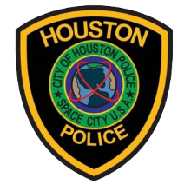
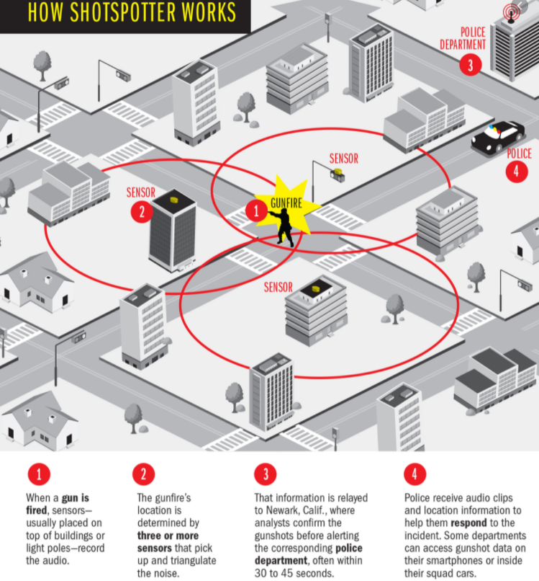
A Review of the ShotSpotter System
“Three or more sensors pick up the sound of a gunshot and triangulate its location.
“A technician hears the audio at ShotSpotter’s company California headquarters and determines in about 30 seconds if it was, in fact, a discharge of a firearm.”
If it’s gunfire, an alert is sent to HPD.
Officers are dispatched to the call location. They “get a map of the spot where the shots were fired within 82 feet of the location, the time of shooting, the number of shots, whether the shooter was moving, and in what direction.”
“The ShotSpotter system will allow officers to instantly examine video from nearby cameras.”
https://www.nydailynews.com/new-york/nypd-unveils-1-5m-shotspotter-system-bronx-article-1.2151679
https://time.com/4951192/shots-fired-shotspotter/
Produced by Southeast Crime Analysis Unit, October 2022
Law Enforcement Sensitive – For Official Use Only

Slide 3
Houston ShotSpotter Southeast Zone
Southeast Patrol Division
Pilot Program – Initial Implementation Area
Produced by Southeast Crime Analysis Unit, October 2022
Law Enforcement Sensitive – For Official Use Only

Slide 4

Total Available Alerts (Published, Dismissed, & Suppressed) DECEMBER 28, 2020 – February 12, 2023
A total of 15,449 alerts are available to HPD in the ShotSpotter program in this date range in the Southeast Zone.
Total Alerts: 15,449
Total Gunfire: 15,449
Total Rounds: 57,668
Produced by Southeast Crime Analysis Unit, February 2023
Law Enforcement Sensitive – For Official Use Only

Slide 5
Published Alerts DECEMBER 28, 2020 – February 12, 2023
ShotSpotter reviewers determined 5,450 Alerts were gunfire and sent those results to HPD.
Total Alerts: 5,450
Total Gunfire: 5,450
Total Rounds: 20,999
The next 5 slides concentrate on the
5,450 Published Alerts for 12/28/2020 – 02/12/2022.
Produced by Southeast Crime Analysis Unit, February 2023
Law Enforcement Sensitive – For Official Use Only

Slide 6
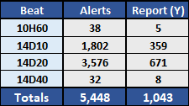
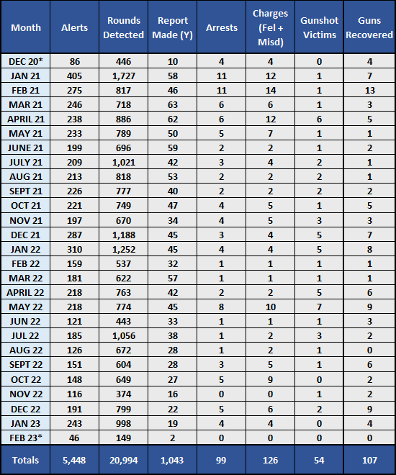
The 5,450 Published Alerts DECEMBER 28, 2020 – February 12, 2023
Report information Breakdown
Of the 5,450 Published Alerts, ShotSpotter detected a total of 20,999 discharged rounds.
Alert results include:
- 1,043 Offense Reports (ORI’s) generated, which is just over 19% of all Published Alerts.
- 14D20 had the most alerts and reports generated (it also has greater ShotSpotter coverage).
- 99 Arrests (1 additional suspect has been identified and for a fatality incident that is under investigation as a possible case of self-defense).
- 126 Charges (60 Felony & 66 Misdemeanor).
- 54 gunshot victims (19 Fatalities)
Note:
”DUP” – Used to indicate multiple alerts which were later determined to be related to the same incident. Therefore, an incident can have multiple alerts associated with it.
*December 2020 is only the 28th – 31st , and February is only the 1st – 12th.
Produced by Southeast Crime Analysis Unit, February 2023
Law Enforcement Sensitive – For Official Use Only

Slide 7
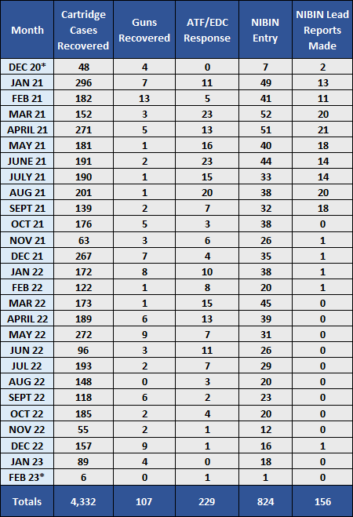
The 5,450 Published Alerts DECEMBER 28, 2020 – February 12, 2023
evidence information Breakdown
Alert results also include:
- 4,332 fired cartridge cases out of the 20,999 rounds detected were recovered by officers & ATF (an approx. 20.6% recovery rate).
- 107 Guns were recovered/tagged.
- 229 of the 1,043 ORI’s had ATF Explosive Detection Canine (EDC) response (approx. 22%).
- 773 of the 4,332 recovered cartridge cases were from ATF’s response (approx. 18%).
- 849 of the 1,043 total ORI’s had fired cartridge cases recovered (approx. 81%).
- 824 of the 1,043 total ORI’s were entered into the National Integrated Ballistic Information Network (NIBIN) (approx. 79%).
- *At least 156 ShotSpotter related incidents have produced NIBIN investigative leads. This is a preliminary total due to current availability of leads received for review. This number is subject to change as investigations continue and new leads are developed.
Produced by Southeast Crime Analysis Unit, February 2023
Law Enforcement Sensitive – For Official Use Only
Notes:
Many ORI’s had no evidence recovered. Some fired cartridge cases/firearms did not qualify for NIBIN entry or some incidents were missed by the HPD Property Room IBIS Unit. A list of incidents will be provided to Property Room for further review/entry into NIBIN.

Slide 8
Houston ShotSpotter Southeast Zone
Southeast Patrol Division
Initial Implementation Area
From 01/01/2023 – 02/12/2023
Produced by Southeast Crime Analysis Unit, February 2023
Law Enforcement Sensitive – For Official Use Only

Slide 9
Total Available Alerts (Published, Dismissed, & Suppressed) January 1, 2023 – February 12, 2023
A total of 990 alerts are available to HPD in the ShotSpotter program in this date range in the Southeast Zone.
Total Alerts: 990
Total Gunfire: 990
Total Rounds: 4,034
Produced by Southeast Crime Analysis Unit, February 2023
Law Enforcement Sensitive – For Official Use Only

Slide 10
Published Alerts January 1, 2023 – February 12, 2023
ShotSpotter reviewers determined 289 Alerts were gunfire and sent those results to HPD.
Total Alerts: 289
Total Gunfire: 289
Total Rounds: 1,147
The next 5 slides concentrate on the
289 Published Alerts for 01/01/2023 – 02/12/2023.
Produced by Southeast Crime Analysis Unit, February 2023
Law Enforcement Sensitive – For Official Use Only

Slide 11
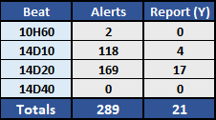
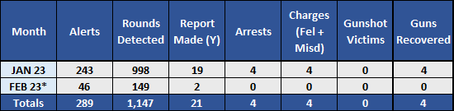
The 289 Published Alerts January 01, 2023 – February 12, 2023
Report information Breakdown
Of the 289 Published Alerts, ShotSpotter detected a total of 1,147 discharged rounds.
Alert results include:
- 21 Offense Reports (ORI’s) generated
- 14D20 had the most alerts and reports generated.
- 4 Arrests.
- 4 Charges
- 0 gunshot victims (0 Fatalities).
Note:
”DUP” – Used to indicate multiple alerts which were later determined to be related to the same incident. Therefore, an incident can have multiple alerts associated to it.
*Incomplete months.
Produced by Southeast Crime Analysis Unit, February 2023
Law Enforcement Sensitive – For Official Use Only

Slide 12
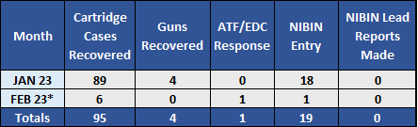
The 289 Published Alerts January 1, 2023 – February 12, 2023
evidence information Breakdown
Alert results also include:
- 95 fired cartridge cases out of the 1,147 rounds detected were recovered by officers & ATF (an approx. 8% recovery rate).
- 4 Guns were recovered/tagged.
- 1 of the 21 ORI’s had ATF Explosive Detection Canine (EDC) response (approx. 5%).
- 3 of the 95 recovered cartridge cases were from ATF’s response (approx. 3%).
- 20 of the 21 total ORI’s had fired cartridge cases recovered (approx. 95%).
- 19 of the 21 total ORI’s were entered into the National Integrated Ballistic Information Network (NIBIN) (approx. 90%).
Produced by Southeast Crime Analysis Unit, October 2022
Law Enforcement Sensitive – For Official Use Only
Notes:
Many ORI’s had no evidence recovered. Some fired cartridge cases/firearms did not qualify for NIBIN entry or some incidents were missed by the HPD Property Room IBIS Unit. A list of incidents will be provided to Property Room for further review/entry into NIBIN.

Slide 13
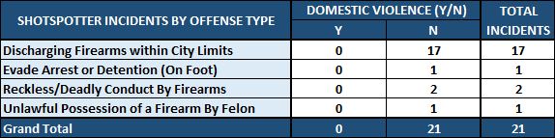
The 289 Published Alerts JANUARY 1, 2023 – February 12, 2023
offense type information Breakdown
Produced by Southeast Crime Analysis Unit, February 2023
Law Enforcement Sensitive – For Official Use Only

Slide 14

Training and Policy Updates
Response Protocols
Benefits
Arrests and Charges
Accurate picture of gunfire in the community
Collection of firearms intelligence data (NIBIN, Etc.)
Community Confidence
Lives Saved
Produced by Southeast Crime Analysis Unit, October 2022
Law Enforcement Sensitive – For Official Use Only

Slide 15
Questions?
Produced by Southeast Crime Analysis Unit, October 2022
Law Enforcement Sensitive – For Official Use Only

