Slide 1

HFSC Overview and Update
Dr. Peter Stout, HFSC President and CEO
Houston City Council, Public Safety and Homeland Security Committee
February 16, 2023
®
Notes:
Reminder of what HFSC is.

Slide 2
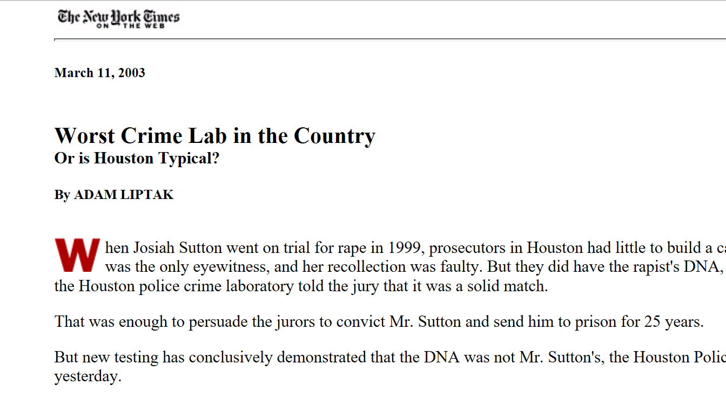

Slide 3
Forensics in Texas
Statewide roughly $140M/year funded to labs. This is less than 1/3 of the need compared to national statistics.
Roughly 200,000 requests received annually. Less than half what is expected per capita.
Texas public labs employ about 1,300 personnel with about 80% of those directly involved in case work
Average in Texas is ~$650/request
Minimum average needed estimate $1,203/request
Report to Congress: Needs Assessment of Forensic Laboratories and Medical Examiner/Coroner Offices (ojp.gov), May 2020,
Project FORESIGHT Annual Report, 2020-2021 (wvu.edu),

Slide 4
Progress in 2022

Slide 5
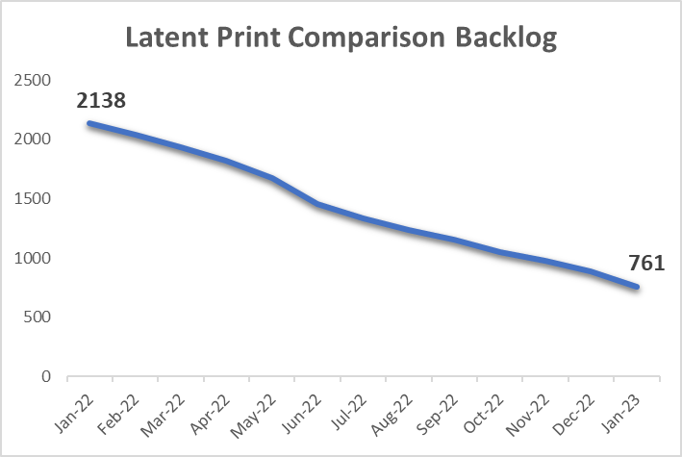
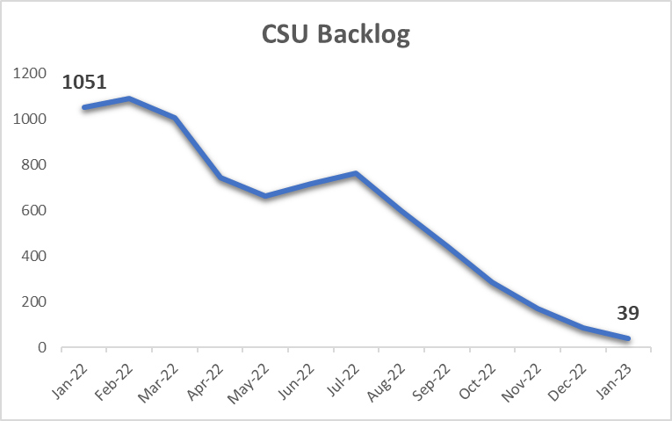
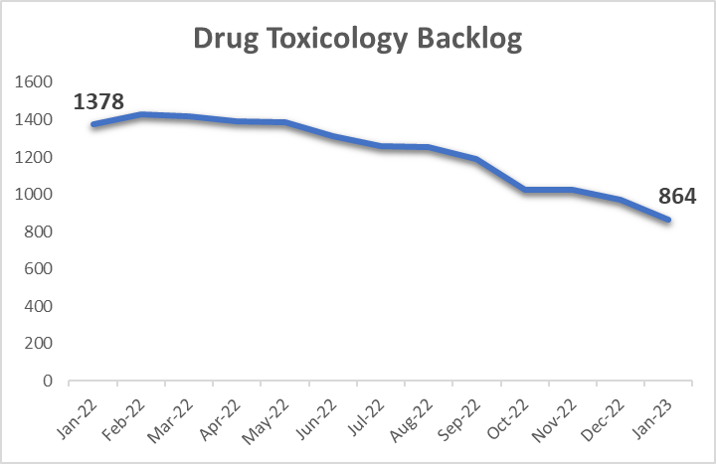
Backlog progress
Overall backlog at HFSC decreased by 20%
Latent print backlog reduced by 58%
CSU backlog reduced by 92%
Drug Toxicology backlog reduced by 29%
“Backlog” means more than 30 days old from the time of request
Notes:
January 2022 Total Backlog
December 2022 Total Backlog
7,166
5,730

Slide 6
Current progress ARPA grant from City of Houston ($3M, One Safe Houston)
Overtime for CSU and firearms
1,600 hours since August 2022. Helped with the 92% reduction in CSU backlogged reports.
Allowed maintaining a 6 day turn around on NIBIN
Outsource of drug toxicology backlog
Sent 444 cases. Meant a 29% decrease in the backlog
Training hours
Provided 15,000 hours of training
Two new latent print processors, allows examiners to work cases
One new NIBIN tech, addressed growing NIBIN backlog
7 CSI’s, 2 firearm examiners, 1 NIBIN tech, 3 seized drug analysts and 1 toxicology supervisor all in training

Slide 7
Challenges in 2023
Impact of Court Backlog and Reduction Efforts
Key Challenges in Forensic Sections
Forensic Biology
Seized Drugs
Digital Multimedia
Firearms
Staffing- Retention and Training
Notes:
SAK over 90 NOT including outsource reviews is 192, if you include outsource reviews it is 251
SAK over 30 NOT including outsource reviews is 262 and including outsource reviews it is 353
In May of 2017, defendant Joseph Colone was convicted and sentenced to death for the 2010 murder of more than one person during the same criminal transaction. On March 2, 2022, the Texas Court of Criminal Appeals granted Colone post-conviction habeas relief
2013 lab work, 2015 testimony
On October 1, 2013, the items were transported in a Styrofoam cooler from Jefferson County to the DPS regional crime laboratory in Houston. The cooler had an external sticker marked “refrigerate upon arrival.” DPS employees received the evidence, reviewed the submission form and stored the evidence at room temperature based on the description of clothing items listed on the submission form. The cooler also contained extracts requiring refrigeration, but they were not listed on the form. Evidence handling personnel did not open the cooler, but rather placed it in storage at room temperature. On October 31, 2013, forensic biology screening analyst Adam Vinson opened the cooler and began screening the items. Inside the Styrofoam cooler, Vinson observed a FedEx envelope containing four 9x12 paper envelopes, one 6x9 paper envelope, and one clear plastic bag. At the bottom of the container were four melted ice packs and foul-smelling liquid.

Slide 8
Courts came back in Houston
Subpoenas from HCDAO are 84% more than pre- pandemic

Slide 9
Court support demand accelerating
COVID relief money funded emergency dockets, expanded dockets and administrative courts
More court activity means more demand from prosecutors going to trial
Demand for much more extensive documents is accelerating more and more complex
Need to improve information systems to better automate production and delivery
Affects EVERY division including support (HR, quality, legal)

Slide 10
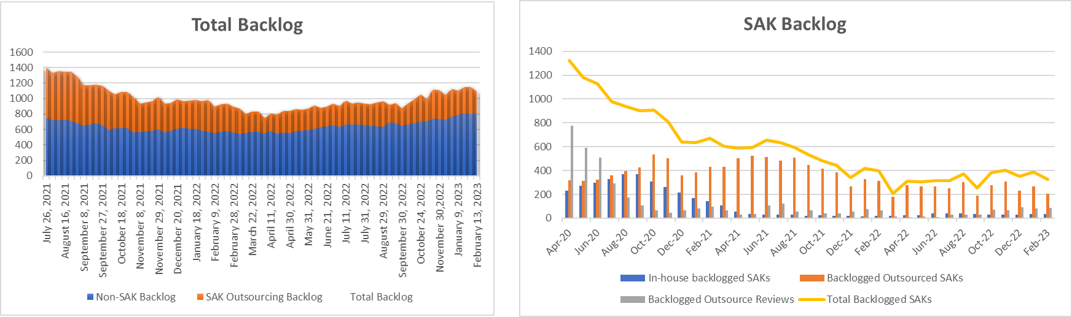
Challenges in Forensic Sections
Forensic Biology
Recent personnel issues created unexpected loss of staff and re-work in the section. Thousands of cases have potential rework.
Total backlog has increased 16% in 2022. (975 up to 1128)
Sexual assault kit (SAK) backlog had no significant change.
Notes:
SAK over 90 NOT including outsource reviews is 192, if you include outsource reviews it is 251
SAK over 30 NOT including outsource reviews is 262 and including outsource reviews it is 353
In May of 2017, defendant Joseph Colone was convicted and sentenced to death for the 2010 murder of more than one person during the same criminal transaction. On March 2, 2022, the Texas Court of Criminal Appeals granted Colone post-conviction habeas relief
2013 lab work, 2015 testimony
On October 1, 2013, the items were transported in a Styrofoam cooler from Jefferson County to the DPS regional crime laboratory in Houston. The cooler had an external sticker marked “refrigerate upon arrival.” DPS employees received the evidence, reviewed the submission form and stored the evidence at room temperature based on the description of clothing items listed on the submission form. The cooler also contained extracts requiring refrigeration, but they were not listed on the form. Evidence handling personnel did not open the cooler, but rather placed it in storage at room temperature. On October 31, 2013, forensic biology screening analyst Adam Vinson opened the cooler and began screening the items. Inside the Styrofoam cooler, Vinson observed a FedEx envelope containing four 9x12 paper envelopes, one 6x9 paper envelope, and one clear plastic bag. At the bottom of the container were four melted ice packs and foul-smelling liquid.
March 2022 was a low of 741

Slide 11
Challenges in Forensic Sections
Seized Drugs
Staff turnover and promotions reduced the number of drug analysts to 5 in 2022 (4 analysts work non-marihuana cases, 1 analyst works marihuana cases).
The total backlog increased from 451 to 1,345 in 2022.
Training and technology review is a focus in 2023 to re-build capacity.
Worked with HCDAO and HPD to agree to cancel dismissed case requests.
Process has retired 15% of the total backlog and 30% of the marihuana backlog since January 2022 (closed 127+ requests, mostly marihuana).

Slide 12
Challenges in Forensic Sections
Digital Multimedia
The section lost about 50% of their staff early in 2022
Able to hire and sign all the new staff off in cell phone analysis within the year.
A 42% reduction in cell phone requests was seen due to HPD adding their own capacity in cell phone data retrieval.
We are already seeing a 21% decrease in the backlog from its highest point in 2022 (392 May 2022 to 309 Dec 2022).

Slide 13
Staffing– retention and training
2-4 years to train a new hire to production
$300K to $500K investment to train an analyst
Currently more than 20 vacant positions an ~$10M replacement cost

Slide 14
2023 Priorities and Needs

Slide 15
What are the worries and needs
Resources, resources, resources
All sections are a worry, firearms, forensic biology and CSU are particularly worrying. None are scaled for the need now, much less future
HFSC at ~$950/request. Better than most of Texas. Still at least 20% low of national estimates ($1,203/request).
HFSC completed 28,134 requests in 2022. Based on per capita request estimates nationally, need to be capable of about 45,000/year
Accelerating court demand
County COVID relief has expanded court demand
Turnover at the DA’s office means increased demand on the lab
Document production and delivery becoming paralytic
Court backlog will keep this pressure in place for years

Slide 16
Options
Additional ARPA money from city for possible strategies
FY24 budget
Additional personnel in firearms, CSU, toxicology and FBIO
Capital expenditures that have been delayed
Need a route to sustained cost of additional personnel
Very long path to training
Very long path to recruiting
Retention is a challenge
Notes:
Those 4 concepts could be ~$2M.

Slide 17
Property and Evidence – another strategy
Challenges
Opportunity
Property and evidence management is challenging for HPD (and everyone)
Dangers of drug storage
Evidence quality for the rest of the system
Inefficiencies system wide that need focus to solve
Transition property and evidence to HFSC
Expand footprint in 500 Jefferson
Cost effective storage designed for the hazards
Personnel space
Seek efficiencies over time that then fund lab system expansion
Notes:
Potential shift of 86 personnel from HPD to HFSC.
The return of approximately 30 officers in this transition gains HPD officer resources
a continuation of our journey started in 2011 solidified by the 2013 ILA to transition forensics to HFSC. The storage of property, much of which is evidence, is the beginning of the forensic process and thus this is a logical next step in that transition and ultimately over time classified personnel working in Property would be able to transition back to other police functions.

