Slide 1


Slide 2
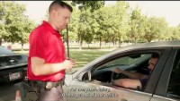

Slide 3
CITY OF HOUSTON GUN BUY BACK PROGRAM
Program Overview
About/Objective
On February 2, 2022, Mayor Sylvester Turner released One Safe Houston: The Mayor’s Public Safety Initiative to combat violent crime, which focuses on four key areas:
Violence Reduction and Crime Prevention
Crisis Intervention, Response and Recovery
Youth Outreach Opportunities
Key Community Partnerships
The robust gun buyback initiative is part of the Violence Reduction and Crime Prevention section of the Houston Police Department. In an effort to reduce violence and prevent crime the City of Houston committed to invest $1 million in a robust gun buyback initiative. The goal is to remove illegal or unwanted firearms from the street to reduce violence and prevent crime.
Primary Partnerships & Department Involvement:
White House (pending)
Host: Mayor Sylvester Turner
Co-host: Commissioner Rodney Ellis (Harris County Precinct One)
Houston Police Department Divisions
  Office of Community Affairs
  Houston Police Academy – Firearm Training Instructors
  Tactical Operations Division – Bomb Squad Technicians & SWAT
  Traffic Enforcement Division – Mobility Units
  Property Room Division
  Patrol Division Personnel
Office of Policing Reform & Accountability (OPRA)
Houston Forensic Science Center
Mayor’s Office of Governmental Affairs
Mayor’s Office of Communications
Purpose
Solidifying the Gun Buy Back event location to ensure the safety of participating residents and surrounding community members that is accommodating to the event space needs in carrying out successful event(s).
Mayor Turner will be hosting Gun Buy Back events throughout the city over the next three years to accommodate to residents across the Greater Houston–The Woodlands–Sugar Land area increasing visibility and resident turnout.

Slide 4
CITY OF HOUSTON GUN BUY BACK PROGRAM
Program Overview
Mission
The mission of the event is to assign Houston Police Department officers to collect/manage any firearms turned in by members of the public by ensuring a safe operation of the program and the administrative processing of all relinquished firearms according to the Houston Police Department policy.
Event Procedures
The Gun Buyback is completely anonymous for the public deferring to our goal in retrieving as many firearms as possible from Greater Houston residents. HPD officers will not transcribe any personal information provided to residents, nor run warrant or record checks. Maintaining public trust is critical. Firearms will be checked thru TCIC and NICIC for possible stolen weapons. Any weapons discovered to be stolen will be issued a report or supplement will be made and will be returned to the respective law enforcement agency to clear the stolen hit. All weapons will have a chain of custody, reports, supplements, evidence tagged, NBIN tested by the Houston Forensic Science Center, secured in property room, and disposed after 90 days according to Code of Criminal Procedure Chapter 18, Article 18.17. Disposition of abandoned or unclaimed property, Section C.
If applicable, the respective outside law enforcement agency will be provided report information to successfully clear the stolen firearm(s) from any database.
Key Task of Departments & Police Personnel
Office of Policing Reform and Accountability
Event lead in facilitating a successful and organized event. Office of Commissioner Rodney Ellis (Pct 1)
Event Co-host partner
City of Houston Office of Community Affairs
Provide messaging to the community regarding public safety and the Gun Buy Back event including event details and procedures.
Mayor’s Office of Communications
Provide messaging to the community of the Gun Buy Back event including event details and procedures. They will be working in collaboration with the HPD Office of Community Affairs.
Houston Police Department: Special Events Unit & Traffic Enforcement Mobility Units
This unit along with on scene classified personnel will be able to set-up the staging area to include setting up cones hours before, ensuring parking lot are vacant prior to the event as well as assist with mobility issues for the drive thru event. Due to firearms being involved, members of SWAT, will be strategically placed to monitor the vehicles participating in the program covertly to ensure the public is not overwhelmed with police presence. In addition, officers will be monitoring the exterior of the coned area to identify any walk-up citizen trying to participate.

Slide 5
CITY OF HOUSTON GUN BUY BACK PROGRAM
Program Overview
Firearms Training Instructors & Bomb Squad
Any firearms turned in will be unloaded and secured only by a member of the firearms range staff personnel (they will be in a red shirt uniform) trained in the proper handling of firearms. Bomb squad technicians will be onsite for any weapons (50 caliber) that may contain gunpowder. Bomb squad will collect and dispose of any ammunition that is turned in by the public. This will allow only Firearm Personnel (they will be in a red academy shirts) to access their guns.
Special Weapons & Tactics Officers and Safety Measures
SWAT officers will be strategically positioned and assigned in a covert capacity throughout the event area to ensure public safety.
Houston Forensic Science Center
The Houston Forensic Science Center (HFSC) maintains a reference collection of firearms. HFSC maintains this reference collection for training new analyst as well as to use for replacement parts when we receive crime firearms that are not functional.
The Houston Forensic Science Center will test all qualified weapons through NIBN. HFSC already has an agreement with HPD of submitting several qualified weapons per day.
Event Timeline
Each event will require approximately, at minimum, four (4) weeks to properly plan, advertise, and host. Following the event, the firearms collected will be processed and destroyed according to department policy. For firearms determined to be stolen or reported lost, personnel will attempt to contact their owner, who will be given the option to surrender them or have them returned.
Event Logistics
Objective: The event will be held via a vehicle drive thru set-up HPD will facilitate check points establishing a smooth transition of submitted firearms and gift card transaction. The event will be highly secured throughout it’s entirety.
Location: Wheeler Avenue Baptist Church Parking Lot, 3826 Wheeler Ave, Houston, TV 77004
Event Time: 8:00 a.m. – 12:00 p.m. | 10:00 a.m. Media Coverage (Elected Officials to arrive onsite)
Event Set-up: (est.) 6:00/6:30 a.m. – 3:00 p.m.
Date: July 30, 2022

Slide 6
CITY OF HOUSTON GUN BUY BACK PROGRAM
Program Overview
Transitional Overview
Checkpoint One: Entry
Initial drive up through the parking lot and exiting that does not cross with the entry point. We defer to the University of Houston Central Campus special events, parking, and governmental affairs.
Academy Firearms Range personnel will remove firearm(s) and ammunition from vehicle; render the firearm(s) safe via a bullet trap. The Firearms Instructions will pass the firearm(s), and ammo to personnel working station 2.
Checkpoint Two: Docking Area (Outside Closed Tent/Van)
**This area will be highly secured and not open to the public and unauthorized personnel**
Receiving area/processing area.
Firearms personnel from HPD will received the firearm(s) and ammo and determine the value of firearms and fill out a receipt to the resident to redeem for gift card(s) in Checkpoint 3.
*Receipts will list the make, model, caliber, and serial number of firearm(s). This information will be used gun/article screen in the mater report through the MDT.
When the officer inventorying the firearm(s) completes his/her entry of the firearm(s) it will given to one of the (6) evidence technicians working in checkpoint 3.
Checkpoint Two: Docking Area (Inside Closed Tent/Van)
Tagging area
  HPD will tag all firearms in accordance with normal procedures, such as rendering the weapon safe and printing labels for firearms inside a protected container/barrel that will be monitored and secured during the entirety of the event. All firearms received from the event will be handled in accordance with normal operating procedures and stored in an appropriate secured location. The firearms will be transitioned from the event alongside with secure patrol vehicles away from the event site on a continuous basics. (This transition will need access to and from a separate entrance/exit of the event site).
Checkpoint Three: Gift cards
Firearm personnel will direct vehicle to station 3 to exchange receipt for the gift card along with a “Thank You” letter to citizens. The classified and civilian staff will maintain a log with receipts. When transaction is completed, the citizen will be directed to safety exit onto the street.
The proposed program would provide a different amount in gift cards for different types of weapons.
  $50 gift card will be exchanged for a non-functioning firearm
  $100 gift card will be exchanged for rifles or shotguns
  $150 gift card will be exchanged for a handgun
  $200 gift card will be exchanged for a fully automatic rifle

Slide 7
CITY OF HOUSTON GUN BUY BACK PROGRAM
Program Overview
Staff Point of Contacts
Crystal Okorafor, Deputy Inspector General, Office of Policing Reform & Accountability (832) 712-2235 or crystal.okorafor@houstontx.gov
Ashley Campbell, Senior Staff Analyst, Office of Policing Reform & Accountability (281) 840-9582 or Ashley.campbell@houstontx.gov

Slide 8
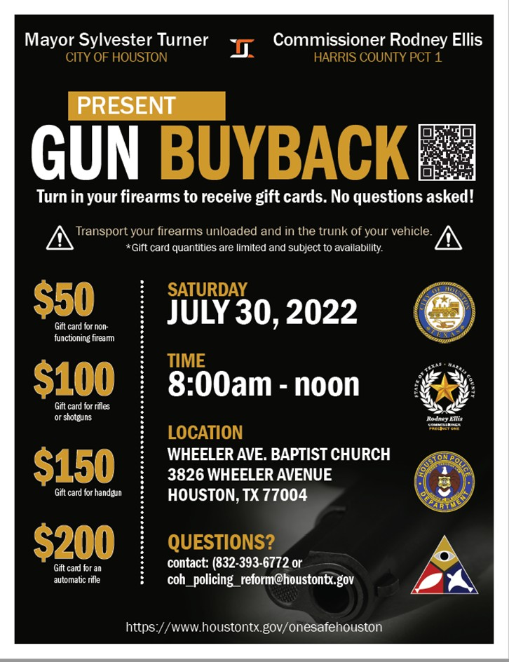




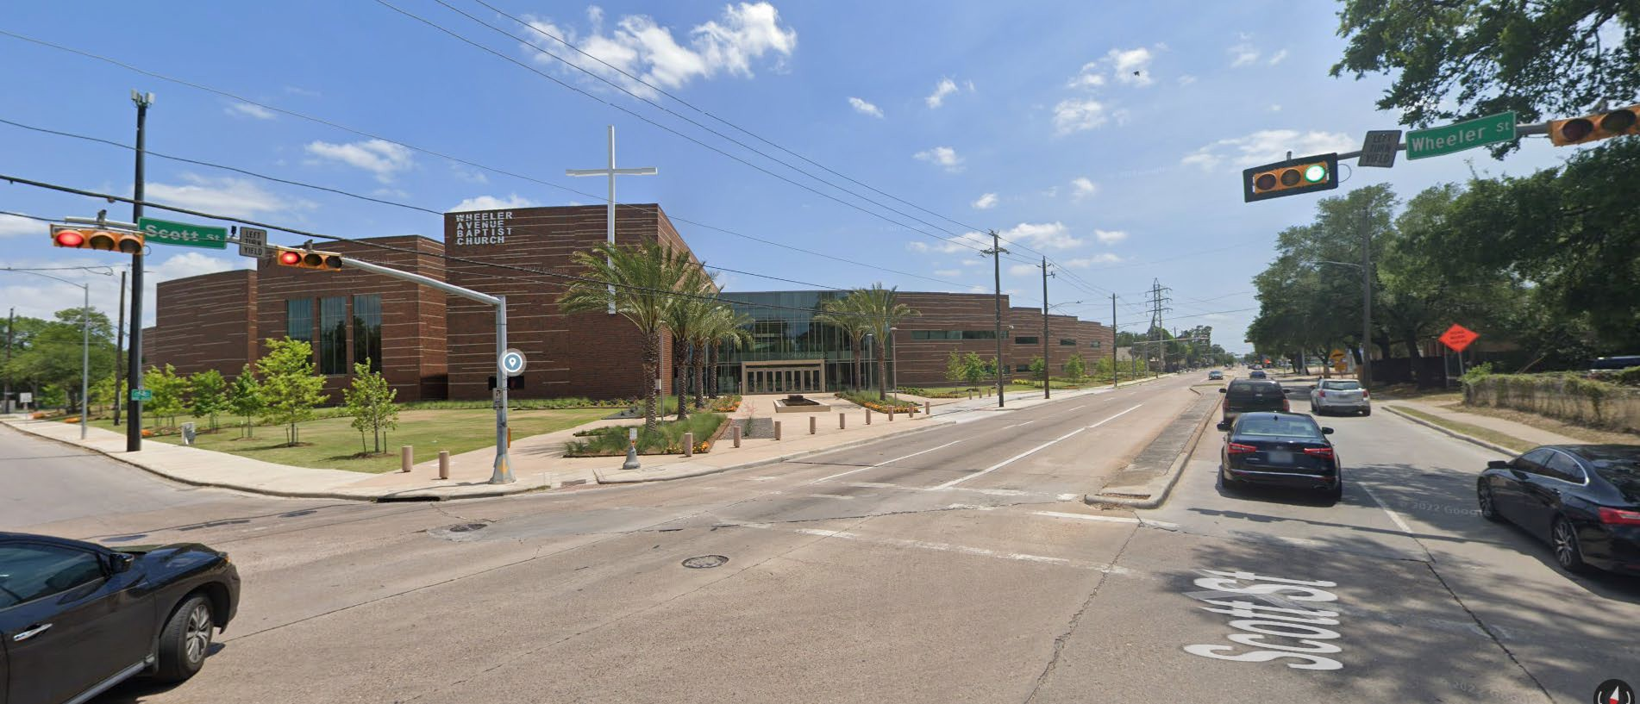
Gun Buy Back Program 7/30/2022 3826-Wheeler Ave. Baptist Church

Slide 9
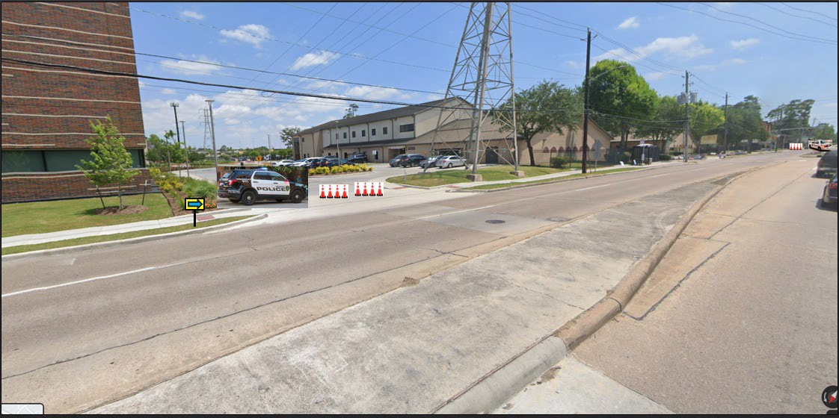



Community Affairs Marked Unit with Strobes (signage and cones)
Mobility Response Unit Traffic Control

Slide 10


3800 Ruth At 3900 Scott St.
Mobility Response Units Traffic Control
Banners / Signage

Slide 11

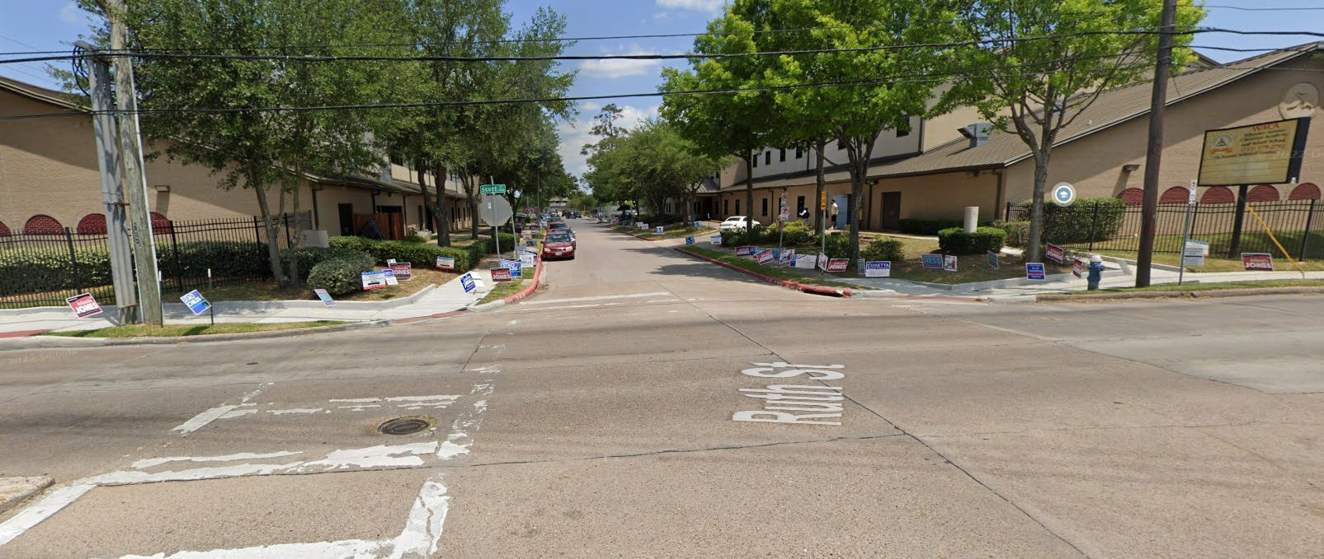

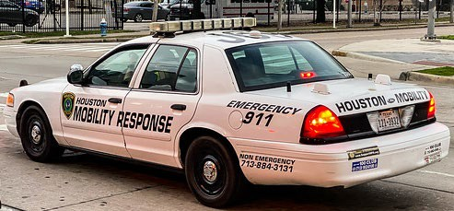



Slide 12

Traffic will pass first entrance
Traffic Flow Pattern
Traffic will be directed to enter second entrance

Slide 13


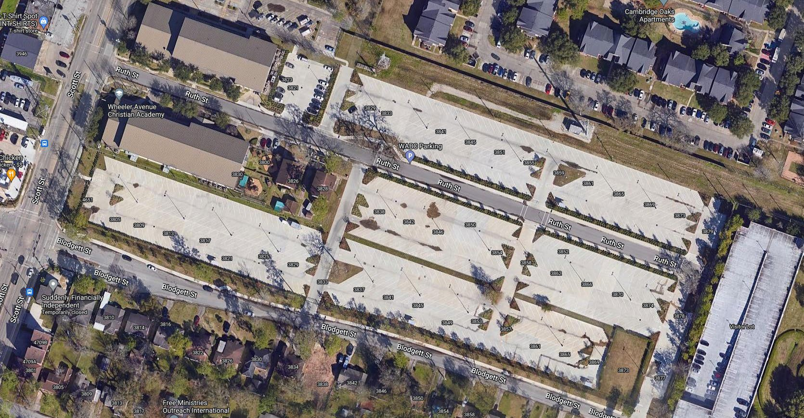



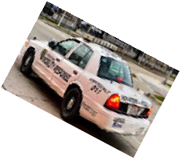








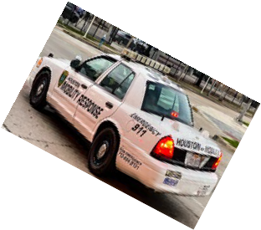





Station #1 Greet and Instructions
Station #2 Firearms Instructors
Station #3 Gift Card Distribution
6 Canopy Tents needed – MRTs and Stations (water stations)
Mobility Response Unit Traffic Control

Slide 14

Houston Police / ATF Partnership

Slide 15
E-Trace
NIBIN
TFO Program

Slide 16
Gun Crime Intelligence Center
Analysts from ATF, HPD, HCSO, and other agencies.
Clearinghouse for all Gun Crime Intelligence across the Greater Houston Area.
Linking of all sources of Gun Intelligence to better address violent crime involving firearms. (E-Trace, NIBIN, RMS reports and data, ShotSpotter, etc.

Slide 17
Questions?

Slide 18

PUBLIC SPEAKERS
Next Meeting: Joint TTI/PSHS
August 4th 10am

