Slide 1

Body Worn Cameras Chief of Police Art Acevedo
Information Presented by:
Assistant Chief James Jones
Special Investigations Command
Deputy Director Mike Bell
Office of Technology Services
September 10, 2019

Slide 2
Description of Project
BWC pilot program was initiated to evaluate use of BWC for front line officers
Existing BWC research indicates that use of BWC increases accountability, reduces complaints, provides additional evidence and training opportunities
Initial roll-out included all patrol and supervisory first responders, and crime reduction unit officers.
Initially was to include all officers working uniformed extra employment
Approximately 2,900 BWCs purchased, original intention was to purchase 4,500 BWCs
Over 5.6 million BWC events have been recorded
Currently have approximately 3.4 million video events stored

Slide 3
Description of Project
WatchGuard was recently purchased by Motorola
Currently 300 TB of data in the cloud, with any video older than 500 days automatically going to cloud storage
Eventually, any video older than 180 days will be in cloud storage
No person currently has the ability or the authority to delete video. It is an automated process that eliminates certain videos following established retention policies
Tactical Operations and Narcotics Divisions recently received BWCs for warrant service, which will be expanded to include other investigative divisions in the near future
HPD BWC Policy: http://www.houstontx.gov/police/pdfs/Circular-No-16-0324-069-and-GO-400-28-Creation-of-General-Order-400-28-Body-Worn-Cameras.pdf

Slide 4
History
August 2012: HPD decided to proceed with a pilot program of 100 BWCs
Early 2014: First evaluation of initial 100 BWCs conducted
December 2014: Funding identified from various sources: Asset Forfeiture from HPD/DAO/State Grants
January 2015: RFP for BWC
November 2015: City Council approved contract for WatchGuard for the purchase of approximately 4500 BWCs
April 2016: HPD deployed first WatchGuard BWCs to Central Division & Crime Reduction Unit (approximately 300)
January 2018: Deployed BWC to newly formed North Belt Division, completing BWC deployment to all patrol stations

Slide 5
History
April 2017: HPD deployed BWC to Eastside/Clear Lake Divisions using a trial kiosk check-out system with the next generation Vista-Wifi model BWCs
July 2018: Completed conversions of all stations to BWC kiosk check-out
February 2019: Implemented mandatory use of BWCs by all classified personnel at all Alcoholic Beverage Establishments for extra employment
BWC project has a budget of $7,963,360
BWC spending total is $6,758,064
BWC balance of approximately $1.2 million
BWC contract with WatchGuard had initial 3 year term, beginning December 2015, with 2 1-year extension options
Final 1 year extension starting December 2019

Slide 6
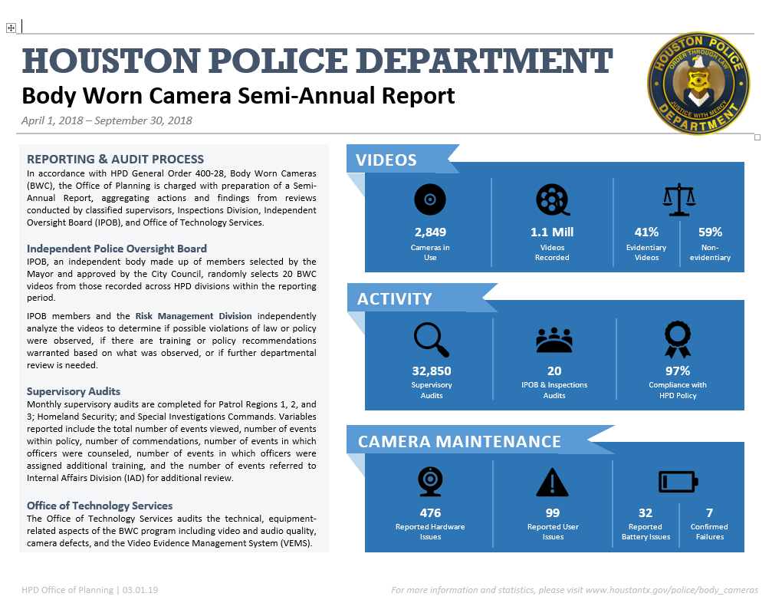
Accountability
BWC Audits being conducted by Risk Management Division, Supervisors and IPOB
http://www.houstontx.gov/police/body_cameras/

Slide 7
Next Generation of BWCs
Battery: longer charge of 12-14 hours, replaceable/rechargeable by end-user, and low battery alerts
CAD or other automated trigger mechanism, along with CAD/RMS integration
Automated classification of BWC videos to simplify case development
Regular hardware refreshes
Real-time video streaming
Automatic video, facial, and tracked object redaction, built into system or option for third-party integration, and bulk redaction
Video analytics – license plate, vehicle, and descriptor recognition
BWC video upload over wireless connection
New standard of video compression to save storage and transmission size limits
Business continuity/disaster recovery capabilities, encompassing off-site storage (the cloud)

Slide 8
Challenges in Moving Forward
Battery Life
Automatic Triggers
Providing videos to DA/open records/law enforcement agencies in timely fashion
Linking BWC videos to specific incidents across time gaps and multiple divisions
Securing necessary funds for RFP
Leasing versus Purchasing BWCs
Approximately $3 million in funding available at this time through a donation, with a $3 million grant application pending

