Slide 1
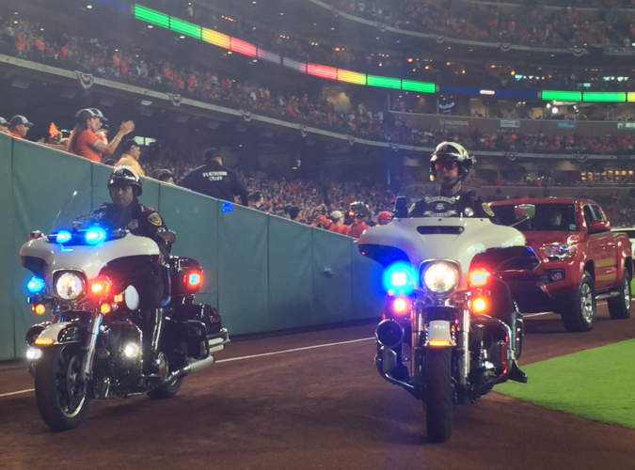
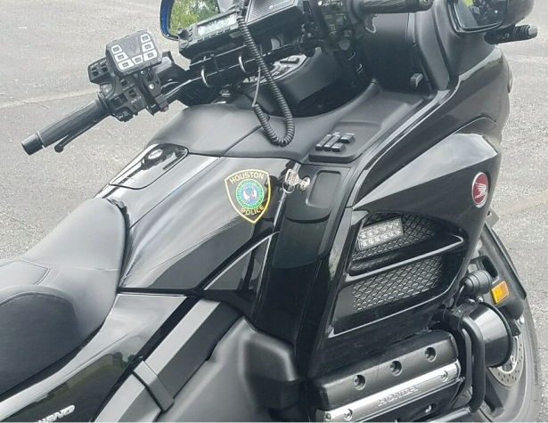



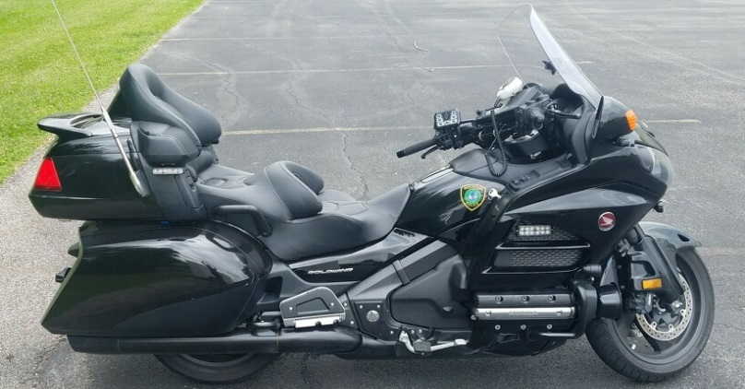
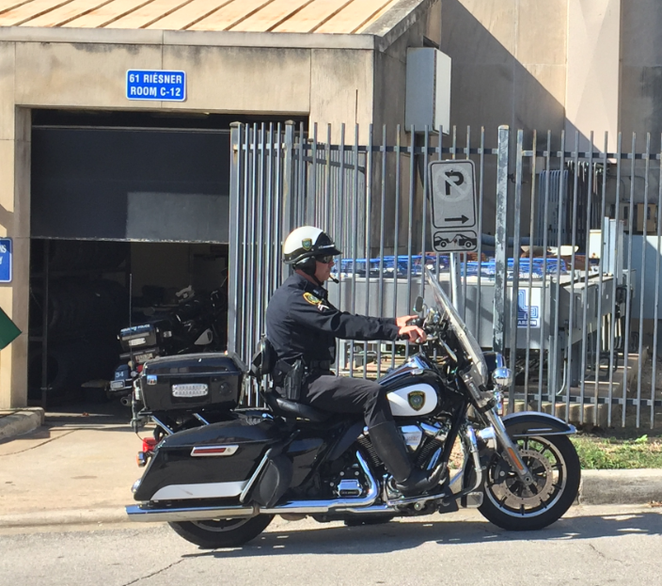
2019 SOLO STIPEND PROPOSAL
August 13, 2019

Slide 2
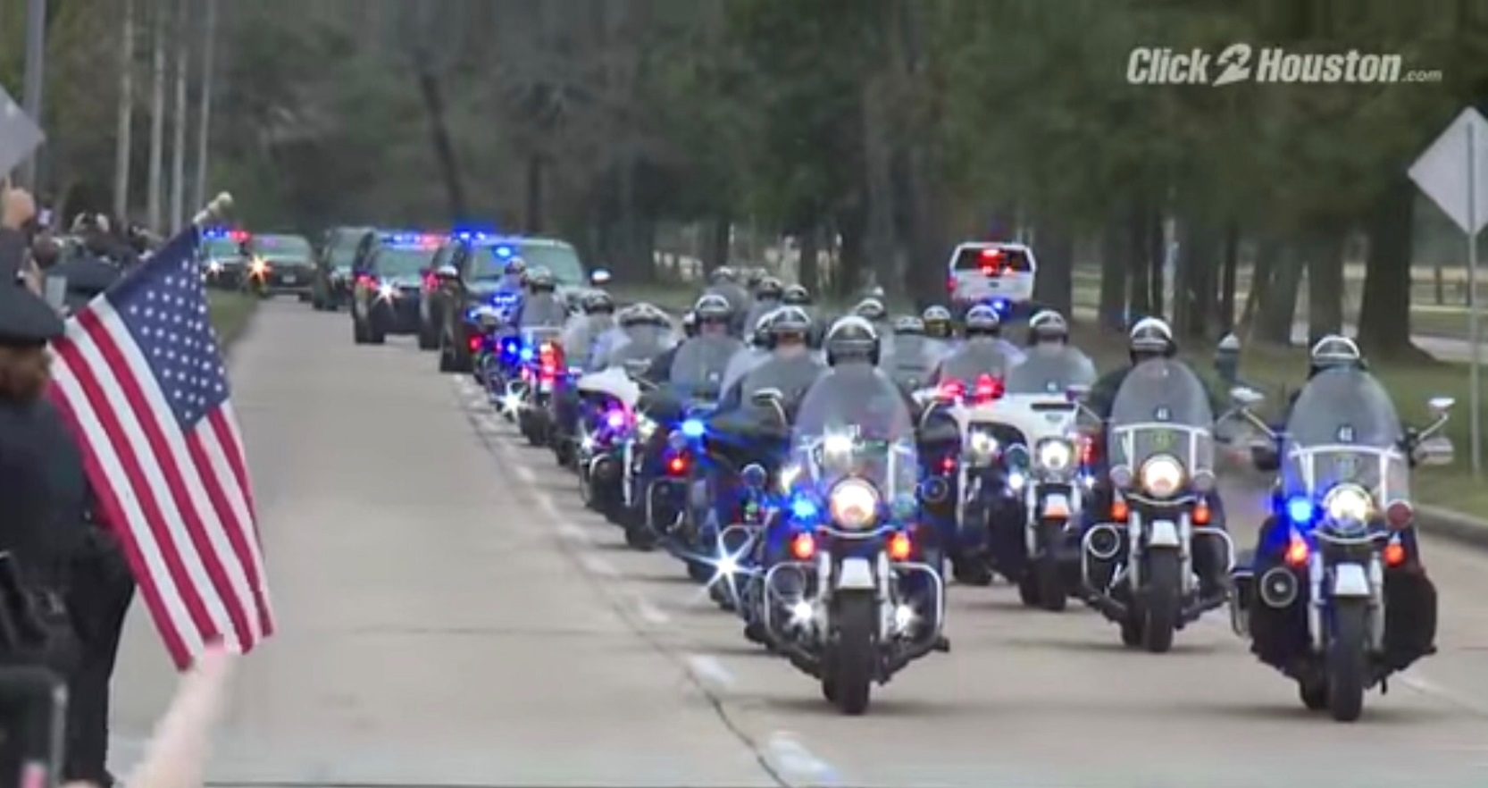
HOUSTON POLICE DEPARTMENT SOLO MOTORCYCLE DETAIL
The unit consists of 40 full time sworn peace officers. All members of this unit ride and operate motorcycles as their primary duty on a daily basis.
1 Lieutenant 5 Sergeants 34 Officers
SOLO Unit Responsibilities:
Traffic Enforcement
Vehicular Crashes
Dignitary Escorts
Funeral Escorts
Community Events
Parades
Traffic Mobility
School Safety
Sporting Events

Slide 3

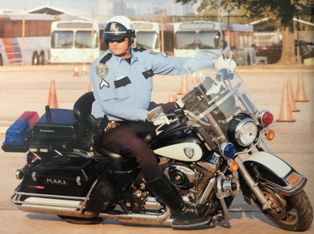
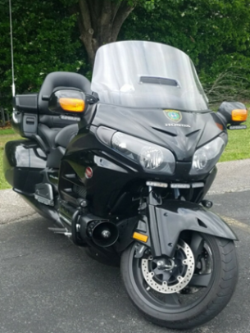
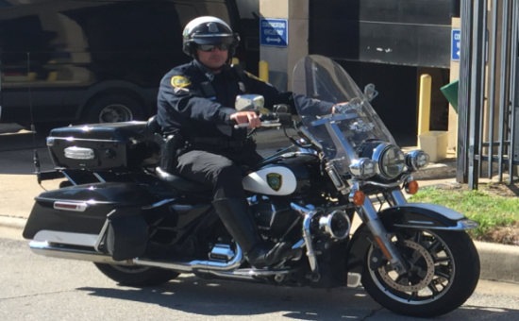
TODAYS CURRENT MOTORCYCLE STIPEND
$425.00 ESTABLISHED IN 1987
Motorcycle Allowance/Stipend History and Origination
City of Houston Ordinance No. 83-1324 Sec. 2 – $175.00 effective 8-23-1983
City of Houston Ordinance No. 83-1324 Sec. 2 – $425.00 effective 9-9-1987
Average Police Motorcycle Cost From Dealer
Not including all Police Equipment
1983 - $6000
1988 - $7300.00
1996 - $11,312.05
2018 - $18,876.41
Percentage Increase
In Cost of Motorcycle
1983 – 2018 314.61%
1988 – 2018 258.58%
1996 – 2018 66.87%

Slide 4


Total Monthly Cost for Motorcycle Ownership
Officer | Year | Total Monthly Operating Cost (Owner Performed Maintenance) | Total Monthly Operating Cost (Dealer Performed Maintenance)
New | 2018 | $981.74 | $1,059.63
Current | 2018 | $804.74 | $882.63
New | 2017 | $964.80 | $1,042.69
Current | 2017 | $787.78 | $865.67
New | 2016 | $943.38 | $1,021.27
Current | 2016 | $766.38 | $844.27
Breakdown of Monthly Cost for Motorcycle Ownership
Officer | Year | Price (TTL) | Rollover owed on Previous Motorcycle | Trade-In Value | Financed Amount | Months Financed | APR | Monthly Payment | Mthly Insurance | Extended Warranty (3 Years) | Emergency Equipment | Mthly Cost (Excl. Maint.)
New | 2018 | $18,876.41 | $5,798.33 | $0.00 | $18,876.41 | 72 | 2.00% | $556.86 | $115.38 | $23.33 | $46.67 | $742.24
Current | 2018 | $18,876.41 | $9,641.81 | $6,000.00 | $12,876.41 | 72 | 2.00% | $379.86 | $115.38 | $23.33 | $46.67 | $565.24
New | 2017 | $18,471.41 | $5,231.08 | $0.00 | $18,471.41 | 72 | 2.00% | $544.92 | $110.38 | $23.33 | $46.67 | $725.30
Current | 2017 | $18,471.41 | $9,479.08 | $6,000.00 | $12,471.41 | 72 | 2.00% | $367.90 | $110.38 | $23.33 | $46.67 | $548.28
New | 2016 | $17,915.08 | $5,124.24 | $0.00 | $17,915.08 | 72 | 2.00% | $528.50 | $105.38 | $23.33 | $46.67 | $703.88
Current | 2016 | $17,915.08 | $9,372.24 | $6,000.00 | $11,915.08 | 72 | 2.00% | $351.50 | $105.38 | $23.33 | $46.67 | $526.88
Avg. Total Monthly Maintenance Cost Performed by Owner
Fluid Change | Front Tire | Rear Tire | Front Pads | Rear Pads | Air Filters | Total Monthly | Total Annually
$62.50 | $45.00 | $87.50 | $27.50 | $13.00 | $4.00 | $239.50 | $2,874.00
Avg. Total Monthly Maintenance Cost Performed by Dealer
$87.50 | $57.5 | $103.00 | $34.80 | $21.30 | $13.29 | $317.39 | $3,808.68
5x Per Year | 2x Per Year | 3x Per Year | 3x Per Year | 3x Per Year | 3x Per Year

Slide 5
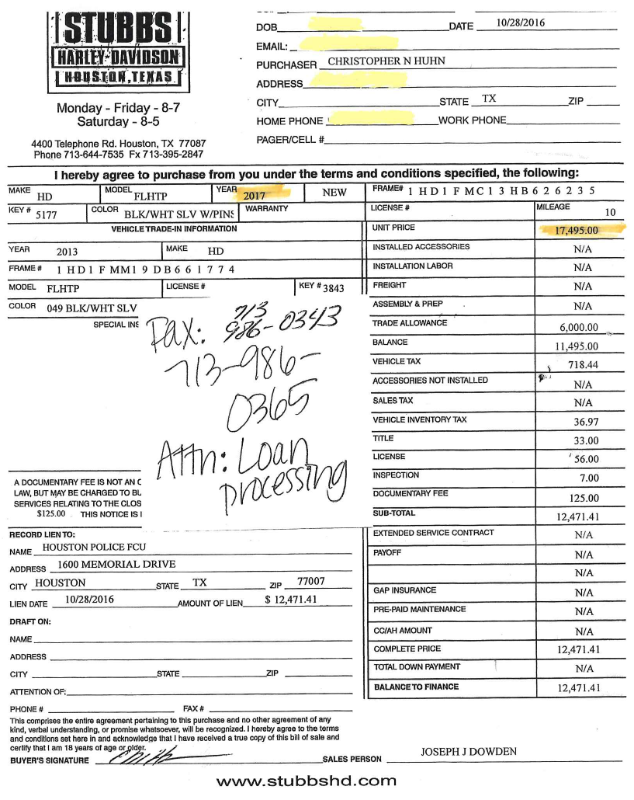
Bill of Sale - 2016 – Illustrates Trade in Value W/No Emergency Equipment Build Out

Slide 6
Local Legislation Requiring Law Enforcement Escorts
  Municipal Ordinances
    Chapter 45 – Traffic / Article IX – Parades and Processions / Division 2 – Funeral Processions
      Sec. 45-253. – Police escort.
Each funeral procession shall be accompanied by a police motorcycle escort which shall be a part of the funeral procession and the police officer’s motorcycle shall constitute an emergency vehicle when the siren and red lights are in operation. There shall be not less than one police motorcycle escort when the vehicles in the funeral procession, including the mortuary vehicles, do not exceed ten and there shall be not less than two police motorcycle escorts when such vehicles exceed ten.

Slide 7
  Tx. DMV Regulations – Oversize and Weight Permits
    Escort and Equipment Requirements
      Escort vehicles are required to ensure the safety of the traveling public and the safe movement of the permitted vehicle.
      TxDMV may require obtaining law enforcement escorts for permitted vehicle.
      Escort vehicles are required to be a single unit with a gross weight of not less than 1,000 pounds and not more than 10,000 pounds.
      An official law enforcement motorcycle may be used as a primary escort vehicle for a permitted vehicle traveling within the limits of an incorporated city if a highway patrol officer, sheriff, duly authorized deputy or municipal police officer operates the motorcycle.
      An escort motorcycle must maintain two-way radio communications with the permitted vehicle and other escort vehicles involved with the movement of the permitted vehicle.
      The escort vehicle operator must warn the traveling public when any of the following conditions exists
        A permitted vehicle must travel over the center line of a narrow bridge or roadway.
        A permitted vehicle makes any turning movements that will require the permitted vehicle to travel in the opposing traffic lanes.
        A permitted vehicle reduces speed to cross under a low overhead obstruction or over a bridge.
        A permitted vehicle creates an abnormal and unusual traffic flow pattern.

Slide 8
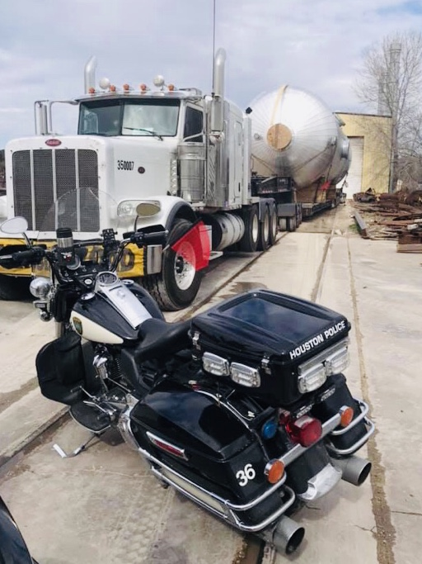
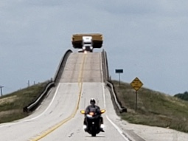
  Tx. DMV Regulations – Oversize and Weight Permits Continued...
    Houston District Permit Restrictions
      Houston District, All Counties, All Highways 12-26-12
        Over 20’ wide
Front and rear law enforcement escorts are required.
The load must move only during the hours of 09:00 PM – 04:30 AM.
The load must not move during Friday evening and Saturday.

Slide 9
Future Considerations
Motorcycle costs extend well beyond the actual initial purchase.
The amount of miles driven on SOLO Motorcycles and wear and tear on internal parts shortens the life span of the motorcycle, creating the demand for motorcycle replacement every 2-3 years.
Mechanical issues and time frames for extended out of service repair as motorcycles age, becomes a significant reality within the 2-3 year time period. Safety is paramount in such circumstances.
Maintenance, extended warranties, and insurance are significant factors in the overall operating costs.
Certified Harley and Honda motorcycle mechanics are required for many of the in-depth repairs.
The above factors all contribute to the overall operating costs of police motorcycles. During this current budget climate it is more advantageous to work with a stipend/increase than for the city to take on the overall costs of providing and servicing an entire fleet.
Conclusion
A SOLO stipend increase is needed in order to sustain the continued staffing of motorcycle services within the Houston Police Department. Additionally, such essential services are necessary as they are mandated by city ordinance and state regulations for the safe movement of vehicles within our city. Accordingly, Houston Police Department Chief Acevedo will discuss this matter further with Mayor Turner regarding amending the existing SOLO stipend ordinance to address this issue. The amount of the increase will depend on factors such as the amount of identified funding, the department’s ability to absorb the funding, and the budget climate of the city.

