Slide 1
Houston Fire Department
FY2020 Staffing and Deployment
Public Safety & Homeland Security Committee Meeting
April 9, 2019
Fire Chief Samuel Peña

Slide 2
HFD FY19 General Fund
Notes:
.

Slide 3
Annual Budget

Slide 4
HFD Staffing
FY19 Budgeted FTE
Emergency Operations* | 3710
HFD Administration/ Support/ OEC/LSB/Arson
 | 380
Grand Total FY19 | 4,090
FY20 Proposed Headcount
Emergency Operations | 3358
HFD Administration/ Support/ OEC/LSB/Arson
 | 354
Grand Total FY20 | 3,712
*including cadets
Headcount as of 3/18/19: 3,999 | Proposed FY20 Headcount: 3,712 | Change from Current HC: -287 | 220 Classified + 67 Cadets

Slide 5
HFD Staffing
*projected

Slide 6
HFD Staffing
FY2019 Division Totals | 4-Shift Classified FTE’s
Minimum Daily Staffing | 845
Emergency Operations* | 3710
HFD Administration/ Support/ OEC/LSB/Arson
 | 380
Grand Total FY19 | 4,090
FY2020 Division Totals | 3-Shift Classified FTE’s
Minimum Daily Staffing | 817
Emergency Operations | 3358
HFD Administration/ Support/ OEC/LSB/Arson
 | 354
Grand Total | 3,712
*including cadet

Slide 7
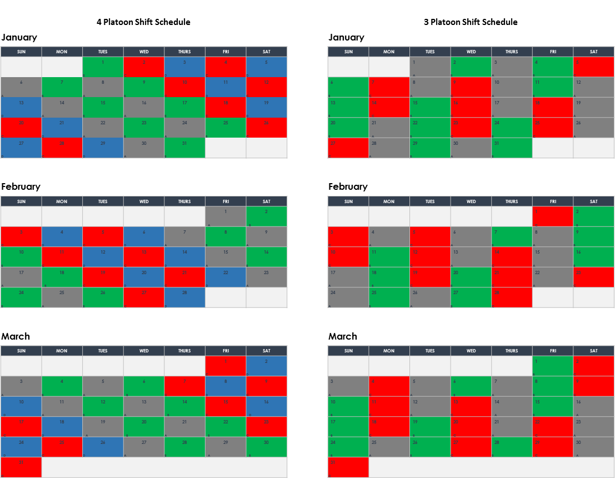
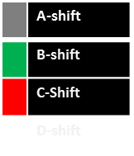
Shift Pattern Change
 | A-shift
 | B-shift
 | C-Shift
 | D-shift

Slide 8
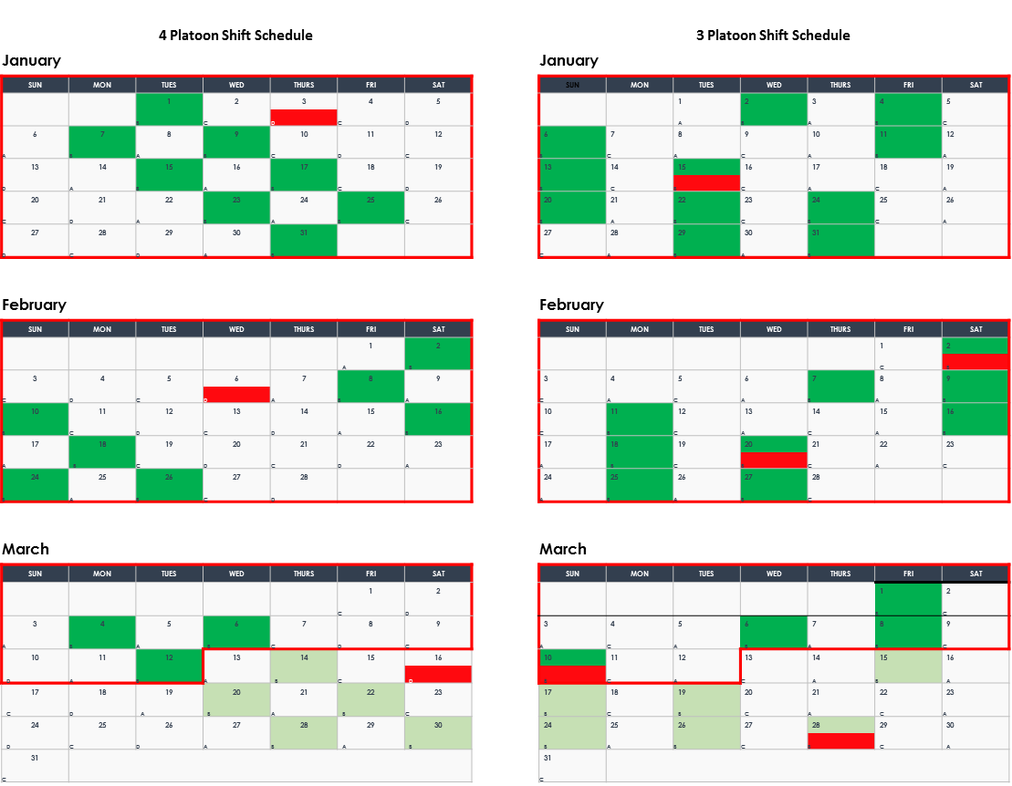


Shift Pattern Change

Slide 9
HFD Shift Pattern Change
Division Totals | 4-Shift Classified FTE’s
Minimum Daily Staffing | 817
Relief | 66
Kelly/Platoon | 0
Firefighters per Shift | = 883
X4 Shifts Emergency Ops | 3532
HFD Administration/ Support/ OEC/LSB/Arson
 | 354
Grand Total | 3,886
Division Totals | 3-Shift Classified FTE’s
Minimum Daily Staffing | 817
Relief | 131
Kelly/Platoon | 171
Firefighters per Shift | = 1,119
X 3 shifts Emergency Ops | 3358
HFD Administration/ Support/ OEC/LSB/Arson
 | 354
Grand Total | 3,712

Slide 10
HFD Historical Service Demand
Year over Year Activity
Year | Fire Incidents (All Type) | HazMat Incidents | EMS | Total
2016 | 39,123 | 2,996 | 293,904 | 336,023
2017 | 41,131 | 3,303 | 297,387 | 341,819
2018 | 40,363 | 3,292 | 296,832 | 340,487

Slide 11
Operational Resource Changes
Current Daily Staff | No. Units | Personnel
Shift Commanders | 2 | 2
District Chiefs | 21 | 42
Supervisors | 10 | 10
Safety | 3 | 3
Ambulances | 58 | 116
Medics | 45 | 90
Engines | 88 | 352
Ladders | 33 | 132
Towers | 5 | 20
Command Van | 1 | 1
Rehab Van | 1 | 1
Cascade | 3 | 3
Rescue | 3 | 13
ARFF | 26 + 8 | 34
HazMat | 3 | 10
OEC | 16 | 16
788 Emergency Ops + 57 Spec Ops |  | 845
Proposed Daily Staff | No. Units | Personnel
Shift Commanders * | 1 | 1
District Chiefs * | 19 | 38
Supervisors * | 9 | 9
Safety | 3 | 3
Ambulances* | 59 | 118
Medics | 45 | 90
Engines* | 86 | 344
Ladders* | 30 | 120
Towers | 5 | 20
Command Van * | 1 | 0
Rehab Van | 1 | 1
Cascade * | 2 | 2
Rescue * | 3 | 12
ARFF | 26 + 8 | 34
HazMat * | 3 | 9
Utility Unit Addition @96’s* 1 2
OEC* | 14 | 14
* Staffing Change
762 Emergency Ops + 55 Spec Ops |  | 817

Slide 12
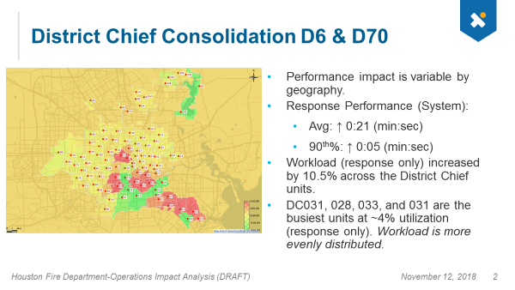
District Chief Consolidation

Slide 13
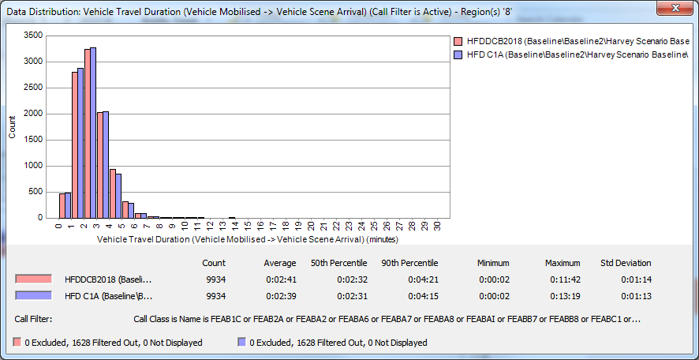
E1/ Ambulance Operational Unit Adjustment
EMS Response Times

Slide 14
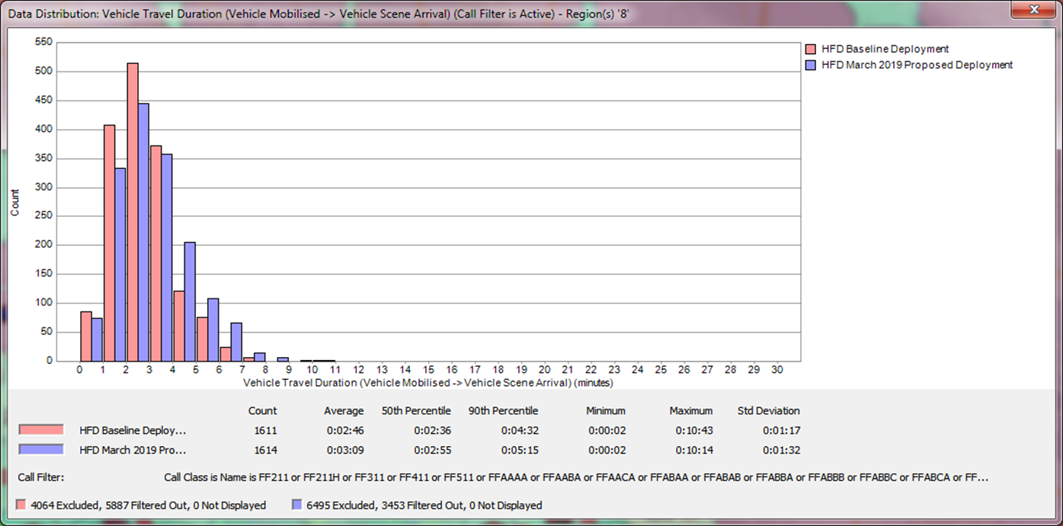
E1/ Ambulance Operational Unit Adjustment
Suppression Response Times

Slide 15
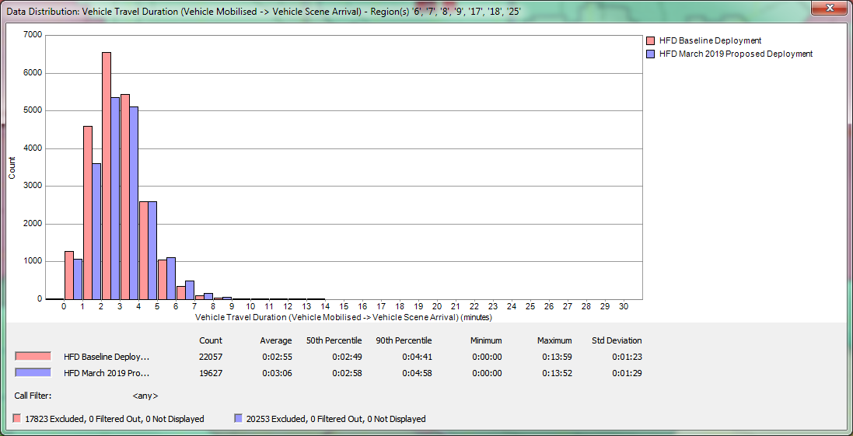
E1 Operational Unit Adjustment
Engine Unit Impact
Notes:
Removing E1 and Replacing with Ambulance unit
Engine 8’s Fire utilization rate increases by 3.04% (from 15.84% to 18.88%)
Engine 7’s Fire utilization rate increases by 1.02% (from 15.72% to 16.74%)
Engine 6’s Fire utilization rate increases by .44% (from 13.04% to 13.48)
All remain below the 20% utilization threshold.
EMS performance remains improved with the impact of the additional ambulance in the area.

Slide 16
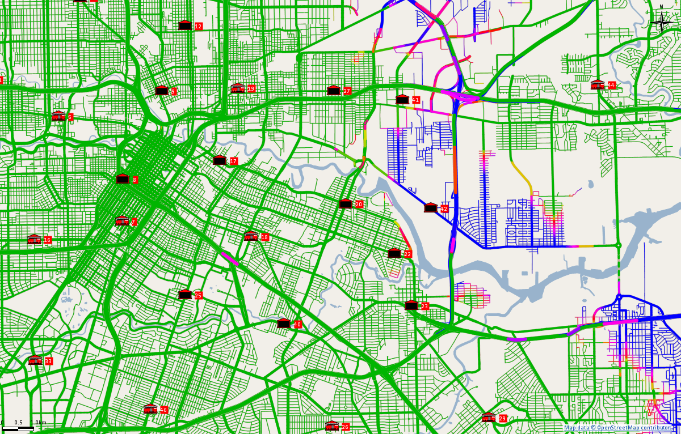
L020 Closure
Green < 8min, Blue > 8.75 min
Response Performance-Still Alarm
  Avg: ↑ 0:25 (min:sec)
  Remaining Units
    D20
    E20
    A20

Slide 17
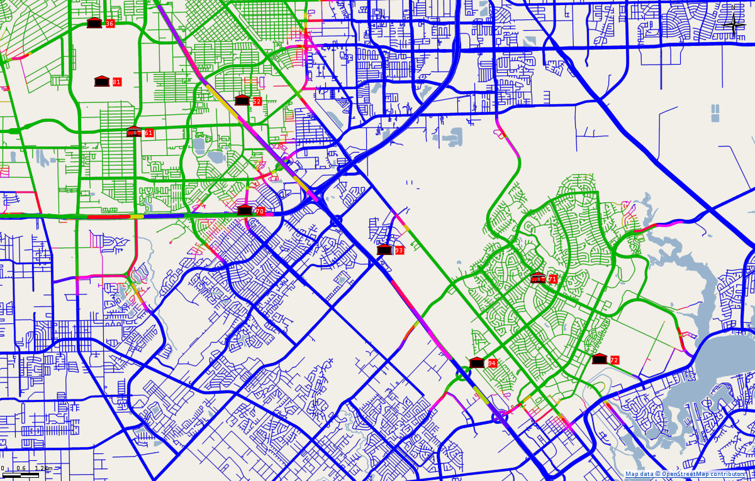
L093 Closure
Green < 8min, > Blue 8.75 min
Response Performance-Still Alarm
  Avg: ↑ 0:05 (min:sec)
  Remaining Units
    E93
    A93

Slide 18
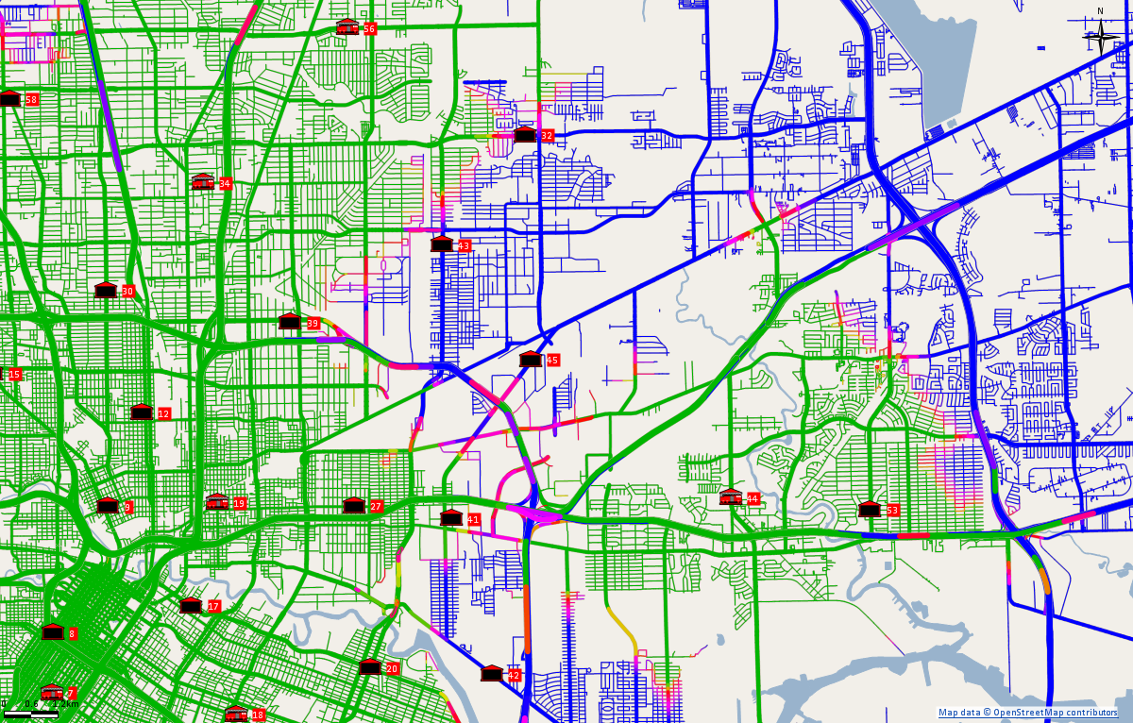
L045 Closure
Green < 8min, > Blue 8.75 min
Response Performance-Still Alarm
  Avg: ↑ 0:28 (min:sec)
  90th%: ↑ 0:39 (min:sec)
  Remaining Units
    D45
    E45
    A45
Notes:
L45 Call Volume
2017:
Total Response = 503
EMS Response = 255 (51%)
Fire Response = 248 (49%)
2018:
Total Response = 479
EMS Response = 282 (59%)
Fire Response = 197 (41%)

Slide 19
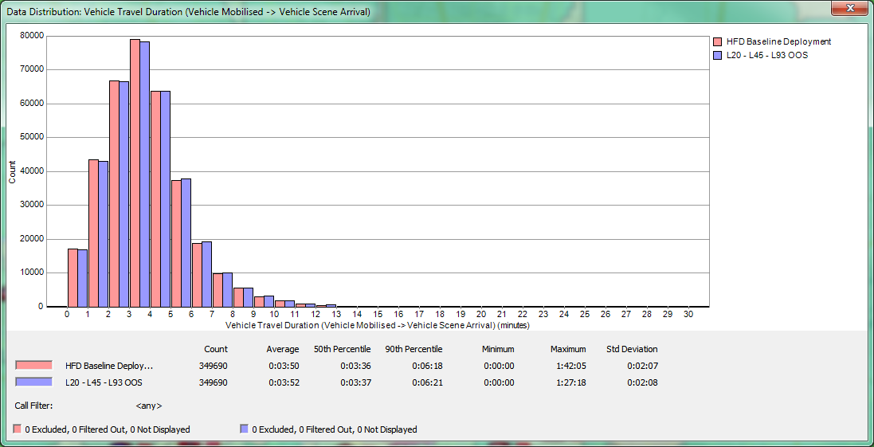
Combined Impact (Suppression)
Response Performance-Still Alarm
  Avg: ↑ 0:02 (min:sec)
  90th%: ↑ 0:03 (min:sec)

Slide 20
Questions

Slide 21
Strategic Restructure
Division | 4-Shift Classified FTE’s
Emergency Operations* | 3710
HFD Administration/ Support/ OEC/LSB/Arson
 | 380
Grand Total | 4,090
Division | 3-Shift Classified FTE’s
Emergency Operations | 3497
HFD Administration/ Support/ OEC/LSB/Arson
 | 354
Grand Total | 3,851
239 Δ in FTE Headcount
*including cadet

Slide 22
Strategic Restructure
*Projected
**127 FF’s >33 yrs. of service

Slide 23
Strategic Restructure
FY2019
FY2020
FY2021
FY2022
FY2023
Restructure Plan Initiation
MCO Approved
Shift Adjustment, Attrition & Rank Consolidations
33%
Apparatus and Equipment Specs/Procurement
100%
Attrition and Rank Consolidations
33%
Apparatus and Equipment Acquisition
100%
Attrition and Rank Consolidations
33%
Paramedic Training
Training/ Certification
Deployment Policy Changes / CAD Programing
100%
Full Transition
2023

