Slide 1
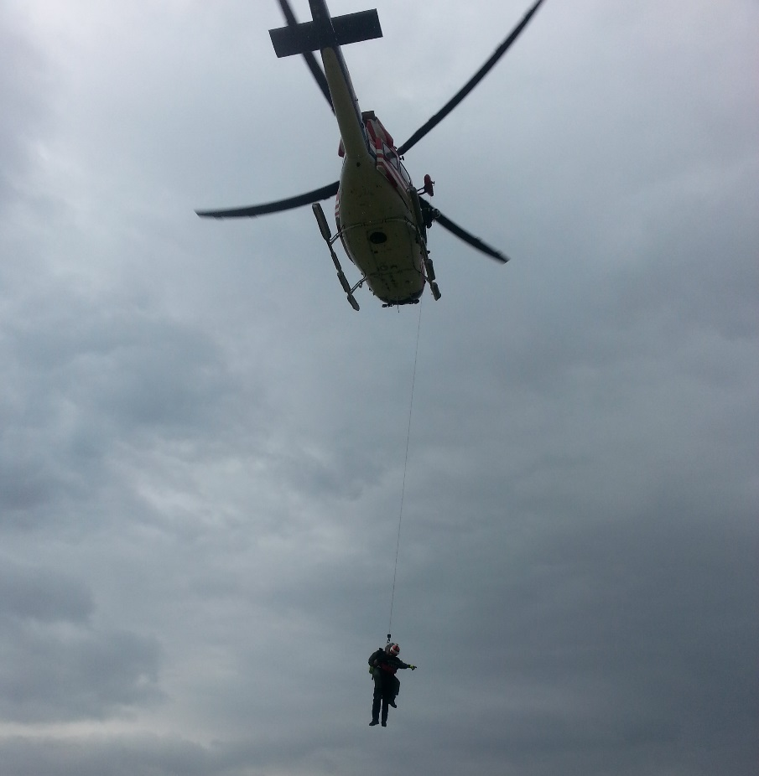
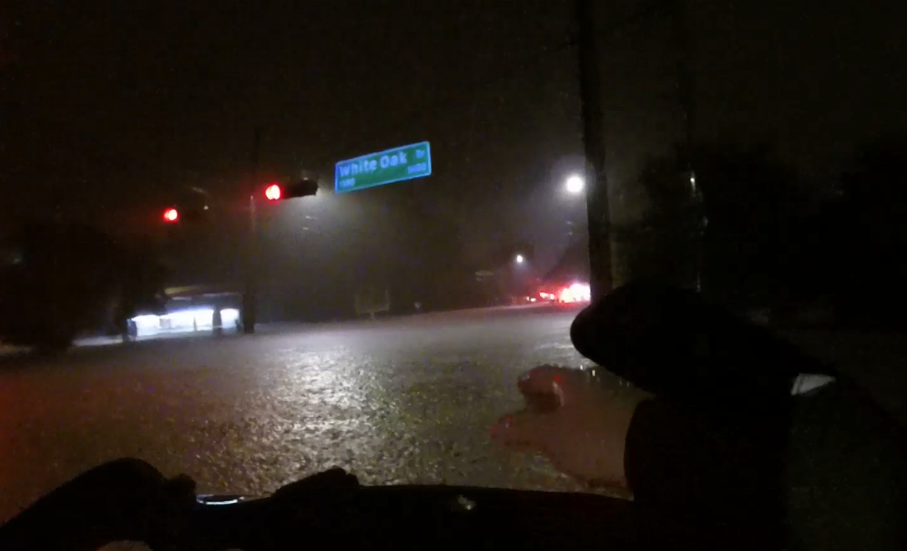

Houston Fire Department Marine Group
Assistant Chief Isaac Garcia
Emergency Response Division
April 2018

Slide 2
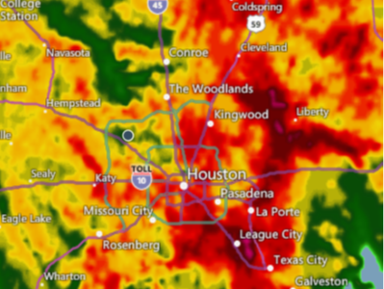
Historical Flooding Events
Flood Events
Harvey
Tax Day
Memorial Day
Allison
Typical Threats
Hurricanes
Tropical storms
Tornadoes
Stalled Fronts
Clusters and Lines of Storms
All have brought rising water and swift water to our area.

Slide 3
Topography
Houston’s topography
large influx of new resident
increased commercial
residential development
flash flooding associated with heavy rainstorms
Potential for long-term multiple flooding events

Slide 4
HFD Fire Stations and Flood Plains

Slide 5
Mission of HFD Operations
Ensure that Houston Fire Department personnel have:
Training
annual training
quarterly
Equipment
Replacement plan
Maintenance-after operational periods
Support
Protect citizens from water related emergencies
Focus on:
Water Rescues-dynamic water
Rising water-Area Flash Flooding
Swift water emergencies
Bayou
Dam releases
Water Evacuations-static water
All require training for effective decision-making for safe outcomes

Slide 6
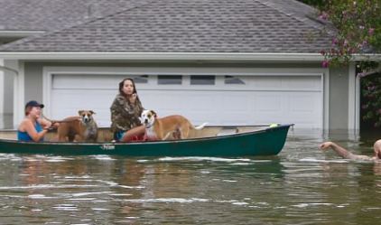
Survival depends on time!

Slide 7
Survival depends on time
Issues with Harvey
Reports of victims waiting for long periods of time
Duplication of calls for same residence due to slow response
Night time operations for rescue only
Most flooding events are a 36 hour event-Harvey lasted days
No distinction between calls for
Calls rescue
Calls for evacuation
Rescue teams committed to boats and HWEV
Limited equipment
PWE personnel not training in HWV driving or conditions
Equipment available (dump trucks) however personnel limited
Interagency Communications a challenge
Citizen volunteer corps helped and also became victims

Slide 8
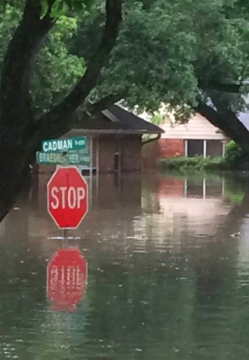
HFD Marine Group
Respond to communities overwhelmed by:
the effects of natural or manmade flood disasters
Rising water
Swift water
Provide specialized resources
For 600 square miles of Houston response area.
Kingwood
Meyerland
Greenpoint
White Oak
Simms Bayou area

Slide 9
What is “Rescue” and What does it include?
NFPA 1006 2017 ed. Defines “Rescue Incident” as
emergency incident that primarily involves the rescue of persons subject to physical danger and that could include the provision of emergency medical care, but not necessarily
NFPA 1006 2017 ed. defines “Rescue” as
activities directed at locating endangered persons at an emergency incident
removing those persons from danger
treating the injured
providing for transport of injured to an appropriate health facility

Slide 10
Solution
Water Strike Team
refers to a set number of resources of the same kind and type operating under a designated leader with common communications between them.
Ensures teams with known capabilities
Highly effective management units
Benefits of the Water Strike Team
Assets of watercraft
High Water Vehicles
trained operators
could be deployed into disaster district with hours incident.

Slide 11
NFPA 1670
Standards for Operations and Training of Technical Search and Rescue Personnel States the following:
“For personnel operating in the hazard zone, the minimum PPE provided shall include the following:
(1) Personal flotation device (PFD)
(2) Thermal protection
(3) Helmet appropriate for water rescue
(4) Cutting device
(5) Whistle
(6) Contamination protection (as needed)” (Association N. F., 2014)

Slide 12
Current status of HFD resources
Current Funding will allow for the Additional HFD water assets, equipment, and training
10 – Evacuation Boats-5 double stacks
5 – Rescue Boats-2 delivered
4 - Wave Runners-0 delivered
10 – Prime Movers-0 delivered
8– High Water Vehicles-3 on hand, 1 delivered in June 2018
80 – person Water Strike Team-completed this summer
Training and equipment for
Technical Rescue Team
Water Strike Team
High Water Vehicle Training
Evacuation Boat Training
Drone program

Slide 13
Water Strike Team used as a Force Multiplier
Purpose:
Target low impact high volume areas
removing large numbers or victims or evacuees
Free up Technical Swift-water flood teams to focus on critical rescue victims in the high impact areas
HFD Water Strike Team will consist of
80 member from suppression
20 per shift
from the ranks of Firefighter through Chief
Disciplines
swift water swimming rescue
advanced boat ops
Wave Runner Ops
HWEV as well as other water rescue related functions.

Slide 14
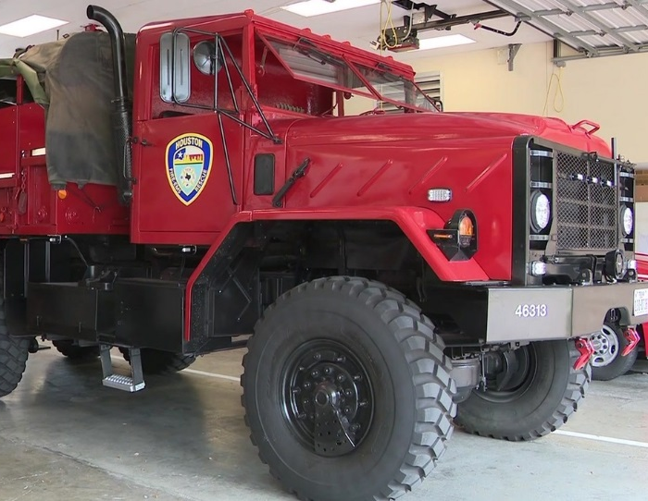
Water Strike Team and HFD Marine Group
Benefits
Available to recall during inclement weather
report to a staging area, for a debriefing
staff staged equipment
Recalled or pre-stage 12-24 hours in advance
Deploy assets to critical areas
high call volume of water evacuation related calls
assist station crews on evacuation boats
Maintain staffing fire apparatus

Slide 15
Marine Group Coordinator Sr. Captain Vogel
Responsibilities:
Coordinate and integrate with all HFD, HPD, COH, and external entities.
Oversee acquisition, deployment, and maintenance of Marine related assets.
Manage training, personnel, and equipment associated.
Train HFD’s rescue and boat operators to national standards.
Maintain and develop new training programs exclusive to HFD based on national standards for:
Evacuation Boat Technician
Evacuation Boat Operator
Swift Water Technician
Rescue Boat Operator
High Water Vehicle
Unmanned Aircraft System (Drone)

Slide 16
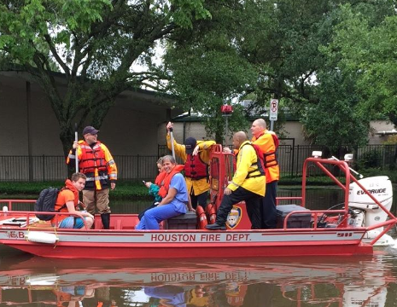
After all assets are purchased HFD will have
20 Evacuation Boats
11 – Rescue Boats
3 - Achilles Boats
9 - Wave Runners
25 – Prime Movers-
4x4 with lift kits
haul boats trailers
8 – High Water Vehicles
Arial Drones

Slide 17
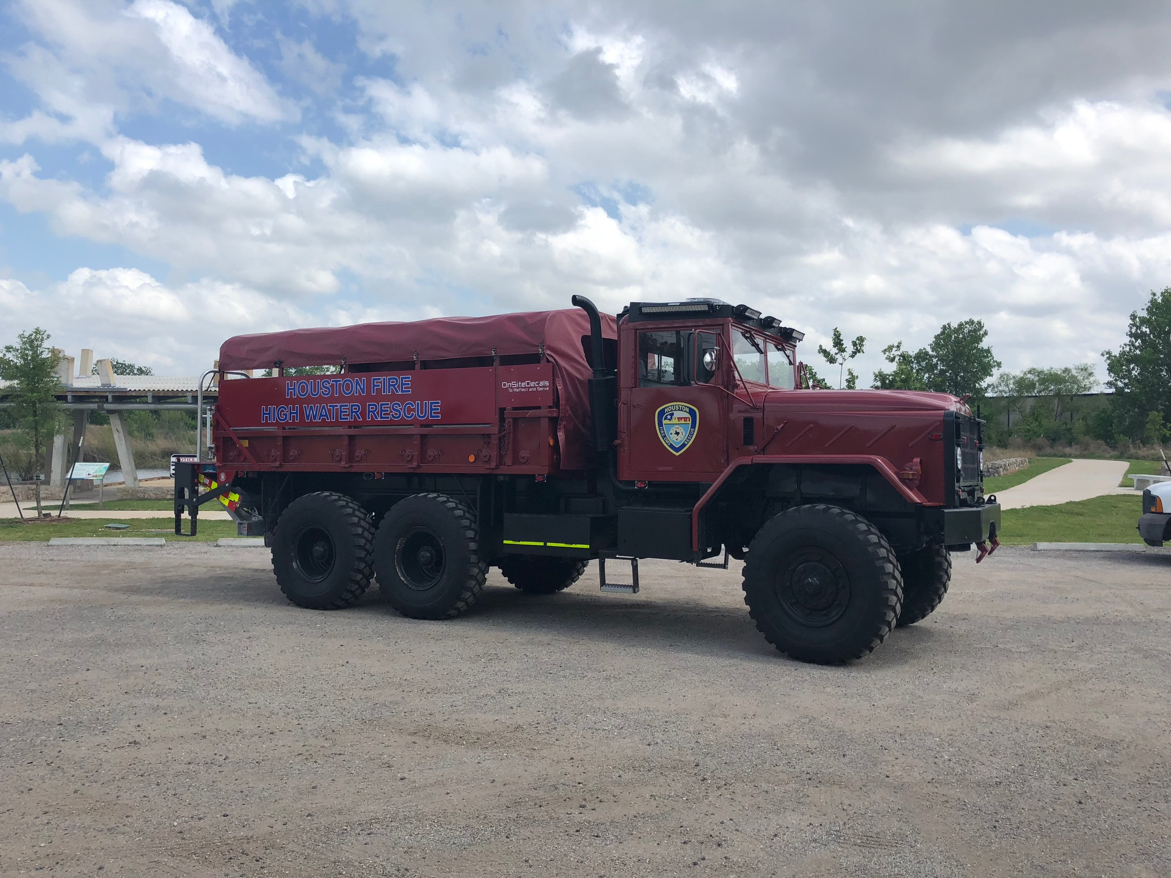
High water evacuation vehicle – Heavy duty tactical vehicle which is capable of operating in flood waters not exceeding 30 inches in depth. Designed to transport citizens or supplies to a collection point determined by a Commanding officer.
HWEV Team: Will be comprised of a minimum of 2 certified members in the cab of vehicle and 2 members in the cargo area. Vehicle is designed to transport an estimated 16 people safely.

Slide 18
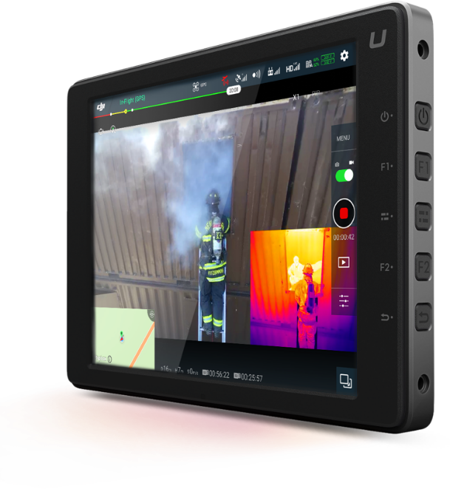
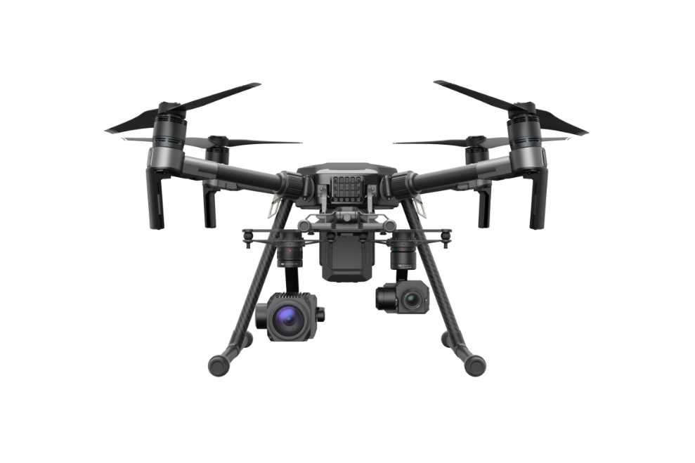
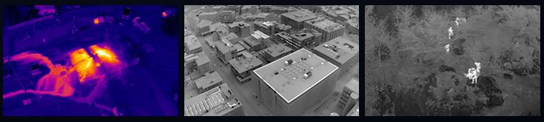
HFD Water Strike Team – UAS Drone
Scope
• Mapping – requires post-flight processing
• Search and Rescue – operated by experienced SAR members
• Live Situational Awareness – real-time stream to multiple devices
• Point of Interest Survey – orbit a fixed point
• Media Generation for Distribution – video/still images for internal or external distribution
Aircraft Capability
24-38 min Flights per battery (8 Batteries)
2.2 mi Range (Must Maintain Visual)
400 ft AGL Altitude (FAA Regulation)
23 knot Max Wind Resistance
IP43 rated for moderate dust and moisture
Dual Gimbals - 2 sensors (Cameras) can mounted at one time
Sensor Payloads
Infrared/Thermal – video/still images at 640x512 30Hz 2x-8x digital zoom
Optical – 30x optical, 6x digital (180x total) zoom 1080p with 1/2.8-inch sensor

Slide 19
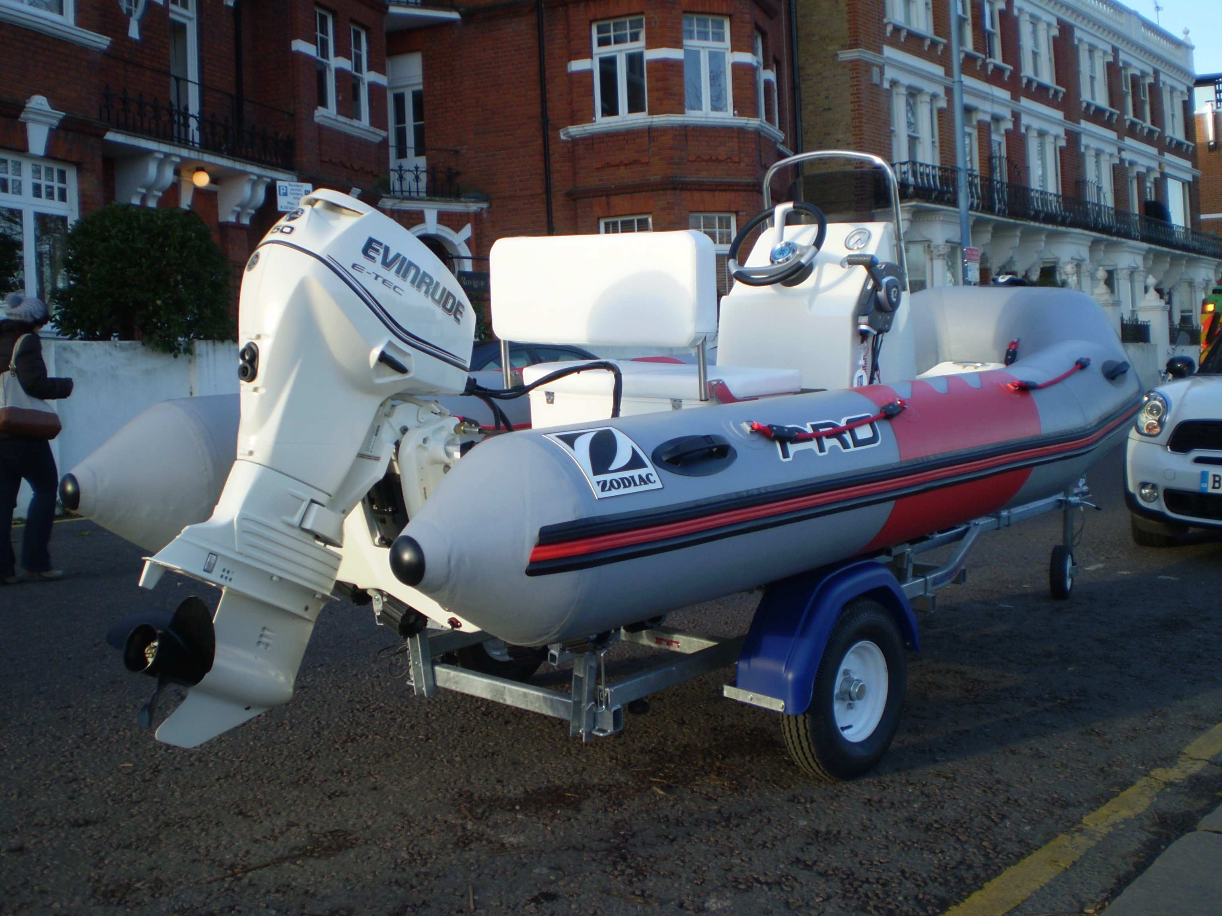
HFD Evacuation and Rescue Boat
The Evacuation Boat is designed to transport an estimated 6 people.
Rescue Boat transport capabilities are water dependent, but are capable of transporting 2 to 3 people.

Slide 20
FY 18 Water Training Schedule for Fire Suppression
100% Completed
100% Completed
40% Completed
100% Completed

Slide 21
FY 18 Water Training Schedule for Technical Rescue Team

