Slide 1

Mayor’s Office of Public Safety and
Homeland Security
4/10/18
George T. Buenik – Director
34-year veteran of HPD – Retired as an Executive Assistant Chief
Currently oversee 287 employees
  244 at HEC
  27 at City Hall Annex
  16 at OEM
  Mission: To assist the city in its preparedness activities to prevent, protect, respond to, and to recover from disaster and major emergencies

Slide 2
Areas of Responsibility
Public Safety and Homeland Security
The Houston Emergency Center (HEC)
The Office of Emergency Management (OEM)
Emergency Operations Center (EOC)
Houston Crackdown
Regional Community Preparedness
Public Safety Video Network

Slide 3
Homeland Security Office
Coordinate Homeland Security for a five county area
20 out of 27 employees are Grant funded
  Grant Coordinators, Administrators, Planners, Trainers, and Financial personnel
Manage grants:
  Securing the Cities - $30 million over 5 years
  Urban Area Security Initiative - $23 million Houston Region ($10 million City)
  Port Security Grant Program - $3.5 million (received in 2017)
  Complex Coordinated Terrorist Attack - $1.7 million
  Countering Violent Extremism - $500,000
  State Homeland Security Grant - $286,000 (expected)

Slide 4


Securing The Cities
$30 million grant program (over 5 years)
  Regional Terrorism Prevention and Response
  Detecting, Deterring, and Defending against terror attacks that use radiological or nuclear material
  Training for First Responders
  Radiation Detection Devices, Backpack Detectors, and Mobile Systems

Slide 5
Urban Area Security Initiative (UASI)
$23 million Grant-funded projects for the region
  Community Preparedness
  Houston Regional Intelligence Service Center (Fusion Center at HEC)
  Regional Planners
  Technology – Digital Sandbox and Public Safety Video Camera System
  Fire Rescue equipment
  Tactical Medical Team
  HPD Air Support equipment
  SWAT, Bomb, and Dive Teams

Slide 6

Port Security Grant Program
$3.5 million in Grant funded projects FY2017
  HFD underwater search and rescue
  Cameras and imaging systems
  Portable X-ray machine
  Dive Suits
  Hazmat vehicle
  Chemical Detectors
  Training for specialized teams

Slide 7
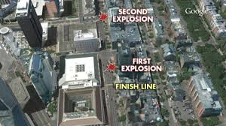
Complex Coordinated Terrorist Attack
$1.7 million grant funded program to
  Develop best practices and ensure that public safety personnel are ready to respond in a coordinated manner
  Conduct capability gap analysis
  Develop scenario-based training
  Conduct a Table Top Exercise
  Develop a public safety video
Boston Marathon

Slide 8
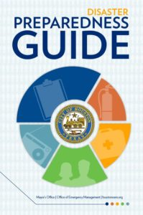

Community Preparedness
Houston Ready – 5 county region
  Make a Plan, Build a Kit, Stay Informed, Know your Neighbors
  Run.Hide.Fight. and Make the Call iwatch terrorism prevention
Houston CERT – Community Emergency Response Team
  Citizens trained how to help themselves and others
  Assist in disaster response
Extreme Weather Expo on June 2nd – 3,000 expected

Slide 9
Countering Violent Extremism Grant
$500,000 grant funded program to
  Reduce terrorism risk and empower the community
  Focuses on reducing the vulnerability of youth to extremist ideologies in a five-county area
  Goal is to create and implement training for parents and youth to educate them on violent extremism
  Program will be led by a steering committee comprised of community leaders, service providers, and non-profit partners

Slide 10

State Homeland Security Grant Program
$286,000 expected in grant funding
  HPD Bomb Squad equipment
  HPD Special Response Group equipment
  Houston Regional Catastrophic Preparedness Initiative Planner
    Terrorism
    IED Attack
    Natural Hazards
    Cyber Terror

Slide 11
Homeland Security Projects
Hurricane Harvey After Action Report
Continuity of Operations After Action Report
Wildfire Table Top Exercise – April 23, 2018
Extreme Weather Expo at GRB – June 2, 2018
Army Cyber Institute Exercise at GRB – July 23, 2018

Slide 12
Hurricane Harvey After Action Report
Areas for Improvement
  Command, Control, and Coordination - 6
  Rescue Operations and Evacuations - 3
  Resource Personnel and Management - 8
  Emergency Purchasing and Finance - 4
  Shelter Operations and Mass Care - 4
  Continuity of Operations - 2
  Information Technology - 3
  Mutual Aid - 4
  Damage Assessment and Debris Management - 3
  Other Areas - 7

Slide 13
Continuity of Operations After Action
Five Objectives
  Evaluate Command and Control
  Assess Alternative Work Sites
  Assess Personnel Management
  Evaluate Communicating with Personnel
  Discuss Technology Capability
  Strengths and Areas for Improvement identified

Slide 14

Regional Wildfire Table Top Exercise
April 23, 2018
Test the Significant Wildfire Incident Concept of Operations by focusing on mutual aid requests, resource management, and information coordination for wildfires affecting multiple jurisdictions within the 13-county region
Participants include:
  Fire Leadership / EMS
  Emergency Management
  Texas A&M Forest Service
  State & Regional partners

Slide 15
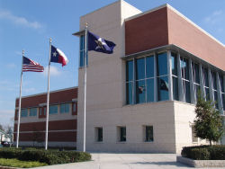
Houston Emergency Center (HEC)
Chief David Cutler – Director
244 Total HEC personnel
  175 Telecommunicators (Call Takers)
Handle 2.8 million calls a year for emergency and non-emergency
  2 million 911 calls
  762,000 Police calls – 10 digit number
  49,000 Fire calls – 10 digit number
  2,500 EMS calls – 10 digit number
  5,800 Text messages

Slide 16

HEC Projects
Working with HITS on a CAD update / replacement
  Timeline for completion – 2 to 4 years
Greater Harris County 9-1-1 will supply HEC with 12 more call taker consoles and 20 laptops to expand call-taking capacity

Slide 17

Office of Emergency Management
Chief Rick Flanagan – Emergency Management Coordinator
Assists City departments in preparing for, responding to, and recovering from disasters and major emergencies
Develops plans for dealing with disasters
Activates the Emergency Operations Center (EOC) where all top level department decision makers coordinate their response

Slide 18

Houston Crackdown
Ray Andrews – Program Director
Coordinates community volunteer projects in alcohol and drug abuse through prevention, education, treatment, and rehabilitation
Referral network for substance abuse programs and events
Over 8,000 people reached in programs and services

Slide 19
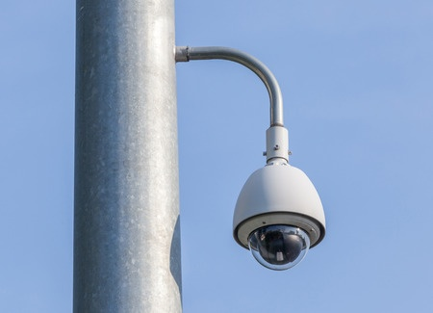
Public Safety Video Network
To improve the security posture of critical infrastructure, Key Resources, and large public venues
Consists of 925 video camera with access to 400 private sector cameras
Main areas of coverage
  Downtown and Discover Green
  Buffalo Bayou and Tinsley Park
  Texas Medical Center
  NRG, Toyota, Minute Maid, and BBVA

Slide 20

Everbridge
Mass Communication System platform that will send out Alert Houston notifications
Capable of storing 500,000 contacts
Can send out emails, text messages, and voice messages
Can “Geo Target” specific areas
Internal Employee notifications
Automatic Translation for Five languages (Spanish, Vietnamese, Chinese, Arabic, French)

Slide 21
Questions

