Slide 1
Life safety bureau
Risk Based Inspection Program
December 5, 2017
Notes:
Thank CM Stardig, Vice-Chair Le, other CM’s & Staff members
Provide an update on the implementation of the Risk Based Inspection Program
RBI became operational in October

Slide 2
HISTORIAL INSPECTION CHALLENGES
Legacy inspection application, ILMS, is difficult to use with limited reporting capabilities
Teams worked individual property lists that were not validated against a master list
LSB did not know when new businesses started or certificates of occupancy changed
Conduction of general inspections was random and coverage of several property types was poor
No consistent or measurable definition of property risk
Blitzes were used to respond to perceived changes in risk – creating inefficiency and confusion
Notes:
Important to realize where we came from and historical challenges
Some were captured in the 2016 audit from the Controllers Office

Slide 3
Risk based inspection goals
Develop a strategic plan for commercial property inspection
Create a consolidated data base of all occupancies required to be inspected on a periodic schedule
Apply standard set of risk factor criteria to each occupancy to establish a risk score for each
Establish a periodic inspection cycle, varying from 1- 5 years, for each occupancy based on the associated risk score
Process established to add new occupancies into the periodic inspection cycle
Notes:
RBI creates a systematic and strategic approach to fire prevention inspections in COH
RBI has been used successfully in other cities in the US such as New York and Atlanta

Slide 4
Risk based inspection program
LSB Inspection
Property Rank | Inspection Frequency
1 | Annually
2 | Every 2 Years
3 | Every 3 Years
4 | Every 4 Years
5 | Every 5 Years
Inspection Results
Property Use Changes
Fire Incident Updates
Population Density Changes
HCAD Property Updates
11 Data Sources were combined to build the master list of commercial properties
Properties are risk scored, ranked and scheduled for inspections over a 5 year period
Inspectors perform scheduled inspections and update property information in model

Slide 5
How is Fire Risk calculated
We calculated fire risk score by using machine learning techniques to estimate probability and developing a weighted factor for the potential consequence of a fire
PROBABILITY
CONSEQUENCE
Location
Inspected in Last 5 Years
Number of Fire Incidents in Vicinity (Last 5 Years)
Building Quality Assessment (HCAD)
Property Type (ILMS)
Population Density (Census)
Property Size (HCAD)
Building Stories (HCAD/ILMS)
HFD Inspection Team
Flammable Material Permits (ILMS)
Property Value (HCAD)
Hazmat Materials Present (ILMS)
Area Population Density (Census)
Property Size (HCAD)
Property Type (ILMS)
Property Value (HCAD)
Number of Floors (HCAD/ILMS)
Fire Alarms/Sprinklers Present (ILMS)
Flammable Permits (ILMS)
Hazmat Materials Present (ILMS)
X
RISK SCORE
It is important to recognize that the risk factor will never be a perfect predictor of fire incidents but provides a consistent method for prioritizing our inspections and refining our approach over time
Notes:
Probablity – 12 factors considered…likelihood of having a fire
Consequence – 8 factors considered….how bad would a fire be if it occured

Slide 6
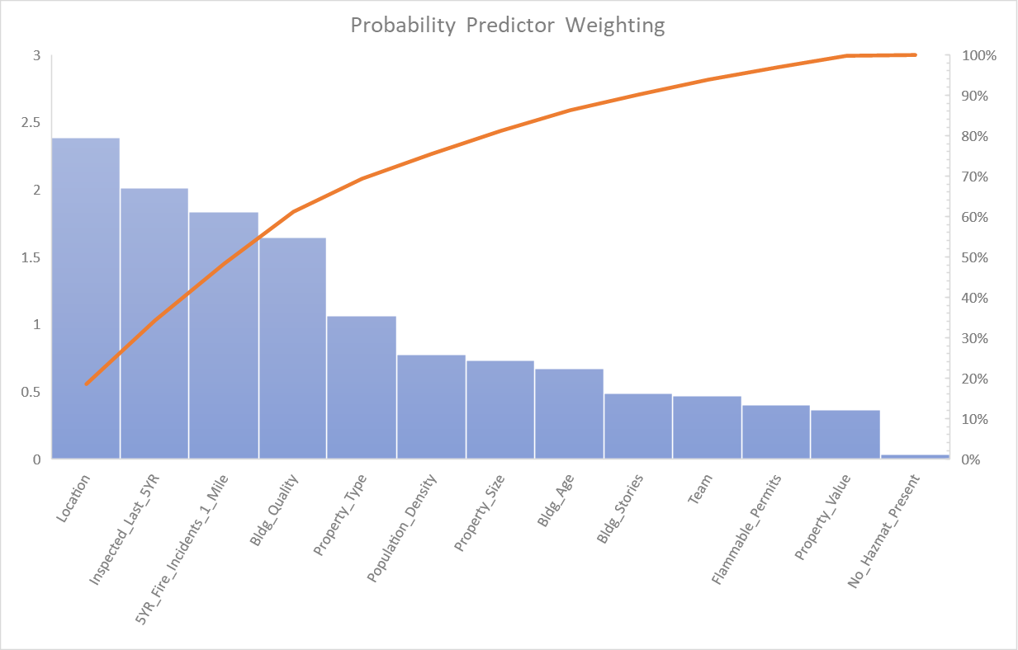
How is Fire Risk calculated
Based on our analysis, there are 6 primary drivers comprising 80% of the overall probability calculation. Of these, the only controllable factor is the performance of field inspections on the property
Primary Drivers*
*Estimated with Treebagger algorithm
Notes:
Even though 12 factors are considered in probability, 6 factors comprise 80% of the calculation
Only 1 of those 6 top factors is controllable and it ranks 2nd overall…if the property has been inspected in the past 5 years
Basically, if it has been inspected within the past 5 years, there is a significant reduction in probability of a fire occuring

Slide 7
risk model accuracy and completeness challenges
Source systems had incomplete information on properties (e.g. missing Fixed Property Use codes)
Some of the identified addresses may no longer exist
Residential properties might have been misclassified as commercial
  Some properties may have multiple addresses associated with a single business
Notes:
Final verification of the Master Property List will require boots on the ground to assure accuracy.

Slide 8
Current status of occupancies in City of Houston
74,604 Occupancies in consolidated data base requiring periodic inspection
  Risk Priority 1 – 9,308 occupancies
  Risk Priority 2 – 14,956 occupancies
  Risk Priority 3 – 14,941 occupancies
  Risk Priority 4 – 14,599 occupancies
  Risk Priority 5 – 20,800 occupancies
Notes:
MPL comprises nearly 75,000 properties and is constantly changing with addition of new certificates of occupancy
Approximately 1/3rd are ranked as Risk Priority 1 or 2

Slide 9
Occupancy risk scores by type of property
Risk | Apart/ Hotels | Gen Occ | HazMat | High Rise | Schools | Institutions | Nights/ Weekends | Grand Total
1 | 877 | 5,741 | 346 | 537 | 990 | 125 | 692 | 9,308
2 | 1,316 | 11,485 | 485 | 538 |  | 167 | 965 | 14,956
3 | 1,755 | 11,485 | 555 |  |  | 252 | 893 | 14,941
4 | 2,193 | 11,486 |  |  |  | 167 | 753 | 14,599
5 | 2,633 | 17,229 |  |  |  | 126 | 812 | 20,800
TOTAL | 8,774 | 57,427 | 1,386 | 1,075 | 990 | 837 | 4,115 | 74,604
Notes:
Shows how the number of properties are broken down by occupancy type and associated risk scores
Note that the majority of these are in the General Occupancy classification and low risk GO (Risk 3-5) account for 40,000 properties

Slide 10
5 year inspection cycle
Risk Rank | Inspection Cycle | Total Number of Inspections | Annual Inspections
1 | Annual | 9,308 | 9,308
2 | Every 2 years | 14,956 | 7,478
3 | Every 3 years | 14,941 | 4,980
4 | Every 4 years | 14,599 | 3,650
5 | Every 5 years | 20,800 | 4,160
TOTAL |  |  | 29,576 Annual Inspections
Notes:
To achieve the 5 year goal, every year, inspections must include:
100% of the Risk 1
50% of Risk 2
33% of Risk 3
25% of Risk 4
20% of Risk 5
Grand Total of nearly 30,000 inspections required annually to achieve the 5 year goal

Slide 11
advantages
Increases public safety
Increases safety for first responders
Alvarez & Marsal estimate additional $10M in revenue over 5-year period by utilizing RBI model
  This assumes inspection of all properties
  Much of this revenue will be realized by inspecting the low risk General Occupancy properties

Slide 12
LSB performance
Current Performance
Target Performance
Based on historical trend
Based on 84 field inspectors
Average 9,500 General Inspections per year
Based on 3 year evaluation of peak period performance
Based on enhancements such as tablet deployment, e-signature capabilities, RMS conversion to INFOR
30% Increase in efficiency
12,500 inspections / 84 field inspectors

Slide 13
The gap
5 year RBI model requires 29,576 completed inspections per year
Current LSB capacity is 12,500 completed inspections per year
    Assumes full staffing of LSB Division
    Currently understaffed by 6 Inspectors
    Pending retirement of 2 Inspectors
Gap in capacity of 17,000 inspections per year to meet the RBI model

Slide 14
Options for filling the gap
Increased efficiency of existing personnel
  Technical improvements have been implemented
  Transition to Infor within 18 months
Increasing community risk by extending the inspection cycle beyond 5 years
Increasing the number of personnel to perform all inspections
Increasing overtime for existing inspectors to perform inspections

