Slide 1

The Independent Monitor of Takata and the Coordinated Remedy Program
Houston Public Safety & Homeland Security Committee Hearing
July 12, 2016

Slide 2



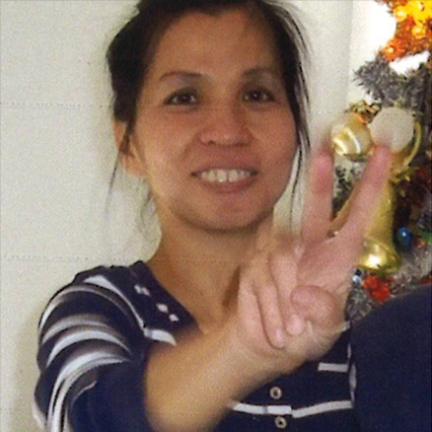


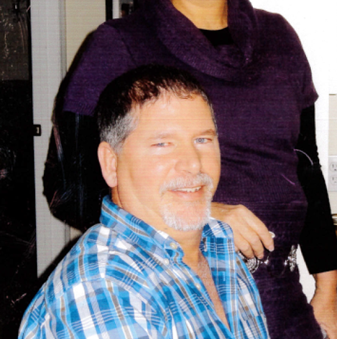

CONFIRMED victims IN THE U.S.
Ashley Parham, 18
Midwest City, OK
2001 Honda Accord
Killed May 27, 2009
Gurjit Rathore, 33
Richmond, VA
2001 Honda Accord
Killed Dec. 24, 2009
Hai Ming Xu, 47
Alhambra, CA
2002 Acura TL
Killed Sept. 13, 2013
Jewel Brangman, 26
San Diego, CA
2001 Honda Civic
Killed Sept. 7, 2014
Hien Thi Tran, 51
Orlando, FL
2001 Honda Accord
Killed Sept. 29, 2014
Carlos Solis, 35
Spring, TX
2002 Honda Civic
Killed Jan. 18, 2015
Kylan Langlinais, 23
Lafayette, LA
2005 Honda Accord
Killed Apr. 15, 2015
Minor Victim (Name Withheld), 13
Mercer County, PA
2001 Honda Accord
Killed Jul. 22, 2015
Joel Knight, 52
Kershaw, SC
2006 Ford Ranger
Killed Dec. 22, 2015
Huma Hanif, 17
Fort Bend County, TX
2002 Honda Civic
Killed Mar. 31, 2016
Notes:
Sources:
“Another death linked to exploding air bag.” CBS News. http://www.cbsnews.com/news/another-death-linked-to-exploding-air-bag/
“Teen dies after possible airbag malfunction.” CBS-Tulsa. http://www.newson6.com/story/10441178/teen-dies-after-possible-honda-malfunction
“Lawsuit Filed in Death of Man Due to Faulty Air Bag.” WRC-TV/NBC-Los Angeles. http://www.nbclosangeles.com/news/local/Lawsuit-Filed-in-Death-of-Man-Due-to-Faulty-Airbag-283928861.html
“Caido and Law.” Bloomberg. http://www.bloomberg.com/photo/caido-and-law-/-iWCk7gh7aQUc.html
“San Diego father talks to team 10 about daughter’s death tied to faulty airbag.” KGTV/ABC-San Diego. http://www.10news.com/news/san-diego-father-talks-to-team-10-about-death-tied-to-faulty-airbag-072915
“It looked like a stabbing, but Takata airbag was the kiler.” The New York Times. http://www.nytimes.com/2014/10/21/business/it-looked-like-a-stabbing-but-takata-air-bag-was-the-killer.html
“Honda Civic Owner Kylan Langlinais Killed by Airbag.” CarComplaints.com. http://www.carcomplaints.com/news/2015/honda-civic-kylan-langlinais-killed-airbag.shtml
“NC widow remembers husband killed by airbag.” WBTV/WNCN/CBS-North Carolina. http://wncn.com/2016/05/09/nc-widow-remembers-husband-killed-by-airbag/

Slide 3
HOUSTON-AREA VICTIM: HUMA HANIF
Huma Hanif, 17
Fort Bend County, TX
2002 Honda Civic
Killed Mar. 31, 2016
Notes:
Source: “Kin of Texas teen killed by Takata air bag say they received no recall notice.” New York Daily News. http://www.nydailynews.com/life-style/health/kin-teen-killed-takata-air-bags-no-recall-article-1.2592566

Slide 4
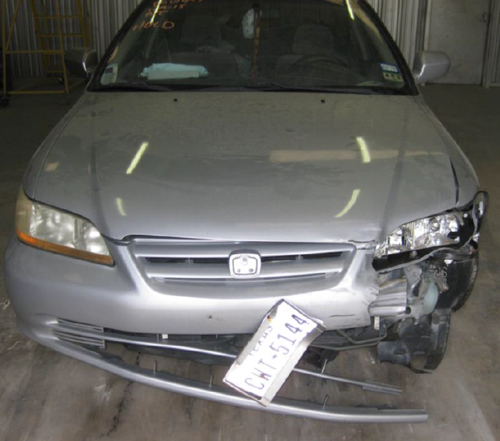
HOUSTON-AREA VICTIM: CARLOS SOLIS
Carlos Solis, 35
Spring, TX
2002 Honda Civic
Killed Jan. 18, 2015
Notes:
Source: “Carols Solis had no idea There was a Shrapnel Bomb in his Steering Wheel.” HoustonPress. http://www.houstonpress.com/news/carlos-solis-had-no-idea-there-was-a-shrapnel-bomb-inside-his-steering-wheel-7455706

Slide 5
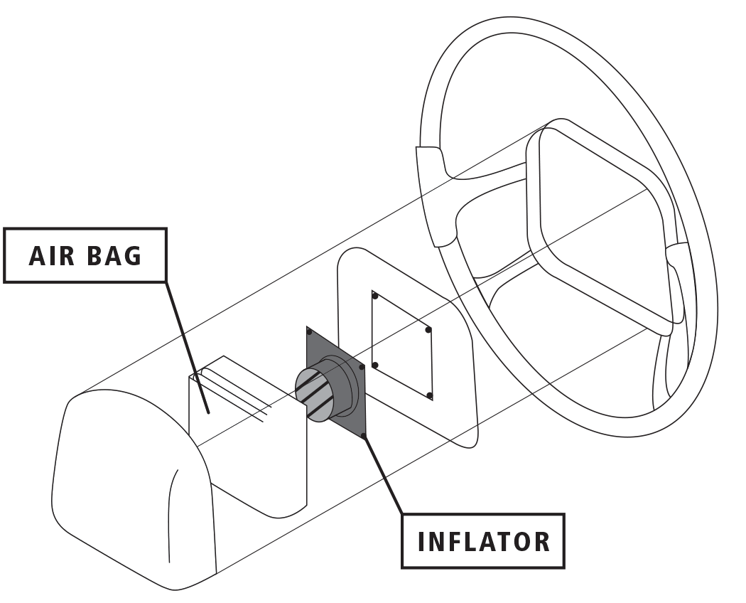
AIRBAG INFLATOR SCHEMATIC
Notes:
Source: “Sixty Million Car Bombs: Inside Takata’s Air Bag Crisis.” Bloomberg. http://www.bloomberg.com/news/features/2016-06-02/sixty-million-car-bombs-inside-takata-s-air-bag-crisis

Slide 6

Airbag deployment
Sources: Takata; Autoliv; Daicel; Explosion (Japan explosives society’s journal) *inflator assembly varies by car model.
Notes:
Source: Reuters “90 million Takata airbags could be recalled in US.” E&T. http://eandt.theiet.org/news/2016/feb/takata-airbag-recall.cfm

Slide 7

Notes:
Source: New York Times. http://www.nytimes.com/video/business/100000003993014/takata-airbag-malfunction.html

Slide 8


