Slide 1
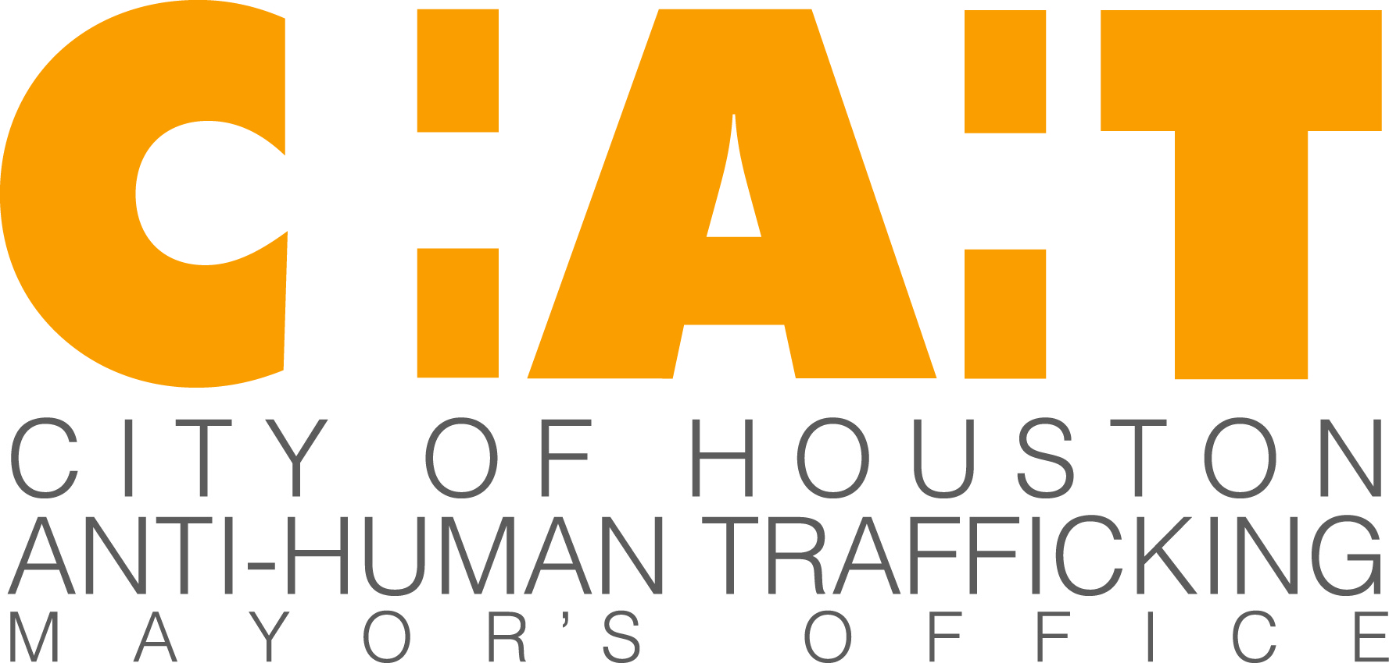

Slide 2

Super Bowl and Human Trafficking – Myth?
Presented by:
Minal Patel Davis
Special Advisor to the Mayor on Human Trafficking
Office of Mayor Sylvester Turner
Office: (832) 393-0977
Cell: (832) 596-9965
E-Mail: Minal.Davis@houstontx.gov
Website: HumanTraffickingHouston.org

Slide 3
II. Claims Surrounding Super Bowl and Sex Trafficking
Debunk claims surrounding Super Bowl
The Claims
“Super Bowl is the single largest sex trafficking incident in the U.S.”
Media claimed that anywhere from “10,000 to 100,000” sex slaves arrive in a host city
Problem with Claims
Not supported by data
Data is evolving, discuss latest one of a kind study published in February 2016 by Carnegie Mellon

Slide 4
III. Latest Study
Researchers with Carnegie Mellon University examined 33 events comparable to Super Bowl in the U.S. from October 2011 to February 2016, and in Canada from July 2013 to February 2016.
Data set included over 32 million online sex ads, researchers used a 7 day window leading up to the event and a 91 day inference window making it a first of its kind of study.
Study focused on online postings of “new-to-town” escort advertisements.
The highest spikes in increased postings were in Vancouver, Myrtle Beach and Charlotte.

Slide 5
III. Latest Study - Continued
The event associated with the spikes in Myrtle Beach was the Memorial Day bike rally. There was no major event in Vancouver and an unidentified local event in Charlotte.
Increases in new to town ads for Super Bowl ranged from 19 to 91 ads during the past 4 Super Bowls, the influx of sex slaves to a Host Super Bowl City is much less than originally thought.
There is a correlation between the Super Bowl that is statistically significant evidence of new to town ads, however, there are other events that show a more significant increase in postings than the Super Bowl.
Finding: New to town ads increased around Super Bowls, but increase, while statistically significant, falls within the variance expected and predicted over time.

Slide 6
III. Latest Study - Continued
Super Bowl | City | Expected - New to town ads | Observed -New to Town ads | New to Town ads- Difference | Expected – All ads | Observed – All ads | All ads- Difference
2016 SB 50 | San Jose | 106 | 169 | 63 | 624 | 1,111 | 487
2015 SB 49 | Phoenix | 124 | 215 | 91 | 2,334 | 2,554 | 220
2014 SB 48 | Manhattan | 84 | 100 | 16 | 1,663 | 2,236 | 573
2013 SB 47 | New Orleans | 61 | 104 | 43 | 325 | 454 | 129
Volume of overall observed advertisements justify the need for a long term response. This ad volume ranged from 454 to 2,554 ads in different Super Bowl Host cities.
The increases in overall observed ads for past Super Bowls range from 129 to 573 ads higher than expected. These include local and new to town ads.
Other events like the Consumer Electronics Show, Formula 1, The Oracle World Convention also showed increases on par with past Super Bowls.

Slide 7
III. Latest Study - Continued
“… our analysis highlights that human trafficking affects our country across varied locations, communities, and events, and we cannot isolate its impact to only one event per year.”
Miller, Kennedy, and Dubrawski, “Do Public Events Affect Sex Trafficking Activity?”: 6-8 (emphasis added).
“Reliance on quantitative evidence accessible through data-driven analysis can inform wise resource allocation, guide good policies, and foster the most meaningful impact.”
Miller, Kennedy, and Dubrawski: 8 (emphasis added).

Slide 8
IV. Guide to Approach
From Jan to June 2015, Houston showed that we had over 20,000 online sex ad postings.
Because we are soon to be the third largest city and we host a variety of events, we need a comprehensive and non reactive approach.
None of the 33 events studied are on the GRB calendar, it is unclear what the impact is on increased ad postings for the specific events Houston is hosting.
Because data continues to evolve, a 365 day-a-year response is best.

Slide 9
V. Anti-Human Trafficking Efforts - Highlights
Vision and Goals
Highlight components of City’s Anti-Human Trafficking response that may be most relevant to hosting upcoming events.
Institutionalize response to human trafficking from within the City of Houston, ensuring that trafficking is structurally addressed.
Change the public’s perception about human trafficking, leading to an increased awareness about, and reporting of, human trafficking.
Partner with key private industries to raise awareness such as the hotel and taxi industry.

Slide 10
IV. Anti-Human Trafficking Efforts Highlights – Cont’d
Objective: Institutionalize City of Houston Response and Implement Trainings
Strategy: Analyze and Pass Ordinances and Departmental Policies
Propose additional ordinance amendments as necessary.
Houston Health Department has signed a policy requiring all 1,200 employees to be trained.
Strategy: Implement Trainings or Informational Videos for City Departments
Engage Houston Health Department, Houston Municipal Court, Houston Police Department (Jail Division), Houston Airport System, Houston Fire Department, and 311 operators.
Highlight: Houston Airport System, incorporating a short video about human trafficking into their airport culture to recognize and report crime as part of their badging process.

Slide 11
IV. Anti-Human Trafficking Efforts Highlights – Cont’d
Objective: Raise Awareness and Change Public Perception
Strategy: Develop and launch joint anti human trafficking media campaign
Leading campaign with HPD, the Harris County DA, and United Against Human Trafficking.
A Houston PR/Consulting firm has offered to develop the campaign and donate all creative capital.
Strategy: Hold Events to Raise the Level of Dialogue and Engage Influencers
Convene human trafficking thought leaders in Houston on an annual basis.
Screen Siddharth Kara’s Hollywood feature film, Trafficked, and conclude with a panel discussion featuring Mr. Kara, Mayor Turner and Texas law enforcement officers.
Develop relationships with influencers to engage their voice in the anti-trafficking movement and influence their fans (e.g. sports leagues and celebrities).

Slide 12
IV. Anti-Human Trafficking Efforts – Highlights – Cont’d
Objective: Implement Joint Initiatives of HAC-HT
Background: The Houston Area Council on Human Trafficking is an initiative of the Mayor’s Office. Stakeholders are convened to collaborate on joint anti-human trafficking initiatives framed by the vision and goals of the Mayor’s Office. Law enforcement is represented, but HAC-HT does not operate in a law enforcement capacity.
Strategy: Implement a Hotel Training Program
Coordinate hotel-based voluntary trainings.
Encourage voluntary trainings by speaking at Hotel and Motel Association events.
Strategy: Engage Taxi Industry
Identify and contact most-used taxi cab companies about implementing employee training and sending mass text and email blasts.
Concentrate and coordinate blasts around events.

Slide 13
References
For reference: “Child Sex Rings Spike during Super Bowl Week,” USA Today, February 1st, 2011.
For reference: Kyle Miller, Emily Kennedy, and Artur Dubrawski, “Do Public Events Affect Sex Trafficking Activity?” published on-line by Auton Lab (February 15th, 2016): 1-10, accessed February 16th, 2016, www.arxiv.org/pdf/1602.05048v1.pdf.
For reference: The inaugural symposium held on October 29th, 2015 featured Bradley Myles (Polaris' Chief Executive Officer), Siddharth Kara (wrote Sex Trafficking: Inside the Business of Modern Day Slavery), Brooke Axtell (Director of Communications and Engagement for Allies Against Slavery), and Dorchen Leidholdt (Director of the Center for Battered Women’s Legal Services at Sanctuary for Families in NYC).

