Slide 1

CITY OF HOUSTON LEGAL DEPARTMENT
Proposition A Committee
Proposition A: Refresher & Updates
Danyahel “Danny” Norris
Senior Assistant City Attorney - Proposition A

Slide 2
OVERVIEW
•Guidelines
•Proposition A Submission Refresher
•Critical Legal and Administrative Considerations
•Observations & Suggestions
•Questions & Contact Info
CITY OF HOUSTON LEGAL DEPARTMENT

Slide 3
Proposition A: Guidelines
CITY OF HOUSTON LEGAL DEPARTMENT

Slide 4
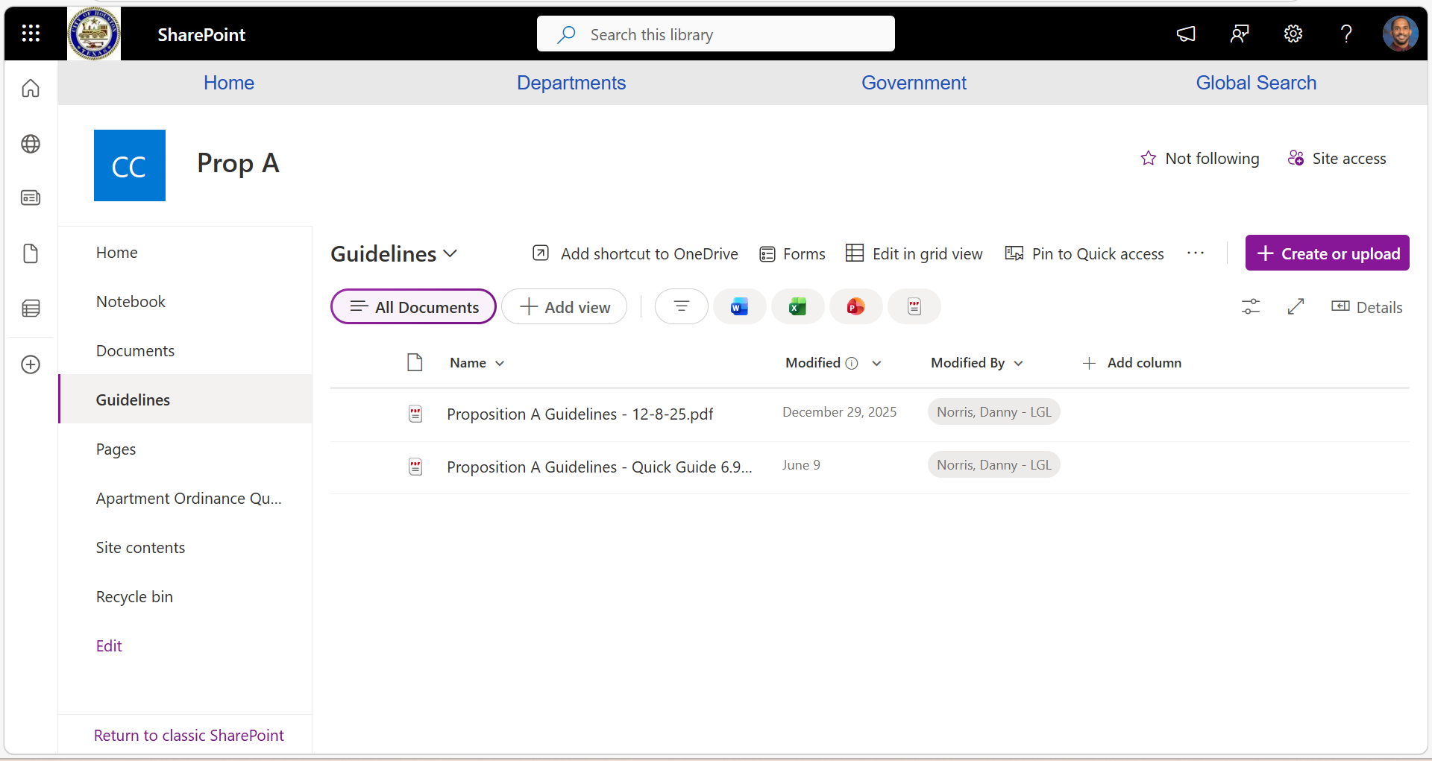
PROPOSITION A: GUIDLINES
Proposition A Guidelines are available on SharePoint
  Standard
  Quick Guide
Each Councilmember and their entire staff should have access

Slide 5
Proposition A: Submission Refresher
CITY OF HOUSTON LEGAL DEPARTMENT

Slide 6

THINGS TO CONSIDER BEFORE A SUBMISSION
Which departments are affected by the proposal?
What is the estimated cost(s) involved in the proposal?
How long will it take to fully implement the planned proposal?
How would the proposal be enforced?
Have the affected departments given any input on the proposal?
Is the item or its enforcement one that involves permits?
Has the City tried a similar proposal before?
• If so, what was the outcome and how is your proposal distinguishable?
Which community interests will be impacted by the proposal?
CITY OF HOUSTON LEGAL DEPARTMENT ​

Slide 7

RULE 23 OR RULE 24 of Section 2-2 of the City Code?
If your proposal is simple, ready, and you have 3-8 signatures
RULE 23
If your proposal is a concept, not fully developed, and/or needs additional discussion
  RULE 24
CITY OF HOUSTON LEGAL DEPARTMENT ​

Slide 8
PROPOSITION A SUBSMISSION REFRESHER
RULE 23​ - 3+ Signatures
Submission Requirements
- Send a written request​ to the agenda office
- 3-8 signatures
- A draft ordinance, resolution, or motion
- Must be a lawful item
Lawfulness Review
- Conducted by General Counsel of the Legal Department
​ - Provided within 7 days, unless complex
- If lawful, goes on agenda within next 2 regular meetings
​Other considerations
- NEVER discuss any item with more than 8 council members to prevent violation of the Texas Open Meetings Act
- Revised submissions require:
      Withdrawal of original item in writing
      Submission of revised item
-Resubmissions restarts the 7-day clock on legal review
RULE 24 - Committee
Submission Requirements
  Draft of proposed item
  Background & brief purpose (Word format)
  Point of Contact
  One hard copy & one PDF
Timeline
  At least a 3-week window
    7+ days for legal review
    Submit proposals 14+ days before committee meeting
Committee Actions​
  Requires Quorum and Public Testimony
  Can’t block Rule 23
  Can do one of the following:
    Place the item on the Council agenda (within 2 meetings)
    Decline to place it on the agenda
    Refer it to the Administration for further work
    Amend it and advance it
    Postpone consideration​
CITY OF HOUSTON LEGAL DEPARTMENT ​

Slide 9
Critical Legal and Administrative Considerations
CITY OF HOUSTON LEGAL DEPARTMENT

Slide 10
Critical Legal and Administrative Considerations
Is the proposal lawful?
Does the language of the proposal allow implementation by the affected departments within their current budgets?
Does the proposal create legal exposure for the City?
CITY OF HOUSTON LEGAL DEPARTMENT ​

Slide 11
Observations & Suggestions
CITY OF HOUSTON LEGAL DEPARTMENT

Slide 12

OBSERVATIONS & SUGGESTIONS
•Contacting the Prop A Attorney
Contact and coordinate with the Proposition A Attorney as early as possible for ALL submissions, especially the complex matters.
- Helps ensure your proposal is fully flushed out
- Prevents surprises on legality
•Batch Submissions
Avoid submitting multiple proposals at the same time.
- Will cause legal reviews to exceed 7 days
- If submitting multiple proposals at the same time, identify the order of priority
•Outside organizations
All legal advice is for Councilmembers and/or their staff, NOT outside organizations.
CITY OF HOUSTON LEGAL DEPARTMENT ​

Slide 13
Questions?
​
Contact Info:
Danyahel “Danny” Norris
danny.norris@houstontx.gov
832-393-6483
CITY OF HOUSTON LEGAL DEPARTMENT

