Slide 1

2024 HOPE Meet & Confer Agreement
October 21, 2024
Presented by:
Jane E. Cheeks, HR Director &
Alisa M. Franklin-Brocks, HR Director’s Chief of Staff

Slide 2
Agenda
History
Meet and Confer
Term & Who is Covered
Agreement Overview
  Operational
  Financial
Q & A

Slide 3

History
  In 2005, Texas Legislature authorized the City of Houston to have a meet and confer agreement (MCA) with a recognized employee association.
  In October 2006, the City recognized the Houston Organization of Public Employees (HOPE) as the sole and exclusive bargaining agent for our civilian employees.

Slide 4
History Cont’d
MCAs are mutual agreements which provides provisions for compensation, non-pension benefits, hours of employment, dispute resolution, as well as other terms and conditions of employment
Approved MCAs to date – 2008, 2011, 2015, 2018 & 2021
  HR has lead MCA negotiations since 2018
Tentative Agreement – 2024
  5 months with over 30 public sessions

Slide 5
History Cont’d
HOPE PAY INCREASES BY FISCAL YEAR
FY | Month | Year | ACB | Minimum
 |  |  | Increase | Base Pay Rate
2016 | Jan | 2016 | 2.1%* | $12.00/hr
2017 | July | 2016 | 4.2%* | $12.00/hr
2018 | July | 2017 | 6.3%* | $12.00/hr
2019 | July | 2018 | 3% | $12.00/hr
2020 | July | 2019 | 2% | $12.00/hr
2021 | July | 2020 | 1% | $12.00/hr
2022 | October | 2021 | 3% | $14.25/hr
 | November |  |  | $15.00/hr**
2023 | July | 2022 | 3% | $15.00/hr**
2024 | July | 2023 | 3% | $15.00**
* ACB reflected as averages which results in lower paid employees receiving higher percentage
** City Council passed pay structure ordinance changing MBPR

Slide 6
Term & Who’s Covered
Term
  Tentatively – November 1, 2024 through June 30, 2027
  Some terms of the agreement may continue until June 30, 2028
Who’s Covered – Bargaining Unit Members (UMs)
  All municipal employees of the City other than department director, elected officials, and classified members of the Police and Fire Departments subject to Chapter 143 TLGC

Slide 7
Agreement Overview
Operational
  Union Stewards
    Required Training
    Cross-departmental representation
  LMCC - advisory council to Mayor
    Discuss issues of mutual concerns to the City and UMs
    Comprised of Department Directors and HOPE Representatives

Slide 8
Agreement Overview
Operational - cont’d
  DLMCC - advisory council to Dept Dir
    Discuss issues of mutual concerns pertaining to or affecting department-specific matters
    Required for dept w/ at least 25 UMs
  Overtime Assignments
    If budgeted, department policy required
    Requires review by DLMCC

Slide 9
Agreement Overview
Operational - cont’d
  Rest Rule
    Applies to non-emergency operations
    Entitled to 10 hours of rest between shifts
      Ex. Employee begins work at 6 am and scheduled shift end at 3 pm, but is asked to work until 10 pm, then this employee is entitled not to begin the next shift until 8 am the next day.
      Employees may waive the 10-hour rest rule
  Sick Leave Regulations
    64-hour rule changes to 80-hour rule
  Uniform process for access to employee worksites

Slide 10
Agreement Overview
Operational - cont’d
  Level Is are grievable
  Formal corrective action
    Issues within 180 calendar days from discovery or awareness by Dept Dir or investigatory body
    Exception – alleged criminal misconduct, fraud waste and/or abuse
  Fact-finding or investigative meetings require a 48-hr notice
    Union Stewards may be present except for OIG and IAD meetings, but
    Non-City employee may be present

Slide 11
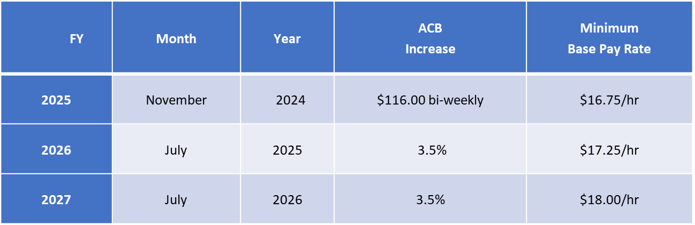
Agreement Overview
Financials
  Every UM will receive at least the new minimum base pay rate or the across-the-board increase, whichever is greater except seasonal interns, seasonal temporaries, and Police and Fire Trainees

Slide 12
Financials – cont’d
  Longevity Pay increase from$2 to $3 bi-weekly
  Bilingual Pay increase from $34.62 to $70 bi-weekly
    AP 3-9: Bilingual Pay Policy for Municipal Employees
Shift | Times | Minimum hourly rate
2nd Shift | Begins between 12:00 noon - 6:00 p.m. | $0.75
3rd shift | Begins between | $1.25
 | 6:00 p.m. - 5:00 a.m.

Slide 13
Agreement Overview
Financials – cont’d
  Compensatory Time for Exempt Employees Non-emergency
    UMs PG 29 and below
    60 hours per calendar year quarter
    Paid in cash or compensatory leave
  Compensatory Time for Exempt Employees Emergency
    All UMs regardless of PG
    80 hours per calendar year quarter
    Paid in cash or compensatory leave

Slide 14
Agreement Overview
Financials – cont’d
  Compensatory Time for Exempt Employees at Health Clinics
    UMs PG 29 and below
    Work more than 40 hours during the work week
    Eligible to be paid in cash
  Call-back pay increases to 4 hr minimum
  Emergency Activation Pay – 2X pay in cash
  Special Event Pay – 1.5X pay in cash
    For non-exempt employees for the overtime worked for the duration of the event

Slide 15
Agreement Overview
Financials – cont’d
  Premium Actual Holiday – 2X pay
    January 1st
    July 4th
    Christmas Eve
    Christmas Day
  Floating holiday hours

Slide 16
Agreement Overview
Financials – cont’d
  Vacation term pay reduced 340/700
  24 Personal Leave Hours
    Regardless of sick leave usage
  Voluntary Separation & Retirement Program
    Municipal Phase Down Program

Slide 17

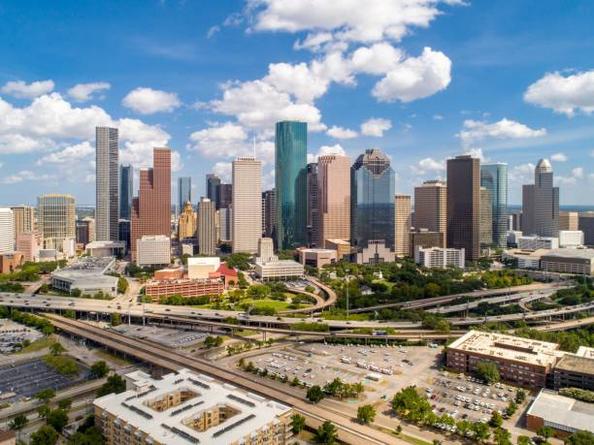

City of Houston
2024 HOPE Meet and Confer Financials
October 21, 2021
Presented To
Presented By
Labor Committee
Melissa Dubowski, Director

Slide 18
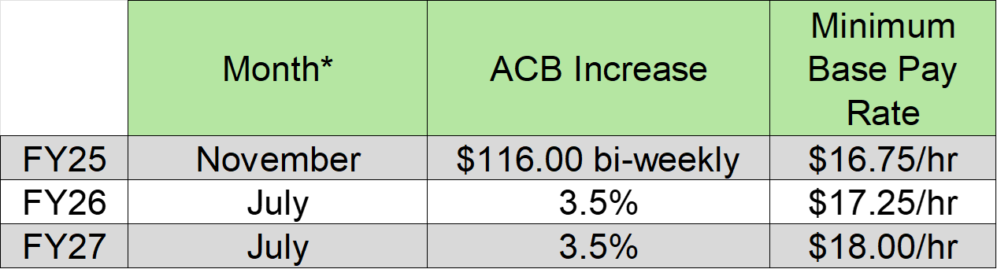
Base Pay Increase
  * First full pay period in specified month

Slide 19
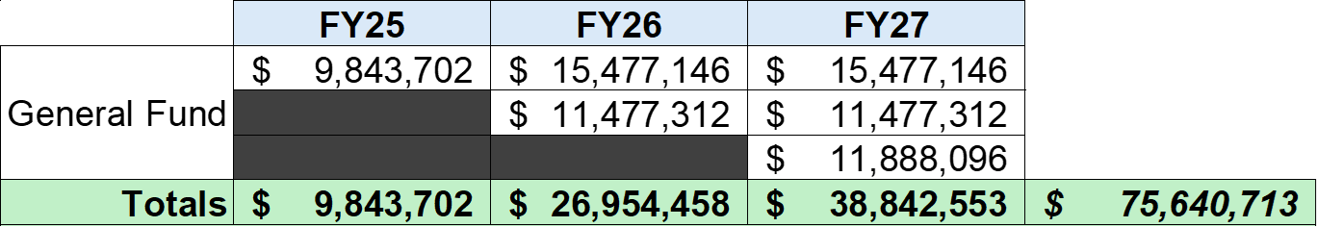
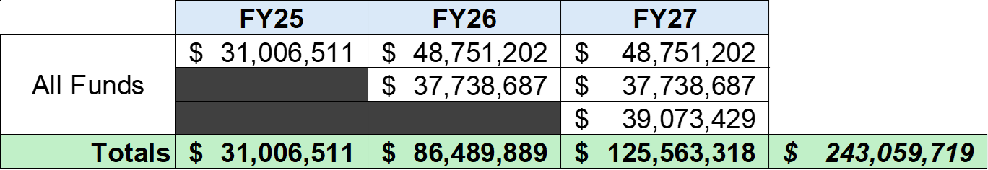
Base Pay Incremental Cost
  * FY25 estimates are calculated using the 16.6 remaining pay periods after the first full pay period in November.
  * FY26 and FY27 estimates are based on 26.1 pay periods
  * All estimates are based on the August 30th payroll including pay increase & minimum wage adjustment.
  * The estimated costs are subject to change.

Slide 20
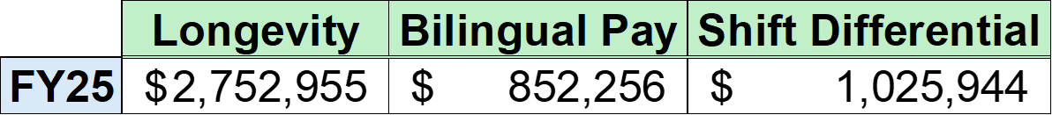
Other Pays
(All Funds)

Slide 21
Questions and Comments

Slide 22


