Slide 1
Housing and Community
Affairs Committee
Keith W. Bynam, Director
August 22, 2023

Slide 2
Agenda
I. Welcome/Introductions
II. Compliance & Grant Administration
III. Public Services
IV. Single Family
V. Director's Comments
VI. Public Comments

Slide 3
II. COMPLIANCE & GRANT ADMINISTRATION
Kennisha London, Assistant Director

Slide 4
II. Substantial Amendment – 2023 Action Plan
(All Districts)
An Ordinance authorizing a Substantial Amendment to the 2023 Annual Action Plan (AAP), changing the target area for HCDD-funded code enforcement activities.
No additional Funding will be provided.

Slide 5
II. Substantial Amendment – 2023 Action Plan
(All Districts)
In accordance with HCDD's Citizen Participation Plan, the City is required to amend components of its Consolidated AAP for a variety of reasons, including:
When changing the purpose, scope, location, or beneficiaries of an activity previously described in the AAP.

Slide 6
II. Substantial Amendment – 2023 Action Plan
(All Districts)
The following Super Neighborhoods will be removed from the targeted service areas:
Fairbanks/Northwest Crossing
IAH/ Airport Area
El Dorado/Oates Prairie
Pleasantville Area
Second Ward
Harrisburg/Manchester
Gulfgate Riverview/Pine Valley
Greater Hobby Area

Slide 7
III. PUBLIC SERVICES
Melody Barr, Deputy Assistant Director

Slide 8
III.a. Avenue CDC Housing Education & Counseling
(District H)
An Ordinance authorizing a Subrecipient Agreement between the City of Houston (City) and Avenue Community Development Corporation (Avenue),
Providing up to $200,000.00 in Community Development Block Grant (CDBG) funds
To provide housing education and counseling services for approximately 475 low-to-moderate income households.

Slide 9
III.a. Avenue CDC Housing Education & Counseling
(District H)
Services will include pre-purchase education classes, post purchase one-on-one counseling and semi-annual workshops, and foreclosure intervention counseling.
The program will serve households who are living at or below 80% AMI and BIPOC (Black, Indigenous, and People of Color) or limited English proficiency households.

Slide 10
III.a. Avenue CDC Housing Education & Counseling
(District H)
Category | Amount | Percent
Program | $180,000.00 | 90.00%
Administrative | $20,000.00 | 10.00%
Total | $200,000.00 | 100.00%
Avenue has received funding through the City since 2000 and had no findings on its last compliance monitoring.
This Agreement would provide funding from October 1, 2023, through September 30, 2024.

Slide 11
III.b. Healthcare for the Homeless-Houston
(All Districts)
An Ordinance authorizing a Subrecipient Agreement between the City of Houston (City) and Healthcare for the Homeless-Houston (HHH),
Providing up to $250,000.00 in Community Development Block Grant (CDBG) funds,
To operate Project Access, a transportation program benefiting a minimum of 3,000 riders experiencing homelessness.

Slide 12
III.b. Healthcare for the Homeless-Houston
(All Districts)
Project Access offers transportation services to homeless persons Monday through Friday, from 7 a.m. to 5 p.m., 52 weeks a year using a 40-passenger, wheelchair-accessible bus traveling a scheduled route.
The service supports 23 agencies that provide essential services such as health care, meals, shelter, and social services.

Slide 13
III.b. Healthcare for the Homeless-Houston
(All Districts)
Funding also supports a community health worker that serves as a resource for riders, collects data, acts as a liaison with other homeless services providers, and serves as the face of the program to promote ridership and improve outreach.

Slide 14
III.b. Healthcare for the Homeless-Houston
(All Districts)
CATEGORY | AMOUNT | PERCENT
Program Services | $250,000.00 | 100%
Administration | $0.00 | 0%
Total | $250,000.00 | 100%
This Agreement provides funding from September 1, 2023, through August 31, 2024.
HHH has received funding through the City for various agreements since 2003 and had no findings on the last compliance monitoring.

Slide 15
III.c. Northwest Assistance Ministries
(All Districts)
An Ordinance authorizing a First Amendment to the Subrecipient Agreement between the City of Houston (City) and Northwest Assistance Ministries (NAM),
Extending the term of the Agreement and providing up to an additional $100,000.00 in Community Development Block Grant – CARES Act (CDBG-CV) funds,
To provide diversion services to a minimum of 125 households.

Slide 16
III.c. Northwest Assistance Ministries
(All Districts)
Diversion services assist clients in crisis to identify immediate alternative housing arrangements in order to avoid emergency shelter or unsheltered living.
Diversion services can include but are not limited to, flexible direct financial assistance, family mediation, and counseling services.

Slide 17
III.c. Northwest Assistance Ministries
(All Districts)
The Way Home is a collaborative partnership between the City of Houston, Harris County, and the Coalition for the Homeless of Houston/Harris County (Coalition).
The CCHP was developed to prevent and respond to COVID-19’s impacts on the homeless.
For CCHP Phase 2, a joint Request for Expression of Interest (REI) from qualified agencies was released in March of 2022 by the Coalition.

Slide 18
III.c. Northwest Assistance Ministries
(All Districts)
NAM was one of the applicants selected by the CCHP partners to receive funding for Diversion services.
The initial Agreement term was October 15, 2022 through September 30, 2023, with an optional one-year extension.
This First Amendment will provide funding and extend the Agreement term through September 30, 2024.

Slide 19
III.c. Northwest Assistance Ministries
(All Districts)
CATEGORY | AMOUNT | PERCENT
Program Services | $100,000.00 | 100.00%
Administration | $0.00 | 0.00%
Total | $100,000.00 | 100.00%
NAM began receiving funding through the City of Houston in 2020.
As of July 1, 2023, NAM achieved 135.56% of its goal and expended approximately 34% of funding.
There were no findings on the annual compliance monitoring.

Slide 20
III.d. The Salvation Army
(All Districts)
An Ordinance authorizing a First Amendment to the Subrecipient Agreement between the City of Houston (City) and The Salvation Army (TSA),
Extending the Agreement term and providing up to an additional $290,000.00 in Community Development Block Grant – CARES Act (CDBG-CV) funds and $336,058.00 in HOME Investment Partnership - American Rescue Plan (HOME-ARP) funds,
For diversion services to a minimum of 350 households at risk for immediate homelessness.

Slide 21
III.d. The Salvation Army
(All Districts)
Diversion services assist clients in crisis to identify immediate alternative housing arrangements in order to avoid emergency shelter or unsheltered living.
Diversion can include but is not limited to, flexible direct financial assistance, family mediation, and counseling services.

Slide 22
III.d. The Salvation Army
(All Districts)
The Way Home is a collaborative partnership between the City, Harris County, and the Coalition for the Homeless of Houston/Harris County (Coalition), developed to prevent and respond to COVID-19’s impacts on the homeless.
For CCHP Phase 2, a joint Request for Expression of Interest (REI) from qualified agencies was released in March of 2022 by the Coalition. TSA was one of the applicants selected to receive funding for Diversion services.

Slide 23
III.d. The Salvation Army
(All Districts)
The initial Agreement term was from October 1, 2022 through September 30, 2023, with an optional one-year extension.
This First Amendment will provide funding and extend the Agreement term through September 30, 2024.
TSA began receiving funding through the City of Houston in 2012.

Slide 24
III.d. The Salvation Army
(All Districts)
CATEGORY | HOME-ARP | CDBG-CV | AMOUNT | PERCENT
Support Services | $336,058.00 | $0.00 | $336,058.00 | 53.68%
Program Services | $0.00 | $290,000.00 | $290,000.00 | 46.32%
Total | $336,058.00 | $290,000.00 | $626,058.00 | 100.00%
As of July 1, 2023, TSA achieved 107.43% of its goal and expended approximately 65.38% of funding.
There were no findings on the annual compliance monitoring report.

Slide 25
III.e. Allies in Hope
(All Districts)
An Ordinance authorizing a Second Amendment to the Subrecipient Agreement between the City of Houston and Allies in Hope (Allies) formerly known as AIDS Foundation Houston Inc.,
Extending the term of the Agreement and providing up to an additional $1,070,514.00 in HOME Investment Partnership - American Rescue Plan (HOME-ARP) funds,
To provide housing and supportive services to 30 unduplicated households experiencing homelessness.

Slide 26
III.e. Allies in Hope
(All Districts)
The project’s scope of work provides permanent supportive housing through the sponsor leasing of one- and two-bedroom units to thirty (30) unduplicated households at two locations who are experiencing homelessness.
Wrap-around services including case management, landlord incentives, mental health assessments and support, and substance abuse counseling will also be provided.

Slide 27
III.e. Allies in Hope
(All Districts)
Allies was selected based on their experience with Parent Leasing under the Housing Opportunities for Persons with AIDS (HOPWA) Program, not a Notice of Funding Availability (NOFA).
The initial Agreement term was from November 1, 2021 and was extended through September 30, 2023.
This Second Amendment will provide funding through September 30, 2024.

Slide 28
III.e. Allies in Hope
(All Districts)
CATEGORY | AMOUNT | PERCENT
Support Services | $560,589.92 | 52.37%
Tenant-Based Rental Assistance | $402,841.00 | 37.63%
Administrative | $107,083.08 | 10.00%
Total | $1,070,514.00 | 100.00%
Allies in Hope began receiving funding through the City of Houston in 1994. As of July 1, 2023, Allies had achieved 100% of their goal and expended approximately 91% of funding. There were no findings on the annual compliance monitoring.

Slide 29
IV. SINGLE FAMILY
Cedrick LaSane, Deputy Assistant Director

Slide 30
IV. Harvey Homebuyer Assistance Guidelines
(All Districts)
An Ordinance authorizing revisions to the guidelines for the Harvey Homebuyer Assistance Program (HbAP) financed with Community Development Block Grant-Disaster Recovery (CDBG-DR) funds for Hurricane Harvey from the Texas General Land Office (GLO).

Slide 31
IV. Harvey Homebuyer Assistance Guidelines
(All Districts)
The HbAP is intended to assist eligible City of Houston (City) households directly impacted by Hurricane Harvey through down-payment, closing cost assistance and principal buydown to assist in securing financing towards the purchase of a home located within the incorporated areas of the City of Houston.

Slide 32
IV. Harvey Homebuyer Assistance Guidelines
(All Districts)
The HbAP will prioritize households impacted by Hurricane Harvey to facilitate the movement of low-and moderate-income households into new homes after their homes were damaged by Hurricane Harvey.
The program will serve eligible households earning up to 120% of the Area Medium Income (AMI).
The City will administer the HbAP in accordance with the guidelines, GLO requirements, and HUD CDBG-DR regulations and guidance.

Slide 33
IV. Harvey Homebuyer Assistance Guidelines
(All Districts)
The HbAP Guidelines were amended as follows:
Updated verbiage to Buyer Contribution and added Closing Requirements
Corrected Definition of First Time Homebuyer
Added Eligible Property Types (1) SF unit
Removed tenant occupied verbiage from Property Location
Added Appraisal vs Sale Price requirement to Property Eligibility Requirements
Added requirements to Debt-to-Income Ratio

Slide 34
IV. Harvey Homebuyer Assistance Guidelines
(All Districts)
Clarified Minimum Construction Standards to include specific standards used and added updated link as a reference
Added Anticipated Rental Income under Income Eligibility
Updated Property Location
Defined Power of Attorney and Communication Designee in the Application Intake Phase
Added clarification on debt payoffs at closing
Added a limit of Liquid Assets with clarification on the effective date

Slide 35
DIRECTOR’S
COMMENTS
Keith W. Bynam, Director

Slide 36
Director’s Comments
Intro/Overview
Keith W. Bynam, Director
CDBG-DR17 Update and HCD Production Report
Temika Jones, Assistant Director and CFO
HCD Project Highlights
Keith W. Bynam, Director

Slide 37
CDBG-DR 2017
Harvey Grant Update
Temika Jones, Assistant Director and CFO
Notes:
We will now move on to an update for the CDBG-DR 2017 Harvey grant.

Slide 38
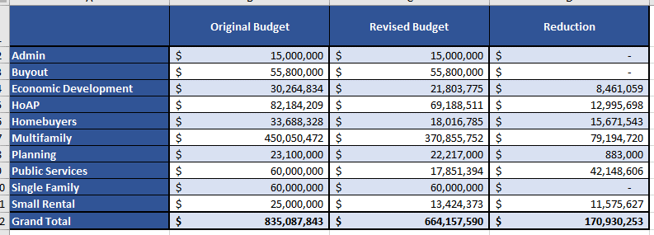
CDBG-DR 2017 Harvey Grant Update
GLO Budget Update – as of March 14, 2023
NOTE: Reduction in Multifamily would result in construction overruns not being covered for some projects.
Notes:
On 1.31.23, HCDD responded to GLO’s 12.19.23 letter requesting updated program budgets. At that time, HCDD requested

Slide 39
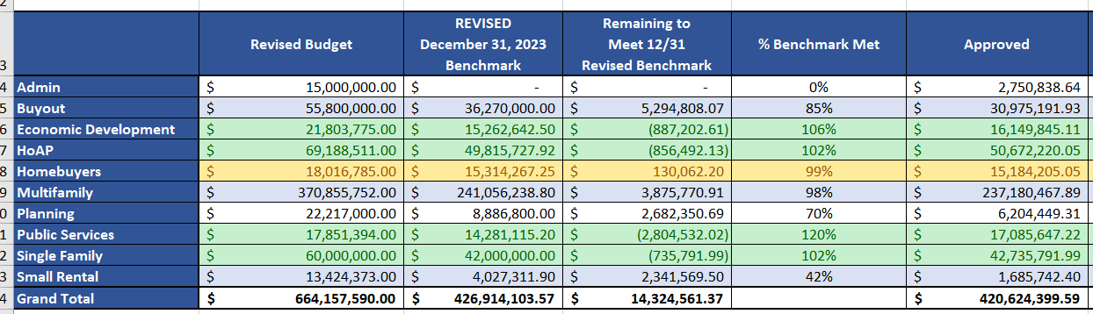
CDBG-DR 2017 Harvey Grant Update Benchmark Progress - as of August 15, 2023
NOTE: Remaining to Meet 12/31 Revised Benchmark total sum does not include programs that have exceeded benchmark.

Slide 40
HCD
Production
Report
Temika Jones, Assistant Director and CFO

Slide 41
Other Programs
(Fiscal Year)
Current Projects
Multifamily (FY24)
1
Projects completed
Multifamily (FY24)
19
0
7
Current Projects
Public Facilities (FY24)
0
Projects completed
Public Facilities (FY24)

Slide 42


HCLT / HLB
Data as of 8/11/23
HCLT/HCP
Pipeline of active files that have not Closed yet
Pending Lenders w/Property | 1
Pending Lenders without/Property | 10
Inspection #1 | 2
Inspection QA/QC | 1
Wire Request Delayed | 2
Wire Request Complete | 1
Close File | 3
Total Pipeline | 20
Closed Files
Closed 2021 | 31
Closed 2022 | 60
Closed 2023 | 39
Total Closed | 130
Total Awarded | $19,086,092.54
HLB
Pipeline of active files that have not Closed yet
Preconstruction | 28
Construction | 19
Completed & pending sale | 13
Total Pipeline | 60
Closed Files (completed & sold)
Closed 2019 | 59
Closed 2020 | 19
Closed 2021 | 45
Closed 2022 | 61
Closed 2023 | 21
Total Closed | 205
Total Sales Price | $40,128,429.85

Slide 43
HCD
Project Highlights
Keith W. Bynam, Director

Slide 44

Virtual Community Office Hours

Slide 45

HCD’s 2023 Summer Interns

Slide 46
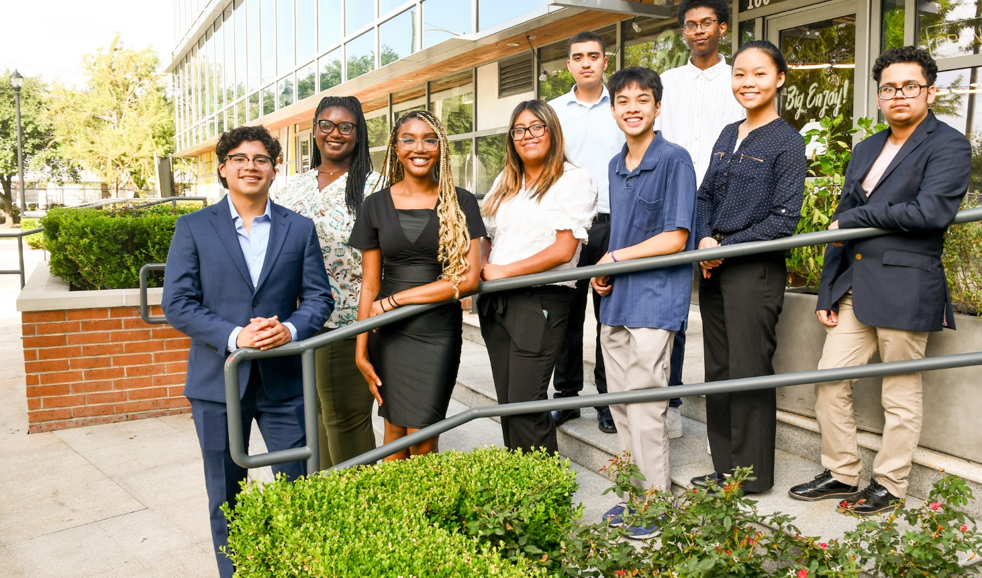
HCD’s 2023 Summer Interns

Slide 47
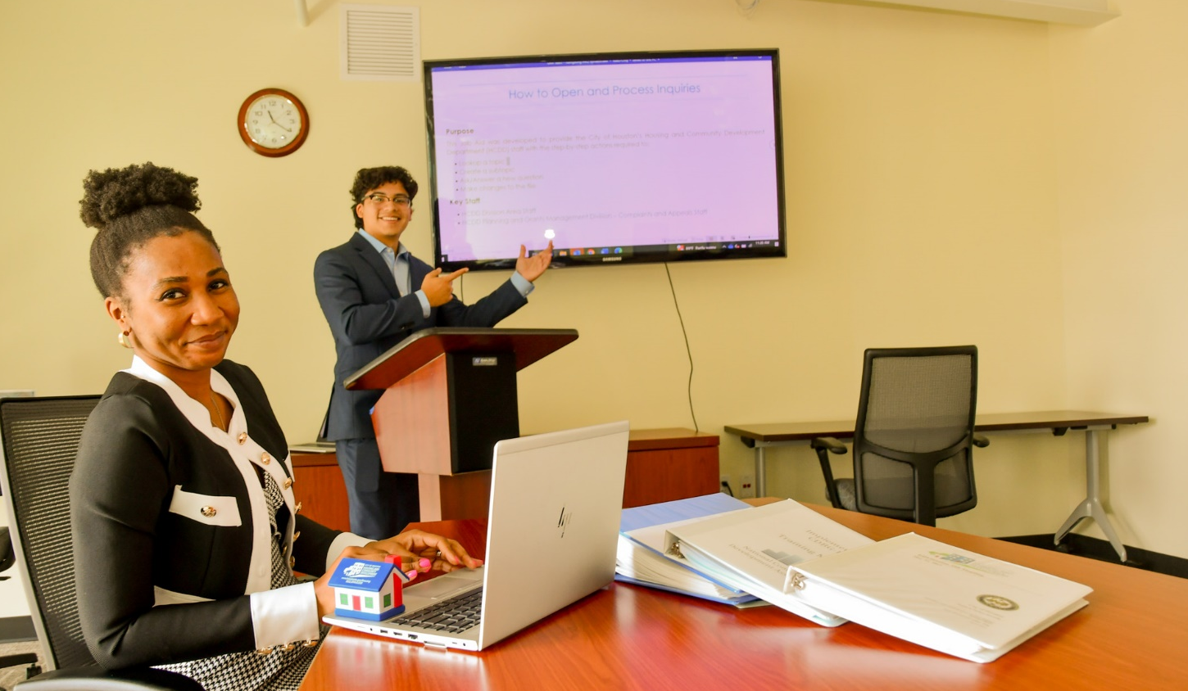
HCD’s 2023 Summer Interns

Slide 48
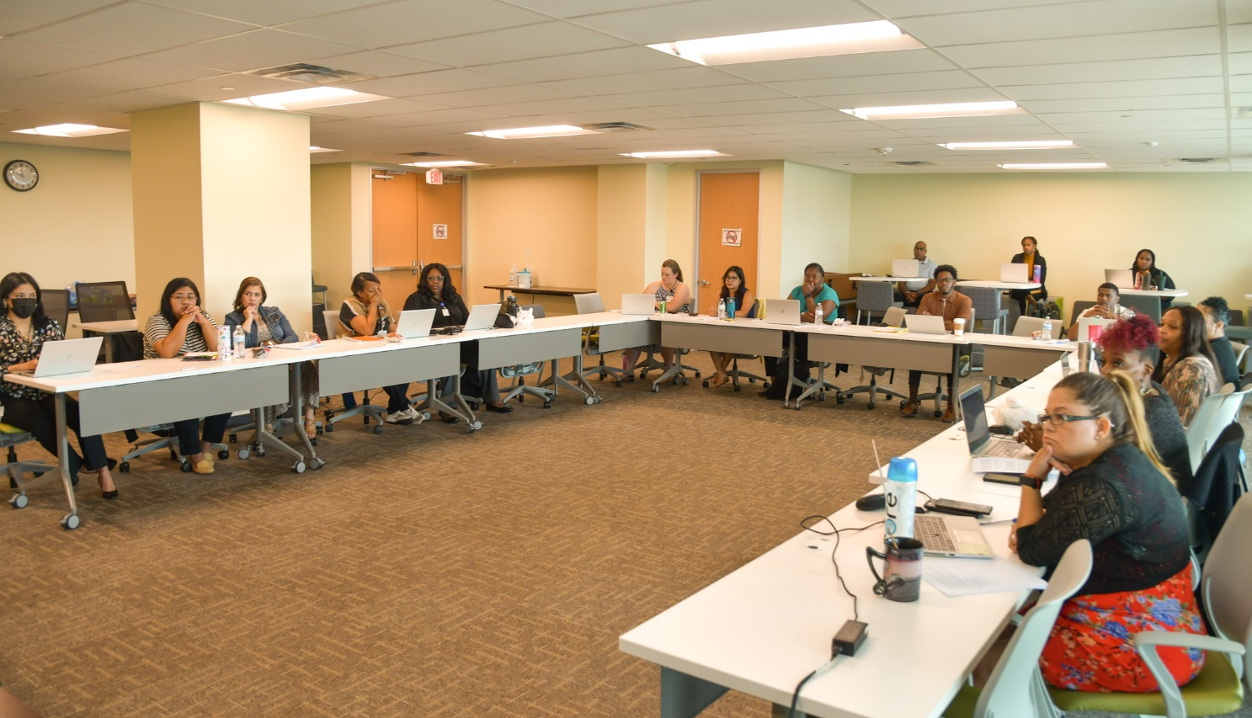
HUD/GLO Uniform Relocation Technical Assistance Training at HCD (8/9/2023)

Slide 49
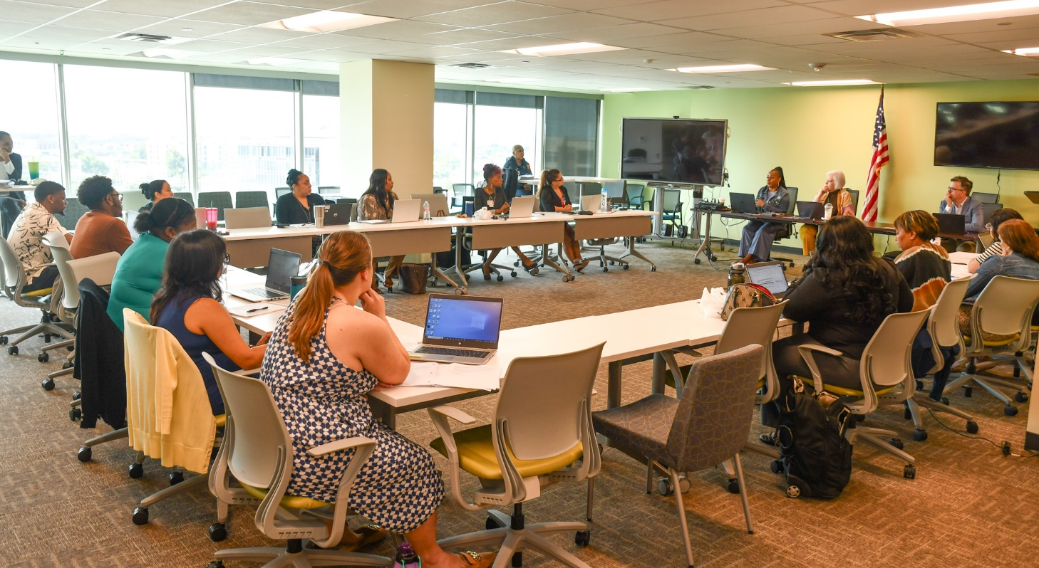
HUD/GLO Uniform Relocation Technical Assistance Training at HCD (8/9/2023)

Slide 50

HUD Fair Housing Training (7/11/2023)
United Way, 50 Waugh Drive (District C)

Slide 51
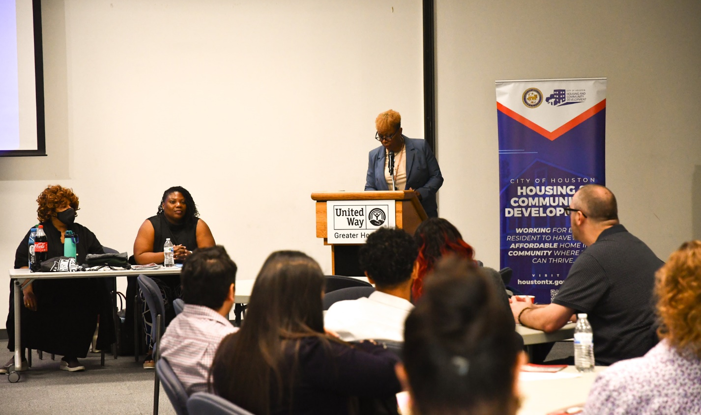
HUD Fair Housing Training (7/11/2023)
United Way, 50 Waugh Drive (District C)

Slide 52
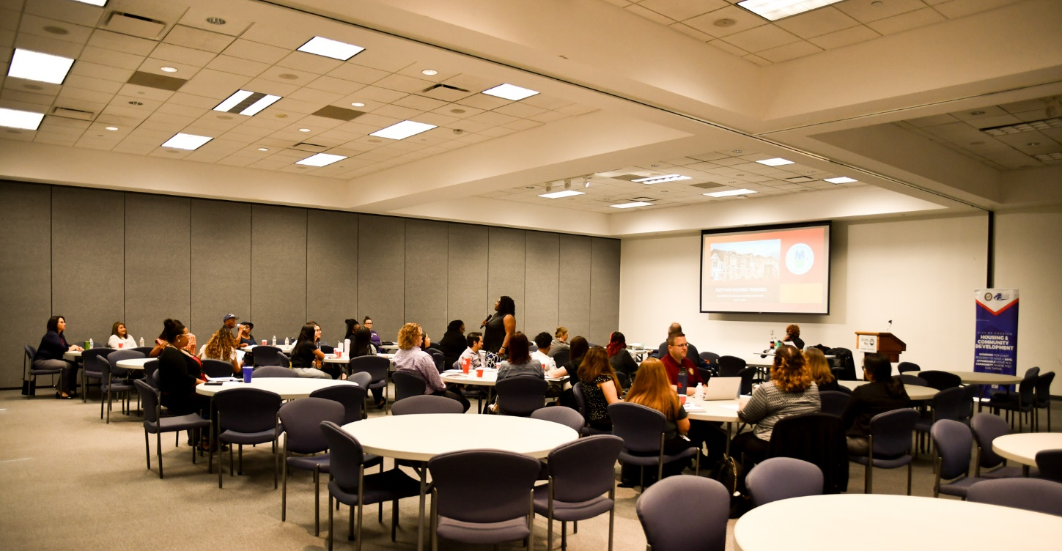
HUD Fair Housing Training (7/11/2023)
United Way, 50 Waugh Drive (District C)

Slide 53
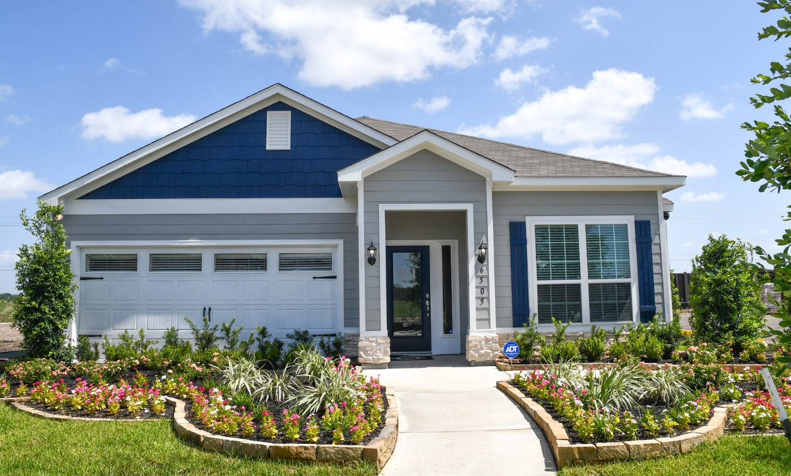
Large Tract - Park Vista at El Tesoro
6498 Selinsky (District D)

Slide 54
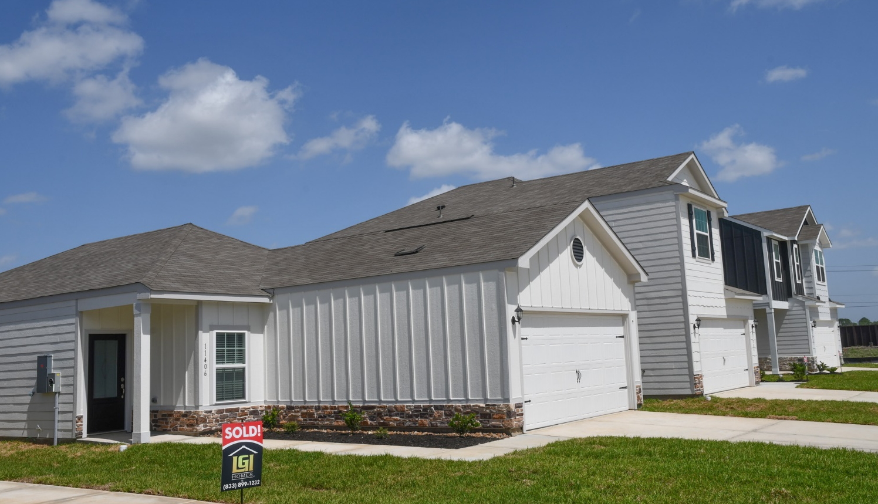
Large Tract - Park Vista at El Tesoro
6498 Selinsky (District D)

Slide 55
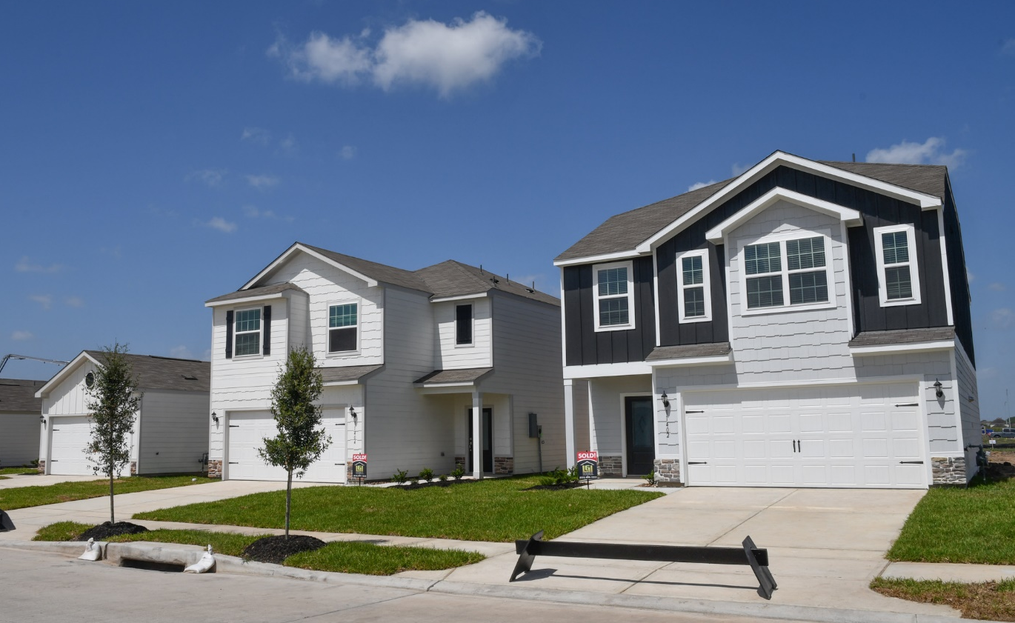
Large Tract - Park Vista at El Tesoro
6498 Selinsky (District D)

Slide 56
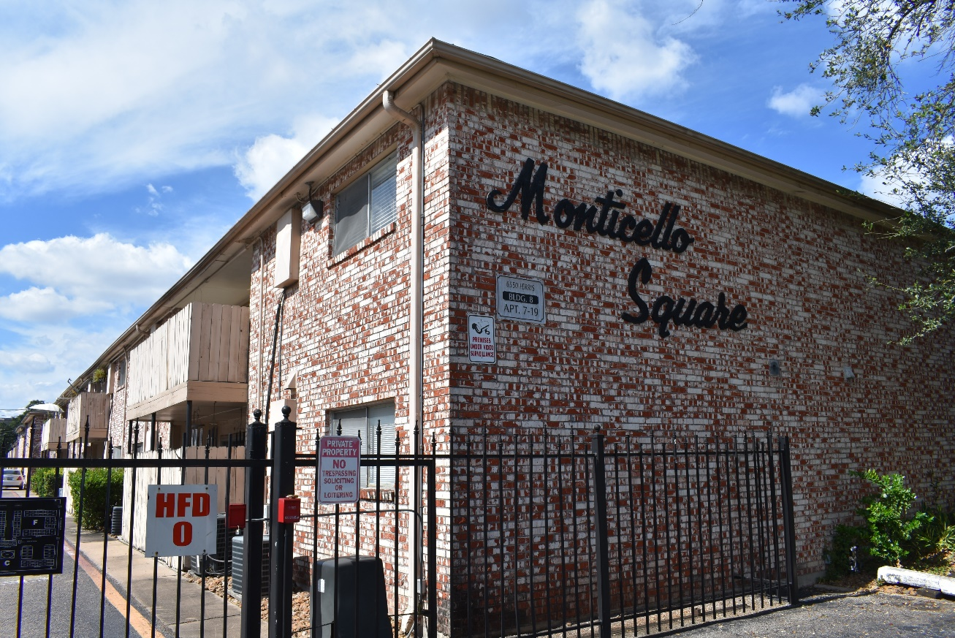
Multifamily Buyout - Monticello Square Apartments
5312 Clarewood (District J)

Slide 57
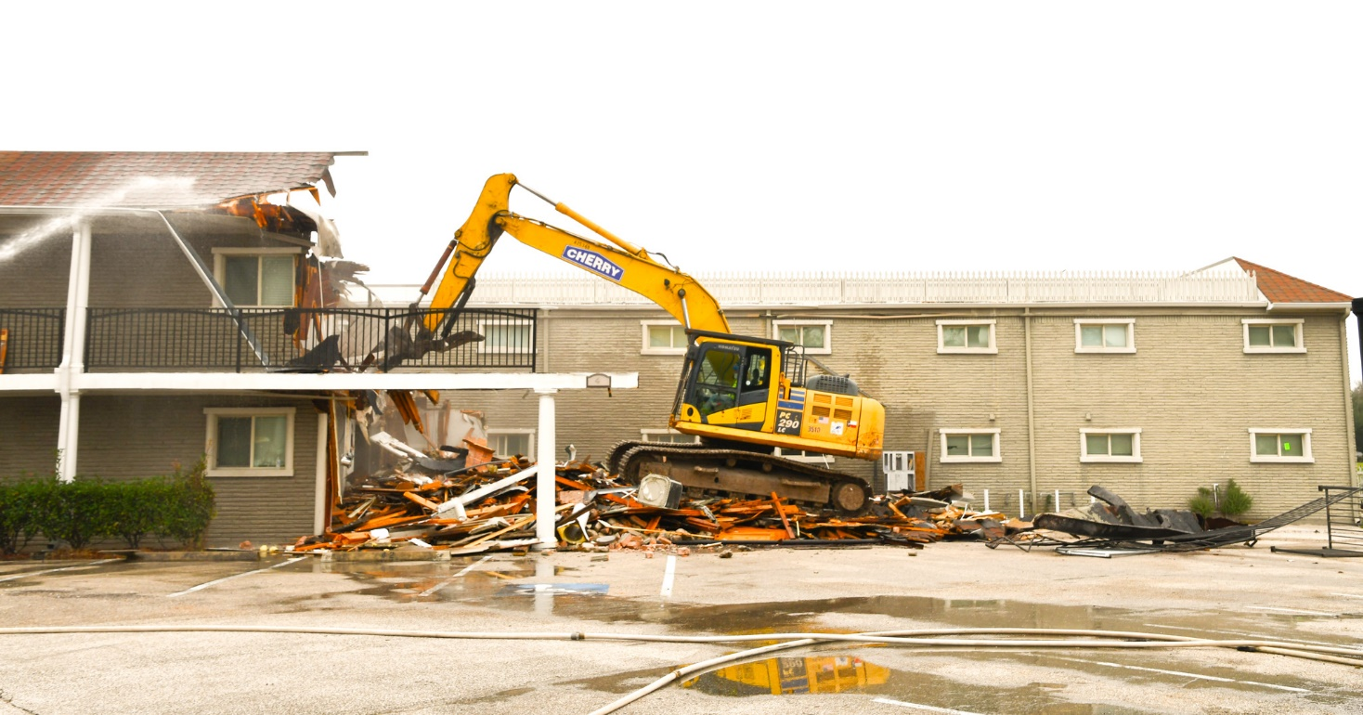
Multifamily Buyout – Appian Way Apartments
3200 N. MacGregor (District D)

Slide 58
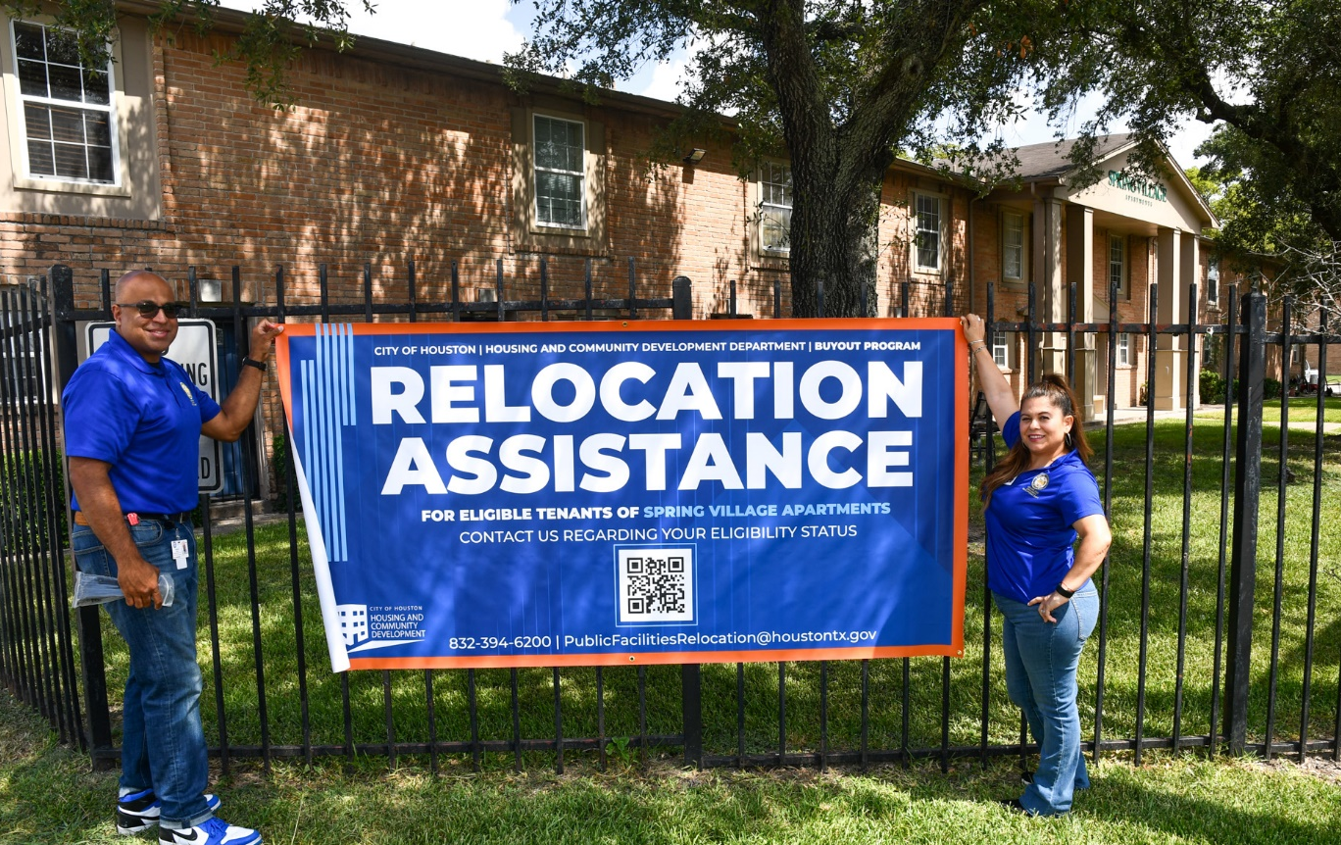
Multifamily Buyout – Spring Village Apartments
11810 Chimney Rock (District C)

Slide 59
Update: Gala at MacGregor New Construction
102-120 Carson St., Houston, 77004 (District D)
Completion Percentage: 99%
Total Number of Units: 85
Total Restricted Units: 75 (30% - 80% AMI)
Total Project Cost: $31,152,603.00
HCD Funding: $9,900,000.00 (CDBG-DR17)
Developer: Gardner Capital
Architect: Humphreys & Partners Architects, LP
Completed: 4/26/2023

Slide 60
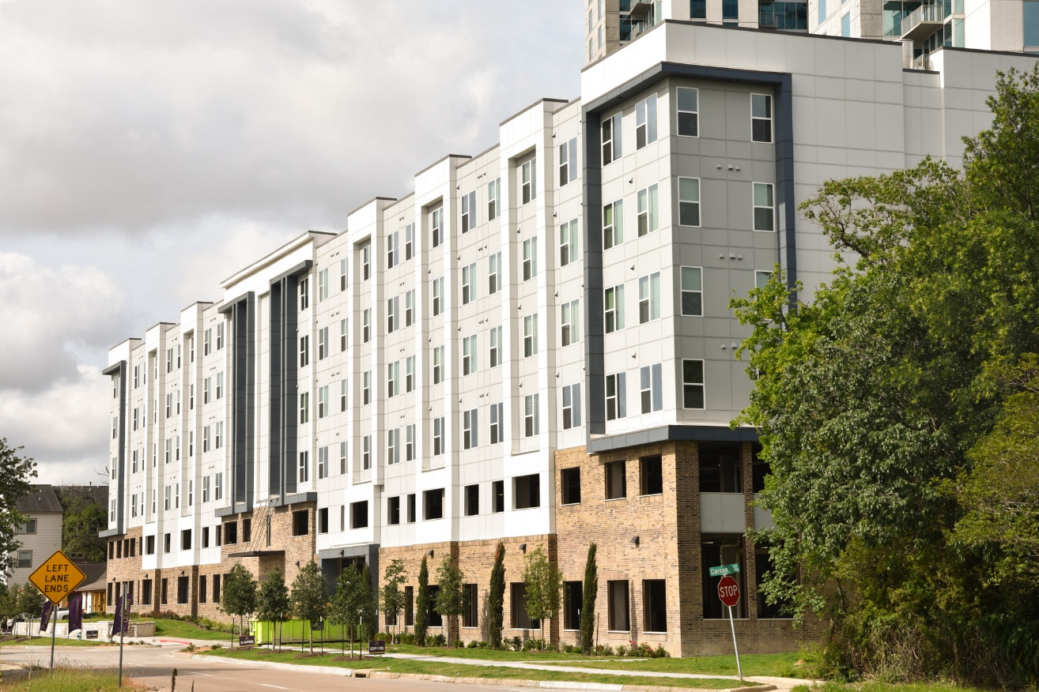
Update: Gala at MacGregor New Construction
102-120 Carson St., Houston, 77004 (District D)

Slide 61
Update: NHH Savoy
6315 Savoy, Houston, 77036 (District J)
Completion Percentage: 98%
Total Number of Units: 120
Total Restricted Units: 120 (30% - 80% AMI)
Total Project Cost: $33,794,447.00
HCD Funding: $13,200,000.00 (CDBG - DR17)
Developer: Houston Area CDC/New Hope Housing
Architect: Garcia Associates, Architects, LLC.
Ribbon Cutting: August 2023

Slide 62
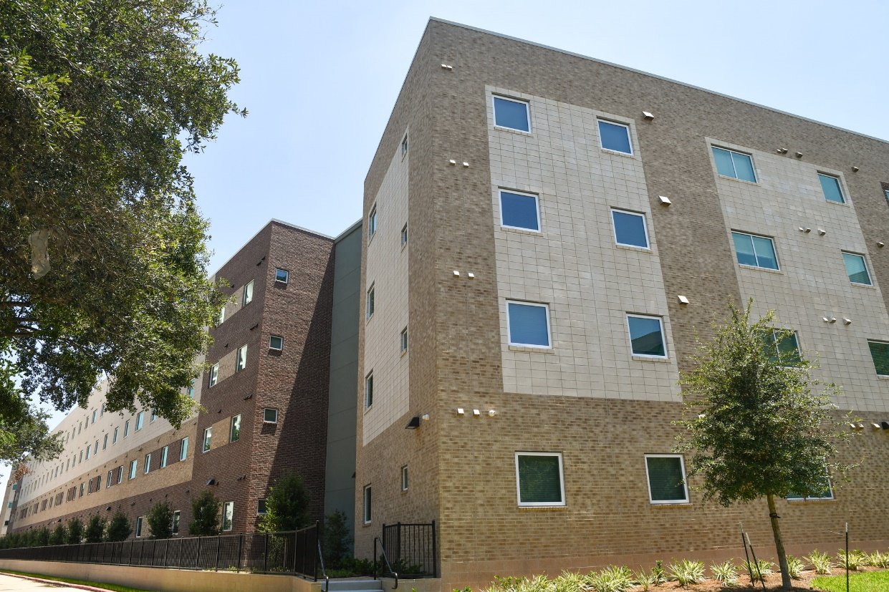
Update: NHH Savoy
6315 Savoy, Houston, 77036 (District J)
Progress as of August, 2023.

Slide 63
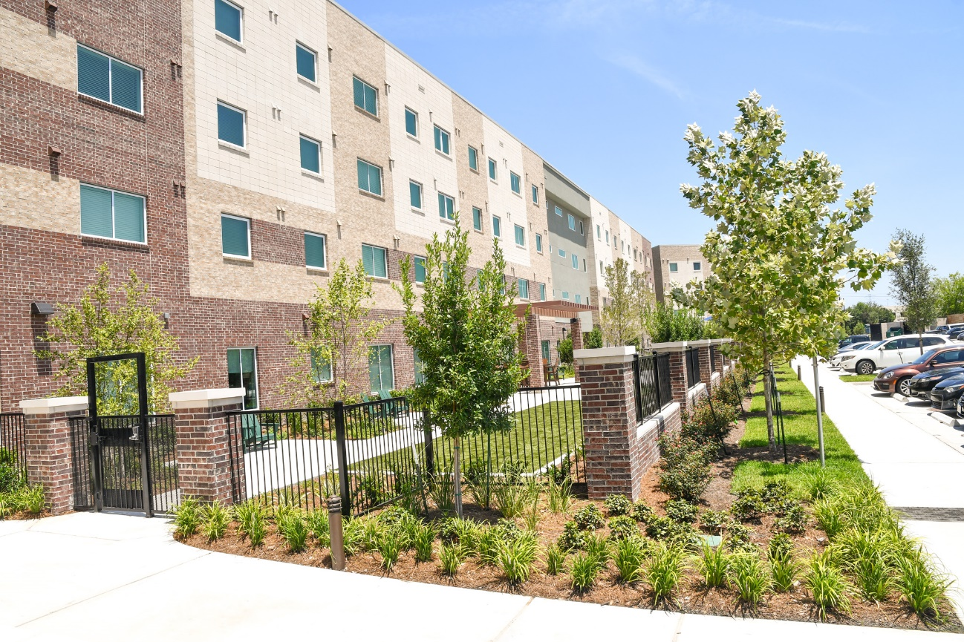
Update: NHH Savoy
6315 Savoy, Houston, 77036 (District J)
Progress as of August, 2023.

Slide 64
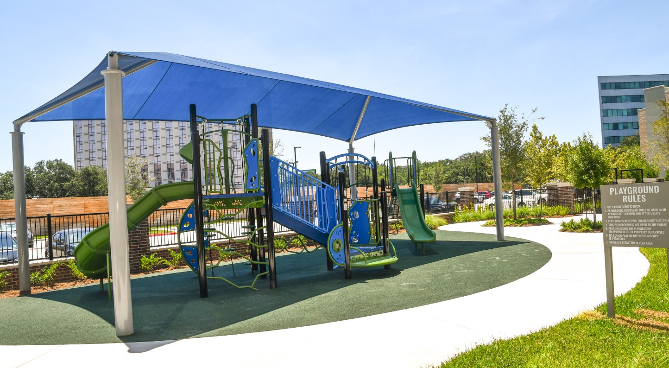
Update: NHH Savoy
6315 Savoy, Houston, 77036 (District J)
Progress as of August, 2023.

Slide 65
Update: Caroline Lofts
2403 Caroline, Houston, 77004 (District D)
Completion Percentage: 98%
Total Number of Units: 119
Total Restricted Units: 80 (30% - 80% AMI)
Total Project Cost: $39,864,269.00
HCD Funding: $19,619,640.00 (CDBG - DR17)
Developer: Mark-Dana Corporation
Architect: Mucasey & Associates
Estimated Completion: July 26, 2023

Slide 66
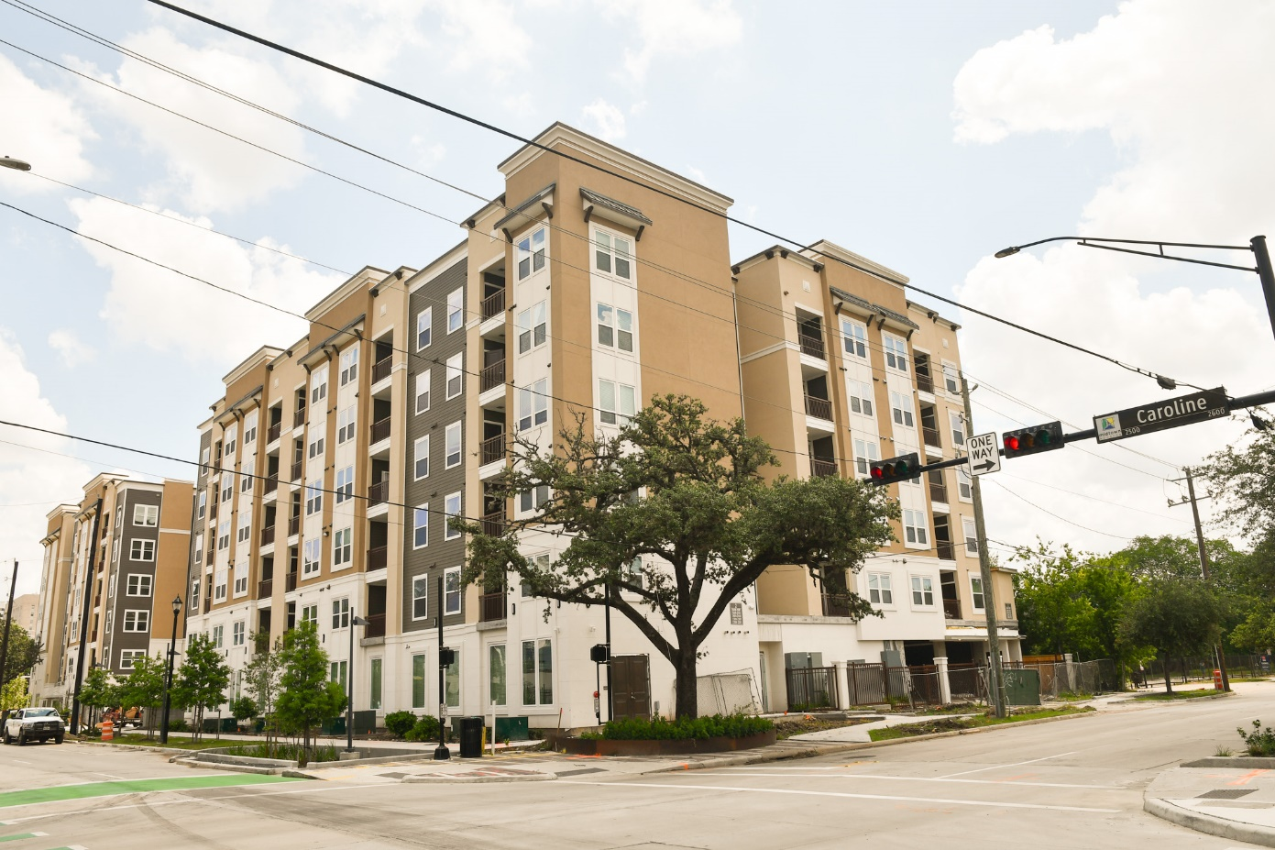
Update: Caroline Lofts
2403 Caroline, Houston, 77004 (District C)
Progress as of July, 2023.

Slide 67
Update: Temenos Place
1703 Gray Houston, 77003 (District D)
Completion Percentage: 73%
Total Number of Units: 94
Total Restricted Units: 94 (30% - 80% AMI)
Total Project Cost: $32,596,735.00
Funding: $12,500,000.00 (HOME, Bond, DR-17, HTC)
Developer: Temenos CDC
Architect: Forge Craft Architect + Design
Estimated Completion: 7/26/2023

Slide 68
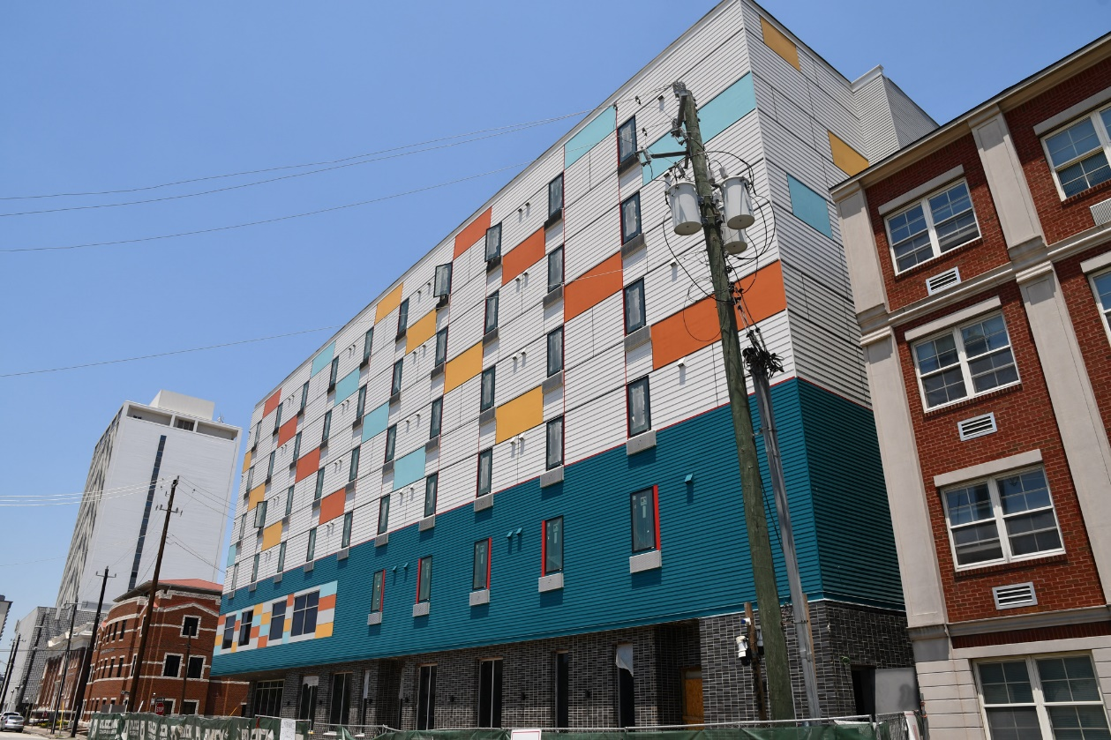
Update: Temenos Place
1703 Gray Houston, 77003 (District D)
Progress as of July of 2023.

Slide 69
Update: 2100 Memorial
2100 Memorial, Houston, 77007 (District H)
Completion Percentage: 53%
Total Number of Units: 196
Total Restricted Units: 100 (30% - 80% AMI)
Total Project Cost: $61,799,200.00
HCD Funding: $25,000,000.00 (CDBG-DR17, HTC)
Developer: HHA/Columbia Residential
Architect: JHP Architecture/Urban Design
Estimated Completion: 10/26/2023

Slide 70
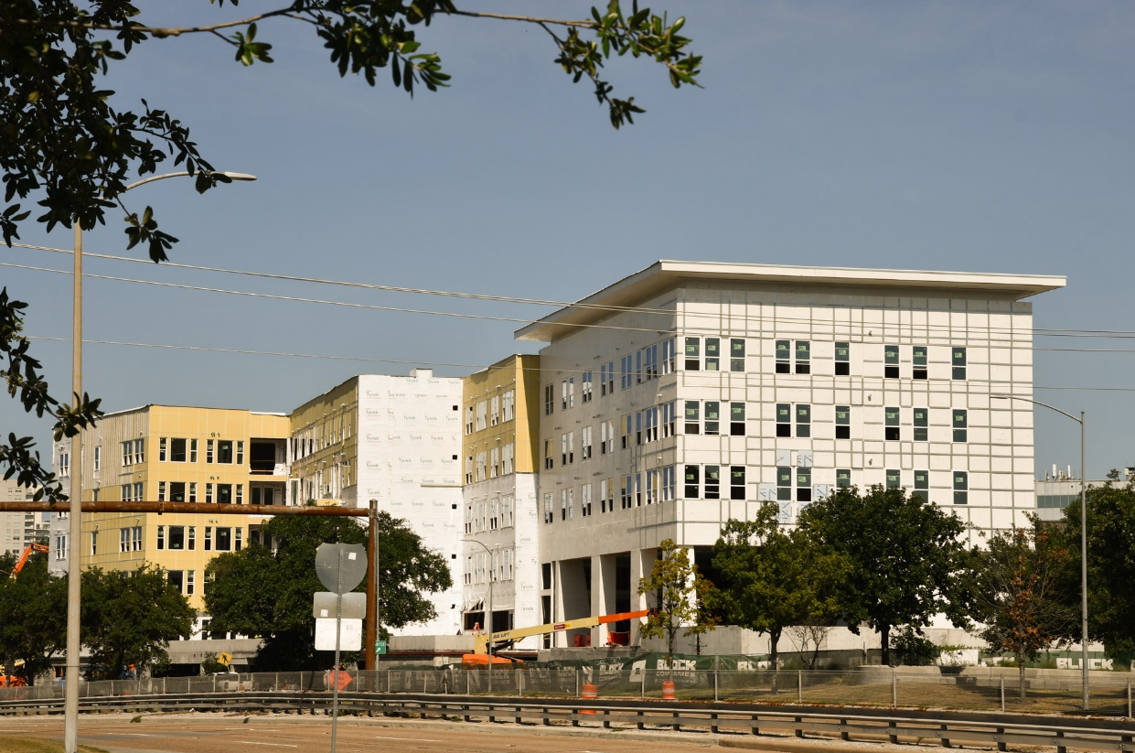
Update: 2100 Memorial
2100 Memorial, Houston, 77007 (District H)
Progress as of August of 2023.

Slide 71
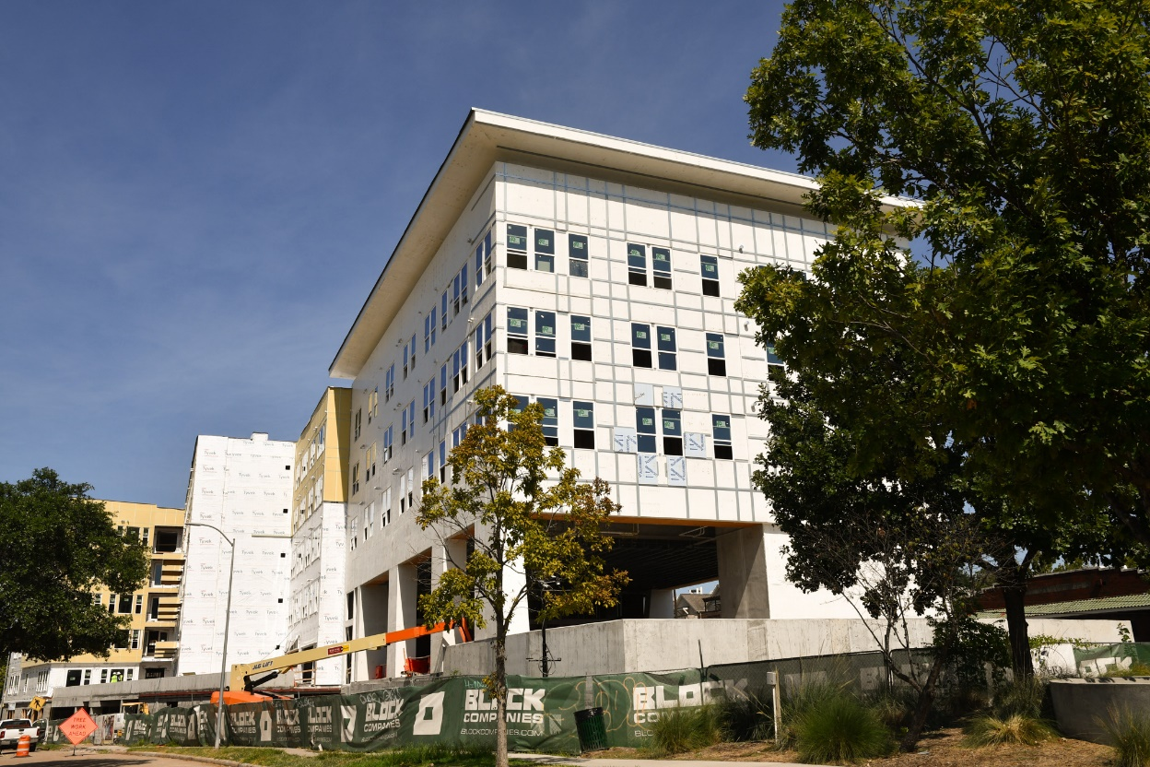
Update: 2100 Memorial
2100 Memorial, Houston, 77007 (District H)
Progress as of August of 2023.

Slide 72
Update: Summit at Renaissance Park
12121 Greenspoint, Houston, 77060 (District B)
Completion Percentage: 63%
Total Number of Units: 325
Total Restricted Units: 166 (30% - 60% AMI)
Total Project Cost: $88,570,081
HCD Funding: $48,594,968 (CDBG-DR17, HTC)
Developer: TXZNH, LLC
Architect: Forge Craft
Estimated Completion Date: November, 2023

Slide 73
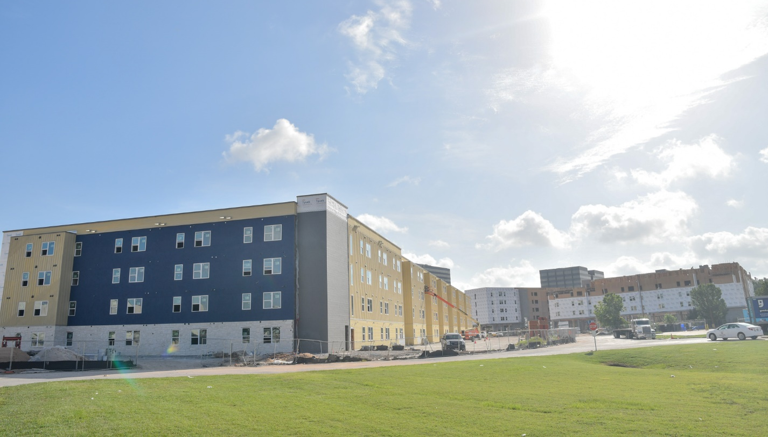
Update: Summit at Renaissance Park
12121 Greenspoint, Houston, 77060 (District B)
Progress as of August of 2023.

Slide 74
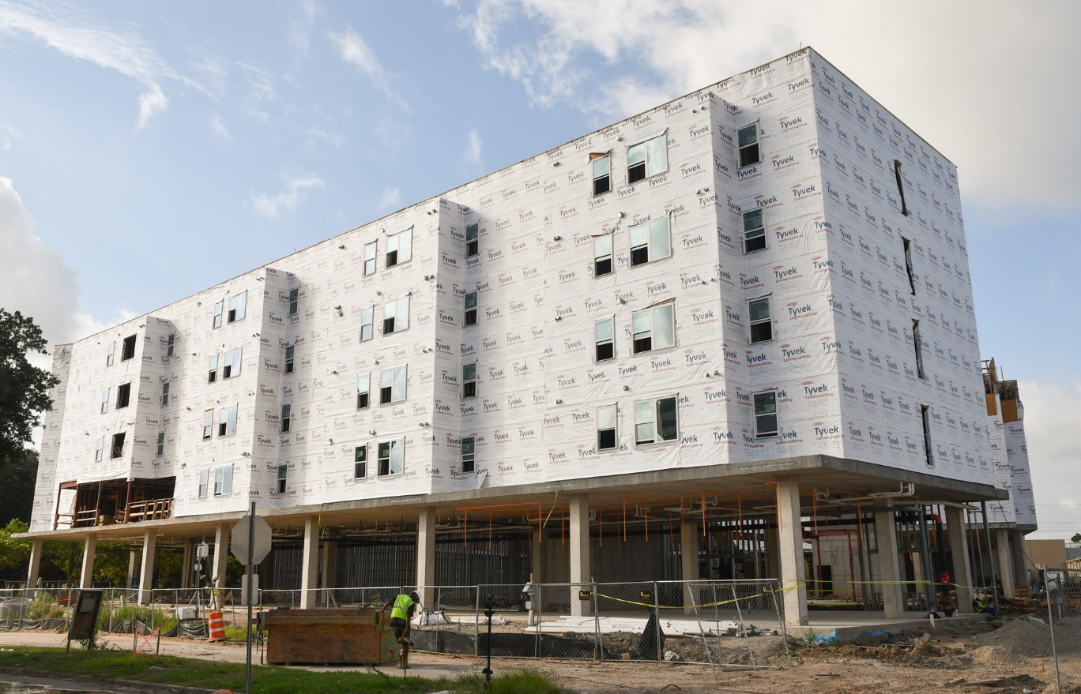
Update: Summit at Renaissance Park
12121 Greenspoint, Houston, 77060 (District B)

Slide 75
Update: Houston Area Women’s Center
3077 El Camino, Houston, TX 77054 (District D)
Completion Percentage: 14%
Total Number of Units: 135
Total Restricted Units: 135 (30% - 80% AMI)
Total Project Cost: $33,315,616.00
HCD Funding: $15,850,000 (HOME-ARP)
Developer: New Hope Housing & HAWC
Architect: GSMA
Estimated Completion Date: November, 2024

Slide 76
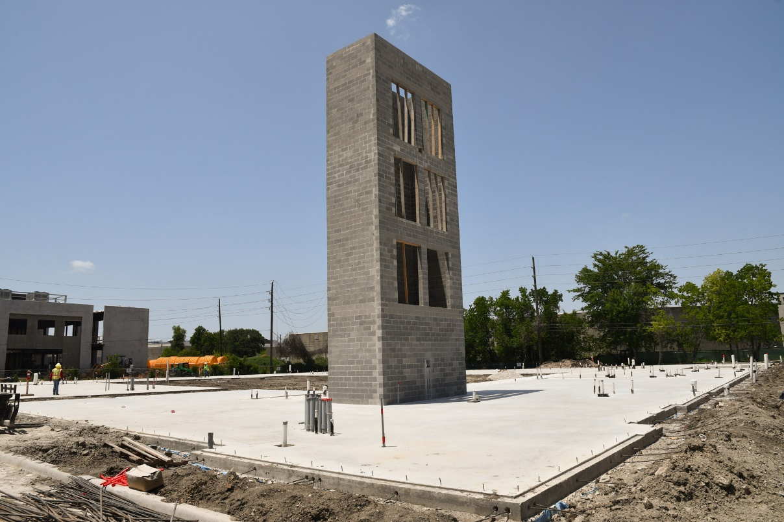
Update: Houston Area Women’s Center
3077 El Camino, Houston, TX 77054 (District D)
Progress as of August of 2023.

Slide 77
PUBLIC
COMMENTS

Slide 78
Update: Sunrise Lofts
3103 McKinney St.,Houston,TX 7700
(District I)
Completion Percentage: 100%
Total Number of Units: 93
Total Restricted Units: 89 (30% - 80% AMI)
Total Project Cost: $23,075,827.00
HCD Funding: $1,560,000.00 (HOME Funds)
Developer: The Tejano Center for Community Concerns & Covenant Community Capital
Architect: Mucasey & Associates
Ribbon Cutting : August 25, 2023

Slide 79
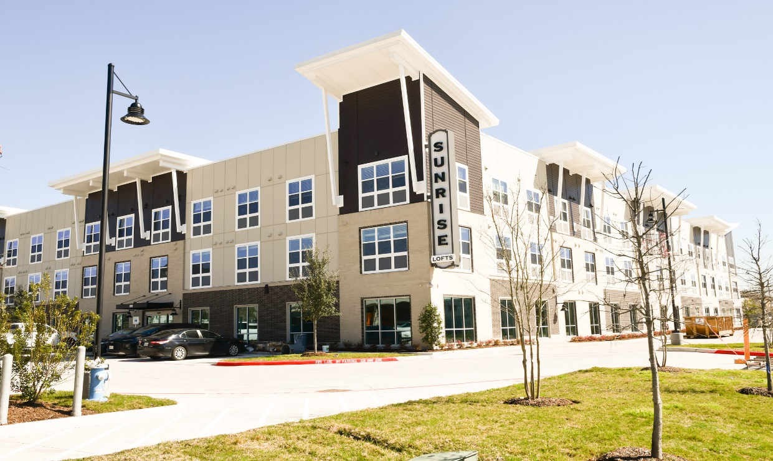
Update: Sunrise Lofts
3103 McKinney St.,Houston,TX 7700
(District I)

Slide 80
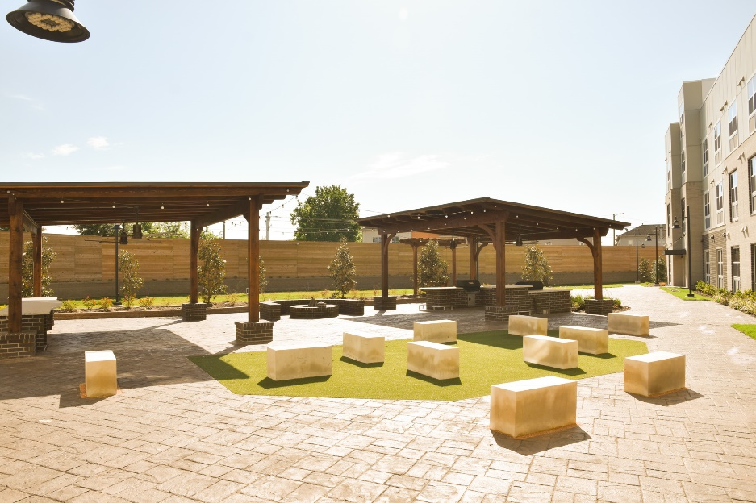
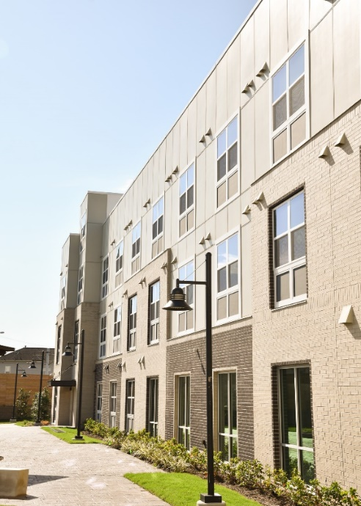
Update: Sunrise Lofts
3103 McKinney St.,Houston,TX 7700
(District I)

Slide 81
Update: Heritage Senior Residences
1120 Moy St. Houston, TX 77007
(District C)
Completion Percentage: 100%
Total Number of Units: 135
Total Restricted Units: 94 (30% - 80% AMI)
Total Project Cost: $40,356,370.00
HCD Funding: $14,350,000.00 (CDBG-DR Funds)
Developer: Atlantic Pacific Companies
Architect: Mucasey & Associates
Ribbon Cutting : September 2023

Slide 82
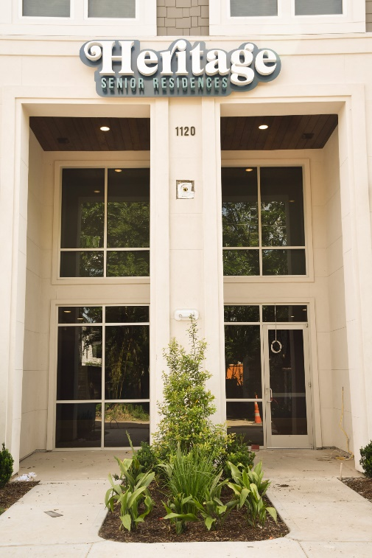
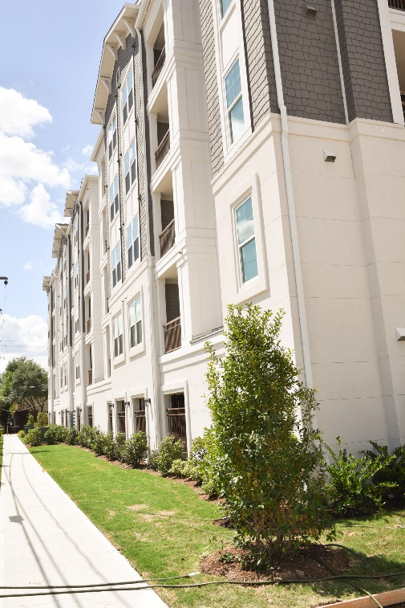
Update: Heritage Senior Residences
1120 Moy St. Houston, TX 77007
(District C)

Slide 83
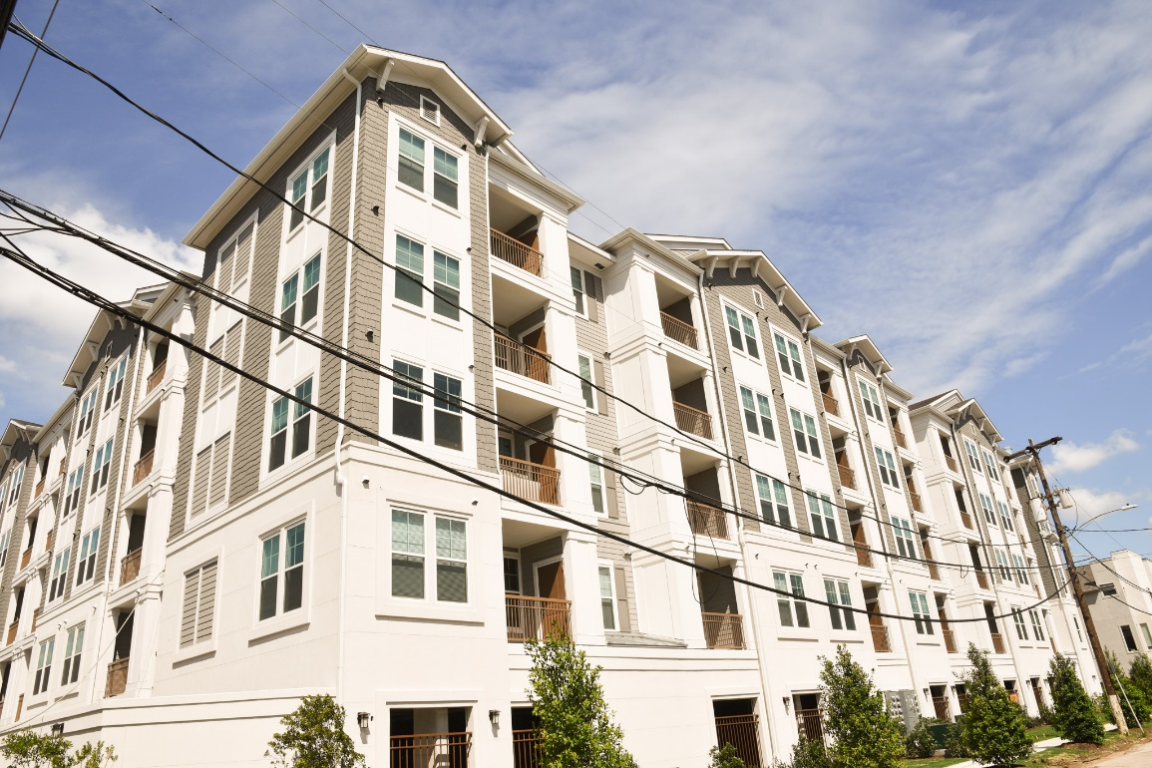
Update: Heritage Senior Residences
1120 Moy St. Houston, TX 77007
(District C)

