Slide 1

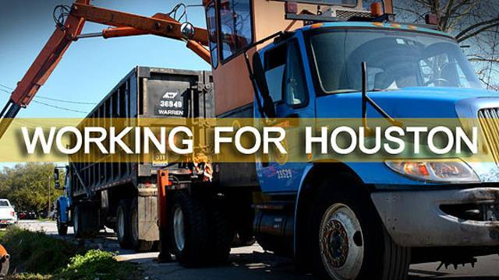
Solid Waste Management Department
FY22 Budget Amendment Presentation
September 21, 2021
Carolyn Wright, Interim Director
Sylvester Turner, Mayor
Regulation & Neighborhood Affairs – Council Member Sallie Alcorn, Chair
Housing & Community Affairs – Council Member Tiffany Thomas, Chair
Quality of Life - Council Member Robert Gallegos, Chair

Slide 2
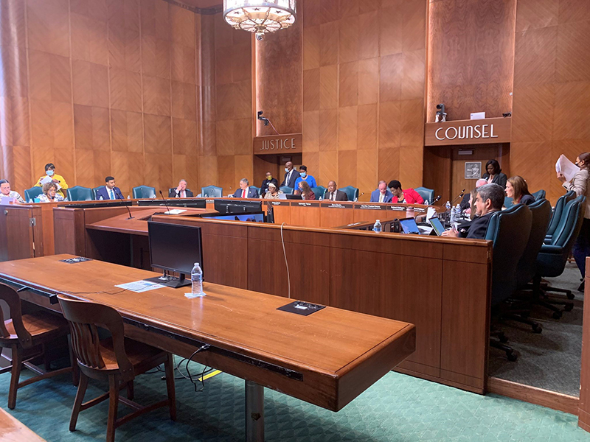
FY22 Budget Amendment Process
During the FY22 budget approval process, 20 amendments were presented which impacted the delivery of the city’s solid waste management services.
Council action on the 20 amendments were as follows:
  7 withdrawn
  12 approved
  1 already in place
  1 prohibited by local or state law.

Slide 3

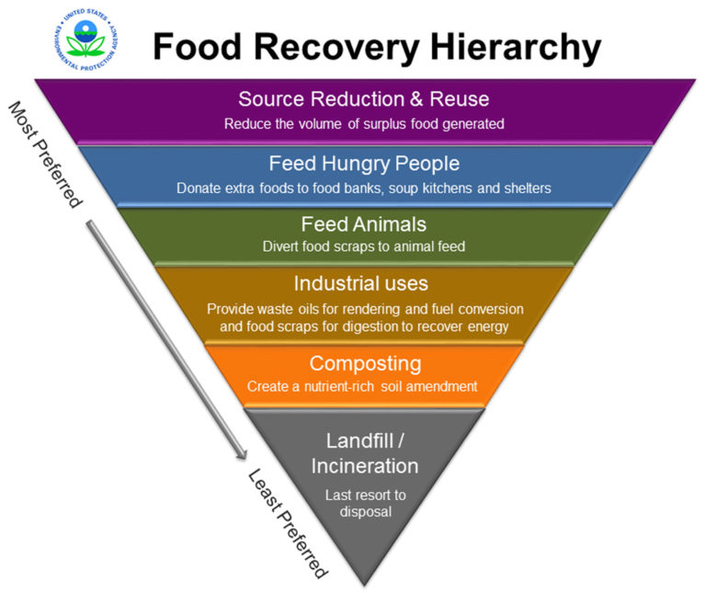
Amendment 5.07: Composting Pilot Program Sponsor: Council Member Sallie Alcorn
Implement a cost-neutral composting pilot program to divert more materials away from the landfill. This six-to-eight-week program will introduce composting and its benefits to residents in up to three Houston neighborhoods.
The department supports this amendment:
  Aligns with the City’s Long Range Solid Waste Plan.
  Addresses a valuable portion of the waste stream which has immediate value and reuse across several industrial lines
  Program testing and further system-wide adoption addresses an approximate 22% slice of the waste stream according to recent EPA study data.
  The department, SPD and ARA have worked to prepare a scope of work for bidding the project. A pilot program is expected to run for 6 weeks in 3 neighborhoods in Council Districts B, C & I.
  No Fiscal Impact

Slide 4
Amendment 6.13: On-Call Collections Contractor
Sponsor: CM Amy Peck
An on-call contract subject to vendor availability and following procurement rules to assist with Solid Waste Management collections as needed in each council district if directed through Council District Service Funds.
SPD is prepared to send out a scope of work for potential vendors for individual projects in each council district
Funding source identified, allocated funds not to exceed $50,000 per council district and council member’s desired use of such a program.
Council should note that private collections will only net a few hundred pickups based on national study rates for private hauling services.
Given current driver and vehicle shortages, anticipated costs may be higher than illustrated herein.

Slide 5

Amendments 6.14 & 6.15: Messaging/Text Apps
Sponsors: CMs Amy Peck / Tarsha Jackson
The Solid Waste Department shall explore the possibility of sending automatic text messages for those who opt in to remind them each month of their trash/recycling days and whether it is junk or tree waste month.
An app shall be created to show where Solid waste Management trucks are located in real time. Once a street is collected, this shall be reflected on the map so that individuals can see when their trash/recycling will be picked up or if their house was missed.
  SWMD Supports these amendments as they align with our new HTX Collects App – where citizens may sign up for service notification reminders. Note that sending text messages in not an option at this time.
  Once procured, Rubicon Global, LLC, will provide technical support for vehicle tracking, vehicle routing and performance management for the department’s fleet which may become a part of a real time customer viewable dashboard.

Slide 6
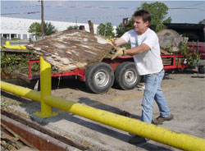
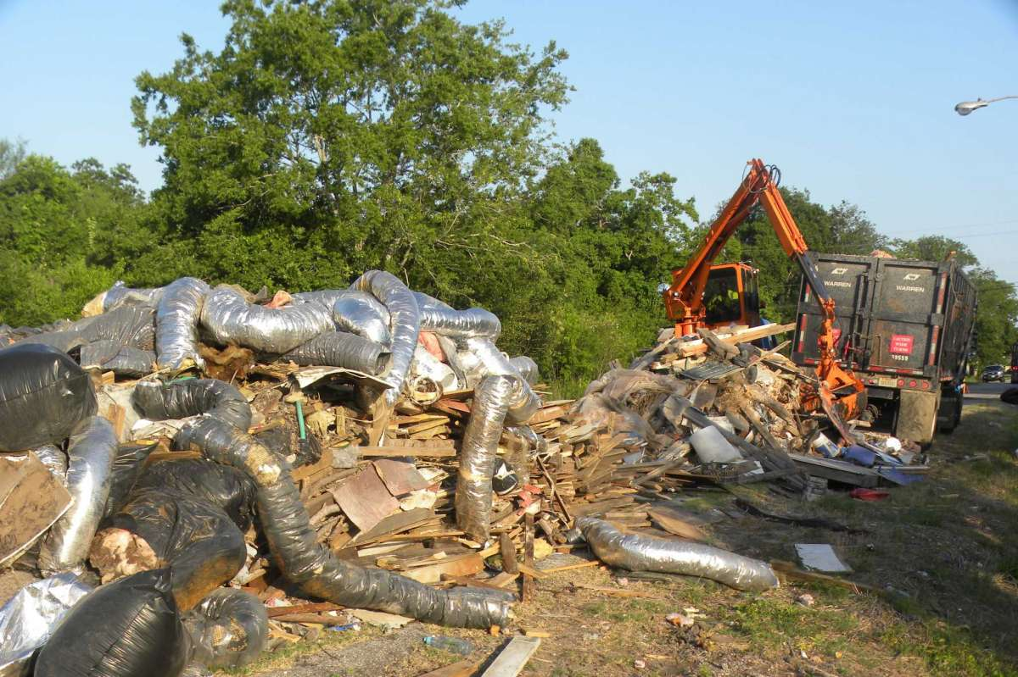
Amendment 7.01: Neighborhood Depositories
Sponsor: Council Member Tarsha Jackson
The illegal dumping problem in the city is out of hand, and is especially egregious in a number of districts, including B. One way to mitigate the problem is by giving people greater access to disposing of their trash and tires legally at depositories. This amendment would increase the number of days of operation at the existing depositories from 5 to 6 days a week.
The department supports this amendment.
Effective July 1, 2021, all Neighborhood Depository sites were officially opened six (6) days a week, Tuesday-Sunday, 9 a.m. – 7 p.m.
Fiscal Impact for this action is estimated to be $291,000.00 for FY22 and will impact the General Fund.

Slide 7

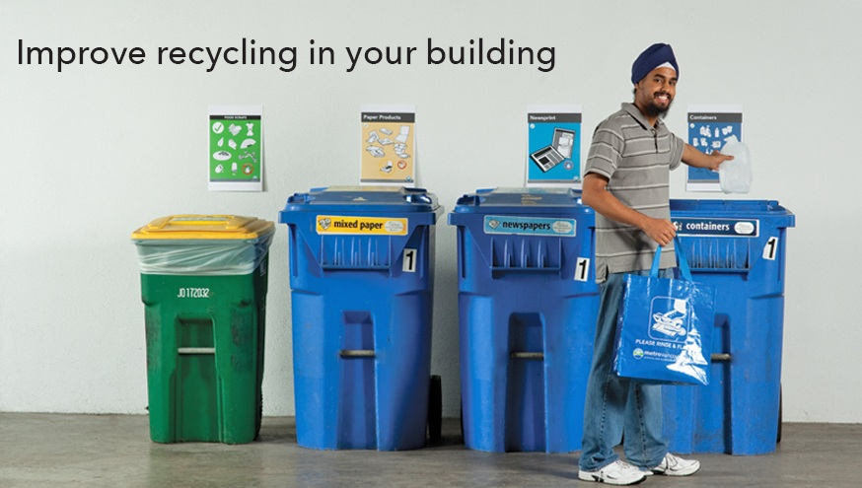
Amendment 8.01: Multi-Family Recycling
Sponsor: Council Member Kamin
Before the end of FY22, the Solid Waste Management Department shall begin the stakeholder engagement process regarding mandatory multi-family recycling. The Solid Waste Management Department shall present an ordinance for a vote before Houston City Council for a program that will begin implementation no later than January 2024.
The department supports this amendment.
The amendment aligns with the City’s Long-Range Plan.
Kinder Institute 2020 Housing Report indicates trends toward future housing in the city will be multifamily.
More than one-half of Houston's 2.3 million residents are multi-family dwellers, generating on average 7 lbs. of waste per person per day (TCEQ), or an estimated 800K – 1 million tons annually of home garbage.

Slide 8
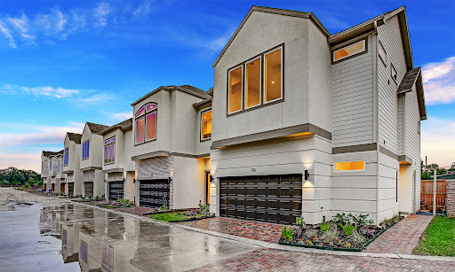
Amendment 14.04: Developer Fee
Sponsor: CM Robert Gallegos
The City of Houston shall create and assess a developer impact fee for new residential development if the development requires refuse collection to be provided by the Solid Waste Management Department. The fee shall be calculated by multiplying the number of new single-family dwellings in the development by the cost to deliver a new refuse container as established in the City Fee Schedule (currently $24.86). The impact fee shall not be imposed on a new development if the refuse collection service is privatized.
Ch. 395 TX Local Gov’t Code - Impact Fees authorize cities to charge a fee for capital improvements.
This fee does not fit in this category
The law prohibits the City from charges twice for the same fees. The proposed is within the scope of fees already charged with the container lease fee.

Slide 9
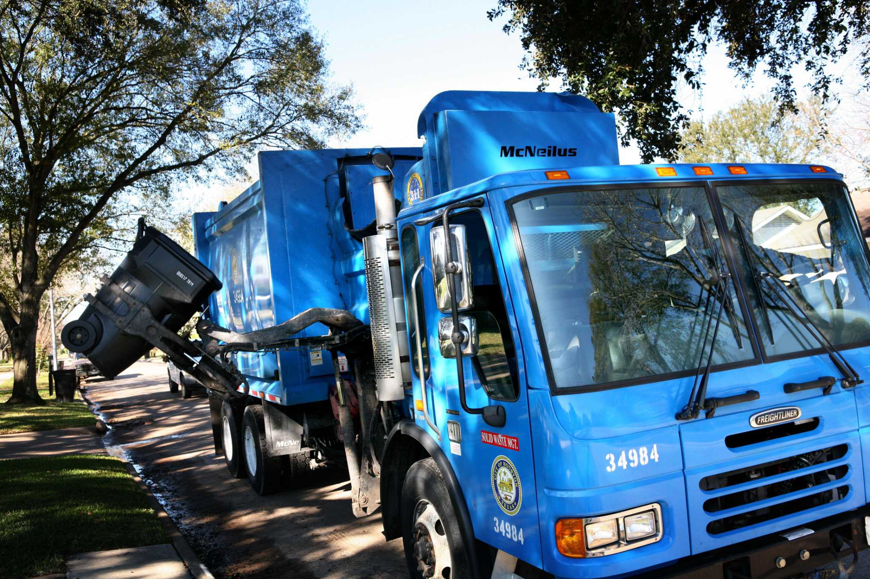
Amendment 14.05: One-Time Setup Fee
Sponsor: CM Robert Gallegos
The City of Houston shall create and assess a one-time setup fee for new residential development waste service customers equal to the “fee for change of customer at same address” as established in the City Fee Schedule ($5.94). If a new city refuse container is required, the customer shall pay the refuse container delivery fee (currently $24.86) as established in the City Fee Schedule in addition to the setup fee.
This fee is usually associated with an enterprise utility service and not a general fund service.
The law prohibits the City from charges twice for the same fees. The proposed is within the scope of fees already charged with the container lease fee.

Slide 10

Amendment 14.06: Management District Partnership
Sponsor: CM Robert Gallegos
The Solid Waste Management Department shall conduct a pilot program in partnership with interested management districts to retrieve illegally dumped tires, on an as-needed basis, from city right-of-way and public spaces. Under the pilot, dumped tires would be picked up by participating management district crews, at no cost to the city, and taken to city neighborhood depositories to be collected, transported, and disposed of under the existing solid waste tire disposal contract and at no cost to the management district.
The department does not support this amendment.
Management Districts are state sanctioned entities that raise funds to support their services. They raise and expend funds based on the continued development and betterment of their “state-designated and sanctioned” boundaries. Management districts may contract with private entities to support their respective business needs.
Depositories are established to support citizen self-service. The stations are currently at and above capacity due to usage and driver shortages. The department has reported for several years the need to have at least 5 to 7 additional sites around the city to meet the needs of past and future growth trends.
The department recommends the Council Districts that are in favor of such an approach utilize their Council District Service Funds to subsidize the Management Districts needs. Programs are in place in other council districts which can be modeled.

Slide 11
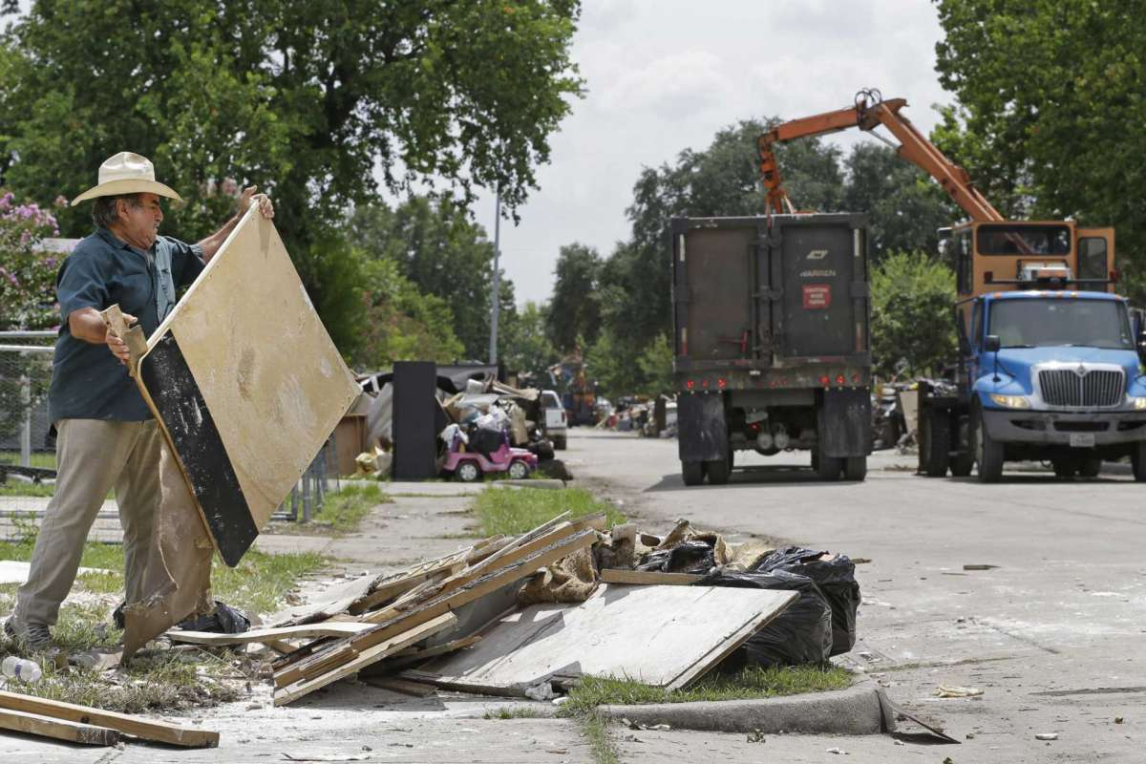
Amendment 14.07: Tree/Junk Waste Study
Sponsor: CM Robert Gallegos
The Houston Solid Waste Department shall conduct a study of its residential Tree and Junk Waste Program collection schedule to determine if a revised schedule, that could provide 8 total Tree and Junk collections per year and increase the Junk Waste collection period, would be more efficient and sustainable for the department, and more reliable and better meet the needs for customers, than the existing monthly pickup schedule. As part of this study, the department should also consider establishing and assessing extra collection service fee (to be determined as part of this review) to residential customers who require additional pickup beyond what could be provided under a revised Tree and Junk Waste collection schedule.
SWMD does not support this amendment due to the potential for increased illegal dumping in already overburdened areas.
The amendment does not comport with current and past Long Range Plans/Studies which cite waste minimization and diversion as needed efforts to preserve long range landfill disposal airspace.
Delayed collection would only mean more waste to collect with reduced schedules and insufficient crews to cover. The financial burden to the city to cover additional collections would run into several million general fund dollars.
Increased use at the depositories would also drive general fund costs provided new facilities could be built in time to cover the higher demand.

Slide 12
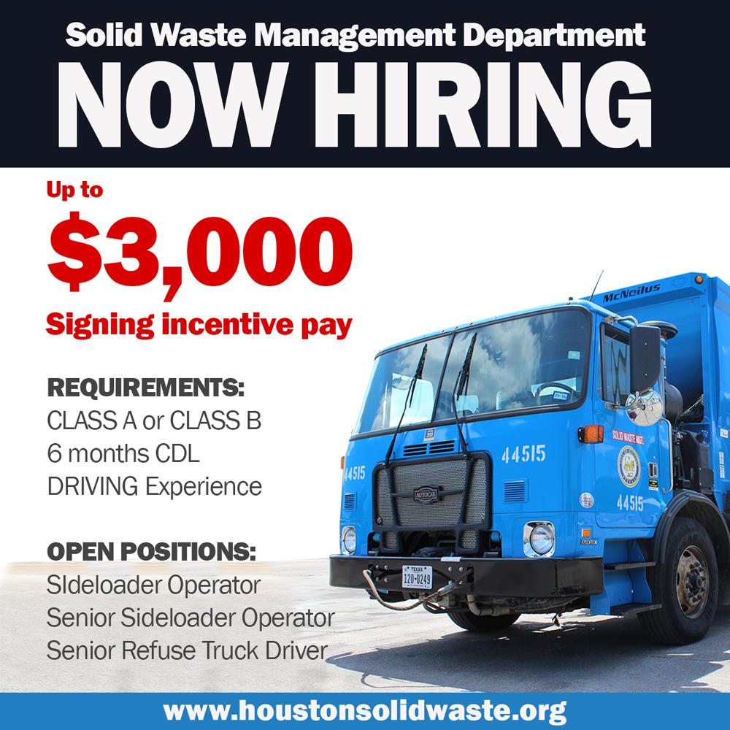
Amendment 16.02: Driver Signing Bonus
Sponsor: Council Member Martha Castex-Tatum
The City of Houston will offer $3,000 sign-on incentive pay for licensed CDL drivers that commit to 3 years of employment as a Solid Waste driver until open positions are filled.
The department supports this amendment.
Administrative Procedure has been drafted and approved by the Administration.
Fiscal Impact: $120,000 for 40 positions over three (3) fiscal years.

Slide 13


Amendment 16.05: Tagging & Enforcement
Sponsor: CM Martha Castex-Tatum
The City of Houston will determine a process to identify, tag and charge any resident putting out more than 8 cubic yards of junk waste or tree waste each month.
This amendment is not needed as tagging processes are already in place and covered by the current Houston Code of Ordinances.
Solid Waste drivers tag over the limit garbage to include junks/tree waste and non-conforming yard waste bags.
DON tags and cites residents for early placement and other matters related to city neighborhood standards as dictated by the Houston Code of Ordinances

Slide 14
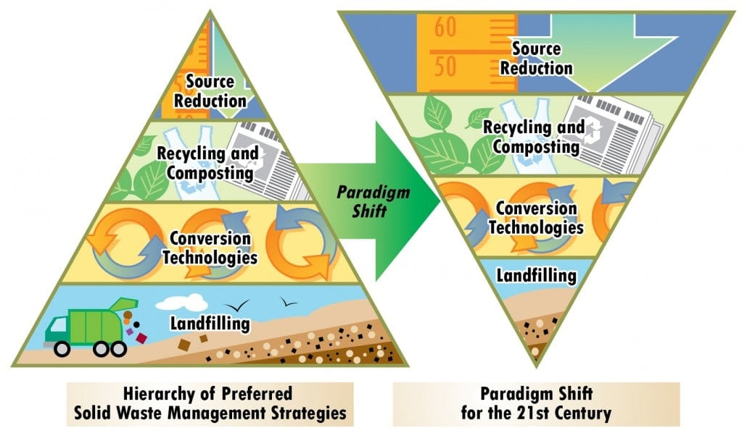
Questions

