Slide 1
Housing & Community Affairs Committee
Agenda Items
September 15, 2020

Slide 2
HCDD Agenda
I. Welcome/Call to Order
II. Public Services
III. Multifamily
IV. Director's Comments
V. Public Comments

Slide 3
The CARES Act
*On March 27, 2020, the Coronavirus Aid, Relief, and Economic Security Act (CARES Act), Public Law 116-136, authorized a special allocation of funds from the U.S. Department of Housing and Urban Development (HUD) to states and local jurisdictions to prevent, prepare for and respond to the coronavirus pandemic (COVID-19)*

Slide 4
The Way Home
Covid CARES Housing Plan
The Way Home developed the COVID CARES Housing Plan (CCHP) to support Houston’s most vulnerable residents impacted by COVID-19 – people experiencing homelessness.
Through The Way Home, a collaborative partnership was developed specifically to support CCHP, which includes: The City of Houston’s HCDD, Harris County’s Community Services Department and The Coalition for the Homeless of Houston and Harris County.

Slide 5
The Way Home
Covid CARES Housing Plan
Applications for Request for Expression of Interest (REI) from qualified agencies were accepted by the three partners in July 2020.
The following are the applicants recommended by the CCHP partners for the first round of funding.

Slide 6
II.a. Public Services
Career and Recovery Resources, Inc.
(All Districts)
An Ordinance authorizing a Subrecipient Agreement between the City of Houston and Career and Recovery Resources, Inc. (CRR), providing up to $1,380,204.00 in Emergency Solutions Grants - Coronavirus (ESG-CV) and Community Development Block Grant - Coronavirus (CDBG-CV) funds to help prevent and respond to the impacts of COVID-19 through Rapid Rehousing Case Management services to a minimum of 75 households impacted by COVID-19.
Case Management services include vocational training and job placement support, transportation, referrals to health care providers, behavioral health, and household management so that households can obtain economic stability.

Slide 7
II.a. Public Services
Career and Recovery Resources, Inc.
(All Districts)
This is CRR’s first Cares Act agreement with the City.
This agreement provides funding from October 1, 2020 - March 31, 2022.
FUNDING SOURCE | AMOUNT | Percent
ESG-CV (Direct Services) | $1,254,731.00 | 91%
CDBG-CV (Indirect – Administration) | $125,473.00 | 9%
Total | $1,380,204.00 | 100%

Slide 8
II.b. Public Services
Catholic Charities of the Archdiocese of Galveston-Houston (All Districts)
An Ordinance authorizing a Subrecipient Agreement between the City of Houston (City) and Catholic Charities of the Archdiocese of Galveston-Houston (Catholic Charities), providing a combined total of $3,031,894.00 in Emergency Solutions Grant - Coronavirus (ESG-CV) and Community Development Block Grant - Coronavirus (CDBG-CV) funds to help prevent and respond to the impacts of COVID-19.
Catholic Charities will provide case management services to pair with Rapid Rehousing for a minimum of 400 households that have been impacted by COVID-19.

Slide 9
II.b. Public Services
Catholic Charities of the Archdiocese of Galveston-Houston (All Districts)
Catholic Charities began receiving grant funds for various activities through the City in 2003.
This agreement provides funding from October 1, 2020 September 30, 2022.
FUNDING SOURCE | AMOUNT | Percent
ESG-CV/CDBG-CV (Direct Services) | $2,756,267.00 | 90%
CDBG-CV (Indirect – Administration) | $275,627.00 | 10%
Total | $3,031,894.00 | 100%

Slide 10
II.c. Public Services
SEARCH (All Districts)
An Ordinance authorizing a Subrecipient Agreement between the City of Houston (City) and SEARCH Homeless Services (SEARCH), providing up to $1,136,960.00 in Community Development Block Grant - Coronavirus (CDBG-CV) funds to help prevent and respond to the impacts of COVID-19.
SEARCH will provide Rapid Rehousing case management services and navigation services for a minimum of 150 households that have been impacted by COVID-19.

Slide 11
II.c. Public Services
SEARCH (All Districts)
SEARCH began receiving grant funds for various activities through the City in 2000.
This agreement provides funding from October 1, 2020 -September 30, 2022.
FUNDING SOURCE | AMOUNT | Percent
CDBG-CV (Direct Services) | $1,043,137.00 | 91.75%
CDBG-CV (Indirect – Administration) | $93,823.00 | 8.25%
Total | $1,136,960.00 | 100%

Slide 12
II.d. Public Services
Endeavors (All Districts)
An Ordinance authorizing a Subrecipient Agreement between the City of Houston (City) and Family Endeavors, Inc., dba Endeavors providing up to $2,010,016.00 in Community Development Block Grant - Coronavirus (CDBG-CV) funds to help prevent and respond to the impacts of COVID-19.
Endeavors will provide Rapid Rehousing case management services to a minimum of 200 unduplicated persons and Diversion services to a minimum of 100 unduplicated persons who have been impacted by COVID-19.

Slide 13
II.d. Public Services
Endeavors (All Districts)
This is Endeavors’ first Public Services contract with the City of Houston.
This agreement provides funding from October 1, 2020 – September 30, 2022.
FUNDING SOURCE | AMOUNT | Percent
CDBG-CV (Direct Services) | $1,827,287.00 | 91%
CDBG-CV (Indirect – Administration) | $182,729.00 | 9%
Total | $2,010,016.00 | 100%

Slide 14
II.d. Public Services
Spring Branch Community Health Center
(All Districts)
An Ordinance authorizing a Subrecipient Agreement between the City of Houston (City) and Spring Branch Community Health Center (SBCHC), providing up to a combined total of $734,878.00 in Emergency Solutions Grant - Coronavirus (ESG-CV) and Community Development Block Grant - Coronavirus (CDBG-CV) funds to help prevent and respond to the impacts of COVID-19.
SBCHC will provide Rapid Rehousing case management services to a minimum of 100 households that have been impacted by COVID-19.

Slide 15
II.d. Public Services
Spring Branch Community Health Center
(All Districts)
This is SBCHC’s first agreement with the City.
This agreement provides funding from October 1, 2020 – March 31, 2022.
FUNDING SOURCE | AMOUNT | Percent
ESG-CV (Direct Services) | $668,071.00 | 90.91%
CDBG-CV (Indirect – Administration) | $66,807.00 | 9.09%
Total | $734,878.00 | 100%

Slide 16
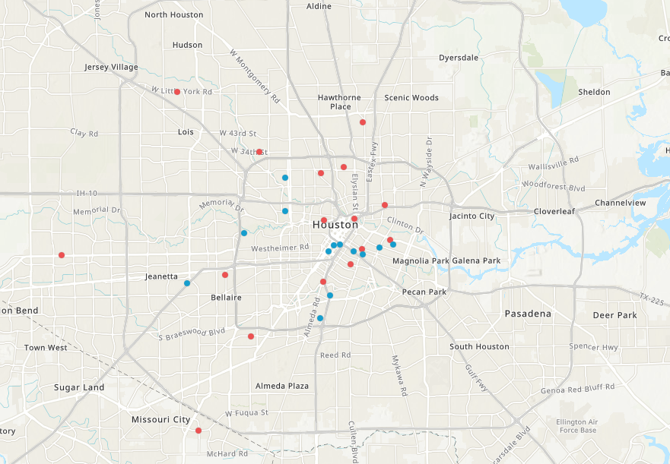
Citywide Map of Multifamily Projects
https://recovery.houstontx.gov/multifamily-program/

Slide 17
III. Multifamily Overview: Funding
The following Multifamily projects are funded by CDBG-DR17 program funds awarded by the United States Department of Housing and Urban Development, through the Texas General Land Office.
The aim is to provide affordable rental units for low- to moderate- income households, in accordance with the City’s Harvey Multifamily Program Guidelines, implemented by HCDD.

Slide 18
III. Multifamily Overview: Affordability
The loan and affordability period will be 40 years and will commence when the construction period is completed. The loan will be non-amortizing throughout both the construction and affordability period.
Following project completion, the outstanding principal balance of the note shall accrue at 1% interest. Borrower will pay an annual installment of interest from available cash flow.

Slide 19
III.a. Multifamily
Canal Street Lofts (District H)
An Ordinance authorizing $12,000,000.00 of Community Development Block Grant - Disaster Recovery 2017 (CDBG-DR17) funds, for a Contract between the City of Houston (City) and Education Based Housing, Inc., (Borrower) a nonprofit partner of Blazer, a Houston-based, long-term owner of many affordable apartment communities.
The loan will be used towards the land acquisition and new development of Canal Street Lofts, to be located at 5601 Canal St. Houston, TX 77011, in the Second Ward Complete Community.
The development will be a 150-unit podium style affordable rental development serving working families.

Slide 20
III.a. Multifamily
Canal Street Lofts (District H)
Canal Street Lofts will provide a mix of one-, two-, and three-bedroom units serving low- to moderate-income households at 30%, 50%, and 60% of the Area Median Income. There are no existing Low Income Housing Tax Credit -financed communities within the census tract.
The property is transit-oriented with a METRO high‐frequency bus stop on its front corner, and less than a 5‐minute walk to a METRORail stop and the Harrisburg Hike & Bike Trail.
The community will offer children’s after‐school activities, mentoring opportunities, adult‐education classes, career training/placement partnerships, health & wellness seminars, and onsite activities/social events.

Slide 21
III.a. Multifamily
Canal Street Lofts (District H)
Sources & Uses
Sources | Amount | Uses | Amount
City of Houston Request (CDBG DR-17) | $12,000,000.00 | Hard Cost | $18,751,448.00
Permanent Lender | $7,730,000.00 | Soft Cost | $6,796,428.00
9% Housing Tax Credit Proceeds | $14,248,575.00 | Acquisition Cost | $4,500,000.00
Other | $ - | Developer Fee | $3,625,000.00
In-Kind Equity/ Deferred Developer Fee | $446,425.00 | Reserves | $752,124.00
Total Source of Funds: | $34,425,000.00 | Total Project Cost: | $34,425,000.00

Slide 22
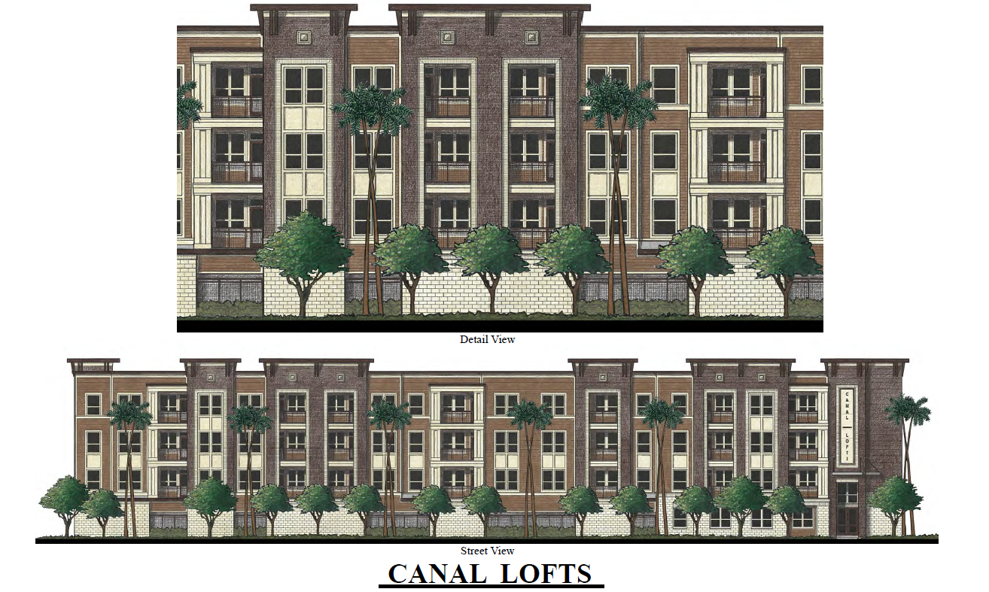
III.a. Multifamily
Canal Street Lofts (District H)

Slide 23
III.b. Multifamily
Heritage Senior Residences (District C)
An Ordinance authorizing $11,700,000.00 in Community Development Block Grant - Disaster Recovery 2017 (CDBG-DR17) funds, for a Contract between the City of Houston (City) and Heritage Senior Residences, LP (Borrower).
The loan will be used towards the land acquisition and the new development of Heritage Senior Residences, to be located at the NE Corner Lot of Center St. and Moy St., Houston, TX 77007.
Heritage Senior Residences will be a 135-unit podium style affordable rental development serving seniors 55 years of age or older, and homeless persons.

Slide 24
III.b. Multifamily
Heritage Senior Residence (District C)
Heritage Senior Residences will provide a mix of one- and two-bedroom units serving low- to moderate-income households at 30%, 50% 60%, and 80% of the Area Median Income.
This development would be the first Low Income Housing Tax Credit (LIHTC) development in the census tract in 30 years, per Texas Department of Housing and Community Affairs’ property inventory listing.
Heritage Senior Residences is aligned with the Resilient Houston Plan by providing affordable housing near transit and jobs. The environmentally friendly building incorporates resilient design and many energy-saving features.

Slide 25
III.b. Multifamily
Heritage Senior Residence (District C)
Sources & Uses
Sources | Amount | Uses | Amount
City of Houston Request (CDBG-DR17) | $11,700,000.00 | Hard Cost | $18,368,474.00
Permanent Lender | $6,750,000.00 | Soft Cost | $6,329,075.00
9% Housing Tax Credit Proceeds | $14,998,500.00 | Acquisition Cost | $5,000,000.00
Fee Waiver | $500.00 | Developer Fee | $3,366,116.00
In-Kind Equity/ Deferred Developer Fee | $299,022.00 | Reserves | $684,357.00
Total Source of Funds: | $33,748,022.00 | Total Project Cost: | $33,748,022.00

Slide 26
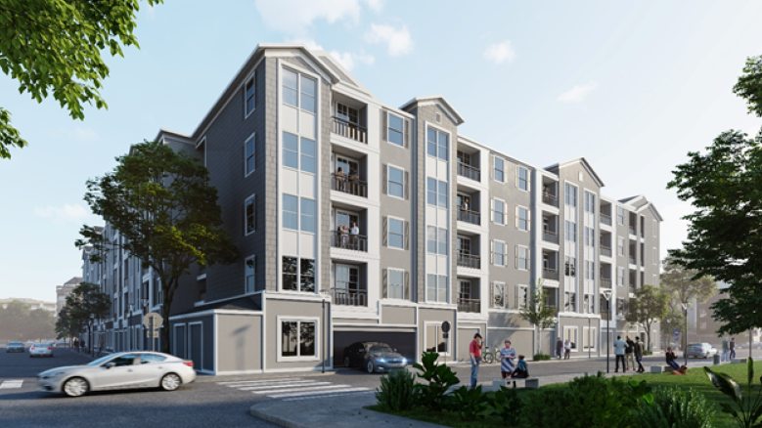
III.b. Multifamily
Heritage Senior Residence (District C)

Slide 27
III.c. Multifamily
New Hope Housing – Savoy (District J)
An Ordinance authorizing $12,000,000.00 of Community Development Block Grant - Disaster Recovery 2017 (CDBG-DR17) funds, for a Contract between the City of Houston (City) and Houston Area Community Development Corporation (Borrower).
The loan will be used towards the land acquisition and new development of New Hope Housing Savoy, to be located at approximately 6301 Savoy Drive, Houston, TX 77036.
New Hope Housing Savoy will be a 120-unit four story elevator-accessible affordable rental development serving families.

Slide 28
III.c. Multifamily
New Hope Housing – Savoy (District J)
New Hope Housing Savoy will provide a mix of one-, two-and three-bedroom units serving low- to moderate- income households at 30%, 50%, 60%, and 80% of the Area Median Income.
The development is designated as permanent supportive housing to provide safe housing for individuals with disabilities and families at risk of homelessness. The Borrower is building on a solid 26-year track record of creating quality affordable rental housing.
New Hope Housing Savoy will be the eleventh property in the Borrower’s portfolio and the third housing facility aimed at serving families.

Slide 29
III.c. Multifamily
New Hope Housing – Savoy (District J)
Sources & Uses
Sources: |  | Uses:
City of Houston (CDBG-DR17) | $12,000,000.00 | Acquisition | $3,978,000.00
9% Housing Tax Credit Proceeds | $12,448,754.00 | Hard Costs | $15,143,261.00
Charitable Contributions | $1,208,858.00 | Soft Costs | $3,985,853.00
In-Kind Equity/ Def. Developer Fee | $677,180.00 | Reserves | $378,561.00
 |  | Developer Fee | $2,849,117.00
Total Source of Funds: | $26,334,792.00 | Total Project Cost: | $26,334,792.00

Slide 30
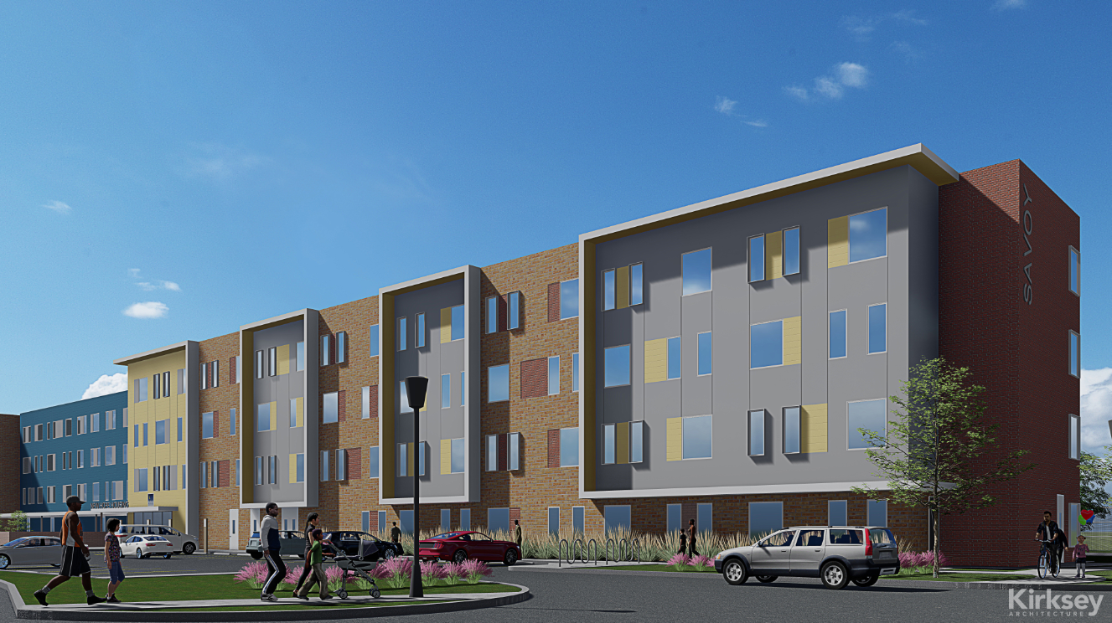
III.c. Multifamily
New Hope Housing – Savoy (District J)

Slide 31
III.d. Multifamily
Regency Lofts (District D)
An Ordinance authorizing $12,500,000.00 of Community Development Block Grant - Disaster Recovery 2017 (CDBG-DR17) funds, for a Contract between the City of Houston (City) and William A. Lawson Institute for Peace & Prosperity (WALIPP), a non-profit partner of DWR Development Group (Borrower).
The loan will be used towards the land acquisition and new development of Regency Lofts, to be located at 3232 Dixie Rd. Houston, TX 77021.

Slide 32
III.d. Multifamily
Regency Lofts (District D)
Regency Lofts will be a 120-unit podium style affordable rental development serving families.
The property will provide a mix of one-, two-, and three-bedroom units serving low- to moderate- income households at 30%, 50% 60% and 80% of the Area Median Income.
Regency Lofts will also provide a stand-alone quality pre-kindergarten center available to residents and open to the neighborhood.

Slide 33
III.d. Multifamily
Regency Lofts (District D)
Sources & Uses
Sources: |  | Uses:
City of Houston (CDBG-DR 17) | $12,500,000.00 | Acquisition | $5,510,000.00
9% Housing Tax Credit Proceeds | $13,948,605.00 | Hard Costs | $19,751,374.00
Conventional Loan | $5,480,000.00 | Soft Costs | $2,923,542.00
In-Kind Equity/ Def. Developer Fee | $19,298.00 | Other Development Costs | $575,372.00
 |  | Developer Fee | $3,187,615.00
Total Source of Funds: | $31,947,903.00 | Total Project Cost: | $31,947,903.00

Slide 34
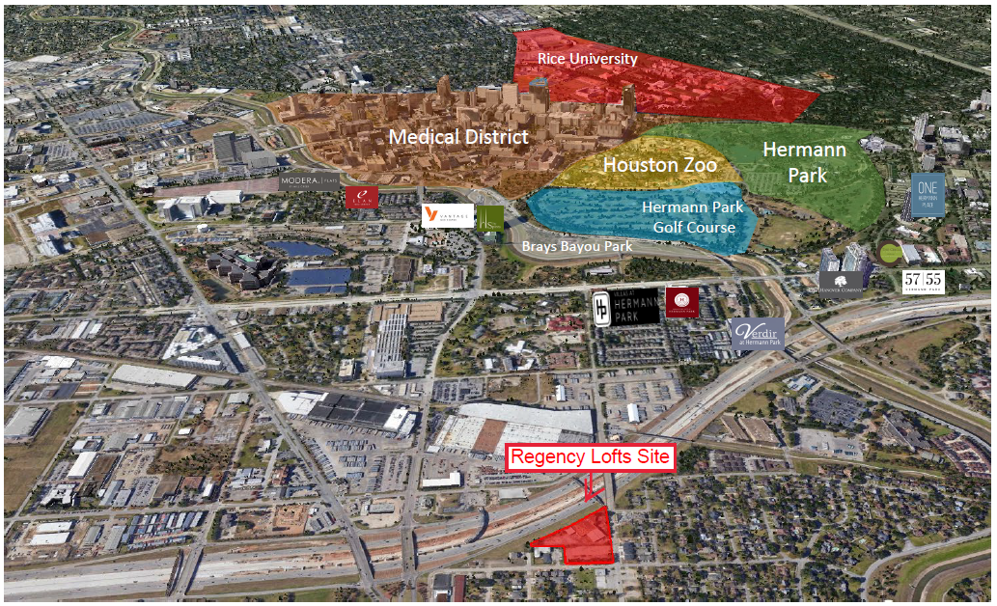
III.d. Multifamily
Regency Lofts (District D)

Slide 35
III.e. Multifamily
Campanile on Briar Hollow (District G)
An Ordinance authorizing $8,500,000.00 in Community Development Block Grant - Disaster Recovery 2017 (CDBG-DR17) funds, for a Contract between the City of Houston (City) and Kilday Operating LLC (Borrower).
The loan will be used towards the land acquisition and new development of Campanile on Briar Hollow, to be located at the SE corner of Post Oak Blvd and Briar Hollow Lane, Houston, TX 77027.

Slide 36
III.e. Multifamily
Campanile on Briar Hollow (District G)
Campanile on Briar Hollow will be an 85-unit podium style affordable rental development serving seniors.
The property will provide a mix of one- and two- bedroom units serving low- to moderate- income households at 30%, 50% and 60% of the Area Median Income.
The property is in close proximity to shopping, churches, restaurants and other conveniences. Amenities will include elevators and a community center for resident activities and business services.

Slide 37
III.e. Multifamily
Campanile on Briar Hollow (District G)
Sources & Uses
Sources: |  | Uses:
City of Houston (CDBG DR-17) | $8,500,000.00 | Acquisition | $3,000,000.00
9% Housing Tax Credit Proceeds | $13,648,635.00 | Hard Costs | $17,987,222.00
Conventional Loan | $3,600,000.00 | Soft Costs | $1,959,573.00
In-Kind Equity/ Def. Developer Fee | $29,678.00 | Developer Fee | $2,231,518.00
Total Source of Funds: | $25,778,313.00 | Total Project Cost: | $25,778,313.00

Slide 38
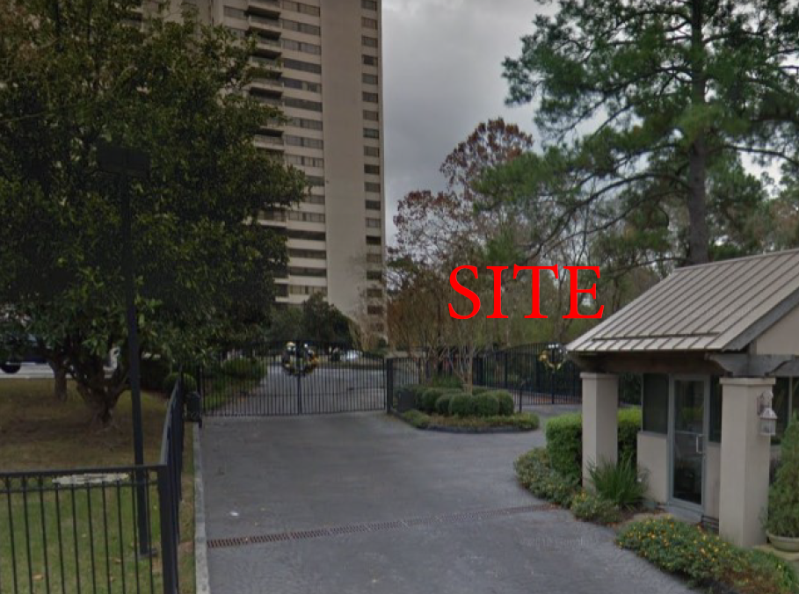
III.e. Multifamily
Campanile on Briar Hollow (District G)

Slide 39
DIRECTOR’S COMMENTS

Slide 40

Virtual Community Office Hours

Slide 41
UNDER CONSTRUCTION

Slide 42
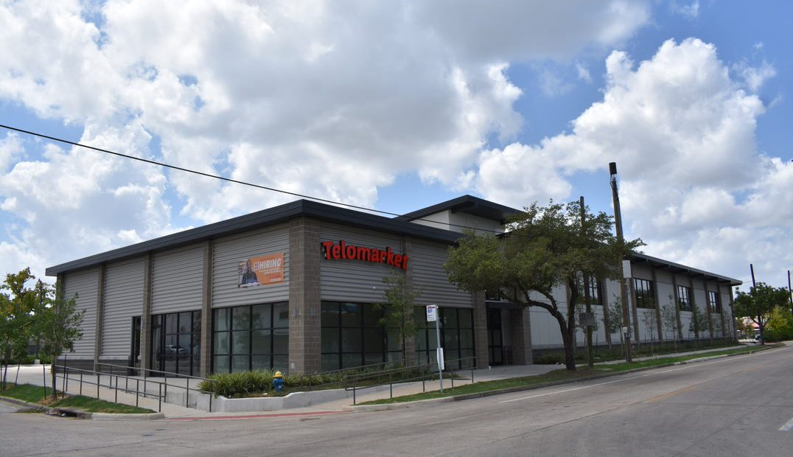
Telomarket
Telomarket is a new 15,000 sqt. ft. supermarket located at 5702 Lyons in the heart of Houston’s Fifth Ward. It is projected to open in late 2020.

Slide 43
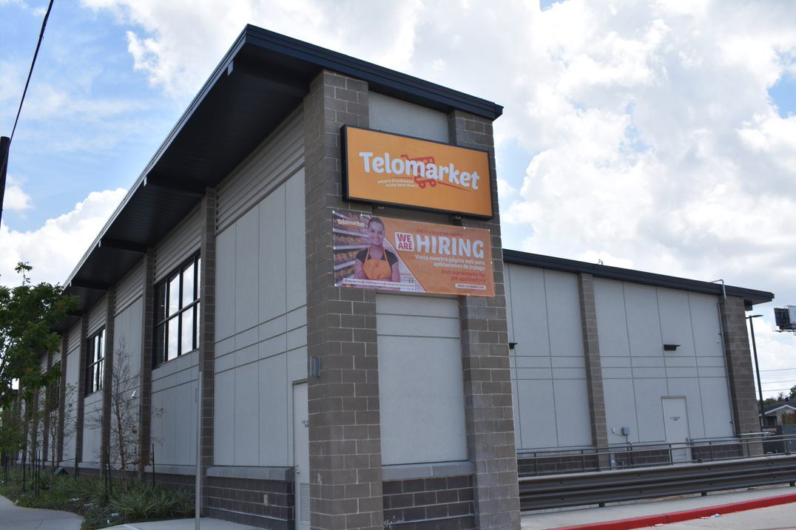
Telomarket
Telomarket will create over 71 new jobs in the community.

Slide 44
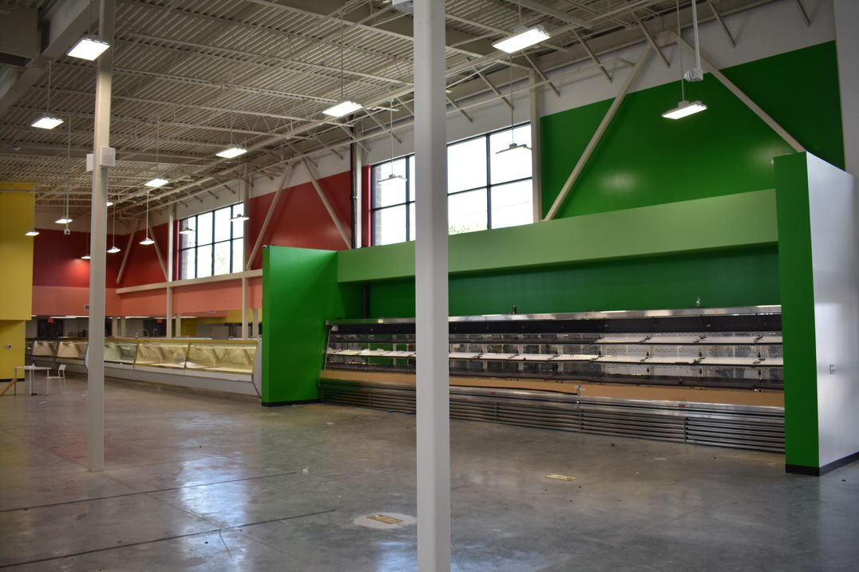
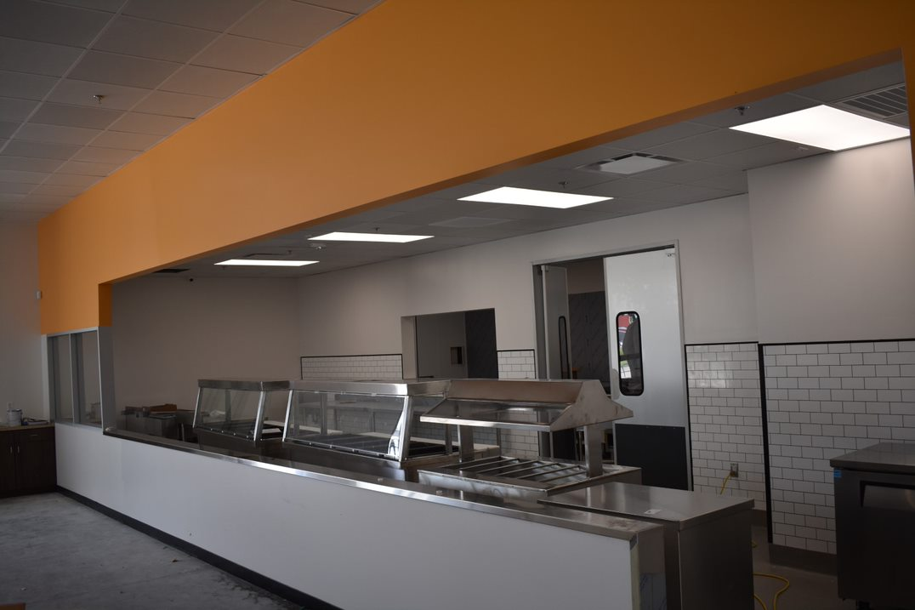
Telomarket
Shoppers will enjoy fresh food & produce; bakery; tortilla factory; meat department & a kitchen area for casual dining.

Slide 45
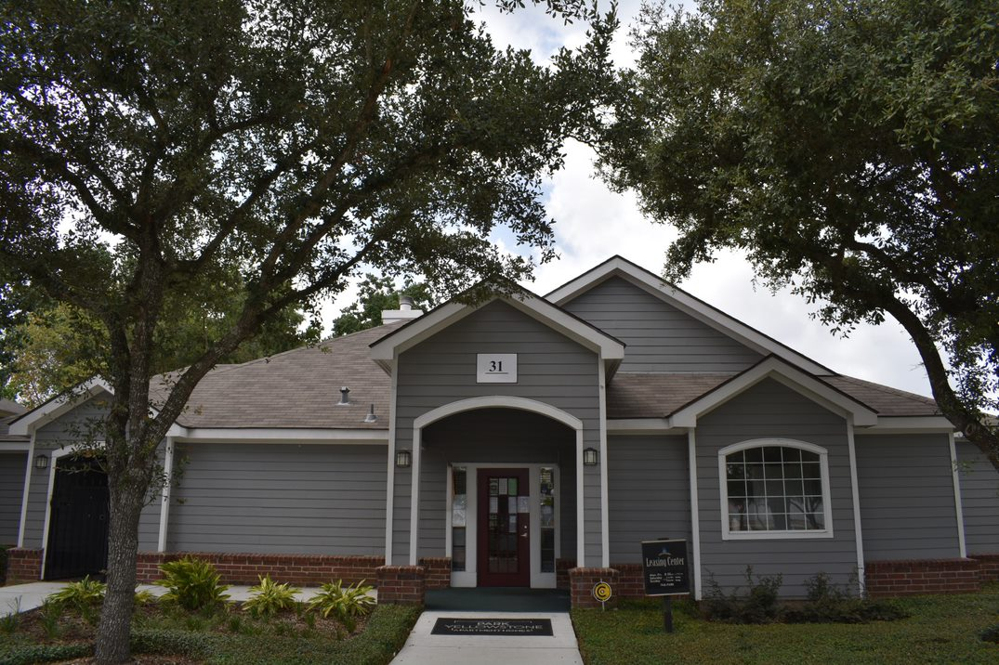
Park Yellowstone Rehab
Park Yellowstone Apartment Homes is located at 3322 Yellowstone Blvd 77021 in Southeast Houston (OST/Almeda area).

Slide 46
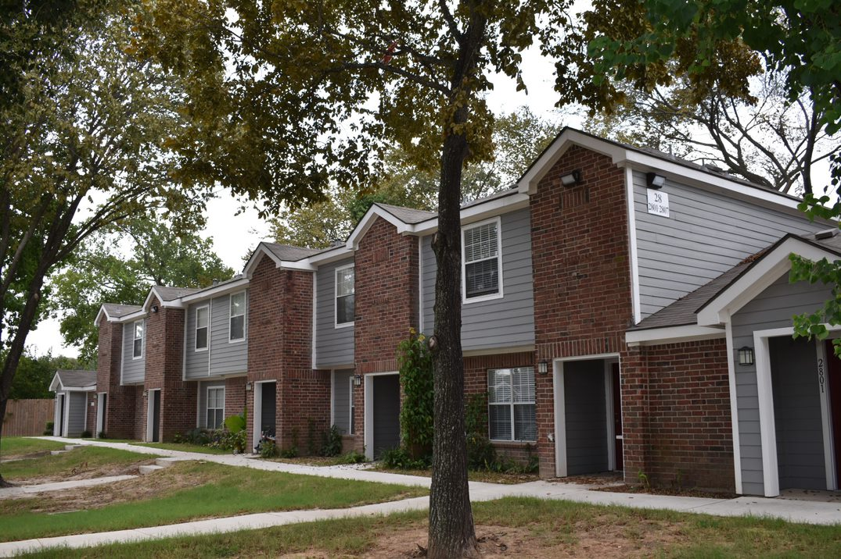
Park Yellowstone Rehab
The property consists of 210 affordable housing units (one-, two-, & three- bedrooms) serving low-to moderate- income families.

Slide 47
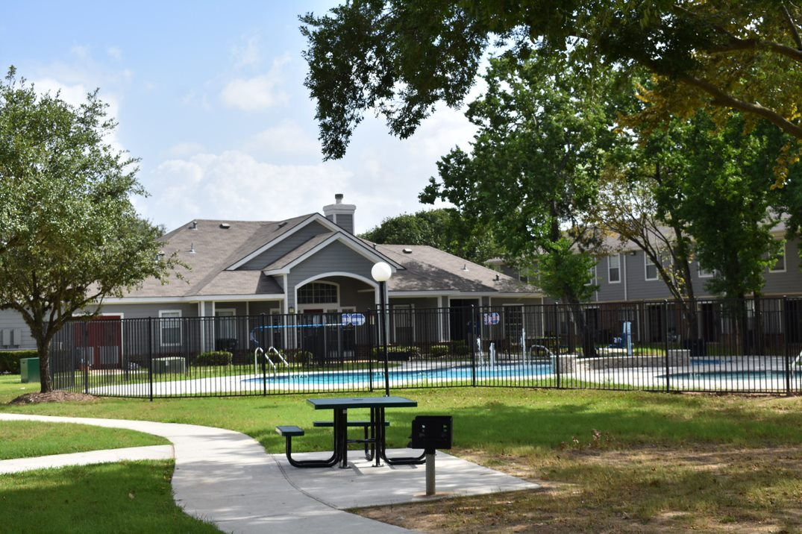
Park Yellowstone Rehab
Community amenities include: controlled access gates; swimming pool, learning center, community garden & community building.

Slide 48
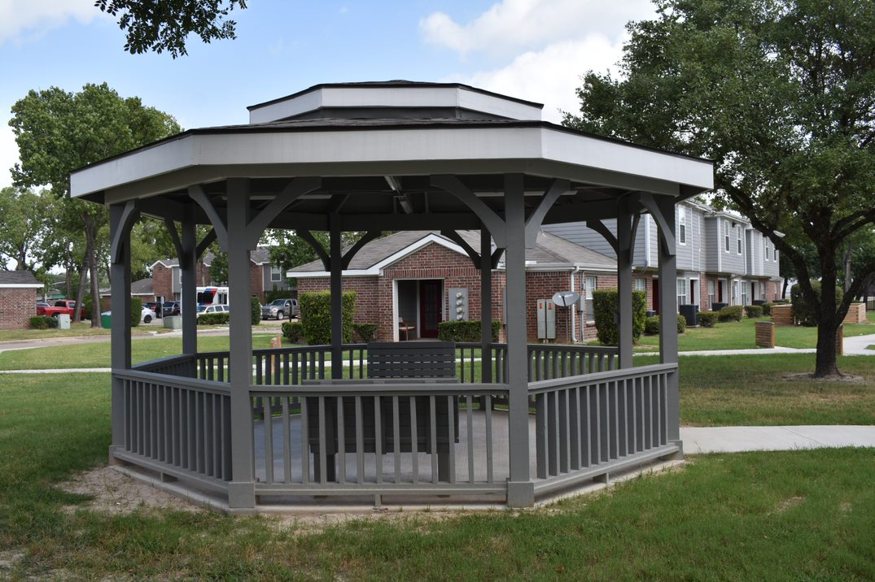
Park Yellowstone Rehab

Slide 49
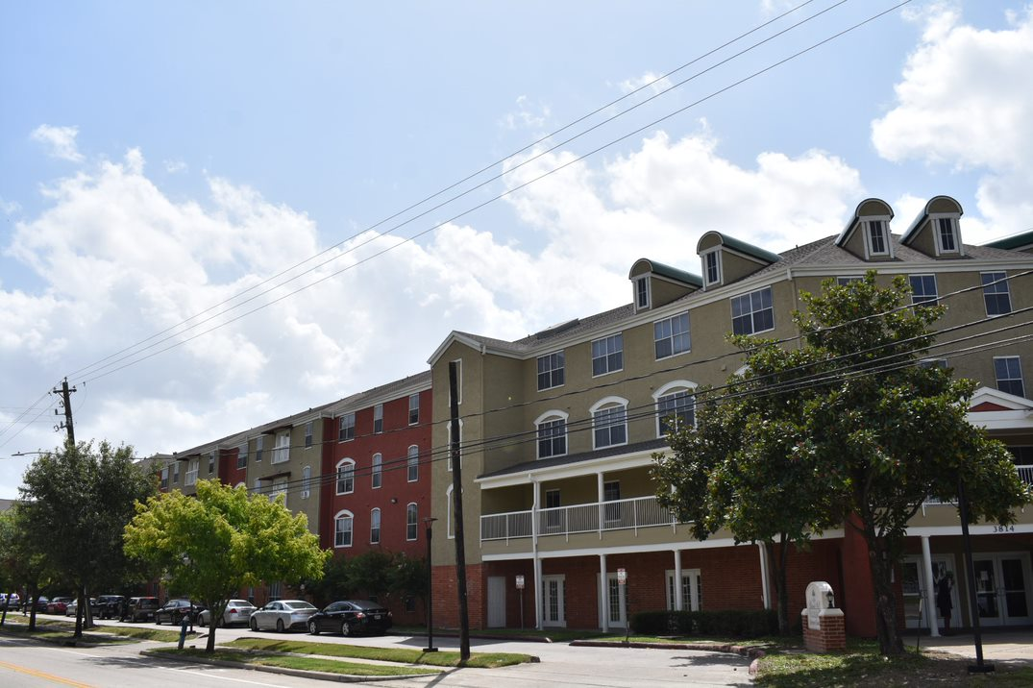
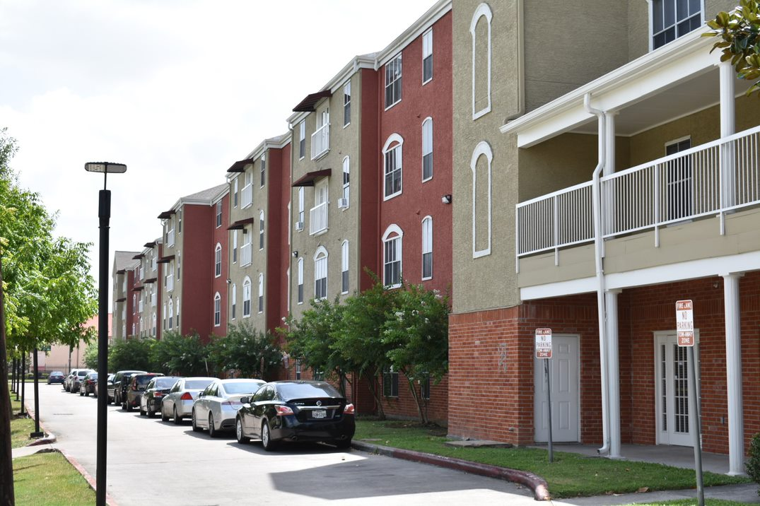
Pleasant Hill Village
Retirement Community
Pleasant Hill Village Retirement Community is a 165-unit senior living facility located at 3814 Lyons Avenue 77020 in Houston's Historic Fifth Ward. The facility was recently rehabilitated to include the following repairs: HVAC, roof replacement, interior/exterior repairs, and electrical upgrades.

Slide 50
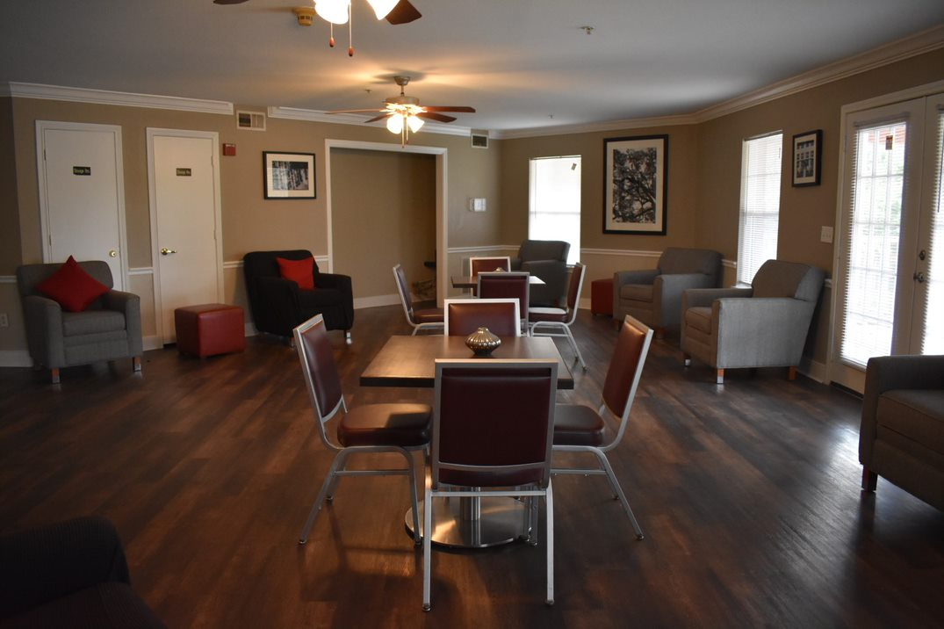
Pleasant Hill Retirement Community
Community amenities include: a health clinic within walking distance, a bus stop and 10 minutes travel to downtown Houston.

Slide 51
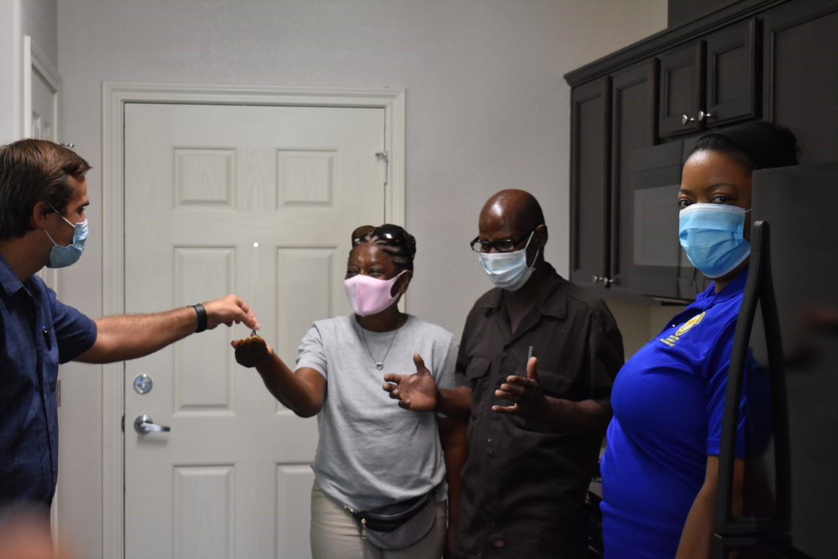
HoAP Trinity Gardens
Homeowner Robert Cerf, Jr. & family are proud residents of their new home in Houston's Trinity Gardens.

Slide 52
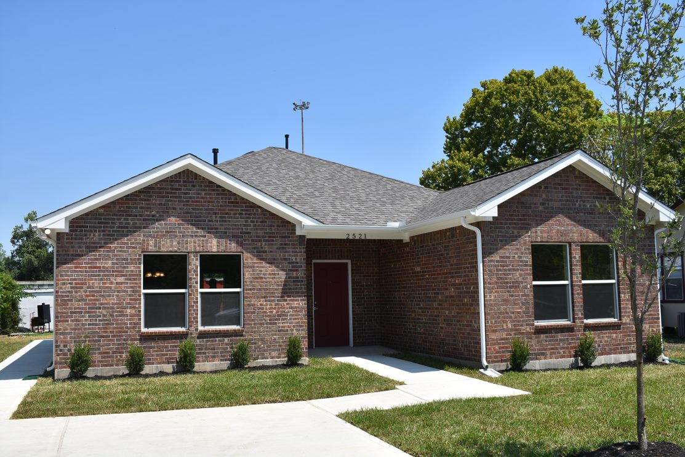
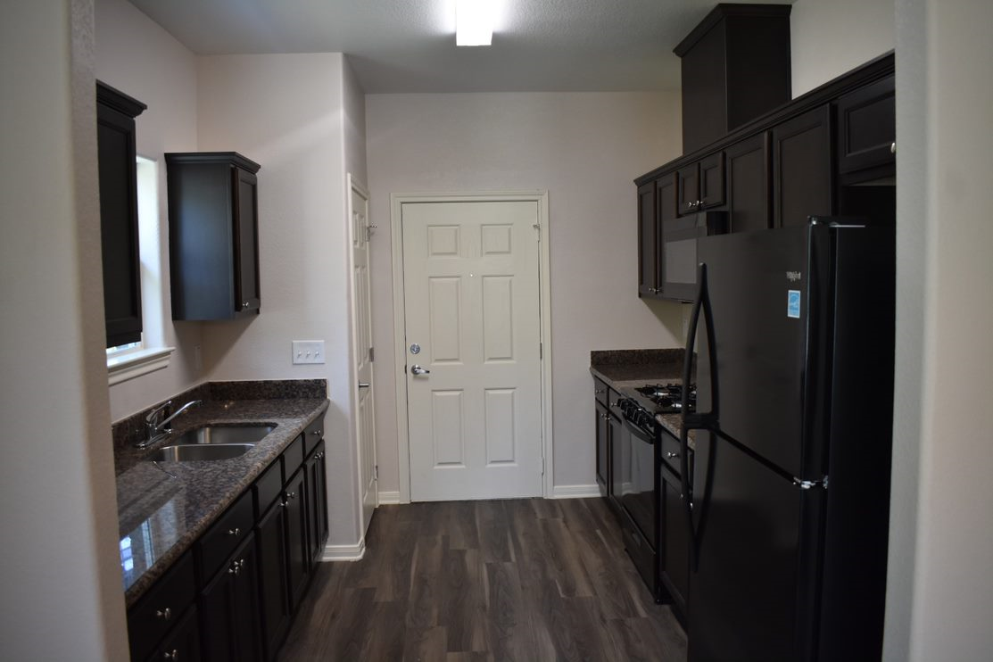
HoAP Trinity Gardens
Mr. Cerf recalls his old home: "My cabinets & sink were falling, floors buckling & rain water pouring through the ceiling…"
“My new home is beautiful. It's a blessing!”

Slide 53
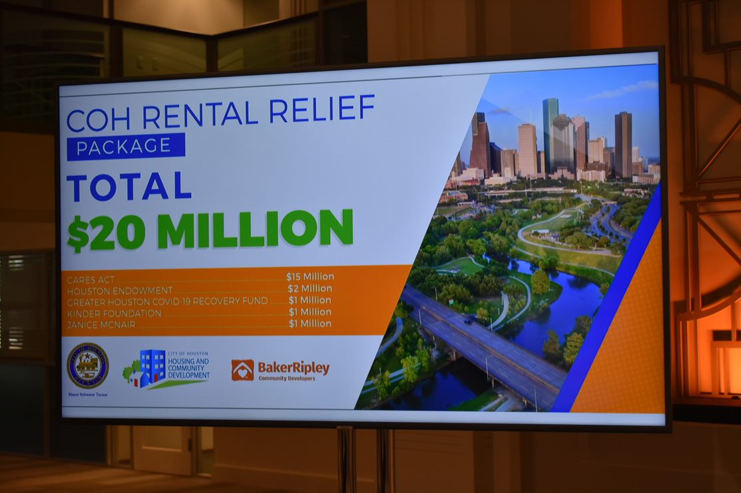
Mayor's Press Briefing
Rental Assistance Program

Slide 54
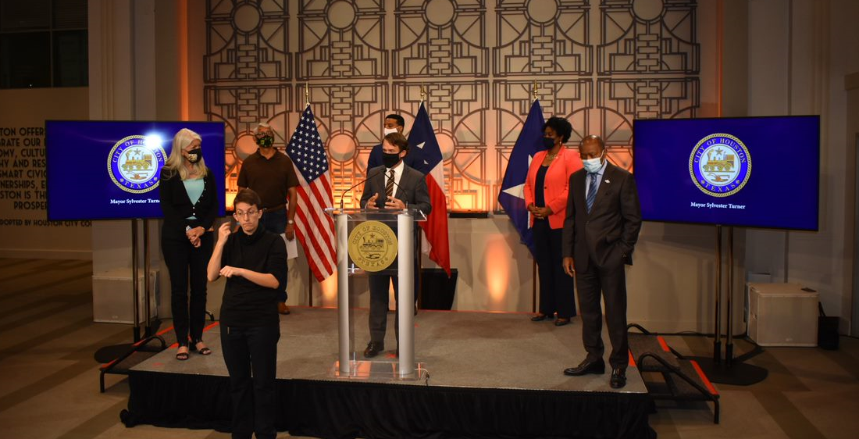
Mayor's Press Briefing
Rental Assistance Program
The BakerRipley COVID-19 Rental Assistance Program, funded by Harris County and the City of Houston, will bring financial relief to thousands of tenants impacted by the health and economic impacts from the COVID-19 pandemic.

Slide 55
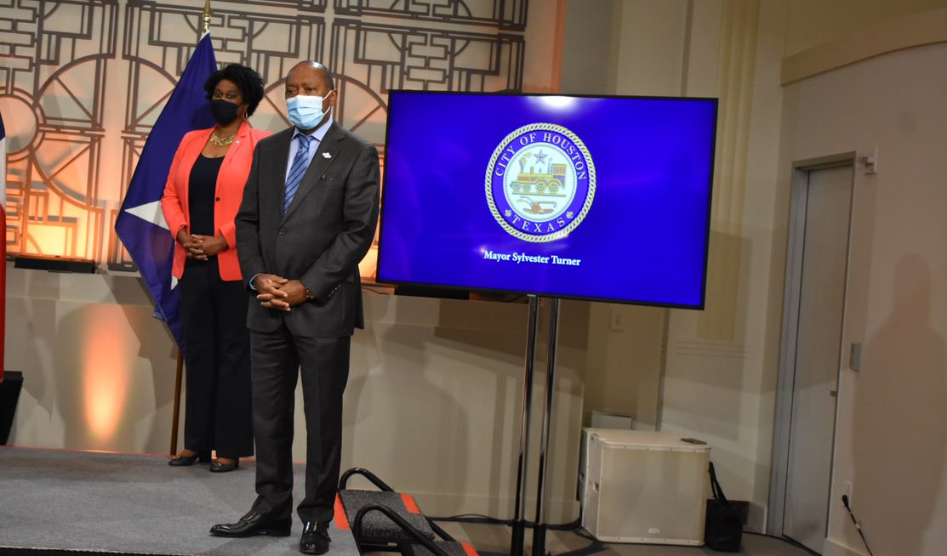
Mayor's Press Briefing
Rental Assistance Program
Harris County provided $25 million in funding and the City of Houston provided $20 million, which will be distributed to Participating Landlords on behalf of eligible tenants.

Slide 56
Homebuyer Assistance Program
Provides up to $30,000 to help Houstonians purchase a home

Slide 57
Single Family Home Repair Program
New Home Development
Repairs and reconstructs existing homes for homeowners

Slide 58
New Home Development Program
New Home Development
NHD builds new homes for sale at affordable prices

Slide 59
Other Programs (Fiscal Year to Date)
3,136
Service Visits –
Public Services (Jul ‘20)
11
Projects under construction –
Public Facilities (FY21)
Note: Public Services numbers have a one-month lag in reporting due to the nature of these programs.

Slide 60
Spending by Program Area
FY21 (to date) vs. FY20
New Home Development
Note: FY21 numbers
do not include
project delivery

Slide 61
THANK YOU!

