Slide 1
Housing & Community Affairs Committee
Agenda Items
October 15, 2019

Slide 2
HCDD Agenda
I. Call to Order/Welcome
II. Public Services, Melody Barr
III. Multifamily/Public Facilities, Ray Miller
IV. Single Family, Anderson Stoute
V. Real Estate, Rupa Sen
VI. Planning & Grants Management, Derek Sellers
VII. Disaster Recovery, Tom McCasland
VIII. Public Comments
IX. Director’s Comments, Tom McCasland

Slide 3
Item II.a. – PUBLIC SERVICES
Avenue 360
(All Districts)
A first amendment to extend a contract with Houston Area Community Services dba Avenue 360 (HACS) to November 30, 2020 and provide up to $3,672,845.00 in Housing Opportunities for Persons with AIDS (HOPWA) funding for the following:
Tenant-Based Rental Assistance (TBRA) with supportive services.
Short-Term Rent, Mortgage, and Utility Assistance (STRMUA) with supportive services.
Permanent Housing Placement Services (PHPS), and
Operation of a transitional medical respite facility (Operations).

Slide 4
Item II.a. – PUBLIC SERVICES
Avenue 360
(All Districts)
HACS will provide TBRA, STRMU, respite care, and supportive services to a minimum of 642 low-income households as follows: (1) TBRA for 297 households; (2) STRMUA for 218 households; (3) PHPS for 82 households; and (4) Operations 45. HOPWA funds represent 52% of the cost of this program.
Category | Total Contract Amount | Percent
Administrative | $229,517.92 | 6.2%
Supportive Services | $441,350.28 | 12.0%
Permanent Housing Placement | $49,920.01 | 1.4%
TBRA | $2,213,044.73 | 60.2%
STRMUA | $494,573.05 | 13.5%
Operations (Transitional Medical Respite Facility) | $244,439.03 | 6.7%
Total | $3,672,845.00 | 100%

Slide 5
Item II.b. – PUBLIC SERVICES
Catholic Charities
(District C)
A first amendment to extend a contract with Catholic Charities of the Archdiocese of Galveston-Houston and providing up to $1,231,216.98 in HOPWA funds for housing and supportive services to individuals and families living with HIV and AIDS to include:
Tenant-Based Rental Assistance (TBRA) Program with supportive services to 45 households;
Short-Term Rent, Mortgage, and Utility Assistance (STRMUA) Program with supportive services to 85 households; and
Permanent Housing Placement Services to 20 households (PHPS).

Slide 6
Item II.b. – PUBLIC SERVICES
Catholic Charities
(District C)
Catholic Charities will provide housing assistance and supportive services to approximately 150 low-income households. The agency’s AIDS Ministry is a holistic program providing case management, as well as housing and financial assistance for persons affected by HIV/AIDS.
Category | Total Contract Amount | Percent
Administrative | $86,000.00 | 7%
Supportive Services | $208,949.54 | 17%
Supportive Services – Permanent Housing Placement (Deposits) | $15,000.00 | 1%
Tenant-Based Rental Assistance Program | $464,796.32 | 38%
Short-Term Rent, Mortgage, Utility Program | $456,471.12 | 37%
Total | $1,231,216.98 | 100 %

Slide 7
Item II.c. – PUBLIC SERVICES
Houston SRO Corporation
(District D)
A first contract amendment between the City of Houston and Houston SRO Housing Corporation, providing $212,797.90 of federal HOPWA funds for a community residence with supportive services for a minimum of 34 very-low income households affected by HIV/AIDS.
Supportive services include comprehensive case management and referrals for general health services, job training and placement, mental health and substance abuse counseling.
Operating costs include, but are not limited to property management, utilities, and property insurance.

Slide 8
Item II.c. – PUBLIC SERVICES
Houston SRO Corporation
(District D)
HCDD conducted a Request for Proposal (RFP) for Public Services contracts for fiscal year 2019 with a one-year renewal option for fiscal year 2020. Houston SRO was one of the agencies selected. This first contract amendment will provide funding through November 30, 2020.
Category | Total Contract Amount | Percent
Administrative | $12,880.00 | 6%
Supportive Services | $53,068.24 | 25%
Operating Costs | $146,849.66 | 69%
Total | $212,797.90 | 100%

Slide 9
Item II.d. – PUBLIC SERVICES
SEARCH Homeless Services Program
(All Districts)
A first contract amendment with SEARCH Homeless Services, Inc., for up to $750,000.00 in Homeless Housing Services Program (HHSP) and Tax Increment Reinvestment Zones (TIRZ) funds to serve 1,675 homeless Houstonians.
The Mobile Outreach team provides interventions, assessments and referrals to services for homeless persons living on the streets.
The Welcome Center is a day shelter and point of entry for services facilitating employment, housing and self-sufficiency.
The Housing Case Management program provides housing and supportive services on a long-term basis to formerly homeless clients.

Slide 10
Item II.d. – PUBLIC SERVICES
SEARCH Homeless Services Program
(All Districts)
HCDD conducted a Request for Proposals (RFP) for Public Services contracts for fiscal year 2019 with a one-year renewal option for fiscal year 2020. SEARCH was one of the agencies selected and has received funding through the City of Houston since 1996.
Category | Total Contract Services | Percent
Administrative | $13,253.00 | 1.8%
Program Services | $736,747.00 | 98.2%
Total | $750,000.00 | 100%

Slide 11
Item II.e. – PUBLIC SERVICES
Houston Housing Authority
(All Districts)
A Second Contract Amendment with the Houston Housing Authority, providing a 12-month extension and up to $2,863,000.00 in HOME Tenant Based Rental Assistance (TBRA) funds, Homeless Housing and Service Program (HHSP) and Tax Increment Reinvestment Zones (TIRZ) funds through the Financial Assistance Intermediary (FAI).
This funding will help up to 200 homeless Houstonians move into permanent housing through the following services:
Management of the Houston/Harris County Continuum of Care Rapid Rehousing Collaborative financial assistance funds, and
Operation of direct rental and utility assistance to a minimum of 200 chronic or near chronic homeless clients.

Slide 12
Item II.e. – PUBLIC SERVICES
Houston Housing Authority
(All Districts)
The City is providing less than 59% of the budget for this program with the remaining 41% from other federal funding sources. This second contract amendment provides funding through December 31, 2020.
Support services, including case management, will be provided to everyone served through The Way Home program.
Category | Total Contract Amount | Percent
Administrative | $0.00 | 0%
HHSP | $218,000.00 | 7.61%
TIRZ | $245,000.00 | 8.56%
HOME TBRA | $2,400,000.00 | 83.83%
Total | $2,863,000.00 | 100.00%

Slide 13
Item II.f. – PUBLIC SERVICES
SEARCH House of Tiny Treasures
(District I)
A first contract amendment with SEARCH Homeless Services for up to $132,579.00 for SEARCH’s Foshee Family House of Tiny Treasures, an early development childcare facility for families living with HIV.
This program will provide developmentally appropriate child care services to a minimum of 16 homeless and formerly homeless households living with HIV.
Supportive services include case management, transportation, counseling for the caregiver, child therapy as needed, and referral services in support of basic and emotional needs.

Slide 14
Item II.f. – PUBLIC SERVICES
SEARCH House of Tiny Treasures
(District I)
The first contract amendment will provide funding for a 12-month period through November 30, 2020.
The City provides 42% of the budget for this program, while the remaining 58% is provided by other sources.
SEARCH has received funding through the City of Houston for various contracts since 1996.
Category | Total Contract Services | Percent
Administrative | $9,274.00 | 7.00%
Supportive Services | $123,305.00 | 93.00%
Total | $132,579.00 | 100%

Slide 15
Item III.a. – PUBLIC FACILITIES
Edison Arts Foundation
(District K)
Approval of a contract with the Edison Arts Foundation, providing $2,610,000.00 in CDBG entitlement funds for the acquisition of 7100 W. Fuqua, site of the proposed Edison Performing Arts Center (EPAC).
The financing for the project will be divided into two tranches:
Tranche I of this project ($2.6 million) will fund the acquisition of the property, support tenant relocation, finance soft-costs, and partial demolition of the property.
Tranche II of the project ($3.5 million) will finance the redevelopment of the property to be submitted to council at a later date.

Slide 16
Item III.a. – PUBLIC FACILITIES
Edison Arts Foundation
(District K)
In the event the requirements outlined in the grant agreement are not met, HCDD will finance the demolition of the building to benefit the community by fulfilling the national objective of reducing slum and blight on a spot basis.
Sources | Amount | Uses | Amount
COH/HCDD (CDBG-Entitlement) | $2,610,000.00 | Land | $1,500,000.00
 |  | Soft Costs | $167,327.00
 |  | Tenant Relocation | $100,000.00
 |  | Demolition | $836,267.00
Total | $2,610,000.00 | Total | $2,603,594.00

Slide 17
Item III.b. – PUBLIC FACILITIES
Harvey Buyout Program Guidelines
(All Districts)
Approval of an ordinance adopting guidelines for the Harvey Buyout Program, funded with $40,800,000.00 in CDBG-DR 2017 funds from the GLO.
Proposed sites will be selected internally by HCDD and Houston Public Works (HPW) based on the following preferences:
Properties affected by Hurricane Harvey
Properties located in a Floodway and/or Floodplain
Properties with repetitive flood loss from 2015-2017
Properties located adjacent to an HPW flood mitigation project

Slide 18
Item III.b. – PUBLIC FACILITIES
Harvey Buyout Program Guidelines
(All Districts)
Eligible Harvey Buyout Program activities and costs include the following:
Acquisition of existing properties, land and soft costs directly related to acquisition.
Relocation of owner-occupants and/or tenants from vulnerable areas.
Clearance and demolition of structures.
This program activity is pending approval from the GLO.

Slide 19
Item IV. – SINGLE FAMILY
Downpayment Assistance Program
(All Districts)
Approval of an allocation of $750,000.00 in TIRZ funds for down payment and closing cost assistance through the Homebuyer Assistance Program (HAP), to increase homeownership opportunities for low-to-moderate income homebuyers with Hurricane Harvey recovery funding.
This request is being made to resolve a funding discrepancy between the City and the Texas General Land Office (GLO) regarding technicalities of applicant eligibility.
HCDD will make every effort to secure full reimbursement for all households served through Harvey funding from the GLO.

Slide 20
Item V. – REAL ESTATE (Single Family)
1100 Frawley
(District H)
HCDD is interested in acquiring 5,000 square feet of land located at 1100 Frawley Street through a Memorandum of Understanding with HPW.
The intended use is to create owner occupied Single Family affordable housing under the New Home Development Program and supplement an additional tract in the area to be acquired by HCDD.
In addition, since Near Northside already owns units in the area owned by City/HCDD, this site will enhance the density of single family homes in the area.

Slide 21
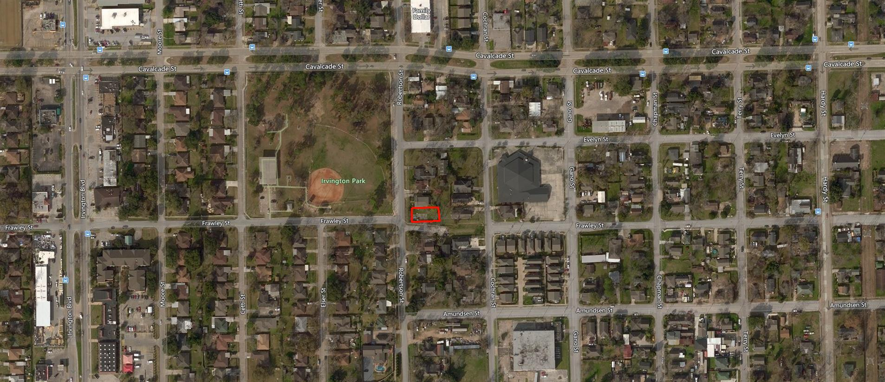
Item V. – REAL ESTATE (Single Family)
1100 Frawley
(District H)
The property is located east of Airline Drive, south of the 610 North Loop, west of the Hardy Toll Road and north of Quitman Street.

Slide 22
Item VI. – REAL ESTATE (Single Family)
1100 Frawley
(District H)
Sources | Amount | Uses
Multi Family TIRZ 2019 Fund | $120,000.00 | Acquisition of Land
Multi Family TIRZ 2019 Fund | $ 30,000.00 | Closing related costs and Post-closing maintenance
TOTAL Estimated Acquisition Cost: | $150,000.00
The purchase price is $120,000.00, per the appraised value.
Additional costs will be incurred related to due diligence, post maintenance and closing costs in the amount of $30,000.00.
HCDD proposes to fund the full development cost.

Slide 23
Item VI. – PLANNING & GRANTS MANAGEMENT
Substantial Amendment
(All Districts)
HCDD recommends Council approval of three (3) Substantial Amendments. Per HUD’s Citizen Participation Plan regulations, the City is required to amend components of its Consolidated Plan/Annual Action Plan when:
A reallocation of funds increases or decreases the budget by more than 25%
A new activity is added or deleted, and
The scope of an activity changes.

Slide 24
Item VI. – PLANNING & GRANTS MANAGEMENT
Substantial Amendment
(All Districts)
1. HCDD is proposing to reallocate $2,400,000.00 in HOME Investment Partnerships Program funds from Multifamily Development activities to Tenant Based Rental Assistance activities.
HOME Investment Partnership Program Grant
Activity | Delete/Decrease | Add/Increase
The Program Year 2017 Budget is Amended as follows:
Multifamily | $2,400,000.00
Tenant Based Rental Assistance |  | $2,400,000.00
Total HOME Budget Changes: | $2,400,000.00 | $2,400,000.00

Slide 25
Item VI. – PLANNING & GRANTS MANAGEMENT
Substantial Amendment
(All Districts)
2. HCDD is proposing to transfer $1,390,000.00 in Community Development Block Grant (CDBG) Program Year 2019 Funds from Public Facilities activities to Economic Development activities.
Community Development Block Grant
Activity | Delete/Decrease | Add/Increase
The Program Year 2019 Budget is Amended as follows:
Public Facilities | $1,390,000.00
Economic Development |  | $1,390,000.00
Total CDBG Budget Changes: | $1,390,000.00 | $1,390,000.00

Slide 26
Item VI. – PLANNING & GRANTS MANAGEMENT
Substantial Amendment
(All Districts)
3. HCDD is proposing to create a new activity of Clearance in PY 2019 for acquisition, demolition and clearance. In addition, we will reallocate $2,610,000.00 in funding from Public Facilities activities to Clearance.
Community Development Block Grant
Activity | Delete/Decrease | Add/Increase
The Program Year 2019 Budget is Amended as follows:
Public Facilities | $2,610,000.00
Clearance |  | $2,610,000.00
Total CDBG Budget Changes: | $2,610,000.00 | $2,610,000.00

Slide 27
Item VII. – DISASTER RECOVERY
HoAP Lien Modification
(All Districts)
HCDD recommends Council approval to modify the lien requirements for assistance provided through the Harvey Homeowner Assistance Program (HoAP). Assistance will be provided in the form of either a grant or a zero-interest forgivable loan as follows:
Assistance amounts of $20,000.00 or less will be considered a grant.
Assistance amounts from $20,001.00 to $80,000.00 will have a three (3) year unsecured compliance period.
Assistance amounts of $80,001.00 and up will have a 20 year compliance period secured by a lien.

Slide 28

Questions

Slide 29
PROGRAM REPORTING and DIRECTOR’S COMMENTS

Slide 30
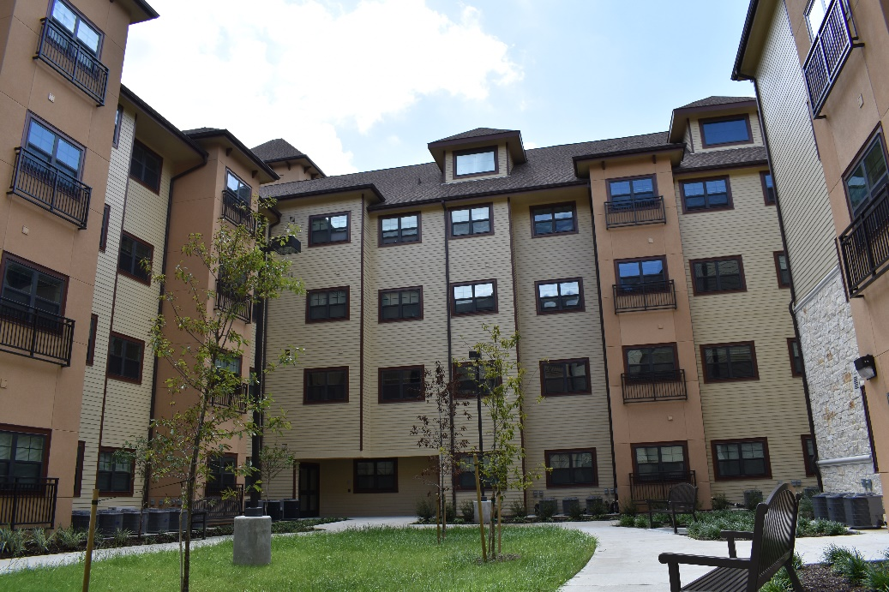
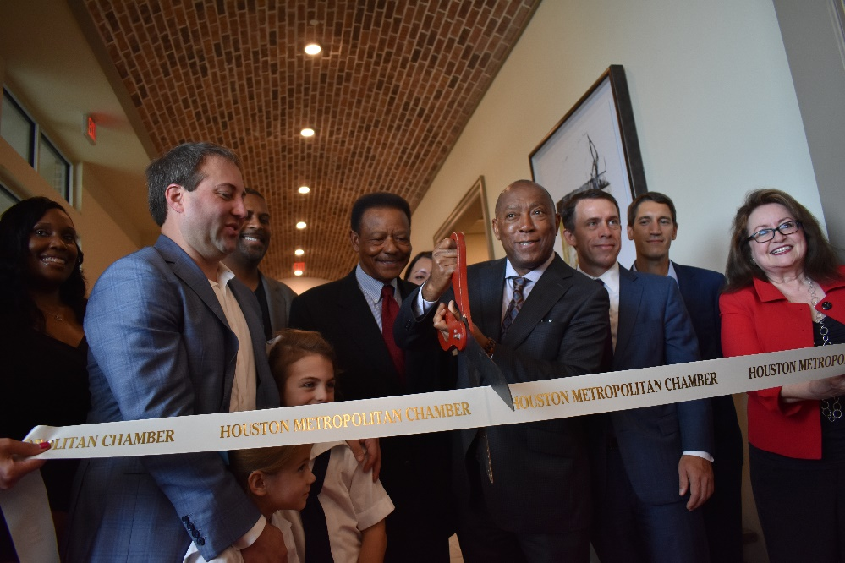
Hardy Yards Apartment Homes
Grand Opening
Friday, September 27, 2019
179 Affordable Units
171 Market Rate Units
350 Total Units

Slide 31
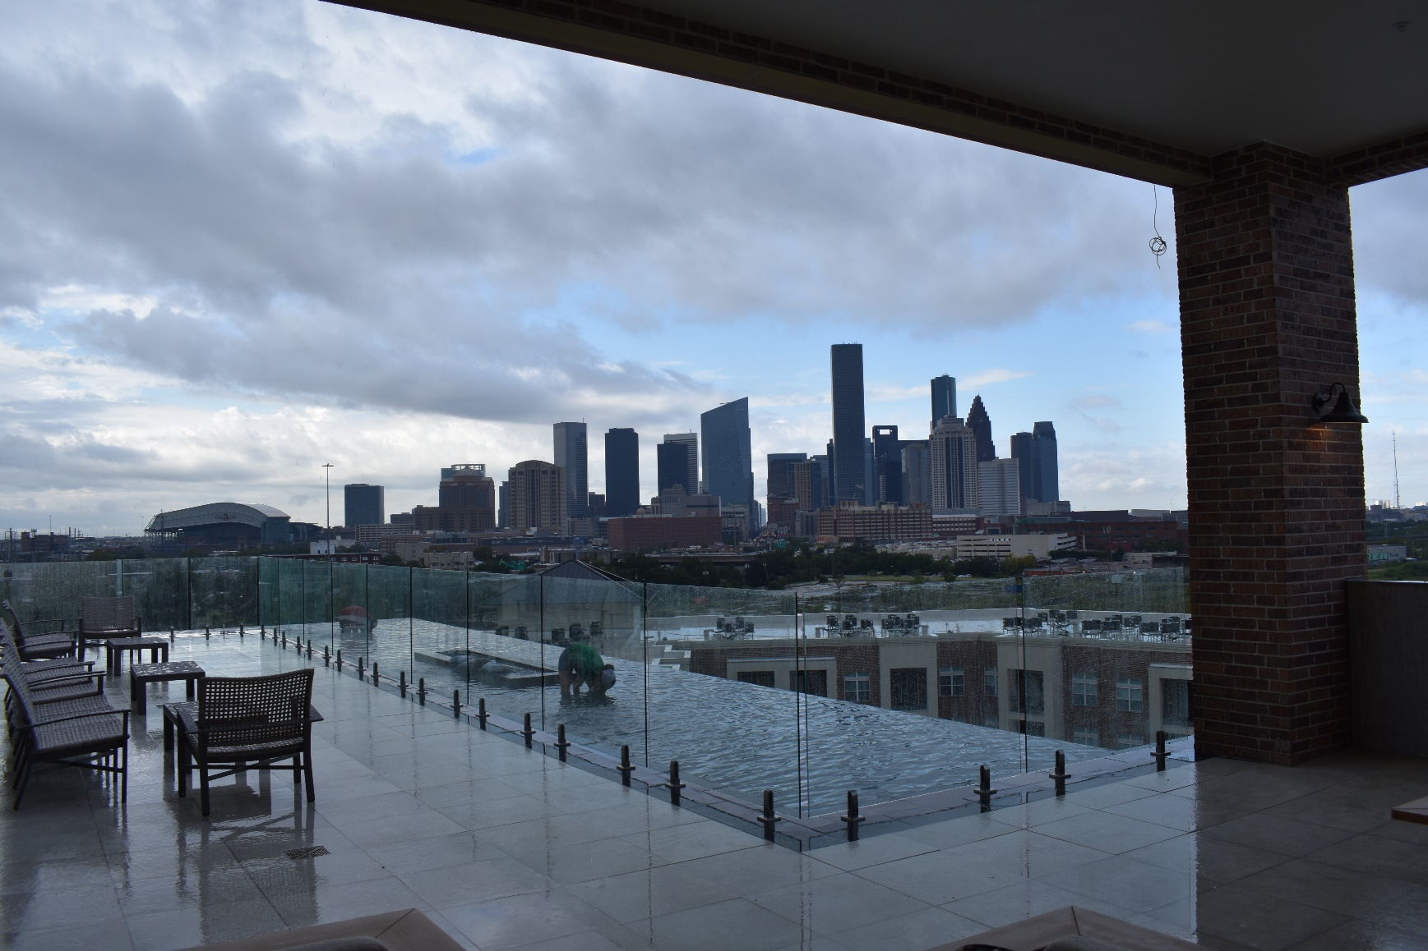
Hardy Yards Apartment Homes

Slide 32
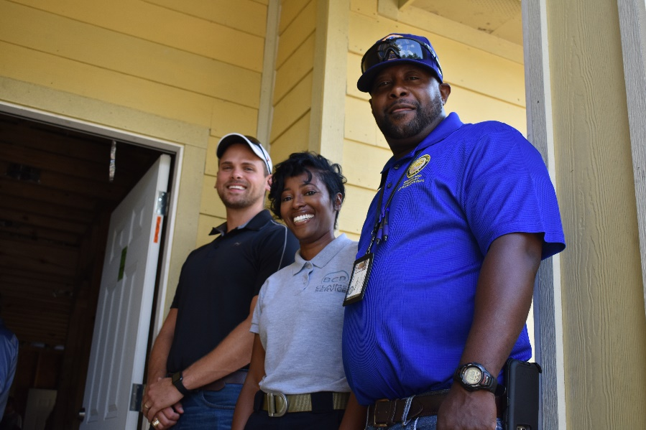
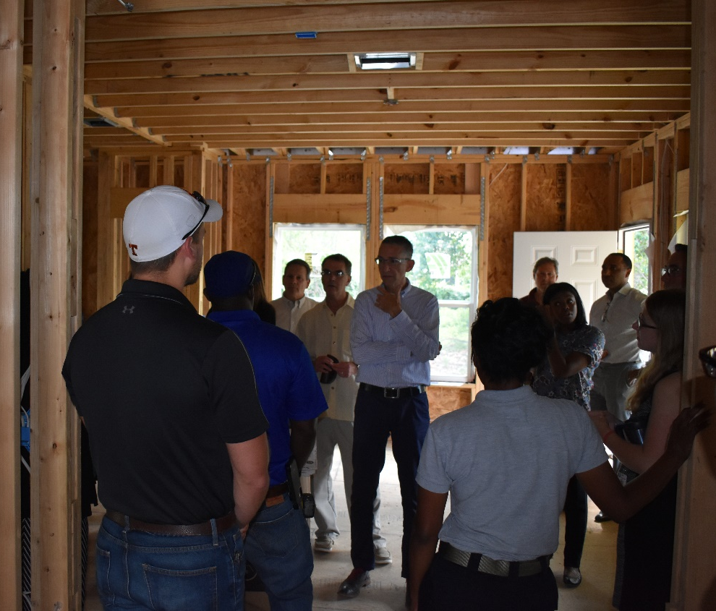
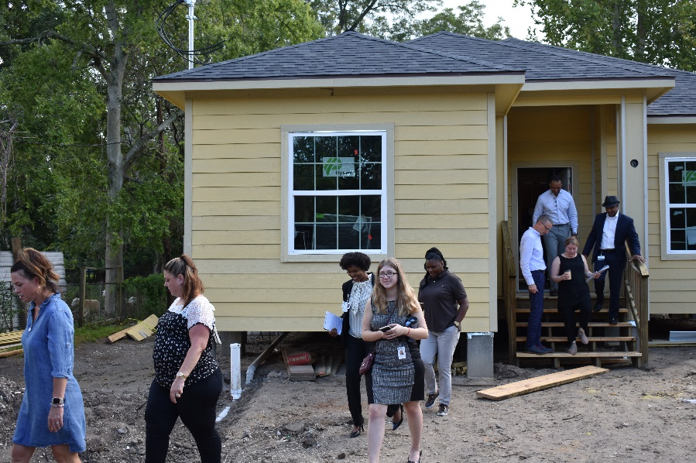
HUD Tour of HCDD Projects
Single Family Home Repair Program

Slide 33
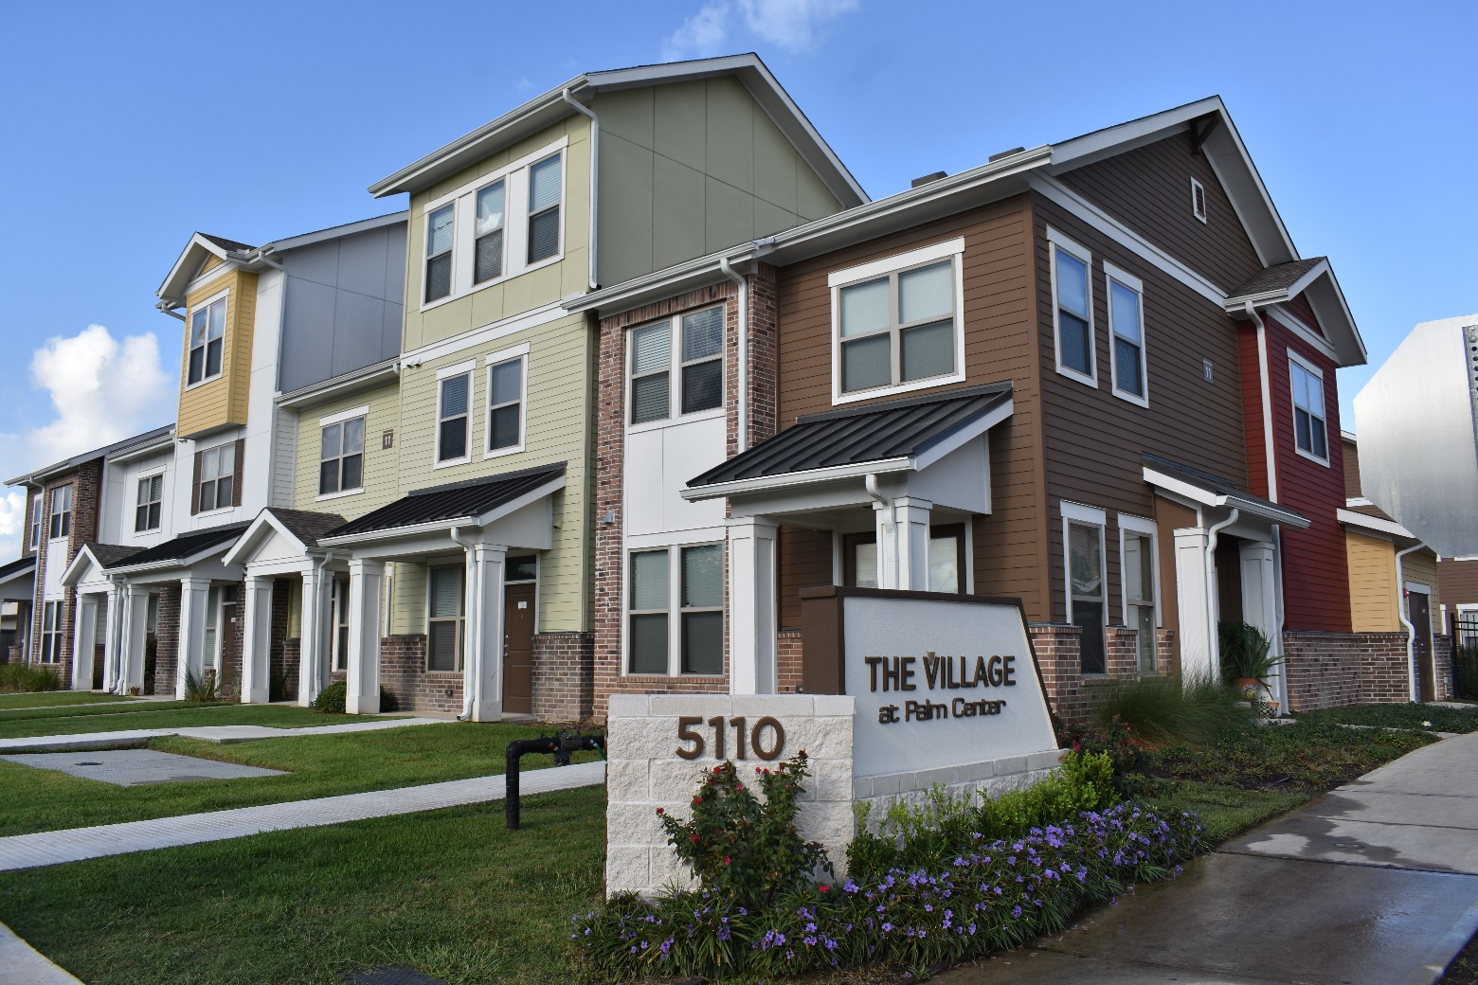
HUD Tour of HCDD Projects
The Village at Palm Center
September 11, 2019

Slide 34
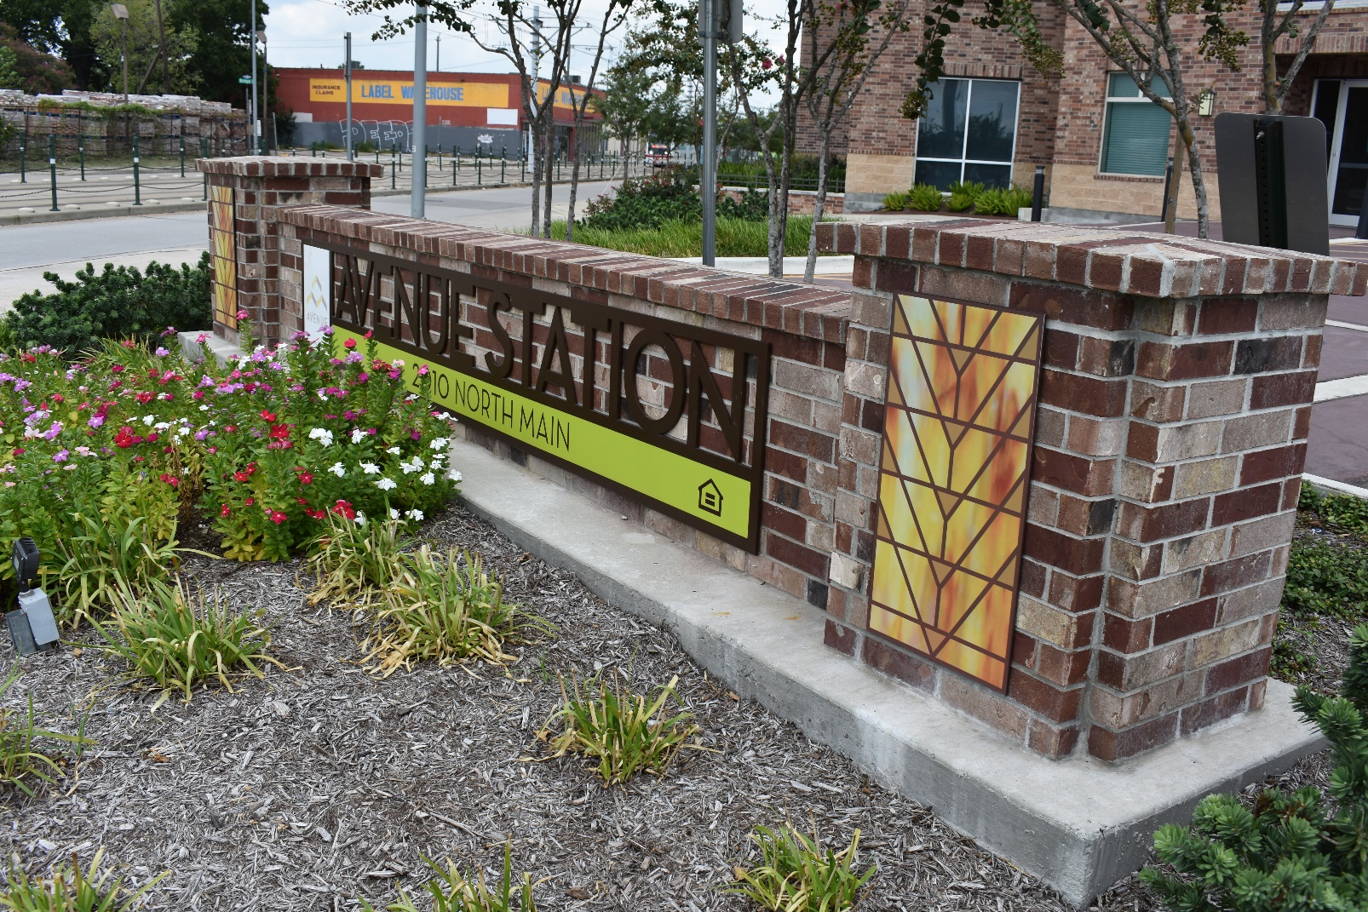
HUD Tour
Avenue Station Apartments
September 11, 2019

Slide 35

Community Office Hours
Wednesdays from 1:00 p.m. – 4:00 p.m.
2100 Travis (9th Floor), Houston, TX 77002

Slide 36
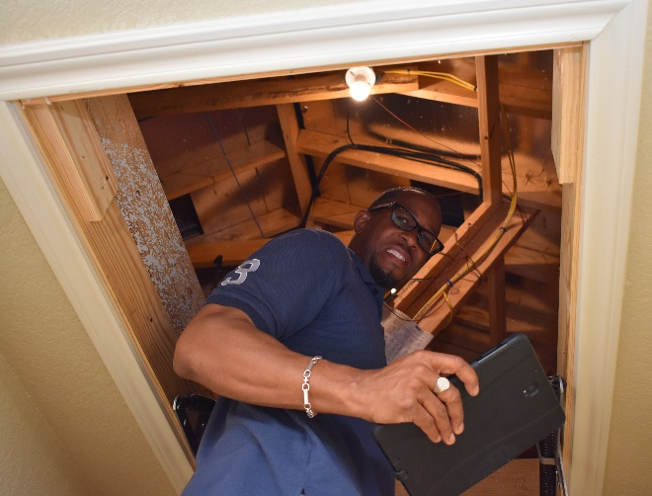
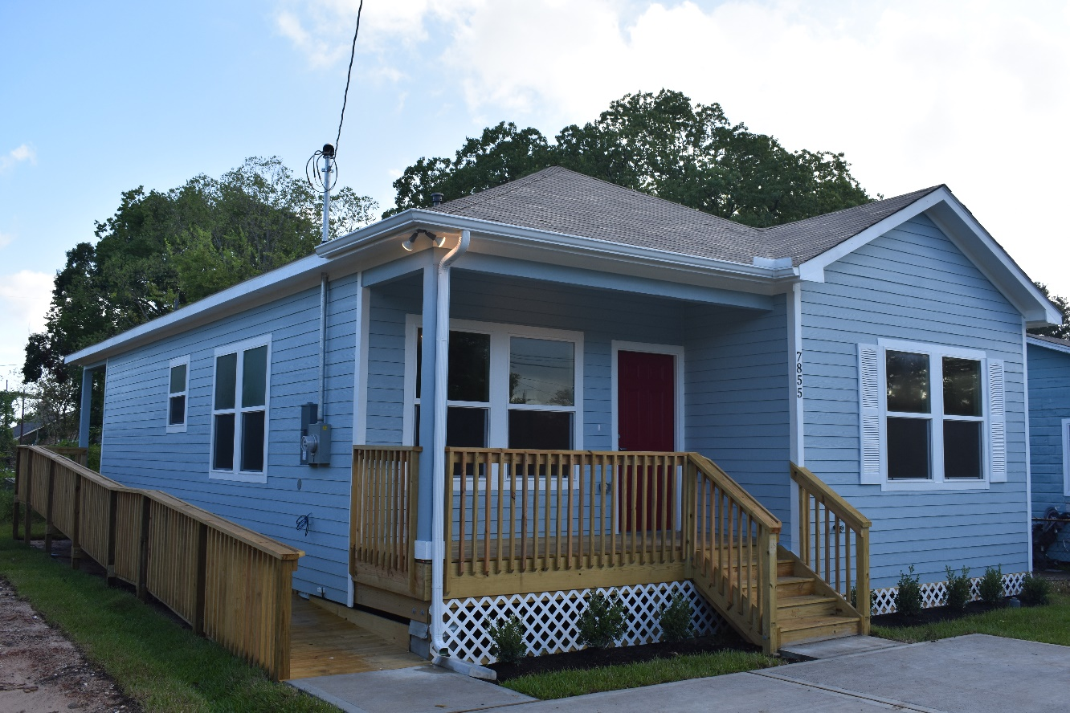
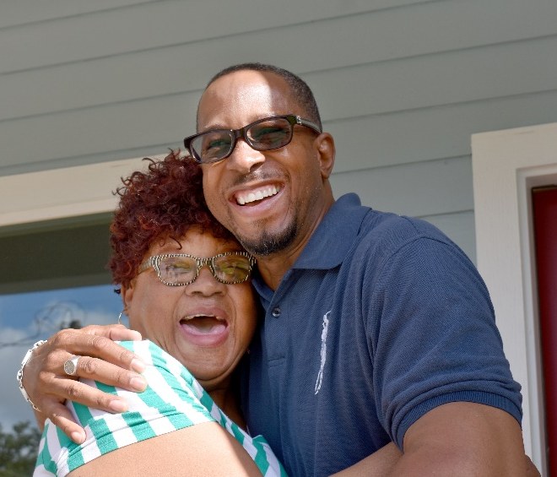
Home Repair Program
Key Exchange Wednesday, September 25, 2019.
7858 Hanna in Settegast (NE Houston).

Slide 37
DR17 Harvey Homeowner Assistance Program (HoAP)
Assists homeowners whose homes were damaged during Hurricane Harvey
42 homeowners served FY20
+31 since last month

Slide 38
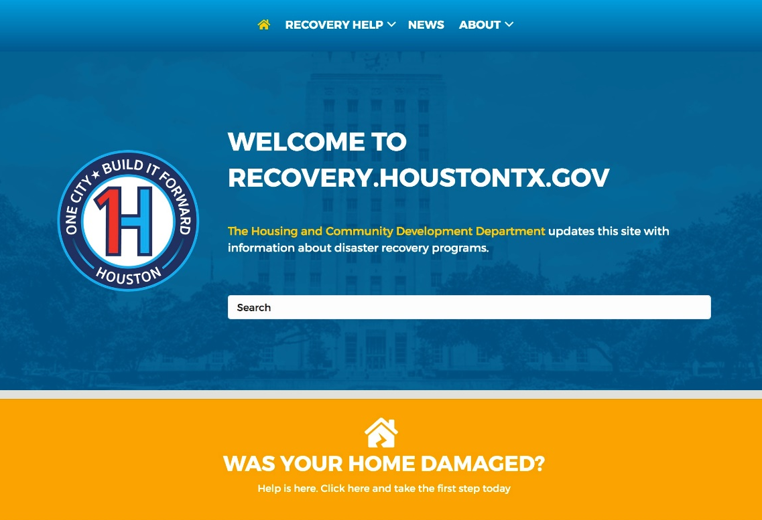
Recovery.HoustonTX.gov
PLACE YOUR IMAGE HERE

Slide 39
Homebuyer Assistance Program
Provides up to $30,000 to help Houstonians purchase a home
163 homebuyers served FY19
11 served in Sep ‘19

Slide 40
Single Family Home Repair Program
New Home Development
Repairs and reconstructs existing homes for homeowners

Slide 41
New Home Development Program
New Home Development
NHD builds new homes for sale at affordable prices

Slide 42
Other Programs
3,644
Service Visits –
Public Services (Aug ‘19)
25
Projects under construction –
Public Facilities (Sep ‘19)
Note: Public Services numbers have a one month lag in reporting due to the nature of these programs.

Slide 43
Financial Reporting by Program Area FY19 v FY20 (Sep)
New Home Development

Slide 44
Single Family: Homes Sold
Homes built by HCDD’s Single Family Division are sold through the Houston Land Bank. Some homes are sold on the open market and some are sold into the Houston Community Land Trust.
Open market sales with NHDP assistance
Houston Community
Land Trust (HCLT)
$180,000 target sale price
$39,900 NHDP Assistance
Serves buyers 80% AMI and below
5 year affordability period
$75,000+ target sale price
Land is held in trust with a 99-year lease
Serves buyers 80% AMI and below
Must be sold at a set affordable price to the next buyer
2 homes sold (open market) FY20
0 homes currently under contract
5 homes entered the CLT FY20
+3 homes currently under contract

Slide 45

Comments

