Slide 1

Housing & Community Affairs Committee
March 19, 2019
Sylvester Turner, Mayor
Tom McCasland, Director

Slide 2
Item II.: Mayor’s Office of Veteran’s Affairs (All Districts)
Director - Dr. Steven L. Hall, (USAF Ret)
Overview of Current Initiatives

Slide 3
Item III.: HCD19-28 Authorizing Submission of the 2019 Annual Action Plan (All Districts)
Submission of 2019 Annual Action Plan to HUD, including an application for all entitlement grants (CDBG, HOME, HOPWA and ESG)
The execution of the agreements between the City of Houston and HUD for the entitlement grants by the Mayor or his designee
An estimated $45,464,359.00 in federal funds and $4,280,187.00 in program income will benefit income-eligible residents from July 1, 2019 to June 30, 2020.
Notes:
Project is winding down and nearing completion.

Slide 4


Slide 5
Allocates federal entitlement funds to activities for the year
Annual Action Plan
Will allocate federal entitlement funds for Program Year 2019
(July 1, 2019 – June 30, 2020)
2019 Action Plan
Notes:
The 2019 Annual Action Plan will be the fifth and final Annual Action Plan of the 2015-2019 Consolidated Plan.
The Annual Action Plan is the annual update to the Consolidated Plan.
In the Annual Action Plan HCDD lists the budgets, activities, and annual numeric goals that we expect to accomplish during the year.
This is not only a blueprint of the year’s activities for the public, but it also serves as the grant application to HUD for the entitlement grants.

Slide 6
Housing and Community Development Department
Funding Priorities for HUD Grants
HCDD receives Entitlement Grants and Special Grants
Affordable Homes
Supportive Services
Infrastructure/ Neighborhood Services
Community Economic Development
Notes:
HCDD serves primarily low- and moderate-income residents with federal funds from the U.S. Department of Housing and Urban Development (HUD).
HCDD’s funding priorities consist of
Affordable Homes
Supportive Services
Infrastructure/Neighborhood Services
Economic Development
HCDD funds developers to build and sustain affordable homes and also funds organizations to provide services for low- and moderate-income persons.
HCDD does not own housing and usually does not provide direct services to citizens through our offices. The exceptions are the Homebuyer Assistance Program and some home repair activities.
HCDD also receives special grants, like Disaster Recovery funding.

Slide 7
Entitlement Grants
CDBG
Community Development Block Grant
HOME
HOME Investment Partnerships Grant
HOPWA
Housing Opportunities for Persons with AIDS
ESG
Emergency Solutions Grant
Finances affordable homes, public services, public facilities, and economic development
Promotes public/private partnerships to expand affordable housing stock for renters and owners
Funds affordable homes and social services for persons with HIV/AIDS and their families
Funds shelter and services for homeless persons and those at risk of becoming homeless
Notes:
HCDD receives four federal entitlement grants each year from HUD.
These grants, also known as formula grants, each have a specified formula determined by the federal government, which controls how much funding each community will receive every year. The formula takes into account various local demographics of each community. For instance, the number of low- and moderate-income households is considered in the CDBG formula.
Community Development Block Grants, or CDBG, is the largest and most flexible entitlement grant we receive. CDBG can be used for various activities to support low- and moderate-income residents and residents with special needs. Activities can include housing, public services, public facilities, and economic development activities.
Next, the HOME Investment Partnerships Program, or HOME, is a grant that is intended to expand the stock of affordable homes for renters and homeowners.
Housing Opportunities for Persons with HIV/AIDS, or HOPWA, funds affordable homes and services that support persons with HIV/AIDS and their families.
Emergency Solutions Grant, or ESG, supports housing and sheltering for individuals who experience homelessness or are at risk of becoming homeless

Slide 8
Estimated 2019 Annual Entitlement Allocations
Total: $45,464,359
CDBG $23,946,316
HOME $9,937,146
HOPWA $9,738,444
ESG $1,968,996

Slide 9
Estimated 2019 Entitlement Allocations
GRANT | AMOUNT
Community Development Block Grant (CDBG)* | $28,099,960
HOME Investment Partnerships Program (HOME)* | $9,937,146
Housing Opportunities for Persons With AIDS (HOPWA) | $9,738,444
Emergency Solutions Grant (ESG) | $1,968,996
TOTAL* | $49,744,546
*Amount includes estimated Program Income (CDBG - $4,153,644 and HOME - $126,543)

Slide 10
Estimated 2019 Entitlement Allocation
CDBG | AMOUNT | PERCENT
Neighborhood Facilities and Improvements | $7,227,284 | 25.7%
Public Services | $4,041,569 | 14.4%
Home Rehabilitation | $7,427,285 | 26.4%
Multifamily Housing Program | $300,000 | 1.1%
Economic Development | $400,000 | 1.4%
Code Enforcement | $2,808,830 | 10.0%
Lead-Based Paint | $275,000 | 1.0%
Program Administration | $5,619,992 | 20.0%
TOTAL* | $28,099,960 | 100.0%
*Amount includes estimated Program Income of $4,153,644

Slide 11
Estimated 2019 Entitlement Allocation
HOME | AMOUNT | PERCENT
Multifamily Home Rehabilitation and Development | $7,252,861 | 73.0%
Single Family Housing Development | $1,690,572 | 17.0%
Planning & Administration | $993,713 | 10.0%
TOTAL* | $9,937,146 | 100.0%
*Amount includes estimated Program Income amount of $126,543

Slide 12
Estimated 2019 Entitlement Allocation
HOPWA | AMOUNT | PERCENT
Operating Costs | $2,300,000 | 23.6%
Supportive Services | $2,000,000 | 20.5%
Project or Tenant Based Rental Assistance | $3,000,000 | 30.8%
Short-term Rent, Mortgage, & Utility Subsidies | $1,403,753 | 14.4%
Resource Identification/ Technical Assistance/ Housing Information | $65,000 | 0.7%
Grantee Administration | $288,000 | 3.0%
Sponsor Administration | $681,691 | 7.0%
TOTAL | $9,738,444 | 100.0%

Slide 13
Estimated 2019 Entitlement Allocation
ESG | AMOUNT | PERCENT
Homeless Management Information System (HMIS) | $79,000 | 4.0%
Emergency Shelter | $655,000 | 33.3%
Homeless Prevention | $395,000 | 20.1%
Rapid Rehousing | $692,000 | 35.1%
Administration | $147,996 | 7.5%
TOTAL | $1,968,996 | 100.0%

Slide 14


2019 Annual Action Plan
Four Public Hearings to Solicit Citizen Comments
November 2018
7
Northeast
MSC
April
2019
April
2019
2
4
November 2018
Near Northwest
Management District
6 p.m.
Magnolia MSC
6 p.m.
8
Sunnyside
MSC

Slide 15
2019 Annual Action Plan
30-day public comment period for the Draft 2019 Annual Action Plan
Comment period: March 18, 2019 to April 17, 2019
The Plan is available at the following locations:
Online at www.houstontx.gov/housing
Main Public Library – 500 McKinney, 77002
Housing and Community Development Department – 2100Travis St, 9th Floor, Houston, TX 77002 (copies may be obtained at this location)
Comments may be e-mailed to: Fatima.Wajahat@houstontx.gov
Comments may be mailed to: HCDD, Attn: Fatima Wajahat, 2100 Travis, 9th Floor, Houston, TX 77002

Slide 16
Item IV.: HCD19-29 Homeowner Assistance Program (HoAP) Form Contracts (All Districts)
HCDD recommends City Council approve $335,000,000 for the contract, agreement or other approved and authorized undertaking
Seeking approval of standard HoAP contract documents including the Forgivable Loan Agreement, Promissory Note and Deed of Trust and Grant acknowledgement
Approval of contract documents will allow the HCDD Director to process contracts on behalf of HCDD and allow the Mayor and City Controller to execute contracts

Slide 17
Item V.: HCD19-23 Amendment to the Mayberry Homes Neighborhood Stabilization Program Loan Agreement (Districts: A, B, D, E, F, H, I, J, K)
This amendment will extend the completion dates for work under the contracts as follows:
The work completion date is extended to August 30, 2019.
The date by which all 100% of the Grant shall have been drawn and expended is extended to December 31, 2019.
The stated Maturity Date is extended to end on the earlier to occur of: (1) Developer's sale of all the Properties covered by the Agreement, and (2) December 31, 2019.

Slide 18
Agenda Item: VI. HCD19-24 Rice Parking Lot Lease (District C)
144 additional parking spots at 2109 Travis, 914 Gray and 918 Gray, Houston, Texas
Rent – $93,000.00 per year for 10 years, payable monthly at $7,750.00
Renewal – May be renewed or extended by the last day of the 9th year of the term.
Termination – By either party after 5 years with 180 days prior written notice

Slide 19
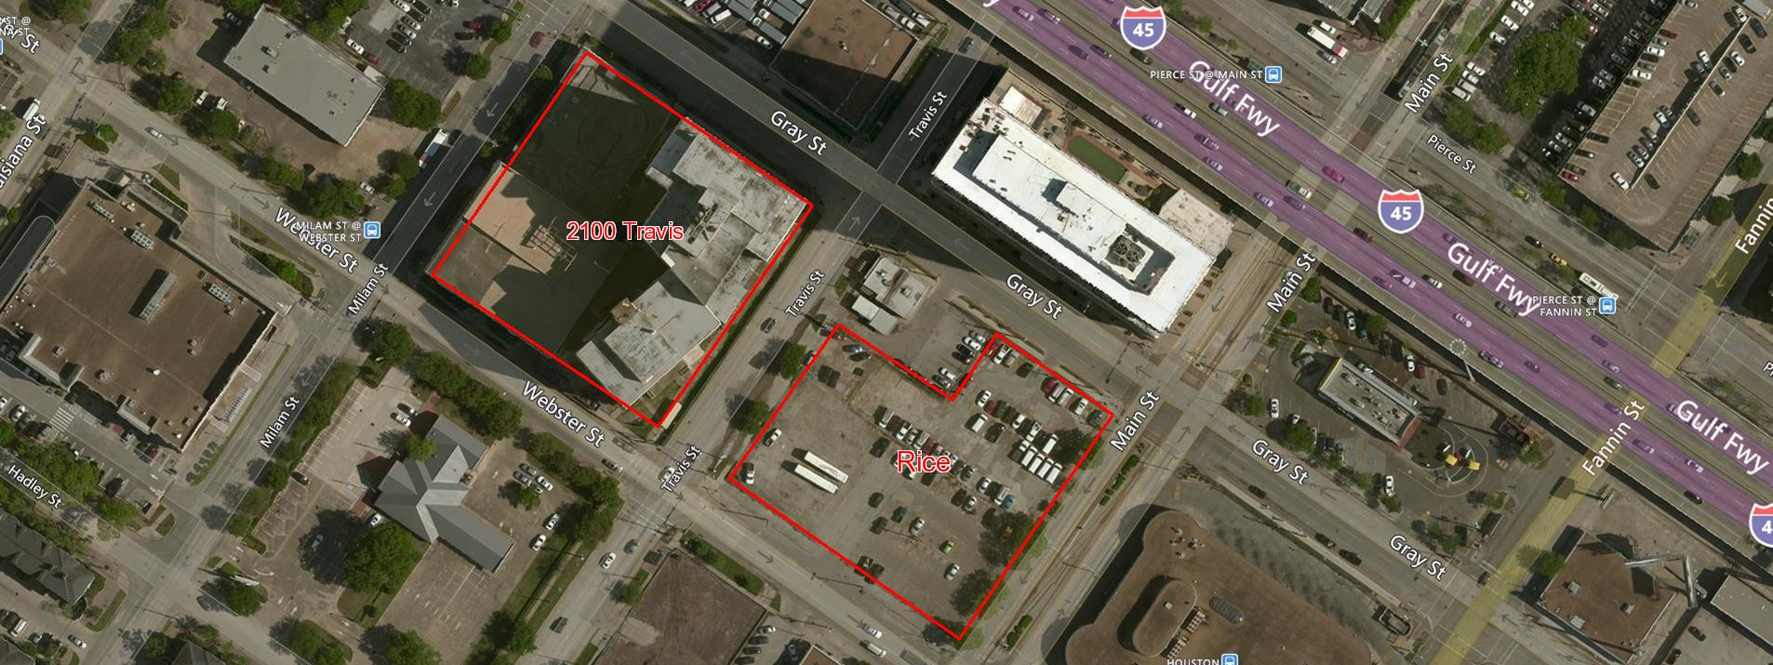
Agenda Item: VI. HCD19-24 Rice Parking Lot Lease (District C)
Tenant Improvements – Landlord will pay up to $50,000.00 for surface repairs; HCDD will pay $27,097.82

Slide 20
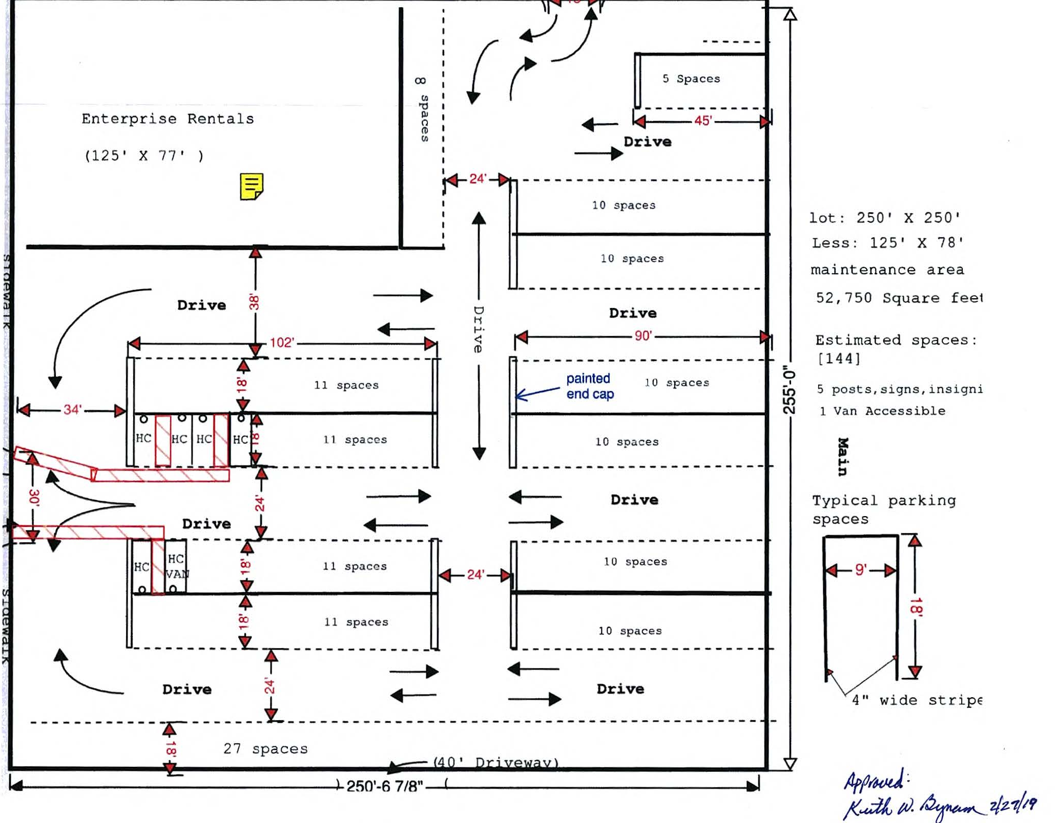
Agenda Item: VI. HCD19-24 Rice Parking Lot Lease (District C)

Slide 21
Item VII.a.: HCD19-15 Capital IDEA Houston (All Districts)
Providing up to $200,000.00 in CDBG funds for a workforce development program for up to 150 low- and moderate-income participants
Capital IDEA lifts low-income working families out of poverty by enabling participants to pursue associate degrees in higher-paying and careers that lead to life-long independence
The agency anticipates 41 graduates in the class of 2019
Category | Amount | Percentage
Administration | $ 23,991.70 | 12%
Services | $176,008.30 | 88%
Total | $200,000.00 | 100%

Slide 22
Item VII.b.: HCD19-15 Coalition for the Homeless of Houston-Harris County Homeless Management Information System (HMIS) (All Districts)
HMIS is a software application designed to record and store client data, including the types of services needed by Houston’s homeless community.
The HMIS wait list ranks the vulnerability of new clients based on their needs and assistance is provided based on this ranking.
All agencies receiving federal funds for homeless services are required to participate in the HMIS.
The City is contracting with the Coalition to comply with this requirement.

Slide 23
Item VII.b.: HCD19-15 Coalition for the Homeless of Houston/Harris County Homeless Management Information System (All Districts)
Category | ESG | HOPWA | Total | Percent
Administrative | $0 | $4,525.28 | $4,525.28 | 3%
Program | $79,200.00 | $60,121.57 | $139,321.57 | 97%
Total | $79,200.00 | $64,646.85 | $143,846.85 | 100%
The contract term is May 1, 2019 - April 30, 2020.

Slide 24
Item VII.c.: HCD19-26 Access Care of Coastal Texas, Inc. (ACCT) (All Districts)
A contract between the City of Houston and ACCT providing $629,500.00 in HOPWA funds
ACCT will provide tenant-based rental assistance (TBRA); (2) short-term rent, mortgage, and utilities assistance (STRMU); and (3) supportive services for 95 persons with HIV/AIDS
Supportive services include housing placement, case management, nutritional and transportation services to 95 low-income households.

Slide 25
Item VII.c.: HCD19-26 Access Care of Coastal Texas, Inc. (All Districts)
Category | Total | Percent
Administrative | $38,500.00 | 6%
Supportive Services | $120,600.00 | 19%
Supportive Services – PHPS | $20,400.00 | 3%
TBRA | $350,000.00 | 56%
STRMU | $100,000.00 | 16%
Total | $629,500.00 | 100%
The contract term will run from May 1, 2019 – April 30, 2020.

Slide 26
Agenda Item: VII.d. HCD19-27 The Montrose Center (All Districts)
A Contract with The Montrose Center, providing $1,487,210.00 in HOPWA funds to serve 265 low-income households living with HIV/AIDS as follows:
Tenant-based rental assistance (TBRA) for 55 households
Short-term rent, mortgage, and utilities assistance (STRMU) for 190 households, and
Permanent housing placement services (PHPS) for 20 households of persons living with HIV/AIDS.

Slide 27
Agenda Item: VII.d. HCD19-27 The Montrose Center (All Districts)
Category | Total | Percent
Administrative | $104,146.11 | 7%
Supportive Services | $247,856.27 | 17%
Supportive Services – PHPS | $23,116.70 | 2%
TBRA | $510,522.73 | 34%
STRMU | $601,568.19 | 40%
Total | $1,487,210.00 | 100%
The contract term will run from May 1, 2019 – April 30, 2020.

Slide 28
Director’s Report Monthly Production
Notes:
Reports from agencies receiving funding typically run about a month late.

Slide 29
Public Services Programs
65,151 Clients served from February 2018 - January 2019
Total expenditures (all sources) for this period: $20,936,719.38
Total Administrative Costs: $1,049,919.39 (5.01%)

Slide 30
Public Facilities Projects
Average number of projects in progress per month for February 2018 – January 2019: 23
Total expenditures (all sources) for this period: $5,635,681.38
Total Administrative Costs: $320,100.50 (5.68%)

Slide 31
Multifamily Projects
HCDD Restricted Units Completed for February 2018 – January 2019: 558
Total Units Completed for January 2018 – December 2018: 865
Total expenditures for this period: $12,760,197.81
Total Administrative Costs: $817,278.00 (6.4%)

Slide 32


HOUSING RECOVERY – SINGLE FAMILY
PROGRAM | INTAKE PIPELINE | ∆ | PRE-CONSTRUCTION¹ | ∆ | NTPS ISSUED⁵ | ∆ | UNDER CONSTRUCTION | ∆ | COMPLETED | ∆ | TOTAL²
HRP – TIER 1 MINOR REPAIRS Less than $10,000 | 5 | 5 | 0 | 6 | 0 | 0 | 6 | 6 | 0 | 0 | 6
HRP – TIER 2 SUBSTANTIAL REPAIRS Greater than $10,000 | 324 | 41 | 192 | -25 | 0 | 0 | 4 | -6 | 40 | +7 | 236
HRP – TIER 3 RECONSTRUCTION Greater than $65,000 |  |  | 219 | +29 | 0 | -8 | 34 | 18 | 5 | 5 | 258
2015 STORM DAMAGE⁴ | 15 | 8 | 35 | +2 | 0 | 0 | 0 | 0 | 2 | 0 | 38
NEW HOME DEVELOPMENT | 68 lots | -57 | 39 | +39 | 0 | 0 | 12 | 4 | 0 | 0 | 57
TOTALS | 344 | 54 | 485 | +51 | 0 | -8 | 56 | 22 | 53 | +18 | 594
PROGRAM | Population | Active Construction | ∆ | Final Inspection Scheduled | ∆ | Final Inspection Complete | ∆ | IN CLOSEOUT with GLO | ∆
DALHR | 185 | 0 |  | 0 |  | 0 |  | 185
∆ shows changes from the December 17, 2018 report (NOTE NO DELTAS FOR DALHR BECAUSE OF NEW REPORTING FRAMEWORK)
1. Pre-construction includes QC, pre-QC applications, Pending Damage Assessment, Pending TIER determination, Pending Environmental Clearance and Environmental Complete, Pending Site Specific Surveys and Pending Permitting.
2. Totals in far right column shows the total number of active files in each program (does not include intake pipeline)
3. 2015 Storm Damage reduction due to incomplete documentation submitted by Homeowners and or files moved to an inactive status
4. New Home Development lots reduction from 125 to 69 represents remaining lots. The number or lots are not included in the Intake Pipeline total (Intake pipeline total represents specific individuals/households identified for intake; New Home Development lots are not targeted to specific individuals or households).
Last updated: 03/19/19

Slide 33


