Slide 1

Housing & Community Affairs Committee
June 20, 2017
Sylvester Turner, Mayor
Tom McCasland, Director

Slide 2

Rebuilding Together Houston Contract Amendment
Add $4 million to contract
Repairs capped at $10K (with following exceptions)
  Current contract allows waiver for repairs up to $25K
  Amendment increases waiver maximum from $25K to $65K
  Director’s approval required for repairs over $10K
Add affordability period for non-roof home repairs
  Above $10K = 5 years
  Above $30K = 10 years
TIRZ AFFORDABLE HOUSING FUNDS

Slide 3
TIRZ Affordable Housing Funds
Fund | Amount
2400 | $ 333,318.82
2409 | $ 1,401,077.97
2410 | $ 86,582.82
2416 | $ 29,072.01
2417 | $ 1,350,630.52
2418 | $ 319,652.28
2420 | $ 479,665.58
TOTAL | $ 4,000,000.00

Slide 4
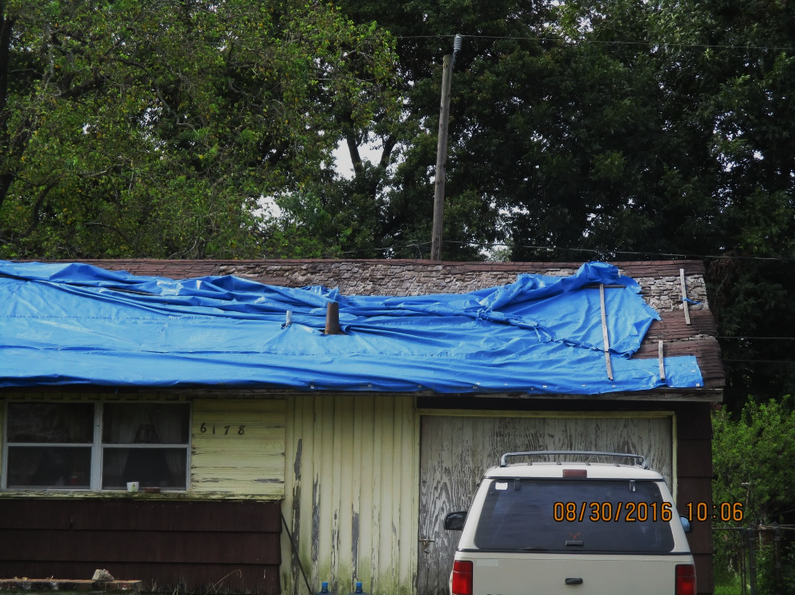
Program History
$2 million approved for minor home repair
Program targets roof repairs
HCDD requests additional $4 million
$2 million added to contract
Apr 2016
Sep 2016
Jan 2017
Jun 2017

Slide 5
Allocation to Date: $4 Million
Average cost/home for roof repair = $7,456
790 Applications approved and in process
381 Roofs completed (as of June 19)
ROOF REPAIRS (AS OF JUNE 19)
381
Roof Repairs Completed
Estimated Cost
$2,840,736
557
Approved Applications
Estimated Cost
$4,152,992
700
Estimated Roof Repairs Anticipated
Estimated Cost
$5,219,200

Slide 6
Allocation to Date: $4 Million
Average cost/home for critical system repair = $4,798
320 Unassessed applications received to date
HOME REPAIRS
50
Critical System Repairs Completed to Date
Cost
$239,900
320
Repairs Anticipated
(Scope Unassessed)
Estimated Construction Cost
$2.8 Million

Slide 7
Estimated Program Expenditures
TOTAL ROOF AND CRITICAL SYSTEM
700
Blue Tarp
Repairs Anticipated
Estimated Construction Cost
$5,219,200
320
Repairs Anticipated
(Scope Unassessed)
Estimated Construction Cost
$2.8 million
ESTIMATED TOTAL: $8,019,200

Slide 8
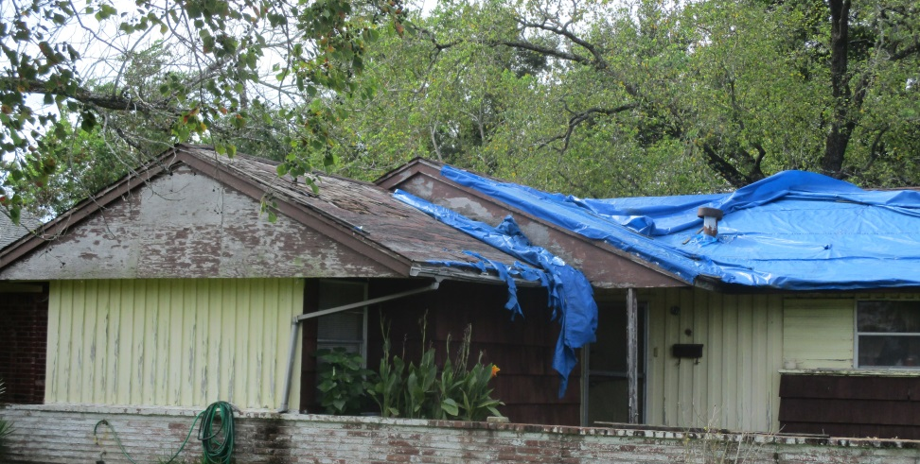
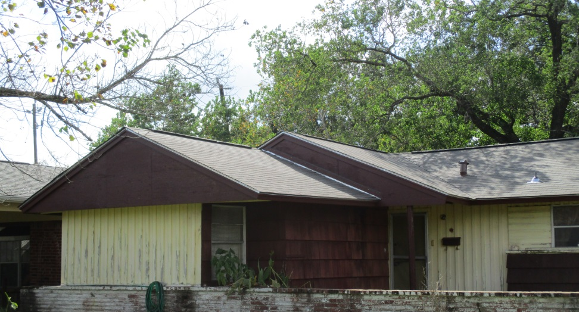

Slide 9
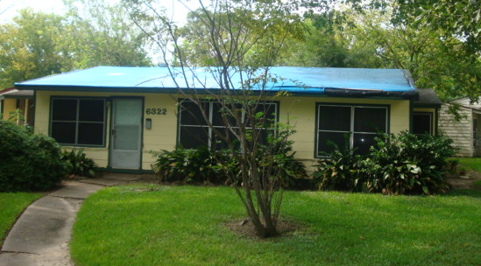
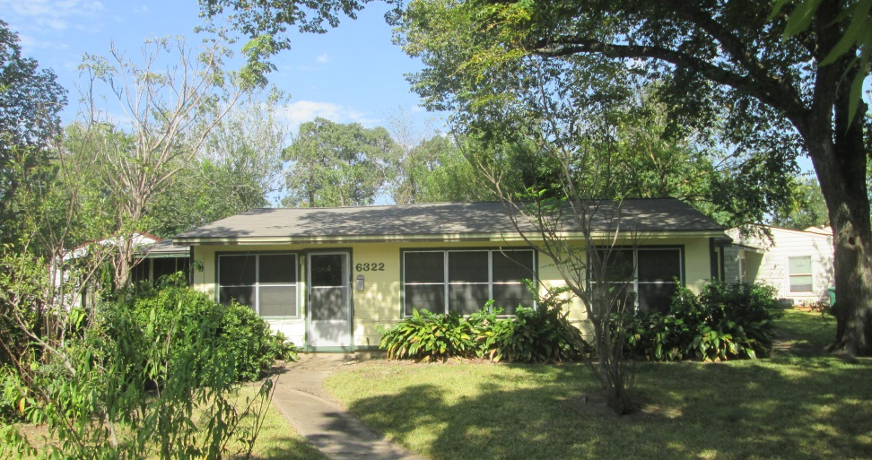

Slide 10
SEARCH Homeless Services
Contract Extension
Adding 1 Year
July 31, 2018 expiration
Funding Level
$133,883
Funding Source
General Fund
(0 for Admin)
General Funds used to leverage other grants and provide comprehensive service package
Contract activities not eligible for federal dollars

Slide 11
SEARCH Homeless Services
Engagement Services Program
Serves to 475 homeless individuals
Outreach and stabilization to 175
Essential services in Care Hub to 300
  Lunches
  Clothing
  Bus passes
  Blankets
  Information and referral
  Hygiene supplies
  Computer access

Slide 12
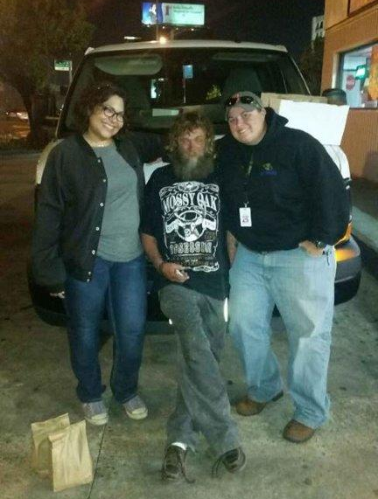
SEARCH Homeless Services
Engagement Services Program
Other services:
Employment referral
Substance abuse counseling
HIV education and testing
Medical/dental assistance

Slide 13
Housing & Community Affairs Committee
Director’s Report
June 20, 2017
Sylvester Turner, Mayor
Tom McCasland, Director

Slide 14
TIRZ Affordable Housing Bonds
TIRZ | Year | Fund | Amount
Uptown | 2001 | 2400 | $ 333,318.82
Uptown | 2002 | 2410 | $ 86,582.82
Midtown | 2001 | 2416 | $ 29,072.01
Uptown | 2004 | 2417 | $ 1,350,630.52
Uptown | 2004 | 2418 | $ 319,652.28
Midtown |  | 2420 | $ 479,665.58
 |  | TOTAL | $ 2,598,922.03

Slide 15
TIRZ Affordable Housing Bonds
Balances will be immediately allocated and spent for roof replacement and other home repair
Staff members are continuing to research prior spending and current balances
Issuances occurred prior to the use of the City’s SAP financial system, limiting access to necessary documents

Slide 16
TIRZ Affordable Housing Bonds
All available HCDD funding will be tracked
Funding for affordable homes and community development will be used expeditiously for good projects

Slide 17
Disaster Recovery 2015 Floods
City originally received $66,560,000 in CDBG – Disaster Recovery 2015 Flood funds
Additional $20,532,000 appropriated
Coming Soon: HUD Federal Register notice defining application requirements and criteria for use of additional funds
Notes:
The City is set to receive an additional $20,532,000 in Community Development Block Grant – Disaster Recovery funds in response to 2015 Flood Events.
The City originally received $66,560,000 in Community Development Block Grant – Disaster Recovery funds in response to 2015 Flood Events.
The US Department of Housing and Urban Development will shortly publish a notice in the Federal Register which will define application requirements and the criteria for the use of the additional funds.

Slide 18

JUNE IS
HOMEOWNERSHIP MONTH

Slide 19
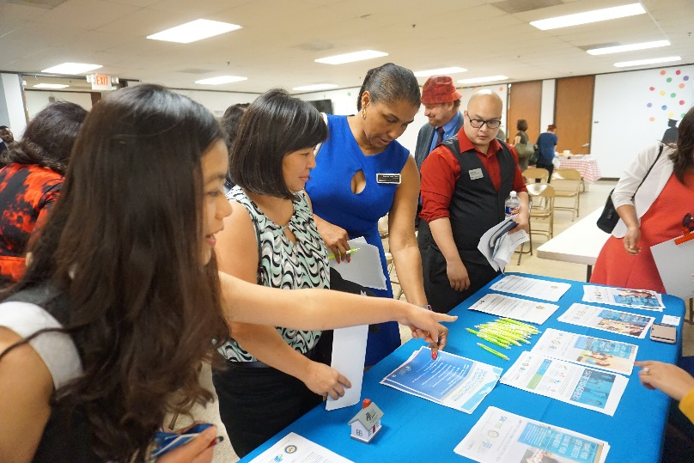
Homebuyers Assistance Program
GOALS:
To provide financial assistance to qualified low- and moderate-income first-time homebuyers by covering eligible down payment and closing costs

Slide 20
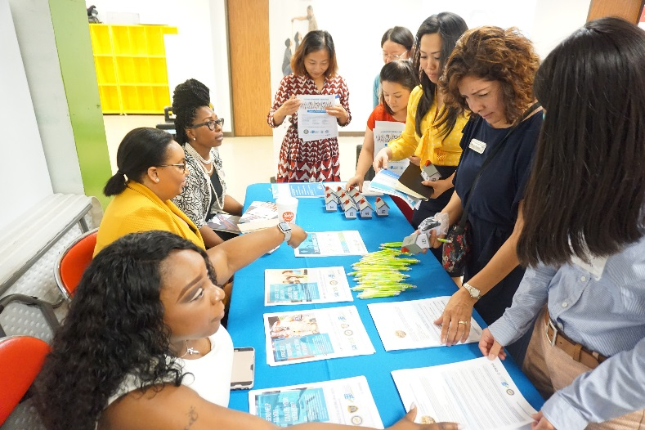
Homebuyers Assistance Program
MISSION:
Increase homeownership and sustainability
Grow the City of Houston’s tax base
Encourage complete communities

Slide 21
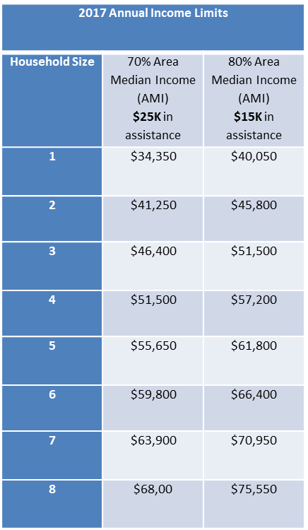
Eligibility Requirements

Slide 22
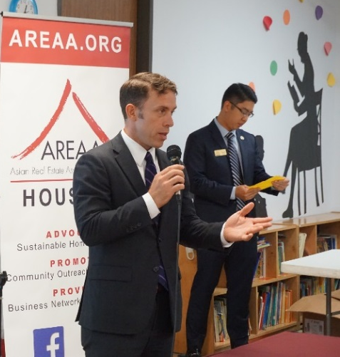
Eligibility Requirements
Applicants must:
Have not owned a home within the last three years
Meet income and household size restrictions
Qualify for a mortgage
Obtain a first-time homebuyer education certificate
Complete the HAP application
Select an eligible property

Slide 23
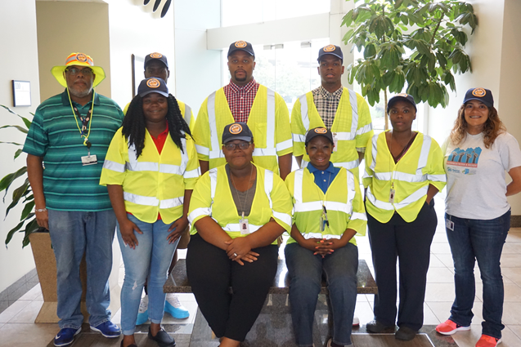
Community Outreach
Promoting health & housing initiatives

Slide 24
Blue Tarp Initiative Progress Report As of 06/15/2017
Status Report | Count
Intake Applications | 1,503
Income-Approved Applications | 557
Ineligible & No Response | 707
Applications Under Review | 133
Title Issues | 27
Tax Issues | 27
Declined Services | 26
Tax and Title Issues | 26
Council District | A | B | C | D | E | F | G | H | I | J | K | Total
Completed | 11 | 230 | 6 | 185 | 5 | 1 | 0 | 67 | 20 | 1 | 31 | 557
No Response | 1 | 26 | 0 | 55 | 3 | 2 | 0 | 38 | 15 | 0 | 10 | 150
Notes:
Data on this slide refers to Applications only.

Slide 25
Blue Tarp Home Repair Program
Total Cost of Repairs: $2,392,581
Total Admin: $172,588 (7%)
Notes:
Note: Numbers may fluctuate as Construction Data numbers are based on invoices received. Therefore, this data may be adjusted upward to reflect invoices received in the future.
Data on this chart refers to Construction Data only.
Average spent on repairs per home (including Admin) is $7,128.49

Slide 26
Disaster Recovery 2 Single-Family Home Program
Expenditures: $8,654,686
Admin & Project Delivery: $2,069,483 (24%)
Notes:
Project is winding down and nearing completion.

Slide 27
Public Services
Total Expenditures: $19,222,379
Total Admin & Project Delivery: $485,940 (2.5%)
Notes:
Data on clients served not available for May 2016 and June 2016
The significant increase in Clients Served is due to Youth Enrichment’s letter of agreement with the Parks Department, which recently became active.
Reports from agencies receiving funding run about a month late.

Slide 28
Public Facilities
Total Expenditures: $2,567,351
Current Projects: 24
Total Admin & Project Delivery: $822,427 (32%)
Notes:
Data on clients served not available for May 2016 and June 2016
The significant increase in Clients Served is due to Youth Enrichment’s letter of agreement with the Parks Department, which recently became active.
Reports from agencies receiving funding run about a month late.

Slide 29
Homebuyer Assistance Program
Total Expenditures to Date: $390,036
Total Admin: $268,281 (68%)

Slide 30
Multifamily Housing Programs
30
Notes:
Projected monthly estimates for MFH are calculated as follows:
Current monthly Expenditures + Previous monthly Expenditures are Divided by the total budget for the year = percentage for that month.
This Percentage is then multiplied by the total units reported by MFH = Monthly Units

Slide 31
Multifamily Housing Programs
Total Expenditures: $11,352,816
Total Admin & Project Delivery: $764,238 (6.7%)
31
Notes:
Projected monthly estimates for MFH are calculated as follows:
Current monthly Expenditures + Previous monthly Expenditures are Divided by the total budget for the year = percentage for that month.
This Percentage is then multiplied by the total units reported by MFH = Monthly Units

Slide 32


