Slide 1


City of Houston
Matching Grants Program
Sponsored by the Department of Neighborhoods

Slide 2
What is the Matching Grant?
Our goal is simple. We want to improve the quality of life for Houston communities and partner with active residents to:
Improve neighborhood organization and pride
Improve community appearance
Enlist and increase community participation
Notes:
The Neighborhood Matching Grant Program helps neighborhoods fund various beautification and improvement projects by providing a dollar-for-dollar matching grant reimbursement ranging from $500.00 to $5,000.00. This program is administered in partnership through the City of Houston Department of Neighborhoods and the City of Houston Council Member’s Offices via Council District Service Funds.

Slide 3
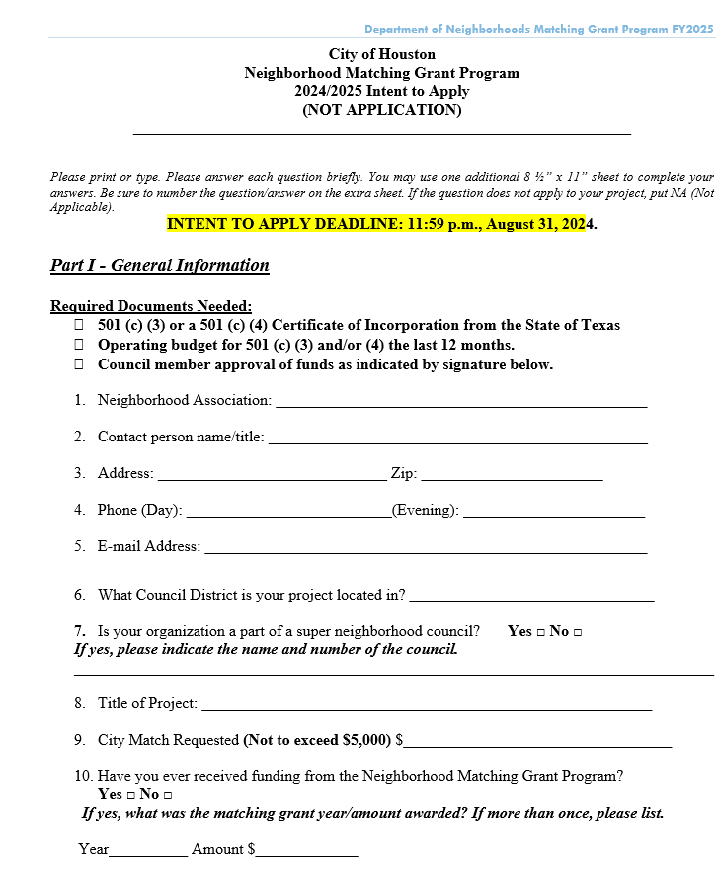
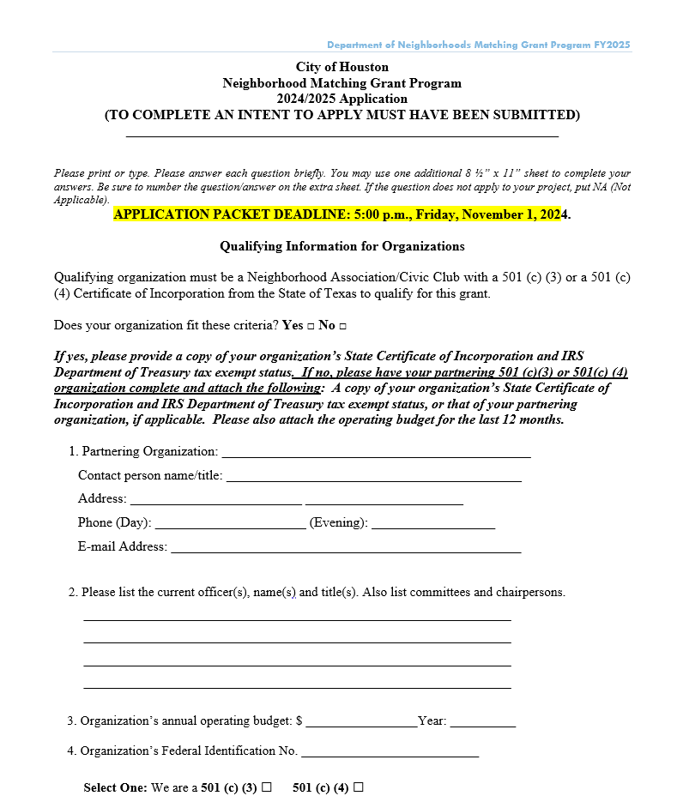
Matching Grant Amounts
The grant money represents a partnership between the City (through the Council Member’s Office) and an organization.
City will reimburse up to 50% of a projects total budget (not to exceed $5,000).
Minimum project $1,000/ minimum matching grant award amount is $500.
Maximum matching grant award amount is $5,000.

Slide 4
Approval Process
Complete Training and the Intent to Apply by August 31st
DON Director review & approval
Legal Dept review and approval
Mayor’s Office Review and Approval
DON Finance & Matching Grant Coordinator will review to process Letters of Approval
COMPLETED application due November 1st
NO EXCEPTIONS!
October 1st deadline to submit projects to other COH Department Stakeholders
PROJECTS SHOULD NOT BEGIN BEFORE APPORVAL LETTER IS ISSUED IN ACCORDANCE WITH AP 4-11.

Slide 5
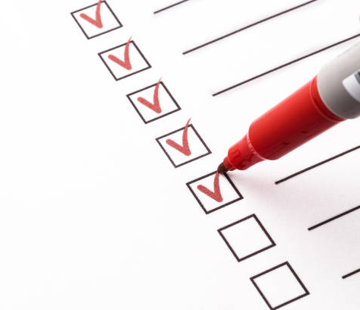
Phase II- Procurement Process for Reimbursement
The grant money represents a partnership between the City of Houston (through a Council Member’s Office) and an organization.
Must obtain a City Vendor number
Photo of completed project
Proof of services and payments (Original receipts, invoices, checks, credit card statements, bank statements etc.)
Project must be paid in full by eligible organization for reimbursement
NOTE: Cash transactions or in-kind services (food, materials, volunteers or equipment) cannot be submitted for reimbursement.
Projects must be completed by May 31, 2025
Applicants will receive reimbursement within 30 business days

Slide 6

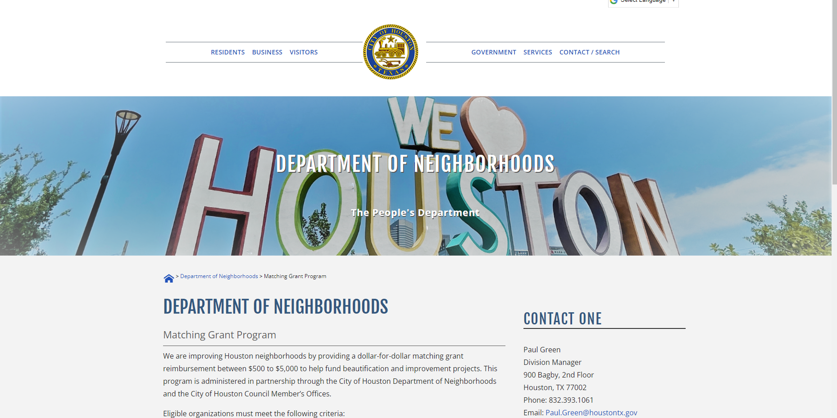
Proposed Projects
Eligible organizations must meet the following criteria:
Complete the required training workshop
Council Member approval of projects and funds Intent to Apply application August 31st
Complete Matching Grant application
Applicants must be a neighborhood-based organization and/ or civic club incorporated as a 501 (c) (3) or 501 (c) (4) non-profit organization through the State of Texas
Submit 12-month operating budget from organization
Proposed projects must be within City Houston limits
Applicants must identify how the organization will fund and support the project in the future
https://www.houstontx.gov/neighborhoods/matching-grant-program.html

Slide 7
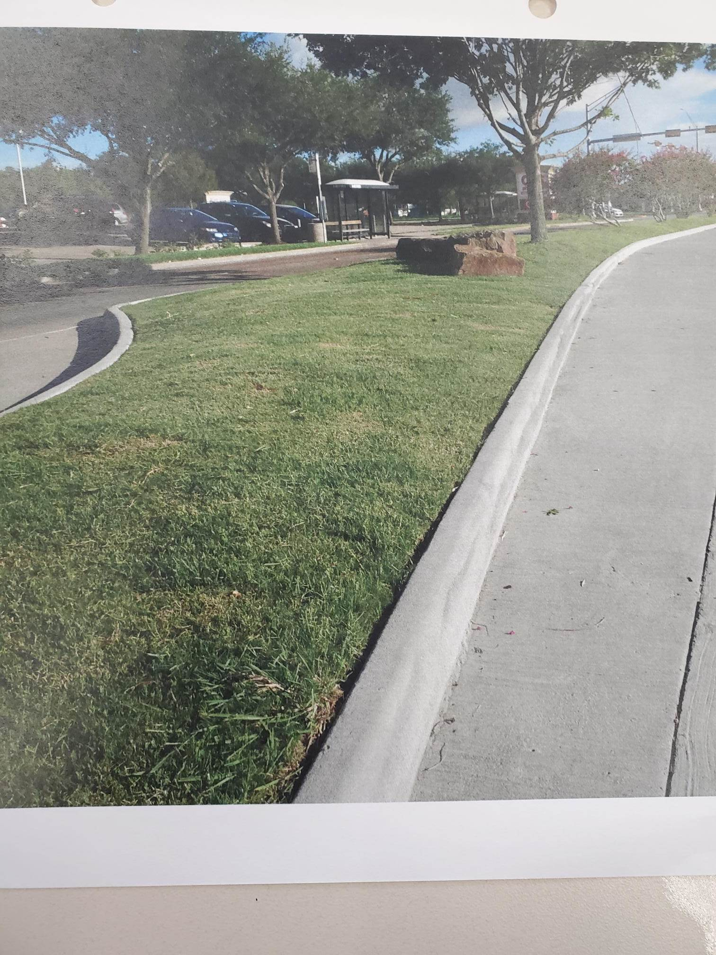
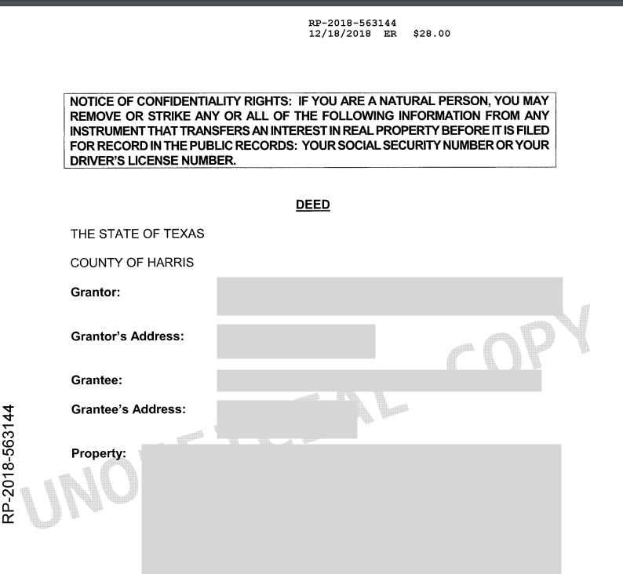

Proposed Projects, cont.
Project criteria continued:
Letter of permission from property owners and/or government agencies of the proposed site at the time of submittal (The property owner may be a government agency, the owner of private property, or an association if the property is a common area.)
Proof of ownership of proposed site (Ex: Copy of Deed, HCAD record, etc.)
Photo of proposed site
Accessible to the public

Slide 8
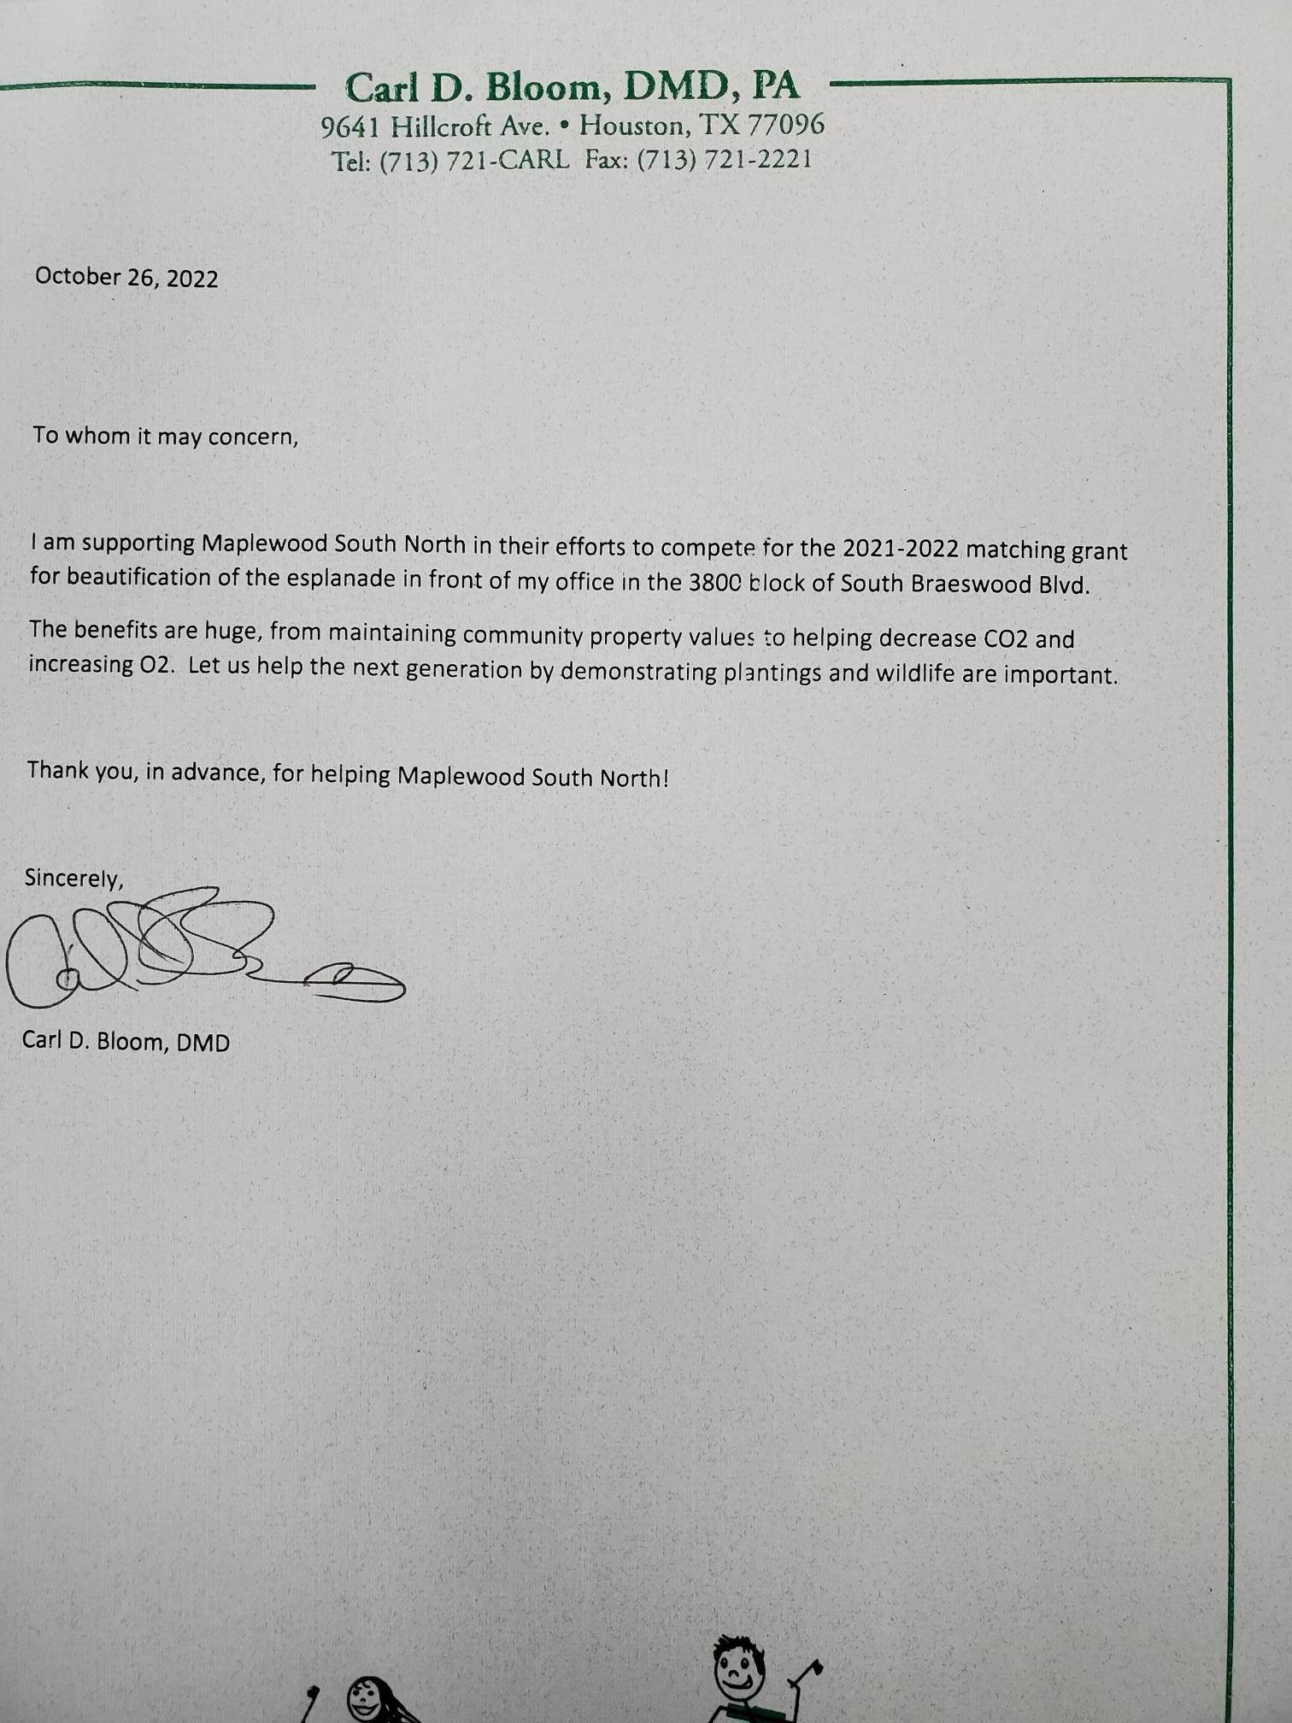
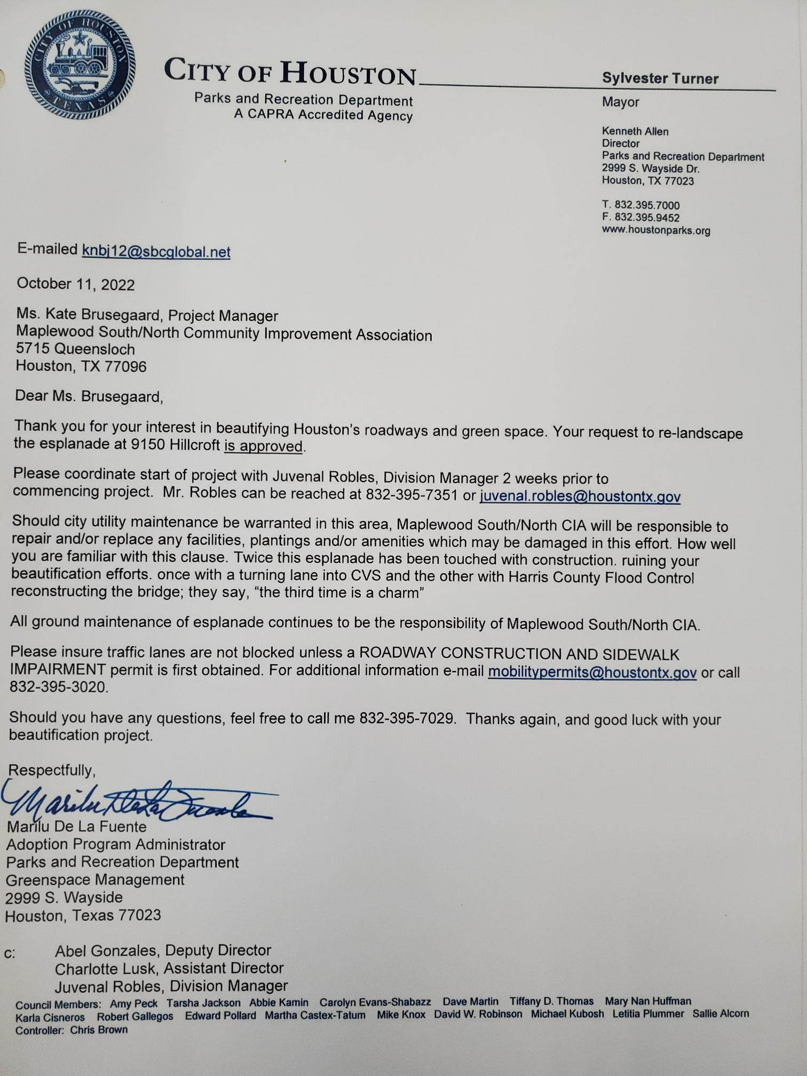
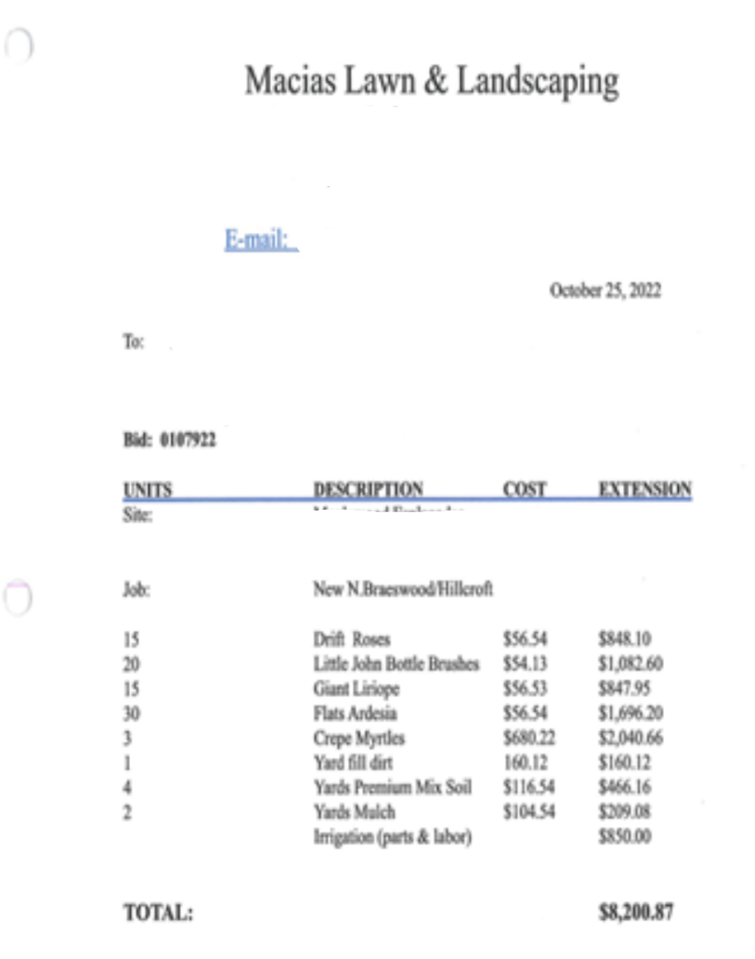
Proposed Projects, cont.
Project criteria continued:
Three letters of support for your project.
If the proposed projects require approval and/or permitting from a City of Houston department, pre-approval from the appropriate city department is required. (Houston Public Works, Houston Parks and Recreation, etc.)
Scope of work
Examples of approved projects include, but are not limited to, street sign toppers, entryway signage, entryway columns, esplanade landscaping and irrigation, park benches, electrical signage, walkways with pavers, murals, etc.

Slide 9
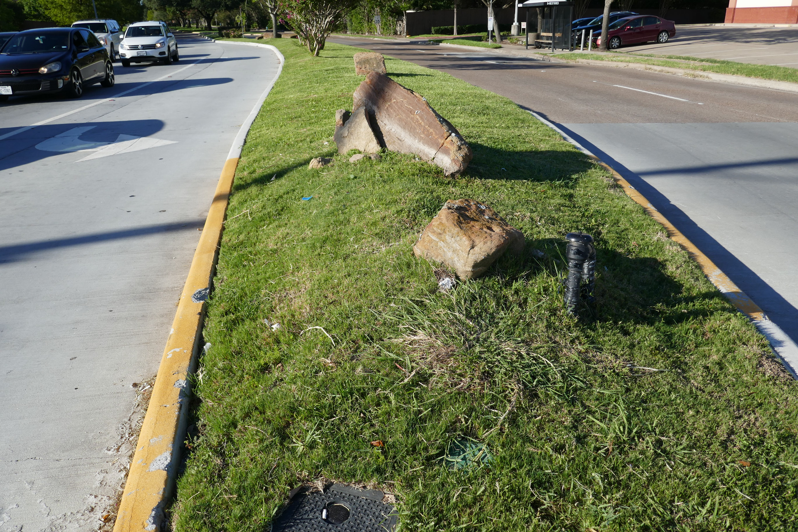
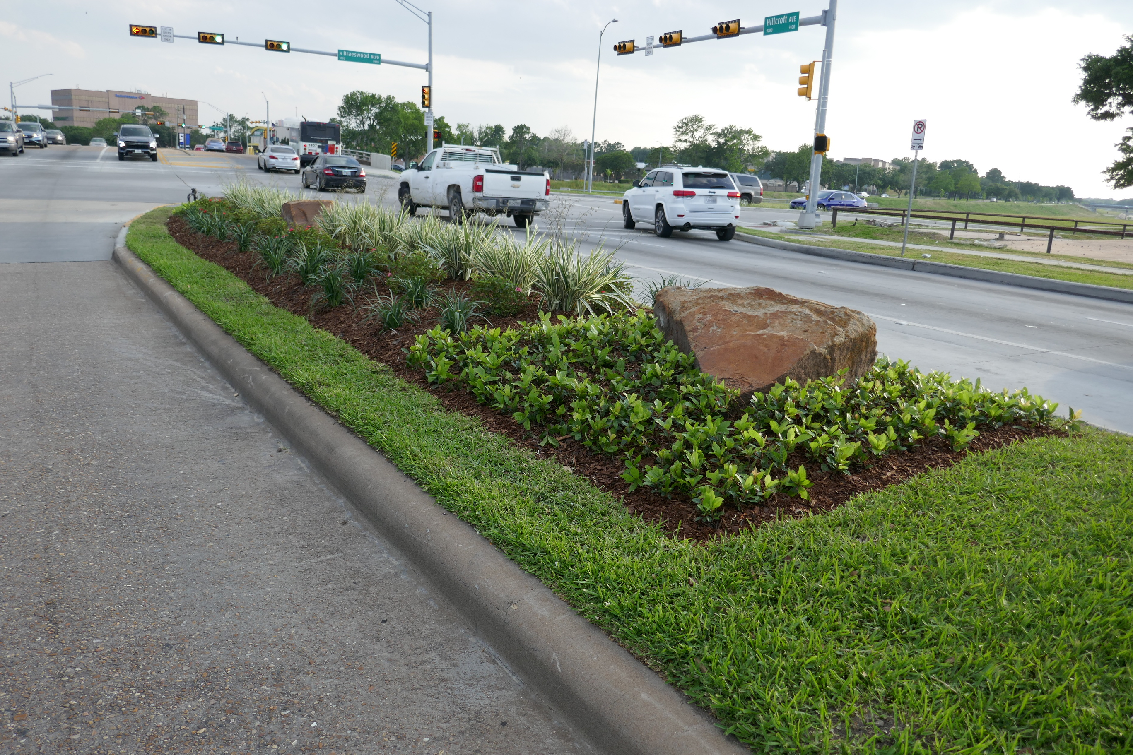
Maplewood Community
Matching Grant Project
Before and after

Slide 10
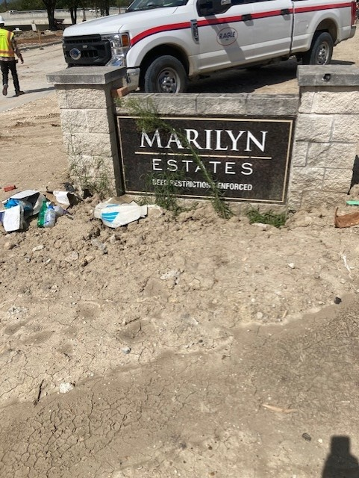
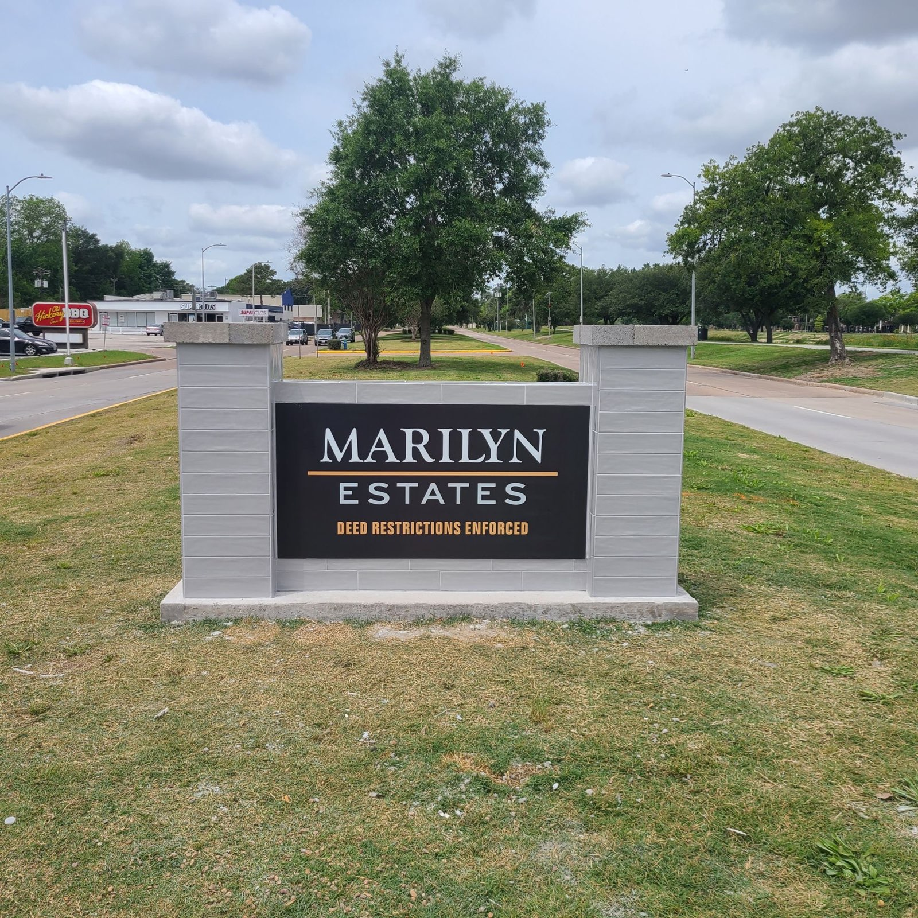
Marilyn Estates
Matching Grant Project
Before and after

Slide 11
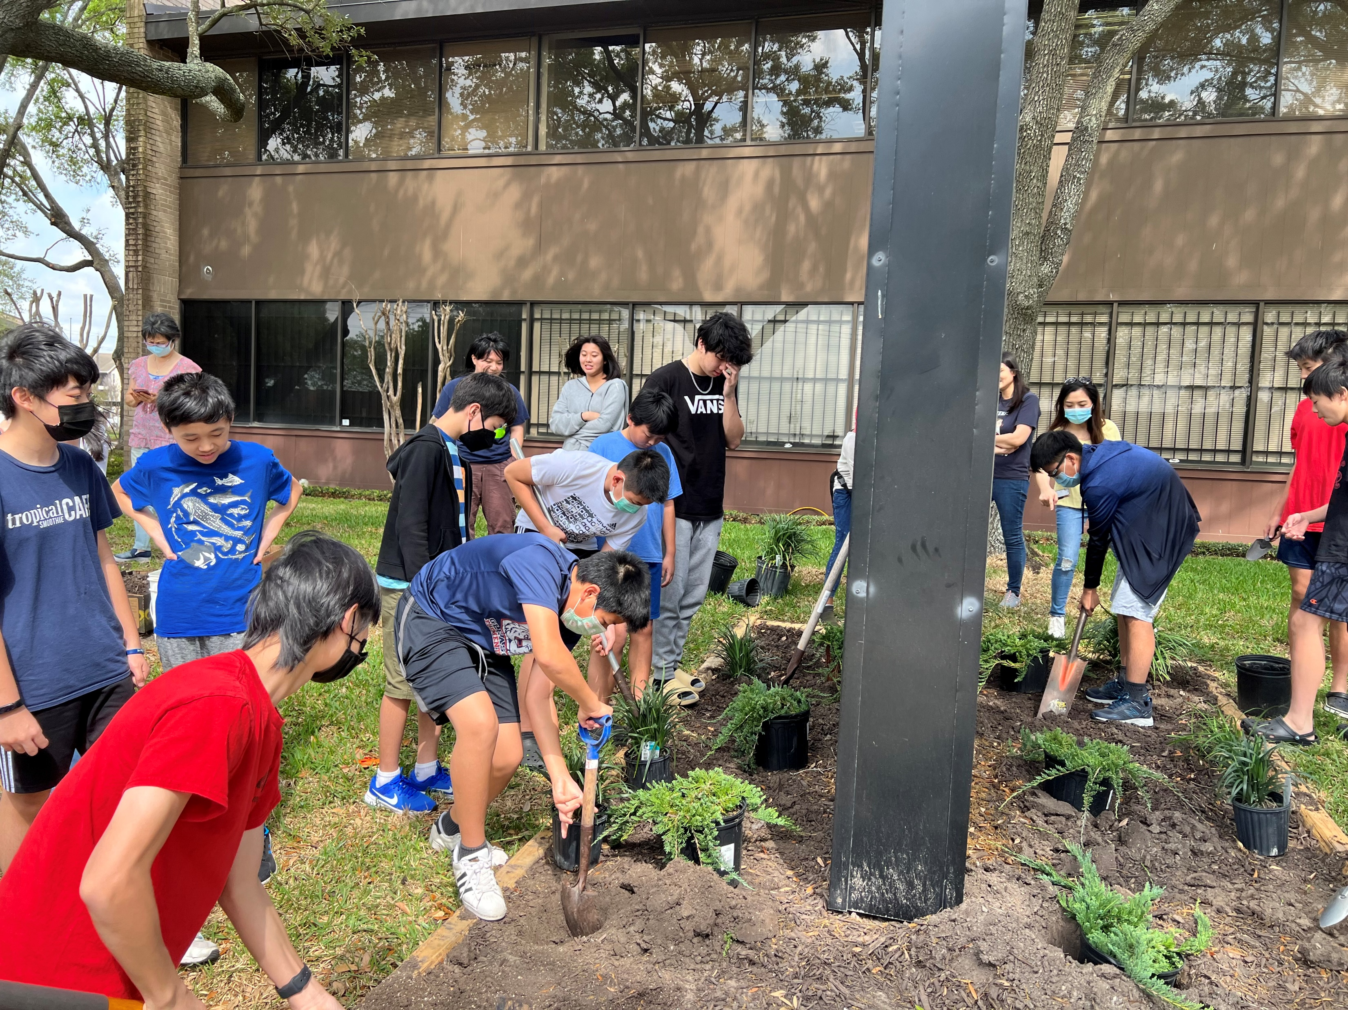
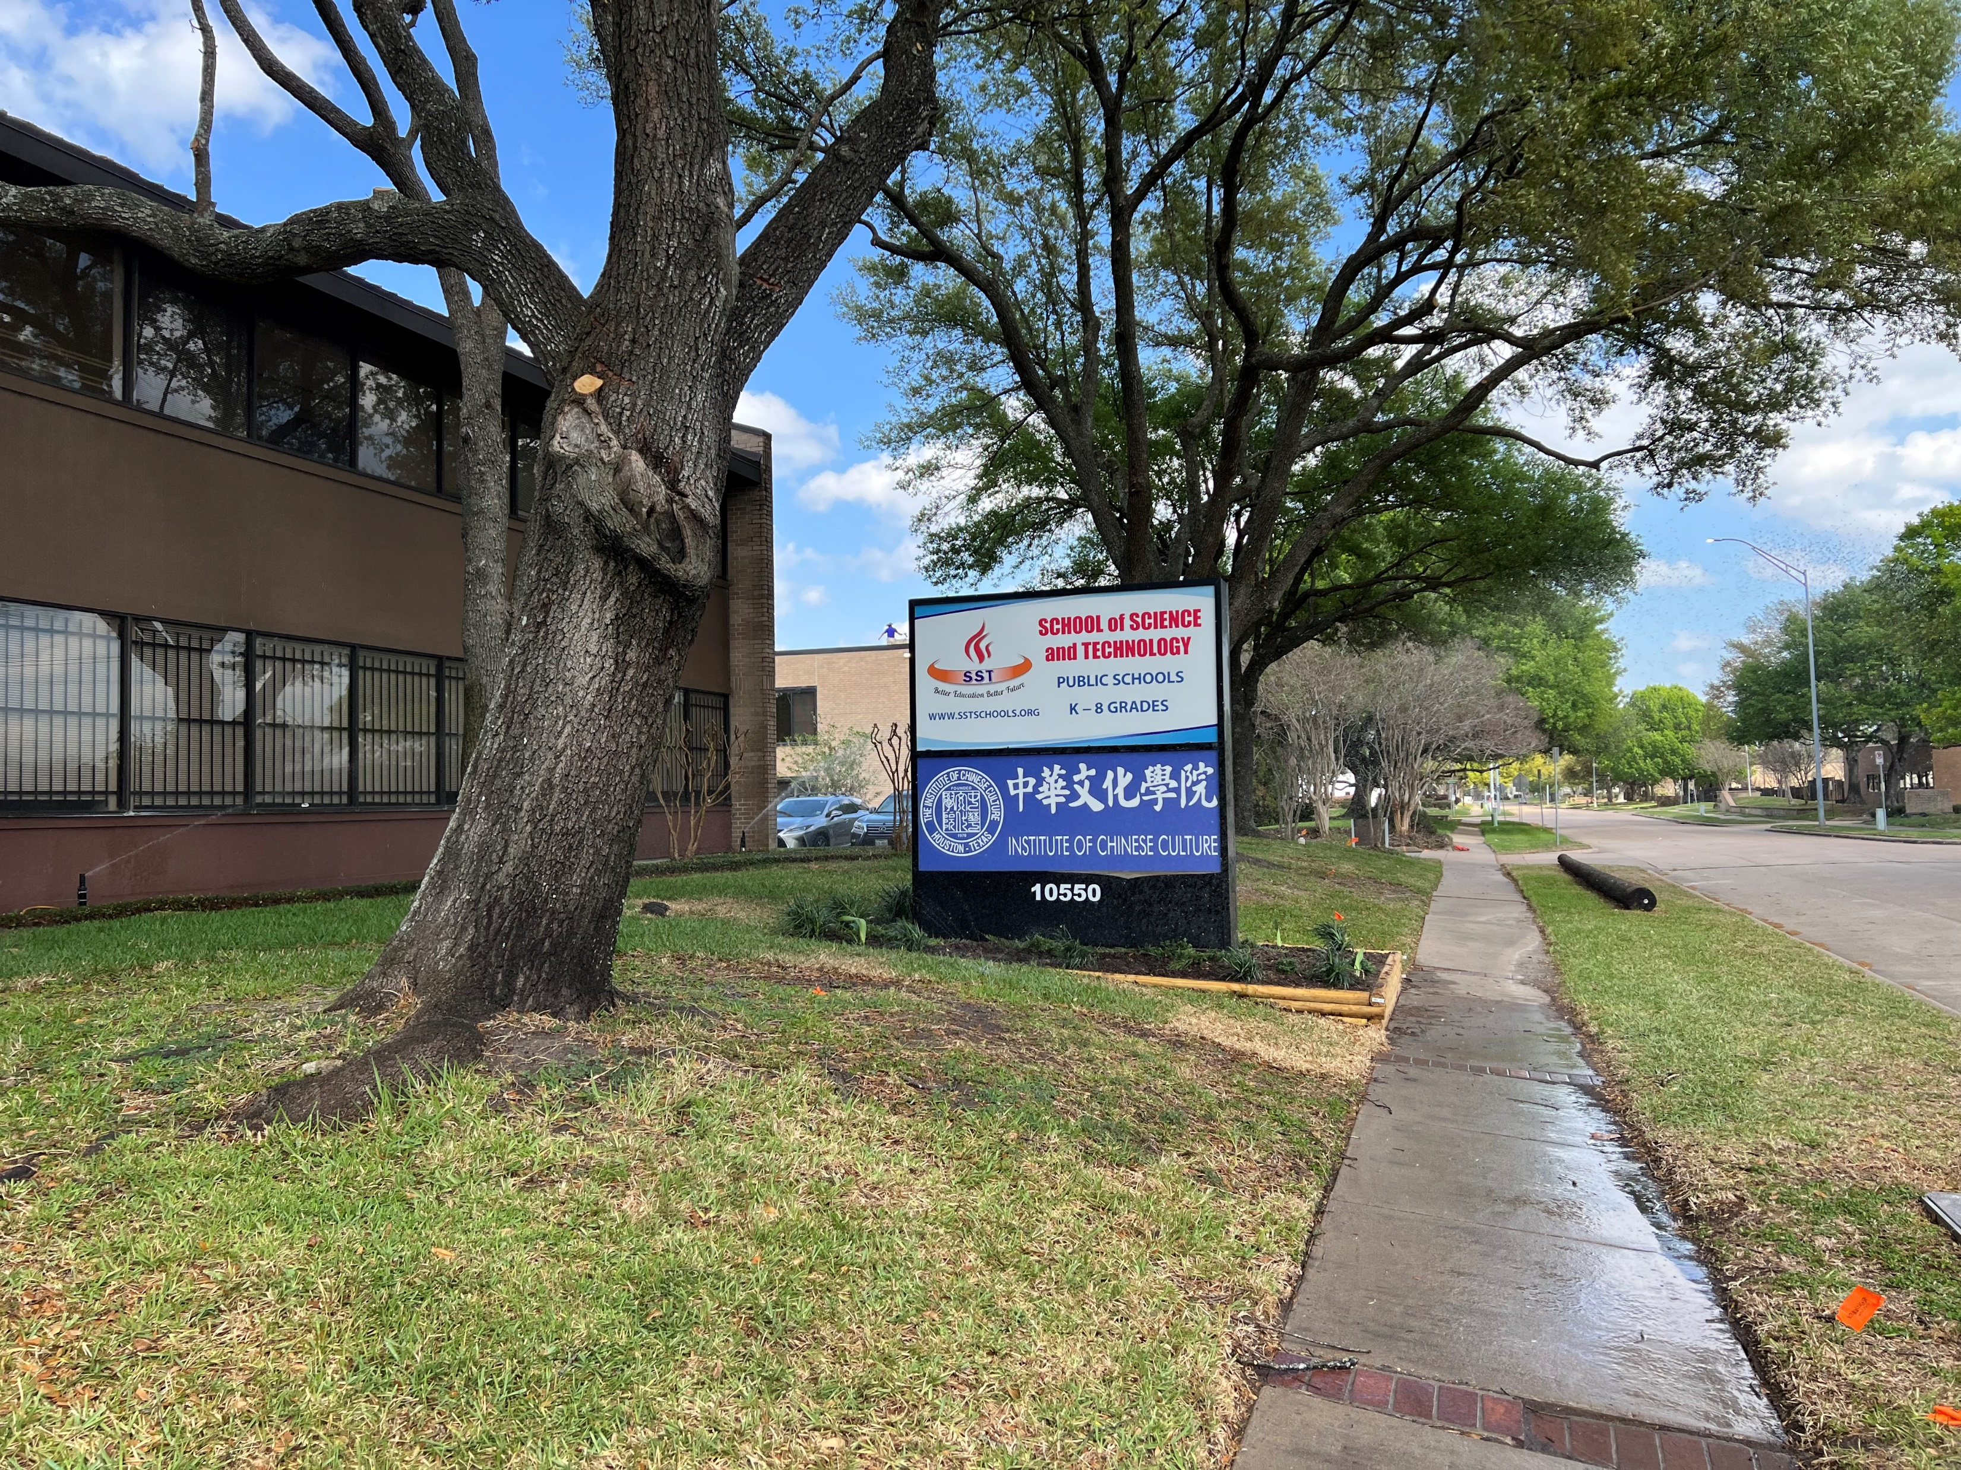
Institute of Chinese Culture
Matching Grant Project

Slide 12
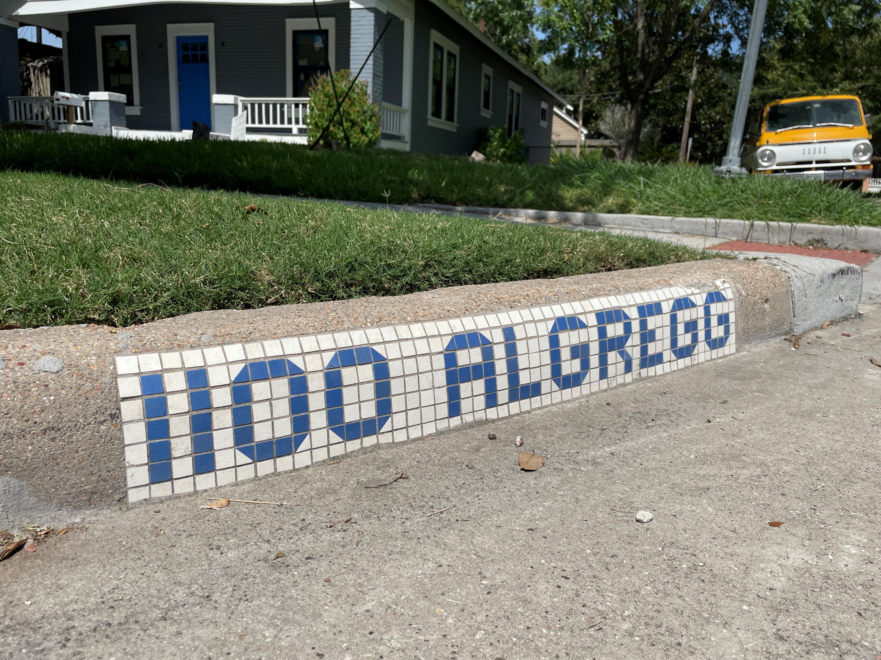
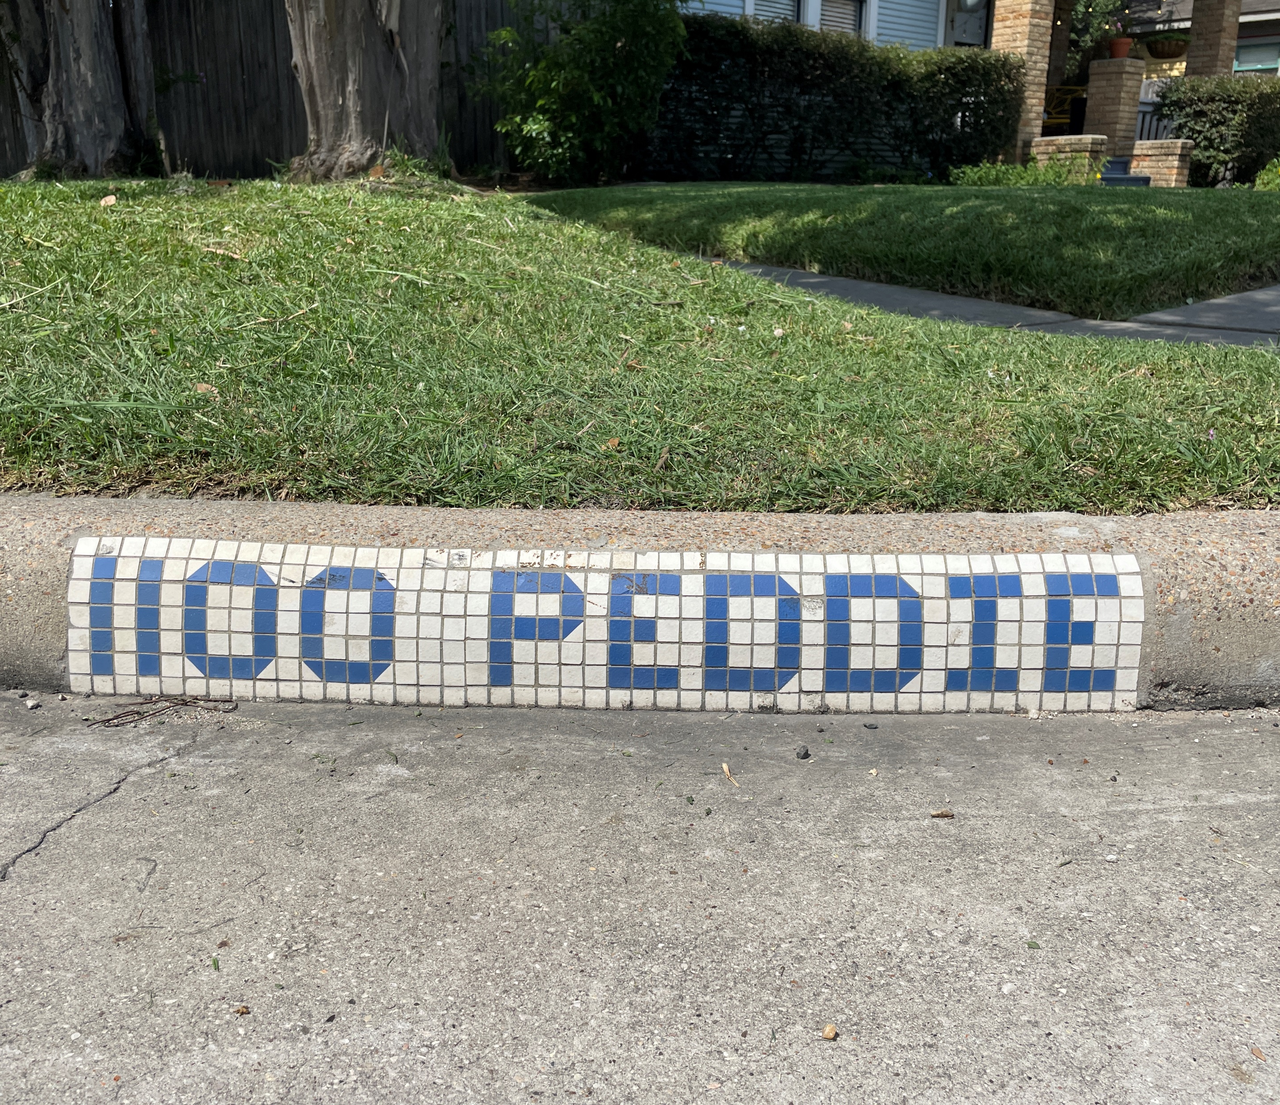
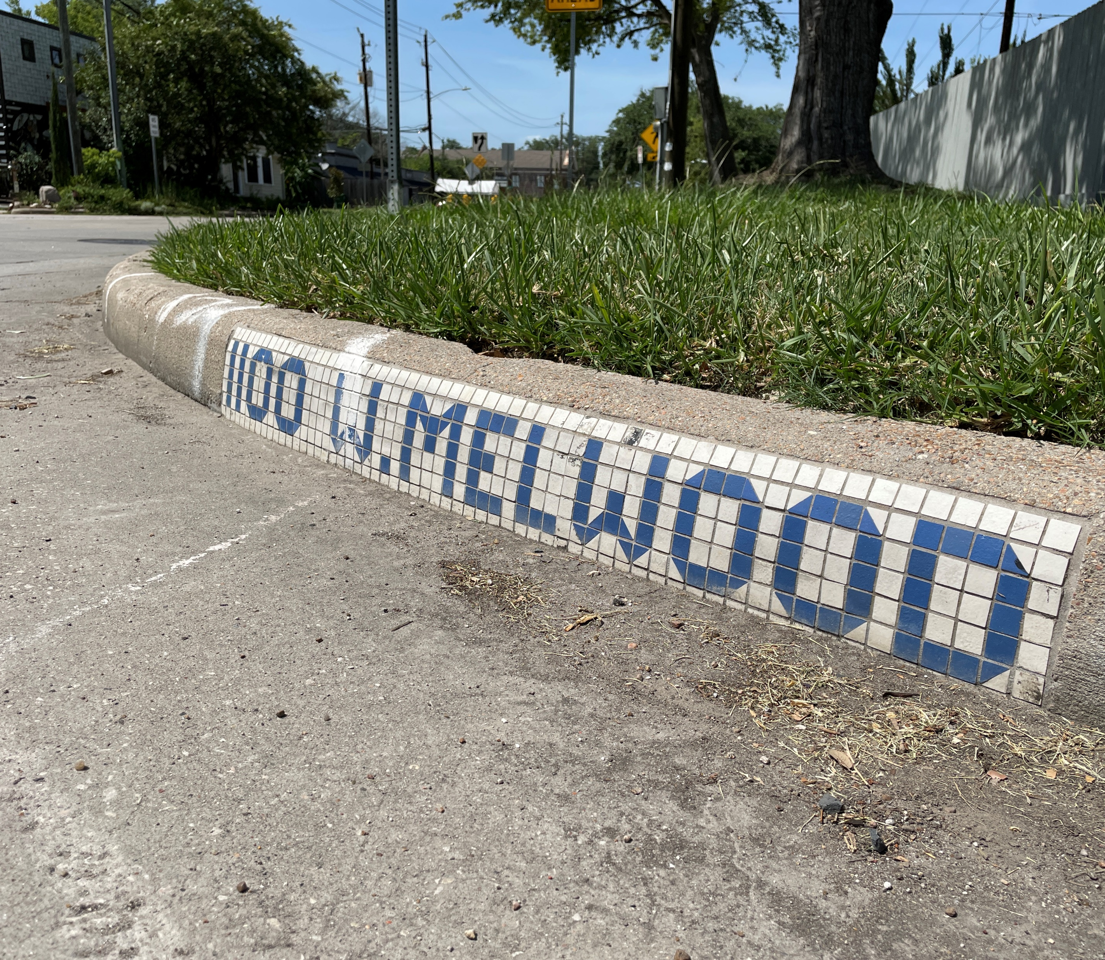
Norhill Neighborhood Association
Matching Grant Project

Slide 13
City of Houston
Matching Grants Program
Roman Aguilar
Matching Grant Program Coordinator
Roman.Aguilar@houstontx.gov
832-393-1043

